Slide 1
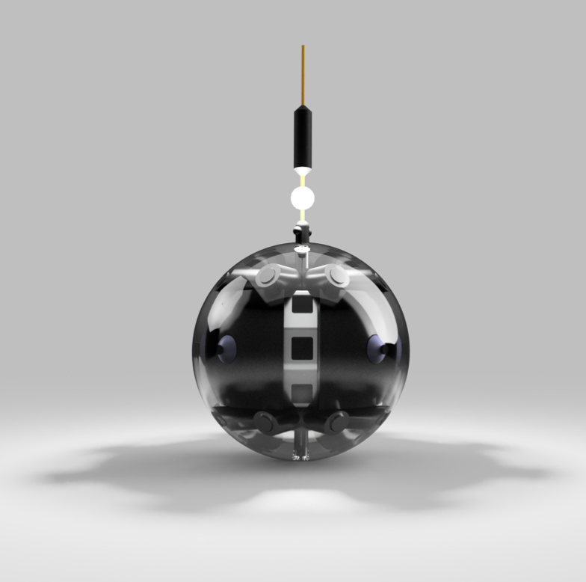

DAEDALUS
Descent And Exploration in Deep Autonomy of Lava Underground Structures
Andreas Nüchter and the Daedalus Team
Final presentation 2 - 29th January 2020
Notes:
Welcome to the DAEDALUS presentation. DAEDALUS is Descent and Exploration in Deep Autonomy of Lava Underground Structures. My name is Andreas Nüchter and I had the pleasure to lead a marvelous team of international scientists.

Slide 2
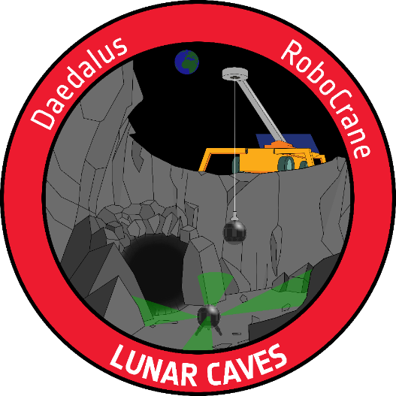
CDF Team
RoboCrane & Daedalus

Slide 3
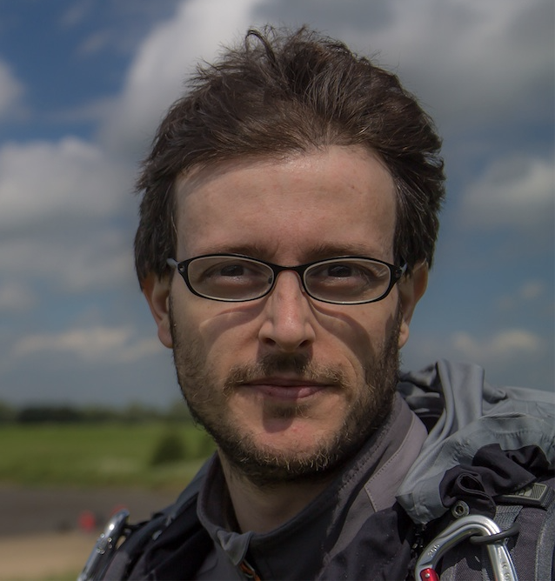
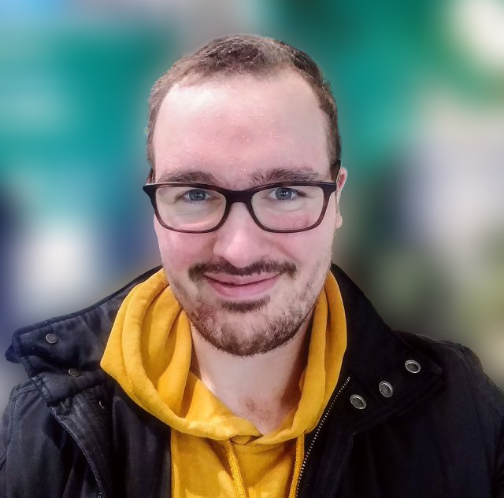
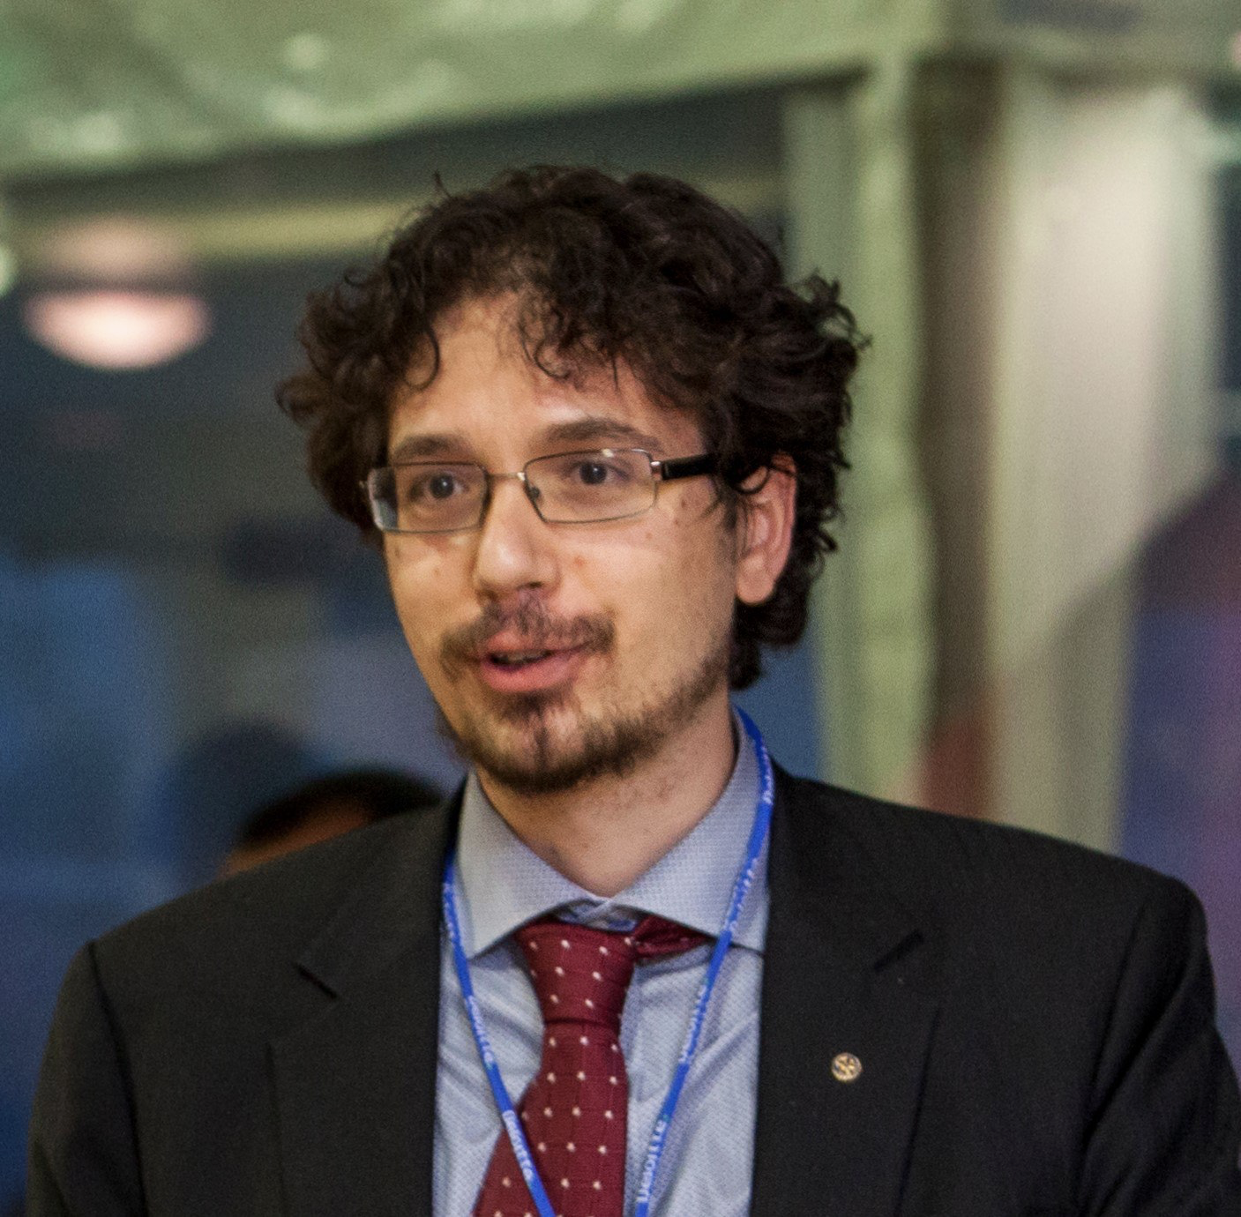
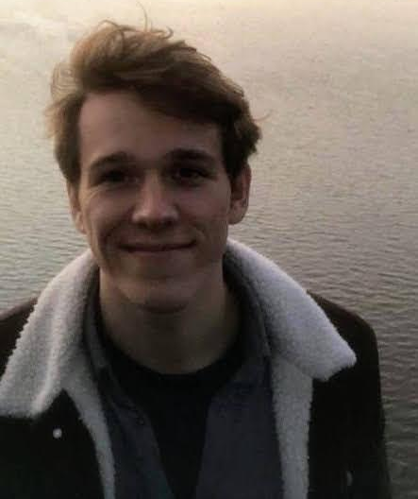
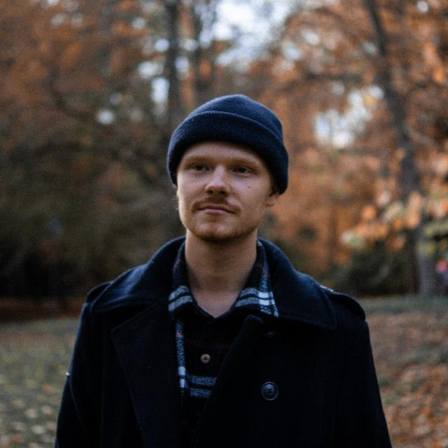
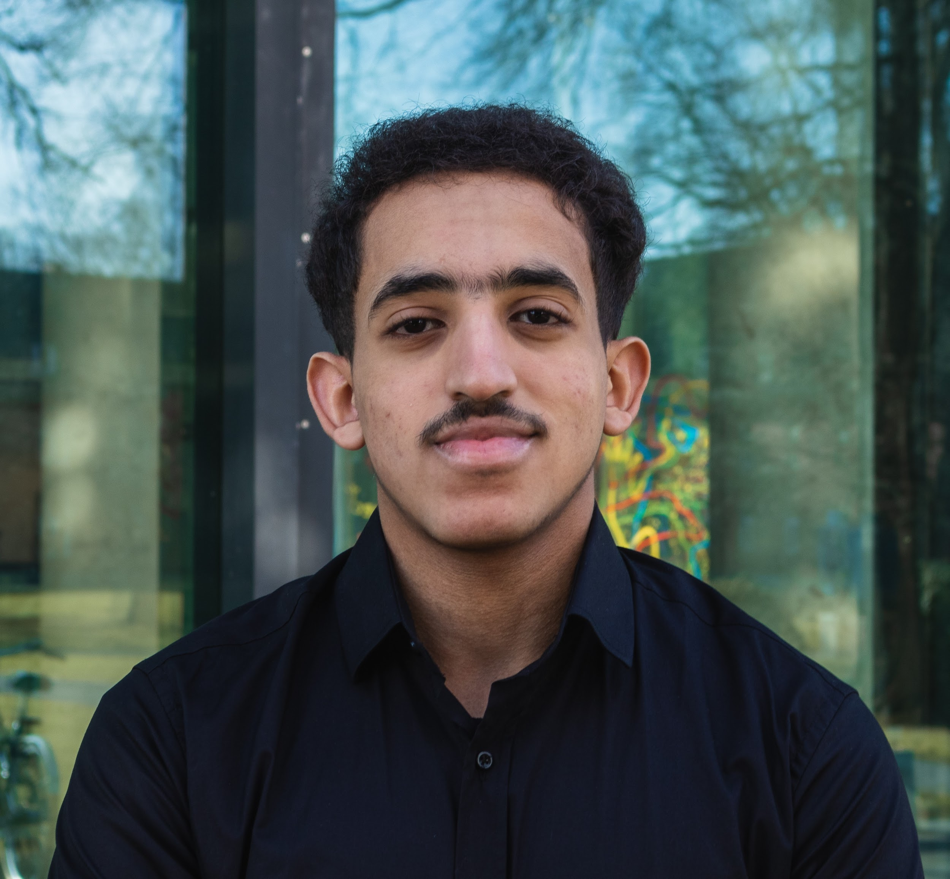
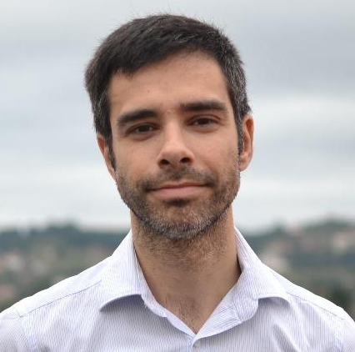
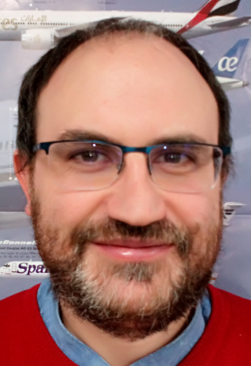
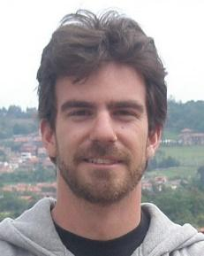
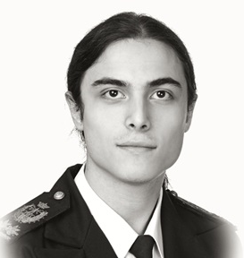
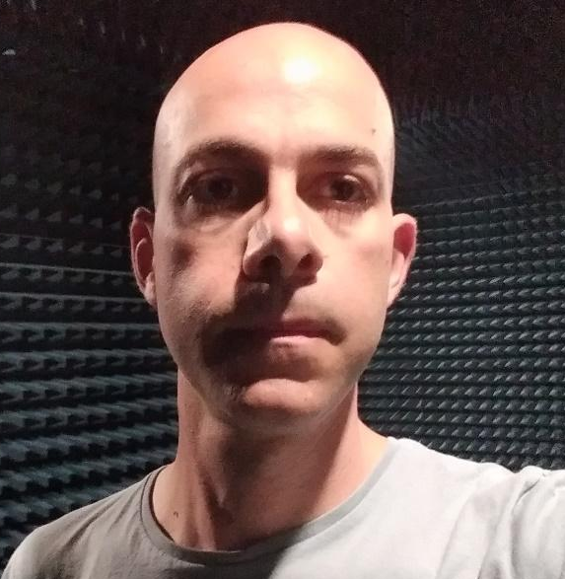
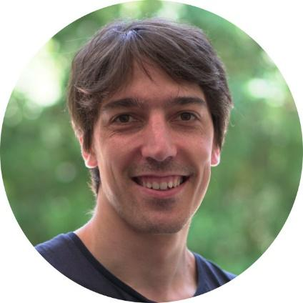
Who’s who
DAEDALUS
Angelo Pio Rossi
Teamleader
JUB
Jasper Zevering
System Engineer
Mechanism
JMU
Francesco Maurelli
Robotics
JUB
Anton Bredenbeck
Thermal / Power
JMU
Fabian Arzberger
Data Handling / Communication
JMU
Kedus Mathewos
Structures
JUB
CRANE
Manuel Arias
Teamleader
OVIEDO
Fermín Navarro
System Engineer
Thermal
UVIGO
Pablo F. Miaja
Mechanisms
Structures
OVIEDO
Daniel G. Aller
Power
OVIEDO
Germán León
Communication
OVIEDO
Diego Nodar
Data Handling
ALENSPACE

Slide 4
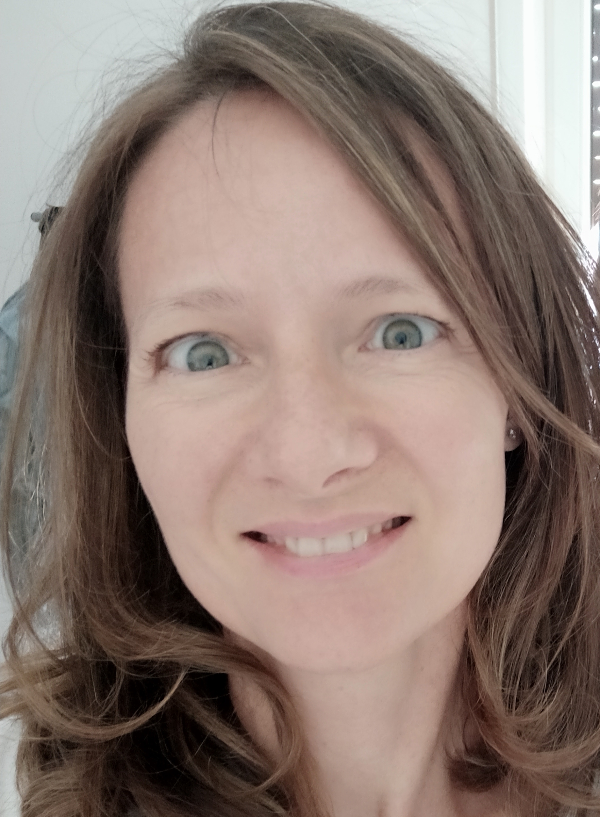
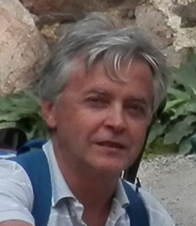
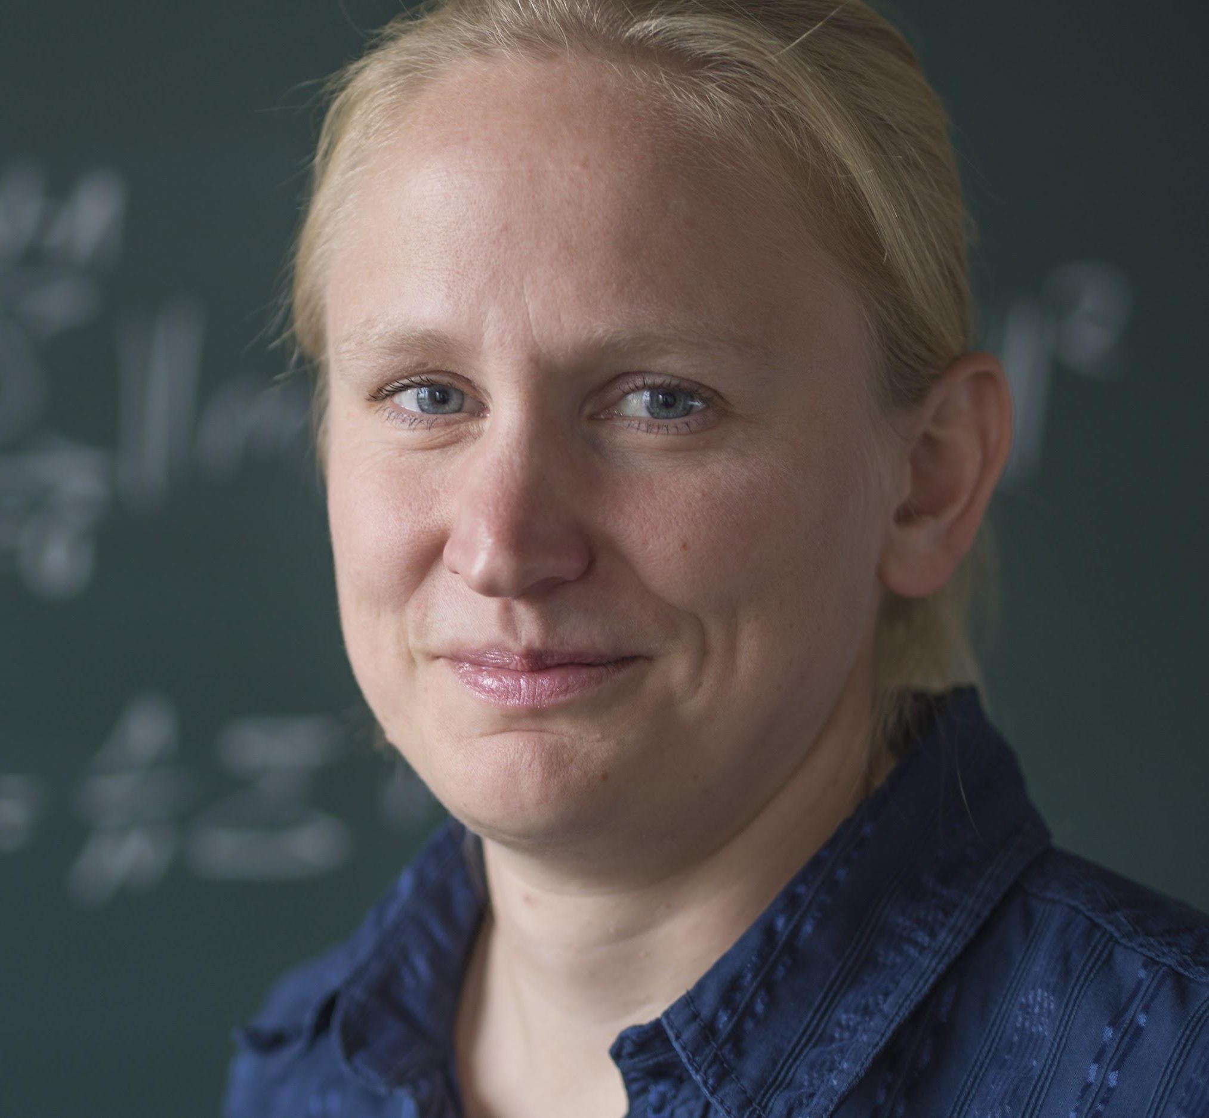
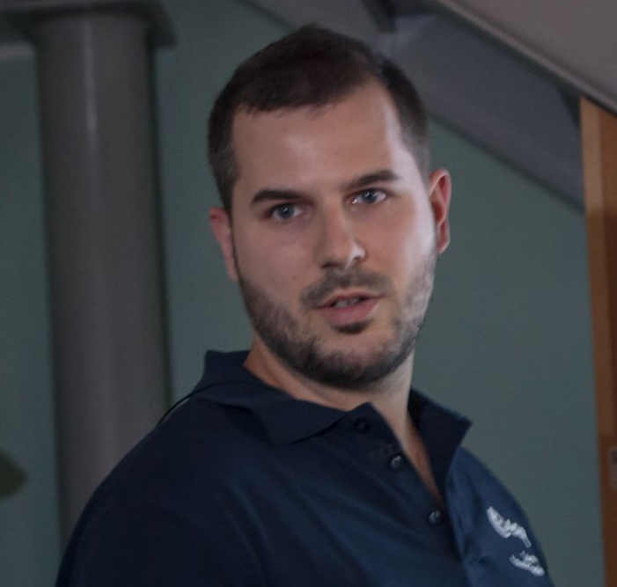
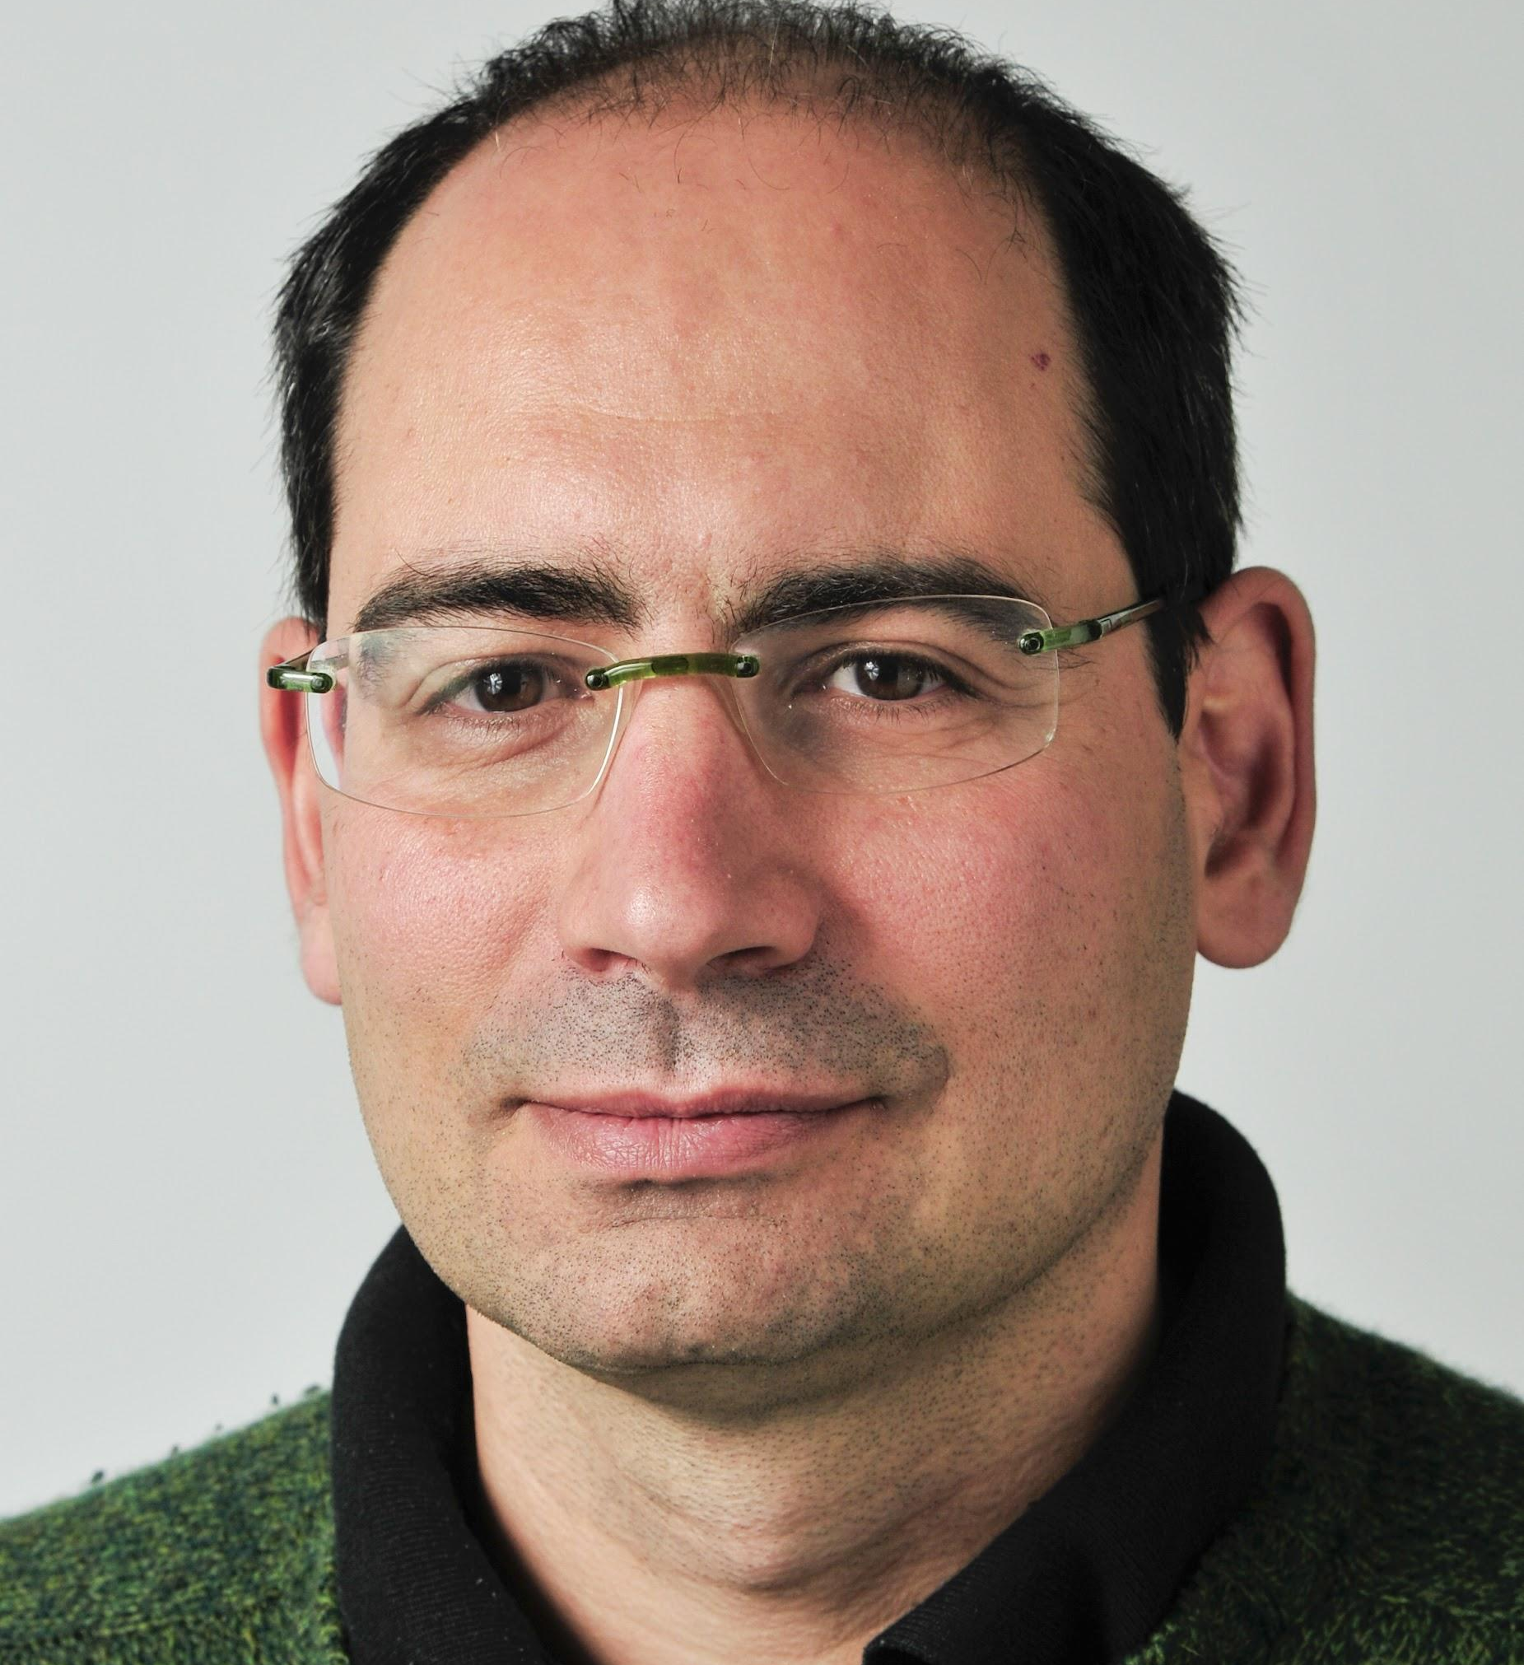
Who’s who
DAEDALUS
Sabrina Ferrari
Instruments (camera)
UPD
Claudio Pernechele
Instruments (camera)
INAF
Dorit Borrmann
Instruments (LIDAR)
JMU
Riccardo Pozzobon
Environment
UPD
Matteo Massironi
Environment
UPD
CRANE

Slide 5
E-Mail List
Name | Email
Angelo Pio Rossi | an.rossi@jacobs-university.de
Jasper Zevering | jasper.zevering@stud-mail.uni-wuerzburg.de
Francesco Maurelli | f.maurelli@jacobs-university.de
Anton Bredenbeck | anton.bredenbeck@stud-mail.uni-wuerzburg.de
Fabian Arzberger | fabian.arzberger@stud-mail.uni-wuerzburg.de
Kedus Mathewos | k.mathewos@jacobs-university.de
Sabrina Ferrari | sabrina.ferrari@unipd.it
Claudio Pernechele | claudio.pernechele@inaf.it
Dorit Borrmann | dorit.borrmann@uni-wuerzburg.de
Riccardo Pozzobon | riccardo.pozzobon@unipd.it
Matteo Massironi | matteo.massironi@unipd.it
Name | Email
Manuel Arias | ariasmanuel@uniovi.es
Fermín Navarro | fermin.navarro.medina@uvigo.es
Pablo F. Miaja | fernandezmiapablo@uniovi.es
Daniel G. Aller | garciaadaniel@uniovi.es
Germán León | gleon@uniovi.es
Diego Nodar | diego.nodar@alen.space
CRANE
DAEDALUS

