Slide 1
PolySLAM6D
An optimized polygon based SLAM algorithm for mobile mapping using efficient planar clustering and enhanced 6D gradient descent.

Slide 2
PolySLAM6D
An optimized polygon based SLAM algorithm for mobile mapping using efficient planar clustering and enhanced 6D gradient descent.

Slide 3
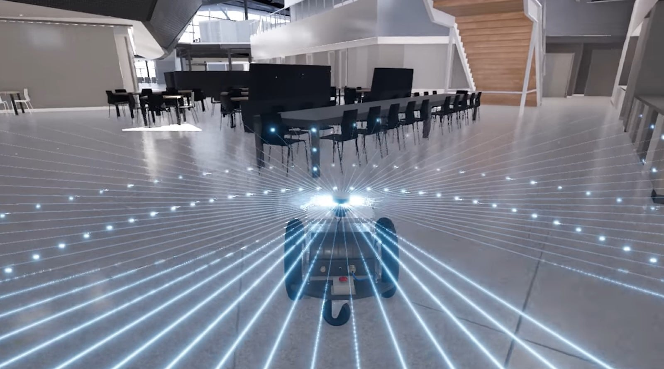
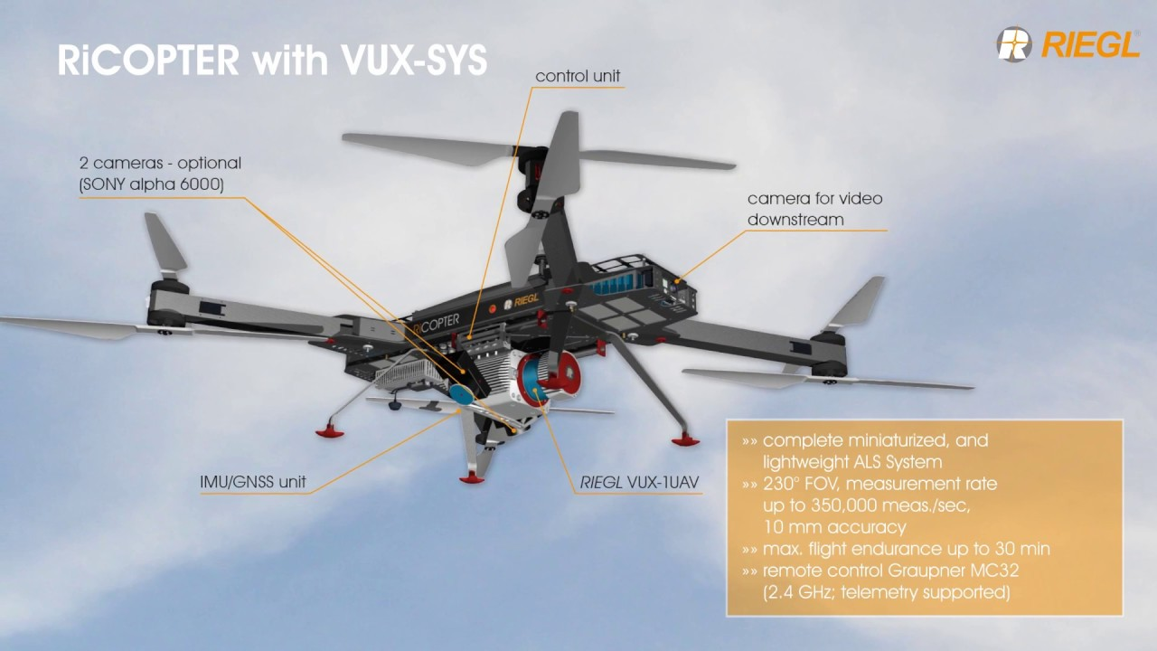
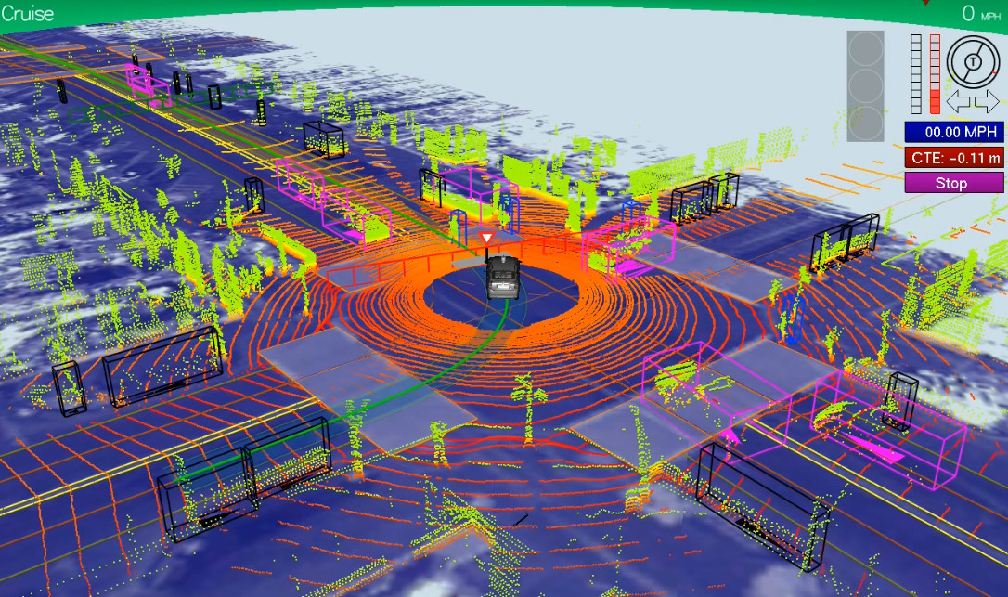
Simulataneous Localization And Mapping
LiDAR
(Light Detection And Ranging)
Image sources:
https://blogs.nvidia.com/blog/2019/07/25/what-is-simultaneous-localization-and-mapping-nvidia-jetson-isaac-sdk/
https://betanews.com/2013/05/02/googles-self-driving-cars-gather-nearly-1gb-of-sensor-data-every-second-would-you-trust-them/
https://www.youtube.com/watch?v=t4rwKoLmgVI&ab_channel=WageningenUniversity%26Research

Slide 4
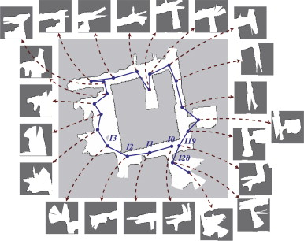
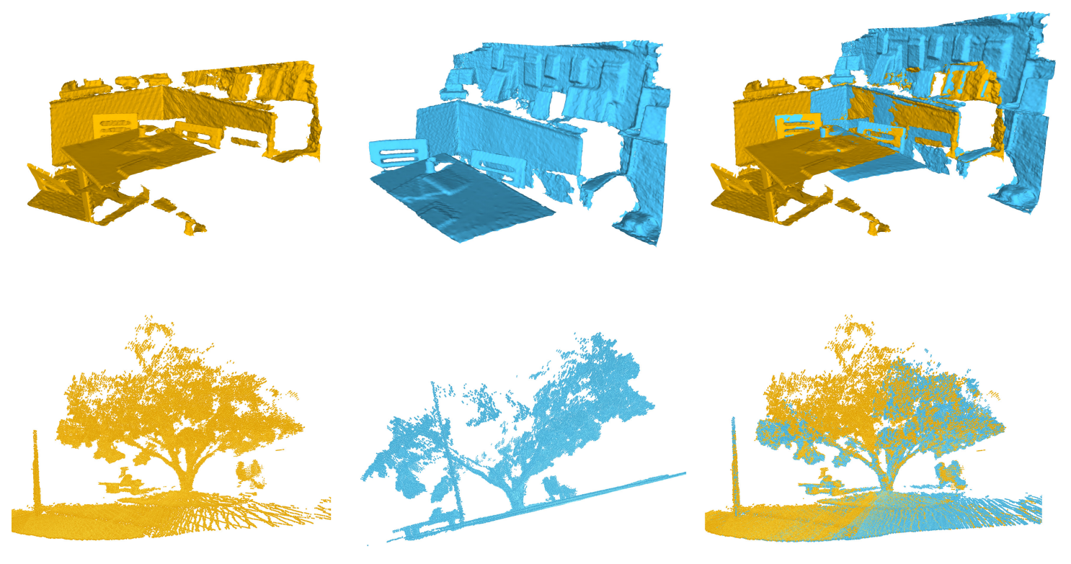
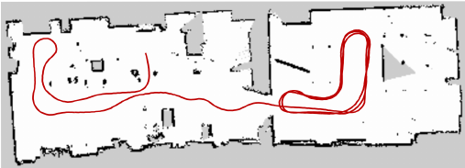
Simulataneous Localization And Mapping
Image sources:
https://openaccess.thecvf.com/content_CVPR_2019/papers/Gojcic_The_Perfect_Match_3D_Point_Cloud_Matching_With_Smoothed_Densities_CVPR_2019_paper.pdf
https://www.researchgate.net/publication/280040097_A_Benchmark_Survey_of_Rigid_3D_Point_Cloud_Registration_Algorithms/figures?lo=1&utm_source=google&utm_medium=organic
https://www.sciencedirect.com/science/article/abs/pii/S0952197614003029

Slide 5
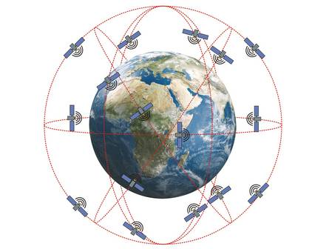
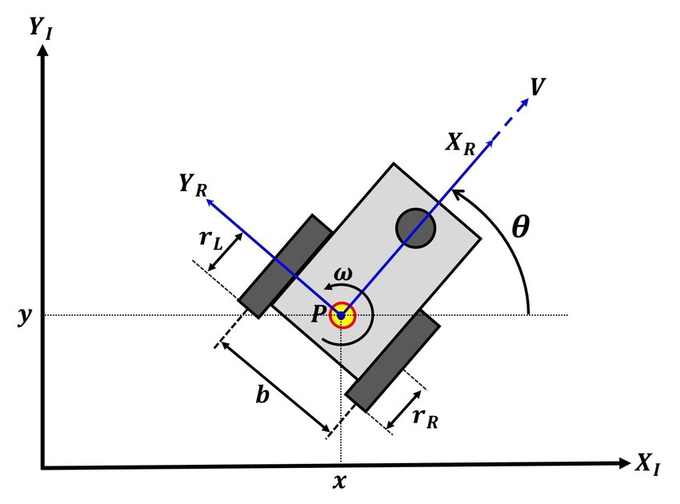
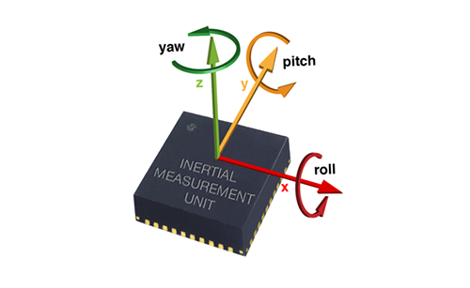
Simulataneous Localization And Mapping
GPS
Odometry
IMUs
→ Controllable motion
→ High point density
→ Overlap
Image sources:
https://www.conrad.de/de/ratgeber/technik-einfach-erklaert/gps.html
https://www.researchgate.net/publication/335317557_Simultaneous_Calibration_of_Odometry_and_Head-Eye_Parameters_for_Mobile_Robots_with_a_Pan-Tilt_Camera/figures?lo=1
https://vrtracker.xyz/handling-imu-drift/

Slide 6
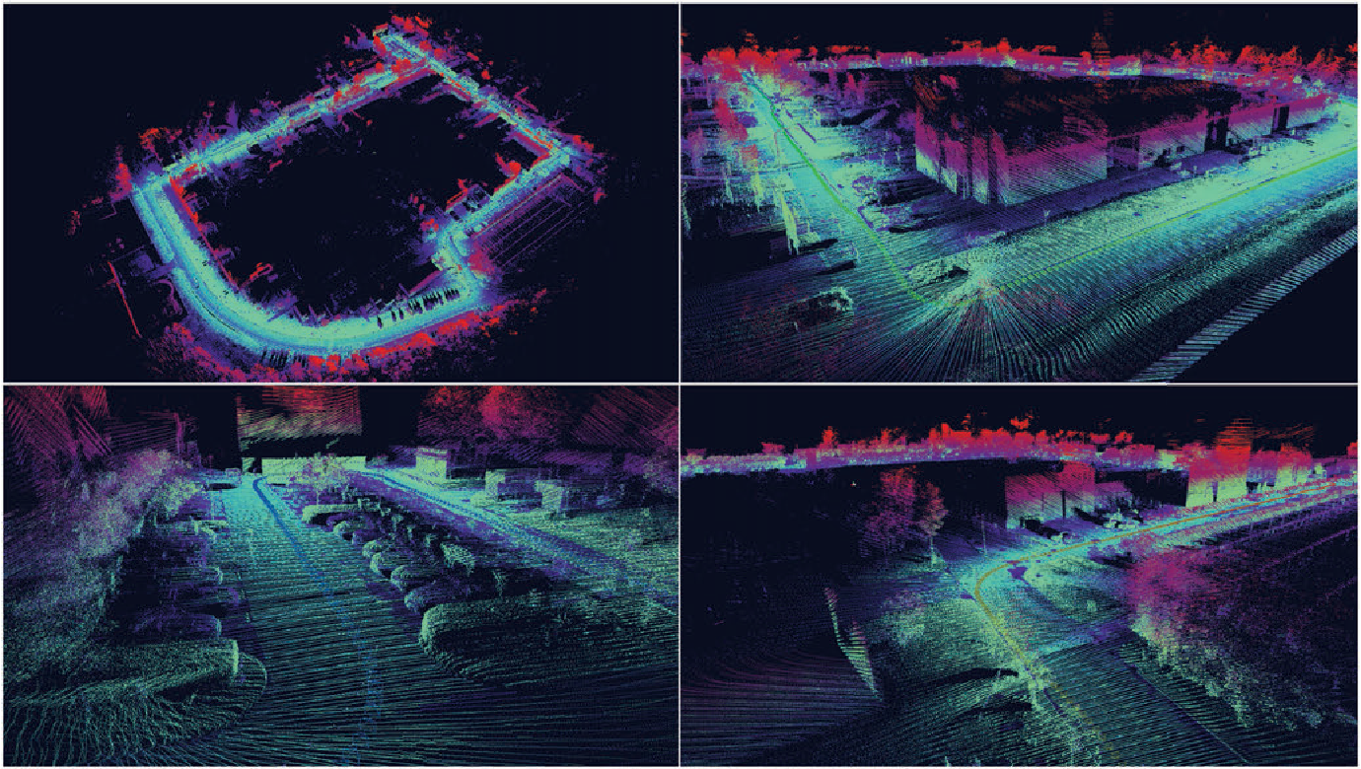
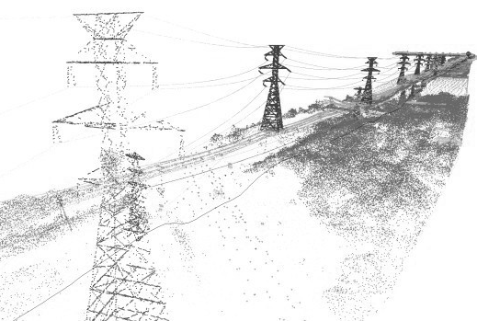
Simulataneous Localization And Mapping
Image sources:
https://www.semanticscholar.org/paper/Low-cost-3D-mobile-mapping-system-by-6-DOF-using-Yokozuka-Hashimoto/6a3ff076a8f40779dc283067026fbfdeb84faaf7
https://www.mapzen.com/blog/point-clouds/

Slide 7
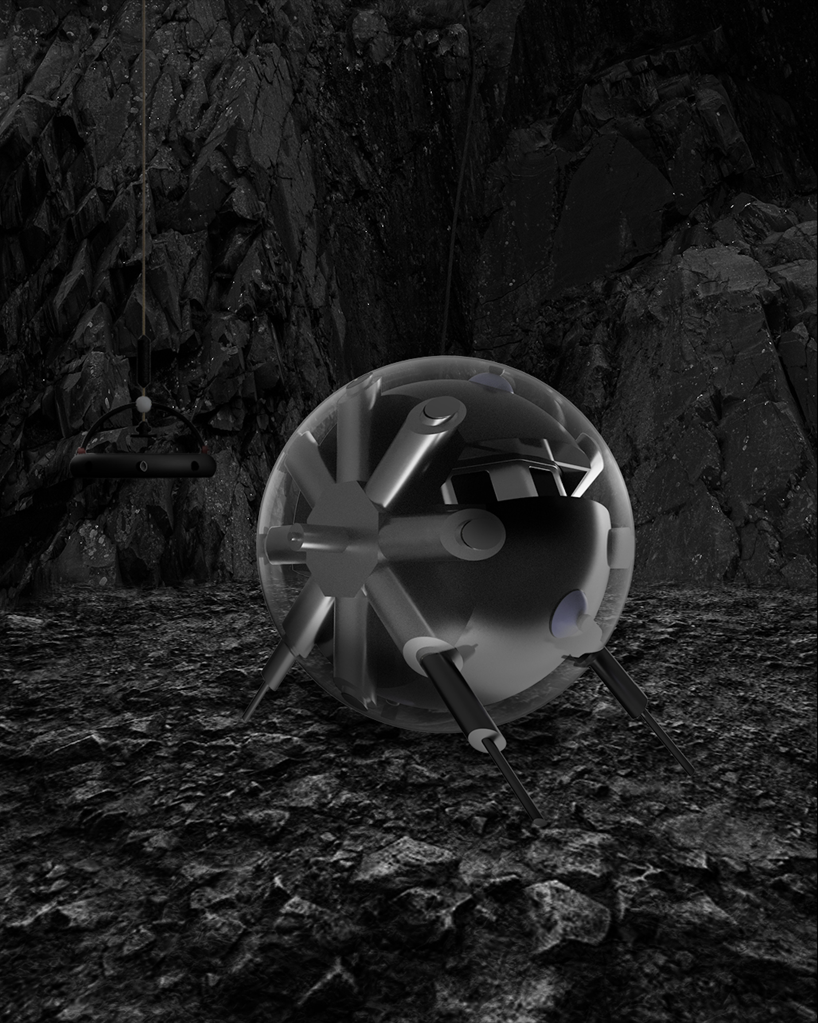
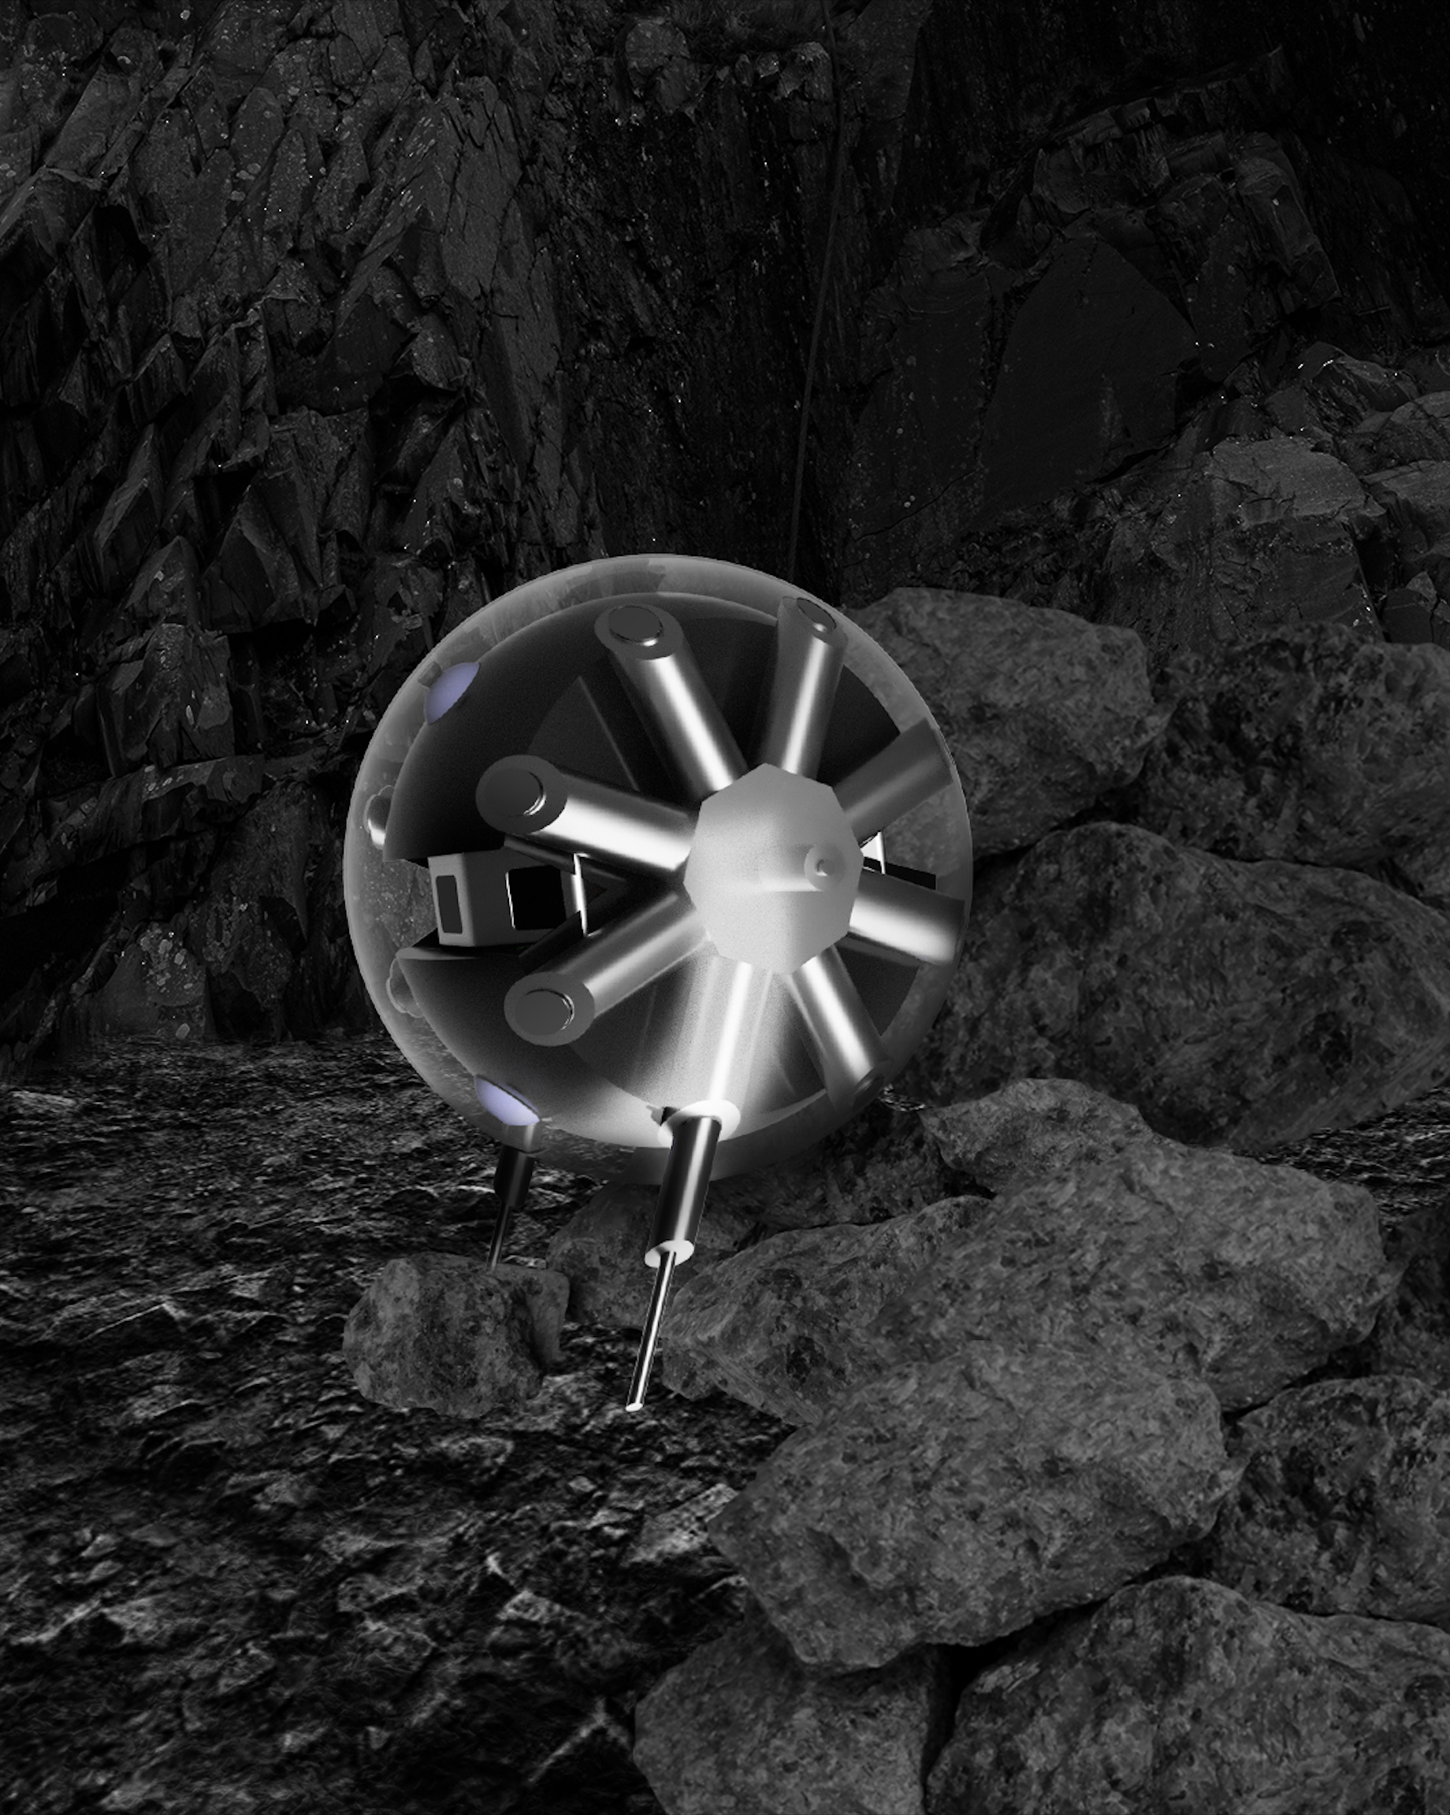
Simulataneous Localization And Mapping
Descent And Exploration in Deep Autonomy of Lava Underground Structures (DAEDALUS)

Slide 8
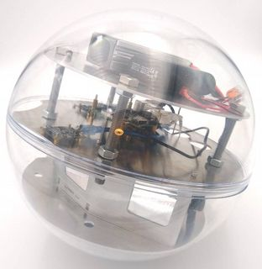
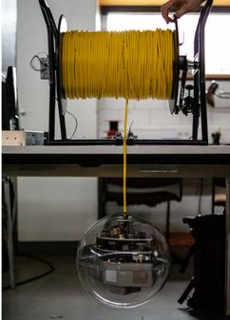
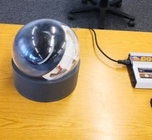
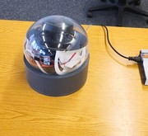
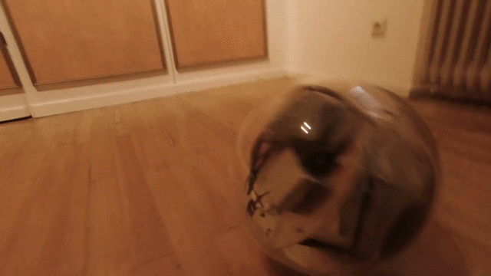
Simulataneous Localization And Mapping

Slide 9
Simulataneous Localization And Mapping
GPS
Odometry
IMUs
(Error-prone, very noisy!)
→ Controllable motion
→ High point density
→ Overlap
Image sources:
https://www.conrad.de/de/ratgeber/technik-einfach-erklaert/gps.html
https://www.researchgate.net/publication/335317557_Simultaneous_Calibration_of_Odometry_and_Head-Eye_Parameters_for_Mobile_Robots_with_a_Pan-Tilt_Camera/figures?lo=1
https://vrtracker.xyz/handling-imu-drift/

Slide 10
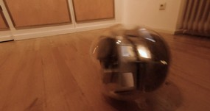
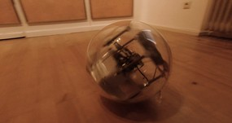
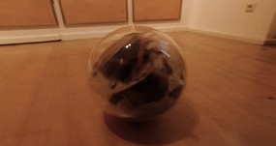
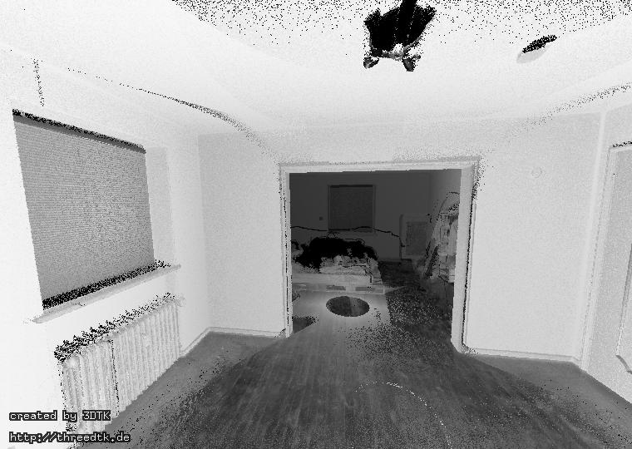
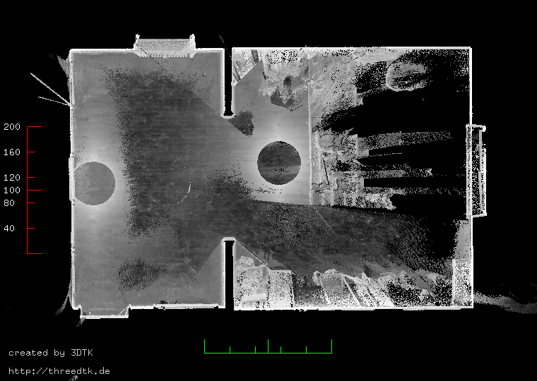
Simulataneous Localization And Mapping
Rolling Sphere
→ Carefully rolled by hand
→ Livox Mid 100,
Low Cost
3D laserscanner
→ Low Cost Phidget IMUs
(Ground truth point cloud, obtained by Riegl VZ 400)

Slide 11
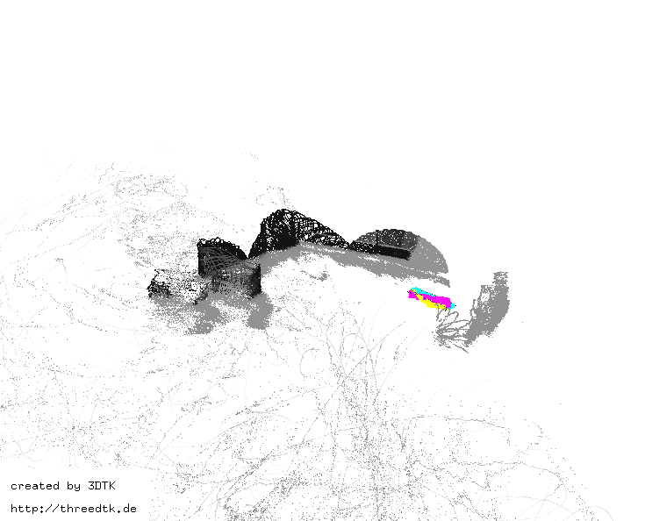
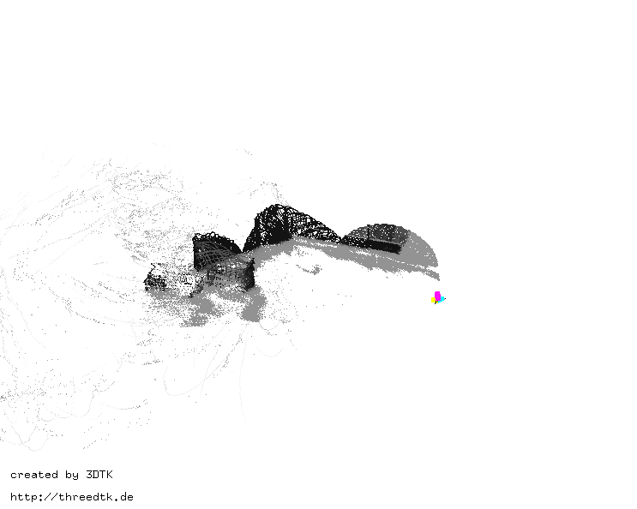
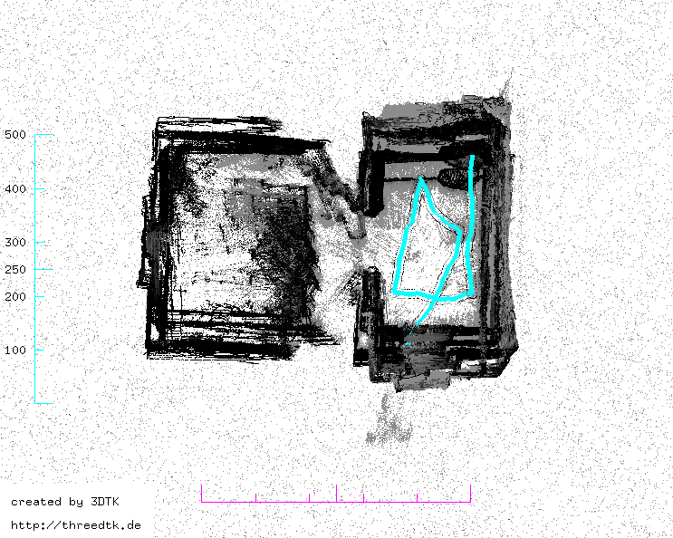
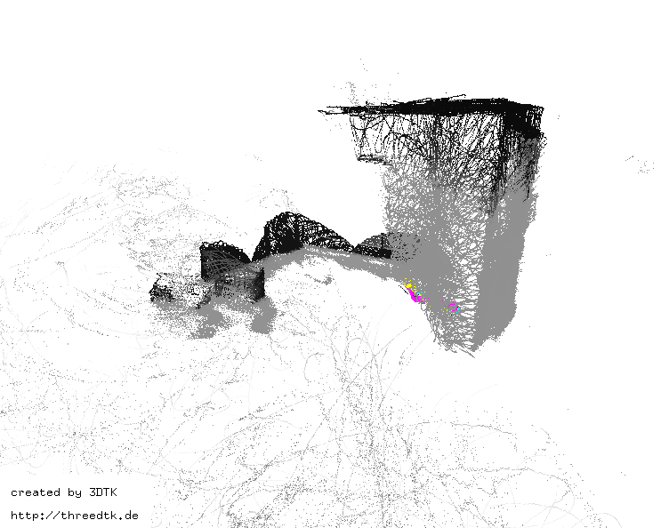
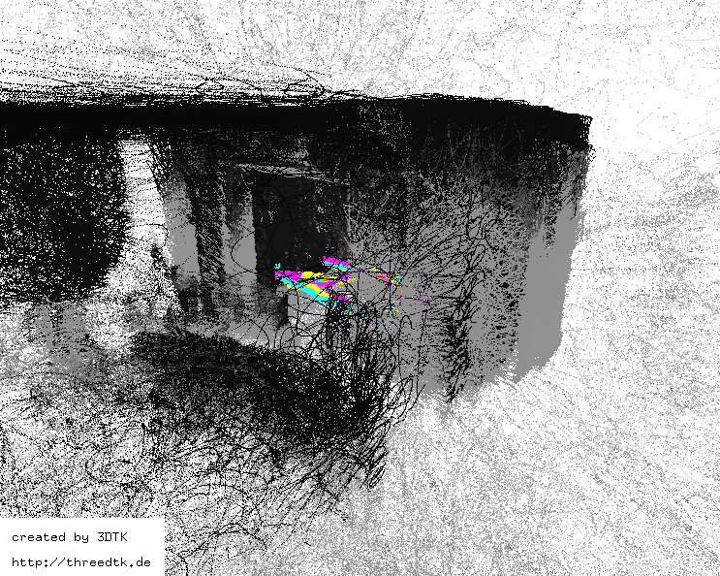
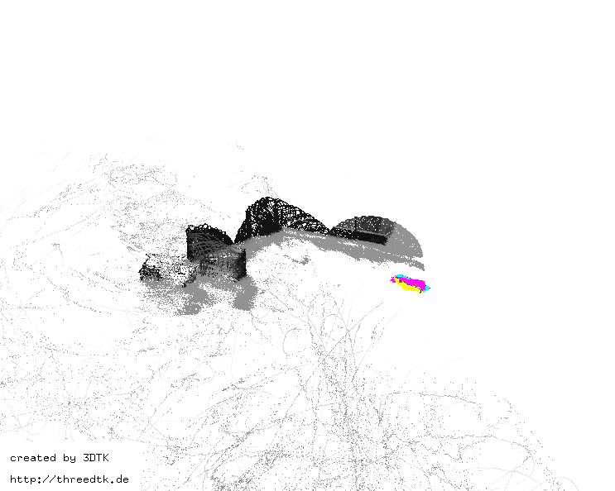
Simulataneous Localization And Mapping
Rolling Sphere

Slide 12
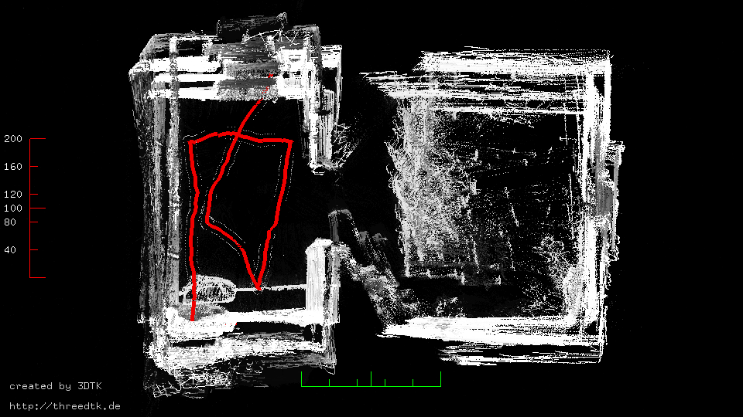
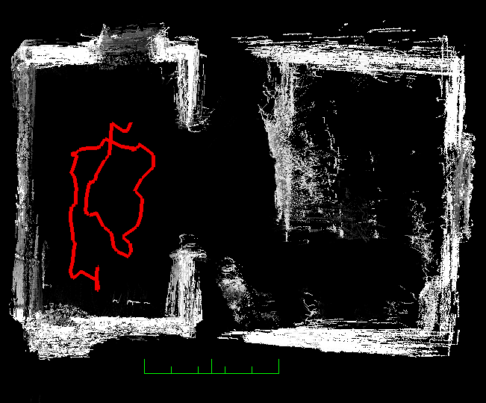
Simulataneous Localization And Mapping
Rolling Sphere

Slide 13

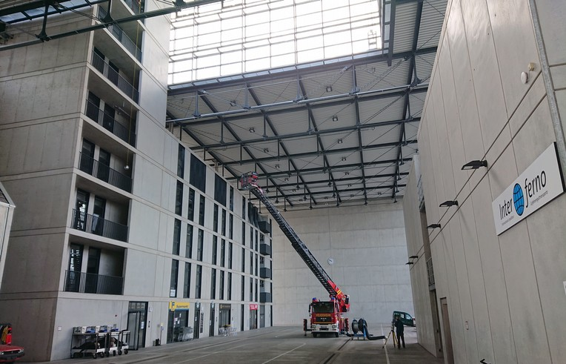
Simulataneous Localization And Mapping
Crane Descent
→ Rotation induced by
cable, uncontrollable
→ Livox Mid 100, Low Cost
3D laserscanner
→ Low Cost Phidget IMUs

Slide 14
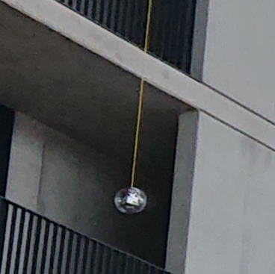
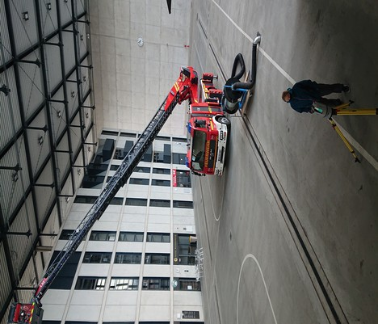
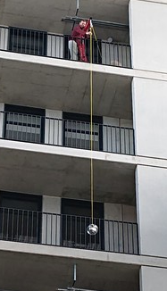
Simulataneous Localization And Mapping
Crane Descent
Notes:
Here you can see anton, as he carefully descends the sphere with a crane.
And in the other image you can see Dorit with the terrestrial laserscanner on a tripod.

Slide 15
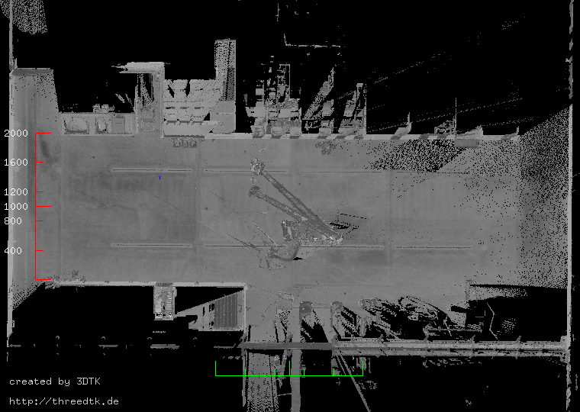
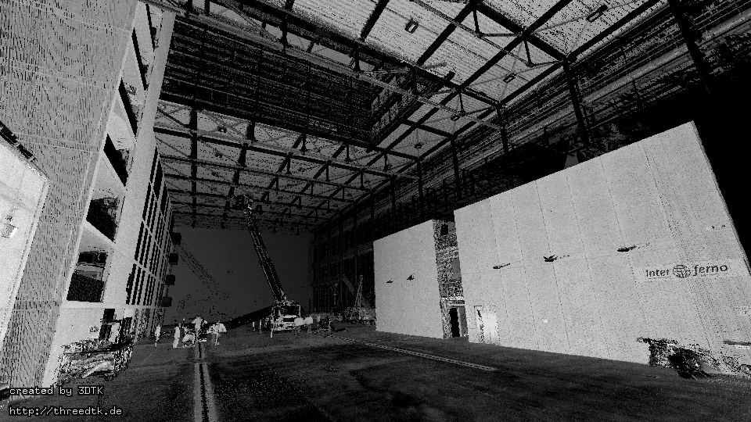
Simulataneous Localization And Mapping
Crane Descent
(Ground truth point cloud, obtained by Riegl VZ 400)

Slide 16
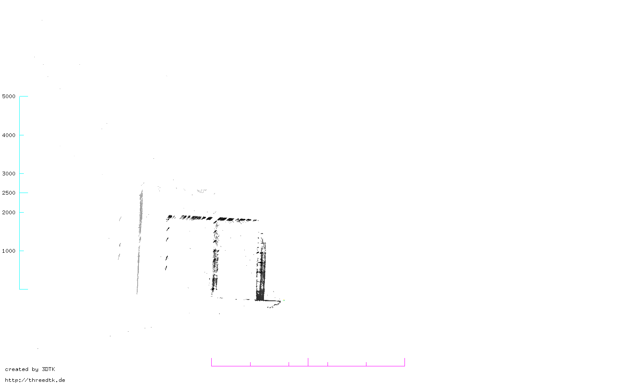
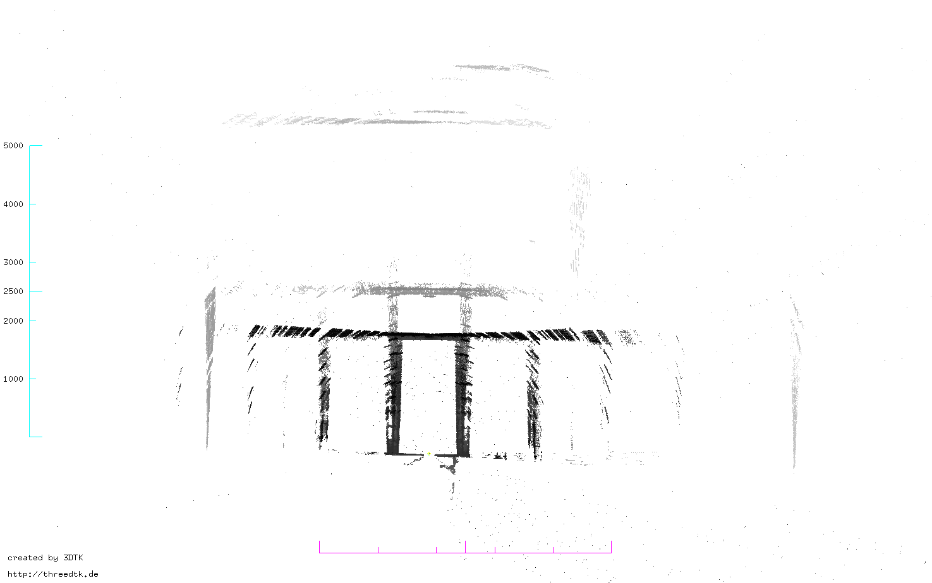
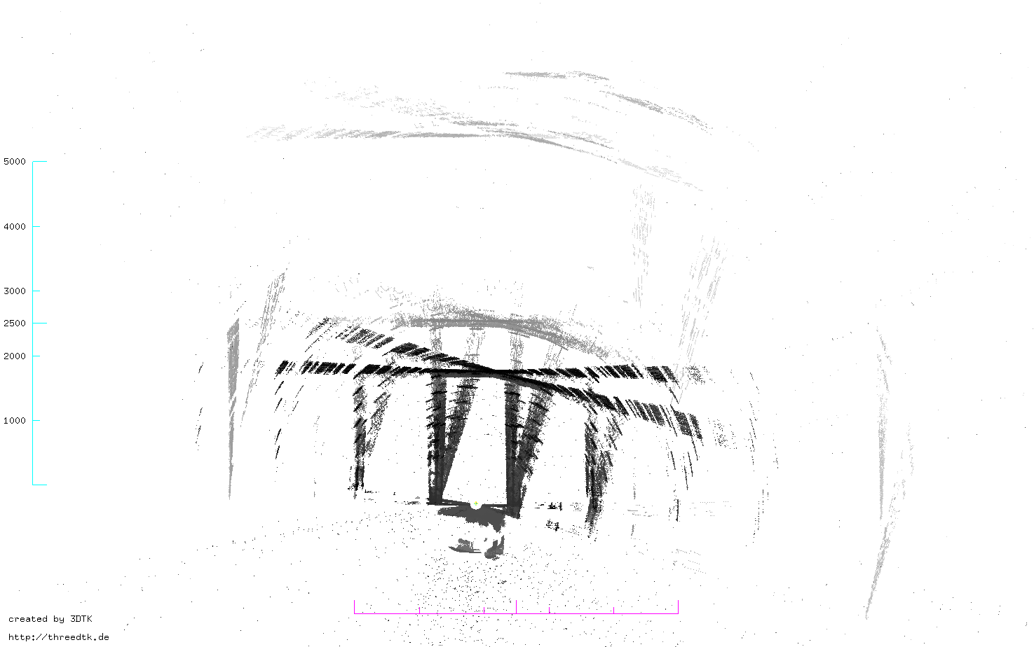
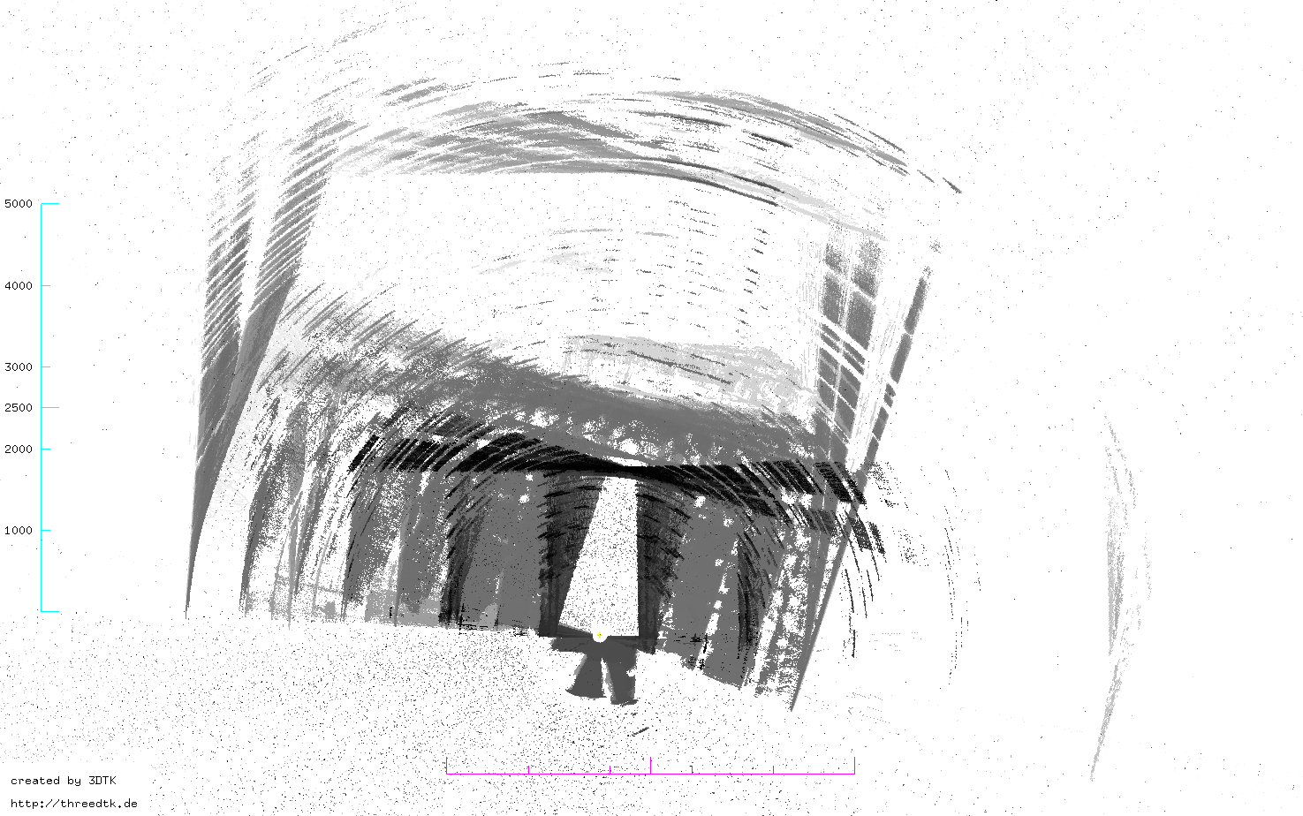
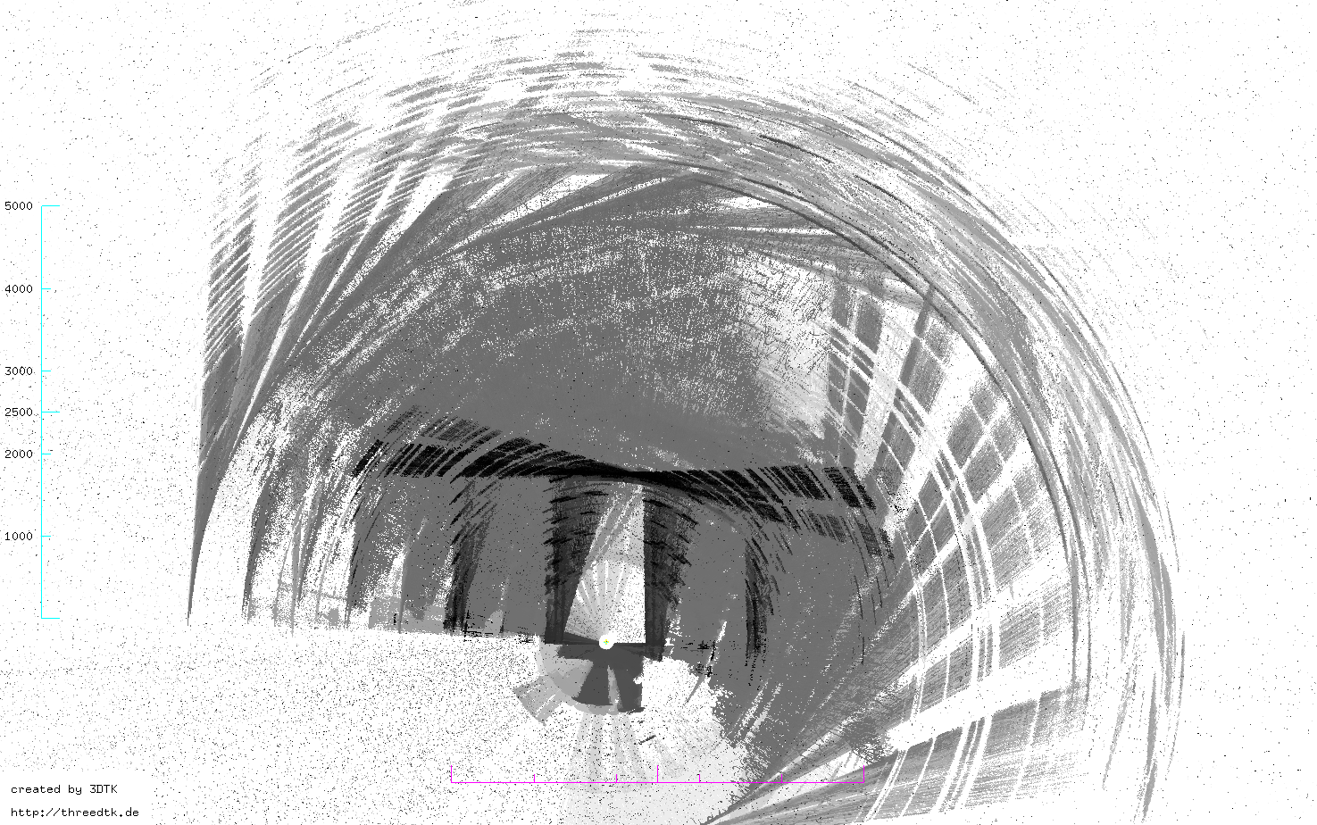
Simulataneous Localization And Mapping
Crane Descent
Notes:
First few seconds: Steal beams, walls
Next ten seconds or so: smeares due to imprecise IMU
Progressing further in time: accumulation of IMU error gets visible
The more we progress in time, the worse the accumulation of IMU error gets.
In the end , we have a point cloud that does not at all represent the environment.
Can SLAM correct this?
Yes, let me show you.

Slide 17
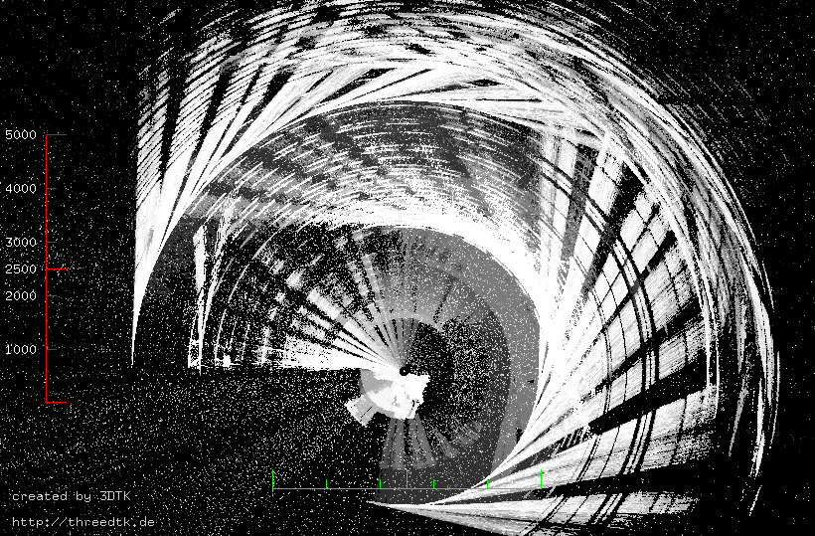
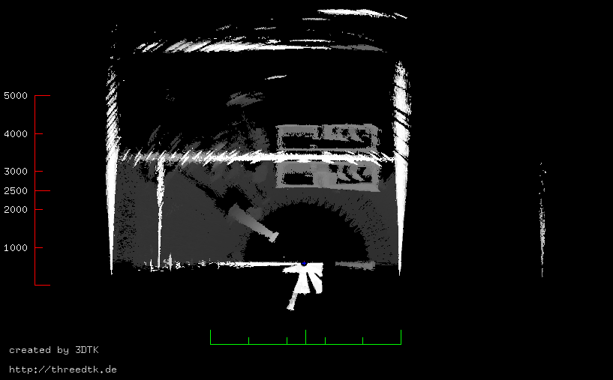
Simulataneous Localization And Mapping
Crane Descent
Notes:
So, This was actually corrected by PolySLAM.
And As you can see, the smearing gets successfully reduced by… well , lets call it „a lot“.

Slide 18
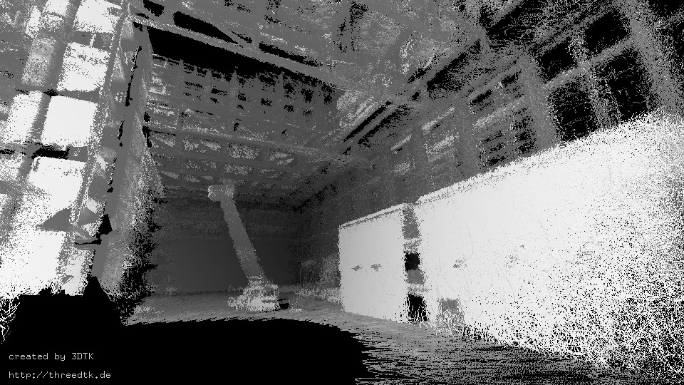
Simulataneous Localization And Mapping
Crane Descent
Notes:
Lets also make an indoor comparison with the ground truth point cloud.
Beautifull, isnt it?
Note that the point cloud from the prototype is , of course, much more noisy due to remaining IMU related errors and SLAM errors.
Also, the laserscanner itself has some range noise itself.

Slide 19
PolySLAM6D
An optimized polygon based SLAM algorithm for mobile mapping using efficient planar clustering and enhanced 6D gradient descent.
Notes:
You should now have a rough idea on what SLAM algorithms do, why we need them, and what problems arise with the prototypes that WE use.
Now, lets dive deeper into HOW the PolySLAM can correct these point clouds.
Actually, it says it right here: it is a polygon based slam that uses planar clustering!
So what does that mean?

Slide 20
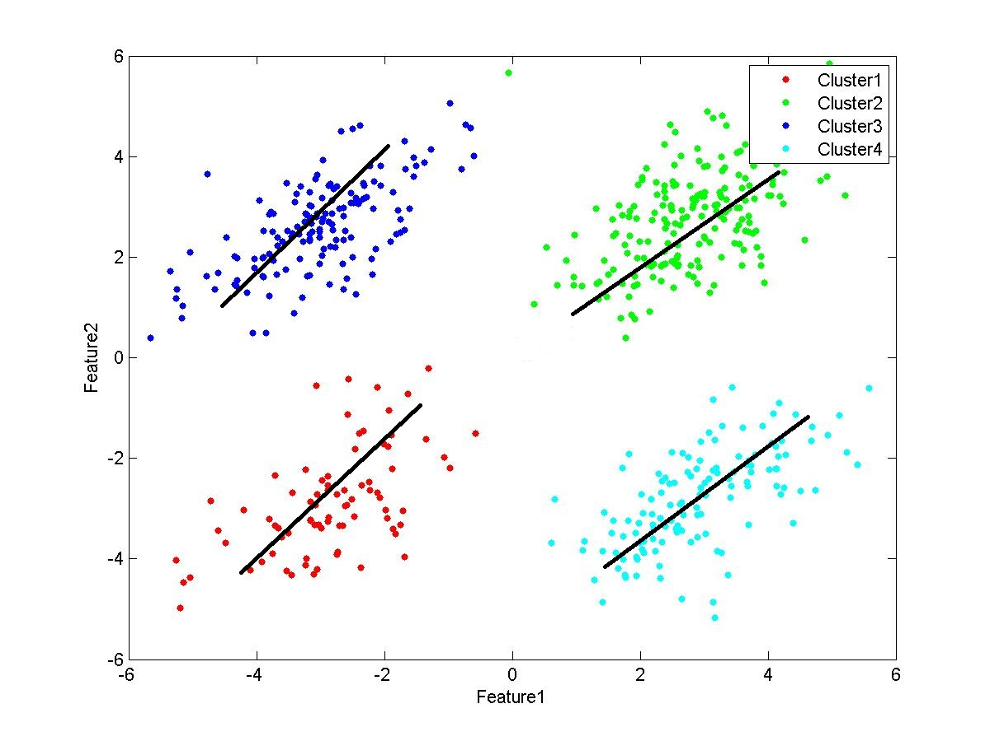
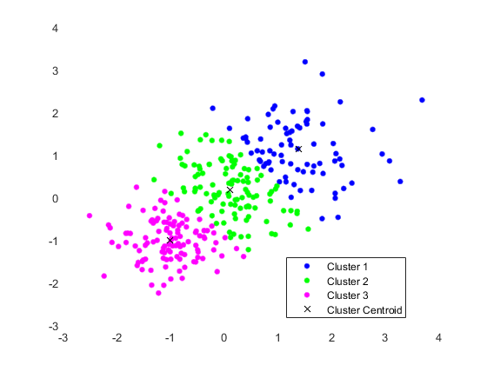
Planar Clustering and Polygons
wrong!
correct!
Image sources:
https://stackoverflow.com/questions/21667531/regression-lines-for-cluster-of-points-in-matlab
https://www.researchgate.net/publication/332053160_A_Clustering_Approach_for_Customer_Billing_Prediction_in_Mall_A_Machine_Learning_Mechanism/figures?lo=1
https://www.rolofcomputeracademy.edu.ng/jnss.asp?iid=86873111&cid=28
Notes:
Clustering, in the context of point clouds, refers to the act of grouping similar points together.
Lets look at these 2D examples.
In both images, we want to fit lines to these points.
However, we dont know how many lines there will be at the beginning.
In the left image, four clusters were correctly identified. (KLICK)
But in the right image, three clusters were found instead of just one big line.
This is called an oversegmentation, but we will later see that our algorithm does not do this.

Slide 21
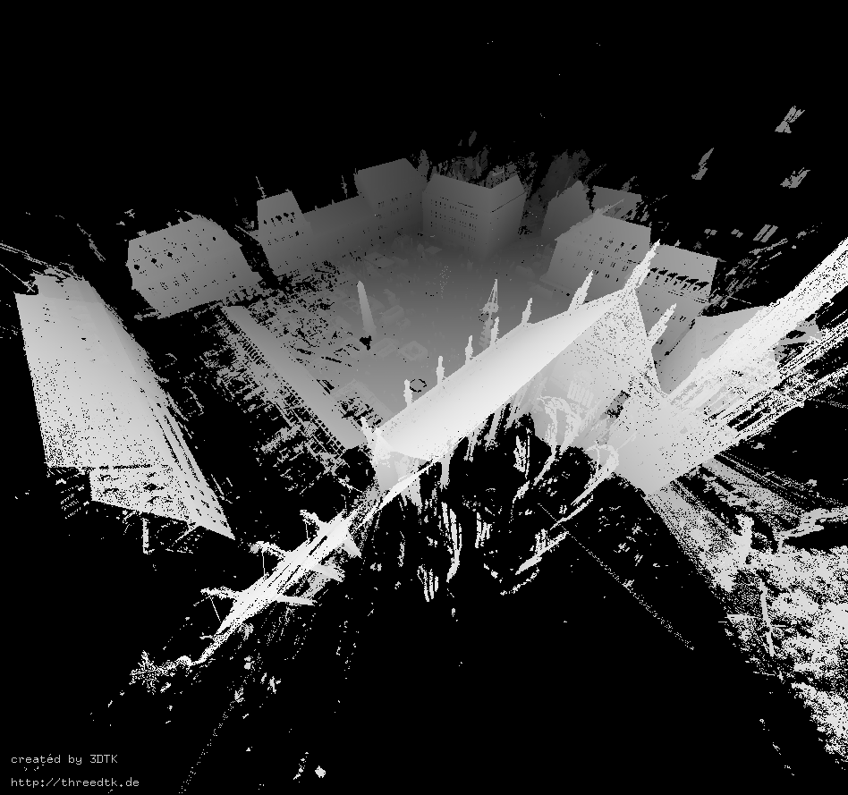
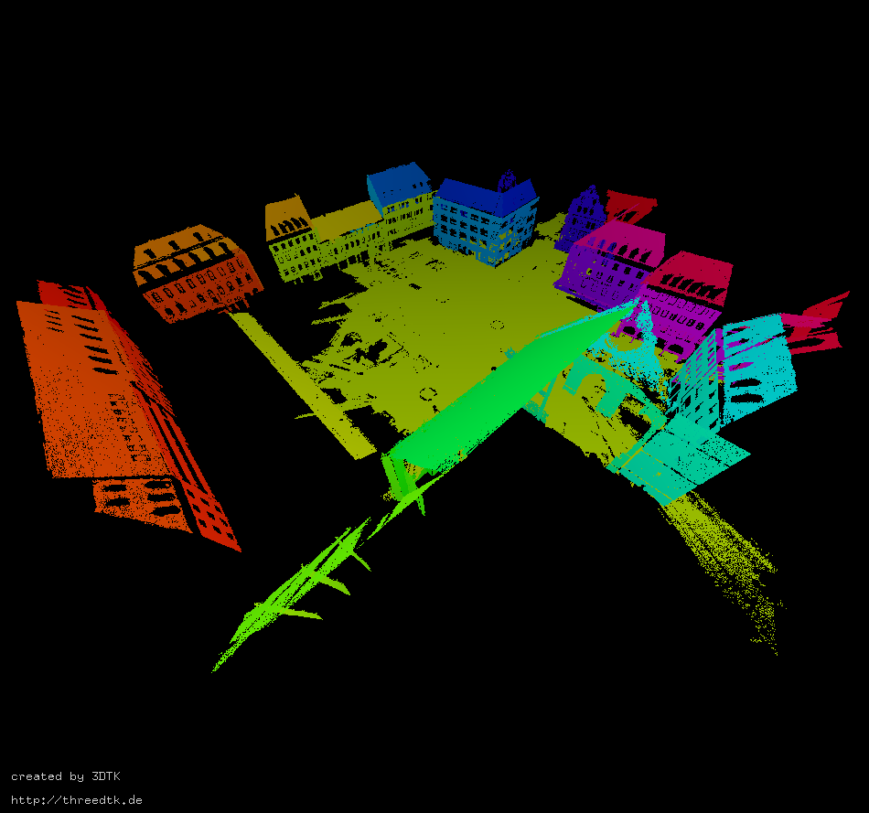
Planar Clustering and Polygons
Notes:
Lets now look at a clustering example on a 3 dimensional point cloud.
This time, we dont want to find lines, but the 3D anolgy: which are planes.
The dataset you see was collected, again, by a terrestrial scanner on a tripod, on the market square of würzburg.
Spires are not visible,
Obilisk is not visible,
Only big planes

Slide 22
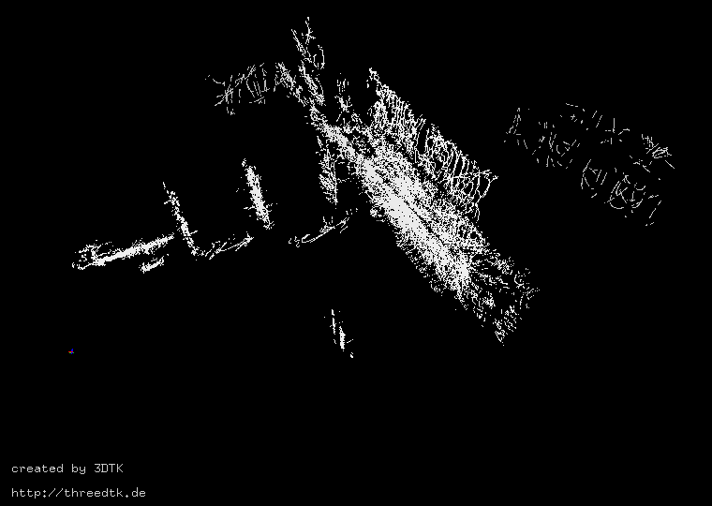


Planar Clustering and Polygons
3D Point Cloud Data
t = 1 s
t = 2 s
t = 3 s

Slide 23



Planar Clustering and Polygons
Localy Clustered
3D Point Cloud Data
t = 1 s
t = 2 s
t = 3 s

Slide 24



Planar Clustering and Polygons
Localy Clustered
3D Point Cloud Data
With Polygons
t = 1 s
t = 2 s
t = 3 s
Notes:
Then, we can build polygons around these clusters.
We then find similarities between these polygons in subsequent scans.
Once two polygons are similar , we can consider them a match and therefore, merge them together. (NEXT)

Slide 25
Planar Clustering and Polygons
Matching
Localy Clustered
3D Point Cloud Data
With Polygons
d_{PPD}
e
d_{H}
r
s =
w_{α}
s_{α}
+
w_{r}
s_{r}
+
w_{H}
s_{H}
+
w_{PPD}
s_{PPD}
+
w_{e}
s_{e}
w_{α} = 1
w_{r} = 1
w_{H} = 0.5
w_{PPD} = 0.1
w_{e} = 0.1

Slide 26
Planar Clustering and Polygons
Localy Clustered
3D Point Cloud Data
With Polygons
t = 1 s
t = 2 s
t = 3 s
Notes:
Only some merge, others dont

Slide 27

Planar Clustering and Polygons
Globaly Clustered
3D Point Cloud Data
With Polygons
Notes:
We compare any other subsequent scan that come next, to these global polygons.
That means, we calculate clusters again, polygonize them, and match them to these global clusters.
Therefore, point-to-plane correspondences arise for any point in the local cluster, to the global polygons.

Slide 28
PolySLAM6D
An optimized polygon based SLAM algorithm for mobile mapping using efficient planar clustering and enhanced 6D gradient descent.
Notes:
Of course, before merging all the points into a single , new polygon, we have to optimize the robots position and orientation, or „pose“ for short.
This is done by gradient descent.
Once you know how that works, you have a least an idea of what every part in the algrithm does.

Slide 29
1D optimization by gradient descent
Point-to-Plane Distance Error
Robots Pose
Start Pose
Optimal Pose
Notes:
So how does gradient descent work?
As you can rember, we established matches between points and polygons a few seconds ago.
This means, that we know the distance error from each point to its corresponding plane.
I like this graph because it shows one idea pretty well: a change in the robots pose also leads to a change in the distance error.
Because moving the scan around changes these distances.
Lets say the robot starts out here.
The gradient descent should avoid those local minima and find the globally optimal pose.
This is a simplified example, of course, because its only one dimension.

Slide 30

2D optimization by gradient descent
Notes:
A 2D representation you often find is this one.
But how do you vizualize 6D gradient descent?
This gets really difficult to plot, but you can vizualize what happens to the robots pose and the point clouds.

Slide 31

6D optimization by gradient descent

Slide 32

6D optimization by gradient descent

Slide 33
PolySLAM6D
+
=
An optimized polygon based SLAM algorithm for mobile mapping using efficient planar clustering and enhanced 6D gradient descent.
Notes:
Hopefully, by now the confusion when reading these words is gone, and you all have instead these images in your head.
That we cluster similar points together and build polygons with them.
That we match points-to-planes and
that the gradient descent use these to find the global optimum for the pose.
Even if simplified, this is what makes up the whole SLAM algorithm.
If you got all this:
Congrats, you now fully understand what the algorithm does, and therefore, you understand the first scientific contribution of the thesis.
Now, lets look at the clustering algorithm in more detail.
It is the second scientific contribution, because it is quite optimized for speed.

Slide 34
Clustering with Trees
Normals

Slide 35
Clustering with Trees
x > 3
x < 3
p₀
p₁
p₂
...
p_{N-1}
log₂(N/B)
y > 1
y < 1
N
y > 5
y < 5
p₂
p₅
p_{n-1}
p₀
...
B
→ Nearest neighbors in O(N)
→ Nearest neighbors in O(log(N))
Notes:
When you store the points in an array like this, there is no other way for you to look at each point before you know what the nearest neighbors are. (KLICK)
We say that the time complexity is O of N, which means we have to look at each point once. (KLICK)
Many computer scientists will know the idea of storing something in a tree structure.
For point clouds, we use the k-d tree, which always divides the 3D space evenly along one axis.
This happens at each node, until a leaf contains only B points. (KLICK)
Therefore, the height of that tree is… (KLICK)
Now, when searching the nearest neighbors in the tree structure, we have only logarithmic time complexity.

Slide 36
Clustering with Trees
Normals

Slide 37
Clustering with Trees
Normals

Slide 38
Clustering with Trees
Region Growing
Near enough: ~ 10cm
Similar normals?
Near enough?
Near enough: ~ 1cm

Slide 39
Clustering with Trees
Region Growing
only if new points belong to the cluster!

Slide 40
Clustering with Trees
Region Growing

Slide 41
Clustering with Trees
Region Growing

Slide 42
Clustering with Trees
Region Growing

Slide 43
Clustering with Trees
Region Growing
Cluster 1

Slide 44
Clustering with Trees
Region Growing
Cluster 4
Many other small clusters
Cluster 3
Cluster 1
Cluster 2
Cluster 5

Slide 45
Clustering with Trees
Region Growing
+ Filter
Cluster 4
Cluster 1
Cluster 5

Slide 46

Clustering with Trees
Region Growing
Edge points
Notes:
The same principal is also true for 3 dimensions.
This histogram shows how many points are in the clusters, shown in that image.
The biggest six clusters, those are the ones with the nice colors, correspond to each side of the cube.
Note that these are only six, but there are a total of almost 2000 clusters.
The rest are just edge clusters with 20 points or so.
We can easily cut them away with a threshold.

Slide 47
Clustering with Trees
Region Growing
Near enough: ~ 10cm
Similar normals?
Near enough?
Near enough: ~ 1cm

Slide 48
Clustering with Trees
What distance does a point have to a cluster?

Slide 49
Clustering with Trees
What distance does a point have to a cluster?

Slide 50
Clustering with Trees
What distance does a point have to a cluster?
thats the shortest!
… but we found it in O(N)
Given any point, what is its nearest neighbor in the cluster?
→ can we use k-d trees?

Slide 51
Clustering with Trees
Given any point, what is its nearest neighbor in the cluster?
log(N)
→ O(log(N))
Notes:
Yes, we can!
As before, the height of a k-d tree is log(N), so we can find the nearest neighbor in O(log(N)) time, which is quite fast.
But we arer then left with a problem:
If we decide that the point belongs to the cluster, we must add it to the kd-tree.

Slide 52
Clustering with Trees
Given any point, what is its nearest neighbor in the cluster?
log(N)
→ O(log(N))
Notes:
For one point this makes the tree a little bit unbalanced.

Slide 53
Clustering with Trees
Given any point, what is its nearest neighbor in the cluster?
log(N)
~N
→ O(log(N))
→ O(N)
k-d trees are only balanced after they have been created
Insertion makes the k-d tree unbalanced
Notes:
But when inserting many points, these long branches arise quite fast.
This means that the tree no longer has a height of log(N), and therefore the time complexity gets worse.
The new time complexity is O(n) , which is again as bad as just checking every possible point.
There are two take aways from this:
First (KLICK)
Second (KLICK)
Therefore, Let me introduce you to another datastructure that makes insertion possible without this performance degredation.

Slide 54
Clustering with Trees
The Bkd-tree: A Forest of Trees
Buffer

Slide 55
Clustering with Trees
The Bkd-tree: A Forest of Trees
Balanced!
Buffer
k-d tree

Slide 56
Clustering with Trees
The Bkd-tree: A Forest of Trees
Balanced!
Buffer
k-d tree
(empty)
k-d tree

Slide 57
Clustering with Trees
The Bkd-tree: A Forest of Trees
Buffer
k-d tree
k-d tree
size M
size M
size 2M

Slide 58
Clustering with Trees
The Bkd-tree: A Forest of Trees
sound inconvenient…
is that fast?
→ Insertion costs O(B⁻¹ log_{M/B}(N/B) log₂(N/M))
(which means it is fast!)
...
Buffer
k-d tree
k-d tree
k-d tree
(empty)
...
k-d tree
size M
size M
size 2M
size 0
...
size 2^{n}M
Notes:
So, summarized, the structure of a bkd-tree is as follows:
First, There is a buffer of size m.
Then, there are trees orderd by their size, also starting with a size of m.
The other trees then always double in size, but there might also be empty trees.
And, Once the buffer is full, we construct a new tree at the first empty spot that we find.
To do this, we take all the points from the previous trees plus the points in the buffer, and just construct a new tree with those points.
All other trees that were there before are then empty.
But can this really be faster? … (KLICK) imrpo

Slide 59
Clustering with Trees
The Bkd-tree: A Forest of Trees

Slide 60


Clustering with Trees
The Bkd-tree: A Forest of Trees
Notes:
A runtime evaluation also shows that region growing with Bkd-trees is actually really faster than just using brute force distance calculation.
In the images, the blue points are the runtimes recorded for the Bkd method, the red points for the brute force method.
Note that the scale is logarithmic, so even if the difference might seem small, it actually isnt.

Slide 61
PolySLAM6D
vs. SRR
An optimized polygon based SLAM algorithm for mobile mapping using efficient planar clustering and enhanced 6D gradient descent
vs.
Semi-rigid registration
Notes:
We have now digged deep into the details of how this algorithm actually does its thing, or at least, does the clustering.
But now its time to compare ourselfs with a state-of-the-art method, currently used by Prof. Andreas Nüchter for his SLAM Needs. (KLICK)
That method is Semi-rigid registration, or SRR for short.
We dont have time to go into the details of this method, so lets do a quick comparision.

Slide 62
PolySLAM6D vs SRR
PolySLAM6D
SRR
→ needs coarse IMU measurements
→ needs planes
→ no loop closing
→ many parameters
→ no pose estimation
needed at all
→ any environment
→ with loop closing
→ many parameters

Slide 63


PolySLAM6D vs SRR
PolySLAM6D
SRR
Notes:
These are the actuall results from both methods.
The coloring represents the distance to the real world.
We know what is „the real world“ because we just use the ground truth point cloud from the terresrtial scanner on the tripod.
Red means a high distance to the real world, which is bad.
Blue means a short distance to the real world, which is good.
To keep things short: Both results show comparable parts of red and blue.

Slide 64


PolySLAM6D vs SRR
PolySLAM6D
SRR
Notes:
This is also confirmed when taking an indoor view.
At first glance, no image is really better than the other.
But if you look really closly, you might see that SRR is a little better on sharp parts of the point cloud.
For example, the firefighter basket, or the details in the steel beams.

Slide 65
PolySLAM6D vs SRR
PolySLAM6D
SRR
→ needs coarse IMU measurements
→ needs planes
→ no loop closing
→ many parameters
→ good accuracy
→ no pose estimation
needed at all
→ needs features
→ with loop closing
→ many parameters
→ good accuracy

Slide 66
PolySLAM6D vs SRR
PolySLAM6D
SRR

Slide 67

PolySLAM6D vs SRR
PolySLAM6D
SRR

Slide 68
PolySLAM6D vs SRR
PolySLAM6D
SRR
→ needs coarse IMU measurements
→ needs planes
→ no loop closing
→ many parameters
→ good accuracy
→ fast
→ no pose estimation
needed at all
→ any environment
→ with loop closing
→ many parameters
→ good accuracy
→ slow
Notes:
So, we conclude, that PolySLAM6D is a really fast method.

Slide 69
PolySLAM6D
An optimized polygon based SLAM algorithm for mobile mapping using efficient planar clustering and enhanced 6D gradient descent
Notes:
So i hope you gained at least a rough insight into what the algorithm does and how it does so.
There is really so much more that i wanted to tell you about the details and other parts of the algorihtms, other datasets, evaluations and comparisons, and many more.
Unfortunatley i could not introduce the full, detailed working pipeline of the SLAM algorithm, and also not the details on how excacly the matching of two polygons works and lots of other stuff
But If you are also interested in such things consider having a read !

Slide 70
Thank you for the attention!
Open Questions?
Notes:
… or, you could just ask me right now.
And After that, i hope you still have capabities to enjoy the next presentation from Jasper about rolling robots.
Thanks for the attention!

