Slide 1
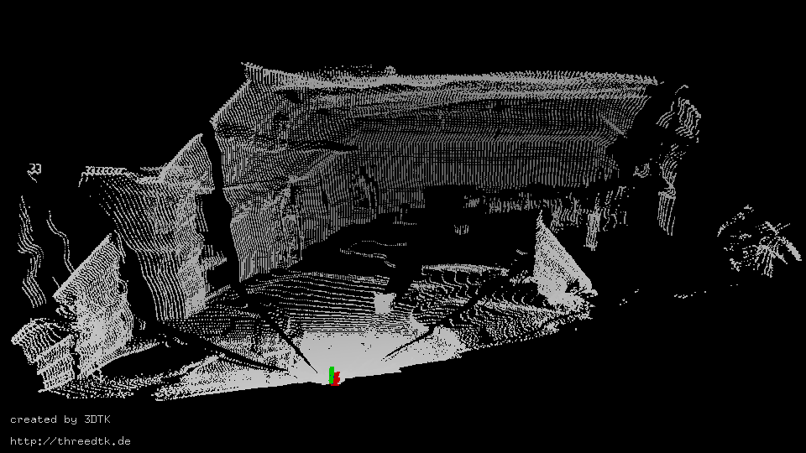
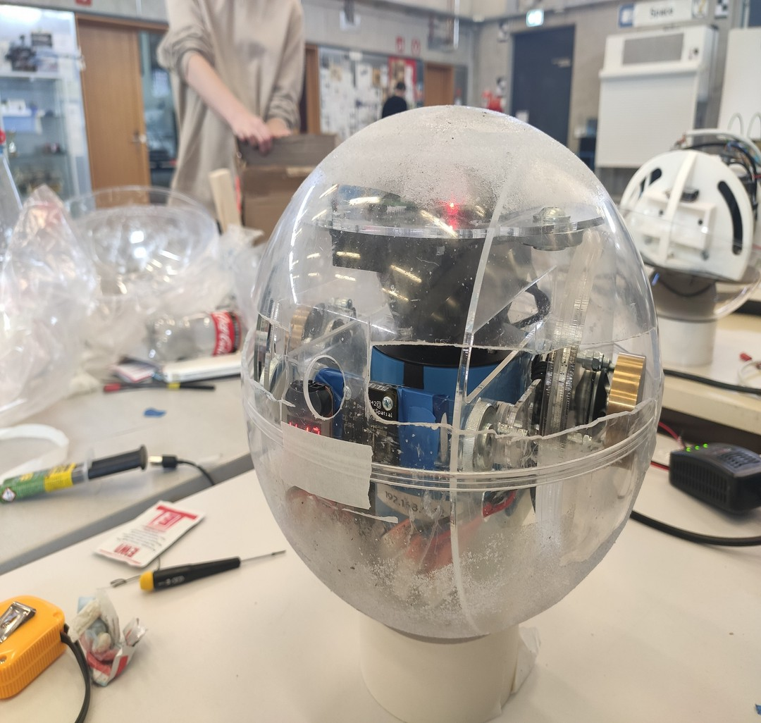
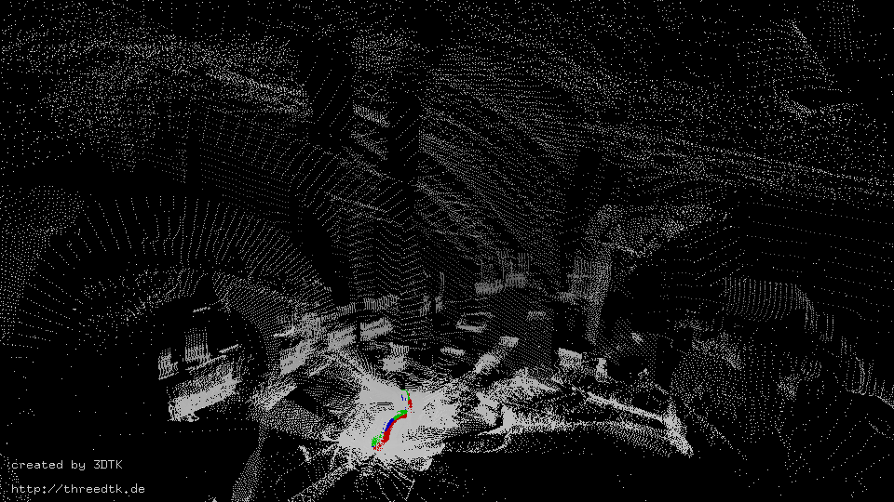
ISER 2020 - L.U.N.A. - A Laser-Mapping Unidirectional Navigation Actuator
Jasper Zevering¹, Anton Bredenbeck¹,
Fabian Arzberger¹, Dorit Borrmann¹ and Andreas Nüchter¹
¹Julius-Maximilians University Würzburg, Germany
Mapping environments using a 2D-Laser-Scanner inside a spherical robot
Uses an Impulse Based Conversation of Momentum (IBCOAM) for locomotion
Pose Estimation via inertial sensors as main challenge

