Slide 1

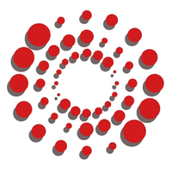


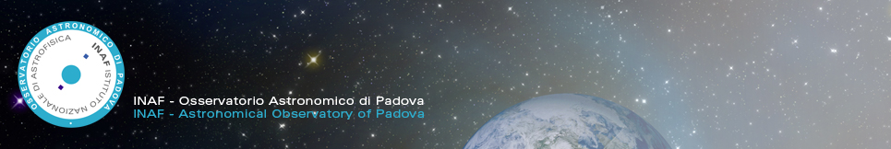
DAEDALUS - Descent And Exploration in Deep Autonomy of Lava
Underground Structures

Slide 2
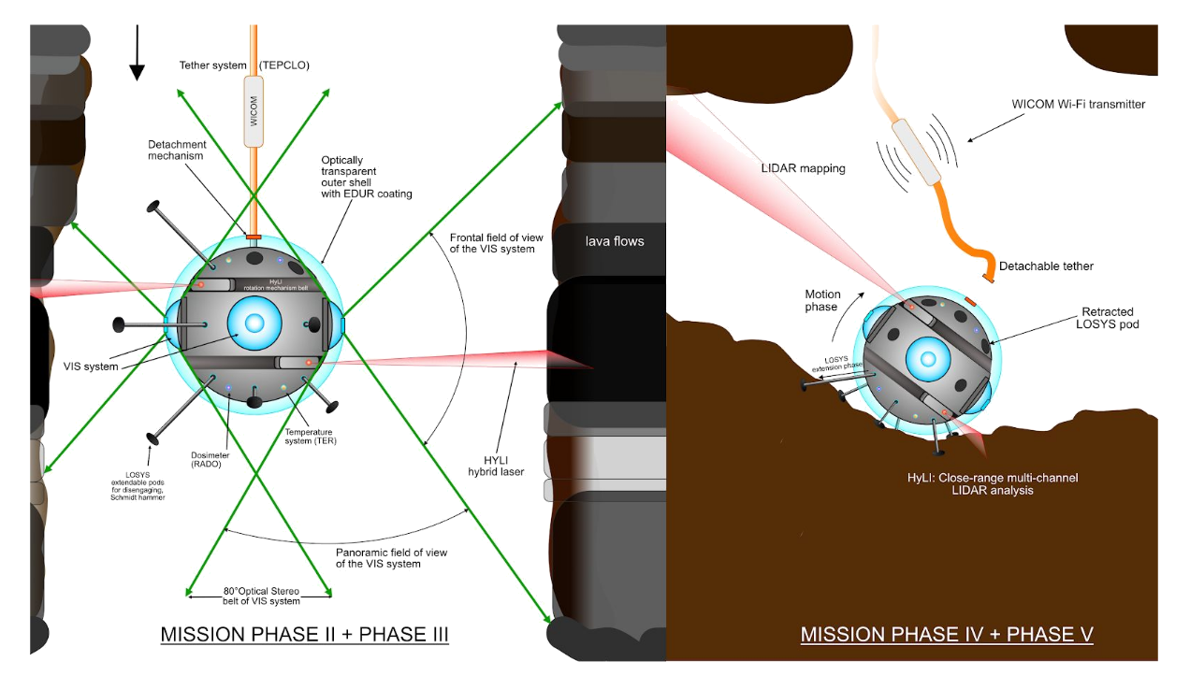
Exploring and characterising the entrance and initial part of Lunar lava tubes
A compact, tightly integrated spherical robotic device
A sphere is ideally suited to protect sensors and scientific equipment in rough, uneven environments.

Slide 3
Exploring and characterising the entrance and initial part of Lunar lava tubes
The tether for lowering the sphere will be used for data communication and powering the equipment during the descending phase
Furthermore, the connector tether-sphere will host a WIFI access point, such that data of the conduit can be transferred to the surface relay station.

Slide 4
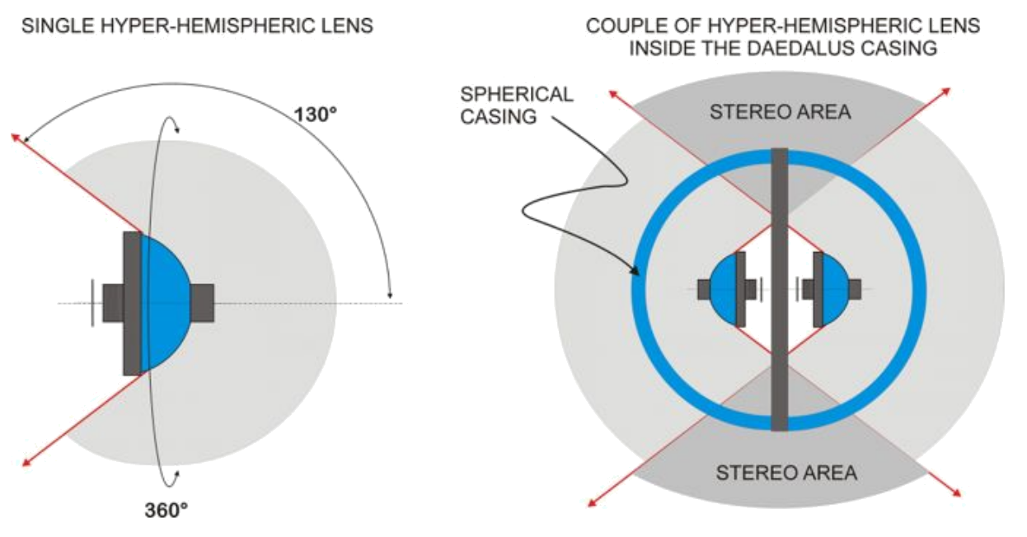
Camera System
panoramic lens
dual-lens system
for stereo
(3D data)

Slide 5
Laser Scanner
LiDAR systems work at any illumination conditions
Direct 3D data, computationally easy to handle
SLAM for creating 3D maps throughout the whole mission

Slide 6
Rolling using
with spikes and pods, the sphere robot is able to overcome obstacles of about half of its own diameter.

Slide 7
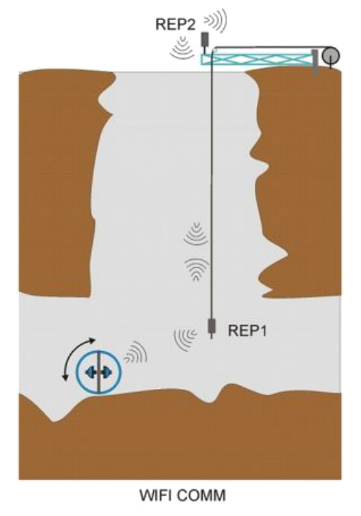
Communication
The communication with the surface will be tethered or, eventually, Wi-FI based
The deployment rover will be enabled to communicate with the remote control room

Slide 8
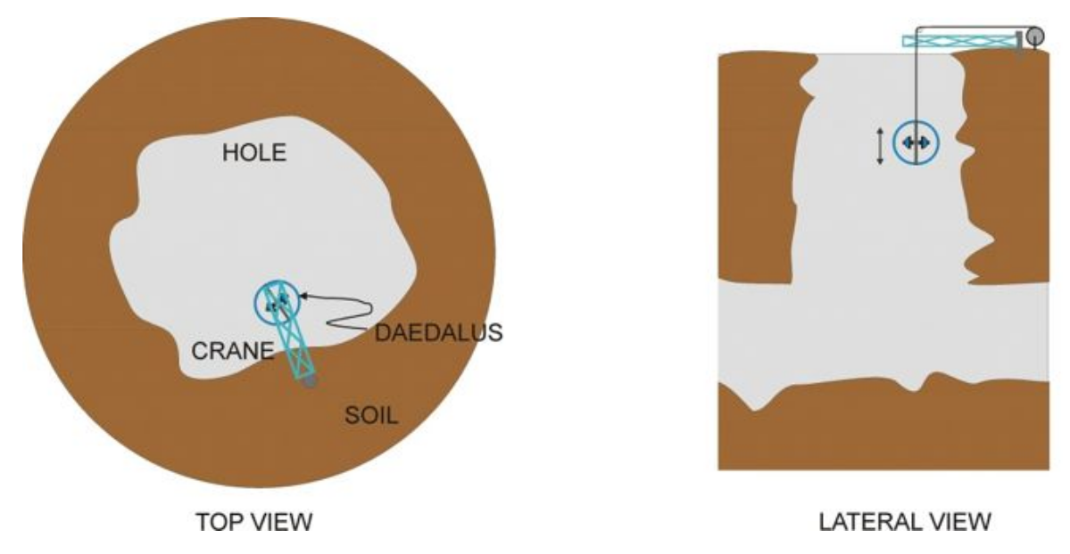
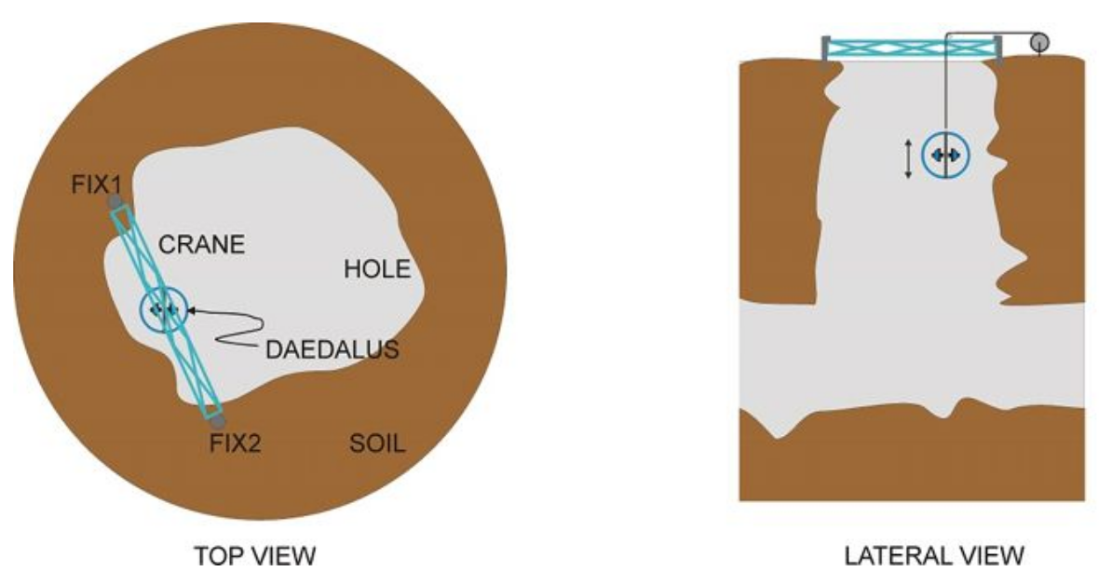
Crane for lowering the sphere
Rim stability is to be accurately studied
double fixing points may prevent possible uprooting of the anchors

Slide 9
Current Workplan
WP | Name | Lead
1 | Coordination (gitlab, owncloud, LaTeX, … )
2 | Robotic Sphere for Descent | JMUW
2.1 | Overall Sphere Design
2.2 | Locomotion
2.3 | The Sensing Subsystem (Camera, LiDARs,...)
3 | Geology and Spectral Requirements | UNIPD
3.1 | Landing Site Characterization
3.2 | Spectral Capabilities Definition/Response to Scientific Requests
3.3 | Instrument Integration in the Sphere

Slide 10
Current Workplan, cont.
WP | Name | Lead
4 | Optics | INAF
4.1 | Optical Performance in Lunar Environment
4.2 | Dust Removal
4.3 | Structure-from-Motion and LiDAR-SLAM
4.4 | Instrument Integration in the Robot
5 | Testing/Simulation | VIGEA
The work package structure will superimpose a structure to the final CDF document
The work packages will be accompanied by real-world experiments

Slide 11
Contact
Andreas Nüchter
University of Würzburg
Robotics and Telematics
Am Hubland
97074 Würzburg, Germany
andreas@nuechti.de or
andreas.nuechter@uni-wuerzburg.de
http://www.nuechti.de
https://www.youtube.com/channel/UC7HAqZXI-jvMmBwoi4vDUew

