Slide 1
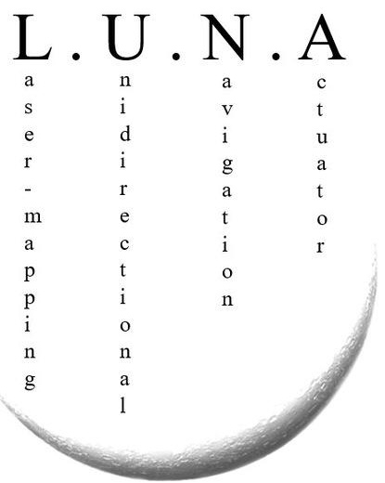

Slide 2
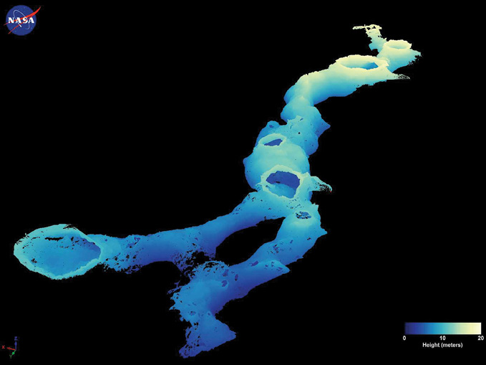

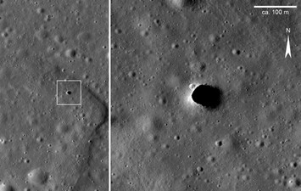
ESA – Lunar caves exploration
August 19
ESA Call for Ideas: exploring lunar caves

Slide 3

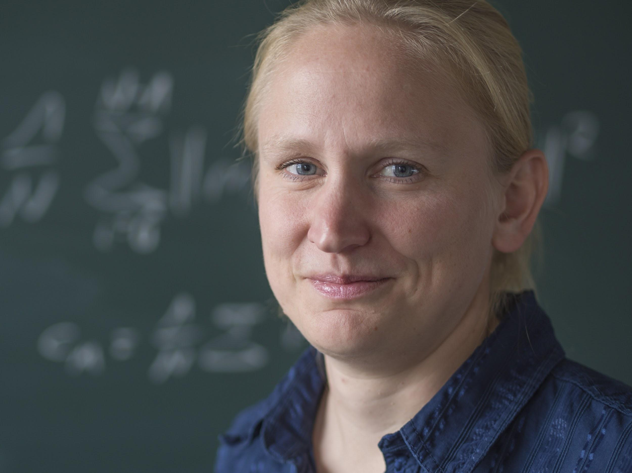



Team – JMU
Jasper Zevering
Anton Bredenbeck
Fabian Arzberger
Dorit Borrmann
Andreas Nüchter

Slide 4
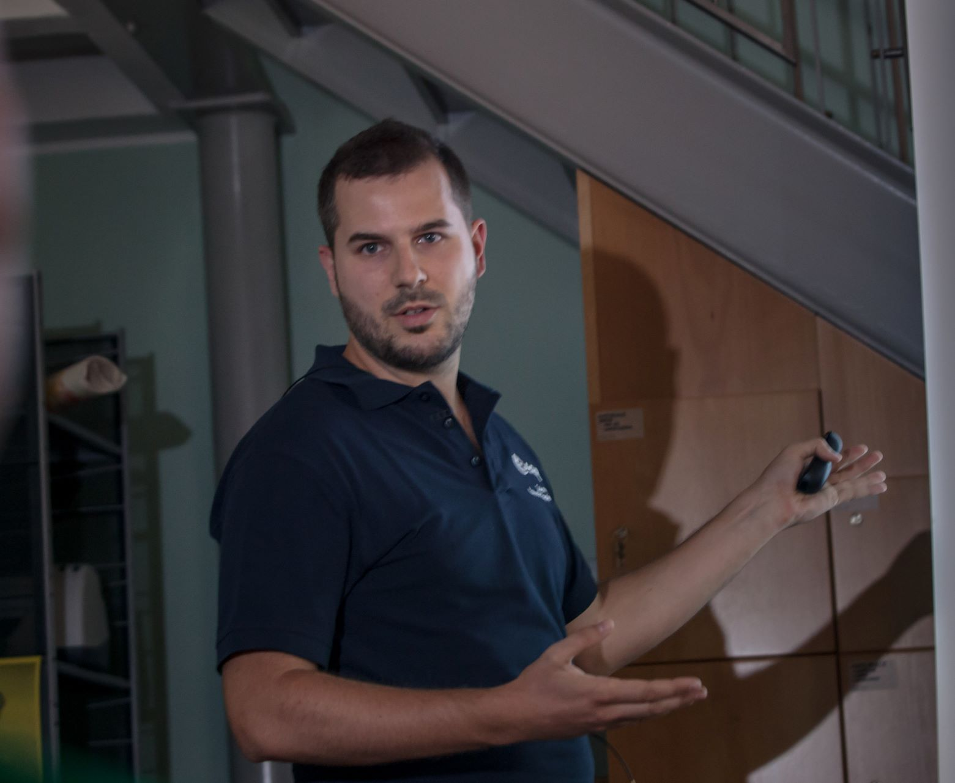
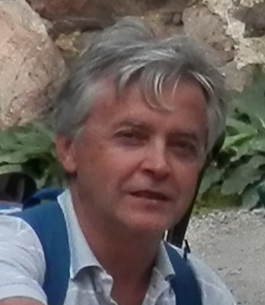



Team - International
Riccardo Pozzobon
Angelo Pio Rossi
Claudio Pernechele
Franceso Maurelli

Slide 5
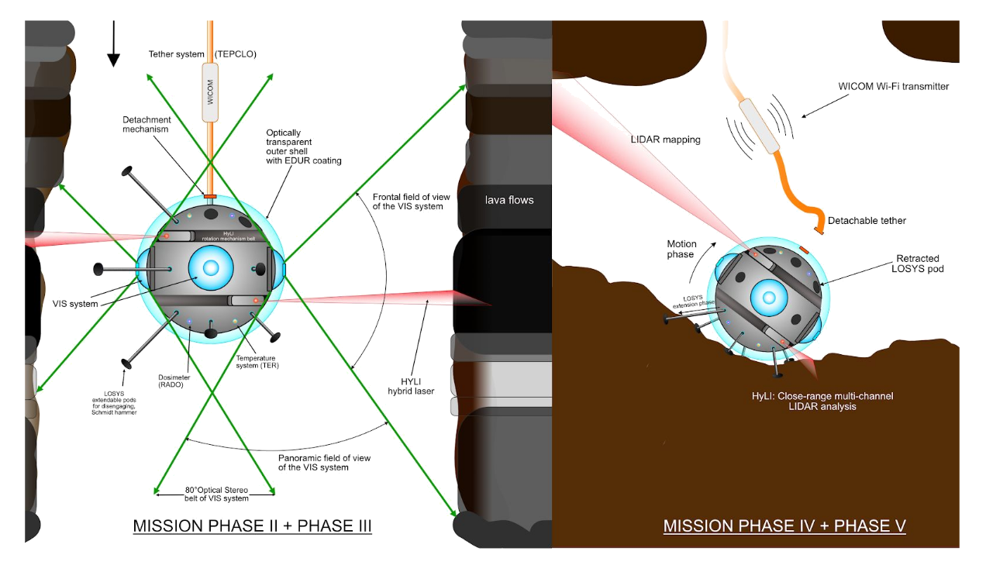
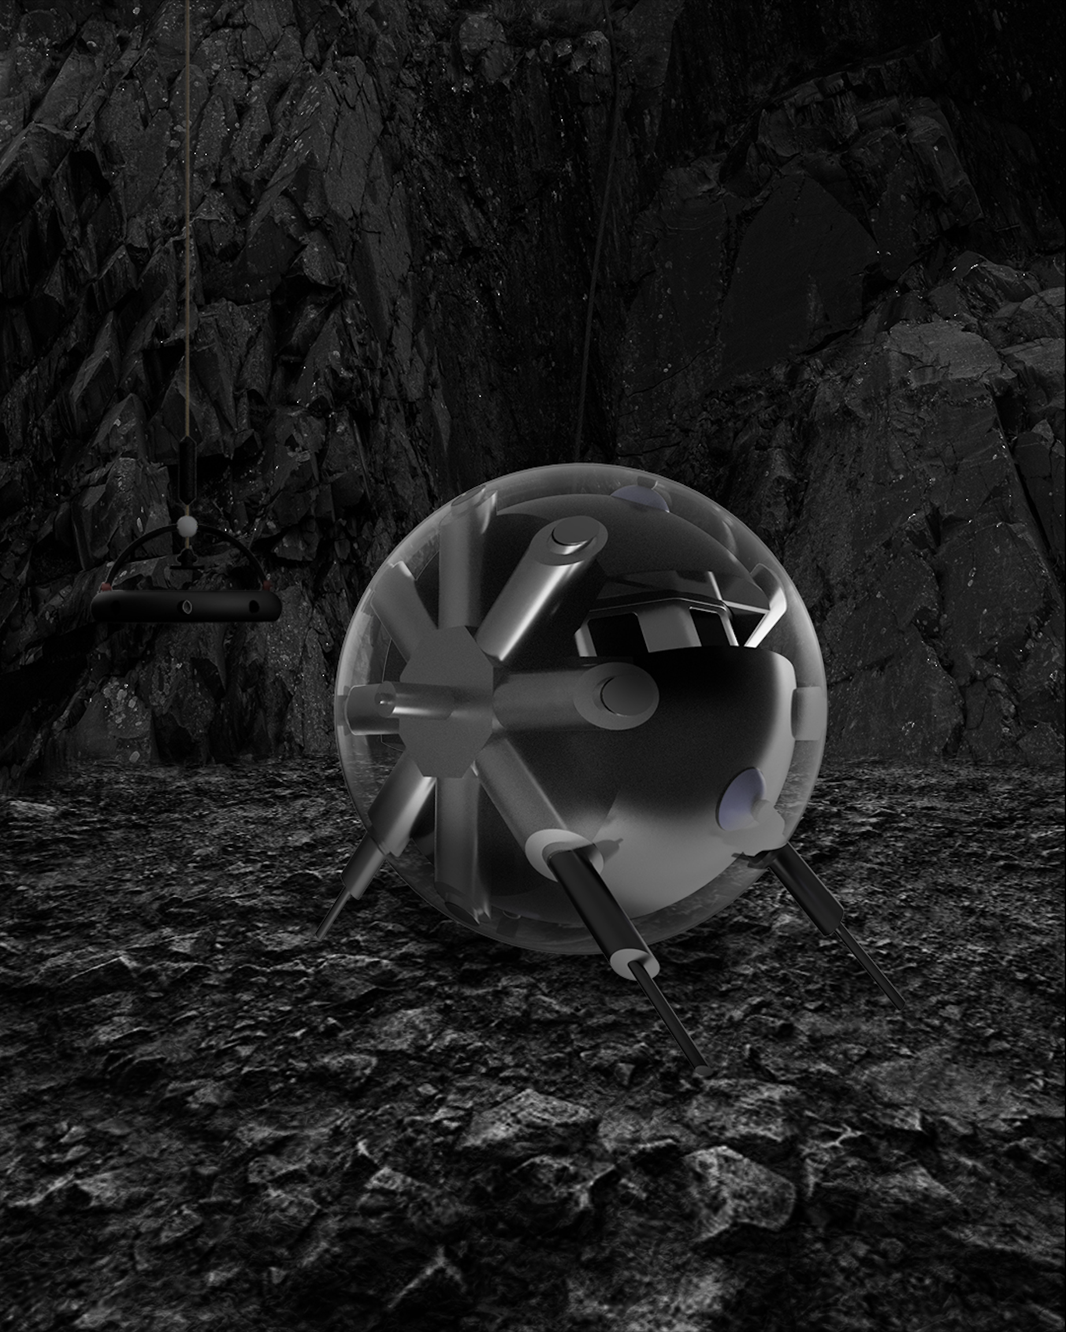
DAEDALUS
Descent And Exploration in Deep Autonomy of Lava Underground Structures
August 19
April 20
ESA Call for Ideas: exploring lunar caves
Proposal to ESA

Slide 6
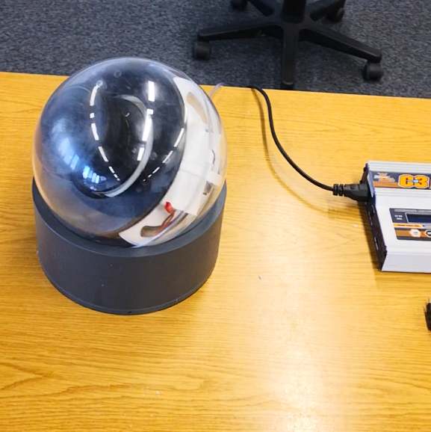
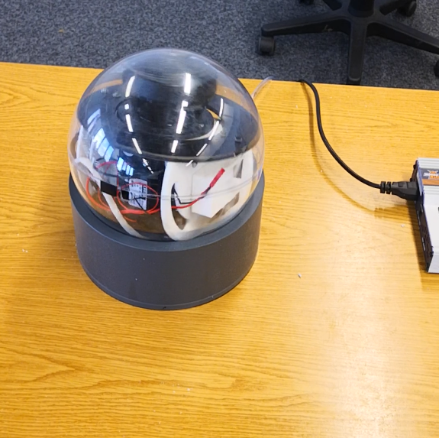
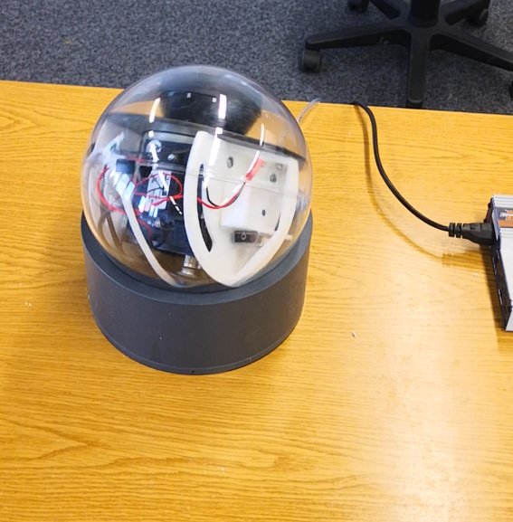
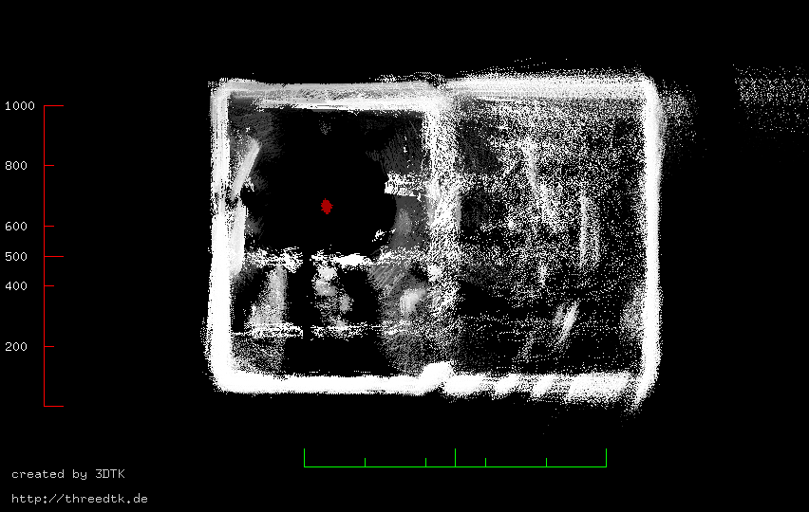
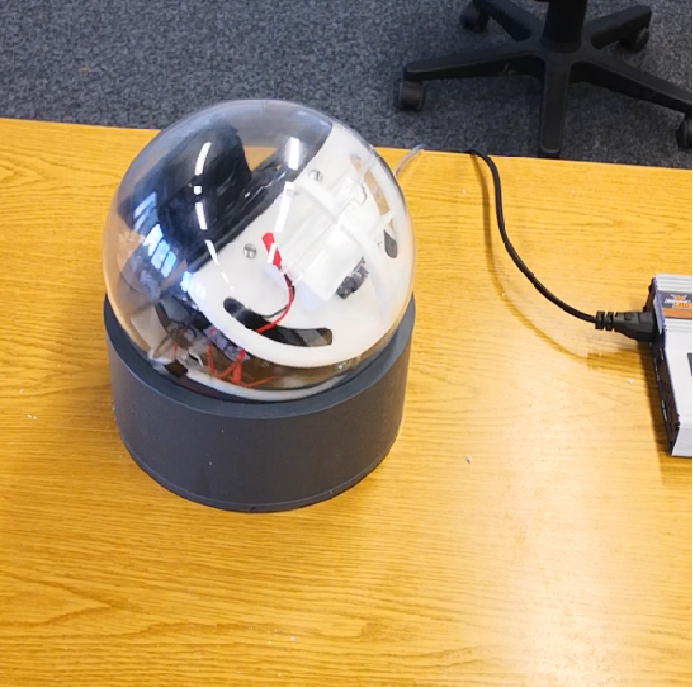
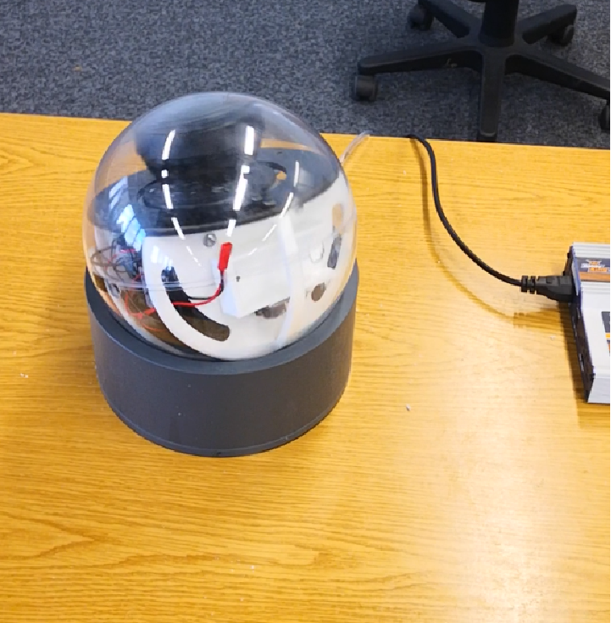
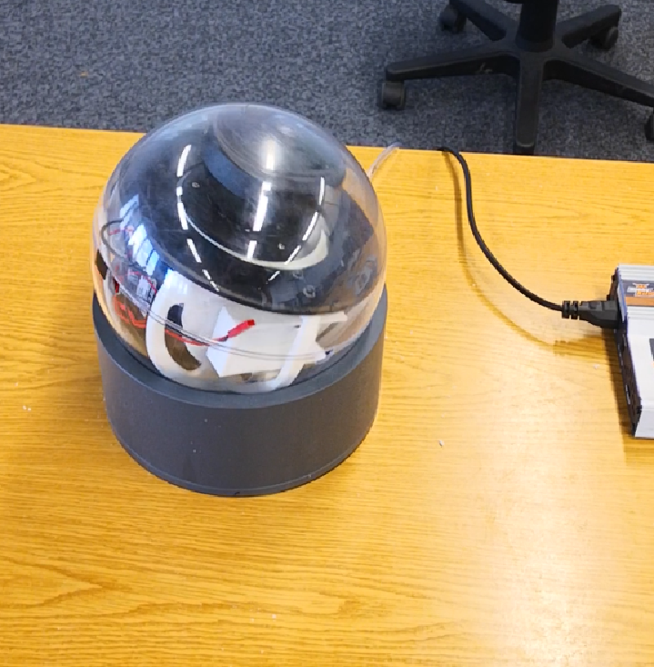
DAEDALUS
August 19
April 20
July 20
3D point cloud
ESA Call for Ideas: exploring lunar caves
Proposal to ESA
Floating
Sphere
2D line scanner!

Slide 7

DAEDALUS
August 19
April 20
July 20
August 20
Proposal to ESA
Floating
Sphere
ESA Call for Ideas: exploring lunar caves
Rolling
Sphere

Slide 8
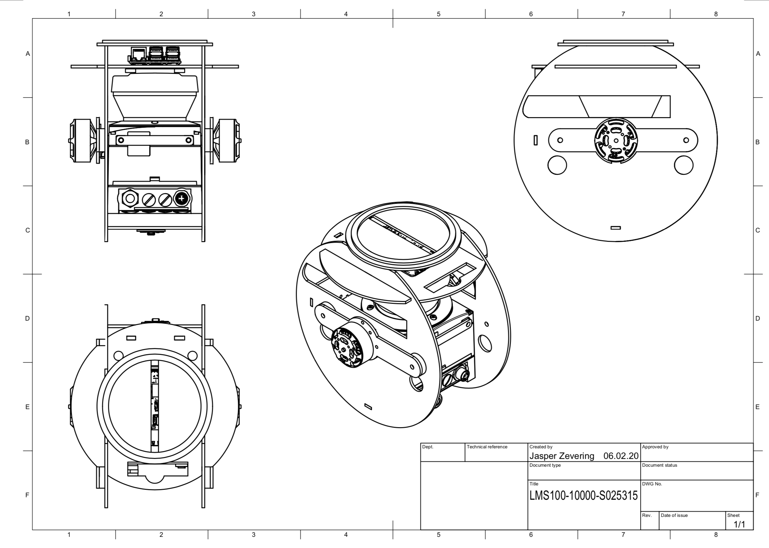
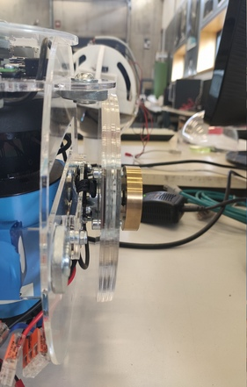
L.U.N.A

Slide 9
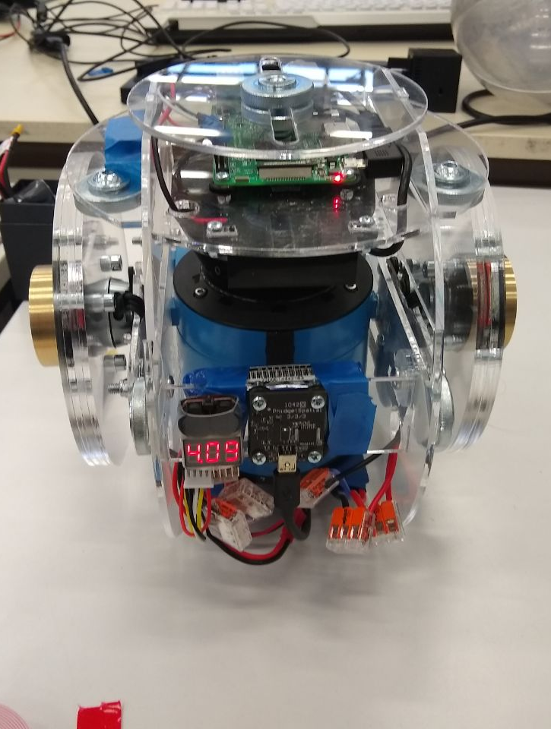
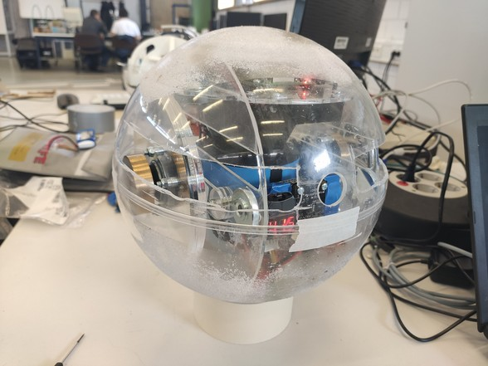
L.U.N.A

Slide 10
L.U.N.A – Impulse by conservation of angular momentum (IBCOAM)

Slide 11
L.U.N.A – Impulse by conservation of angular momentum (IBCOAM)
+ No thrusters
→ environmental impact
+ Proof of Concept
- Power consumption
- Object avoidance
- Torque based!
→ Wheel desaturation
- Vibrations
→ more noise on IMU

Slide 12
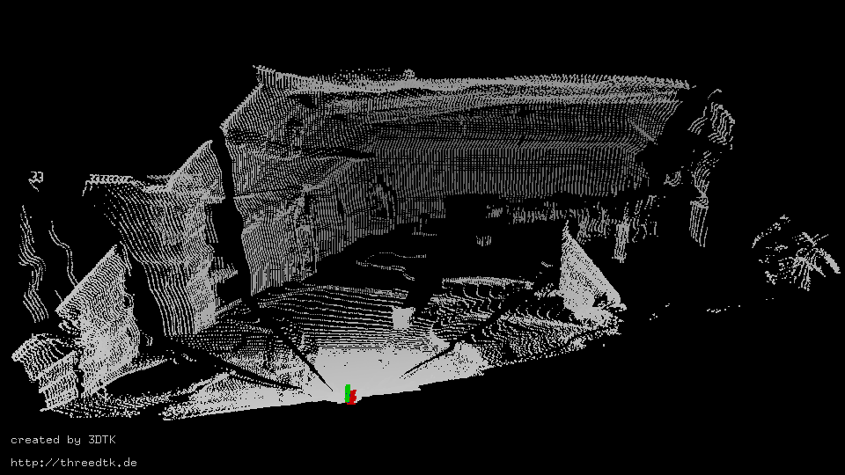
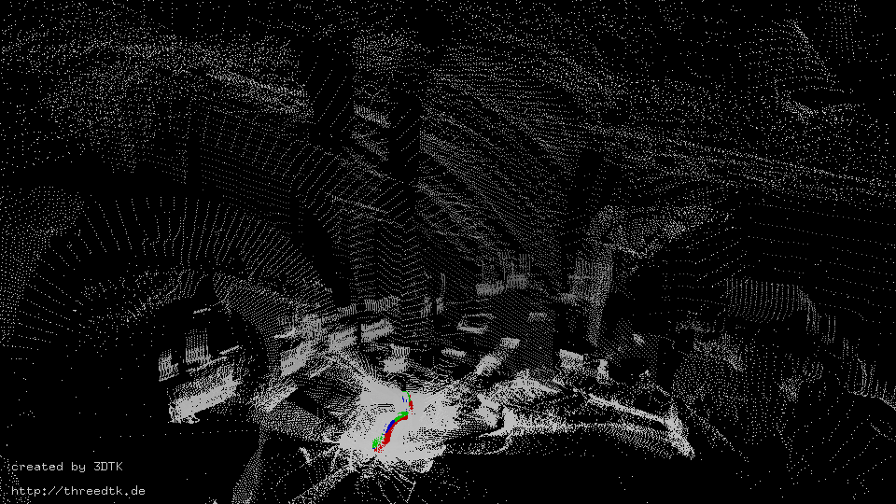
L.U.N.A – Impulse by conservation of angular momentum (IBCOAM)
- Power consumption
- Object avoidance
- Torque based!
→ Wheel desaturation
- Vibrations
→ more noise on IMU
→ worse 3D point cloud

Slide 13
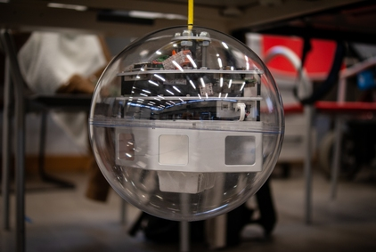
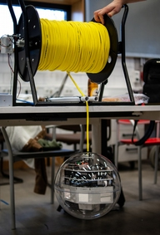
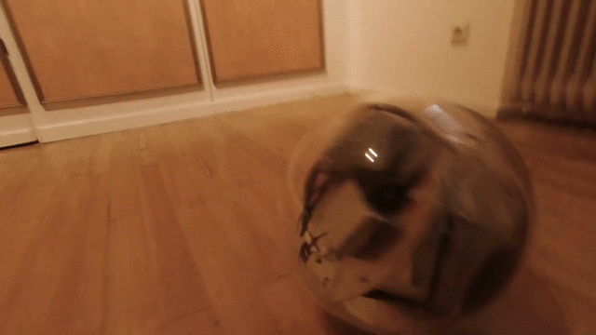
DAEDALUS
August 19
April 20
July 20
August 20
November 20
Proposal to ESA
Floating
Sphere
Rolling
Sphere
ESA Call for Ideas: exploring lunar caves
Descending / Rolling Sphere

Slide 14
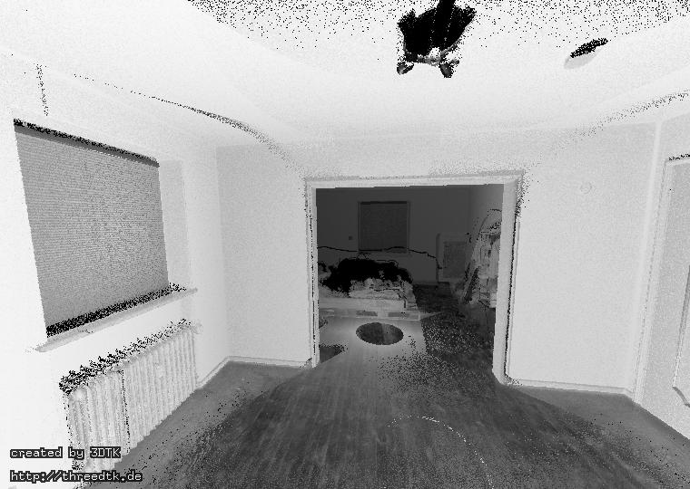
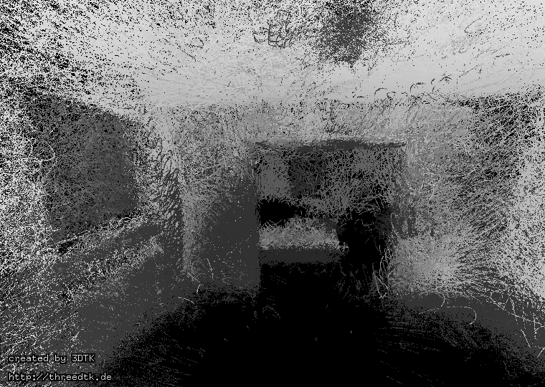
Descending / Rolling Sphere
3D point cloud from TLS (Riegl VZ-400 on tripod)
3D point cloud from the spherical robot (rolling around)

Slide 15
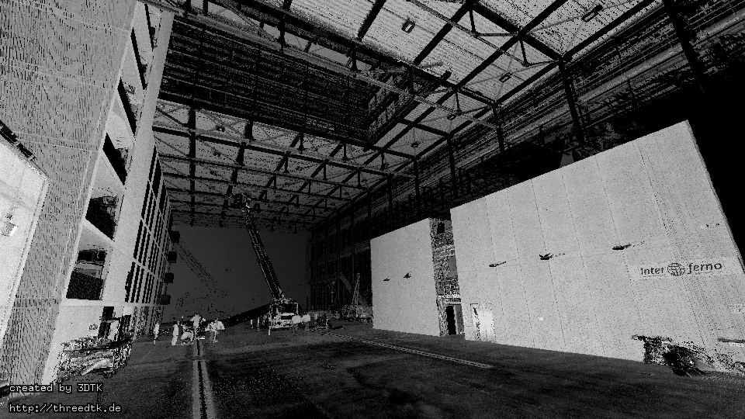
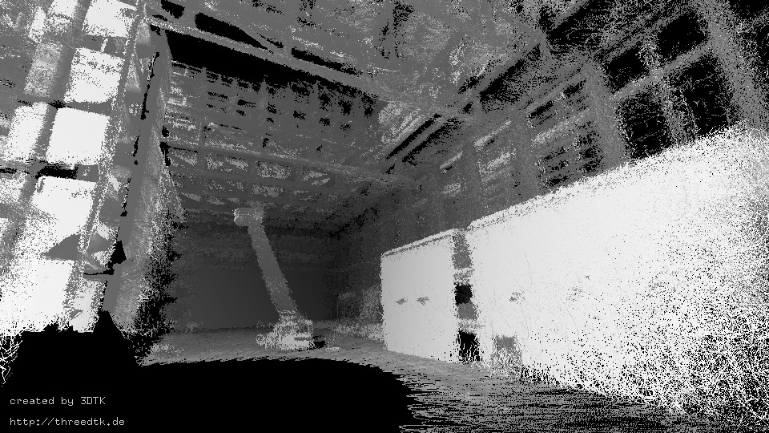
Descending / Rolling Sphere
3D point cloud from TLS (Riegl VZ-400 on tripod)
3D point cloud from the spherical robot (descent + rotation)

Slide 16
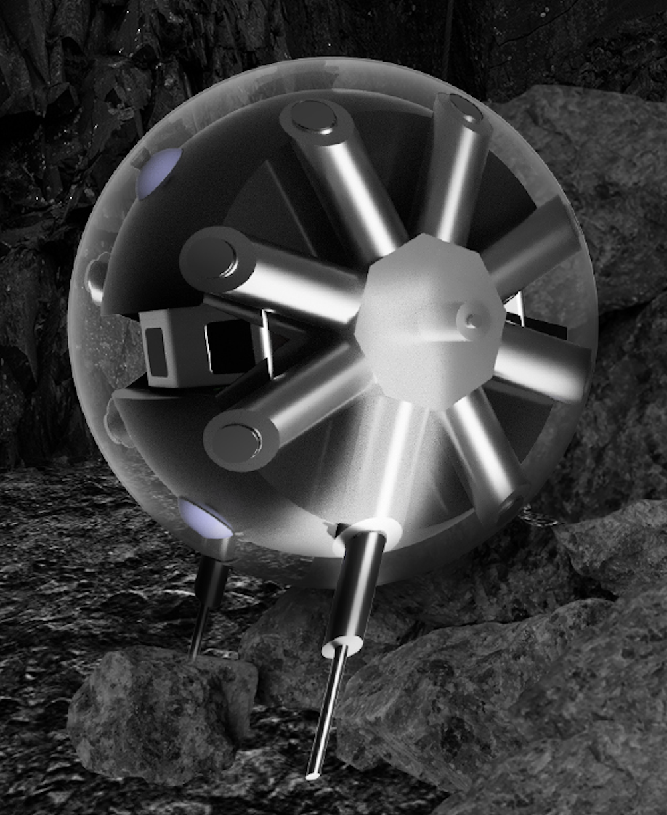
DAEDALUS
August 19
April 20
July 20
August 20
November 20
August 21
Proposal to ESA
Floating
Sphere
Rolling
Sphere
ESA Call for Ideas: exploring lunar caves
Descending / Rolling Sphere
Telescopic-Linear-Actuator-Driven Robot (TLDR)

Slide 17
References

