Slide 1

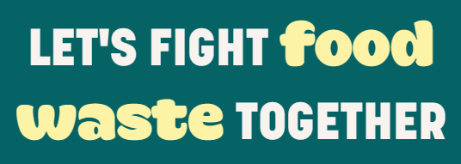
Good Food Good Mood
Farah Al-Masri

Slide 2
Introduction to Good Food Good Mood:
Mission: Reduce food waste by connecting users with surplus food from local restaurants and stores at discounted prices.
Mention the technologies used: PERN stack (PostgreSQL, Express.js, React.js, Node.js).

Slide 3
Features and Benefits
User Registration and Authentication.
Browsing Available Food: Users can browse through a list of available food items and search/filter options are available.
Placing Orders: Authenticated users can add food items to their cart, proceed to checkout, and select pickup time and date.
Order History: Authenticated users can view their order history and track progress.
Restaurant Dashboard: Participating restaurants can manage their available food items and view/manage incoming orders.

Slide 4
Business Model
Good Food Good Mood connects users with surplus food from local restaurants and stores. We generate revenue through commissions from participating restaurants based on transaction amounts and advertising fees for promoting special offers. Our cost structure includes development and maintenance, marketing and promotion, and server and hosting expenses.

Slide 5
Business Model
Our key customer segments are users seeking affordable food options and restaurants/stores with surplus food. We offer value by reducing food waste and providing additional revenue streams for restaurants. Key partnerships ensure a steady supply of surplus food, while excellent customer service and user-friendly channels drive customer relationships and engagement.

Slide 6
Conclusion
Good Food Good Mood aims to reduce food waste by connecting users with surplus food from local restaurants and stores. Through our user-friendly platform and mobile app, we provide affordable food options while supporting participating restaurants' revenue growth. With key partnerships, excellent customer service, and effective marketing strategies, we are poised to launch, onboard restaurants, and attract users to make a positive impact on food waste and accessibility.

Slide 7
Thank you for your attention! For more information or inquiries, please contact us at goodfood@info.com!

