Slide 1
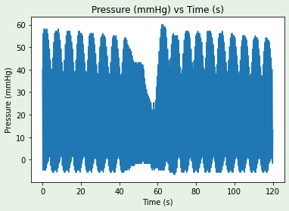
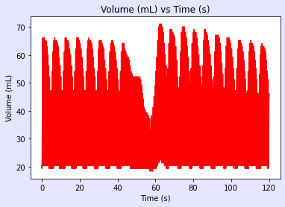
T0
Baseline
T30
End of
Hemorrhage
Pre-IVCO
T74
End of
Intervention
Pre-IVCO
Pre-IVCO
During IVCO
Post-IVCO
Post-IVCO
During IVCO
Post-IVCO
During IVCO
Figure 1. Experimental timeline and raw P-V loop data extraction timepoints. P-V data was extracted from baseline (T0), at the end of 25% hemorrhage (i.e., 30 minutes after baseline, T30) and after 44 minutes of intervention with REBOA or EVAC (i.e., T74). During each experimental timepoint, data was extracted from the pre-inferior vena cava occlusion (IVCO), during IVCO and post-IVCO. Average time of IVCO was 15 seconds. For pre- and post-IVCO segments, data was sampled over 1 minute.
Pre-
IVCO
Post-
IVCO
During IVCO

Slide 2
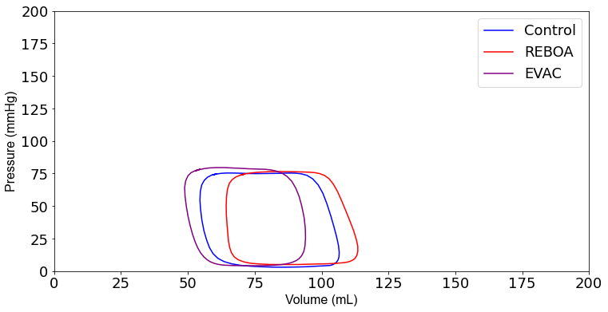
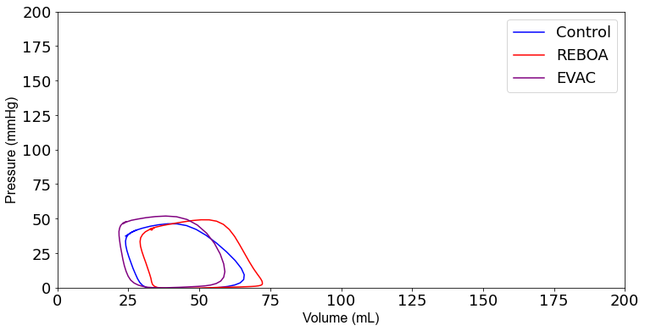
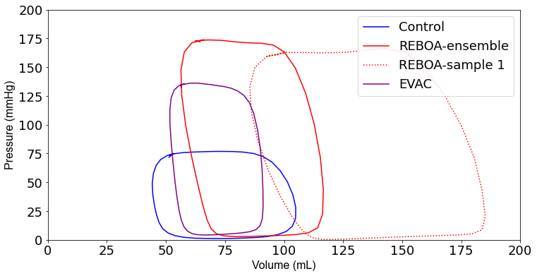
Figure 2. Ensemble average P-V loops. Pressure-volume loops were averaged for all pigs in the three intervention groups: Control (blue), REBOA (red) and EVAC (purple) (n=6/group). These figures illustrate the ensemble averaged P-V loops at A) baseline, B) end of hemorrhage and C) end of intervention for each group. As expected, P-V loops get smaller at the end of hemorrhage, reflective of lower pressures and volumes, followed by a significant increase in pressure and volume with the REBOA intervention. Panel C illustrates the averaged P-V loops each group as well as one of the REBOA pigs (red-dotted line), which illustrates a major deviation from the “averaged” P-V response. A significant amount of variability was observed in the REBOA group.
A.
B.
C.

Slide 3
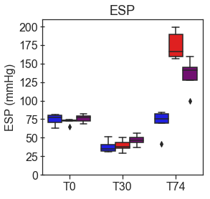
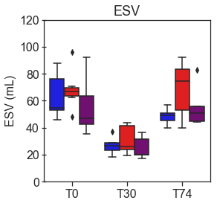
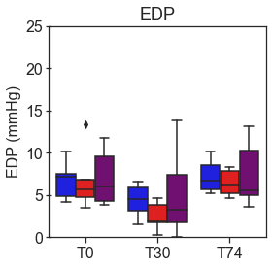
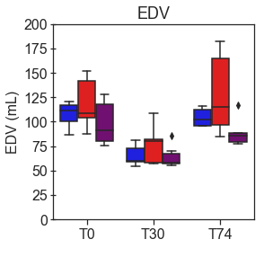
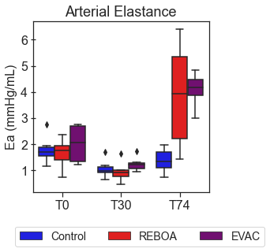
Figure 3. Comparison of end-systolic and end-diastolic pressures and volumes by intervention group. Average End-Systolic A) Pressure (ESP) and B) Volume (ESV) as well as End-Diastolic C) Pressure (EDP) and D) Volume (EDV) are plotted over time by group (n=6/group).
3A) After hemorrhage in all treatment groups,
ESP significantly decreased by an average of 50.7 mmHg with a 95% Confidence Interval (CI) [-58.4, -41.7 mmHg], p<0.001.
At T74, the REBOA group experienced an average increase in ESP by 140.2 mmHg (95%CI [102.7, 184.6 mmHg], p<0.001), while EVAC was associated with an average increase of 76.4 mmHg (95%CI [47.5, 110.9 mmHg], p<0.001).
3B) ESV was found to have significantly decreased after hemorrhage in all groups, with an average decreased by 57.7 mL (95%CI [-63.7, -50.7 mL], p<0.001). In all groups at T74, however, there were no significant differences with the baseline conditions.
3C) There were no significant differences in EDP when compared to baseline conditions in all groups, with the exception of the REBOA group at T30; however the average across all groups at T30 was not significantly decreased when compared to the baseline state, with a pooled decrease of 2.35 mmHg (95%CI [-4.8, .13 mmHg], p=0.064).
3D) EDV was found to have significantly decreased after hemorrhage in all groups, with an average decreased by 42.7 mL (95%CI [-56.0, -29.7 mL], p<0.001). In all groups at T74, however, there were no significant differences with the baseline conditions.
A.
B.
*
*
End-Systole
*
*
*
*
*
*
*
C.
D.
End-Diastole
*
*
*
*

Slide 4
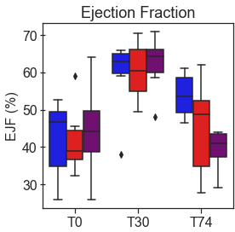
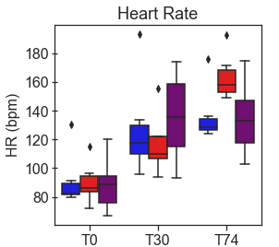
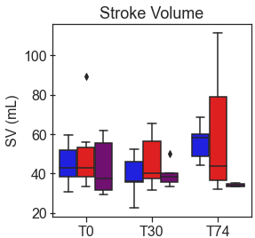
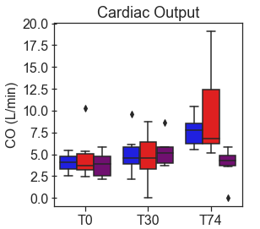
Figure 4. Summary of cardiac performance metrics by intervention group over time. Box plots of A) Ejection Fraction (EJF), B) Heart Rate (HR), C) Stroke Volume (SV), and D) Cardiac Output (CO) at pre-IVCO time periods are illustrated over time and group
4A) EJF was found to have significantly increased after hemorrhage in all groups by an average of 16.8% with 95%CI [8.0, 25.6%]), p<0.001). At T74, while EJF did decrease when compared to the hemorrhage state, it was still significantly higher than that observed in the baseline state by 11.6% with 95%CI [2.8, 20.4%]), p=0.01). The REBOA and EVAC groups, on the other hand, did not lead to significant decrease in EJF at T74 compared to the baseline conditions for both groups (p=0.460 and p=0.206, respectively).
4B) HR was found to have significantly increased after hemorrhage by an average of 38.4 bpm with 95%CI [19.7, 60.1 bpm]), p<0.001. At T74, HR was elevated in in all three intervention groups. HR in the REBOA group increased by an average of 83.2 bpm in HR (95%CI [58.5,111.9 bpm], p<0.001). The EVAC group was associated with an average increase of 55.4 bpm in HR (95%CI [33.1, 81.5 bpm], p<0.001) compared to baseline. By comparison, the control group experienced an increase of 50.8 bpm in HR (95%CI [30.4, 74.4 bpm], p<0.001) compared to baseline.
4C&4D) There were no significant differences in SV and CO when compared to baseline baseline across the three intervention groups.
A.
B.
*
*
*
*
*
*
*
*
*
*
C.
D.

Slide 5
*
*
Figure 5. Arterial elastance varies significantly after REBOA intervention. The average arterial elastance was calculated as the ratio of end systolic pressure to stroke volume. As expected, arterial elastance is comparable between pigs in all three intervention groups at baseline (T0) and at the end of 25% hemorrhage (T30). However, the introduction of REBOA and EVAC significantly increased the calculated arterial elastance to levels nearly 3 times higher than baseline. Data presented is from the pre-IVCO period.

Slide 6
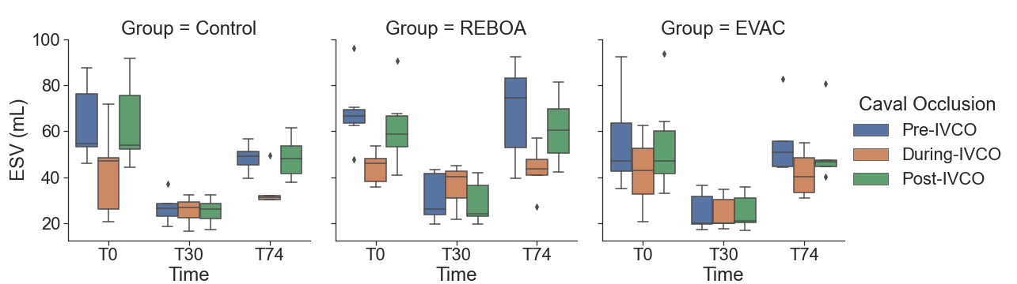
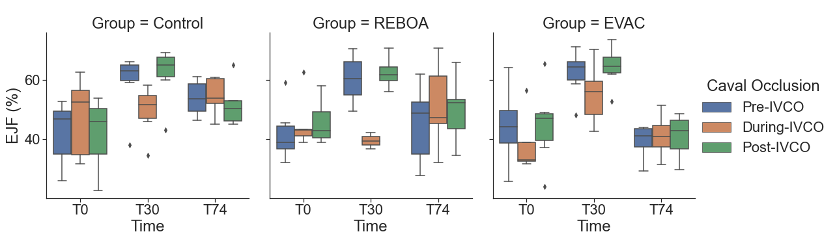
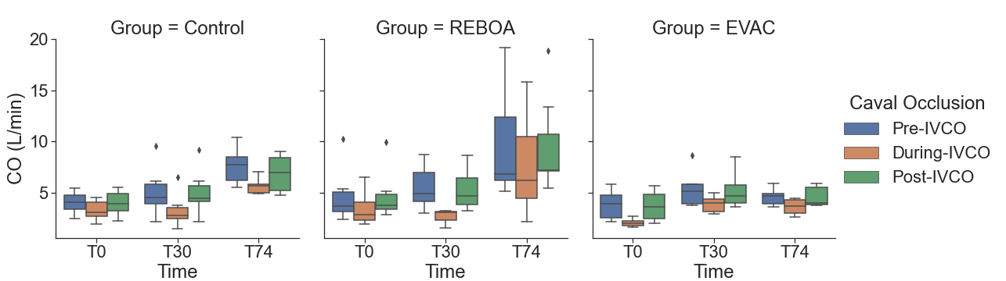
Figure 6. A summary of key cardiac performance metrics pre-IVCO, during IVCO and post-IVCO. We summarize the key cardiac parameters: (A-C) end-systolic volume (ESV), (D-F) stroke volume (SV), and (G-I) cardiac output (CO) for each intervention group during the pre-IVCO (blue), during-IVCO (orange) and post-IVCO (green) periods. As illustrated, we observed a high degree of variation in ESV at baseline. Stroke volume was most variable at T74 across all intervention groups. We did not observe any statistically significant differences in ESV, SV or CO values between pre-IVCO and post-IVCO periods.
A.
B.
C.
D.
E.
F.
G.
H.
I.
Notes:
SV ESV CO

Slide 7
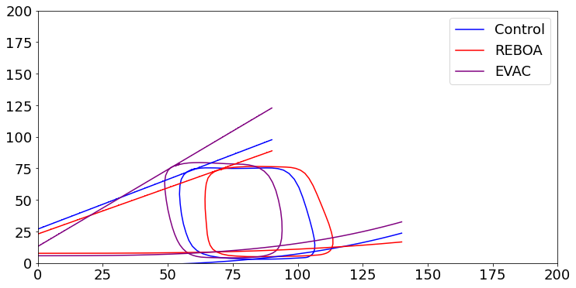
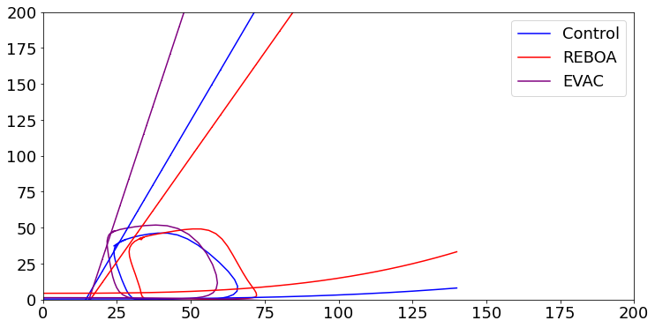
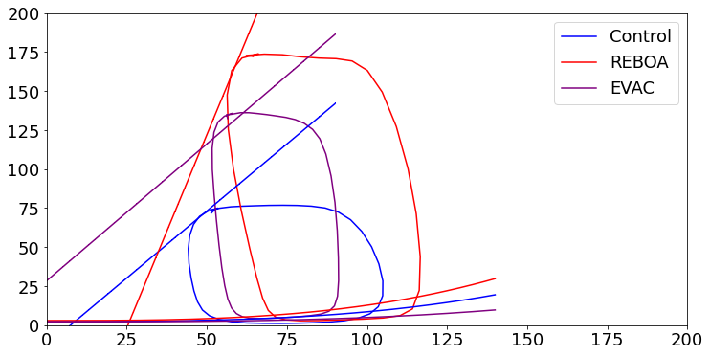
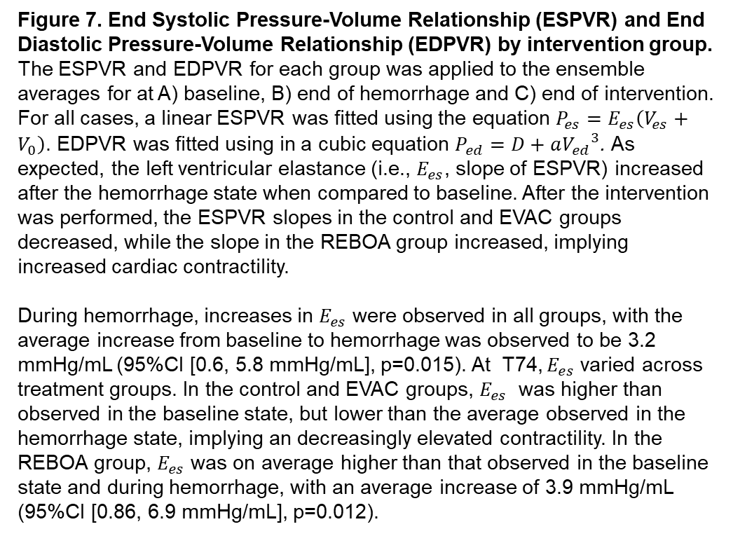
A.
Figure 7. End Systolic Pressure-Volume Relationship (ESPVR) and End Diastolic Pressure-Volume Relationship (EDPVR) by intervention group. The ESPVR and EDPVR for each group was applied to the ensemble averages for at A) baseline, B) end of hemorrhage and C) end of intervention. For all cases, a linear ESPVR was fitted using the equation $P_{es}=E_{es}\left(V_{es}+V_{0}\right)$. EDPVR was fitted using in a cubic equation $P_{ed}=D+a{V_{ed}}^{3}$. As expected, the left ventricular elastance (i.e., $E_{es}$, slope of ESPVR) increased after the hemorrhage state when compared to baseline. After the intervention was performed, the ESPVR slopes in the control and EVAC groups decreased, while the slope in the REBOA group increased, implying increased cardiac contractility.
During hemorrhage, increases in $E_{es}$ were observed in all groups, with the average increase from baseline to hemorrhage was observed to be 3.2 mmHg/mL (95%CI [0.6, 5.8 mmHg/mL], p=0.015). At T74, $E_{es}$ varied across treatment groups. In the control and EVAC groups, $E_{es}$ was higher than observed in the baseline state, but lower than the average observed in the hemorrhage state, implying an decreasingly elevated contractility. In the REBOA group, $E_{es}$ was on average higher than that observed in the baseline state and during hemorrhage, with an average increase of 3.9 mmHg/mL (95%CI [0.86, 6.9 mmHg/mL], p=0.012).
B.
C.

