Slide 1

面向前端开发者的 V8性能优化
@justjavac
https://github.com/justjavac

Slide 2
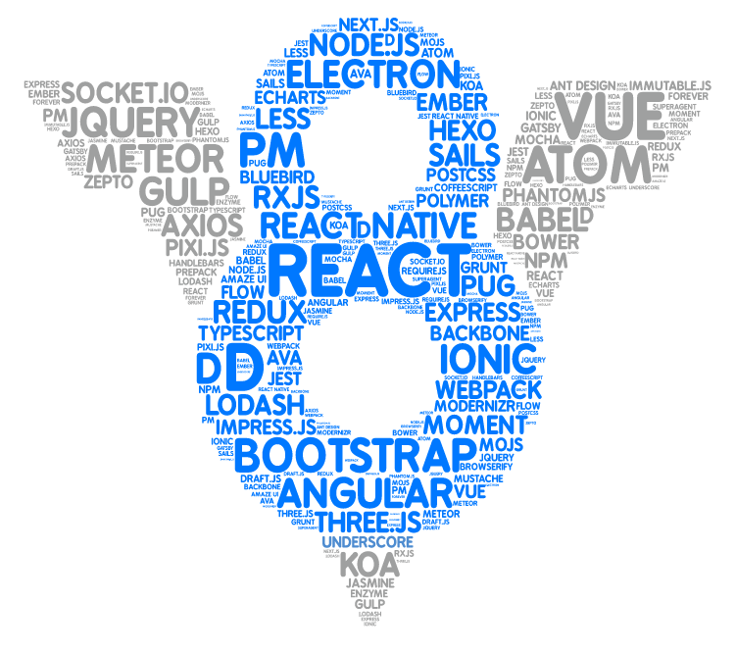

Slide 3
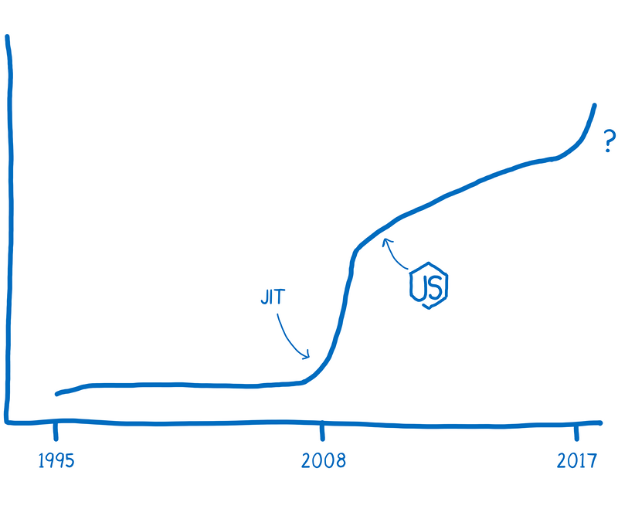

Slide 4
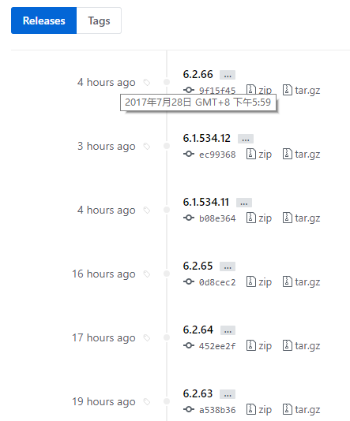
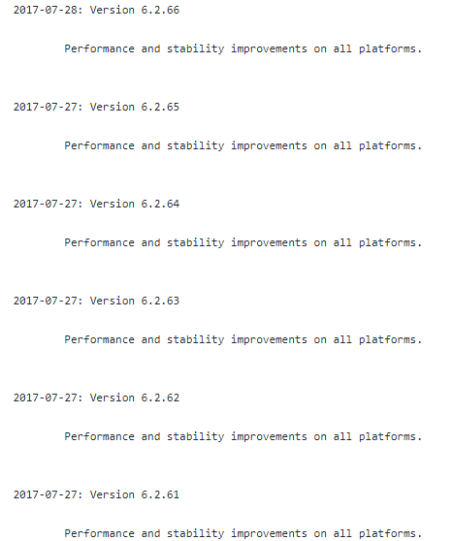

Slide 5
动态语言如何进行快速算术

Slide 6
导读
V8中数字的表示
动态语言的算术运算为何慢
解释器、非优化编译器
类型反馈、优化编译器
去优化（Deoptimization）
截断分析
编译器的挑战
语言设计讨论
新的数字类型提案（Int64，BigNum，SIMD）

Slide 7
Encoding of numbers in V8 (x64)
小整数（Small integers） “tagged pointers”.
整数:
引用:
例如, 整数 42 编码为 0x0000002a00000000 指针 0x12345678 编码为 0x12345679
非整数数值存放在堆里
int32
0000:0000
high 63-bits of pointer
1
Heap
<number header>
1
Pointer to heap num
1
Float64 payload

Slide 8
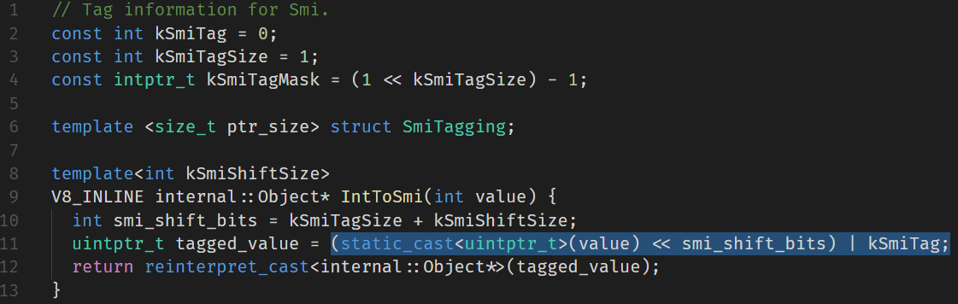
SMI

Slide 9
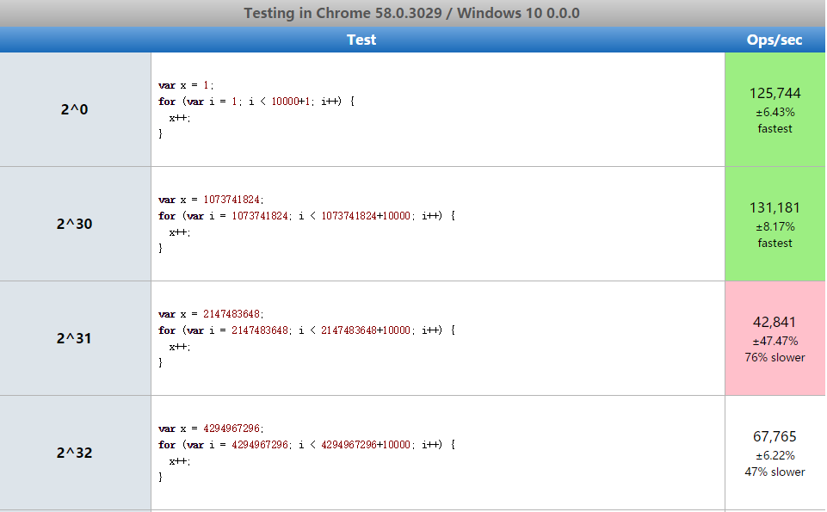
i30 or i31 or i32
// 2^30 is a smi boundary
// on arm and ia32.
var two_30 = 1 << 30;
// 2^31 is a smi boundary
// on arm64 and x64.
var two_31 = 2 * two_30;

Slide 10
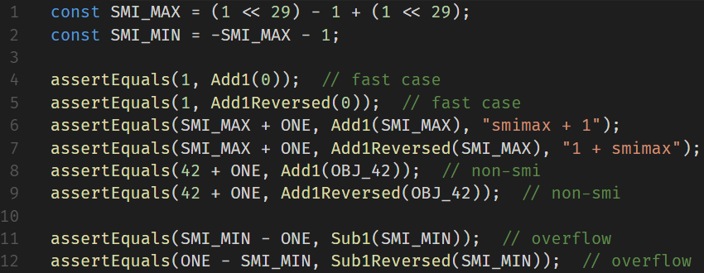
i30 or i31 or i32

Slide 11
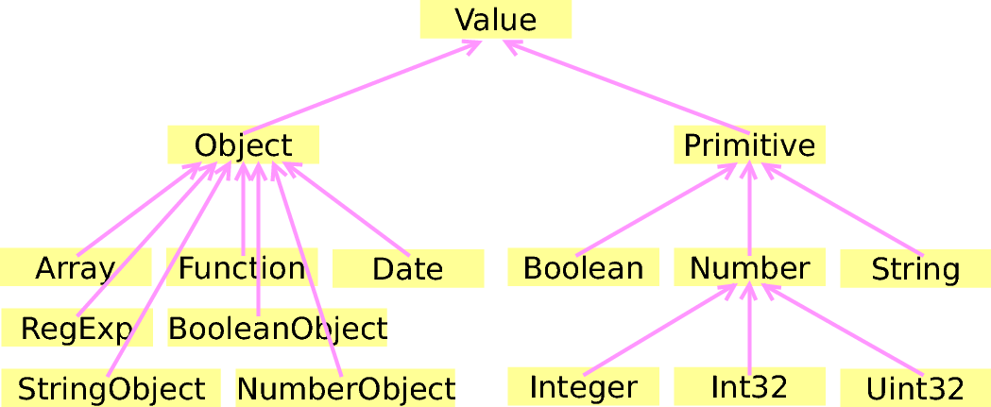
Data type in V8

Slide 12
javascript中的“加法”
为什么 ++[[]][+[]]+[+[]] = 10？
{} + {} 等于多少?
为什么 [1,2] + [3,4] 不等于 [1,2,3,4]？

Slide 13
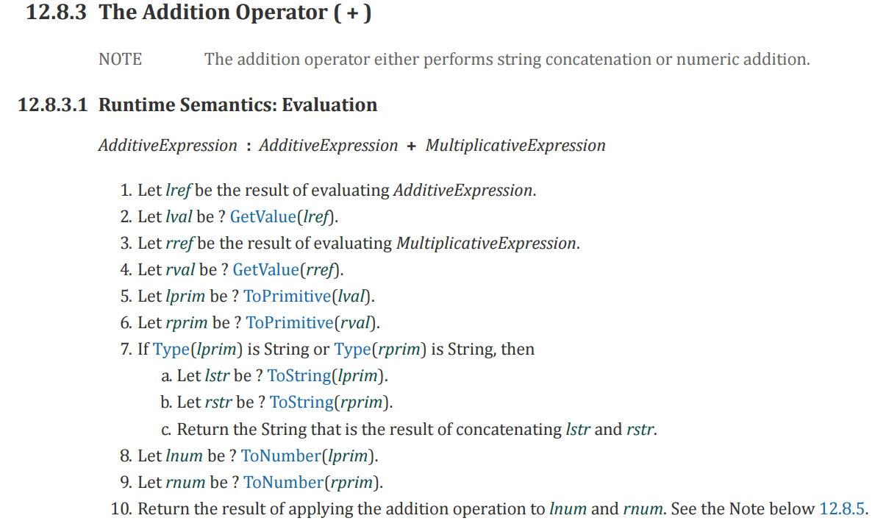
加法操作

Slide 14
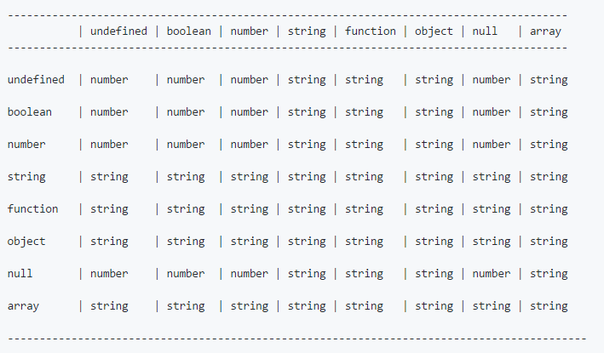
“加法”运算结果

Slide 15
V8的算数运算
快速模式：直接调用二进制代码assembly
小整数
堆区的数值
怪异类型 - undefined, null, true, false.
字符串 (字符串连接运算)
对象（object）运算使用 C++ 实现（慢）

Slide 16
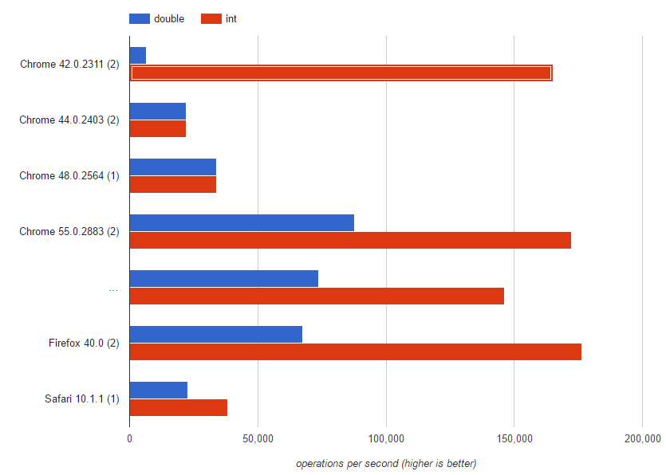
SMI vs Double

Slide 17
快速模式
代码：a + b
常规编译：
mov eax, a
mov ebx, b
call RuntimeAdd
优化编译：
mov eax, a
mov ebx, b
add eax, ebx

Slide 18
Type feedback
二元运算符可以收集函数的 type feedback 信息.
function f(a, b){ var c = a + a; return b + c;
}
函数信息
StackCheck
Ldar a0
Add a0, [2]
Star r0
Ldar r0
Add a1, [3]
Return
Feedback vector
...
...
2: unitialized
3: unitialized

Slide 19
Type feedback
二元运算符可以收集函数的 type feedback 信息.
function f(a, b){ var c = a + a; return b + c;
}
f(1, 2);
函数信息
StackCheck
Ldar a0
Add a0, [2]
Star r0
Ldar r0
Add a1, [3]
Return
Feedback vector
...
...
2: int x int -> int
3: int x int -> int

Slide 20
Type feedback
二元运算符可以收集函数的 type feedback 信息.
function f(a, b){ var c = a + a; return b + c;
}
f(1, 2);
f(1, 0.1)
函数信息
StackCheck
Ldar a0
Add a0, [2]
Star r0
Ldar r0
Add a1, [3]
Return
Feedback vector
...
...
2: int x int -> int
3: num x int -> num

Slide 21
Optimizing compiler
使用 type feedback 做动态检查
一般而言，在编译阶段提前检查
检查之后，使用该类型作为动态类型
如果检查失败，去优化（deoptimize）
去优化之后，可能会使用解释器(ignition)运行中间码

Slide 22
Compile with types
对输入进行检查、相加、返回结果。
function f(a, b){ var c = a + a; return b + c; }
f(1, 2);
f(1, 2);
Feedback vector
...
Optimized code
...
movq rax,[rbp+0x18]
test al,0x1
jnz 115
movq rbx,rax
addq rbx,rax
jo 120
movq rax,[rbp+0x10]
test al,0x1
jnz 125
addq rbx,rax
jo 130
movq rax,rbx
movq rsp,rbp
pop rbp
ret 0x18
...
...
2: int x int -> int
3: int x int -> int
StackCheck
Ldar a0
Add a0, [2]
Star r0
Ldar r0
Add a1, [3]
Return

Slide 23
Compile with types
对输入进行检查、相加、返回结果。
function f(a, b){ var c = a + a; return b + c; }
f(1, 2);
f(1, 2);
f(1, 0.1);//Deopt!
Feedback vector
...
Optimized code
...
movq rax,[rbp+0x18]
test al,0x1
jnz 115
movq rbx,rax
addq rbx,rax
jo 120
movq rax,[rbp+0x10]
test al,0x1
jnz 125
addq rbx,rax
jo 130
movq rax,rbx
movq rsp,rbp
pop rbp
ret 0x18
...
...
2: int x int -> int
3: int x int -> int
StackCheck
Ldar a0
Add a0, [2]
Star r0
Ldar r0
Add a1, [3]
Return
Deoptimizer

Slide 24
去优化Deoptimization
对输入进行检查、相加、返回结果。
function f(a, b){ var c = a + a; return b + c; }
f(1, 2);
f(1, 2);
f(1, 0.1);//Deopt!
Feedback vector
Deoptimizer
生成一个未优化的帧
...
...
2: int x int -> int
3: int x int -> int
-> StackCheck
Ldar a0
Add a0, [2]
Star r0
Ldar r0
Add a1, [3]
Return

Slide 25
去优化Deoptimization
对输入进行检查、相加、返回结果。
function f(a, b){ var c = a + a; return b + c; }
f(1, 2);
f(1, 2);
f(1, 0.1);//Deopt!
Feedback vector
Deoptimizer
生成一个未优化的帧
当运行加法运算时更新 Type feedback 信息。
...
...
2: int x int -> int
3: inum x int -> num
StackCheck
Ldar a0
Add a0, [2]
Star r0
Ldar r0
Add a1, [3]
Return

Slide 26
去优化Deoptimization
对输入进行检查、相加、返回结果。
function f(a, b){ var c = a + a; return b + c; }
f(1, 2);
f(1, 2);
f(1, 0.1);//Deopt!
Feedback vector
...
Optimized code
...
movq rax,[rbp+0x18] test al,0x1 jnz 179 (0x120096c04373) shrq rax, 32 movq rbx,rax addl rbx,rax jo 332 (0x120096c0440c) movq rax,[rbp+0x10] test al,0x1 jz 91 (0x120096c0431b) movq r10,[r13+0x50] cmpq [rax-0x1],r10 vmovsd xmm0,[rax+0x7] jnz 337 (0x120096c04411) jmp 107 (0x120096c0432b) movq r10,rax shrq r10, 32 vxorpd xmm0,xmm0,xmm0 vcvtlsi2sd xmm0,xmm0,r10 vxorpd xmm1,xmm1,xmm1 vcvtlsi2sd xmm1,xmm1,rbx vaddsd xmm0,xmm1,xmm0 movq rbx,[r13+0x7ff3f0] movq rax,rbx addq rax,0x10 cmpq rax,[r13+0x7ff3f8] ja 254 (0x120096c043be) movq [r13+0x7ff3f0],rax incq rbx movq r10,[r13+0x50] movq [rbx-0x1],r10 vmovsd [rbx+0x7],xmm0 movq rax,rbx movq rsp,rbp pop rbp ret 0x18 ...
...
2: int x int -> int
3: inum x int -> num
StackCheck
Ldar a0
Add a0, [2]
Star r0
Ldar r0
Add a1, [3]
Return
Deoptimizer

Slide 27
要避免“去优化”
去优化的消耗是很大的！
主要是因为重新优化（re-optimization）的消耗是很大的！
如果我们不恰当的使用类型反馈信息，那么我们就会陷入去优化的怪圈（deoptimization loop）:
函数不停的去优化，然后再重新优化，直到我们达到了重优化的次数限制，这时我们的函数将再也不会被V8引擎优化。

Slide 28
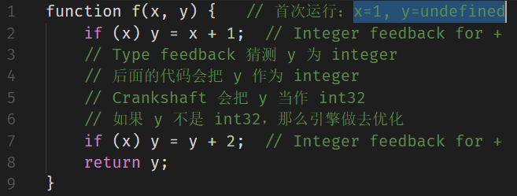
Deoptimization loop example

Slide 29
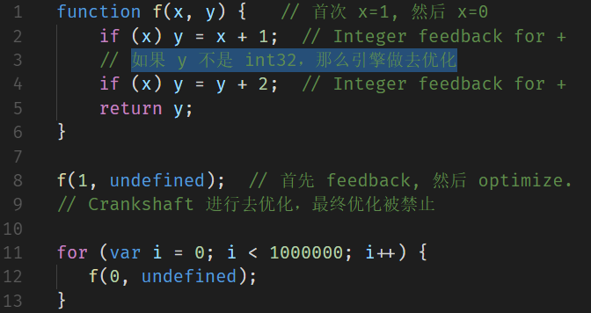
Deoptimization loop example

Slide 30
Can we do better?
Javascript code
var l = a[i] & 0x3fff,
h = a[i++]>>14,
m = xh*l+h*xl; l = ((m&0x3fff)<<14 …
Asm.js code
e=...|0;K=...|0; ...
S=e+K+c+b+f+E+D+m+o+g+a+C+B+A+z+y+R|0
根本不需要做范围检测，因为位运算只对低32位有效。

Slide 31
截断（Truncations）
在 (x + y)|0 运算时，我们只关心低 32 位的结果。即使 x, y 都是int52，我们也只关心 x 和 y 的低 32 位。
表达式 +a[i] 不区分 a[i] = undefined 和 a[i] = NaN。在稀疏数组中，我们会读取到 NaN! 而不是 undefined。
表达式 c ? x : y 也不需要区分 c = 1 和 c = true。

Slide 32
Example 1
var a = (x|0)+(y|0)*(z&0xff)|0
ToInt32
ToInt32
&
*
+
ToInt32

Slide 33
Example 1 (类型上限)
var a = (x|0)+(y|0)*(z&0xff)|0
ToInt32
Type: I32
Type: I32
Type: 0-255
ToInt32
ToInt32
ToInt32
&
&
*
Type: ..-547608329985
*
+
Type: ..-549755813632
ToInt32
ToInt32

Slide 34
Example 1 (截断传播)
var a = (x|0)+(y|0)*(z&0xff)|0
ToInt32
Type: I32
Type: I32
Type: 0-255
ToInt32
ToInt32
ToInt32
&
&
None
None
None
*
Type: ..-547608329985
*
None
+
Type: ..-549755813632
Word32
ToInt32
ToInt32

Slide 35
Example 1 (截断传播)
var a = (x|0)+(y|0)*(z&0xff)|0
ToInt32
Type: I32
Type: I32
Type: 0-255
ToInt32
ToInt32
ToInt32
&
&
None
None
Word32
*
Type: ..-547608329985
*
Word32
+ I32
Type: ..-549755813632
Word32
ToInt32
ToInt32

Slide 36
Example 1 (截断传播)
var a = (x|0)+(y|0)*(z&0xff)|0
ToInt32
Type: I32
Type: I32
Type: 0-255
ToInt32
ToInt32
ToInt32
&
&
Word32
Word32
Word32
*
Type: ..-547608329985
* I32
Word32
+ I32
Type: ..-549755813632
Word32
ToInt32
ToInt32
现在不需要检查范围溢出，所有的操作都是 int32!

Slide 37
Example 2
var a = (y|0)*(z&0xff); f(a); a = (x|0)+(a|0)|0
ToInt32
ToInt32
&
*
+
Call
ToInt32

Slide 38
Example 2
var a = (y|0)*(z&0xff); f(a); a = (x|0)+(a|0)|0
ToInt32
ToInt32
&
Float64
Float64
Word32
* F64
Any
Word32
I32
Call
Word32
ToInt32

Slide 39
Example 2
var a = (y|0)*(z&0xff); f(a); a = (x|0)+(a|0)|0
ToInt32
ToInt32
&
I32 -> F64
I32 -> F64
* F64
F64 -> W32
I32
Call
ToInt32

Slide 40
“截断”的其他用途
截断还可以用于其他优化:
从 double 到 integer 转换时的负零检查
乘法运算的负零检查
读取数组元素时的 undefined 检查
使引擎能更精准地表示类型
截断传播只在 V8 的 Turbofan 编译器有效。

Slide 41
面临的挑战
目前，引擎首先进行截断分析，而类型反馈不影响截断。
例如，（x + y | 0）中 x 和 y 将会被作为整型。
理想情况下，使用x和y的类型反馈，然后进行 int32加法。
然而，很多情况下，最明智的选择往往是“更差”的表示法。
例如，a + b + 0.5 应该是 float64，即使 a，b 被反馈为整型。

Slide 42
未来方向
JavaScript 可以使用任意的精确的整数
我们可以更加精准的控制V8引擎生成的代码!
也许以后会有 (U)Int64 或 BigNum 类型?
TypedArray
WebAssembly
SIMD

Slide 43
其它
V8 Binding
TurboFan 架构
Intermediate Representation
Hidden Classes
Inline Cache

Slide 44
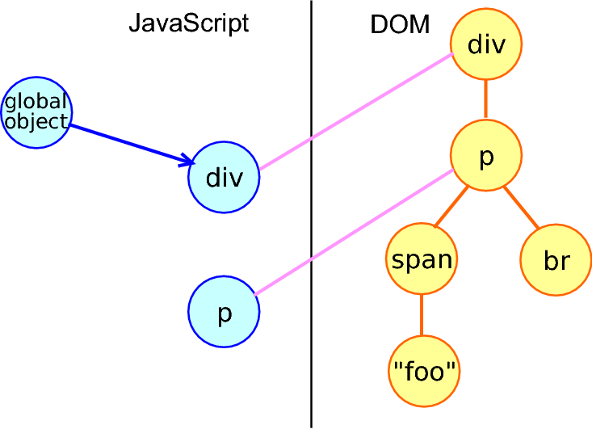
V8 Binding： JS object 和 DOM 对象
div = document.createElement("div");
div.innerHTML = "<p><span>foo</span><br></p>";
div.firstChild;

Slide 45
attribute VS property

Slide 46
DOM properties
<body id="page">
body.id: "page"
body.name = 'tom';
body.age = 90;
body.myData = { name: 'jjc'};
body.fun = () => {};
...

Slide 47
DOM properties
可以是任意类型
大小写敏感

Slide 48
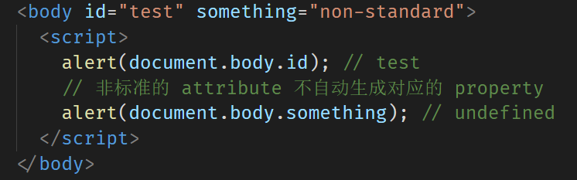
HTML attributes
标准的 HTML attributes 自动生成对应的 DOM properties

Slide 49
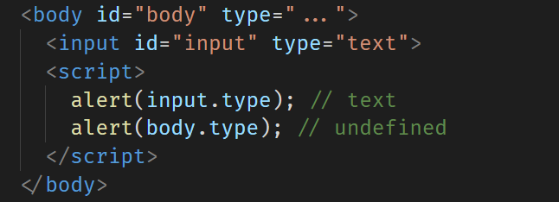
HTML attributes
非标准的 HTML attributes 不会生成对应的 DOM properties

Slide 50
非标准 HTML attributes
elem.hasAttribute(name)
elem.getAttribute(name)
elem.setAttribute(name, value)
elem.removeAttribute(name)

Slide 51
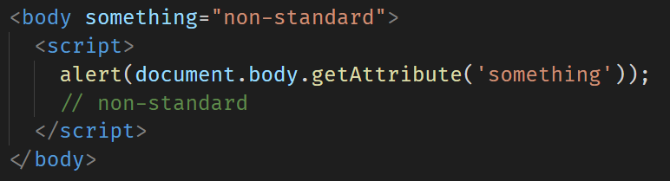
非标准 HTML attributes

Slide 52
HTML attributes
大小写不敏感（id 和 ID 一样）
总是字符串

Slide 53
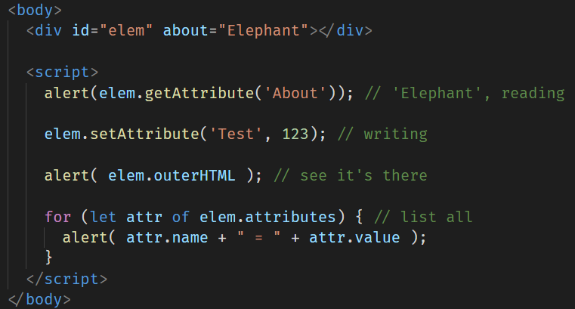
HTML attributes

Slide 54
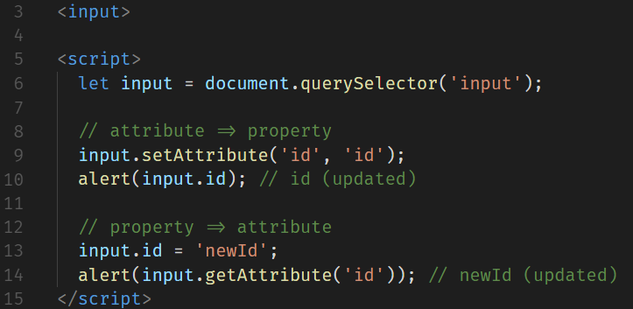
Property-attribute 同步
当标准 attribute 改变时，property 自动改变，反之亦然

Slide 55
BUT

Slide 56
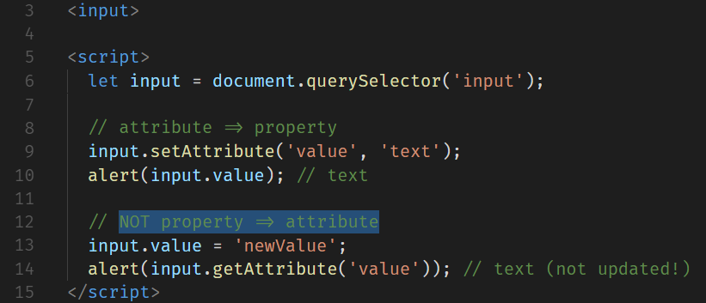
Property-attribute 同步
input.value 的更新是 attribute → property 单向的

Slide 57
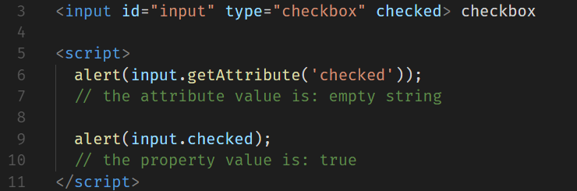
DOM properties are typed
input.checked 是 boolean 类型

Slide 58
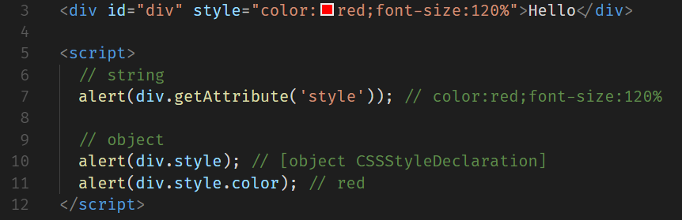
DOM properties are typed
style attribute 是 string
style property 是 object

Slide 59
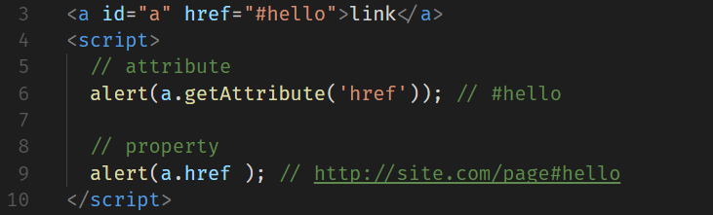
DOM properties are typed
及时类型相同，值也不一定相同

Slide 60
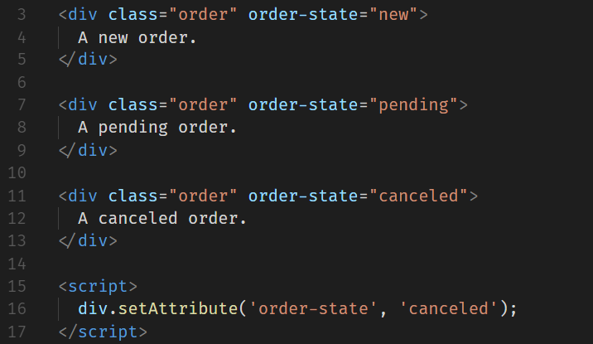
Non-standard attributes, dataset
非标准 attributes VS dataset

Slide 61
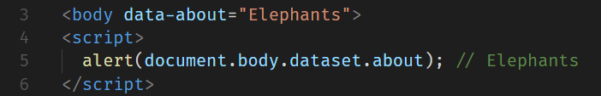
Non-standard attributes, dataset
data-*

Slide 62
总结
Attributes – is what’s written in HTML.
Properties – is what’s in DOM objects.

Slide 63
TurboFan 架构
Wasm
Compiler
CodeStub
Assembler
Code
Assembler
Intel, ARM, MIPS,
PowerPC, etc. code
Machine
Graph
Scheduler
Schedule
Backend
Optimizer
Simplified
Graph
Inliner &
Lowerings
JavaScript
Graphs
Bytecode
GraphBuilder
Ast
GraphBuilder
Google Proprietary

Slide 64
TurboFan IR
function f(x) { return x + 1;
}
Start
FrameState
Context parameter
Parameter x
Constant 1
Checkpoint
FrameState
JSAdd
IfSuccess
Return
加法运算有可能进行去优化(deopt)
End

Slide 65
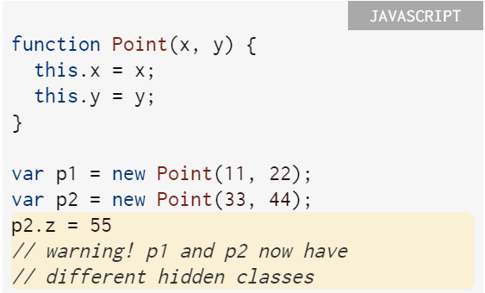
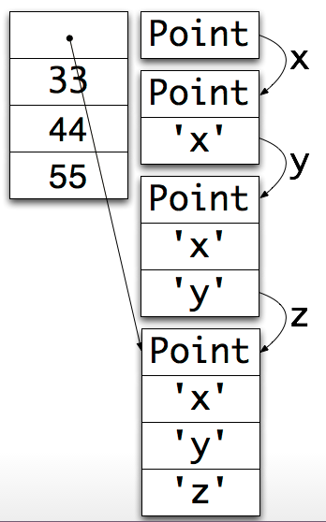
Hidden Classes
http://v8-io12.appspot.com

Slide 66
Talk is cheap. Show me the code.

Slide 67
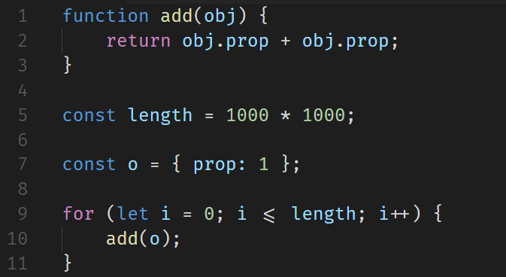
整数相加

Slide 68
d8 --trace-opt-verbose add-of-ints.js
[marking 030ADD65 <JS Function test (SharedFunctionInfo 03E3A99D)> for recompilation, reason: small function, ICs with typeinfo: 3/3 (100%), generic ICs: 0/3 (0%)]
[compiling method 030ADD65 <JS Function test (SharedFunctionInfo 03E3A99D)> using Crankshaft]
[optimizing 030ADD65 <JS Function test (SharedFunctionInfo 03E3A99D)> - took 0.033, 0.067, 0.537 ms]
[completed optimizing 030ADD65 <JS Function test (SharedFunctionInfo 03E3A99D)>]
[marking 030ADA75 <JS Function (SharedFunctionInfo 03E3A8E9)> for recompilation, reason: small function, ICs with typeinfo: 3/3 (100%), generic ICs: 0/3 (0%)]
Notes:
第一次优化的原因是 small function，add 函数是小函数，为了减小函数调用的开销，V8 引擎对 add 做了优化。第二次的原因是 hot and stable

Slide 69
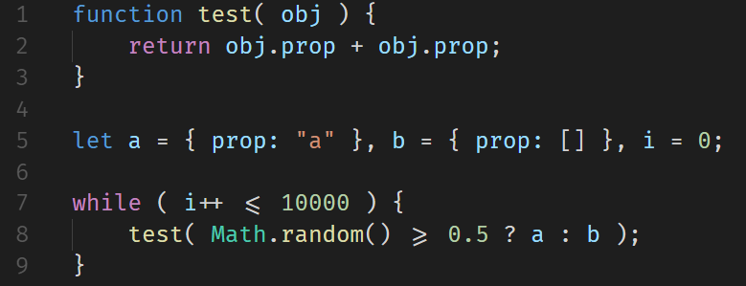
混合相加

Slide 70
d8 --trace-opt-verbose add-of-mixed.js
[marking 03F723E9 <JS Function valueOf (SharedFunctionInfo 03F32765)> for recompilation, reason: small function, ICs with typeinfo: 0/0 (100%), gener
ic ICs: 0/0 (0%)]
[marking 03F6C499 <JS Function toString (SharedFunctionInfo 03F3687D)> for recompilation, reason: small function, ICs with typeinfo: 4/5 (80%), generic ICs: 0/5 (0%)]
[compiling method 03F723E9 <JS Function valueOf (SharedFunctionInfo 03F32765)> using Crankshaft]
[compiling method 03F6C499 <JS Function toString (SharedFunctionInfo 03F3687D)> using Crankshaft]
[optimizing 03F723E9 <JS Function valueOf (SharedFunctionInfo 03F32765)> - took 0.031, 0.112, 0.037 ms]
[completed optimizing 03F723E9 <JS Function valueOf (SharedFunctionInfo 03F32765)>]
[optimizing 03F6C499 <JS Function toString (SharedFunctionInfo 03F3687D)> - took 0.073, 0.211, 0.076 ms]
[completed optimizing 03F6C499 <JS Function toString (SharedFunctionInfo 03F3687D)>]
[not yet optimizing test, not enough type info: 2/3 (66%)]
[not yet optimizing test, not enough type info: 2/3 (66%)]
[not yet optimizing test, not enough type info: 2/3 (66%)]
[not yet optimizing test, not enough type info: 2/3 (66%)]

Slide 71
[not yet optimizing test, not enough type info: 2/3 (66%)]
[not yet optimizing test, not enough type info: 2/3 (66%)]
[not yet optimizing test, not enough type info: 2/3 (66%)]
[not yet optimizing test, not enough type info: 2/3 (66%)]
[not yet optimizing test, not enough type info: 2/3 (66%)]
[not yet optimizing test, not enough type info: 2/3 (66%)]
[not yet optimizing test, not enough type info: 2/3 (66%)]
[not yet optimizing test, not enough type info: 2/3 (66%)]
[not yet optimizing test, not enough type info: 2/3 (66%)]
[not yet optimizing test, not enough type info: 2/3 (66%)]
[marking 037ADADD <JS Function (SharedFunctionInfo 0453A8F5)> for recompilation, reason: small function, ICs with typeinfo: 7/7 (100%), generic ICs:0/7 (0%)]
[not yet optimizing test, not enough type info: 2/3 (66%)]
[not yet optimizing test, not enough type info: 2/3 (66%)]
[not yet optimizing test, not enough type info: 2/3 (66%)]
[not yet optimizing test, not enough type info: 2/3 (66%)]
[not yet optimizing test, not enough type info: 2/3 (66%)]

Slide 72
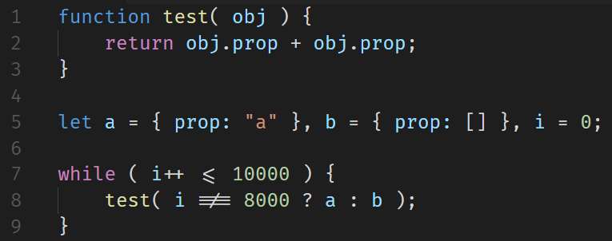
--trace-deopt

Slide 73
[deoptimizing (DEOPT eager): begin 035ADE39 <JS Function test (SharedFunctionInfo 0433ABA1)> (opt #0) @3, FP to SP delta: 12, caller sp: 0x00c2f548]
reading input frame test => node=4, args=2, height=1; inputs:
0: 0x035ade39 ; [fp - 8] 035ADE39 <JS Function test (SharedFunctionInfo 0433ABA1)>
1: 0x03d8a395 ; [fp + 12] 03D8A395 <JS Global Object>
2: 0x035adec1 ; ecx 035ADEC1 <an Object with map 0450DB69>
3: 0x03d6b2b9 ; [fp - 12] 03D6B2B9 <FixedArray[173]>
translating frame test => node=4, height=0
0x00c2f544: [top + 20] <- 0x03d8a395 ; 03D8A395 <JS Global Object> (input #1)
0x00c2f540: [top + 16] <- 0x035adec1 ; 035ADEC1 <an Object with map 0450DB69> (input #2)
0x00c2f53c: [top + 12] <- 0x04433dac ; caller's pc
0x00c2f538: [top + 8] <- 0x00c2f564 ; caller's fp
0x00c2f534: [top + 4] <- 0x03d6b2b9 ; context 03D6B2B9 <FixedArray[173]> (input #3)
0x00c2f530: [top + 0] <- 0x035ade39 ; function 035ADE39 <JS Function test (SharedFunctionInfo 0433ABA1)> (input #0)
[deoptimizing (eager): end 035ADE39 <JS Function test (SharedFunctionInfo 0433ABA1)> @3 => node=4, pc=0x044340e5, caller sp=0x00c2f548, state=NO_REGISTERS, took 5.152 ms]
[removing optimized code for: test]
[evicting entry from optimizing code map (notify deoptimized) for 0433ABA1 <SharedFunctionInfo test>]

Slide 74
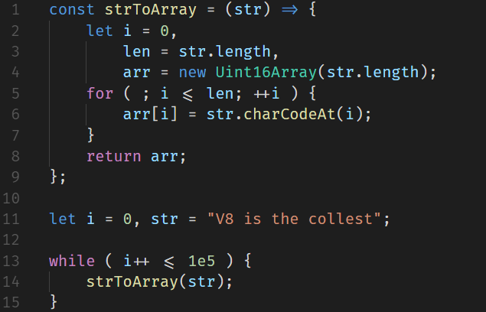
Garbage Collection

Slide 75
d8 --trace-gc gc.js
[14484:01BF4CA8] 9 ms: Scavenge 1.7 (2.5) -> 1.6 (3.5) MB, 0.7 / 0.0 ms [allocation failure].
[14484:01BF4CA8] 11 ms: Scavenge 1.7 (3.5) -> 1.7 (4.5) MB, 0.6 / 0.0 ms [allocation failure].
[14484:01BF4CA8] 131 ms: Scavenge 3.2 (7.5) -> 2.7 (9.5) MB, 1.8 / 0.0 ms [allocation failure].
[14484:01BF4CA8] 196 ms: Scavenge 4.2 (9.5) -> 2.7 (9.5) MB, 6.7 / 0.0 ms [allocation failure].
[14484:01BF4CA8] 223 ms: Scavenge 4.6 (9.5) -> 2.7 (9.5) MB, 8.0 / 0.0 ms [allocation failure].
[14484:01BF4CA8] 250 ms: Scavenge 4.6 (9.5) -> 2.7 (9.5) MB, 8.1 / 0.0 ms [allocation failure].
[14484:01BF4CA8] 275 ms: Scavenge 4.6 (9.5) -> 2.7 (9.5) MB, 8.0 / 0.0 ms [allocation failure].

Slide 76
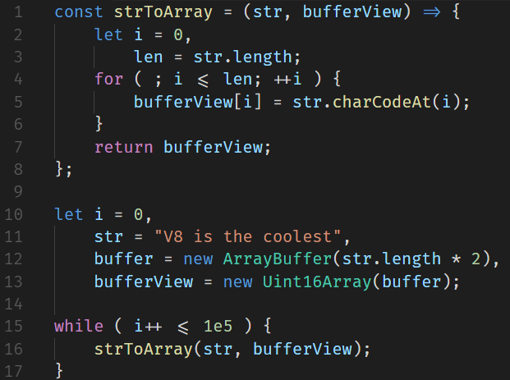
no-gc

Slide 77
[23052:01D277F8] 9 ms: Scavenge 1.7 (2.5) -> 1.6 (3.5) MB, 0.8 / 0.0 ms [allocation failure].
[23052:01D277F8] 10 ms: Scavenge 1.7 (3.5) -> 1.7 (4.5) MB, 0.6 / 0.0 ms [allocation failure].

Slide 78
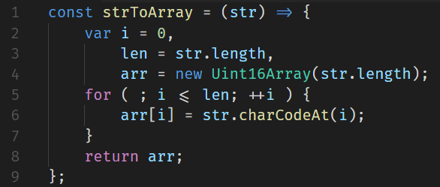
full gc

Slide 79
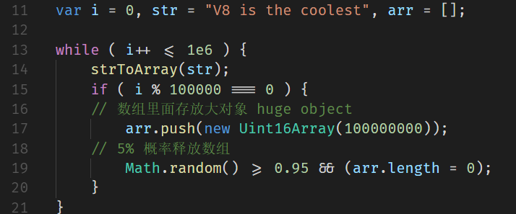
full gc

Slide 80
d8 --trace-gc gc.js
[8664:01E15D10] 9 ms: Scavenge 1.7 (2.5) -> 1.6 (3.5) MB, 0.6 / 0.0 ms [allocation failure].
[8664:01E15D10] 11 ms: Scavenge 1.7 (3.5) -> 1.7 (4.5) MB, 0.7 / 0.0 ms [allocation failure].
[8664:01E15D10] 71 ms: Scavenge 3.2 (7.5) -> 2.7 (9.5) MB, 1.8 / 0.0 ms [allocation failure].
[8664:01E15D10] 94 ms: Scavenge 4.2 (9.5) -> 2.7 (9.5) MB, 6.3 / 0.0 ms [allocation failure].
[8664:01E15D10] 119 ms: Scavenge 4.6 (9.5) -> 2.7 (9.5) MB, 7.6 / 0.0 ms [allocation failure].
[8664:01E15D10] 144 ms: Scavenge 4.6 (9.5) -> 2.7 (9.5) MB, 7.4 / 0.0 ms [allocation failure].
[8664:01E15D10] 169 ms: Scavenge 4.6 (9.5) -> 2.7 (9.5) MB, 8.3 / 0.0 ms [allocation failure].
[8664:01E15D10] 193 ms: Mark-sweep 4.6 (9.5) -> 2.6 (9.5) MB, 5.0 / 0.0 ms [allocation failure] [promotion limit reached].
[8664:01E15D10] 230 ms: Scavenge 4.5 (9.5) -> 2.6 (9.5) MB, 16.9 / 0.0 ms [allocation failure].
[8664:01E15D10] 258 ms: Scavenge 4.5 (9.5) -> 2.6 (9.5) MB, 9.2 / 0.0 ms [allocation failure].
[8664:01E15D10] 282 ms: Scavenge 4.5 (9.5) -> 2.6 (9.5) MB, 7.7 / 0.0 ms [allocation failure].
[8664:01E15D10] 303 ms: Mark-sweep 4.5 (9.5) -> 2.6 (9.5) MB, 4.8 / 0.0 ms [allocation failure] [promotion limit reached].
[8664:01E15D10] 339 ms: Scavenge 4.5 (9.5) -> 2.6 (9.5) MB, 19.2 / 0.0 ms [allocation failure].
[8664:01E15D10] 365 ms: Scavenge 4.5 (9.5) -> 2.6 (9.5) MB, 8.7 / 0.0 ms [allocation failure].

Slide 81
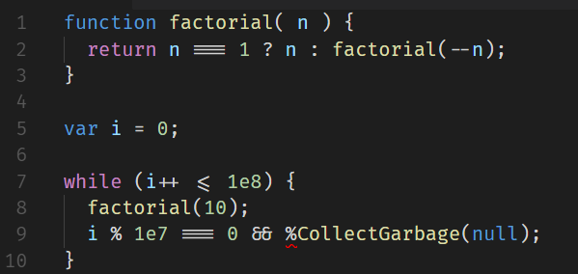
--allow-natives-syntax

Slide 82
d8 --allow-natives-syntax --trace-gc
[21068:00294D18] 7 ms: Scavenge 1.7 (2.5) -> 1.6 (3.5) MB, 0.7 / 0.0 ms [allocation failure].
[21068:00294D18] 8 ms: Scavenge 1.7 (3.5) -> 1.7 (4.5) MB, 0.6 / 0.0 ms [allocation failure].
[21068:00294D18] 561 ms: Mark-sweep 2.8 (7.5) -> 2.6 (10.5) MB, 2.9 / 0.0 ms [%CollectGarbage] [GC in old space requested].
[21068:00294D18] 1060 ms: Mark-sweep 2.6 (10.5) -> 2.5 (9.5) MB, 3.8 / 0.0 ms [%CollectGarbage] [GC in old space requested].
[21068:00294D18] 1563 ms: Mark-sweep 2.5 (9.5) -> 2.5 (9.5) MB, 2.2 / 0.0 ms [%CollectGarbage] [GC in old space requested].
[21068:00294D18] 2063 ms: Mark-sweep 2.5 (9.5) -> 2.4 (9.5) MB, 1.9 / 0.0 ms [%CollectGarbage] [GC in old space requested].
[21068:00294D18] 2564 ms: Mark-sweep 2.4 (9.5) -> 2.4 (9.5) MB, 1.8 / 0.0 ms [%CollectGarbage] [GC in old space requested].
[21068:00294D18] 3058 ms: Mark-sweep 2.4 (9.5) -> 2.4 (6.5) MB, 1.9 / 0.0 ms [%CollectGarbage] [GC in old space requested].
[21068:00294D18] 3561 ms: Mark-sweep 2.4 (6.5) -> 2.4 (6.5) MB, 1.9 / 0.0 ms [%CollectGarbage] [GC in old space requested].

Slide 83
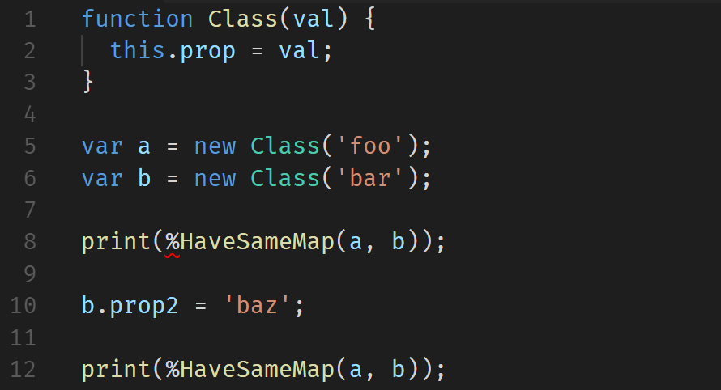
Hidden Classes

Slide 84
d8 --allow-natives-syntax
true
false

Slide 85
bluebird promise
function toFastProperties(obj) {
/*jshint -W027*/
function f() {}
f.prototype = obj;
ASSERT("%HasFastProperties", true, obj);
return f;
eval(obj);
}

Slide 86
尾调用优化
Syntactic Tail Calls (STC)
https://github.com/tc39/proposal-ptc-syntax

Slide 87
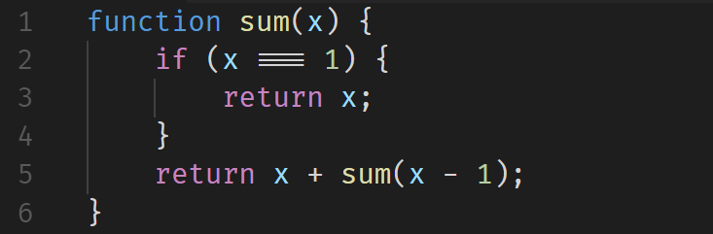
累加

Slide 88
sum(5)
sum(5)
5 + sum(4)
5 + (4 + sum(3))
5 + (4 + (3 + sum(2)))
5 + (4 + (3 + (2 + sum(1))))
5 + (4 + (3 + (2 + 1)))
5 + (4 + (3 + 3))
5 + (4 + 6)
5 + 10
15

Slide 89
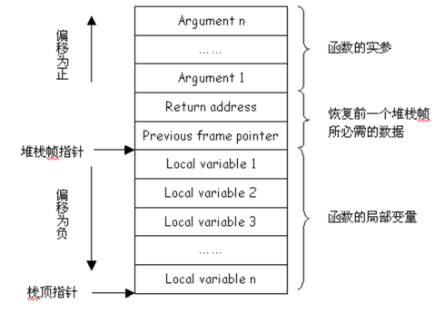

Slide 90
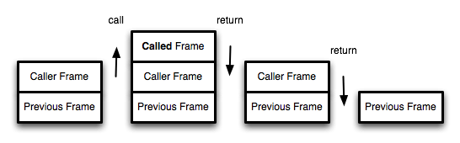
调用栈

Slide 91
存在的问题
function foo(n) {
return bar(n*2);
}
function bar() {
throw new Error();
}
try {
foo(1);
} catch(e) {
print(e.stack);
}

Slide 92
不使用PTC：
Error
at bar
at foo
at Global Code
使用PTC：
Error
at bar
at Global Code

Slide 93
解决方式：显式指定
return continue
!return
#function()

Slide 94
<questions />
by @jjc

