Slide 1
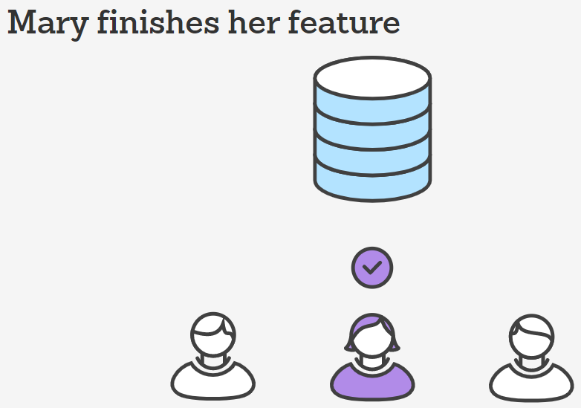
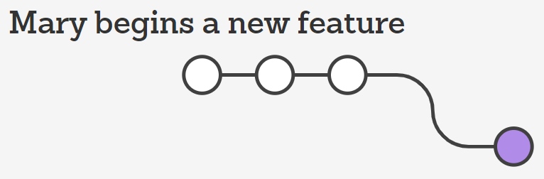
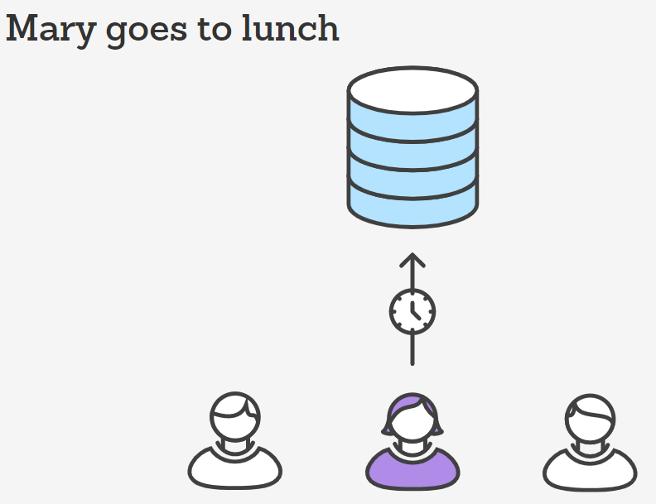
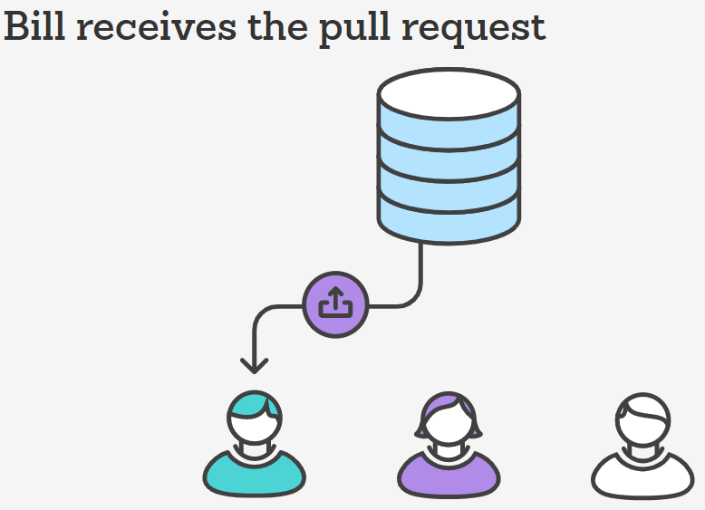
Source control in team work
IT-systems are developed for teams and with teams
All the developed code is common - everyone can work on the code!
git push
git checkout -b marys-feature main
git status git add <some-file> git commit
git push -u origin marys-feature
Bill gives a review and wants some changes
Notes:
Det bliver mere og mere vigtigt at arbejde langt fra hinanden (fx arbejde hjemme). Derfor bliver det også mere vigtigt med ”branching”.
IDE værktøjer – som Visual Studio - har ofte en meget begrænset adgang til kommandoer for Source Control (fx Git).
Således kan det være vanskeligt at løse ”merge”-konflikter, når man ikke har det fulde kommando-reportoiere for . Source Control

Slide 2
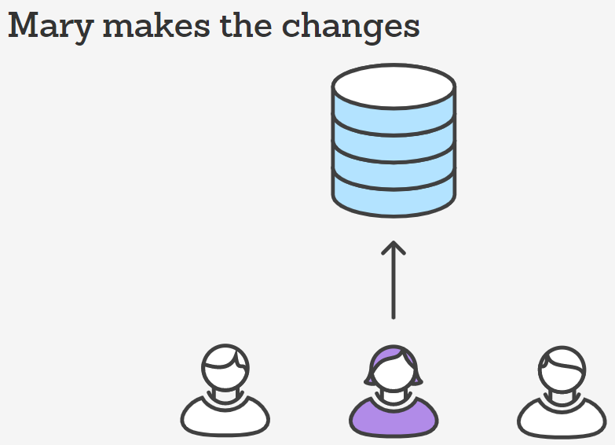
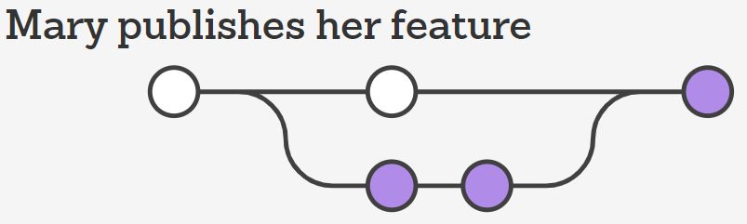
git checkout main git pull git pull origin marys-feature git push
John is doing the same
https://www.atlassian.com/git/tutorials/comparing-workflows/feature-branch-workflow

Slide 3
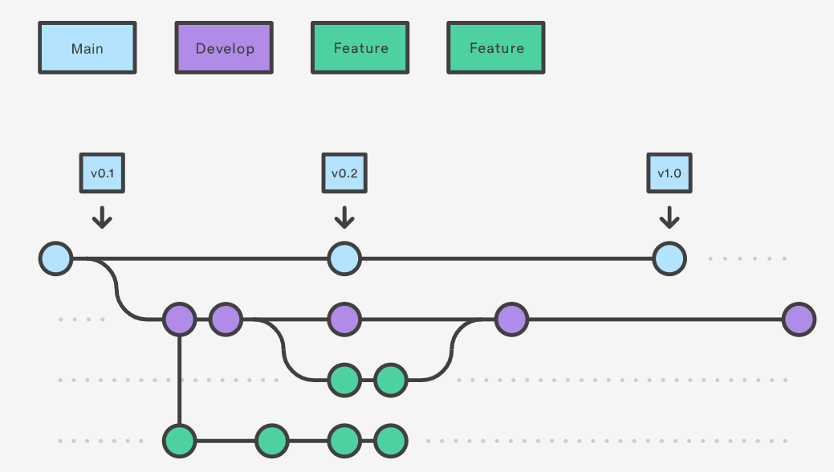

Slide 4
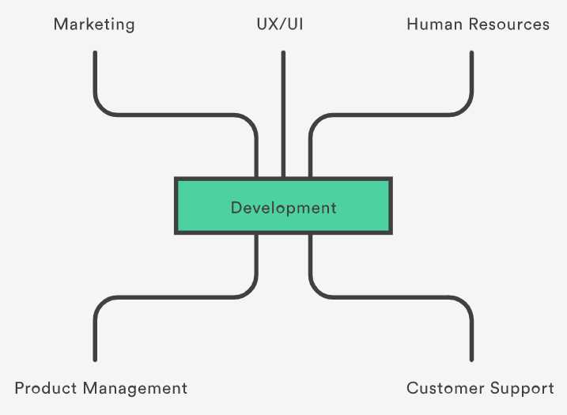
Why branching matters
Have several teams working from a single repository concurrently
Have team members anywhere in the world
Have multiple lines of development running at the same time independent of each other without needing code freezes.
Git - Linus Torvalds
Git is a de facto standard
Git is a open source project
https://www.atlassian.com/git/tutorials/why-git
Notes:
Fortæl om de forskellige grupper af interessenter for et Repository.

Slide 5
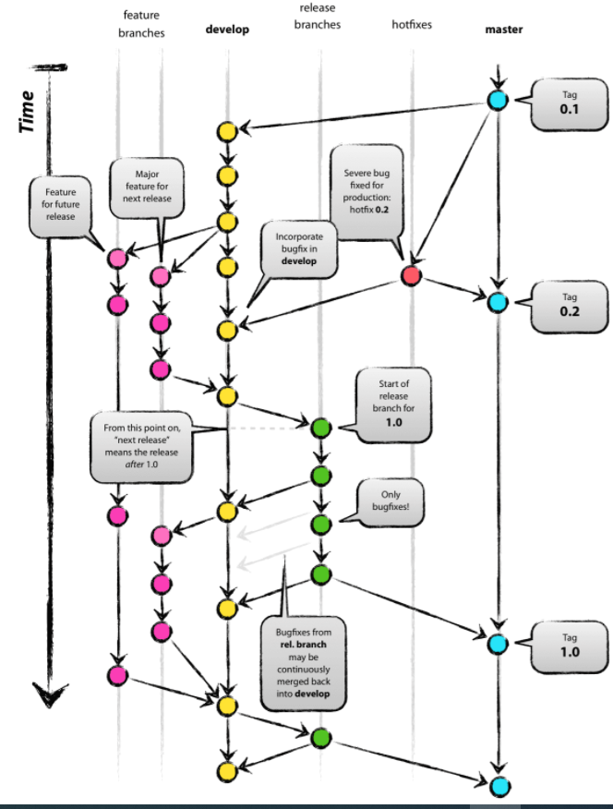
Benefits of version control systems
A complete long-term change history of every file
Branching and merging
Traceability
What to do
Commit often
Ensure you're working from latest version
Make detailed notes
Review changes before committing
Use Branches
Agree on a Workflow

Slide 6
Vis med et konkret eksempel
https://github.com/fals1212/JavaExample1
Som underviser skal du nu gennemføre Mary-eksemplet med dette repository for forsamlingen.
Du skal have installeret Git GUI, CMD, Bash: https://git-scm.com/download/win
Det kræver endvidere at du har gjort dit lokale Git-katalog klar (fx C:\Git\JavaExample1),
og gennemfører følgende kommandoer i Git Bash:
git init
git clone https://github.com/fals1212/JavaExample1
git remote add JavaExample1 https://github.com/fals1212/JavaExample1
git config --global user.email ”<Id>@gmail.com"
git config --global user.name ”<Navn>"
Giv demo af Git GUI og Git CMD

Slide 7
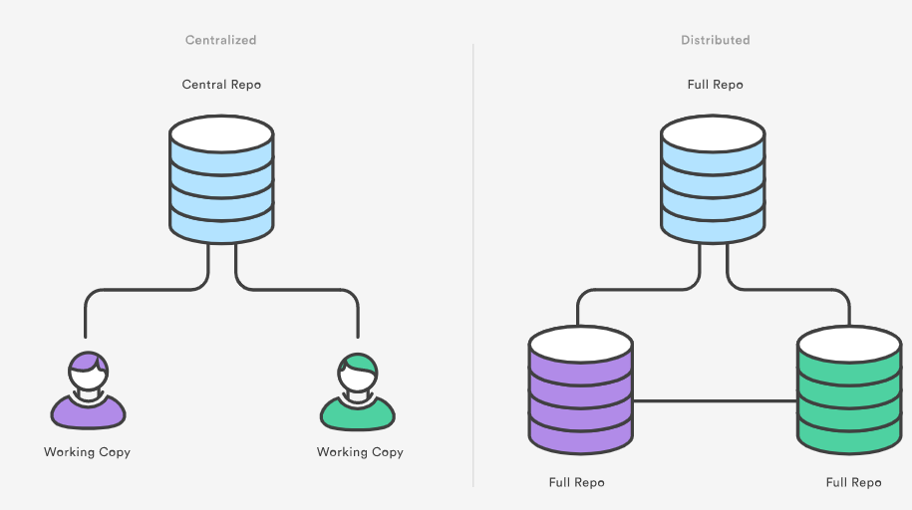
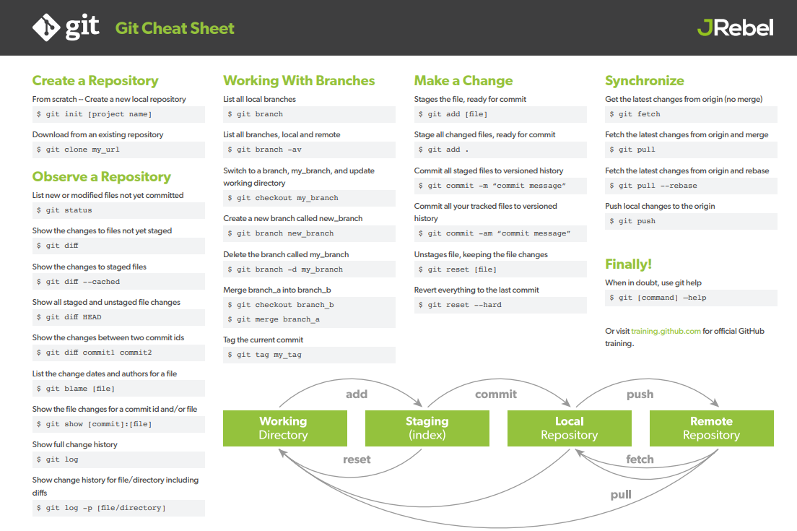
Links til videoer
God indgang til videoer
https://www.youtube.com/playlist?list=PL4cUxeGkcC9goXbgTDQ0n_4TBzOO0ocPR
Video om branching #8:
https://www.youtube.com/watch?v=QV0kVNvkMxc
https://www.youtube.com/watch?v=S2TUommS3O0
Video om merge conflikts #9:
https://www.youtube.com/watch?v=XX-Kct0PfFc
Links til tekster
God indgang til artikler
https://www.atlassian.com/git/tutorials
Eksempler herfra:
https://www.atlassian.com/git/tutorials/why-git
https://www.atlassian.com/git/tutorials/comparing-workflows/feature-branch-workflow
Git Branching and Merging:
https://www.varonis.com/blog/git-branching
Commando-oversigt
https://education.github.com/git-cheat-sheet-education.pdf
Cheat sheet
https://www.jrebel.com/blog/git-cheat-sheet

Slide 9
SLUT

