Slide 1
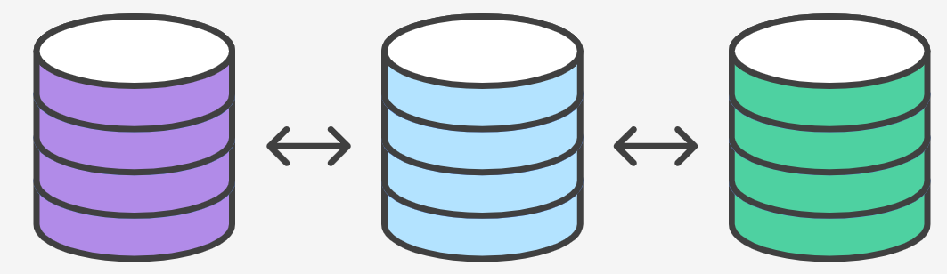
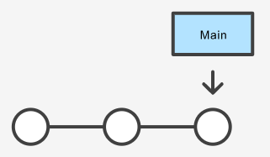
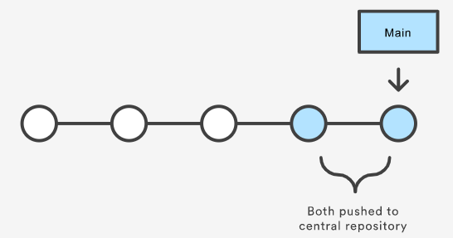
What is a successful Git workflow?
Does this workflow scale with team size?
Is it easy to undo mistakes and errors with this workflow?
Comparing Workflows
Does this workflow impose any new unnecessary cognitive overhead to the team?
Central Repository
Local Repository

Slide 2
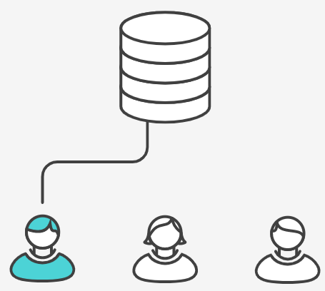
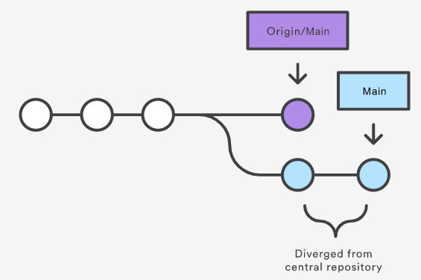
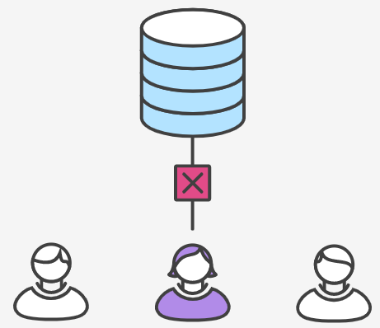
Example - Hosted Centralized Workflow
“I want to add my changes to what everyone else has already done.”
John publishes his feature
Both John and Mary are working on their features
Mary tries to publish her feature
Managing merge conflicts

Slide 3
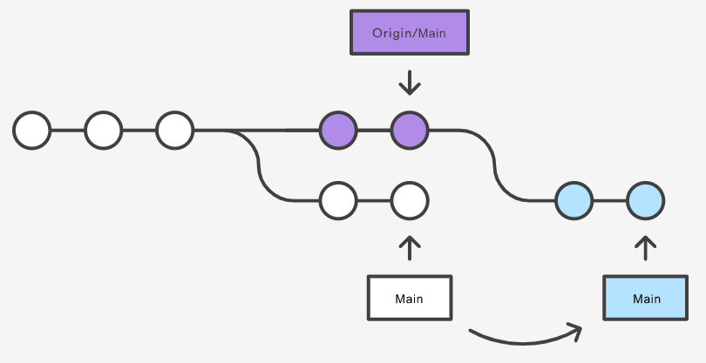
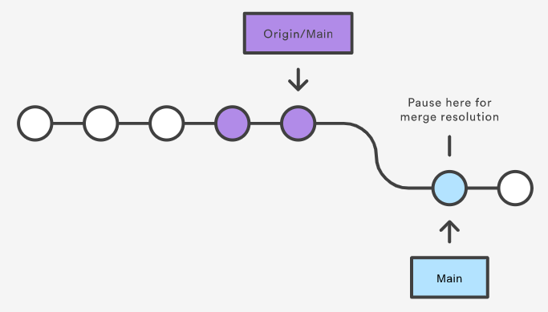
git pull --rebase origin main
Mary should resolve her own merge conflicts
CONFLICT (content): Merge conflict in <some-file>
git status
git add <some-file> git rebase --continue
git rebase --abort
git push origin main
https://www.atlassian.com/git/tutorials/comparing-workflows
Notes:
The --rebase option tells Git to move all of Mary’s commits to the tip of the main branch after synchronising it with the changes from the central repository
Rebasing works by transferring each local commit to the updated main branch one at a time. This means that you catch merge conflicts on a commit-by-commit basis rather than resolving all of them in one massive merge commit. This keeps your commits as focused as possible and makes for a clean project history. In turn, this makes it much easier to figure out where bugs were introduced and, if necessary, to roll back changes with minimal impact on the project.

Slide 4
Trunk-based development best practices
Develop in small batches
Feature flags
Implement comprehensive automated testing
Perform asynchronous code reviews
Have three or fewer active branches in the application's code repository
Merge branches to the trunk at least once a day
Reduced number of code freezes and integration phases
Build fast and execute immediately
https://www.atlassian.com/continuous-delivery/continuous-integration/trunk-based-development
Notes:
Developers create a feature branch and delay merging it to the main trunk branch until the feature is complete

Slide 5
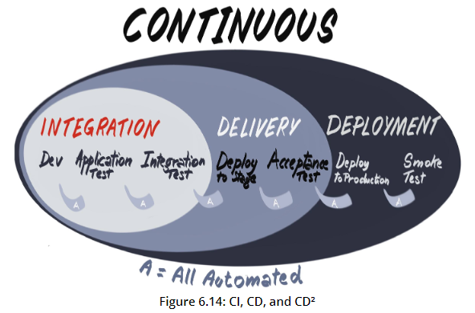
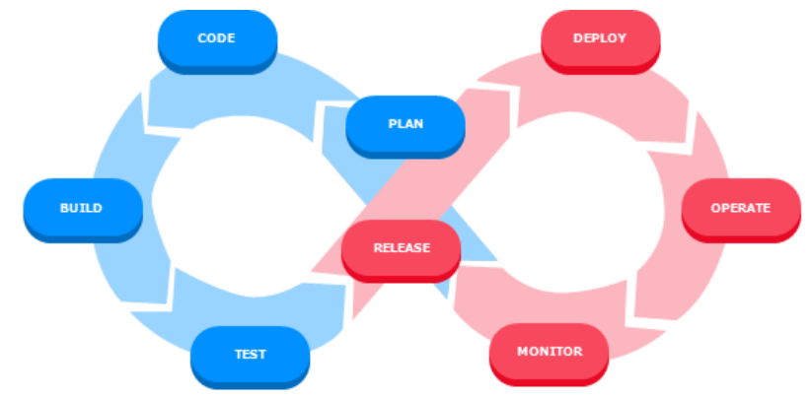
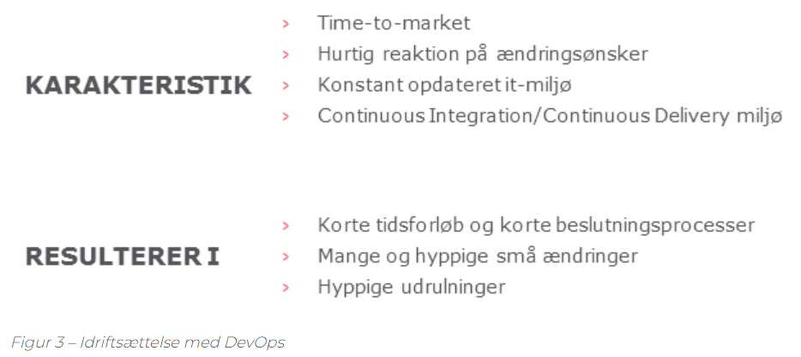
Continuous delivery
Continuous integration
Continuous deployment
DevOps
Notes:
Trunk-based development skal ses i forhold til DevOps tankegangen.

Slide 6
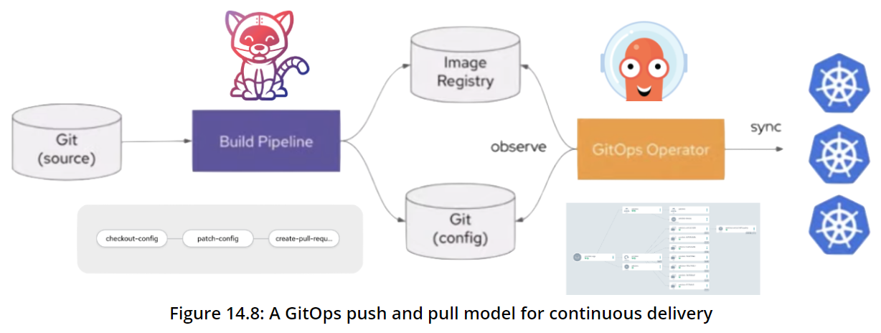

Slide 7
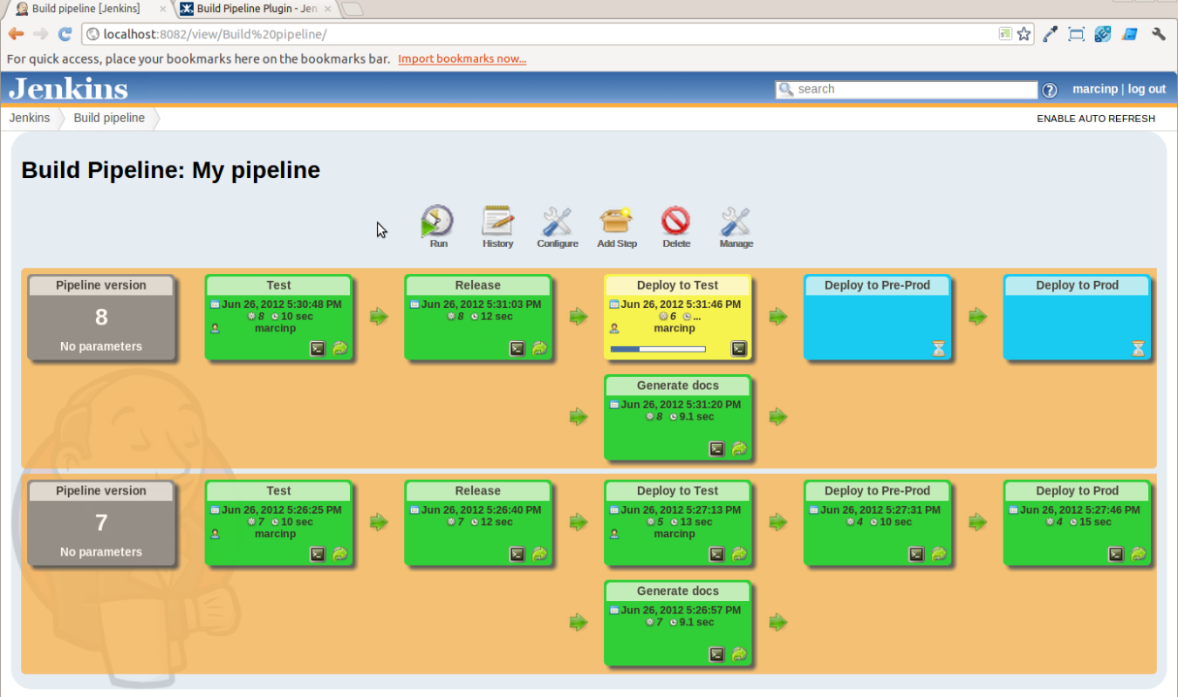

Slide 8
SLUT

