Slide 1
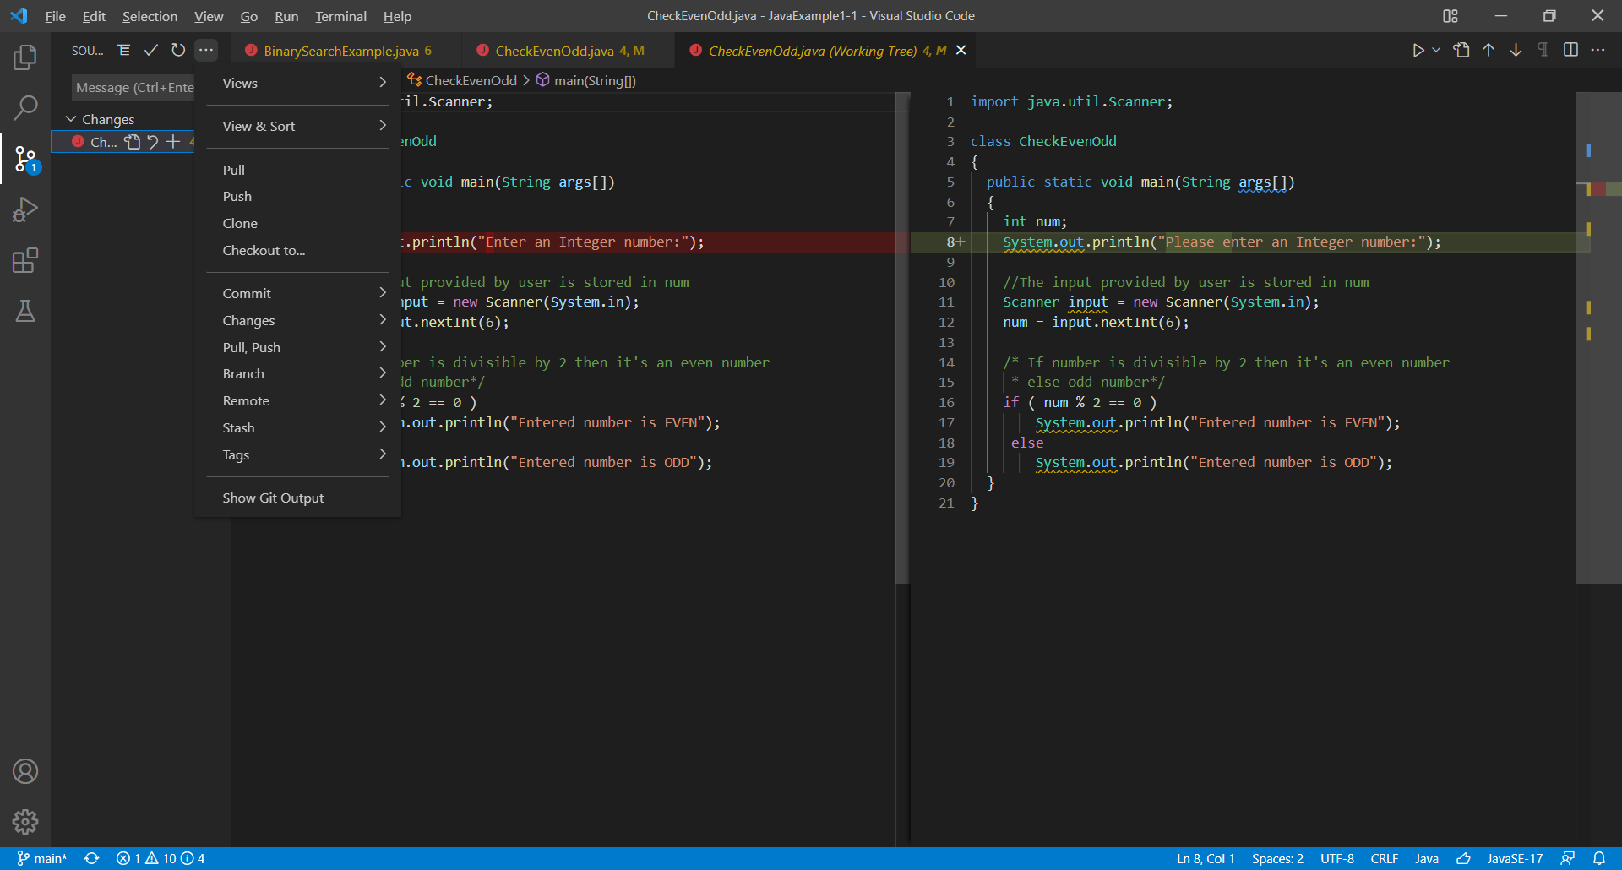
Git i Visual Studio
Version 1.65.0
Notes:
De vigtigste git kommandoer findes nu i produktet3.
Lad eleverne fortælle om de enkelte kommandoer.
https://code.visualstudio.com/docs/editor/versioncontrol

Slide 2
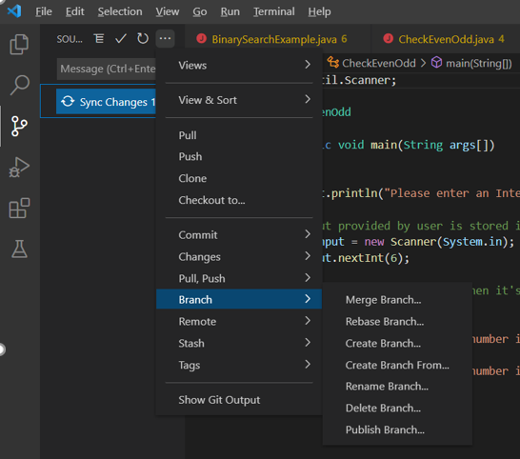
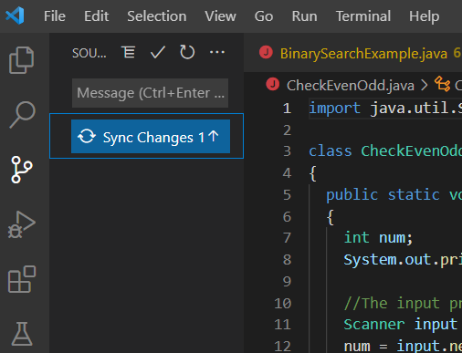
Commit

Slide 3
Git stash is used in order to save all the changes done to the current working directory and to go back to the last commit done on the branch (also called HEAD).
The git blame command is used to examine the contents of a file line by line and see when each line was last modified and who the author of the modifications was.
Git Tags are specific reference points in the Git history. Git tags are used to capture the specific point in the history that is further used to point to a released version. A tag does not change like a branch. They don't have a further history of commits after being created.
git tag -a v1.0 -m 'Version 1.0”
git push origin --tags

