Slide 1
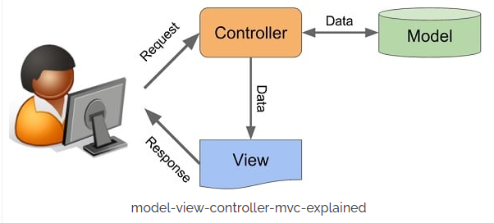

SQL
Which language is best for database programming?
Is SQL better than Java?
Top 5 programming languages that every database administrator must learn
#1. Structured Query Language (SQL) It is a standard programming language that is famous for database development among developers. ...
#2. PHP. ...
#3. Python. ...
#4. R. ...
#5. C#
SQL can be construed as easier than Java. SQL is a domain-specific language for managing data in relational databases, while Java is a general programming language. Furthermore, SQL is a declarative language with its syntax semantic in nature, adding to its comparative simplicity.
Is SQL faster than Java?
Doing maximum amount of data processing in SQL is efficient and faster than writing logic inside the java code. Loading data from the database into application memory and writing it back to the database after computation is a waste of application memory, bandwidth and time.
T SQL is great

Slide 2
Eksempler på SQL
declare @i int
set @i = 0
while @i<50000 begin
set @i = @i+1
insert into XXX (@i, 1, 2, 3)
end
SELECT TOP (1000) * FROM [BikeStores].[production].[products]
ORDER BY [list_price]
CREATE PROCEDURE SelectAllCustomers @City nvarchar(30) AS SELECT * FROM Customers WHERE City = @City GO;
EXEC SelectAllCustomers @City = 'London';
Omfattende programmerings-sprog
Join
Tabel 1
Tabel 2
Rettet mod database-tabeller

Slide 3
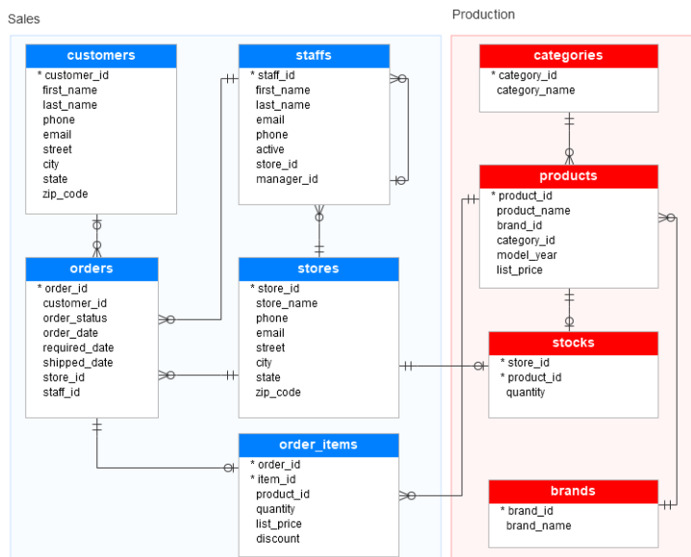
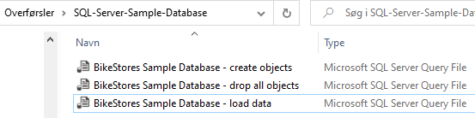
Opgave – gennemfør som beskrevet i:
https://www.sqlservertutorial.net/sql-server-sample-database/
2
CREATE DATABASE [BikeStores]
GO
1
Teori
Dan database
3
USE DATABASE [BikeStores]
GO
Nyttig cmd
5
Work on data
SELECT ROW_NUMBER() OVER ( ORDER BY first_name ) row_num, first_name, last_name, city FROM sales.customers;
4
Just do it

Slide 4
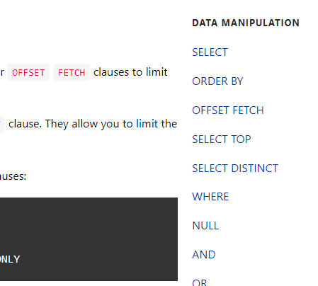
Simple SQL sætninger
select top 10 * from [sales].[customers]
select top 10 * from [History].[customers]
update [sales].[customers] set phone='12345678' where customer_id=1
OFFSET FETCH
SELECT product_name, list_price
FROM production.products
ORDER BY list_price, product_name
OFFSET 10 ROWS FETCH NEXT 10 ROWS ONLY;

Slide 5
GROUPING SETS
SELECT b.brand_name AS brand,
c.category_name AS category,
p.model_year,
round(SUM (quantity * i.list_price * (1 - discount)
), 0) sales INTO sales.sales_summary
FROM sales.order_items i
INNER JOIN production.products p ON p.product_id = i.product_id
INNER JOIN production.brands b ON b.brand_id = p.brand_id
INNER JOIN production.categories c ON c.category_id = p.category_id
GROUP BY
b.brand_name,
c.category_name,
p.model_year
ORDER BY
b.brand_name,
c.category_name,
p.model_year;
select * from sales.sales_summary order by 1,2,3

Slide 6
Hvordan vil du ændre databasen så kunden kan skifte adresse, telefonnr, email, navn ?
CREATE SCHEMA History;
GO
ALTER TABLE sales.customers
ADD
SysStartTime DATETIME2 GENERATED ALWAYS AS ROW START HIDDEN
CONSTRAINT DF_SysStart DEFAULT SYSUTCDATETIME()
, SysEndTime DATETIME2 GENERATED ALWAYS AS ROW END HIDDEN
CONSTRAINT DF_SysEnd DEFAULT CONVERT(DATETIME2, '9999-12-31 23:59:59.9999999'),
PERIOD FOR SYSTEM_TIME (SysStartTime, SysEndTime);
GO
ALTER TABLE sales.customers
SET (SYSTEM_VERSIONING = ON (HISTORY_TABLE = History.customers));
USE BikeStores
https://docs.microsoft.com/en-us/sql/relational-databases/tables/creating-a-system-versioned-temporal-table?view=sql-server-ver15

Slide 7
Yderligere opgaver
1. Lav et program der indsætter ½ mill rækker i tabellen sales.order_items
2. Find gennemsnitsprisen pr produkt i tabellen sales.order_items
3. Lav en trigger på tabellen sales.order_items, der giver en fejl, når prisen er mere end 100000.
Ad 1. Husk at der er foreign keys til flere tabeller
Ad 2. Hvor lang tid tager eksekveringen, når der nu er så mange rækker i tabellen?
Ad 3. Vi har ikke snakket om triggere, men søg på nettet

Slide 8
Lav et program der indsætter ½ mill rækker i tabellen sales.order_items
declare @i int
set @i = 0
while @i<50000 begin
set @i = @i+1
INSERT INTO [sales].[order_items]
([order_id]
,[item_id]
,[product_id]
,[quantity]
,[list_price]
,[discount])
VALUES (1,100+@i,1,1,@i,0)
end
select [item_id],avg([list_price])
from [sales].[order_items]
group by [item_id]
order by 1
(50005 rows affected)
Completion time: 2022-01-24T20:59:01.3768560+01:00

Slide 9
Trigger på tabellen sales.order_items
CREATE TRIGGER order_items_check ON [sales].[order_items]
AFTER INSERT, UPDATE AS
BEGIN
DECLARE @NewValue decimal(10,2);
SELECT @NewValue=[list_price] FROM inserted;
IF @NewValue>100000
BEGIN
RAISERROR ('The price is too big.' ,10,1);
ROLLBACK TRANSACTION ;
END;
END;
INSERT INTO [sales].[order_items]
([order_id]
,[item_id]
,[product_id]
,[quantity]
,[list_price]
,[discount])
VALUES
(1,100,1,1,999999,0)
GO
The price is too big.
Msg 3609, Level 16, State 1, Line 4
The transaction ended in the trigger. The batch has been aborted.

Slide 10
Afrunding
Intro til T SQL
Der er meget mere, som vi ikke har snakket om
Meget stærkt sprog
Undlad at flytte store datamængder mellem model og klient

