Slide 1

D.Eco Application
Presented by Code Monkey

Slide 2

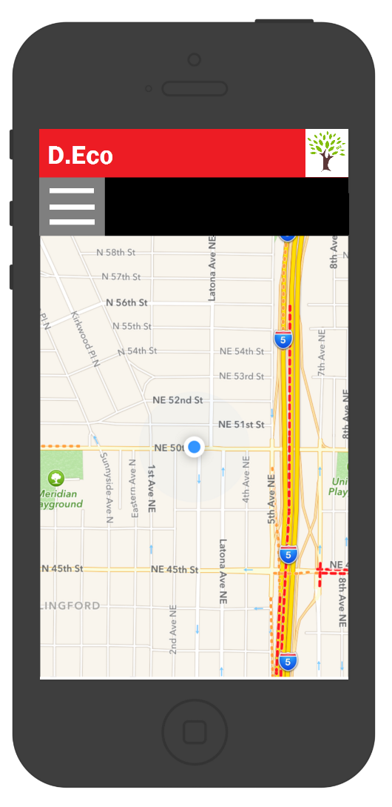
Sprint 1 Inception
Use Case Model
Risk Analysis
Technology Plan
Effort Estimate
System Architecture
Code Monkey
April 5, 2017

Slide 3
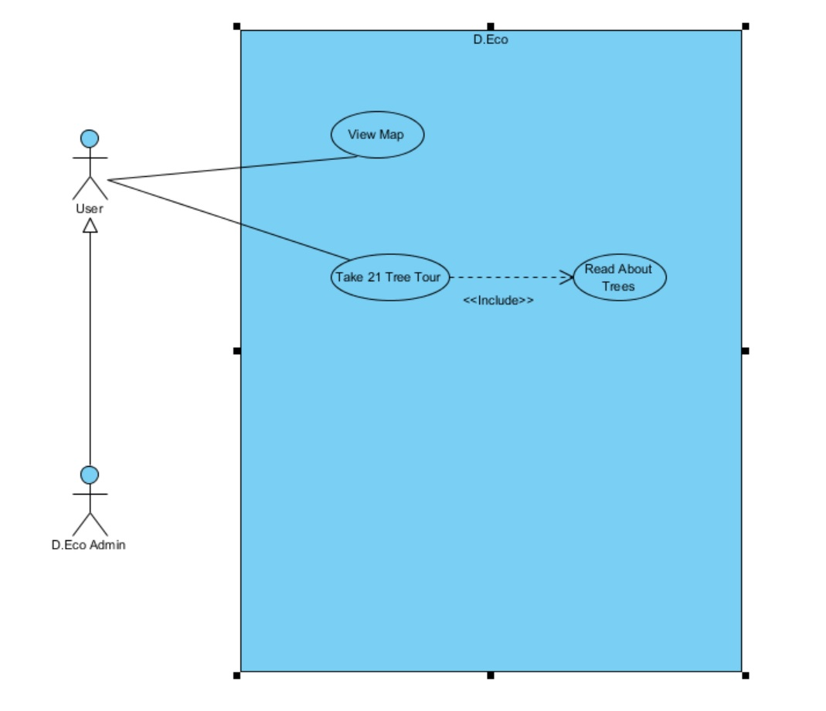
Use Case Model
Code Monkey
April 5, 2017

Slide 4
Technology Plan
Technology | Experience Rating
Phone App Technologies
IOS | Tutorial
Android | None
Map Technologies
Google Maps | Tutorial
Open Layers | None
OpenStreetMap | None
Code Monkey
April 5, 2017

Slide 5
Technology Plan
 | Experience Rating
Application & Web Development
Java | Small Scale
Swift | Tutorial
HTML 5 | Small Scale
Javascript | Tutorial
Code Monkey
April 5, 2017

Slide 6
Risk Analysis
Risk | Mitigation
No experience with IOS development | Schedule time and work through tutorials
No experience with Android development | Schedule time and work through tutorials
Limited experience with app development | Schedule time and work tutorials
Team member conflicting schedules | Plan meetings for in advance
No experience accessing GPS in mobile apps | Schedule time to learn and work through tutorials
No experience with utilizing Google Maps in mobile apps | Schedule time to learn and work through tutorials
Code Monkey
April 5, 2017

Slide 7
Effort Estimate
Screen/Report | Complexity | Object Points | Notes
View Campus | 1 | 1 | Screen will be constructed by reading Drury location from the data source.
Take 21 Tree Tour | 2 | 2 | Screen will be constructed by Drury's location and individual location from the data source.
Subscreen
Read About Trees | 1 | 1 | Simple text with some images on screen.
Code Monkey
April 5, 2017

Slide 8
Effort Estimate Assumptions
Screen/Report | Complexity | Object Points | Notes
3GL Modules
GPS Tour | 1@10 | 10 | Module to find individual location with GPS.
Server Modules | 2@10 | 20 | Data server for all 4 Map Modules.
Total Object Points |  | 34 | Total object points for the project.
Code Monkey
April 5, 2017

Slide 9
Effort Estimate
Productivity (PROD)
PROD estimate is normal (10)
PROD = 160 NOP / 16 person months
PM = 4hr x 1 week x 4 weeks
Justification: students
Some code reuse is anticipated so adjusted effort = NOP
NOP = (160 Obj pts x (100-0.1)) / 100 = 159.8
Effort Estimate in person months (PM) (PM = 16)
Effort(PM) = 159/10 = 15.9 person monthsProductivity (PROD)
PROD estimate is normal (10)
PROD = 160 NOP / 16 person months
PM = 4hr x 1 week x 4 weeks
Justification: students
Some code reuse is anticipated so adjusted effort = NOP
NOP = (160 Obj pts x (100-0.1)) / 100 = 159.8
Effort Estimate in person months (PM) (PM = 16)
Effort(PM) = 159/10 = 15.9 person months
Code Monkey
April 5, 2017

Slide 10
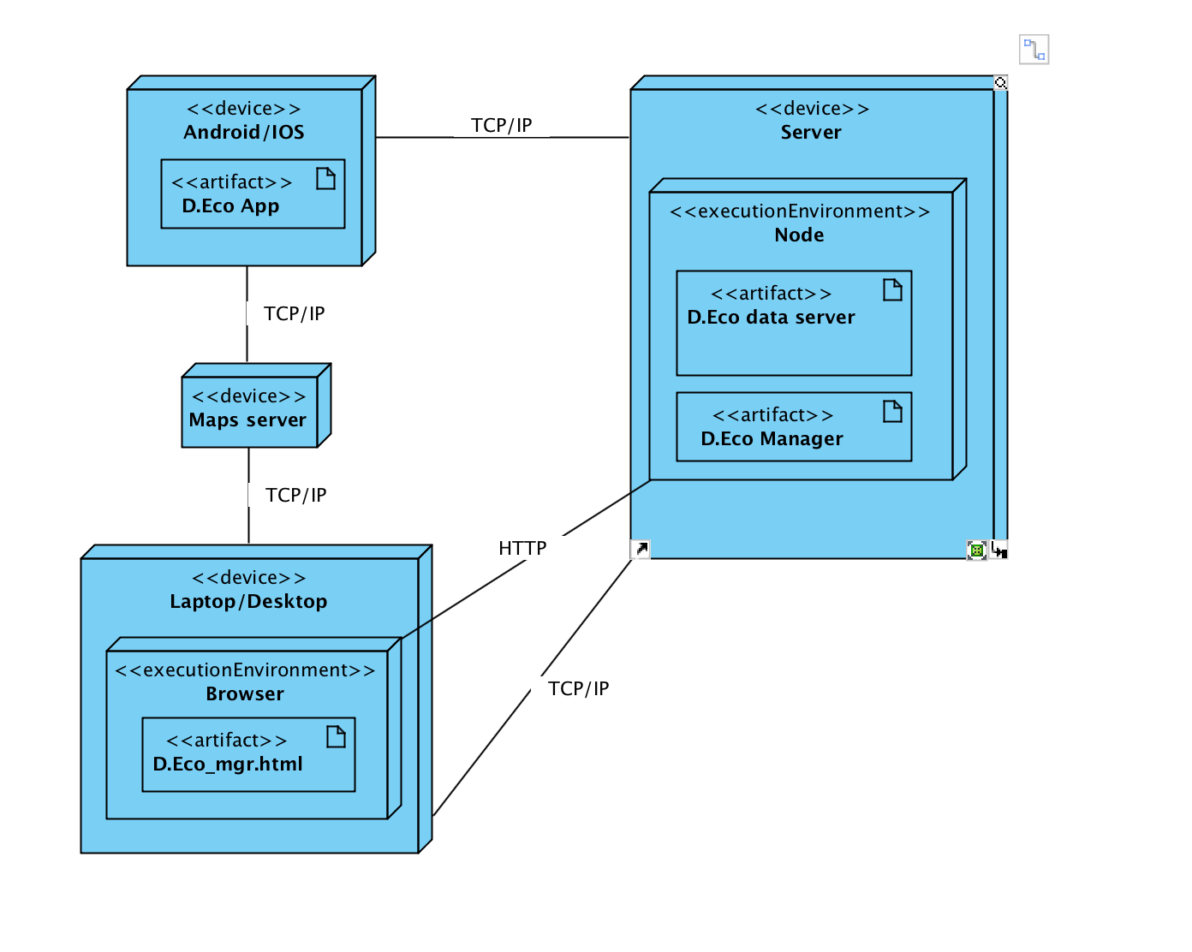
Initial Architecture
Code Monkey
April 5, 2017

Slide 11
Security Risk
Penetration Attacks
Denial of service
MITM Attack
SQL Injection
Code Monkey
April 5, 2017

Slide 12
Plan – Sprint 1 Elaboration
What | Who | When
Update communication diagram | Fiasal | 4/26/17
Create elaboration class diagram | Cory | 4/26/17
Update architecture in Elaboration | Kylie | 4/26/17
Code Monkey
April 5, 2017

Slide 13
Elaborating on the Elaboration Plan
Elaboration Architecture:
During elaboration, we will update the initial architecture to have a better documented architecture.
Create elaboration class diagram:
Work alongside teammates to create an accurate elaboration class diagram.
Updating the communication diagram:
Ensuring all communication is documented properly within the diagram.

