Slide 1

A Film Producer’s Choice:
“Which Genre Film Should I make?”
Given a certain Movie Star,
...which kind of movie has the highest chance of success?
Data From The Movie Database
Popularity measures
Revenue and Budget measures
How can producers predict SUCCE$$ ?

Slide 2




SHOW ME THE DATA !!!
Data Source Chosen: The Movie Database
https://www.themoviedb.org/
Good API -> make requests
Response comes in JSON-like data
Rate Limit of 40 requests/10 seconds
Statistics:
Popularity measure
Money: Revenue and Budget in $$$
Pipeline and clean data in PANDAS
Data filtereded of non-movie genres
Documentaries & TV Movies
Bad money data

Slide 3


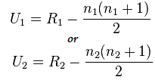
The MANN-WHITNEY U TEST
Non-parametric: Assumes no particular distribution
(hence median rather than mean)
Good for small sample sizes
Samples must be Independent
Ranks the observations & compares the sum of the ranks
Chosen becasue had limited # of movies per actor
Could not assume normal distribution
Results in p-value compared to alpha = .05
Where: n_{1,} n₂ is the sample size for sample 1 & 2
R is the sum of the ranks in sample n_{k}

Slide 4
Hypothesis Testing
General formats for hypotheses are: Given a certain actor...
H0- There is no difference in the success of a movie made in the chosen genre vs. a movie not made in that genre.
HA- There is a difference in the actor’s average(median) success of the chosen genre.
MERYL STREEP chosen Genre: Drama
H0-There is no difference in the success of Meryl Streep movies in the dramatic genre v. non-dramatic genres
HA-There is a difference in success rate for dramatic v. Non-dramatic movies that Meryl Streep has made

Slide 5
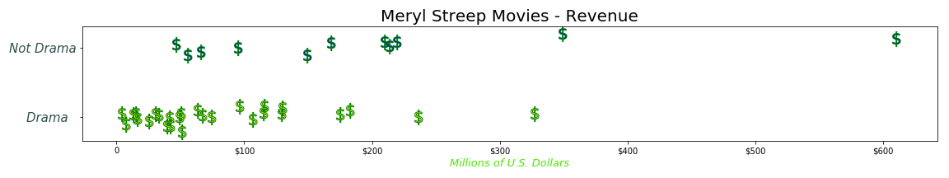
Results: Meryl Streep in Drama
Null Hypothesis- There is no difference in the REVENUE of Streep's movies in
Dramatic vs. non-dramatic categories.
Total Number of Comparisons: 297
Number of 'Not-in-Genre' Movie Wins: 232.0
Number of In Genre: Drama Movie Wins: 65.0
n1 = 27, n2 = 11
p-value for 'Not-in-Genre' Movie Revenue > Drama Movie Revenue: 0.004
Clearly, we can reject the null hypothesis and can state that Non-Dramatic Meryl Streep movies make more money than her Dramatic movies.

Slide 6
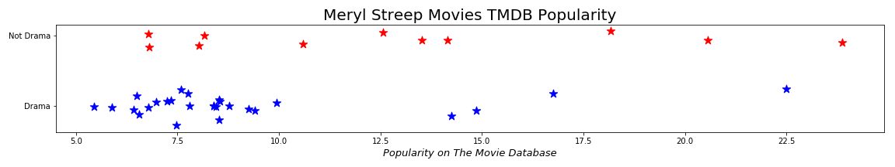
Results: Meryl Streep in Drama
Null Hypothesis- There is no difference in the POPULARITY of Streep's movies in
Dramatic vs. non-dramatic categories.
Total Number of Comparisons: 297
Number of 'Not-in-Genre' Movie Wins: 207.0
Number of In Genre: Drama Movie Wins: 90.0
n1 = 18, n2 = 10
p-value for 'Not-in-Genre' Movie Revenue > Drama Movie Revenue: 0.031
Clearly, we can reject the null hypothesis and can state that Non-Dramatic Meryl Streep movies are more popular than her Dramatic movies, at least for TMDB measures.

Slide 7
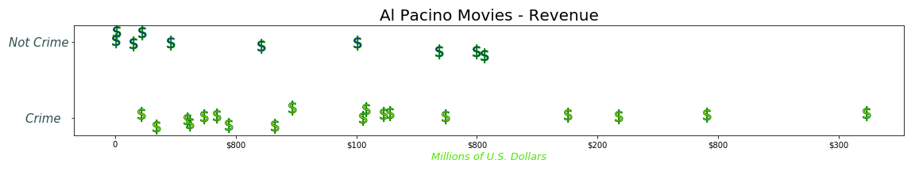
More Results: Al Pacino in Crime
Null Hypothesis- There is no difference in the REVENUE of Pacino's movies in
Crime vs. non-crime categories.
Total Number of Comparisons: 180
Number of 'Not-in-Genre' Movie Wins: 60.0
Number of In Genre: Crime Movie Wins: 120.0
n1 = 18, n2 = 18
p-value for 'Not-in-Genre' Movie Revenue > Crime Movie Revenue: 0.079
We CANNOT reject the null hypothesis and can state that we can’t conclude Non-Crime Al Pacino movies make more money than his Crime genre movies movies on TMDB.

Slide 8

Conclusions & Lessons Learned
Past movie success data CAN help producers predict success per genre
Using the U Test, small samples can be analyzed for prediction
Precise Data is better than not precise (Revenue v. Popularity)
API’s come with limits (rate and type of data - eg. really not JSON data)
SciPy Stats and Pandas make life more analyzable, if not easier
$$$….movie Stars make a ton of money, but perhaps not BIG DATA :)

