Slide 1

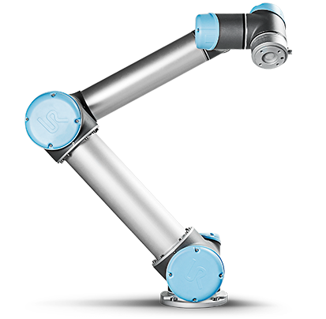


Capstone Code Review
Farah Alyasari
Project Background
_E_LO
[UR5 image source] https://www.universal-robots.com/products/ur5-robot/

Slide 2


UBUNTU
RESEARCHER
PLAYER
word
hint
SERVER
hint
word

Slide 3
UBUNTU
letters
RESEARCHER
guess
PLAYER
SERVER
hint request
hint request
guess
letters

Slide 4
UBUNTU
letters
word
guess
RESEARCHER
PLAYER
hint
hint
SERVER
hint request
hint request
letters
guess
word

Slide 5

Server
initial design choice = ask the server to do everything = big mistake
Parse request for specific information based on the request destination
Figure out the response destination based on the request payload
Sync the request and response based on expected end-user behavior
Result: High Data Coupling + Confusing Server Code
request
request
request
SERVER
response
request
response
request
response
response

Slide 6
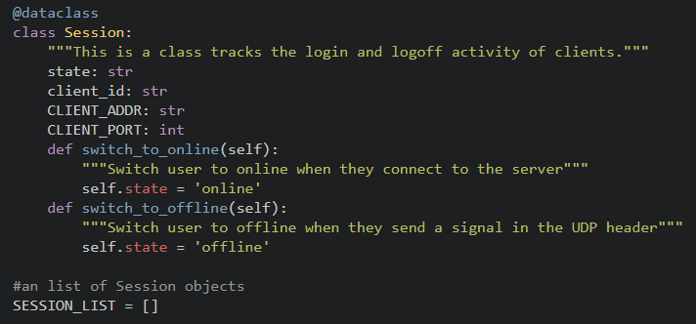
Server
Data Structures:
Session data class
Session list

Slide 7
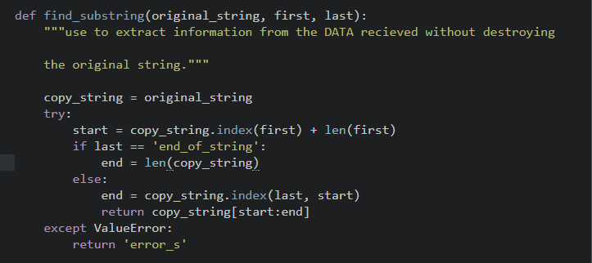
Server
Find sub string
UDP packet contains the following data: client->server#<IP>{port}(online)
Extract the client ID
find_substring(data, “<“, “>”)
Index of < is 17
Length of < is 1
Index of > is 20
Length of > is 1
The first index of > is 20
Extract from index 17 to 20
return IP

Slide 8
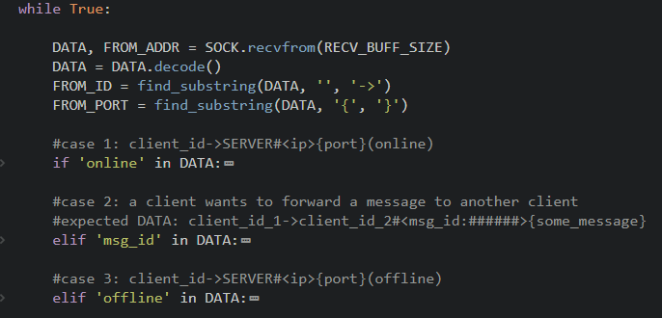
Server
Server has 3 jobs:
Switch client to online
Switch client to offline
Given a UDP header: forward the packet “from” client “to” another client

Slide 9
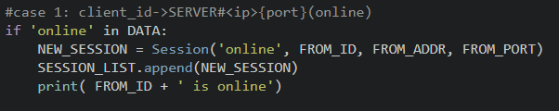
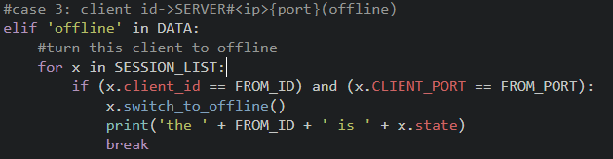
Server
Set client to online
Send UDP packets to online clients only
Switch client offline
Keep previous sessions after they are switched to offline

Slide 10
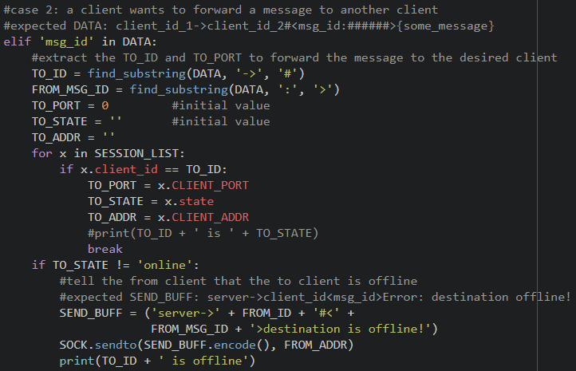
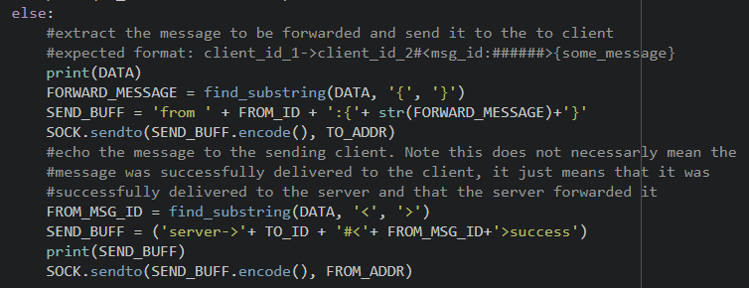
Server
Forward Messages
Server is not concerned with the content of the message
Sender Client must specify who where they want the message to be sent
Send success acknowledgment to sender
Send failure alert to the sender

Slide 11
UBUNTU
RESEARCHER
PLAYER
word
hint
SERVER
hint
word

Slide 12
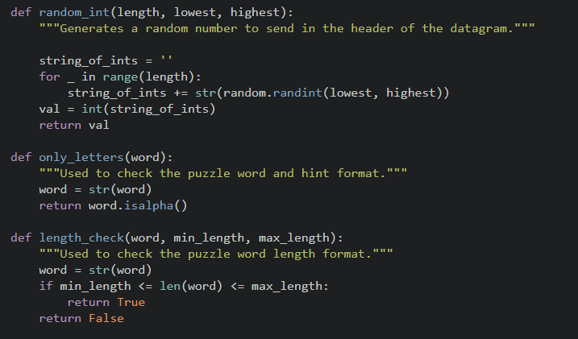
Common to all Clients
Methods:
Find substring
Random int
Only letters
Length Check

Slide 13
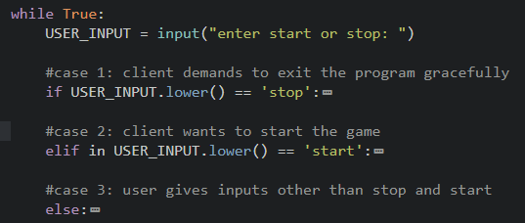
Researcher
Structure:
Start the game
Stop the game
Handle Unexpected input

Slide 14
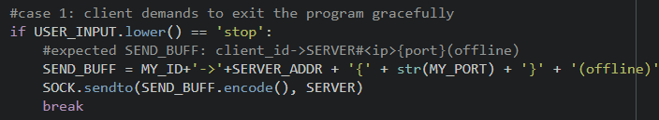

Researcher
Stop the game and handle unexpected inputs

Slide 15
Researcher
Start the Game
Show game instructions
Check bad puzzle word format
Send puzzle word to player through server
Handle packets containing a guess
Handle packets containing a hint
Check hint format with hint instructions
Success acknowledgment
When a guess is correct go back to the initial state

Slide 16
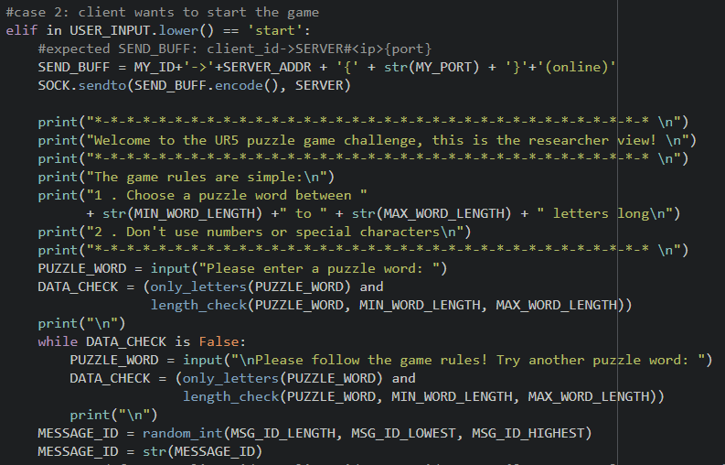
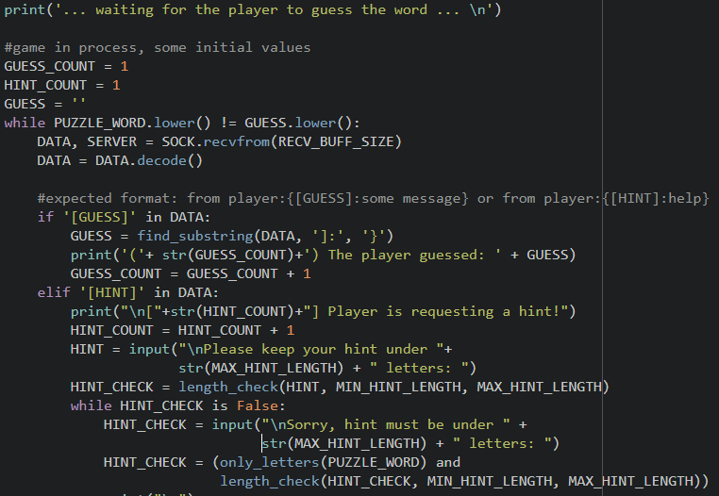
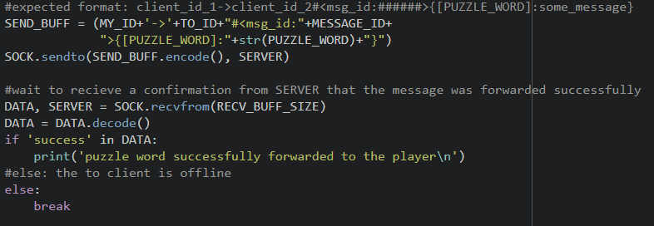
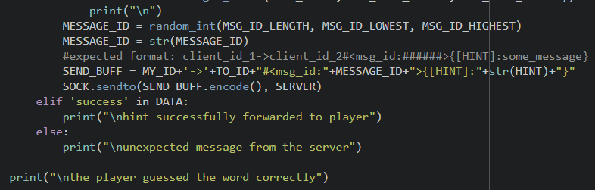

Slide 17
UBUNTU
letters
RESEARCHER
guess
PLAYER
SERVER
hint request
hint request
guess
letters

Slide 18
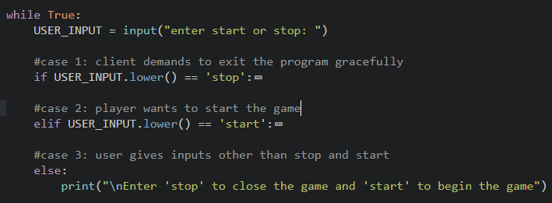
Capstone Code Review
Farah Alyasari
Player
Structure:
Start the game
Stop the game
Handle Unexpected input

Slide 19
Player
Stop the game and handle unexpected inputs

Slide 20
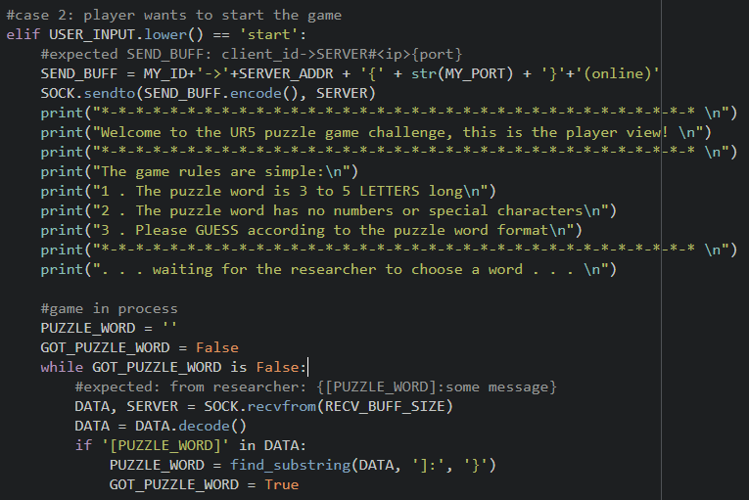
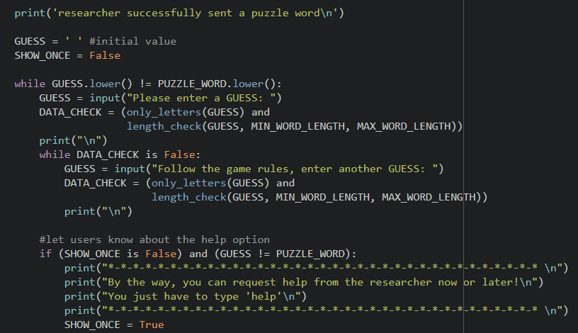
Player
Start the Game
Show game instructions
Let user know about the hint option
Check bad guess format
Get the correct puzzle word

Slide 21
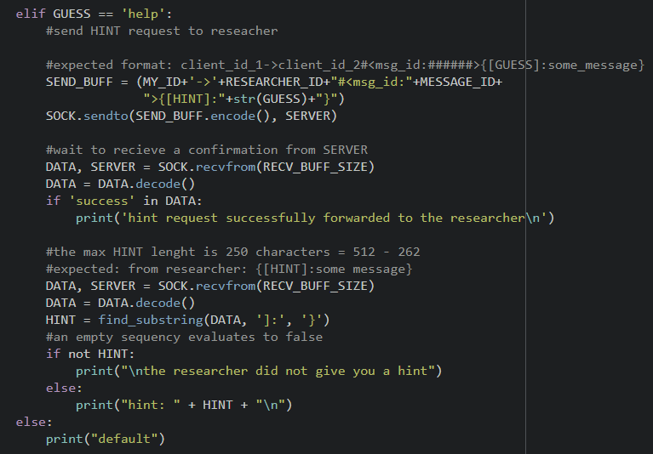
Player
Start the Game – continued
Send correct letters to Ubuntu
Show correct letters to player
Player has a choice to keep guessing or ask for help

Slide 22
Player
Start the Game – continued
Check ‘help’ option
Send hint requests
Handle packets containing a hint request
Researcher does not want to give a hint
Researcher gives a hint
Success acknowledgment
Go back to the initial state when player guesses correctly

Slide 23
UBUNTU
letters
RESEARCHER
guess
PLAYER
SERVER
hint request
hint request
guess
letters

Slide 24
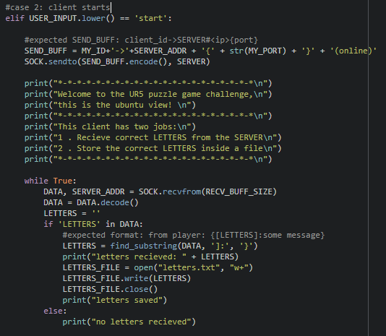
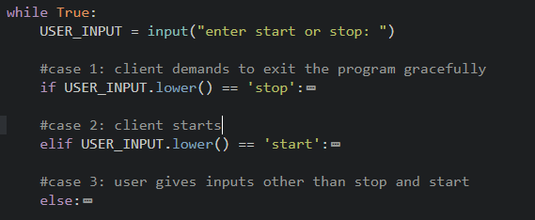
Ubuntu
Start the client

Slide 25
Software Metrics
Analysis done using codacy
Issues | Server | Researcher | Player | Ubuntu
Security | 1 | 1 | 1 | 1
Error Prone | 0 | 0 | 0 | 0
Code Style | 0 | 0 | 0 | 0
Compatibility | 0 | 0 | 0 | 0
Unused Code | 0 | 0 | 0 | 0
Performance | 0 | 0 | 0 | 0
The server and the clients use a line of code which is not safe for cryptography reasons

Slide 26
Software Metrics
Analysis done using Pylint and codefactor
Metric | Server | Researcher | Player | Ubuntu
Rating for PEP 8 Standards | 9.86 / 10 | 9.9 / 10 | 9.53 / 10 | 9.82 / 10
Lines of Code (LOC) | 85 | 122 | 146 | 63
Lines | 116 | 157 | 205 | 86
Complexity | codefactor did not give this value | 8 | 12 | 5
Complexity Per Method | codefactor did not give this value | 2 | 2.4 | 2.5

Slide 27
Thank you

