Slide 1

Molecular dynamics simulations
– theory and method review
or
How to move around the atoms?
SH3141 - Multi-scale modelling of nuclear materials

Slide 2
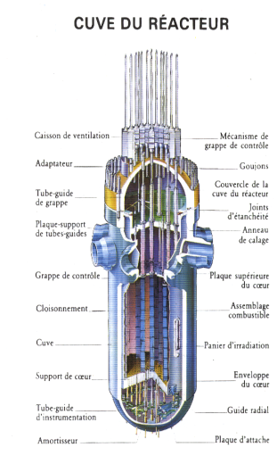
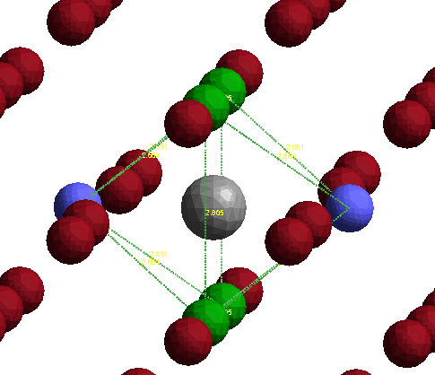
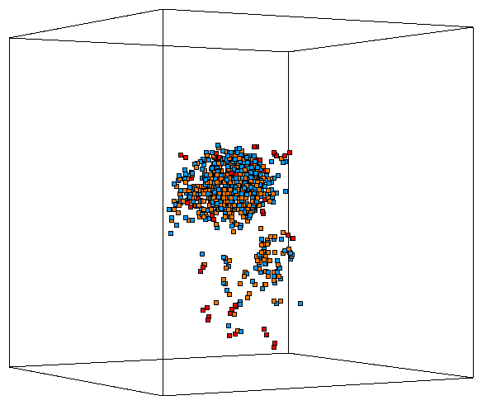
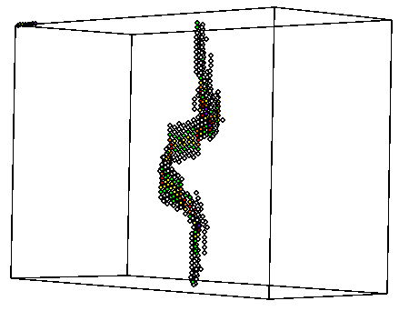

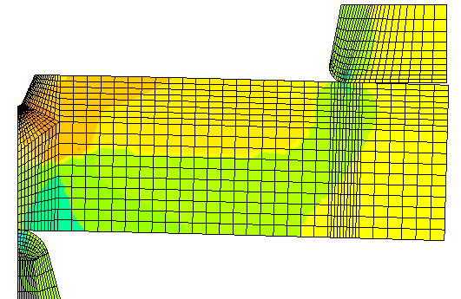
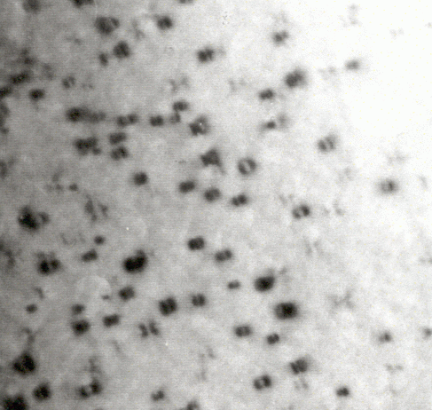
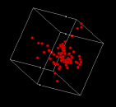
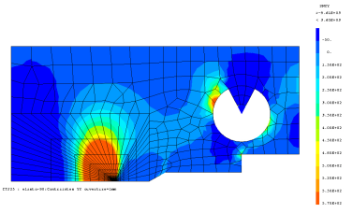
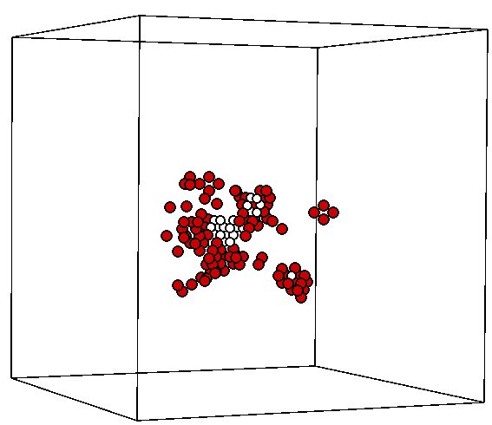

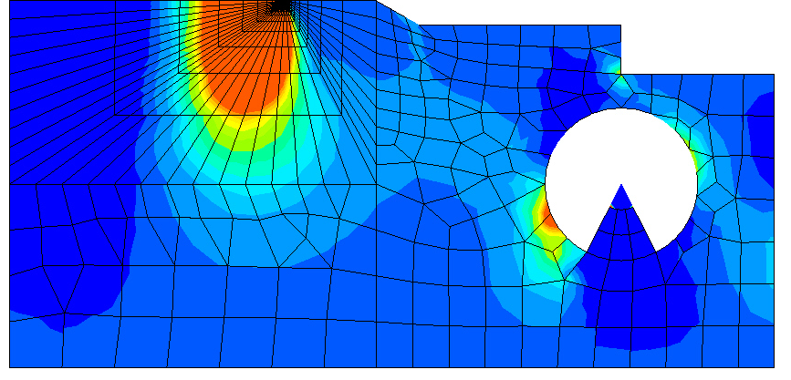
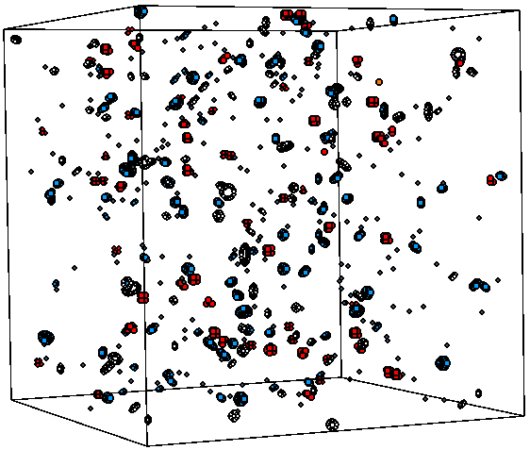
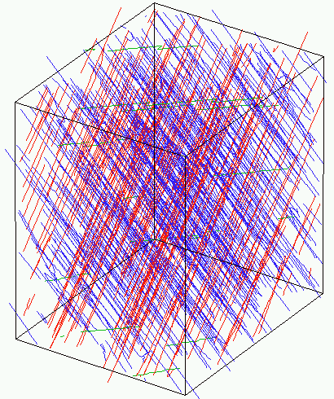
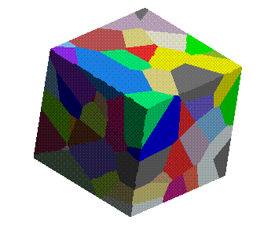
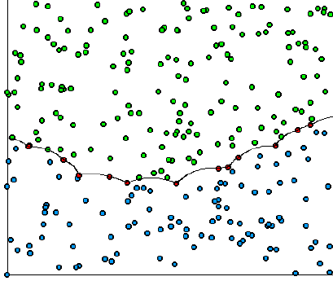

Multi-scale modelling
1nm³
0 - ps
(10-30nm)³
ns
ab initio
Molecular dynamics
m³
40 years
Multi-scale
modelling
+ experimental validation
Finite elements
s - h
cm³
Barbu, CEA
Pareige, U. Rouen
Micro-macro
(30-100nm)³
h-year
µm³
Mesoscopic
SH3141 - Multi-scale modelling of nuclear materials
Dislocation dynamics

Slide 3


The structure of condensed matter
Electronic part
Schrödinger equation
The Hamiltonian
Electrons vs ions:
Electron mass << ion mass
Electrons ”see” ions as fixed particles.
Ions ”see” electrons as a fixed potential surface.
Ionic part
Mixed term
Life according to electrons
Life according to ions
SH3141 - Multi-scale modelling of nuclear materials

Slide 4
History
The basic idea of molecular dynamics (MD) simulations is to calculate how a system of particles evolves in time.
* A little bit of history: why “molecular”?
- The method was first used with a realistic potential by Alder and Wainwright in 1959 to calculate the vibrations of atoms in molecules. The name stuck, unfortunately
* There is an interesting parallel to classical mechanics here. The two-body motion problem was solved by Newton way back then. The three-body problem was solved by a Finnish guy called Sundman in the early part of the last (20th) century - but the solution is utterly impractical.
* The N-body problem, N>3, can not be solved analytically. MD can be described as a numerical way of solving the N-body problem. The solution is of course never exact, but if done properly it can be solved with arbitrary precision.
SH3141 - Multi-scale modelling of nuclear materials

Slide 5
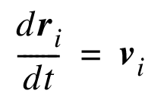
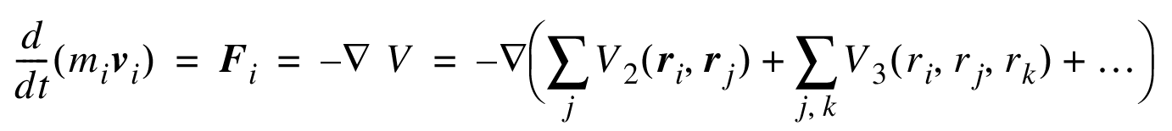
MD basics
Consider a set of atoms at positions r_{i} and some interaction model which gives us the potential energy of the system V(r_{i})
In Newtonian mechanics we then get:
By solving the above set of equations numerically we can derive dr over some short time interval dt
SH3141 - Multi-scale modelling of nuclear materials

Slide 6
The interatomic potential
The physics of an MD simulation is thus completely dependent on the interatomic potential V({r}) used.
Different levels of precision/predictability:
Ab initio MD – forces are directly given by ab initio calculations: Hellmann-Feynman theorem. Precise but slow!
Classical MD – the true electronic interactions are approximated by an interatomc potential, using some functional form, fitted to ab initio and experimental data. Low transferability but fast!
SH3141 - Multi-scale modelling of nuclear materials

Slide 7
Interatomic potentials for classical MD
The great interest of classical MD simulations is that they are orders of magnitude faster than MD DFT simulations.
Different models for the physics of the interactions exist, most based on DFT and/or band theory:
Pair potentials (very simple but unrealistic, esp. for metals!)
Tight binding (motivated by band theory, 2nd moment approx.)
Embedded atom method (pair repulsion + binding from density )
Bond order (beautiful concept, tricky implementation)
SH3141 - Multi-scale modelling of nuclear materials

Slide 8
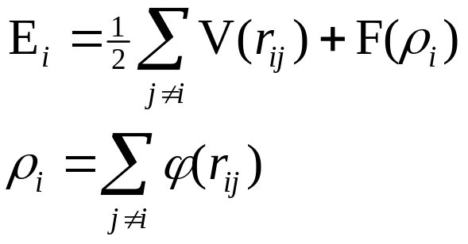
Interatomic potentials: Embedded Atom Method
Mathematical functions of the interatomic distances (sometimes angles between triplets too) with parameters fitted to reproduce a number of fundamental physical properties (e.g. lattice parameter, elastic constants, defect energies, …) for the studied material
Many formalisms exist; most widespread for metals is the so-called embedded-atom method (EAM)
Energy of atom i
Embedding function: translates effect of the “sea of electrons” in which atoms are immersed in a metal
Pairwise contribution
Local electron density
Sum of pariwise density functions, giving the contribution of each atom j to the electronic density around atom i
Pure element → 3 functions to fit
Binary alloy → 9 functions: V_{AA}, V_{BB}, V_{AB}, F_{A}, F_{B}, ϕ_{AA}, ϕ_{BB}, ϕ_{AB}, ϕ_{BA}
…

Slide 9
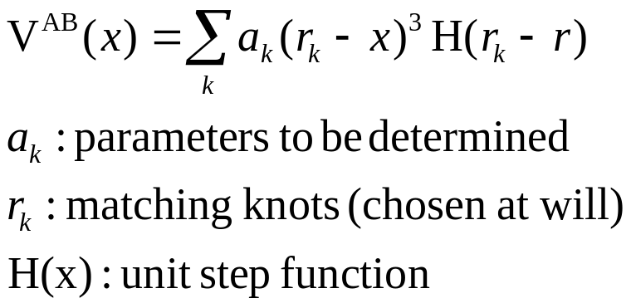
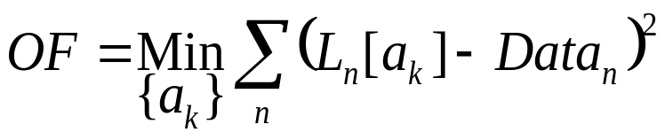
Fitting interatomic potentials
Example: pairwise potential for an A-B alloy, V^{AB}, written as a piecewise cubic polynomial
Linear equations in the energy translate into linear equations in the parameters, L_{n}[a_{k}]
The potential parameters, a_{k} , are found by minimizing the sum of squared deviations between data (from experiment, ab-initio, etc) and corresponding energy-related expressions (so-called objective function, OF):

Slide 10
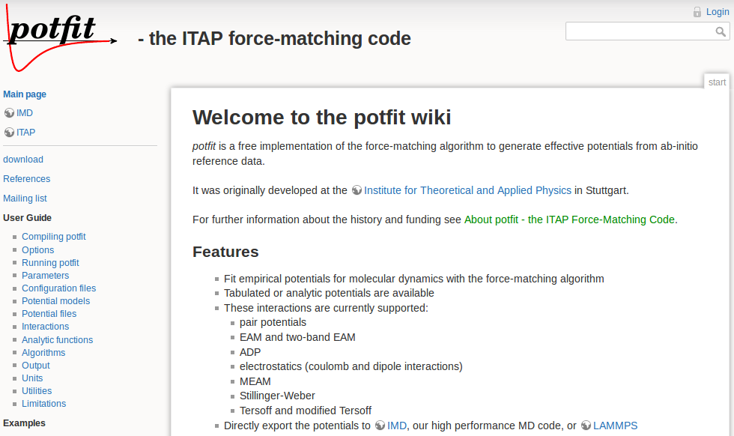
Automated fitting procedures: e.g. potfit

Slide 11
Schematic MD (simplified)
Set initial conditions r_{i}(t₀) and v_{i}(t₀)
Get new forces F_{i}(r_{i})
Solve the equations of motion
r_{i}(t_{n}) → r_{i}(t_{n+1})
numerically over a short step Δt
v_{i}(t_{n}) → v_{i}(t_{n+1})
t = t + Δt
Get desired physical quantities
No
Is t>t_{max}?
Yes
Calculate results and finish
SH3141 - Multi-scale modelling of nuclear materials

Slide 12
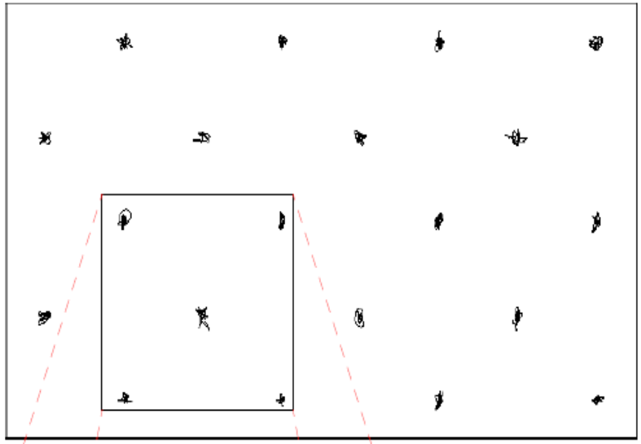
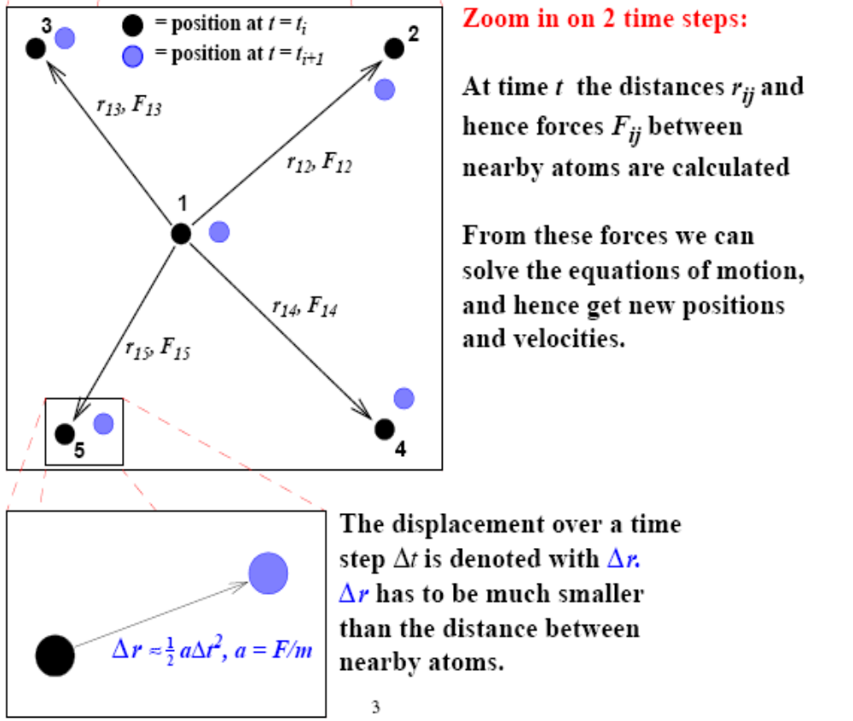
Example
MD-simulation of thermal motion over 100 time steps
SH3141 - Multi-scale modelling of nuclear materials

Slide 13
General considerations
The above was the simplest possible example, the so called microcanonical or NVE ensemble. This means that the approach preserves the number of atoms N, the volume of the system V and the energy E. The NVE ensemble is the true solution of the N-body problem, and corresponds to the real atom motion.
* The possible size of the system for MD (2014):
- N < 10¹² atoms
* First MD simulation:
- B. J. Alder, T. E. Wainwright: Phase transition for a Hard Sphere-System, J. Chem. Phys. 27 (1957) 1208
* If all N atoms interact with all the other atoms, one has to in principle calculate N² interactions. This is prohibitively computationally expensive for millions of atoms.
* Fortunately in practice most atomic interactions decrease rapidly in strength as r→ ∞ . In that case it is enough to calculate only interactions to nearby atoms.
SH3141 - Multi-scale modelling of nuclear materials

Slide 14
Range and locality
- E.g. in diamond-structured semiconductors (Si, Ge, GaAs...) atoms have 4 covalent bonds, so the calculation can be reduced to 4 neighbours ⇒ 4N interactions.
- In metals, atoms more than ~ 5 Å away can usually be neglected ⇒ about 80 N interactions
- In ionic systems the interaction ~ 1/r, i.e. decreases very slowly. It can not be cut off, but there are ways to handle the long range interactions efficiently: Ewald summation and multipole field expansion
SH3141 - Multi-scale modelling of nuclear materials

Slide 15

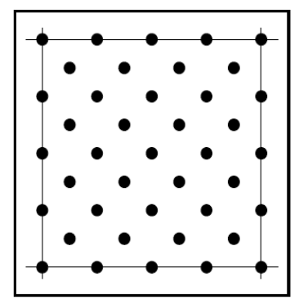
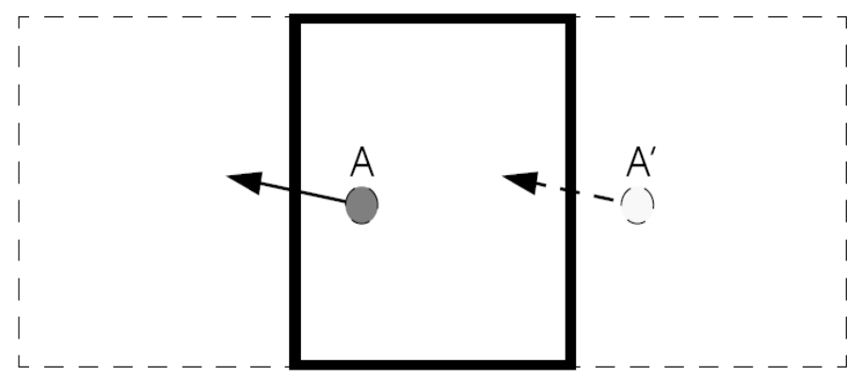
Simulation boxes
Free surfaces:
Sometimes useful, but not good for bulk simulations!
Fixed surfaces:
Unphysical!
Not recommended
Periodic boundary conditions:
Very useful for bulk simulations.
Have to be aware of image interactions!
SH3141 - Multi-scale modelling of nuclear materials

Slide 16
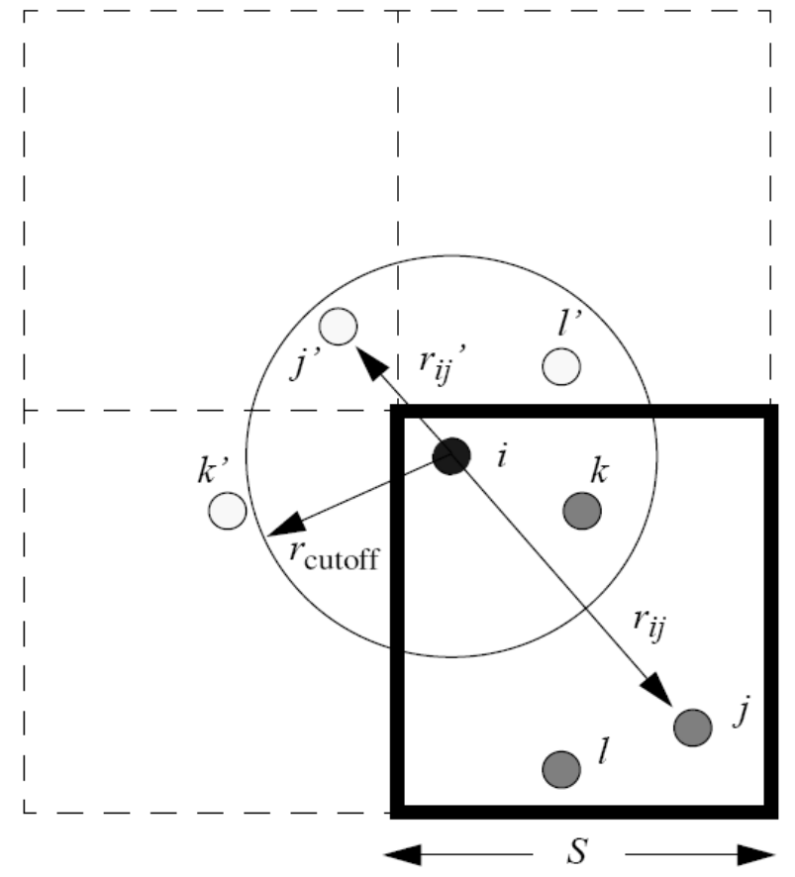
Implementing PBC
Distance calculations have to take image cells into account.
Atoms leaving the box on one side comes back on the other.
SH3141 - Multi-scale modelling of nuclear materials

Slide 17
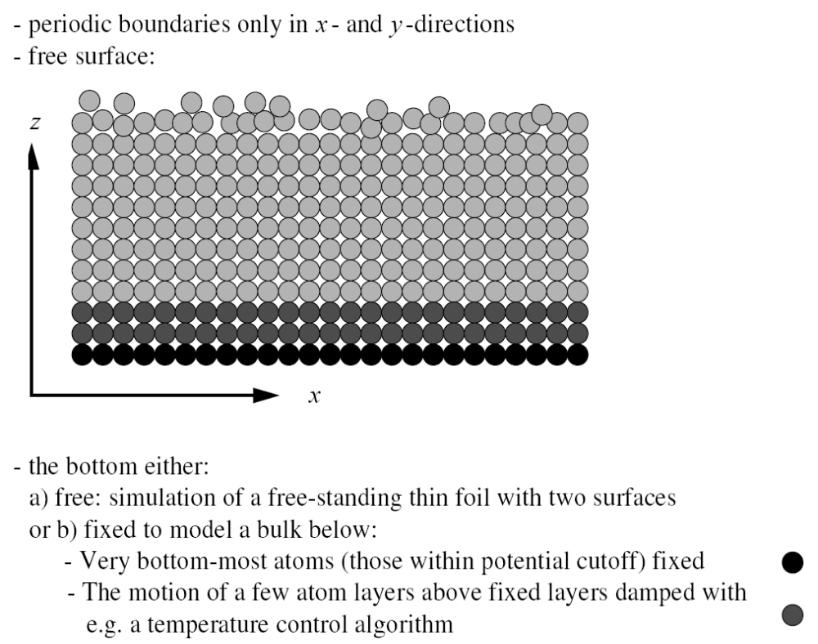
Surface simulation
SH3141 - Multi-scale modelling of nuclear materials

Slide 18
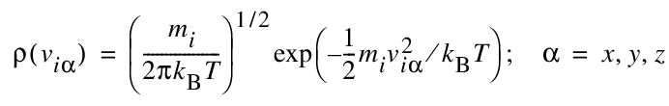
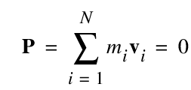
Finite temperature simulations
Most MD simulations are done at finite temperatures. For 0K properties, often DFT is fast enough.
The desired starting temperature of a solid can be defined using a Maxwell-Boltzmann distribution (formally for gases).
Pick randomly for each atom a velocity from the distribution:
In order to avoid simulation cell drift, make sure the total momentum is zero:
SH3141 - Multi-scale modelling of nuclear materials

Slide 19
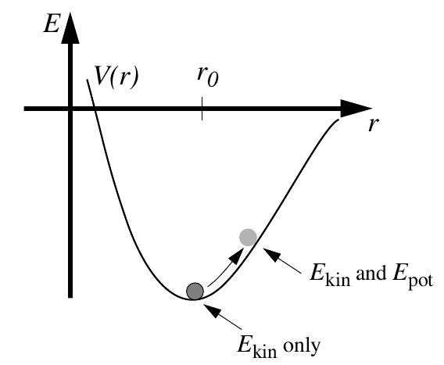
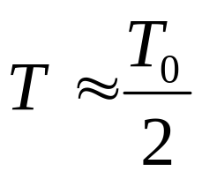
Finite temperature simulations
The initial temperature should be started at about twice the desired simulation temperature, if the simulation is started from perfect atom lattice sites.
Half of the initial kinetic energy will be changed to potential energy after a while due to the equipartition theorem of energy.
SH3141 - Multi-scale modelling of nuclear materials

Slide 20

Choosing a time step
The MD time step should be short enough to be physically correct, but at the same time as long as possible.
A practical, but very rough rule-of-thumb: the atoms should not move more than 1/20 of the nearest-neighbour distance during one time step.
Since atom velocities in average are given by Maxwell-Boltzmann, we can estimate a realistic time step:
But the distribution extends much beyond this (not necessarily to infinity in perfect solids, though).
- Rough estimate of the time step needed: 300 K Cu (m=63.55 u):
5 v_{rms} = 0.017 Å/fs.
Nearest-neighbour distance 2.55 Å ⇒ Δt = (2.55/20)/0.017 = 7 fs.
Thus, for reasons of stability, a Δt of about 5 fs should be safe.
SH3141 - Multi-scale modelling of nuclear materials

Slide 21
Simulation time limit
In practise, very few simulations (of interest) will be stable using time steps longer than 10 fs. This is the main limitation of MD. If we want to simulate a process which, say, takes 1 s, we would need at least 10¹⁴ time steps!
This gives an easy way to estimate the order of magnitude of the upper limit for the time scale MD can handle in a given time:
- Most realistic classical MD interatomic potentials require of the order of 100 flops/atom/time step.
- Say our time step is 1 fs, and we want to simulate a 10000 atom system.
- Hence we need 10⁶ flops/time step. To get to 1 ns = 10⁹ fs we would need
10¹⁵ flops. On a typical (AD 2008) ~ 1 Gflop/s processor, the simulation
would thus require 10¹⁵/10⁹ seconds = 10⁶ s i.e. about 11 days. To get to
1 μs would require some 30 years on this processor.
* Hence we see that in practical use ordinary MD is restricted to <~ 100 ns processes.
SH3141 - Multi-scale modelling of nuclear materials

Slide 22
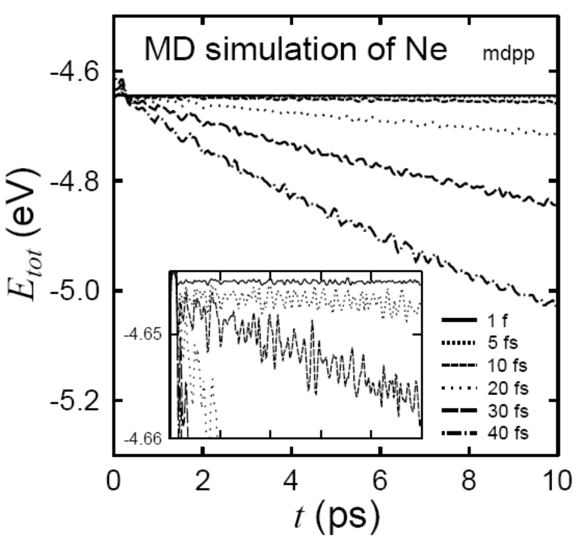
Time step testing
What happens when the time step is too long?
The atoms may move over barriers they normally should not be able to penetrate.
Energy is not conserved!
Hence the real criterion for selecting the time step becomes energy conservation.
For every new system/potential/process/material, some test simulations should be performed to check energy conservation.
30 K
SH3141 - Multi-scale modelling of nuclear materials

Slide 23
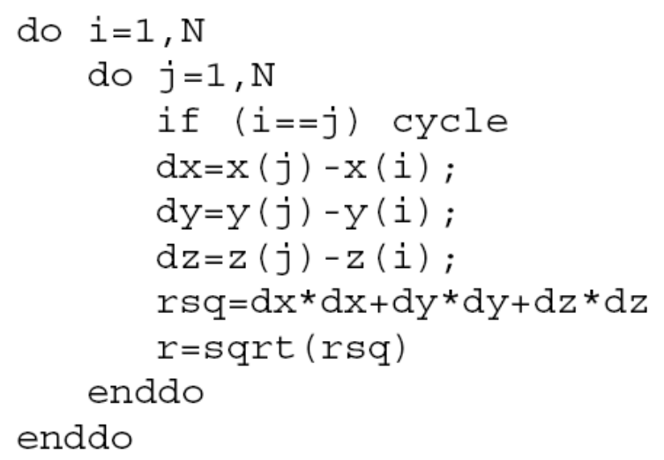
Neighbour lists
In MD simulations (and actually many other applications) one of the central operations is the distances between atoms. In MD this is needed in the force calculation
Trivial calculation of distances between atoms:
This algorithm is O(N²), i.e. very slow when N → ∞
But, since most atoms move a very short distance during each time step, we can avoid the brute force method.
SH3141 - Multi-scale modelling of nuclear materials

Slide 24
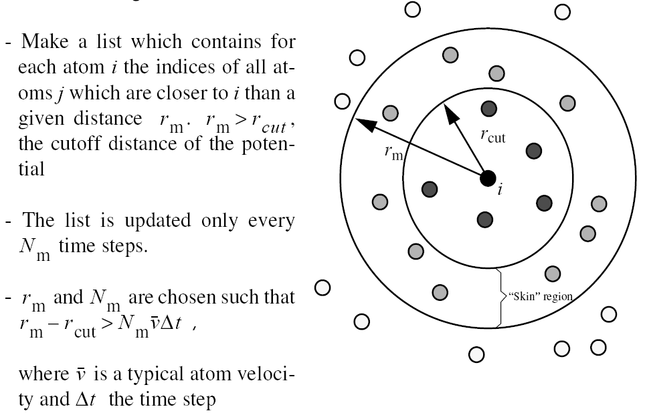
Verlet neighbour list
SH3141 - Multi-scale modelling of nuclear materials

Slide 25
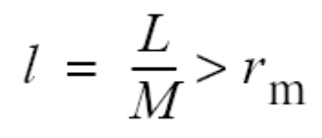
Linked lists
But even using the neighbour list, our algorithm is still O(N²). When N is growing, at some point creating the neighbour list will take a substantial fraction of the total simulation time.
Using a linked list and cellular division of the simulation cell, we can make the algorithm truly O(N):
- Divide the MD cell into smaller subcells: M x M x M cells.
- The size of one subcell l is chosen so that
where L is the length of the MD cell, and r_{m} is as above.
- Now when we look for neighbours of atom i we only have to look through the subcell where i is, and its neighbouring subcells, but not the whole simulation cell!
SH3141 - Multi-scale modelling of nuclear materials

Slide 26
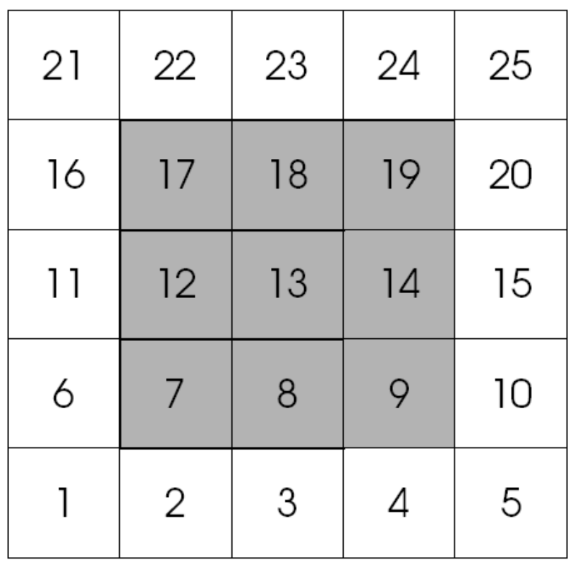
Linked lists
For instance if atom i is in cell 13:
The average number of atoms in a subcell is N_{c} = N / M ³ .
⇒ We have to go through 27NN_{c} atom pairs instead of N(N – 1).
SH3141 - Multi-scale modelling of nuclear materials

Slide 27
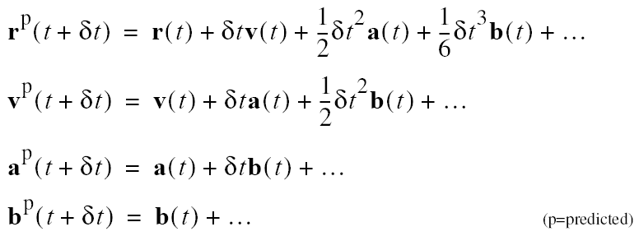
Solving the equations of motion
The intuitive r_{i+1} = r_{i} + v_{i}Δt algorithm is way to simple. Need to get better precision. Use a predictor/corrector scheme of some kind
Prediction:
where a is the acceleration and b is the time derivative of the acceleration.
Correction: From the predicted force, get a^{c}(t+δt)
Now take difference in acceleration as correction factor
Δa(t+δt)= a^{c}(t+δt) – a^{p}(t+δt)
SH3141 - Multi-scale modelling of nuclear materials

Slide 28
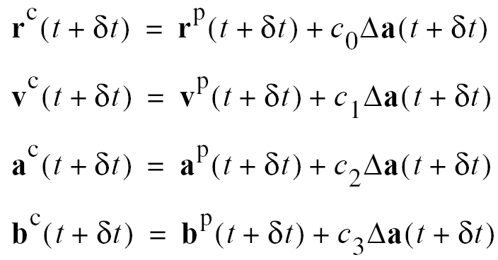
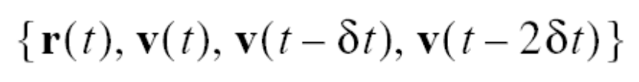
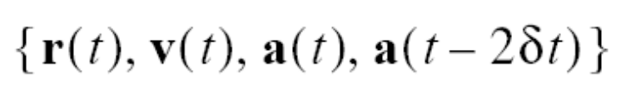
Solving the equations of motion
Take this difference and use it to correct the positions, velocities, etc.
The constants c_{i} depend on how many derivatives of we include and the degree of the equation, etc.
Instead of b, information from previous time steps can be used.
or
SH3141 - Multi-scale modelling of nuclear materials

Slide 29
Predictor-corrector algorithm
Thus we reach the following predictor-corrector approach to solving the MD equations of motion:
1) Predict r, v and a for the time t+δt using the present values of the same variables
2) calculate forces and hence a = f/m from the new r
3) correct the predicted r, v and a etc. using the new a
Examples: Velocity Verlet, Gear, etc
SH3141 - Multi-scale modelling of nuclear materials

Slide 30
Temperature control
It is often desired to control the temperature of the simulation, e.g. when simulating contact with a thermal bath.
Trivial temperature scaling/Berendsen scaling:
force system temperature to T at every time step (not a true thermodynamic NVT ensemble as it takes away temperature fluctutations). In the Berendsen method, a time constant softening is introduced.
Andersen method:
give each atom, with some probability, a new velocity which corresponds to a heat bath temperature T₀. Ok for TD ensembles but questionable for studying processes and kinetics.
Nosé-Hoover method:
introduce a fictional degree of freedom s which adds its own kinetic and potential energy to the Hamiltonian. Solve wrt s using a fictional mass parameter that dampens the temperature.
SH3141 - Multi-scale modelling of nuclear materials

Slide 31
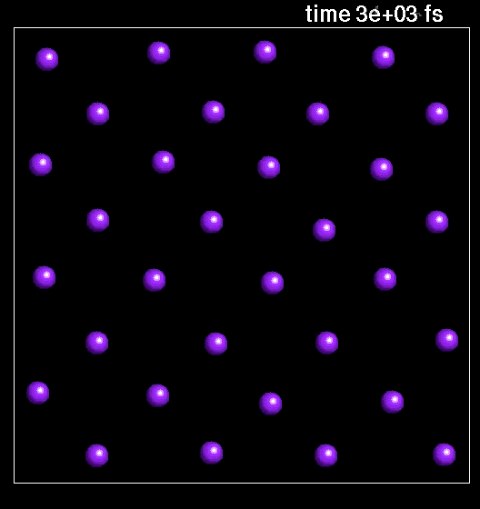
The simplest molecular dynamics simulation

Slide 32
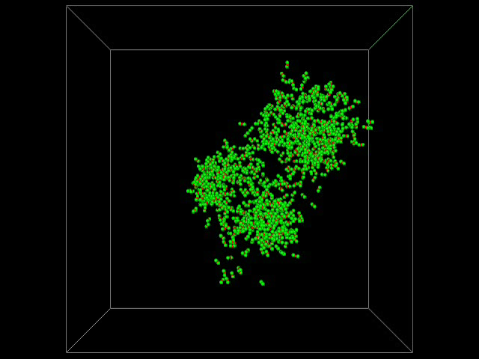
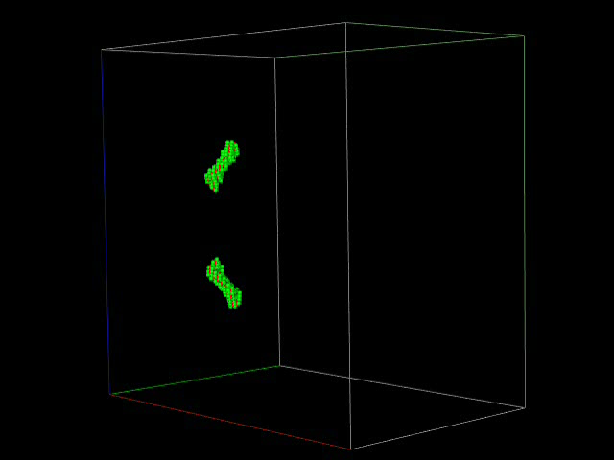
Applications of MD for irradiation problems
20 keV cascade (peak time) in Fe
MD is the technique “par excellence” for displacement cascade simulations:
  one atom is given kinetic energy
  the dynamic evolution of the system is followed
MD also allows stability and mobility of (fast enough) defects to be studied
Finally, MD can be used to model the interaction between dislocations and defects

Slide 33
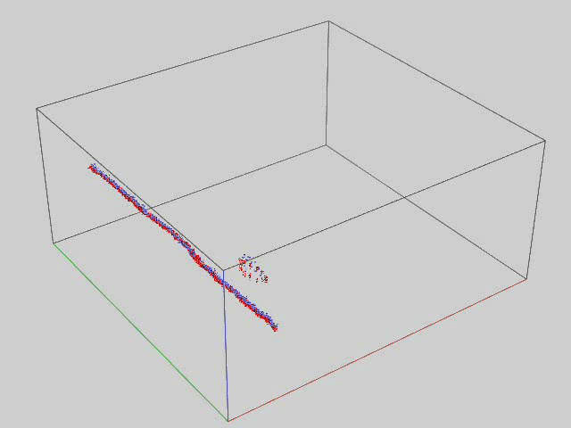
Interaction edge dislocation / prismatic loop
Edge dislocation interacting with SIA loop at 600 K

Slide 34
Pros & Cons of MD
Advantages
  Wide applicability (bulk, surfaces, crystals, amorphous, liquids, ...)
  No analytical simplifications or approximations
  Treats spontaneously complex systems and phenomena at equilibrium or far from it, not accessible to analytical approaches
Limitations
  Evolution of the system calculated by timesteps of ~1 femtosecond
  Limited timescale (tens of nanoseconds, trade-off size/time)
  Limited volumes (normally up to 10⁷ atoms): not big enough for e.g. extended defects
  All the physics is contained in the interatomic potential

Slide 35
Classical MD capabilities
What can we use classical MD for?
Reproduce reliable energies – YES
Predict reliable energies – NO
Reproduce mechanisms and correlations – YES
Predict unexpected mechanisms – YES
Fit what you need –don’t aim for transferability
SH3141 - Multi-scale modelling of nuclear materials

Slide 36
Role of MD in multiscale modelling
• Identifying important processes
• Correlations
• Transformation mechanisms
• Trial defect geometries
• Key configurations for fitting to potential
• Cannot get accurate energies from extrapolation – these come from ab initio
SH3141 - Multi-scale modelling of nuclear materials

Slide 37
Bibliography
  Allen, Tildesley: "Computer simulation of Liquids" (Oxford University Press, Oxford, England, 1989)
  A. Leach: "Molecular Modelling: Principles and Applications" (Prentice Hall, 2001)
SH3141 - Multi-scale modelling of nuclear materials

