Slide 1
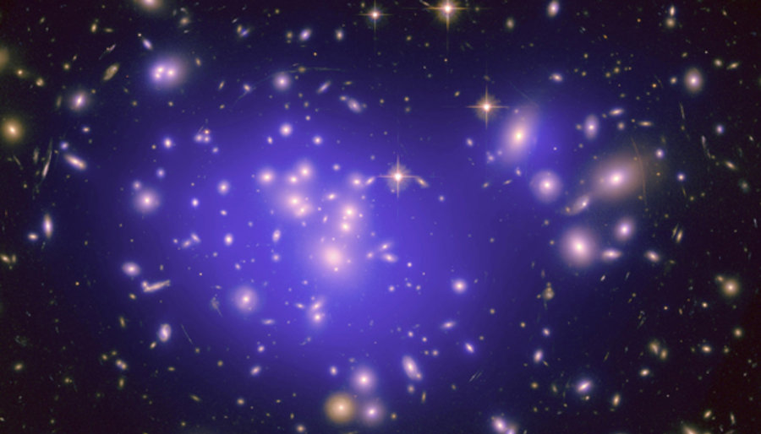
Introduction to Dark Matter:
History & Astrophysical Evidences

Slide 2

Overview
Why do we talk about dark matter i.e. what are the evidences for Dark Matter existence?
What do we think Dark matter is?
What is the role of Dark Matter in the evolution of the Universe?
How can we search for Dark Matter?

Slide 3
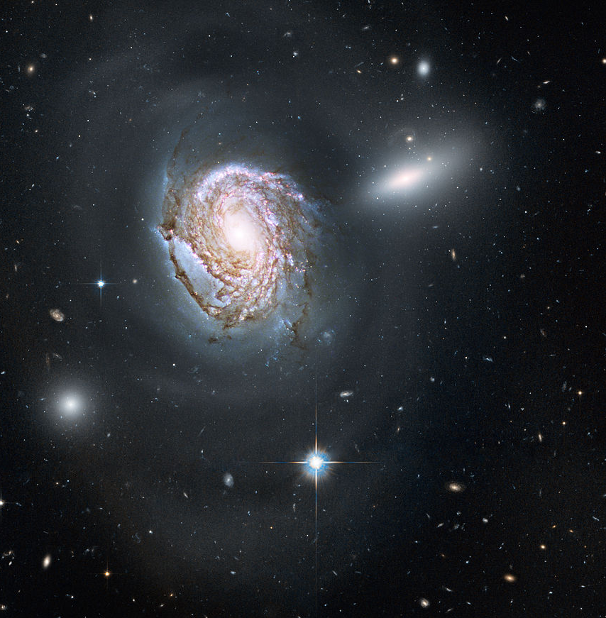
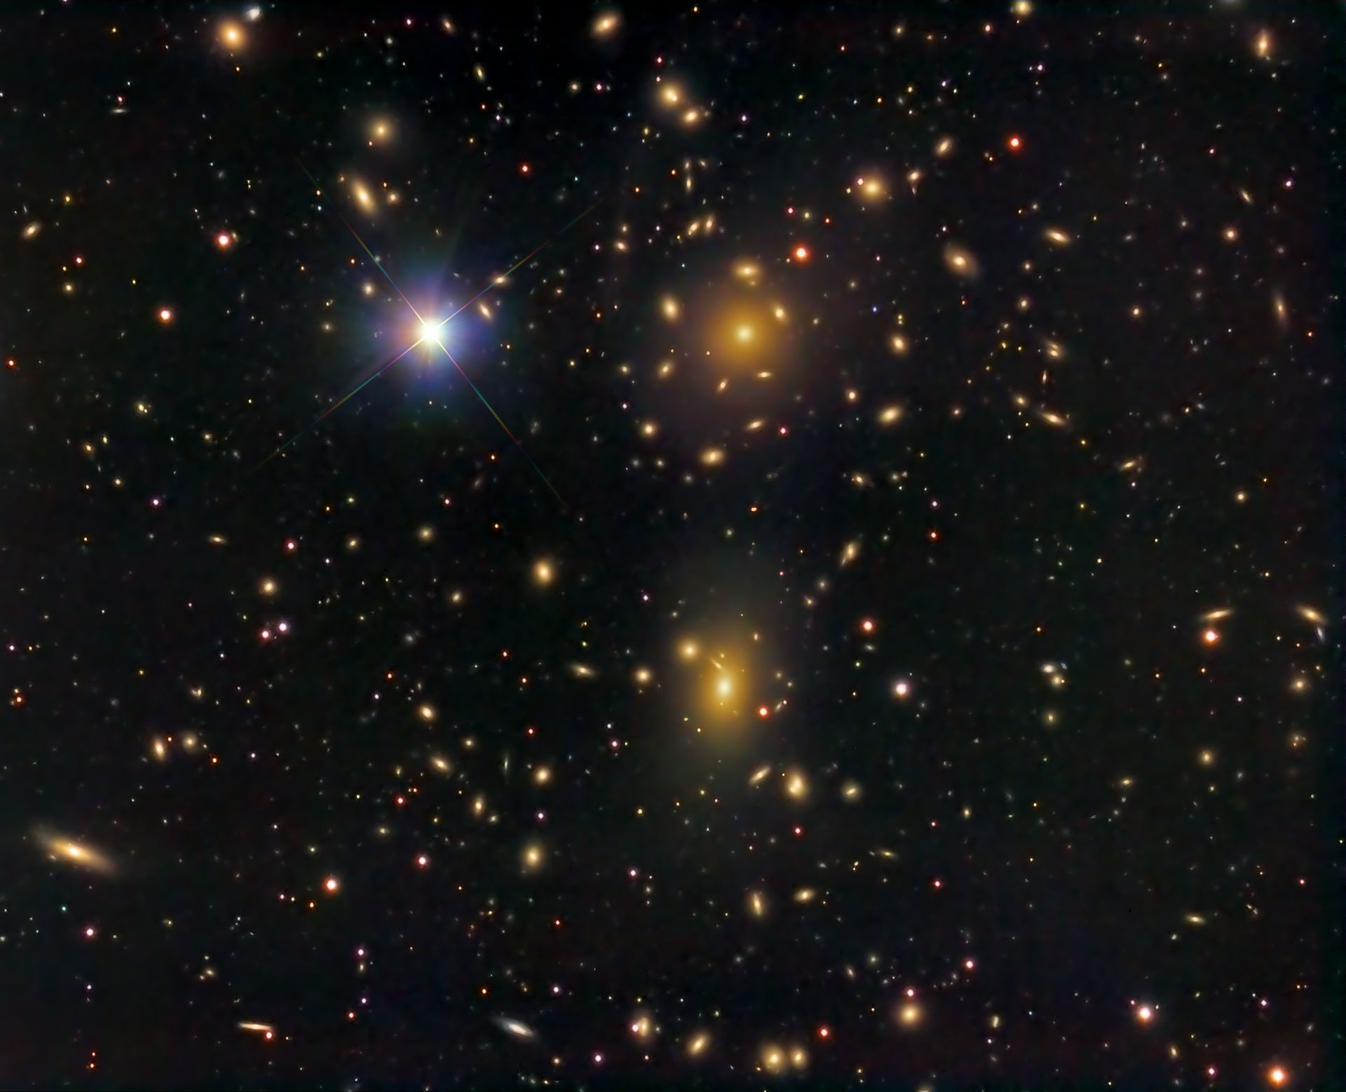
http://hosting.astro.cornell.edu/academics/courses/astro201/vt.htm
Introduction: An Astrophysical Puzzle
https://arxiv.org/pdf/1605.04909.pdf
Dark Matter is a building block of modern Cosmology and of the LambdaCDM model
Pioneer of DM studies: the Swiss-American astronomer Fritz Zwicky (1933)
He studied the velocity dispersion of galaxies inside the Coma cluster (a large cluster of galaxies with more than 1,000 identified galaxies) and found a gravitational anomaly
He was the first to use the virial theorem to determine the mass of a galaxy cluster
He estimated the total mass Mtot of Coma as
    Mtot = 800 * <m>
    where <m>=10⁹Mo is the average mass of the galaxies
    in a radius of the system equal to 10⁶ light-years
He calculated the potential energy, the average kinetic energy, applied the virial theorem
and obtained a velocity dispersion of ~ 80 km/s
!!! The observed average velocity dispersion along the line-of-sight was approximately 1000 km/s.
“If this would be confirmed, we would get the surprising result that dark matter (dunkle materie) is present in much greater amount than luminous matter“
“ [In order to derive the mass of galaxies from their luminosity] we must know how much dark matter is incorporated in nebulae in the form of cool and cold stars, macroscopic and microscopic solid bodies, and gases. “

Slide 4
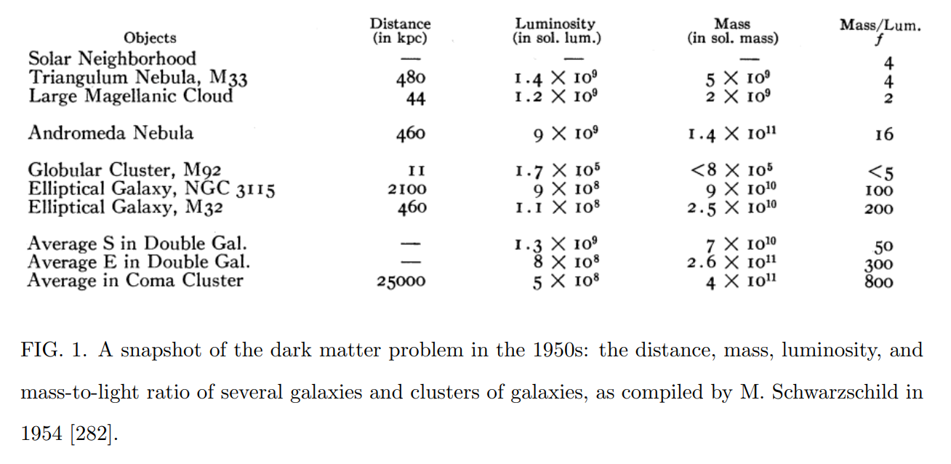
Introduction: An Astrophysical Puzzle
Several galaxies showed an ‘excess of mass’ wrt the total visible luminous emission
Useful astronomical quantity: Mass to Light ratio
It is defined as the ratio of the mass and the luminosity of an object
Typically use the Solar value M0/L0 ~ 5100 kg/W
Segue 1 dwarf spheroidal galaxy: M0/L0 > 3.400
“Segue 1: The Darkest Galaxy”
Ideal objects to study DM annihilation (DM indirect searches)

Slide 5
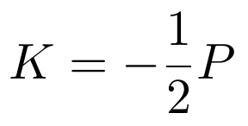
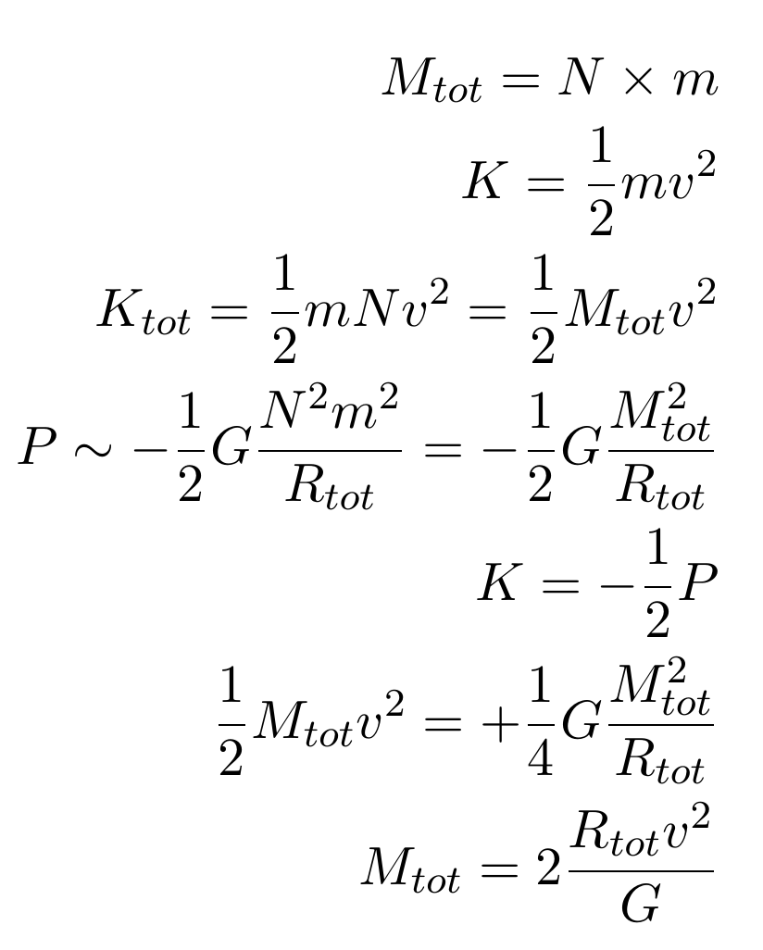
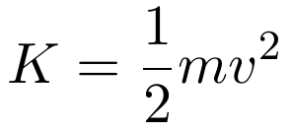
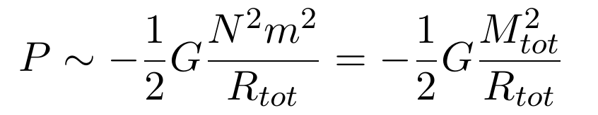
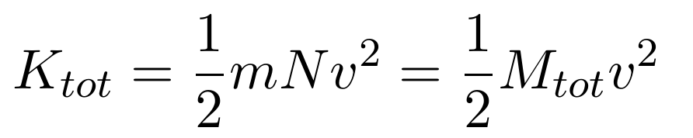
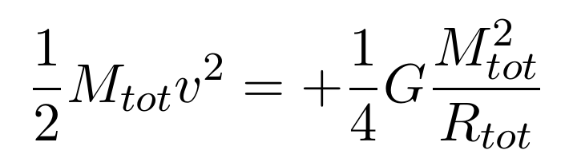
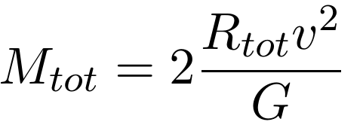
Estimating the Virial Mass of the Cluster
http://hosting.astro.cornell.edu/academics/courses/astro201/vt.htm
Virial Theorem:
Gravitational Potential Energy
Kinetic Energy

Slide 6
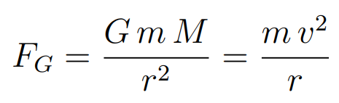
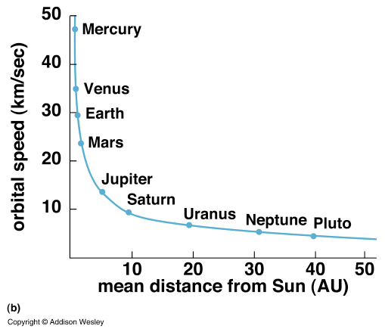
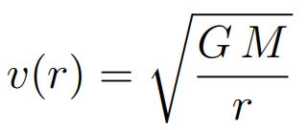


Rotational velocity
Consider the mean orbital speed of planets around the Sun. The gravitational attractive force must be equal to the centripetal force:
This is observed for the planets in the solar system
(sometimes called “Newtonian fall”)
This should also for other dynamical system e.g. the motion of stars in spiral galaxies orbitating around the galactic centre (i.e. supermassive balck hole), or blob of hidrogen

Slide 8
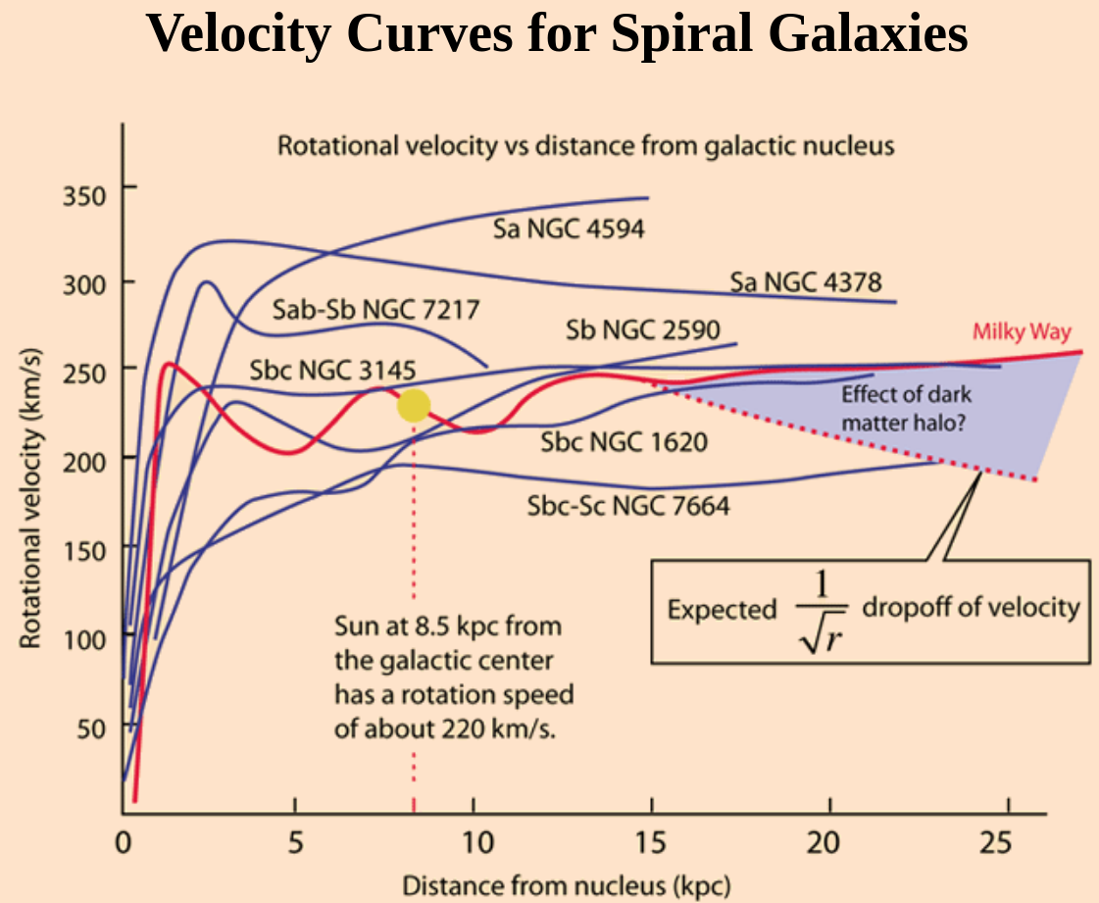
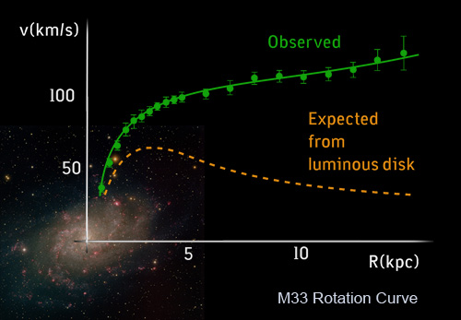
http://hyperphysics.phy-astr.gsu.edu/hbase/Astro/velcurv.html
Rotational velocity
Rotational velocity
However: this behaviour is not observed in the case of spiral galaxies.
Instead of the expected fall, the rotation curves all seem to flatten with increasing distance from the centre.

Slide 9
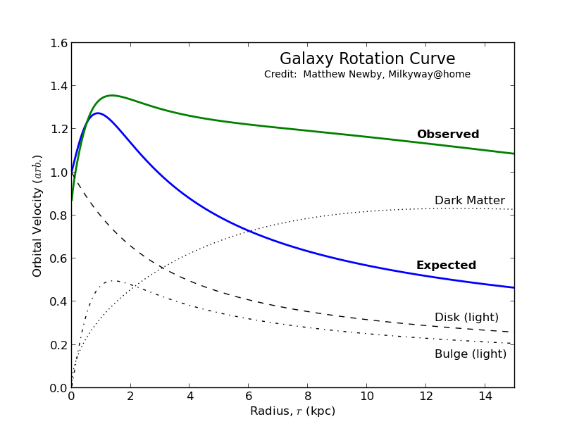
Rotational velocity
How to explain this
Observe the luminous matter distributions of the two components of the galaxy (i.e. the bulge and the disk)
Calculate the gravitational potential, and resulting velocity distribution of start as a function of the distance
Add the contributions→ they do not match the observations
Add a hypotetical distribution of matter, that is not observed, to produce velocites compatible with observations
Calculations/simulations suggest a presence of a halo of non-visible matter, that surrounds the galaxy, and explain the flattening of the rotation curves
The halo component dominates at large radii, while it is less important near the centre

Slide 10
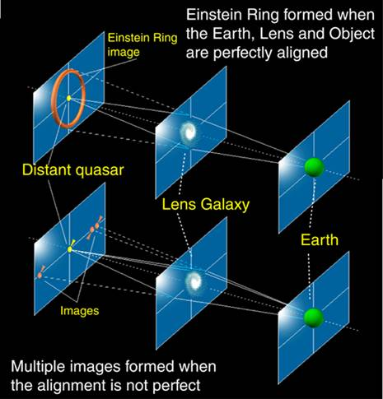
Gravitational Lensing
Yet, another prediction from Einstein general relativit
In the presence of a large mass, the space-time is distorted and particles e.g. photons follow accordingly different geodetics
The image of a distant source (like a quasar) appears on the sky at a different position, or at multiple positions, or distorted due to the intense gravitational field caused by a massive astrophysics placed in between the source and the observer

Slide 11
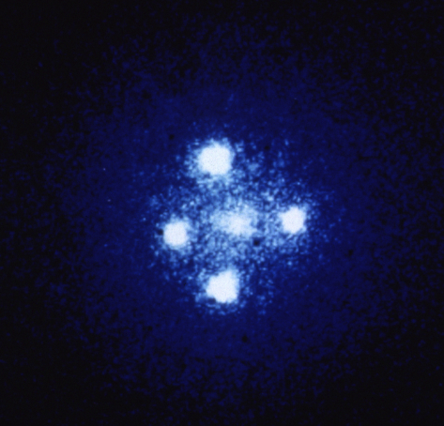
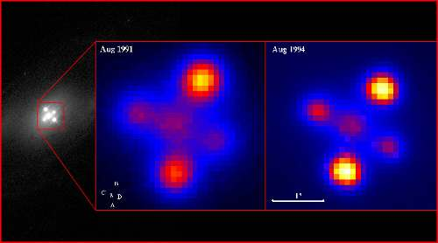
Gravitational Lensing
The Einstein Cross (Q2237+030 or QSO 2237+0305) is a gravitationally lensed quasar
Quasar: “quasi stellar radio source” ,
Due to strong gravitational lensing, the light coming form the quasar splits into four different images
https://phys.org/news/2019-03-einstein.html
http://www.astronomy.com/news/2015/04/alma-sees-einstein-ring-in-stunning-image-of-lensed-galaxy

Slide 12
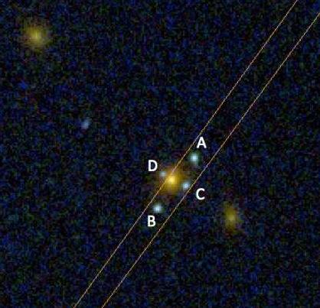
Gravitational Lensing
!!! New Einstein Cross (March 2019) found by The Hubble Space Telescope
“ The object acting as a lens turns out to be an elliptical galaxy located at a distance of approximately 7 billion light years (z = 0.556), while the source is at least 20 billion light years away (z = 3.03). "Normally the source is a quasar, it was with great surprise that we realized the source in this case was another galaxy, in fact a galaxy with very intense emission lines which indicates it is a young object still forming large amounts of stars"
Thanks to these new observations, presented in The Astrophysical Journal, astronomers now have one more tool to investigate the Universe. Gravitational lenses are important because they allow the study of the Universe in a unique way. Because the light of the different images, initially the same light, follows different paths in the Universe, thus any spectral differences must be due to the material that is between us and the source. Moreover, if the source is variable, we can see a time delay (one image illuminates before the others), which provides valuable information about the shape of the Universe.
Of course, the mass of the lens responsible for bending the light can be accurately derived, providing an important independent method to weight galaxies.
Finally, as with a normal glass lens, the gravitational lens concentrates toward us the light from the source, making it possible to see intrinsically unreachable objects. In this case it could be calculated that the source is 5 times brighter than it would be without the lens. “
https://phys.org/news/2019-03-einstein.html

Slide 13
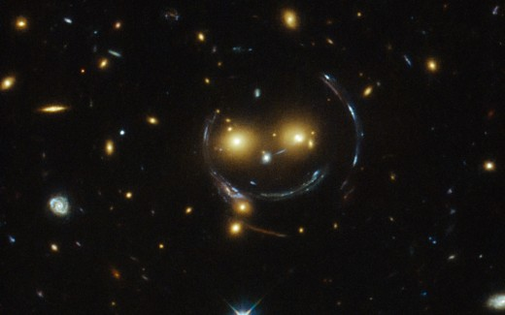

Slide 14
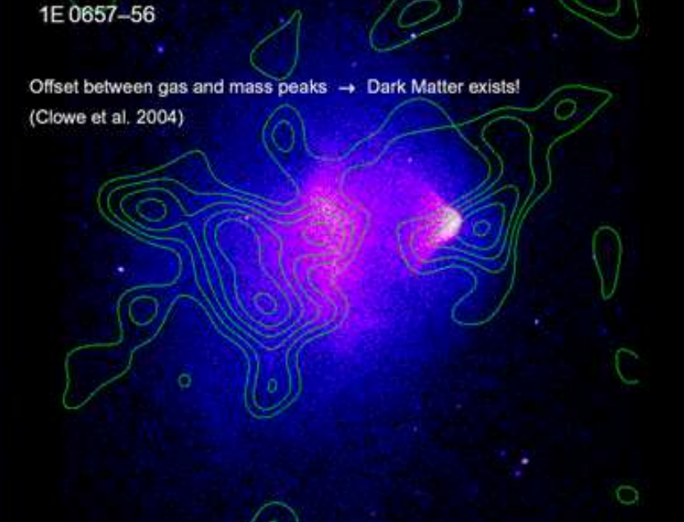
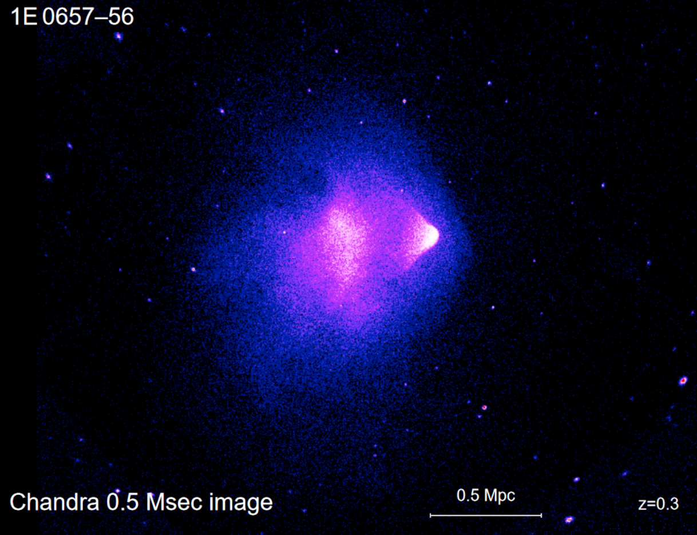
Bullet Cluster (1E 0657–56)
Bullet-shaped hot gas
Shock front
One of the “smoking gun” of the existence of Dark Matter
It is the smallest cluster of a two cluster systems, which is bullet-shaped
The dynamics of visible components (starts and hot gas) is different from the dynamics of Dark Matter
The study of gravitational lensing produced by the system can be explained only by the presence of two DM Halos
The lensing is strongest in two separated regions, which do not overlap with the X-ray emission (from the hot gas) i.e. the centre of mass ODF the baryonic matter
One of the strongest evidence against alternative gravitation theories (like MOND, Modified Newtonian Dynamics)
It is possible to derive a model independent DM annihilation / interaction cross section upper limit
Inferred distribution of gas

Slide 15
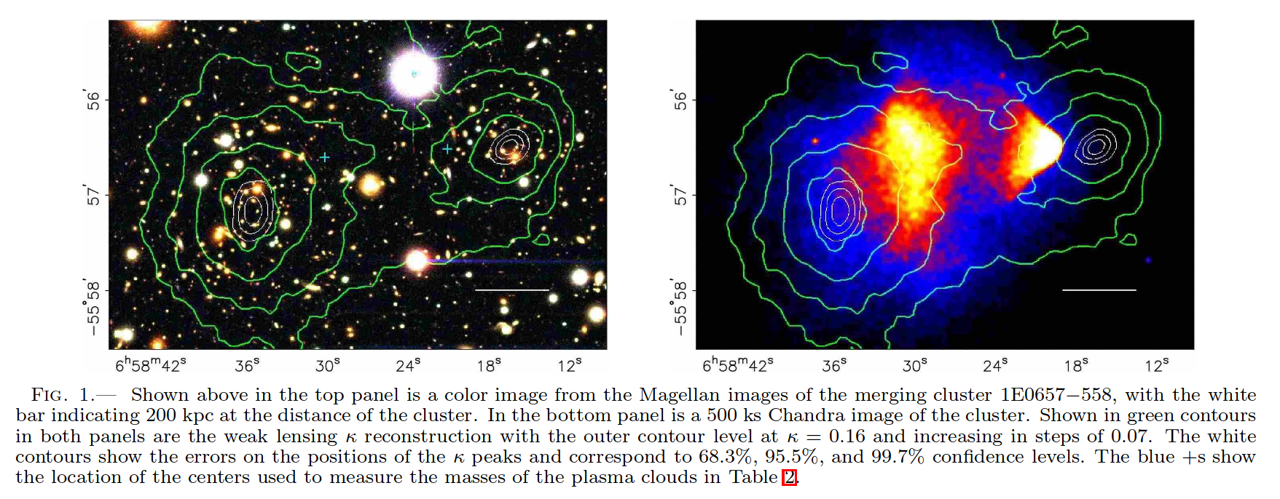
Bullet Cluster (1E 0657–56)
“A DIRECT EMPIRICAL PROOF OF THE EXISTENCE OF DARK MATTER”
https://arxiv.org/pdf/astro-ph/0608407.pdf
We present new weak lensing observations of 1E0657−558 (z= 0.296), a unique cluster merger,that enable a direct detection of dark matter, independent of assumptions regarding the nature of the gravitational force law. Due to the collision of two clusters, the dissipationless stellar component and the fluid-like X-ray emitting plasma are spatially segregated. By using both wide-field ground based images and HST/ACS images of the cluster cores, we create gravitational lensing maps which show that the gravitational potential does not trace the plasma distribution, the dominant baryonic mass component, but rather approximately traces the distribution of galaxies. An 8σsignificance spatial offset of the center of the total mass from the center of the baryonic mass peaks cannot be explaine dwith an alteration of the gravitational force law, and thus proves that the majority of the matter in the system is unseen.

