Slide 1
Exercise 2 - Regression
Machine Learning
SS2021 - TU Wien
Federico Ambrogi, e1449911@student.tuwien.ac.at
Adam Hoer, e11847620@student.tuwien.ac.at
Matteo Panzieri, 12039996@student.tuwien.ac.at
Vienna, 28th May 2021

Slide 2
Overview of the project
Framework
Data set description
Data pre-processing
Algorithm Implementation
Results
Comparison
Conclusion

Slide 3
Framework
Scripting language: python v3. (virtual environment using Anaconda)
Numpy
scikit-learn
pandas
(matplotlib and seaborn for visualizations)
Files description
utilities.py : module containing ancillary common utilites
regressionTree.py: module for the training and evaluation of the regression tree
modelTree.py : module for the training and evaluation of the model tree
run_models.py : main script for running the models

Slide 4
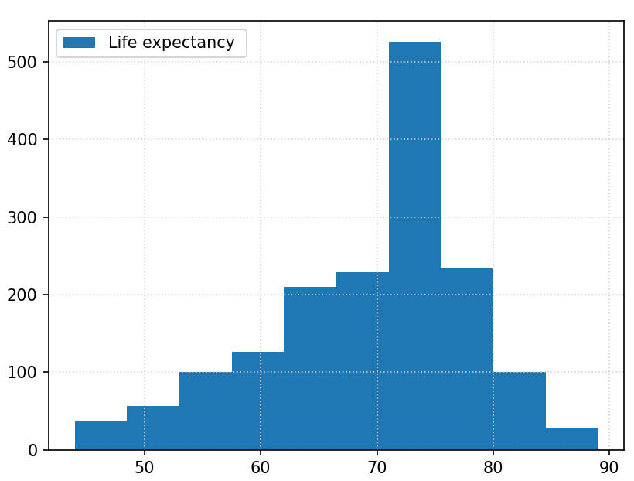
Data Set: “Life” Expectancy
https://www.kaggle.com/kumarajarshi/life-expectancy-who
Aim: predict the life expectancy given multiple indicators such as demographic variables, income composition and mortality rates
Features:
'AdultMortality','infantdeaths', 'Alcohol', 'percentageexpenditure', 'HepatitisB', 'Measles', 'BMI', 'under-fivedeaths', 'Polio', 'Totalexpenditure', 'Diphtheria', 'HIV/AIDS', 'GDP', 'Population', 'thinness1-19years', 'thinness5-9years', 'Incomecompositionofresources', 'Schooling'
Dropped Features:
'Country', 'Year', 'Status'
(we are interested in the evaluation based solely on the indicators above)

Slide 5
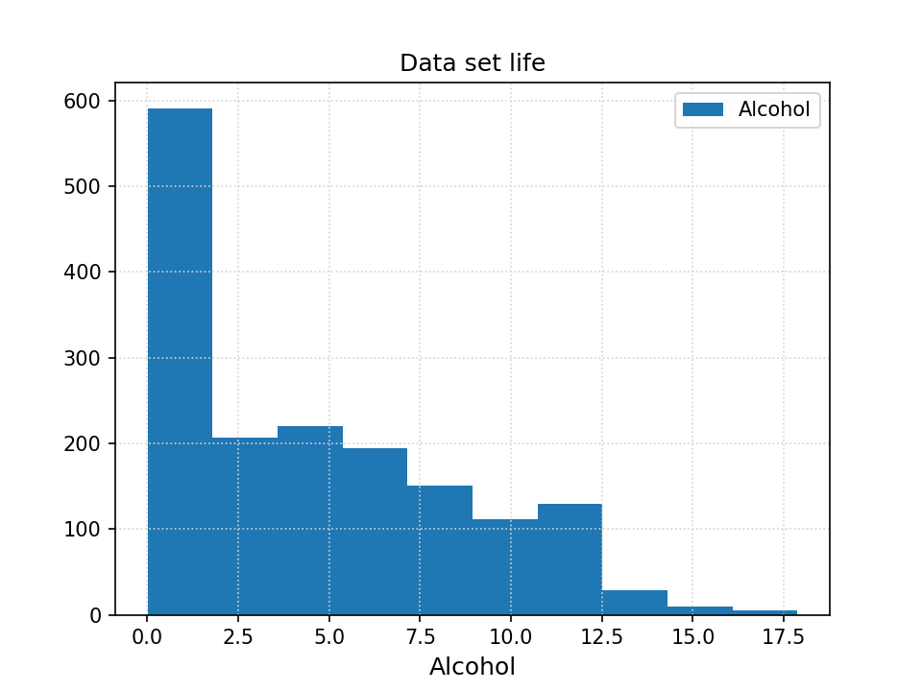
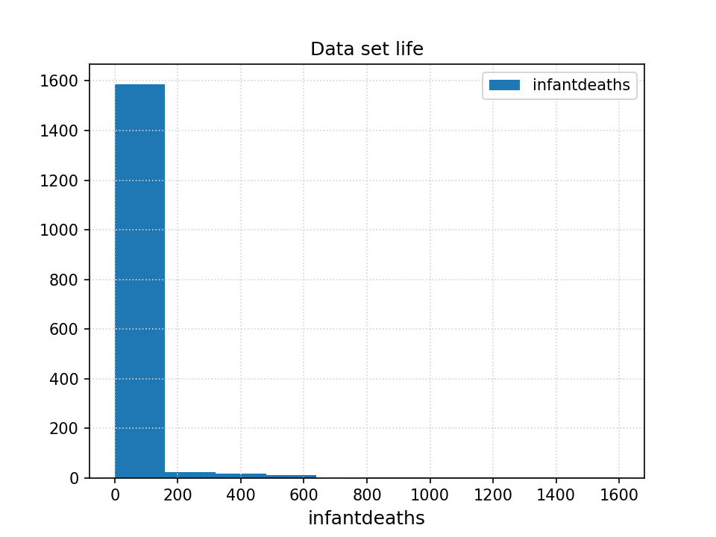
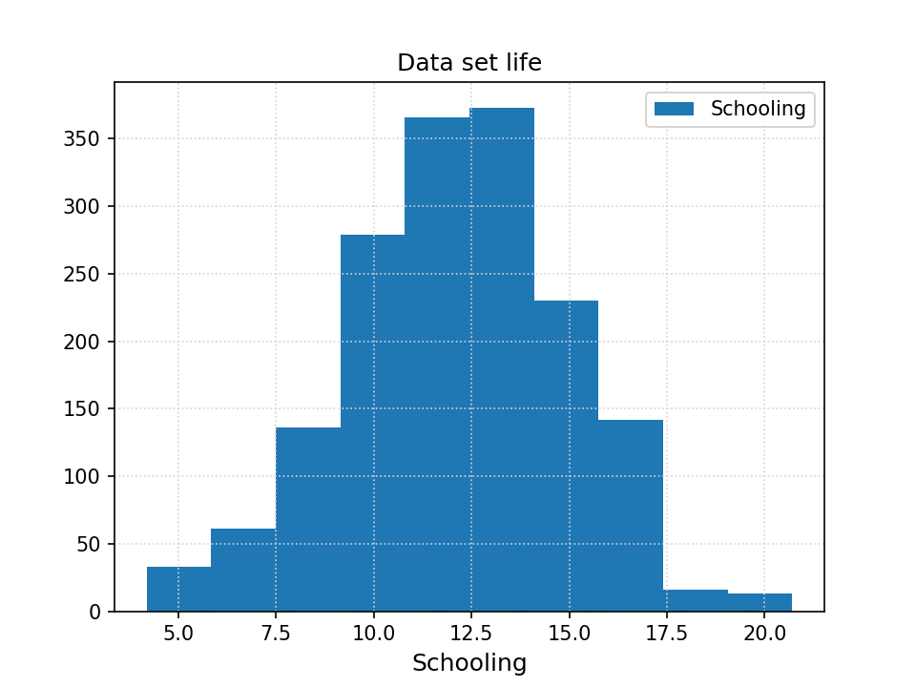
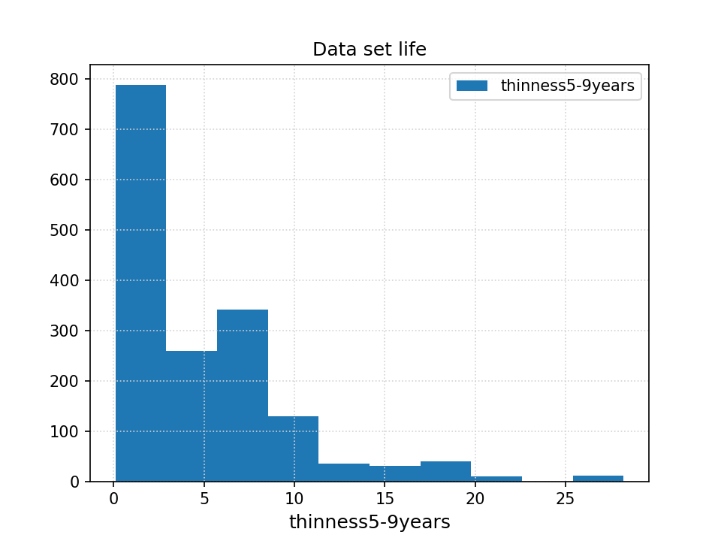
Data Set: “Life” Expectancy - example feature distributions

Slide 6
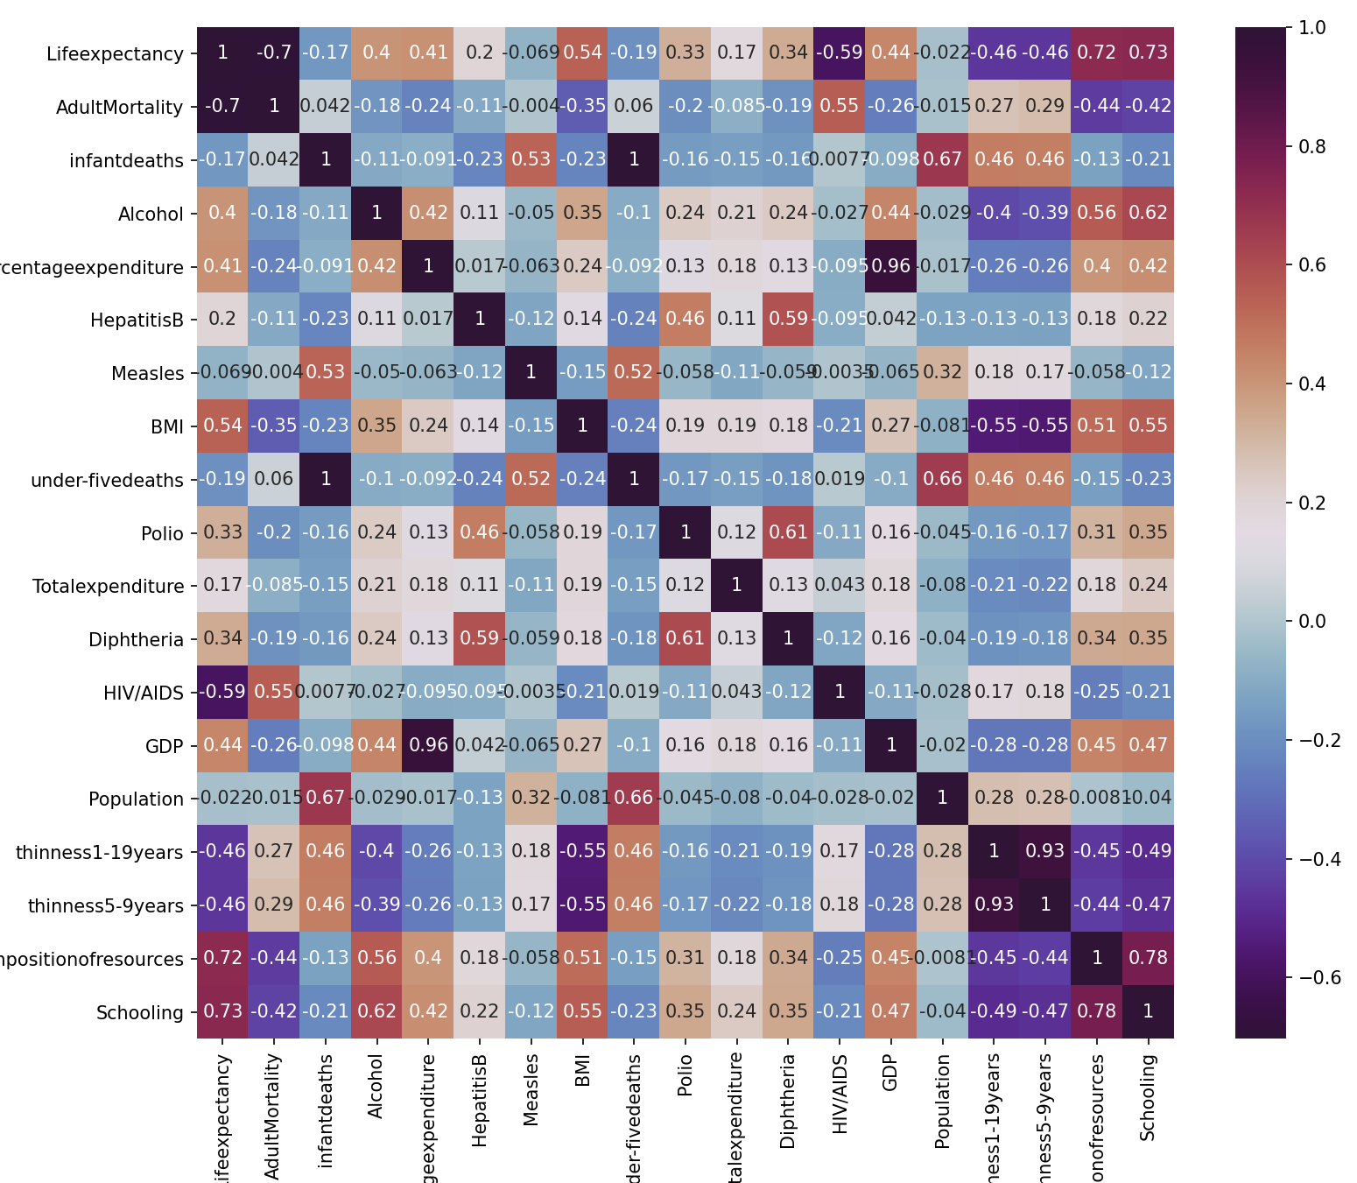
“Life Expectancy” correlation
Pearson Correlation matrix

Slide 7
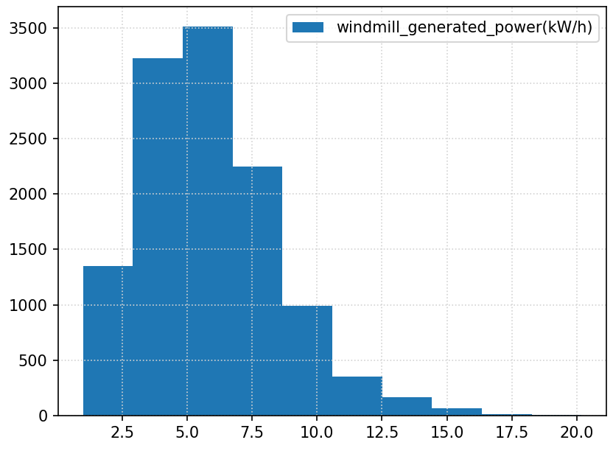
Data Set: “Wind” Turbines Power Output
https://www.kaggle.com/synergystud/a-fine-windy-day-hackerearth-ml-challenge
How do factors such as temperature, wind direction, turbine status, weather, blade length, and so on influence the amount of power generated by wind turbines?
Features:
'wind_speed(m/s)','atmospheric_temperature(°C)', 'shaft_temperature(°C)', 'blades_angle(°)', 'gearbox_temperature(°C)', 'engine_temperature(°C)', 'motor_torque(N-m)', 'generator_temperature(°C)', 'atmospheric_pressure(Pascal)', 'area_temperature(°C)', 'windmill_body_temperature(°C)', 'wind_direction(°)', 'resistance(ohm)', 'rotor_torque(N-m)', 'blade_length(m)', 'blade_breadth(m)', 'windmill_height(m)'
Removed Features:
'turbine_status', 'cloud_level', 'tracking_id', 'datetime'

Slide 9
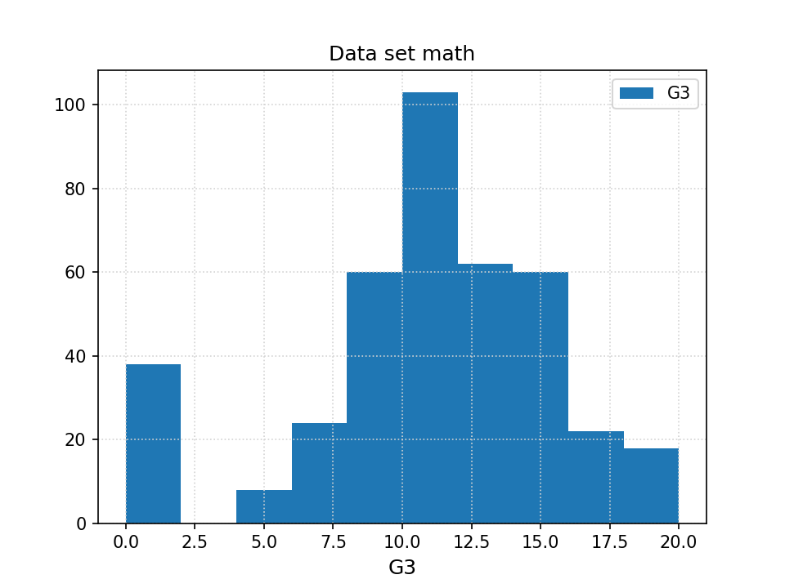
Data Set: “Math” Grades
https://www.kaggle.com/janiobachmann/math-students
This dataset contains the final scores of students at the end of a math programs with several features that might or might not impact the future outcome of these students, given the scores G1 and G2 obtained during the the first study period.
Features:
'school', 'sex', 'age', 'address', 'Pstatus', 'Medu', 'Fedu','traveltime', 'studytime', 'failures', 'schoolsup', 'famsup', 'paid','activities', 'nursery', 'higher', 'internet', 'romantic', 'famrel','freetime', 'goout', 'Dalc', 'Walc', 'health', 'absences', 'G1', 'G2', 'famsize_1', 'famsize_LE3', 'Mjob_at_home', 'Mjob_health', 'Mjob_other', 'Mjob_services', 'Mjob_teacher', 'Fjob_at_home', 'Fjob_health', 'Fjob_other', 'Fjob_services', 'Fjob_teacher', 'reason_course', 'reason_home', 'reason_other', 'reason_reputation', 'guardian_father', 'guardian_mother', 'guardian_other'
Except the target features, all the other are of nominal type.
We have thus performed a hot-encoding and turn them into numeric variable.

Slide 10
Data Pre-processing
loading the text files using pandas to create data frames
remove rows with null values (NAN)
remove flagged values (e.g. -99.0 “wind” datasets )
scale features (e.g. “population” feature in “life” data set)
“hot-encode” categorical values to obtain numeric values
shuffle data for randomization
Train-Test split & Cross-Validation
run a (5-10)-fold cross validation for training:
split original dataset into k-folds sub set
Used the train_test_split method from sklearn to split the data set into training and testing sets (70%-30%)
See plots: metrics for each fold

Slide 12
Split attribute
For each attribute we scan all the values
Considering each value we split the dataset in two parts.
Given the two new datasets we compute the RSS
We compute the best RSS and we use as candidate split value the one that generates that RSS.
The split attribute will be the attribute that minimizes the RSS of the dataset

Slide 13
Split attribute
After having tested the results with this split we realized that the results are comparable with another way of splitting the dataset.
Instead of evaluating each value, we split the dataset looking at the average of the attributes values.
For each attribute the RSS is computed splitting the dataset looking at the average.
Then the split attribute is the one that minimize the RSS.

Slide 14
Regression Tree
In order to prevent overfitting we set a minimum number of observations in the nodes (default=5). To build the tree we recursively split the dataset using the split attribute and the split value. The average target value of the dataset will be the value assigned by that node. The two obtained datasets are used to find the split attribute for the child nodes.When the limit rows is reached or further splits would be redundant (one child gets all rows or all rows have the same target value) we stop expanding the tree’s branch.

Slide 15
Model tree
The model tree was build as the regression tree.
The main difference is that for each node we build a linear regression model.
When we have both the left and the right child of a node we confront the MSE of the node computed looking at the child nodes with the MSE of the linear model.
If the first is bigger than the second we prune the branches and assign as value the value determined by the linear model.

Slide 16
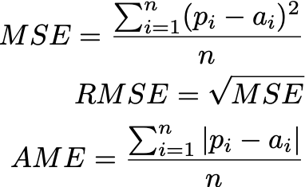
Evaluating Predictions
To assess the value of our implementation, we used three metrics:
MSE (mean-squared error)
RMSE (root mean-squared error)
MAE (mean absolute error)

Slide 17
Comparison with three Alternative Models
We used the following alternative algorithms from sci-kit library:
Decision tree
DecisionTreeRegressor
Parameters: MSE (splitting criterion)
Random Forest
RandomForestRegressor
Linear regression model
LinearRegression

Slide 18
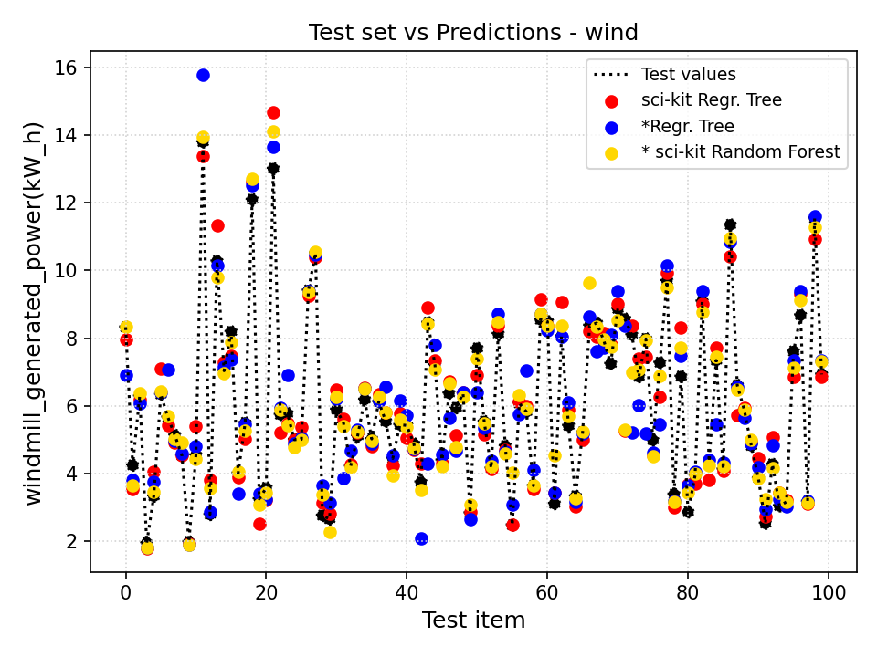
Selection of Results - Wind data set
Plot shows the values of actual data (test values) vs
sci-kit prediction (regression tree)
Our regression tree implementation
sci-kit random forest

Slide 19
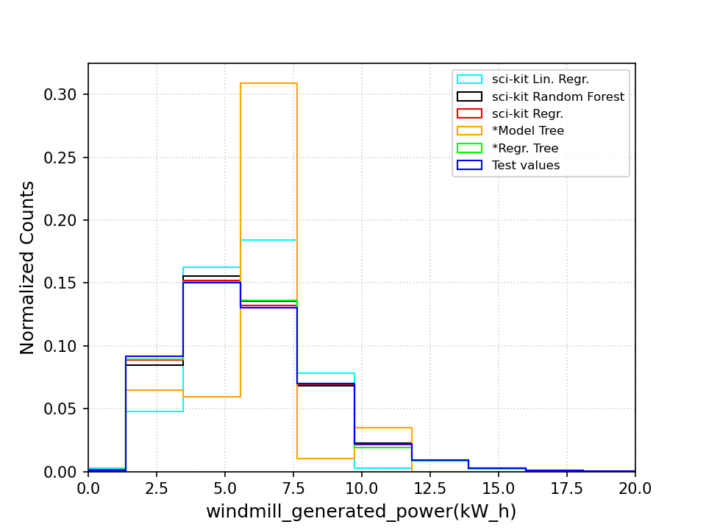
Selection of Results - Wind data set

Slide 20
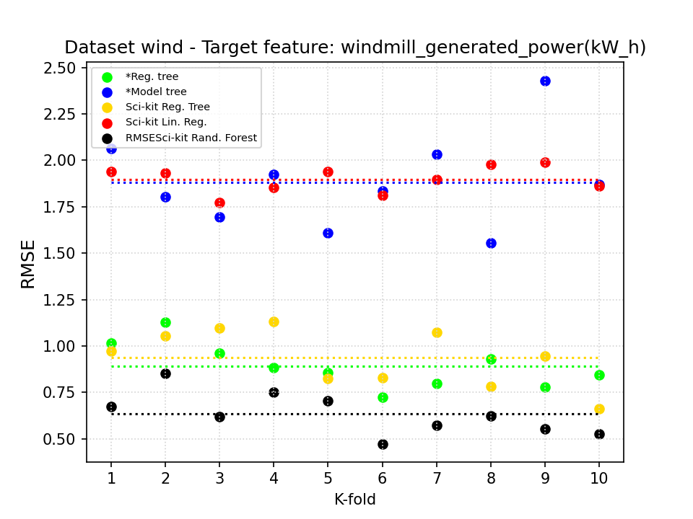
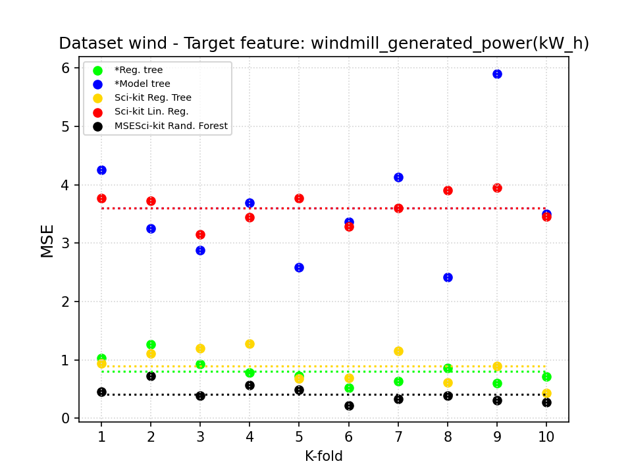
Selection of Results - Wind data set

Slide 21
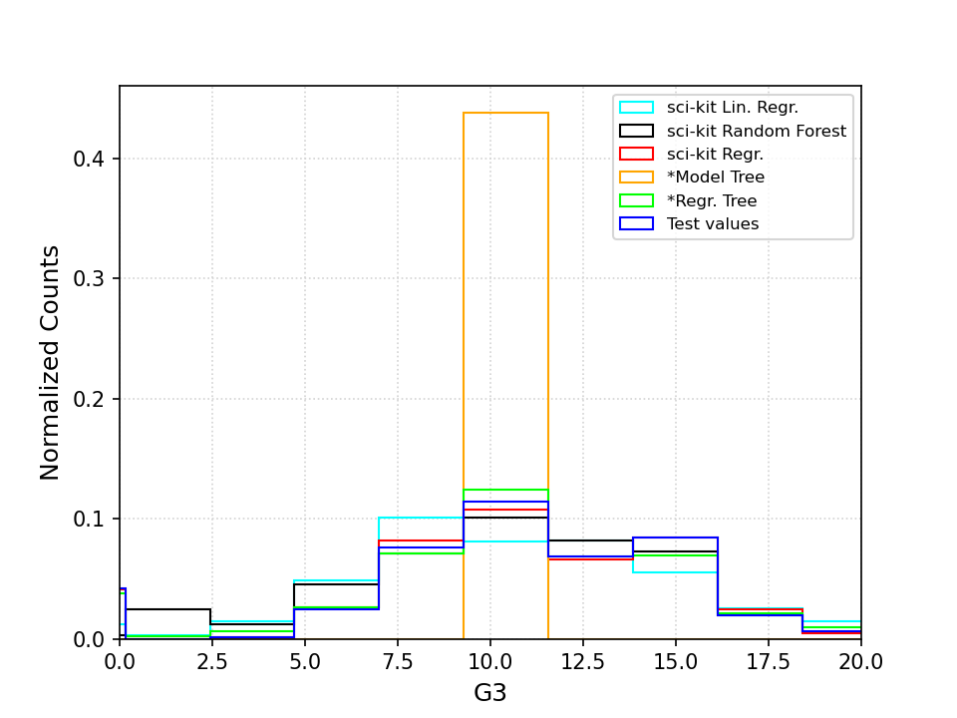
Selection of Results - Math data set

Slide 22
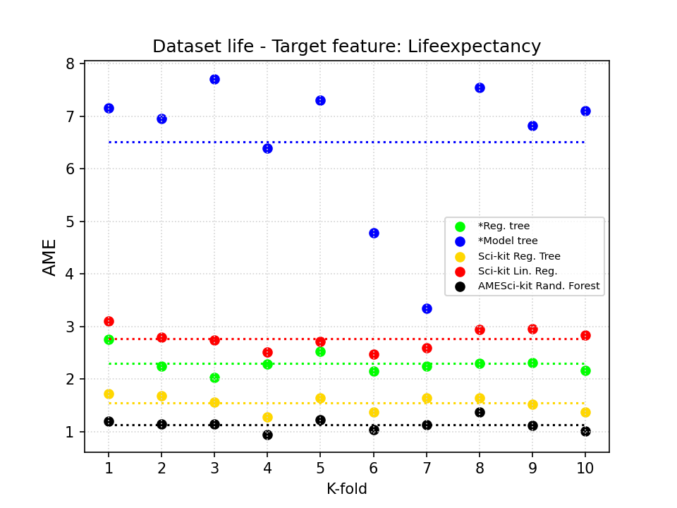
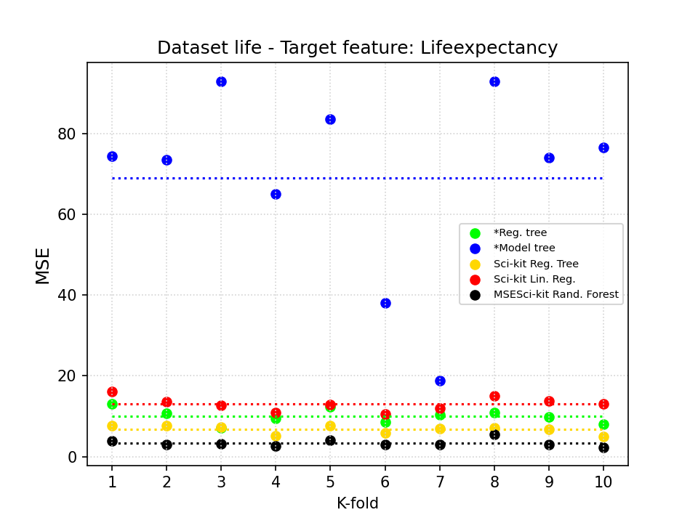
Selection of Results - Life expectancy data set

