Slide 1
Exercise 3.1.3.1
Generation and evaluation of structured synthetic datasets
Machine Learning
SS2021 - TU Wien
Federico Ambrogi, e1449911@student.tuwien.ac.at
Adam Höfler, e11847620@student.tuwien.ac.at
Matteo Panzieri, 12039996@student.tuwien.ac.at
Vienna, 26th July 2021

Slide 2
Overview of the project
Framework
Data set description
Data pre-processing
Algorithm Implementation
Results
Comparison
Conclusion

Slide 3
Framework
Scripting language: python v3. (virtual environment using Anaconda)
Numpy
scikit-learn
pandas
sdv
(matplotlib and seaborn for visualizations)
Files description
classifier.py : main module for splitting data and learning models
generate_data.py: module for generating the synthesized data sets
dataset_analysis.py : module for comparing the results from original and artifical data

Slide 4
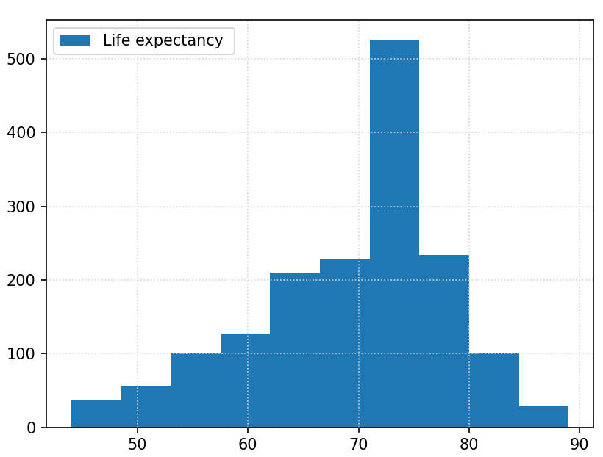
Data Set: Social Network Ads
https://www.kaggle.com/rakeshrau/social-network-ads
Aim: predict the purchase realization given gender, age and the estimated salary of the targeted user
Features:
'Gender','Age', 'Estimated Salary'
← CHANGE PLOT

Slide 5
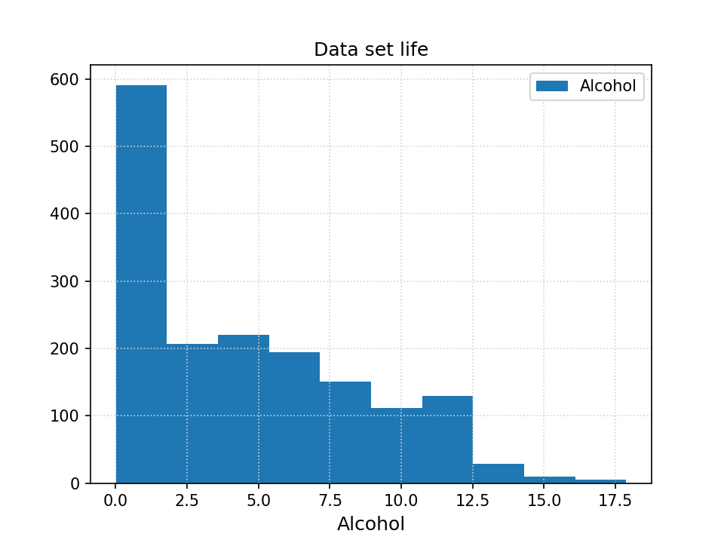
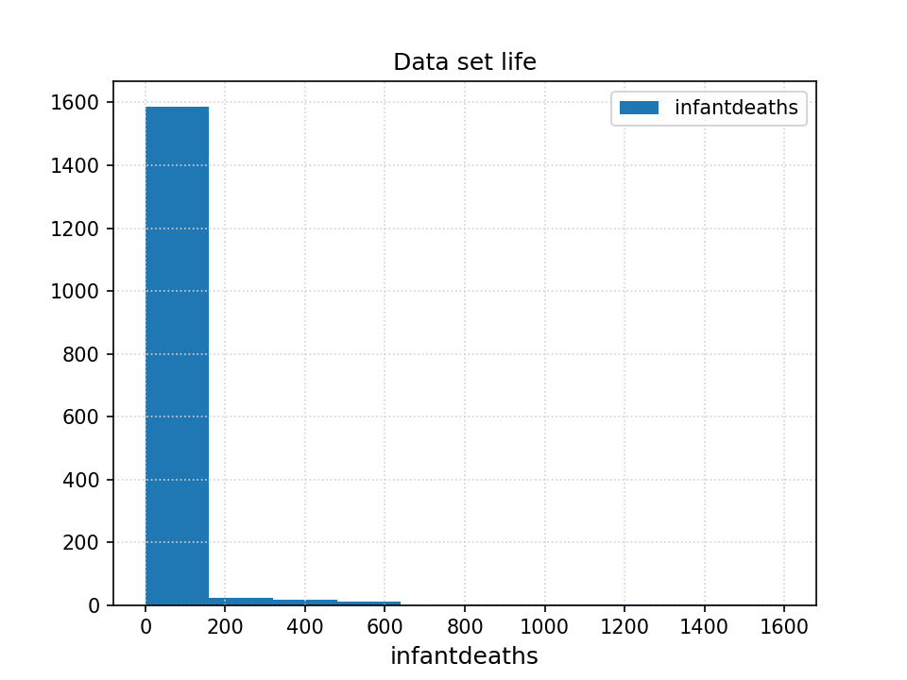
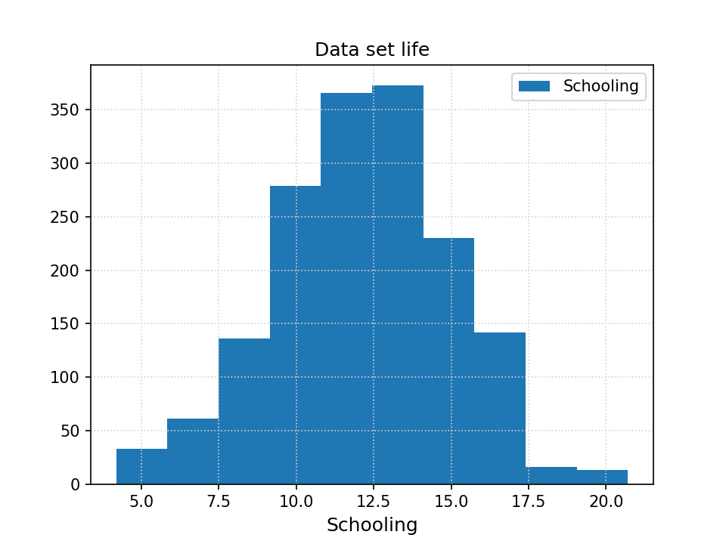
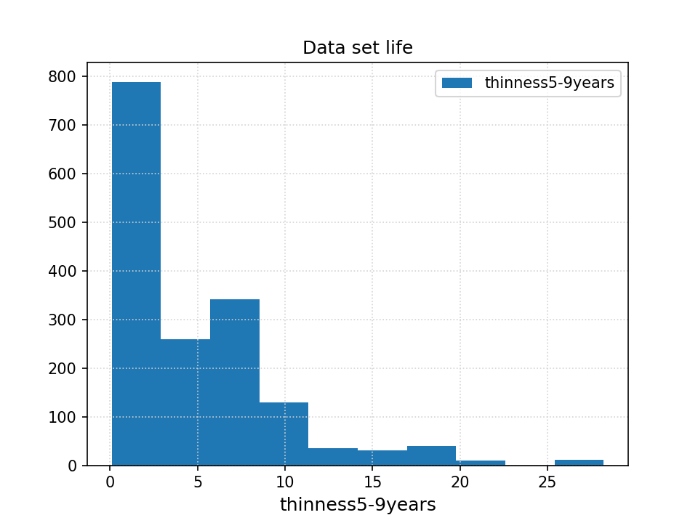
Data Set: Social network ads - example feature distributions
← CHANGE PLOTS

Slide 6
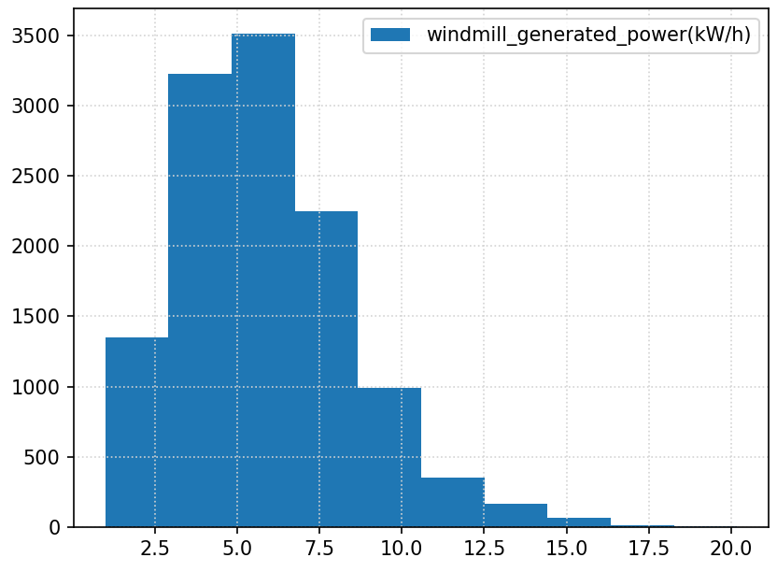
Data Set: Titanic
https://www.kaggle.com/c/titanic/data
How do factors such as ticket class, gender or family size influence the survival of the passengers on the titanic?
Features:
'PassengerId', 'Name', 'Survival', 'Ticket class', 'Sex', 'Age(years)', '# of siblings/spouses aboard', '# of parents / children aboard the Titanic', 'Ticket number', 'Passenger fare', 'Cabin number', 'Port of Embarkation'
← CHANGE PLOT
Removed Features:
'PassengerId', 'Name'

Slide 7
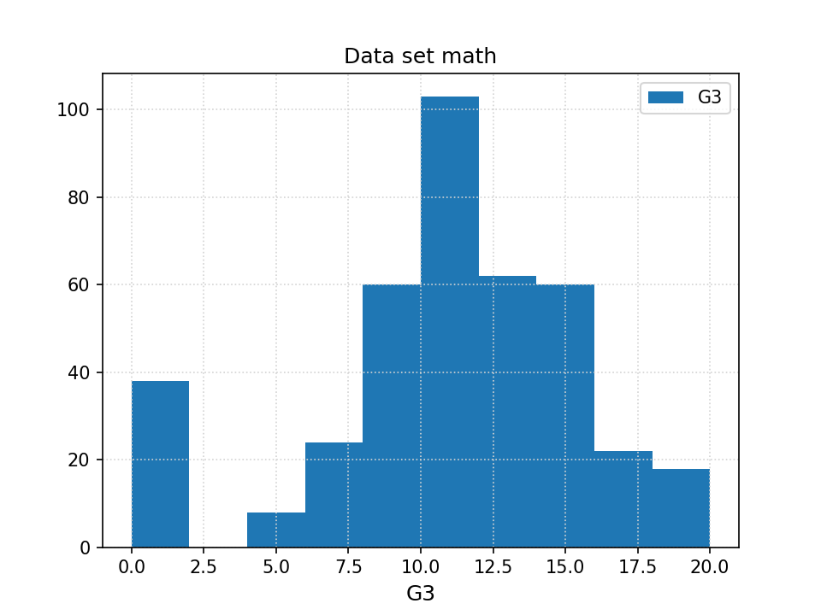
Data Set: Adult Data Set
https://archive.ics.uci.edu/ml/datasets/Adult
Can you predict whether the income of an individual data exceeds $50k/year given “census data” about him.
Features:
'age', 'workclass', 'fnlwgt', 'education', 'education-num', 'marital-status', 'occupation','relationship', 'race', 'sex', 'capital-gain', 'capital-loss', 'hours-per-week', 'native-country'
← CHANGE PLOT

Slide 8
Data Pre-processing
loading the text files using pandas to create data frames
Drop certain columns
factorize categorical values to obtain numeric values
shuffle data for randomization

Slide 9
Objective
Protect sensitive data.
Poisoning attacks become redundant.
Generate more useful data.

Slide 10
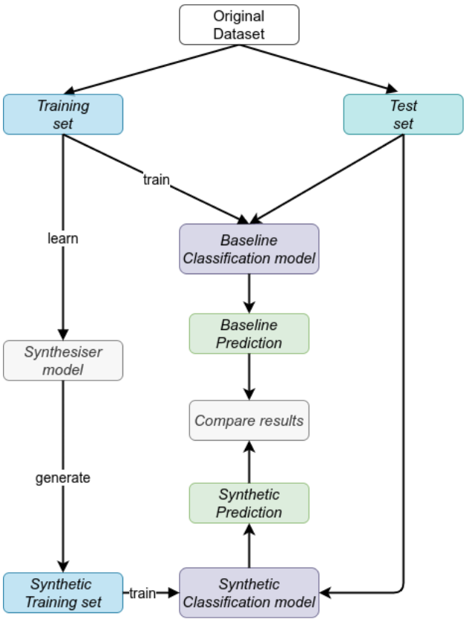
The algorithm
70%-30% split.
The train set is used to model the synthesiser models.
All the 4 model are tested on the same test set

Slide 11
The models
Models taken from SDV (Synthetic Data Vault) library.
Gaussian Copula:Distribution over hypercube
CTGAN model
CopulaGAN model: CTGAN model improved using Gaussian copula.

Slide 12
Implementation
Random forest classifier.
In general no problems with the classifiers.
Relevant time issues with the SDV models.

Slide 13
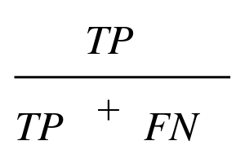
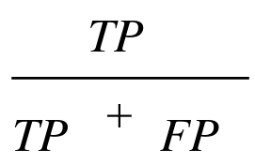
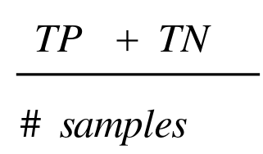
Evaluating Classification
To assess the value of our implementation, we used three metrics:
Recall
Precision
Accuracy

Slide 14
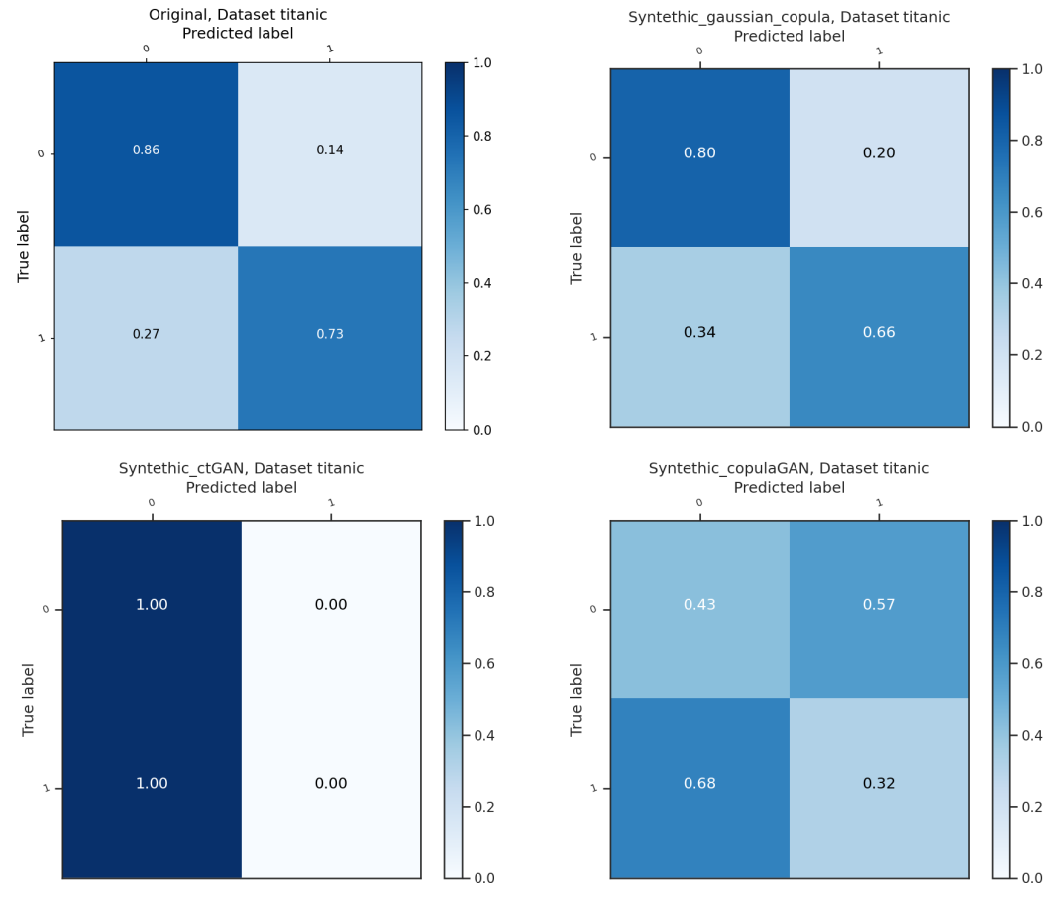
Confusion matrices – Titanic data set

Slide 15
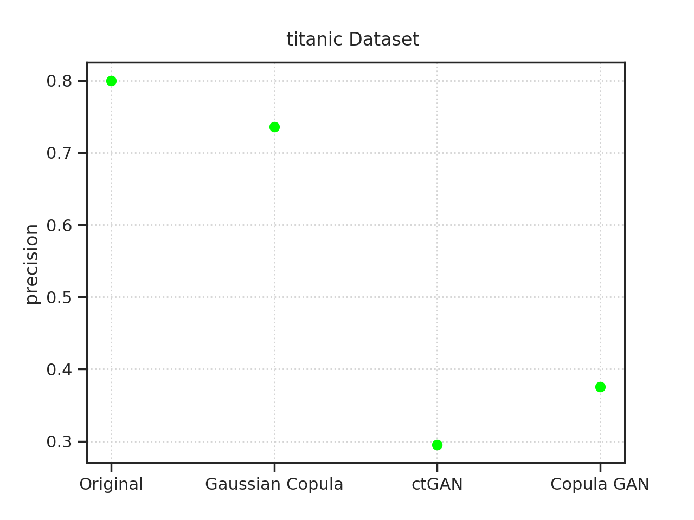
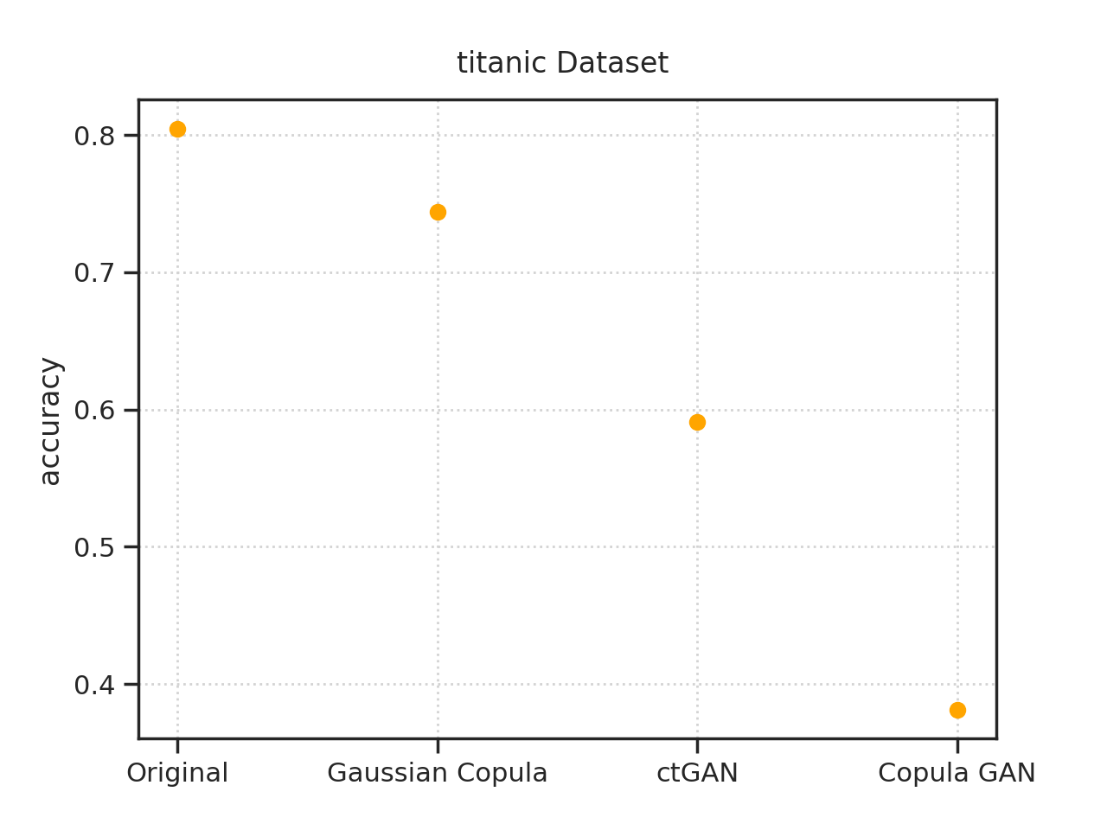
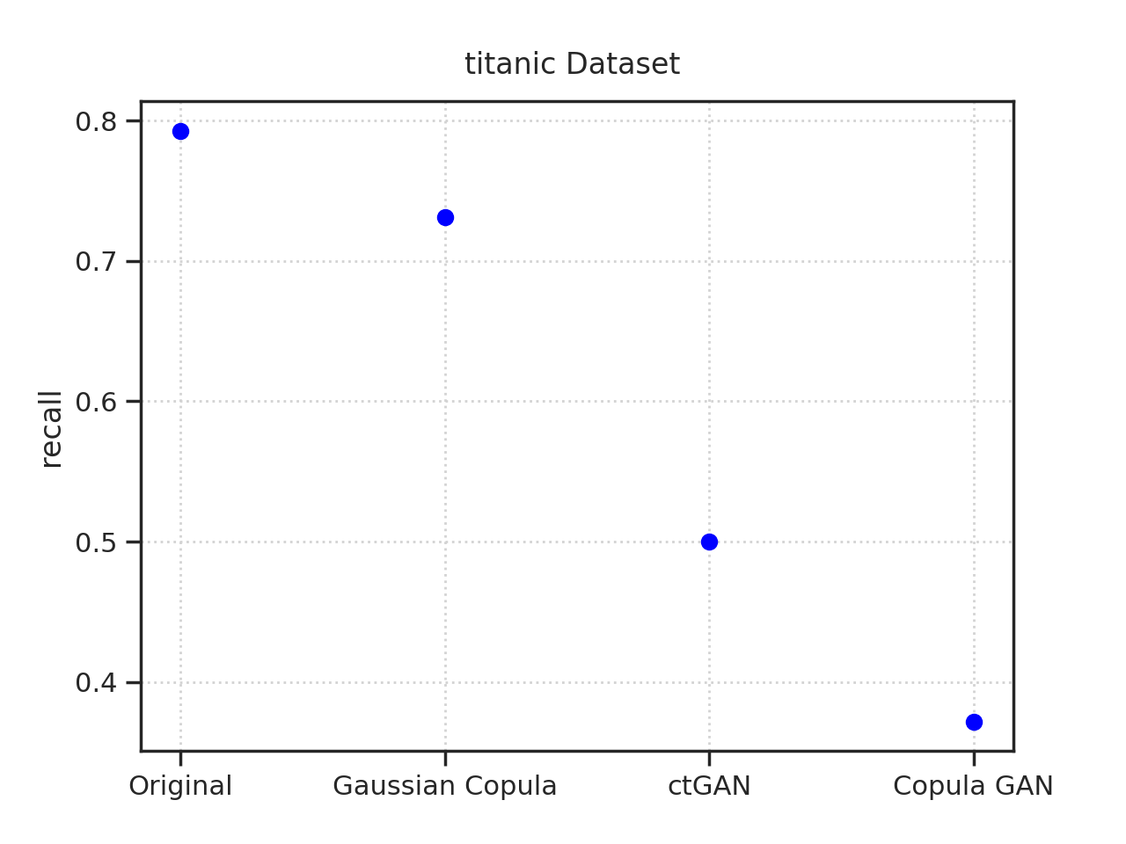
Metrics – Titanic data set

Slide 16
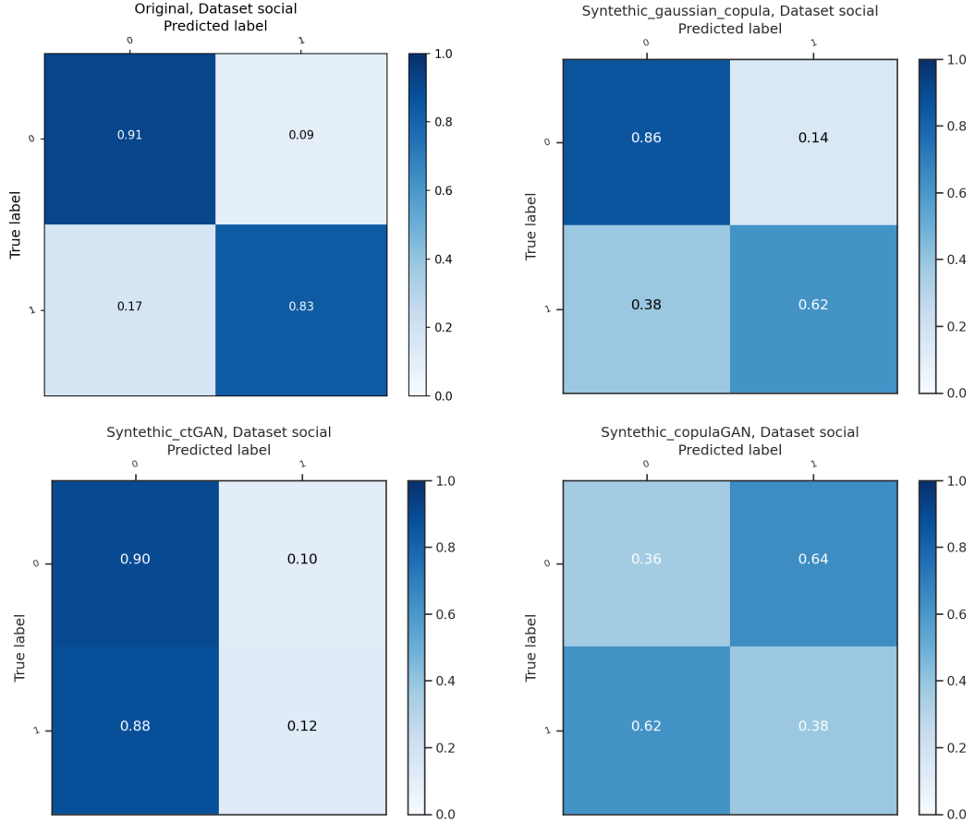
Confusion matrices – Social data set

Slide 17
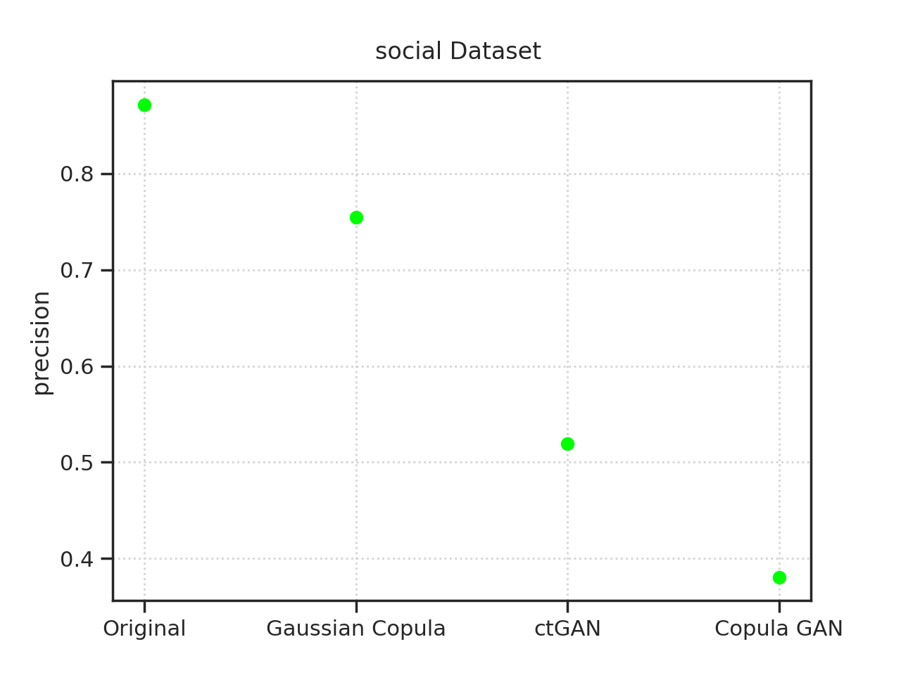
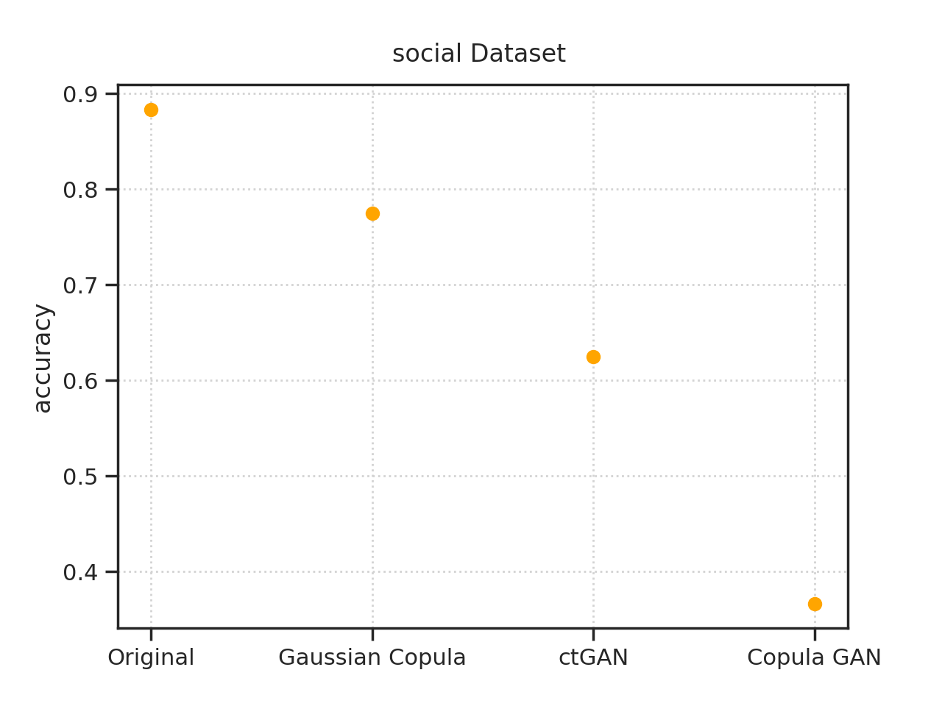
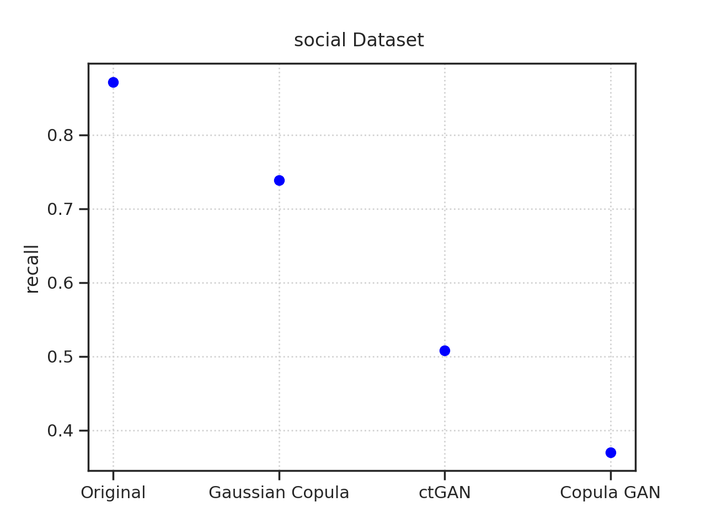
Metrics – Social data set

Slide 18
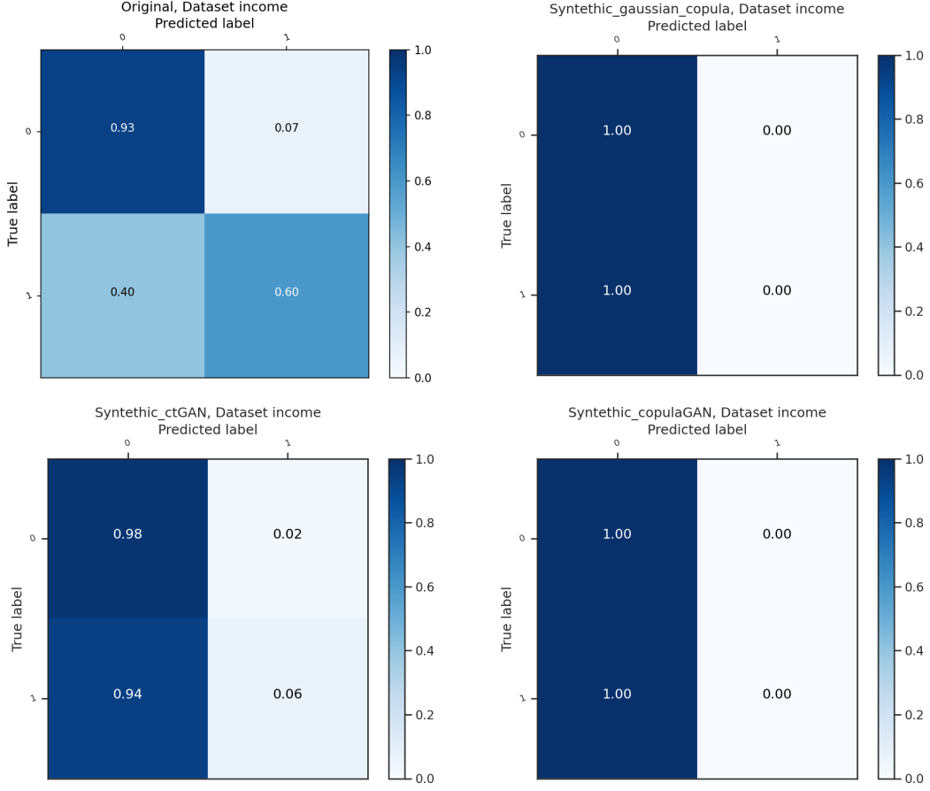
Confusion matrices – Income data set

Slide 19
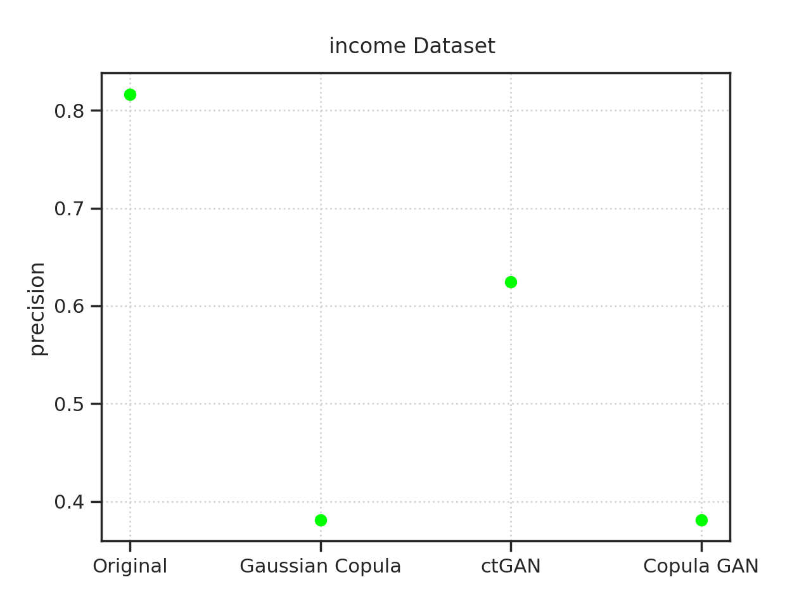
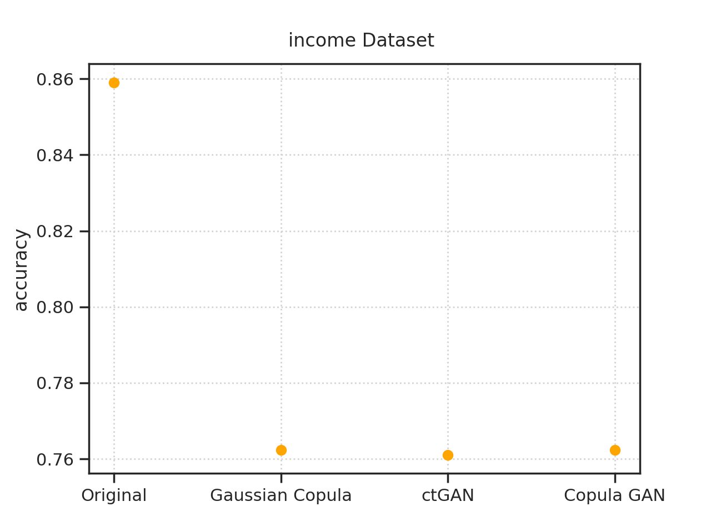
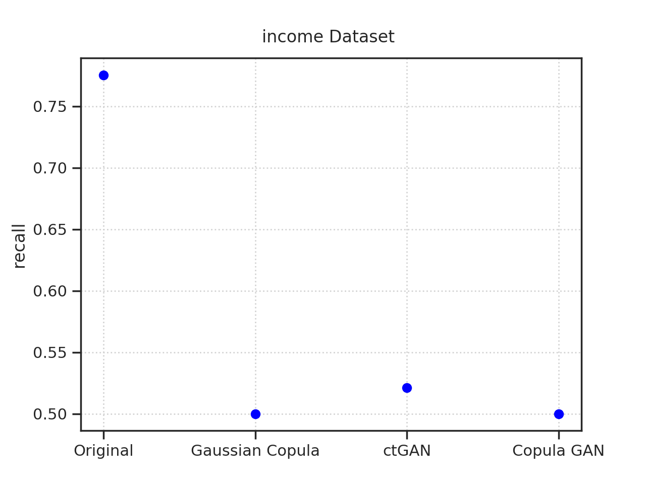
Metrics – Income data set

Slide 20
Conclusion
General performance depends on the underlying data:
GaussianCopula clearly outperforms other methods
ctGAN produces single class data
copulaGAN has problems with correct class assignment
All methods fail on Income data set

Slide 21
Future work
Use other classifiers.
Evaluate the results with the SDV methods.
Try to use different datasets.

