Slide 1
Exercise 2 - Regression
Machine Learning
SS2021 - TU Wien
Group 13
Federico Ambrogi, e1449911@student.tuwien.ac.at
Matteo Panzieri, 12039996@student.tuwien.ac.at
*Adam Hofer, e11847620@student.tuwien.ac.at (today he is sick :-( )
Vienna, 28th May 2021

Slide 2
Overview of the project
Framework
Data set description
Data pre-processing
Generation of Synthetic Data
Evaluation metrics
Algorithm Implementation
Results and model comparison
Conclusion

Slide 3
Data Pre-Processing

Slide 4
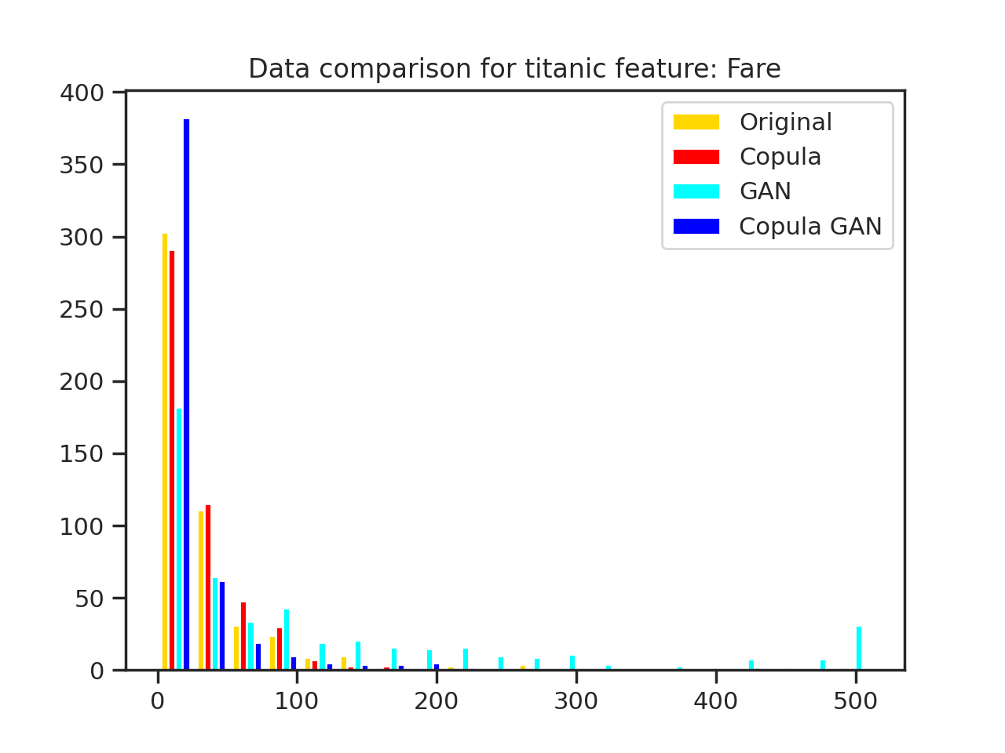
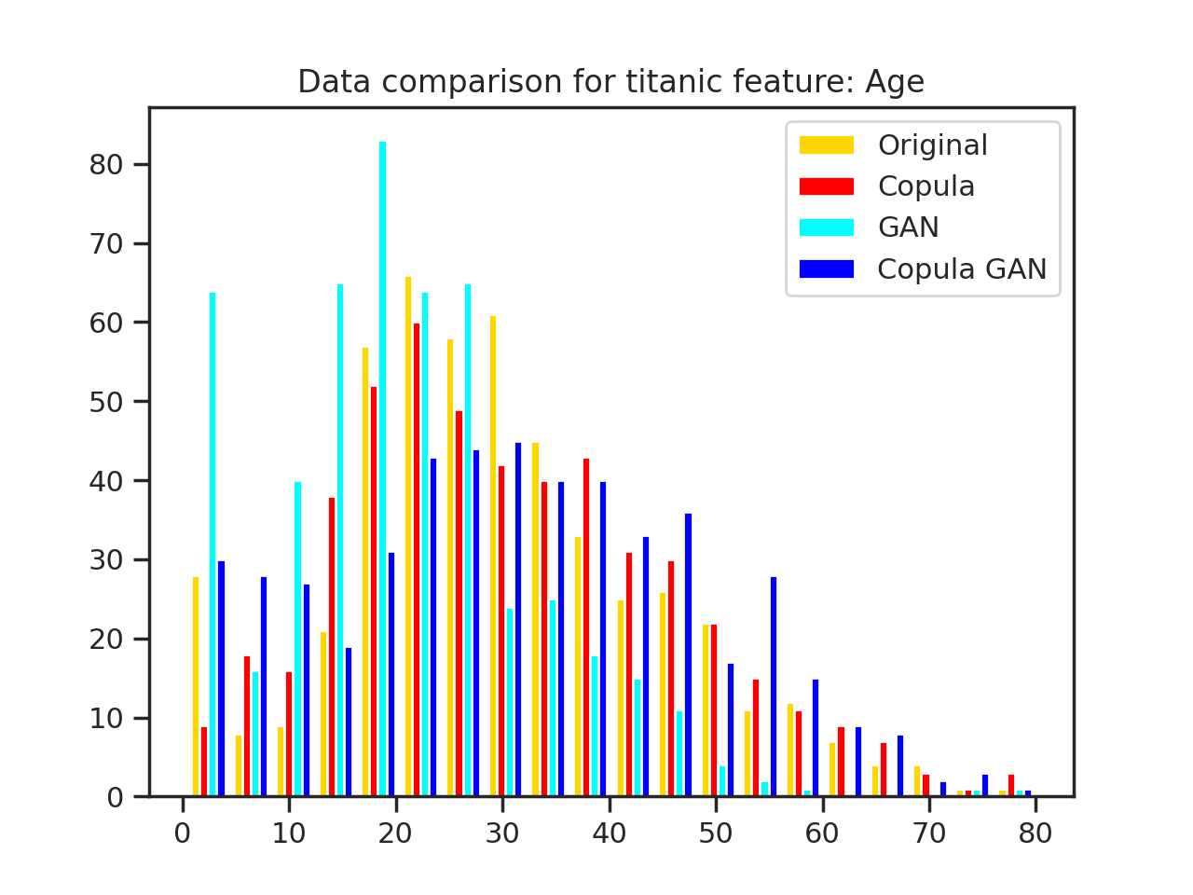
Synthetic Data Sets
Example: “Titanic” Data Set

Slide 5
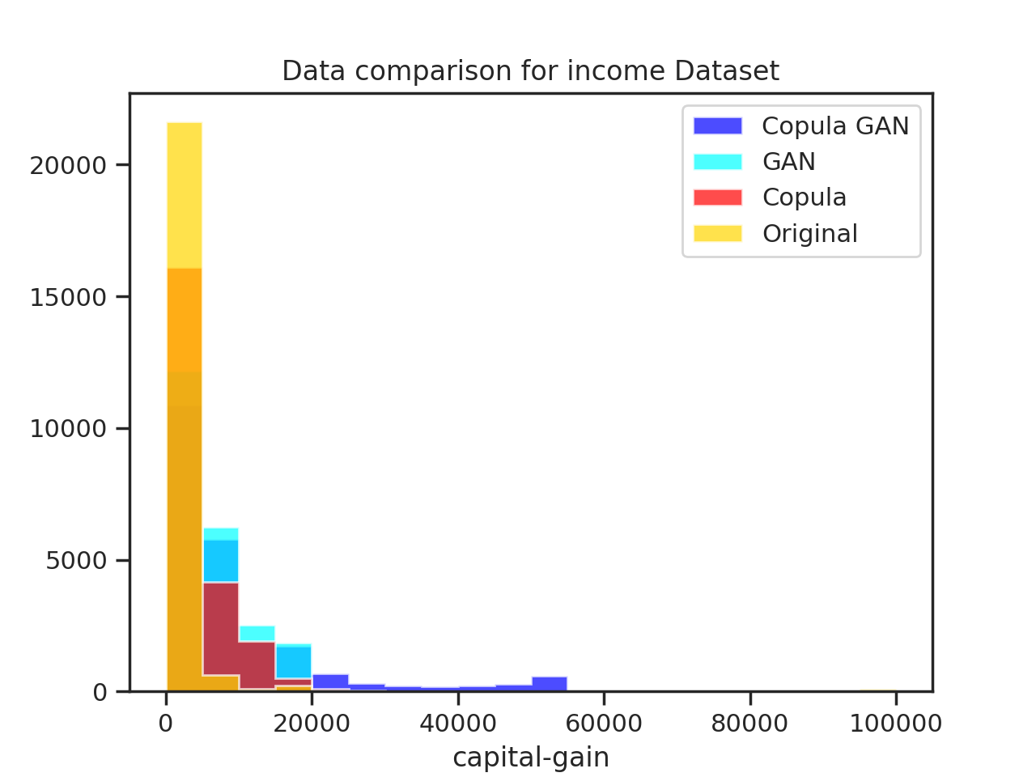
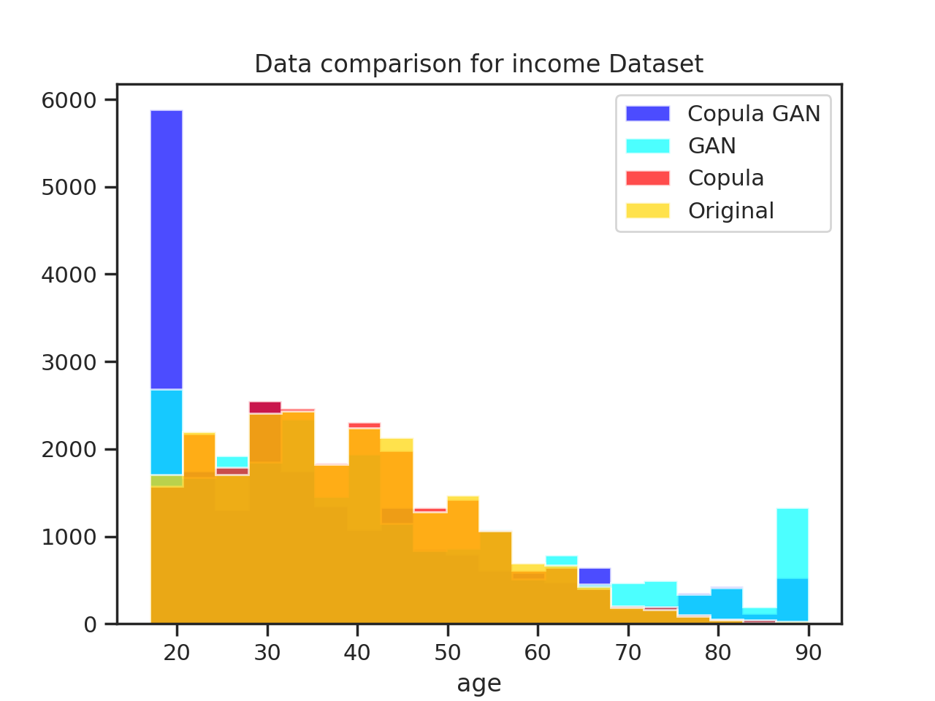
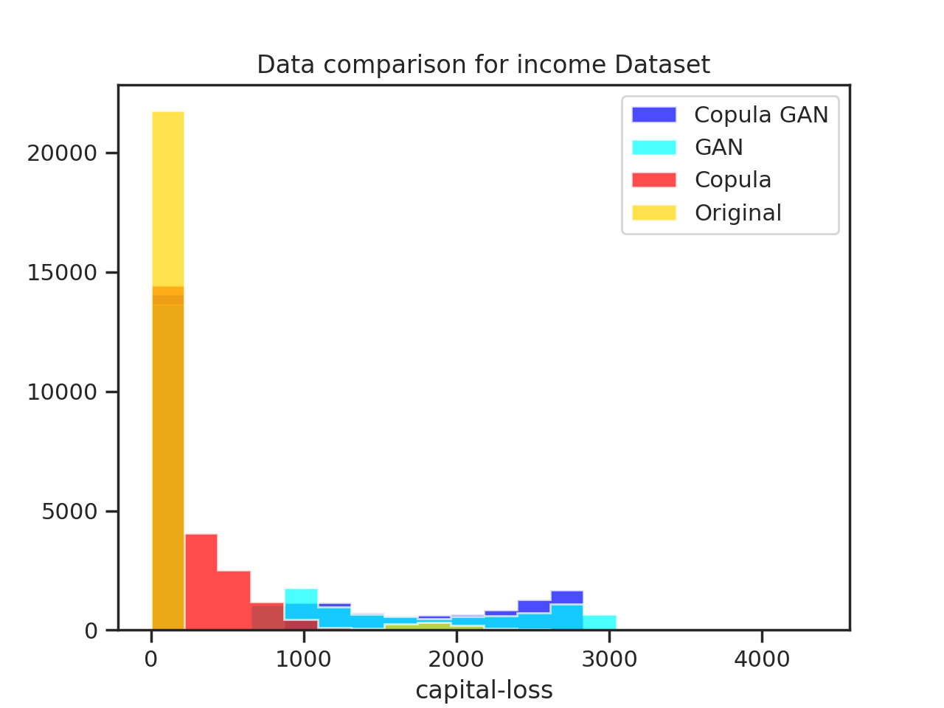
Synthetic Data Sets
Example: “Income” Data Set

Slide 6
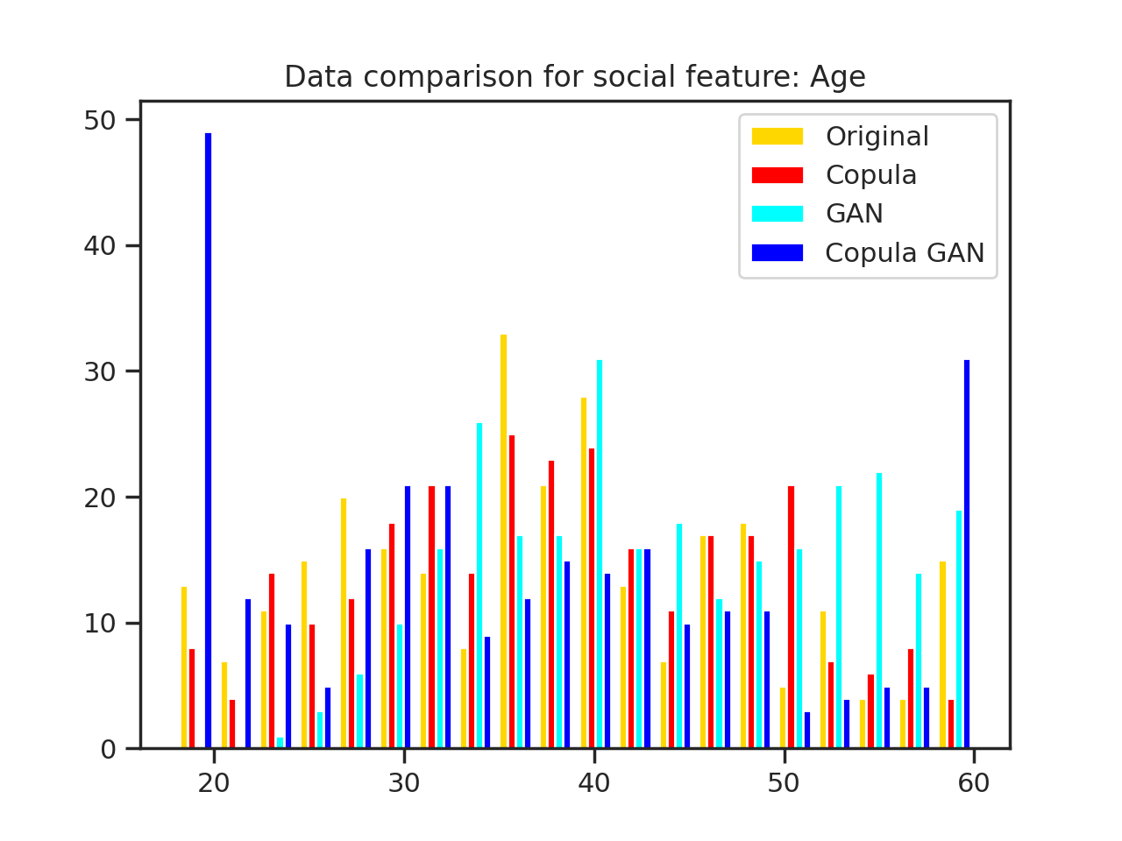
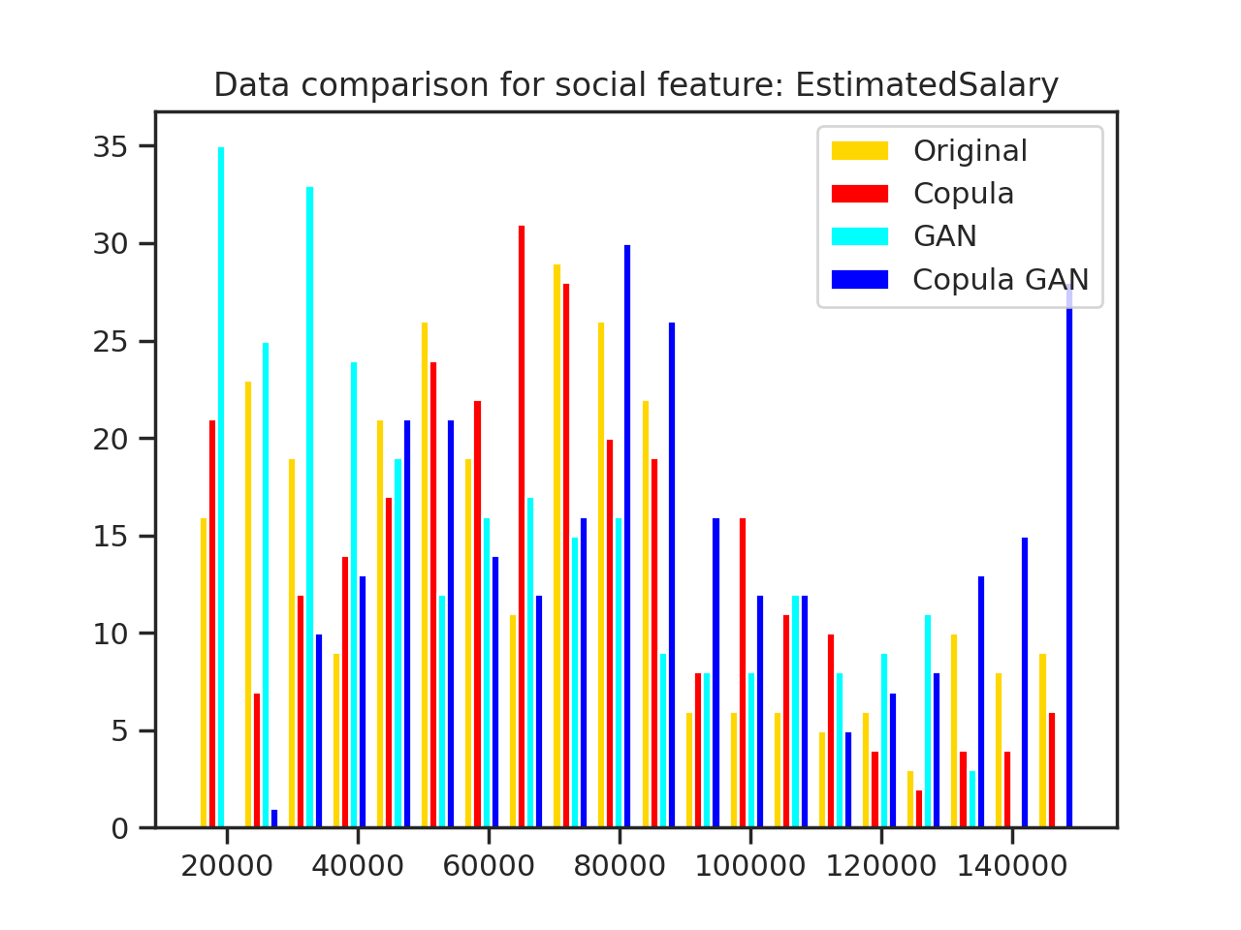
Synthetic Data Sets
Example: “Social” Data Set

Slide 7
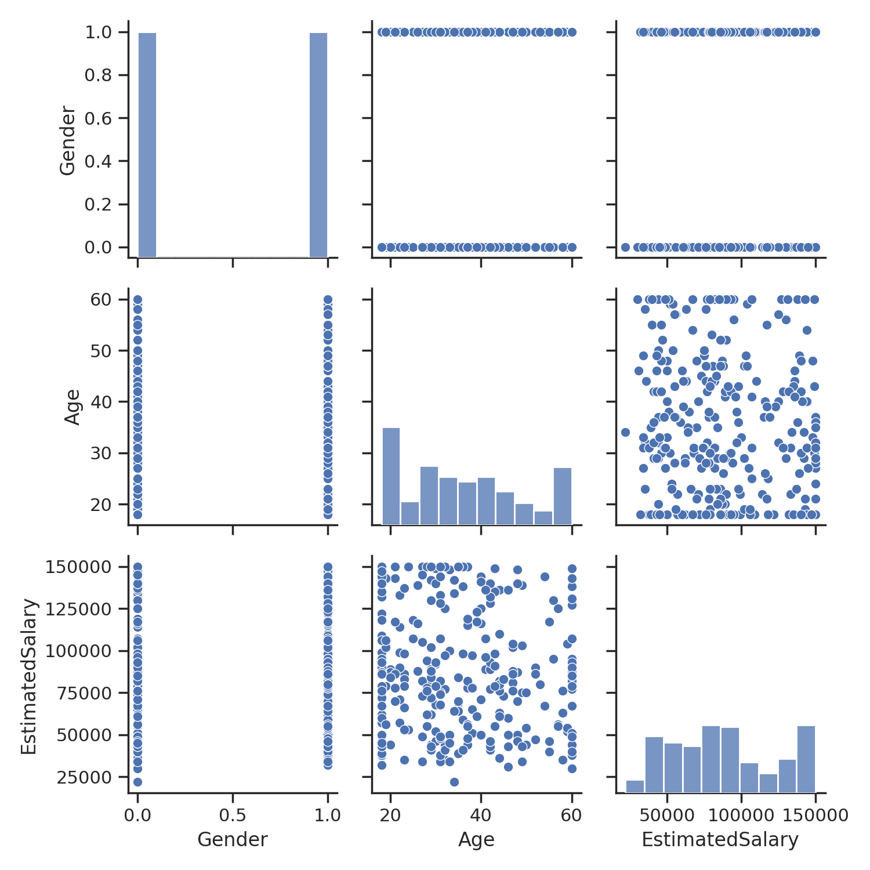
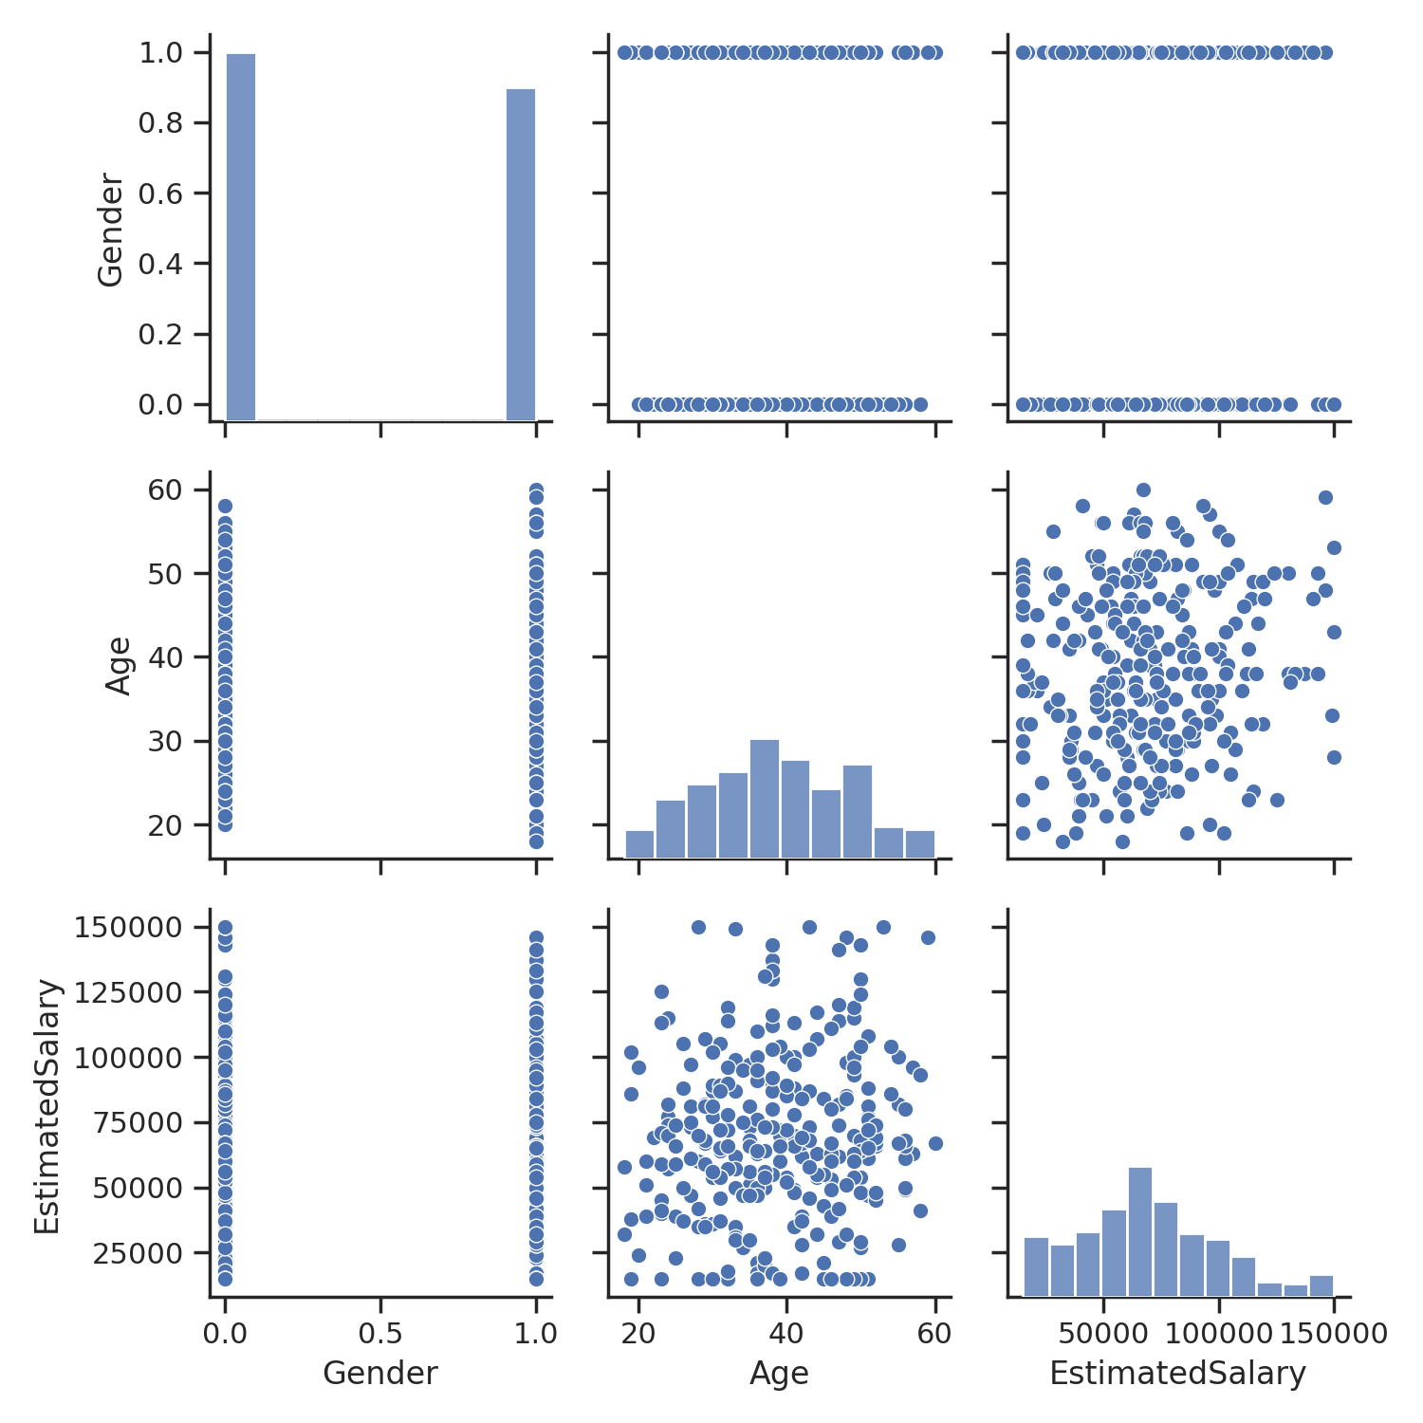
Synthetic Data Sets
Gaussian Copula
Copula GAN

Slide 8
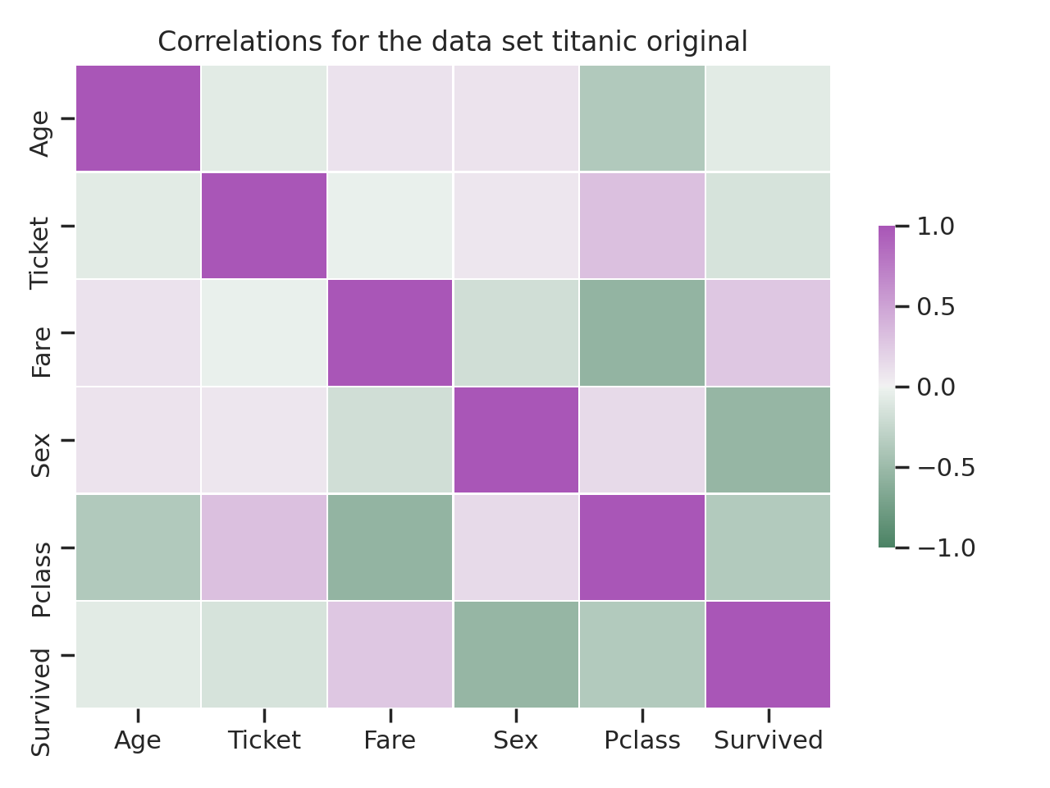
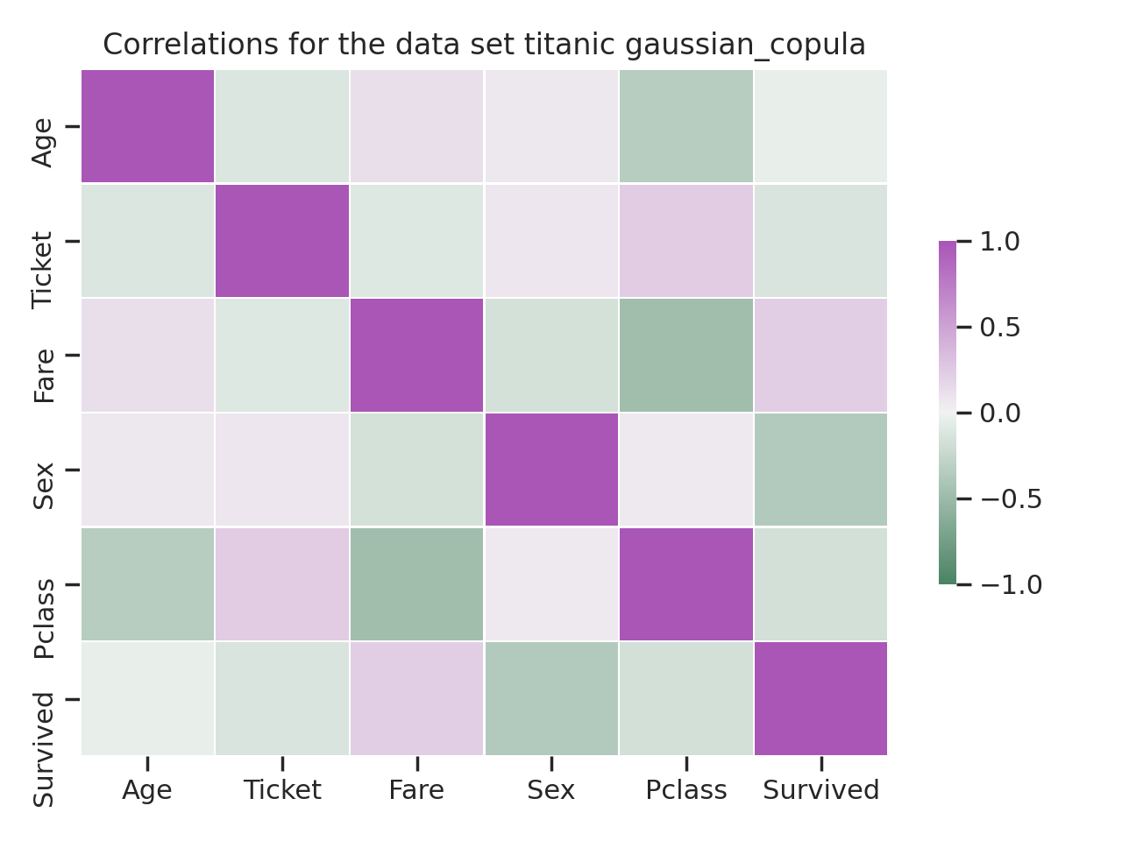
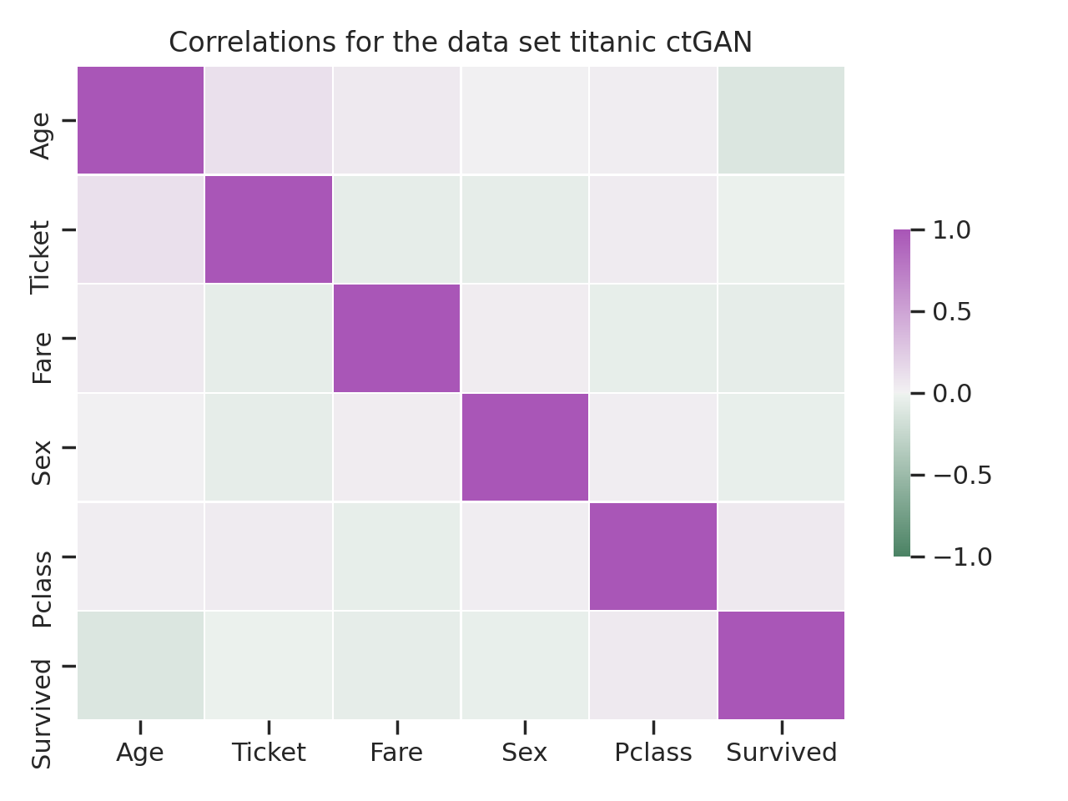
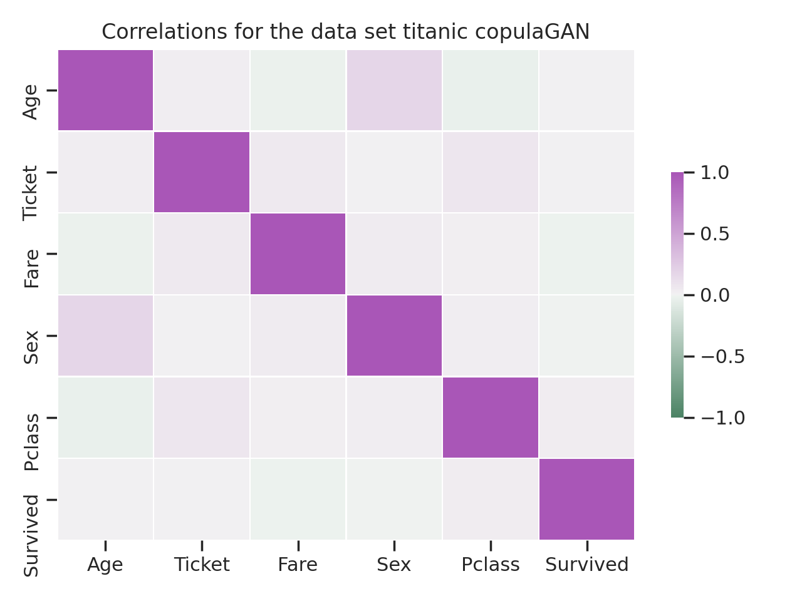
Data Loading and Pre-processing

