Slide 1
Exercise 3.1.3.1
Generation and evaluation of structured synthetic datasets
Machine Learning
SS2021 - TU Wien
Federico Ambrogi, e1449911@student.tuwien.ac.at
Adam Höfler, e11847620@student.tuwien.ac.at
Matteo Panzieri, 12039996@student.tuwien.ac.at
Vienna, 26th July 2021

Slide 2
Overview of the project
Framework
Data set description
Data pre-processing
Algorithm Implementation
Results
Comparison
Conclusion

Slide 3
Framework
Scripting language: python v3. (virtual environment using Anaconda)
Numpy
scikit-learn
pandas
sdv
(matplotlib and seaborn for visualizations)
Files description
classifier.py : main module for splitting data and learning models
generate_data.py: module for generating the synthesized data sets
dataset_analysis.py : module for comparing the results from original and artifical data

Slide 4
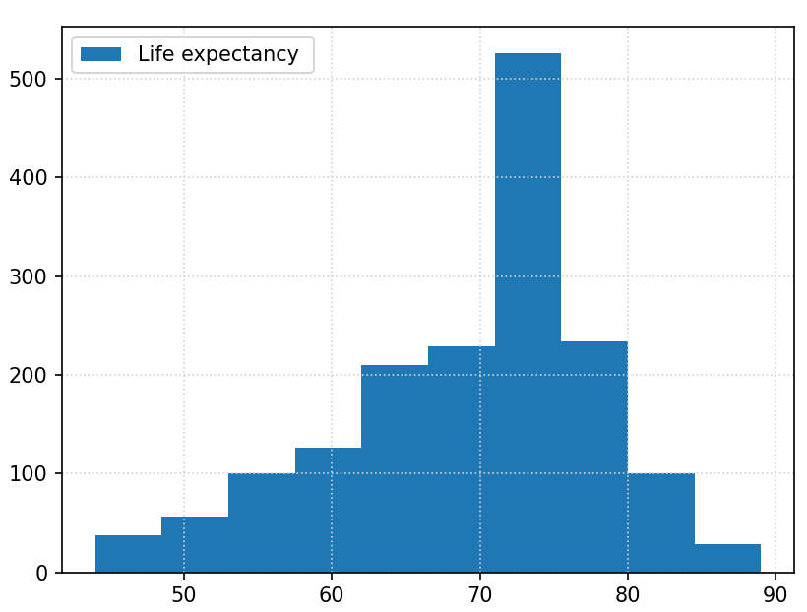
Data Set: Social Network Ads
https://www.kaggle.com/rakeshrau/social-network-ads
Aim: predict the purchase realization given gender, age and the estimated salary of the targeted user
Features:
'Gender','Age', 'Estimated Salary'
← CHANGE PLOT

Slide 5
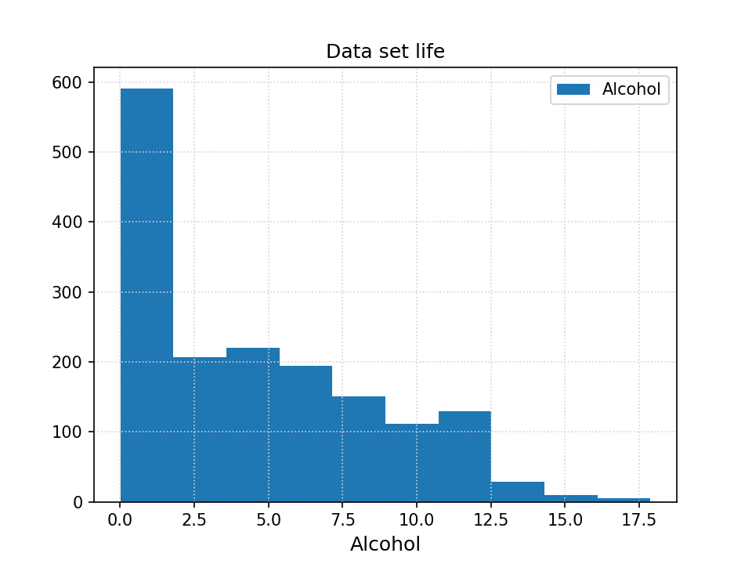
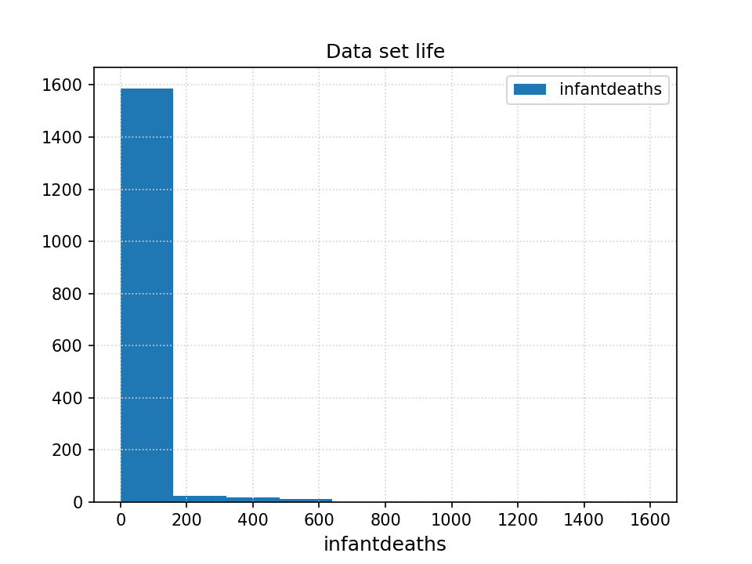
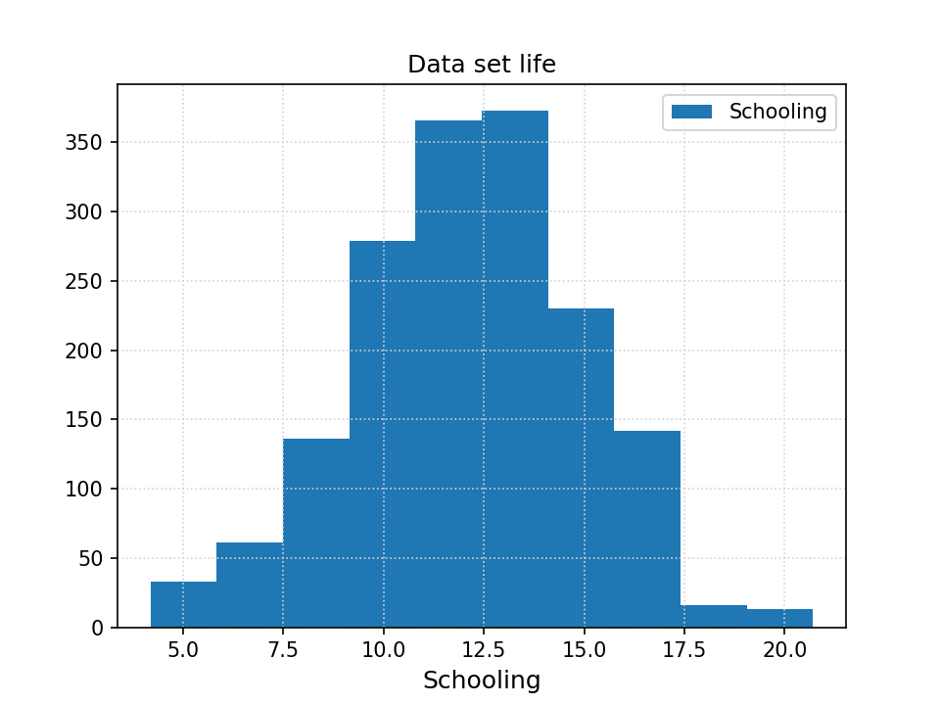
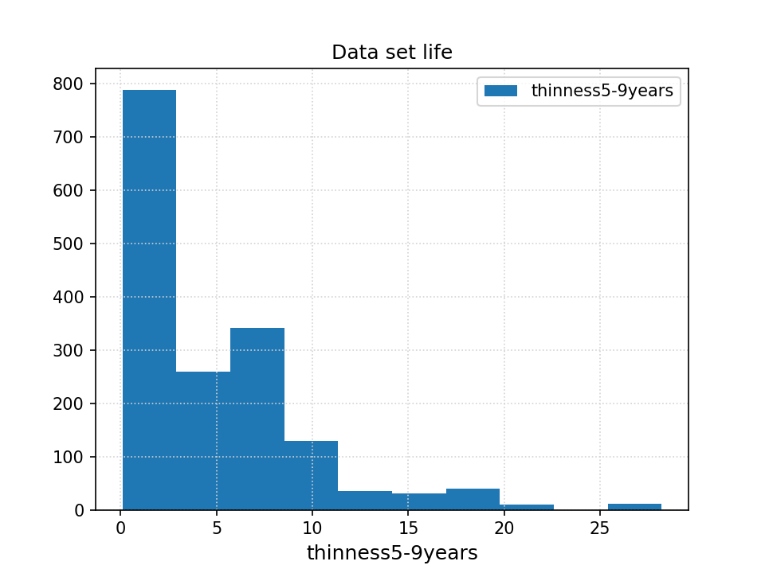
Data Set: Social network ads - example feature distributions
← CHANGE PLOTS

Slide 6
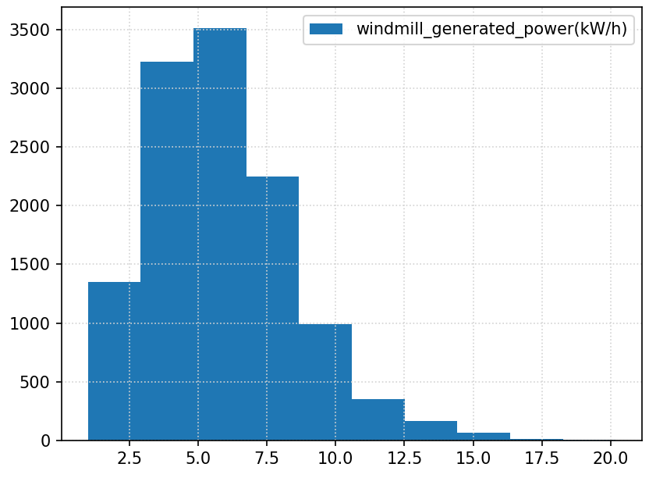
Data Set: Titanic
https://www.kaggle.com/c/titanic/data
How do factors such as ticket class, gender or family size influence the survival of the passengers on the titanic?
Features:
'PassengerId', 'Name', 'Survival', 'Ticket class', 'Sex', 'Age(years)', '# of siblings/spouses aboard', '# of parents / children aboard the Titanic', 'Ticket number', 'Passenger fare', 'Cabin number', 'Port of Embarkation'
← CHANGE PLOT
Removed Features:
'PassengerId', 'Name'

Slide 7
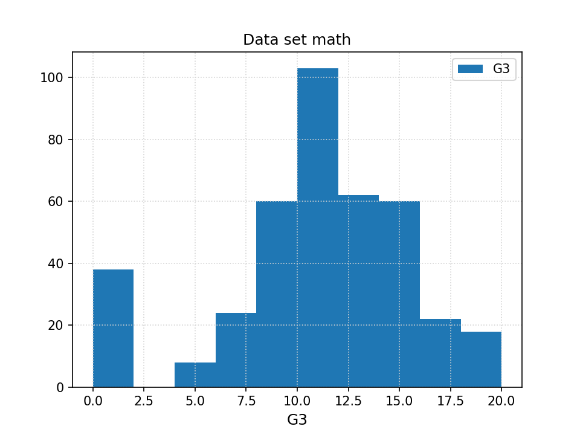
Data Set: Adult Data Set
https://archive.ics.uci.edu/ml/datasets/Adult
Can you predict whether the income of an individual data exceeds $50k/year given “census data” about him.
Features:
'age', 'workclass', 'fnlwgt', 'education', 'education-num', 'marital-status', 'occupation','relationship', 'race', 'sex', 'capital-gain', 'capital-loss', 'hours-per-week', 'native-country'
← CHANGE PLOT

Slide 8
Data Pre-processing
loading the text files using pandas to create data frames
Drop certain columns
factorize categorical values to obtain numeric values
shuffle data for randomization

Slide 9
Objective
Protect sensitive data.
Poisoning attacks become redundant.
Generate more useful data.

Slide 10
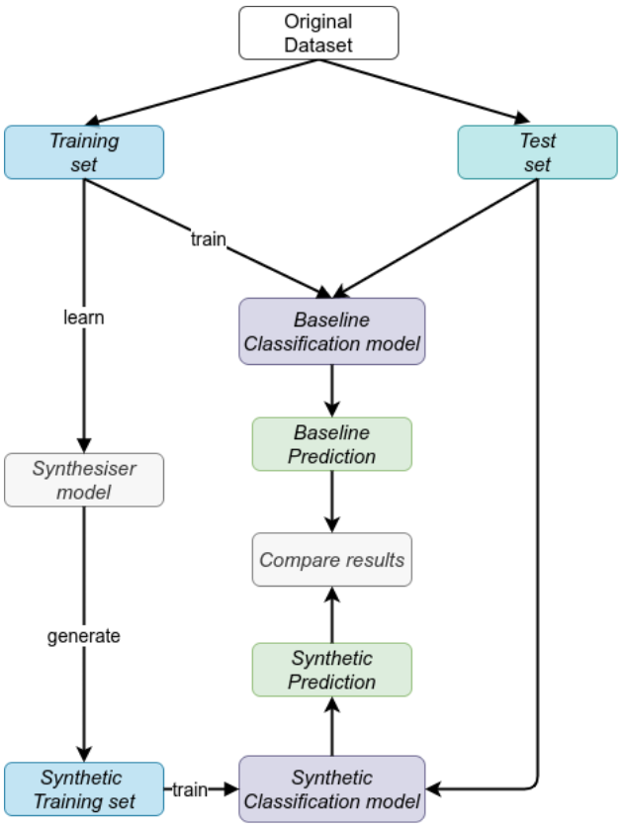
The algorithm
70%-30% split.
The train set is used to model the synthesiser models.
All the 4 model are tested on the same test set

Slide 11
The models
Models taken from SDV (Synthetic Data Vault) library.
Gaussian Copula:Distribution over hypercube
CTGAN model
CopulaGAN model: CTGAN model improved using Gaussian copula.

Slide 12
Implementation
Random forest classifier.
In general no problems with the classifiers.
Relevant time issues with the SDV models.

Slide 13
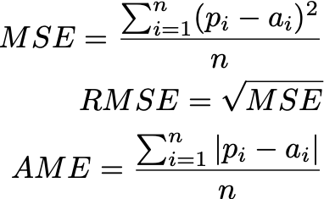
Evaluating Predictions
To assess the value of our implementation, we used three metrics:
MSE (mean-squared error)
RMSE (root mean-squared error)
MAE (mean absolute error)

Slide 14
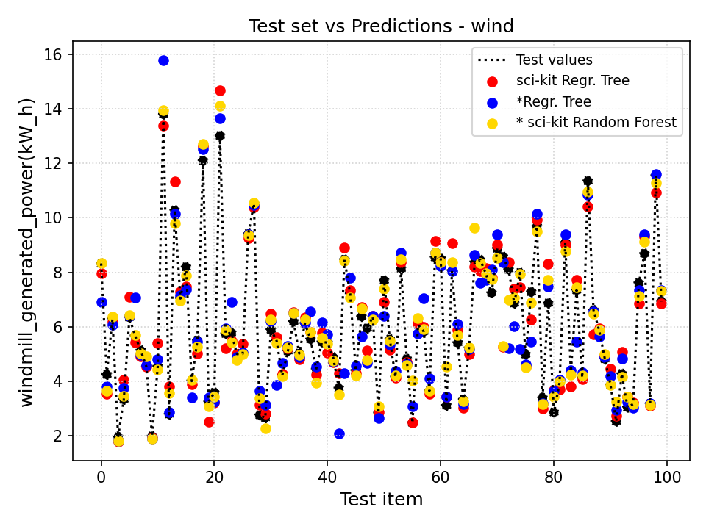
Selection of Results - Wind data set
Plot shows the values of actual data (test values) vs
sci-kit prediction (regression tree)
Our regression tree implementation
sci-kit random forest

Slide 15
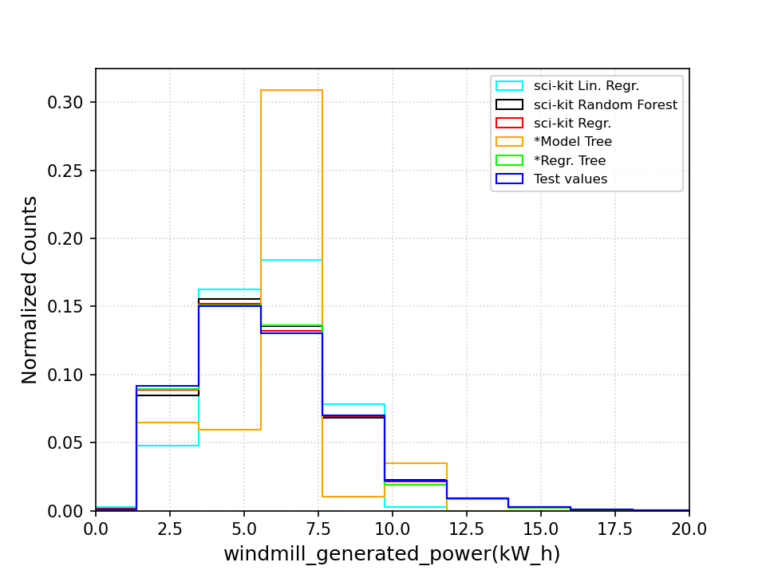
Selection of Results - Wind data set

Slide 16
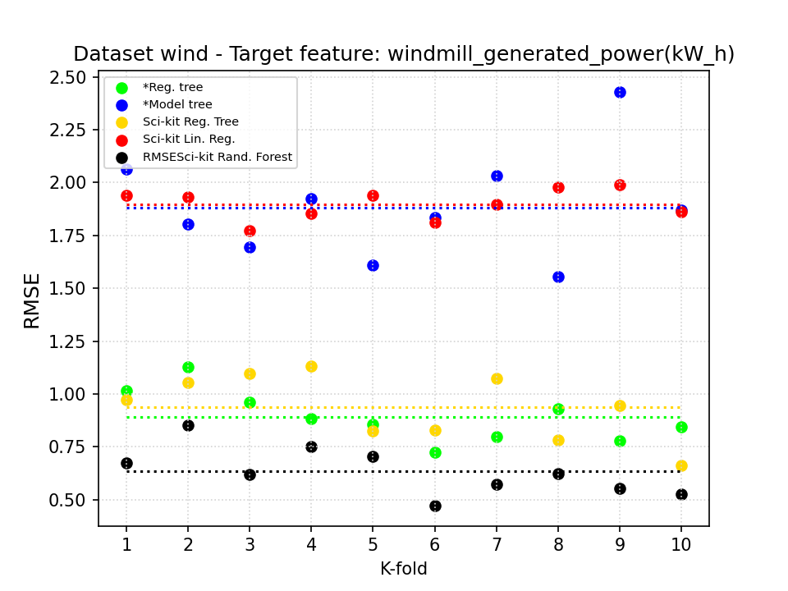
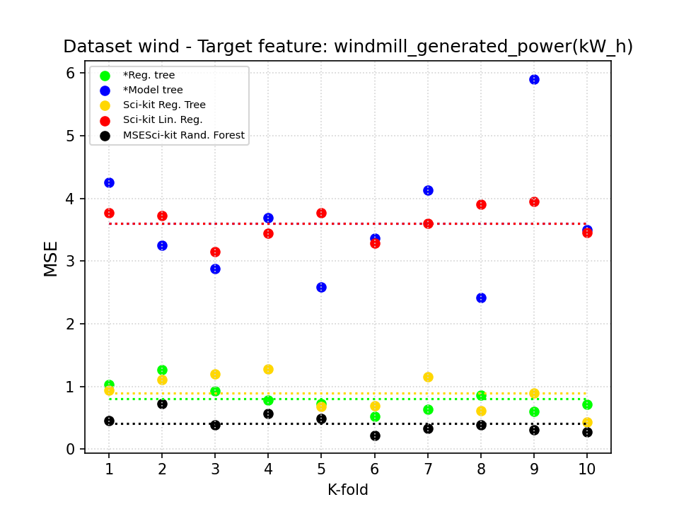
Selection of Results - Wind data set

Slide 17
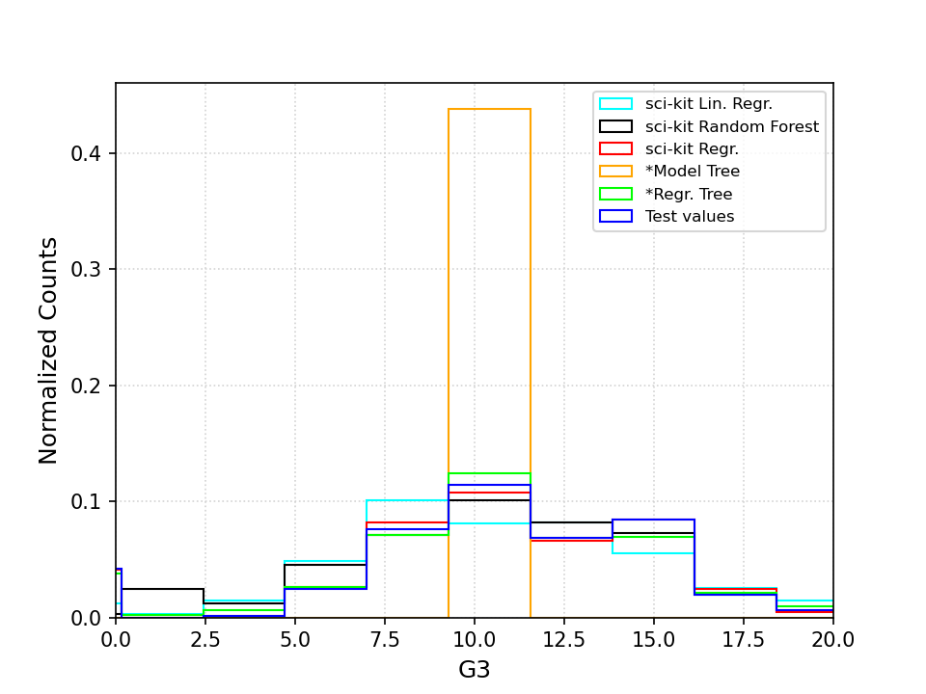
Selection of Results - Math data set

Slide 18
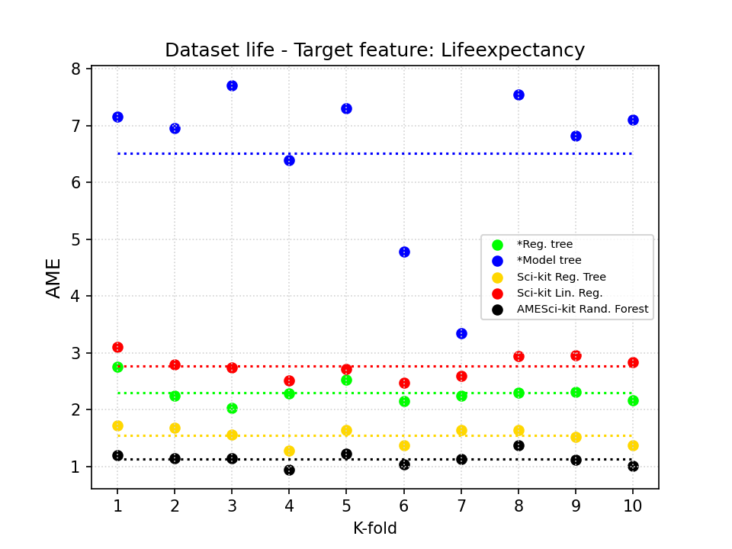
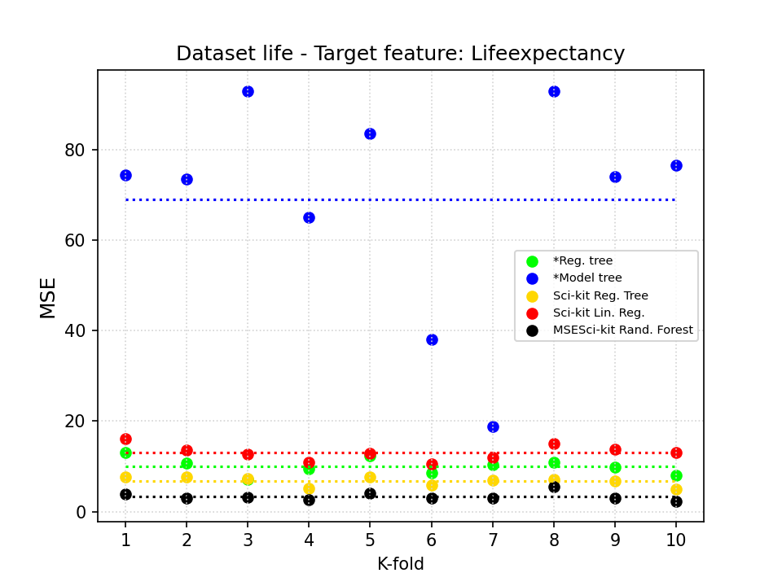
Selection of Results - Life expectancy data set

Slide 19
Future work
Use other classifiers.
Evaluate the results with the SDV methods.
Try to use different datasets.

