Slide 1
Few-Shot Class-Incremental
Learning via Training-Free
Prototype Calibration^{[1]}
Introduction to Machine Learning | Milestone 2 & Lab 1 Presentation
Team 05:
Nguyen Hoang Long: Technical Lead (Pipeline Reproduction, Lab 1 Codebase, W&B Telemetry)
Tran Gia Hien: Presentation Lead (Theoretical Modeling, Slide Deck, Deviation Analysis)
Scientific Openness Credentials:
GitHub
W&B Live Project: teen-cifar100-reproduction
[1] Q.-W. Wang et al., "Few-Shot Class-Incremental Learning via Training-Free Prototype Calibration," in NeurIPS, 2023.
Notes:
Good day, professors and fellow researchers. Today, our team—Long and Hien—presents our comprehensive reading and empirical reproduction of the NeurIPS 2023 paper entitled *"Few-Shot Class-Incremental Learning via Training-Free Prototype Calibration"* (known as TEEN), authored by the LAMDA group at Nanjing University.
This presentation encompasses both Milestone 2—providing a rigorous theoretical re-interpretation and mathematical deconstruction of the paper—and Lab 1, detailing our independent, clean-room reproduction of the algorithm on CIFAR-100 alongside comprehensive deviation analysis and sensitivity exploration.
Our presentation is structured into 28 interconnected slides. Every claim, mathematical derivation, and empirical measurement in this deck is fully tracked in our public GitHub repository and backed by verified, publicly accessible run telemetry on Weights & Biases. Let us begin by examining the core problem that TEEN seeks to address.

Slide 2
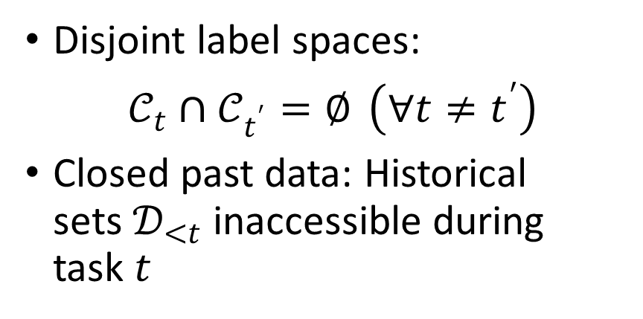
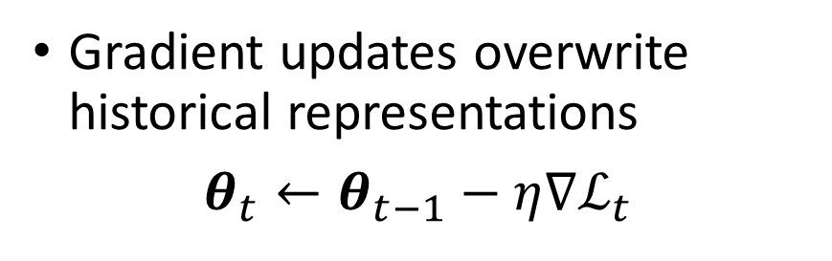
Class-Incremental Learning^{[2]} & Catastrophic Forgetting^{[3]}
PART 1: OVERVIEW & RESEARCH CONTEXT
Sequential Non-Stationary Stream:
CIL & Catastrophic Forgetting:
D₀
D₁
…
D_{T}
Gradient updates overwrite historical representations
$θ_{t}←θ_{t−1}−η∇ℒ_{t}$
Stability-Plasticity Dilemma:
Disjoint label spaces:
$𝒞_{t}∩𝒞_{t^{′}}=∅ \left(∀t≠t^{′}\right)$
Closed past data: Historical sets $𝒟_{<t}$ inaccessible during task $t$
Plasticity: Absorbing novel geometric concepts
Stability: Preserving historical decision boundaries
[2] H.-L. Sun et al., "PILOT: A pre-trained model-based continual learning toolbox," arXiv, 2023.
[3] R. M. French and N. Chater, "Using noise to compute error surfaces in connectionist networks: A novel means of reducing catastrophic forgetting," in Neural Computation., 2002.
Notes:
Real-world artificial intelligence rarely operates in static, closed-world settings; rather, data arrives sequentially over time in dynamic environments. This continual learning setting is formalized as Class-Incremental Learning (CIL), as formulated by Sun et al.
Consider a concrete example: an autonomous vehicle perception system. The vision model is initially trained to detect standard road entities—pedestrians, passenger cars, trucks, and cyclists. Months later, the vehicle is deployed in a modern smart city where it must incrementally learn novel traffic categories, such as electric kick-scooters and autonomous sidewalk delivery robots.
The fundamental challenge in CIL is the notorious catastrophic forgetting problem, formally investigated by French and Chater. When engineers adapt the deep neural network parameterized by theta on these new classes using standard gradient descent, the newly computed gradient updates irrevocably overwrite the weight configurations that encoded representations of earlier classes. Consequently, while the vehicle successfully learns to recognize e-scooters, it suddenly fails to detect oncoming trucks and pedestrians—introducing catastrophic safety hazards.
This introduces the classic Stability-Plasticity Dilemma: a model must remain plastic enough to integrate new knowledge, yet stable enough to prevent catastrophic interference. As we will see, this dilemma becomes exponentially more hazardous when novel classes arrive with severely limited supervision.

Slide 3
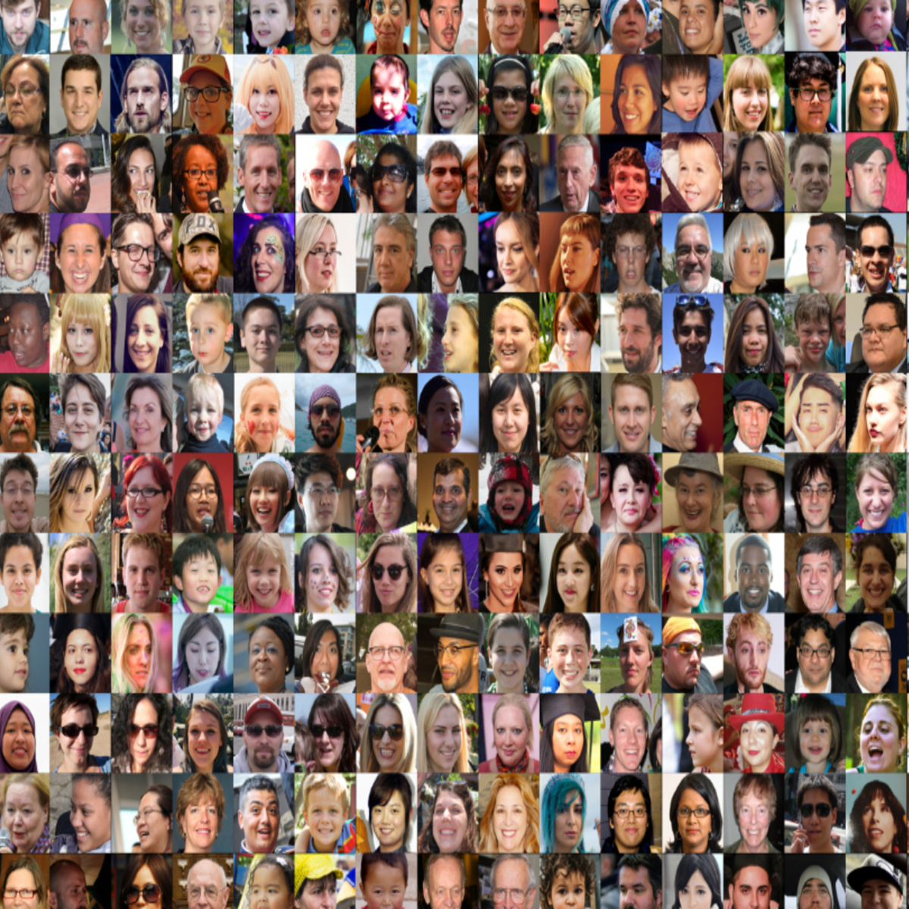
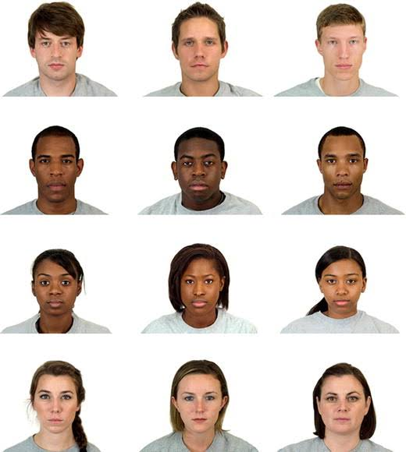
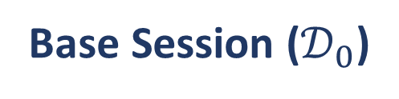
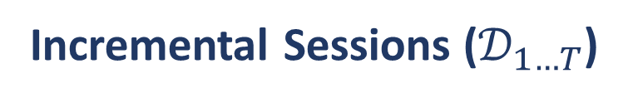
Few-Shot Class-Incremental Learning (FSCIL)^{[4]} & Real-World Application^{[5]}
PART 1: OVERVIEW & RESEARCH CONTEXT
Base Session ($𝒟_{0}$)
Incremental Sessions ($𝒟_{1…T}$)
(Base classes)
(Novel classes)
Class 1
.
.
.
.
.
.
Class 12
Class 13:
Class 14:
Session
1
Class 15:
Class 16:
Session
2
[4] X. Tao et al., "Few-shot class-incremental learning," in CVPR, 2020.
[5] S. Madhavan and N. Kumar, "Incremental methods in face recognition: a survey," in Artificial Intelligence Review, 2021.
Notes:
To bridge the gap between academic benchmarks and physical reality, Few-Shot Class-Incremental Learning (FSCIL) was introduced. In standard CIL, novel classes are assumed to have abundant data. In FSCIL, however, the model encounters a realistic asymmetry: while base classes possess ample training examples, novel incremental classes arrive in an extreme few-shot regime—typically 5 classes at a time with only 5 images per class (5-way 5-shot).
Consider a concrete real-world application: an automated smart campus security system. The system has already learned 1,000 student faces during orientation. Halfway through the term, five transfer students join. The edge camera can only obtain 5 quick snapshots of each newcomer. Under strict privacy regulations, the system is legally prohibited from permanently storing raw facial images of the original 1,000 students. Furthermore, edge microprocessors cannot support multi-epoch backpropagation.
The system must immediately update its classifier to distinguish all 1,005 individuals accurately. This dual constraint—data scarcity and zero data replay—defines the high stakes of FSCIL.

Slide 4
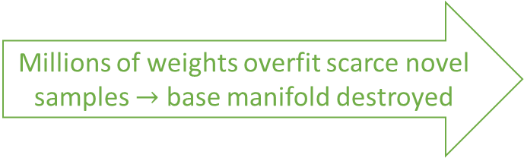
Optimization Dilemma in FSCIL: The Bias-Variance Tradeoff^{[6][7][8]}
PART 1: OVERVIEW & RESEARCH CONTEXT
FSCIL Optimization
Fine-tune Backbone using Gradient Descent
($∇_{θ}ℒ≠0$)
Fine-tune Backbone using Gradient Descent
(∇_𝜽 ℒ≠𝟎)
Freeze Backbone using Frozen Weights
($∇_{θ}ℒ=0$)
Freeze Backbone using Frozen Weights
(∇_𝜽 ℒ=𝟎)
Severe Overfitting & Forgetting
Millions of weights overfit scarce novel samples $→$ base manifold destroyed
A
Rigid & Inflexible Head
Preserves stability, but naive heads fail on novel semantic manifolds
B
[6] A. F. Akyürek, E. Akyürek, D. Wijaya, and J. Andreas, "Subspace regularizers for few-shot class incremental learning," in ICLR, 2022.
[7] Y. S. Abu-Mostafa, "Lecture 08 – The Bias-Variance Tradeoff," CS 156: Learning From Data, California Institute of Technology, 2012. [Online]. Available: https://work.caltech.edu/slides/slides08.pdf
[8] Y. S. Abu-Mostafa, "Lecture 11 – Overfitting," CS 156: Learning From Data, California Institute of Technology, 2012. [Online]. Available: https://work.caltech.edu/slides/slides11.pdf
Notes:
Why can we not simply apply standard deep learning techniques to FSCIL? This slide formalizes the Optimization Dilemma, establishing a direct link to fundamental machine learning principles from our lectures.
If we choose Branch A and compute gradient descent over the novel 5 samples, we optimize over 11 million weights in a standard ResNet. As established in Lecture 11 on Overfitting](https://work.caltech.edu/slides/slides11.pdf) and Statistical Learning Theory [8], generalization bounds depend directly on sample size. When N is merely 5, Empirical Risk Minimization collapses: the model overfits the training samples perfectly while destroying historical features.
Conversely, if we choose Branch B and freeze the backbone to ensure stability, naive linear heads cannot generalize.
Referring to [Lecture 8 on the Bias-Variance Tradeoff](https://work.caltech.edu/slides/slides08.pdf) [7]: with N=5, the variance of any parameter estimator explodes. The empirical mean of 5 images suffers from severe sampling noise, deviating unpredictably from the true population distribution centroid. This mathematical reality renders conventional optimization unsuitable.

Slide 5
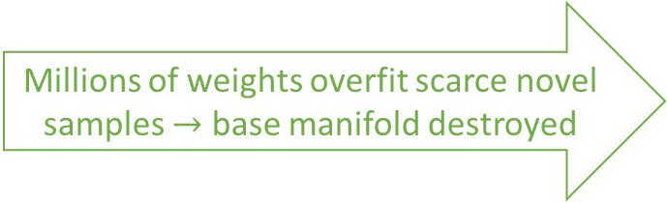
Prior Approach 1 – Replay Buffers & Knowledge Distillation (iCaRL)
PART 2: PRIOR WORK & MISSING RESEARCH GAP
FSCIL Optimization
Fine-tune Backbone using Gradient Descent
($∇_{θ}ℒ≠0$)
Fine-tune Backbone using Gradient Descent
(∇_𝜽 ℒ≠𝟎)
Freeze Backbone using Frozen Weights
($∇_{θ}ℒ=0$)
Freeze Backbone using Frozen Weights
(∇_𝜽 ℒ=𝟎)
Severe Overfitting & Forgetting
Millions of weights overfit scarce novel samples $→$ base manifold destroyed
A
Rigid & Inflexible Head
Preserves stability, but naive heads fail on novel semantic manifolds
B
[6] A. F. Akyürek, E. Akyürek, D. Wijaya, and J. Andreas, "Subspace regularizers for few-shot class incremental learning," in ICLR, 2022.

