Slide 1
AFEM with Hanging Nodes and DUNE-FEM
Introduction to master‘s thesis
F. Meyer
03.09.2012
01 title

Slide 2
Table of contents
Idea for the master‘s thesis
Introduction DUNE-FEM
1-irregular mesh and hanging nodes
AFEM on 1-irregular mesh and error indicator
Source materials
F. Meyer
03.09.2012
02 table of contents

Slide 3
Idea for the master‘s thesis
Goal:
Using AFEM with Dune-FEM on the subtraction approach to solve the Poisson equation
on a multilayer sphere model Ω, that is (more details view [1]):
Therefore we will use a decomposition of Ω into a mesh of elements K, which are open convex quadrilaterals in 2D-case or open convex hexahedrons in 3D-case (with certain properties, which follow).
As a error estimator in the adaption-process we use the error indicator introduced by X. Zhao et al. in the paper [2].
F. Meyer
03.09.2012
03 idea for the master‘s thesis

Slide 4
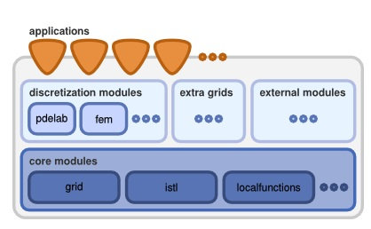
Introduction Dune-fem
„DUNE, the Distributed and Unified Numerics Environment is a modular toolbox for solving partial differential equations (PDEs) with grid-based methods. It supports the easy implementation of methods like Finite Elements (FE), […].
The underlying idea of DUNE is to create slim interfaces allowing an efficient use of legacy and/or new libraries. Modern C++ programming techniques enable very different implementations of the same concept (i.e. grids, solvers, ...) using a common interface at a very low overhead. Thus DUNE ensures efficiency in scientific computations and supports high-performance computing applications.
http://www.dune-project.org/dune.html
DUNE is based on the following main principles:
Separation of data structures and algorithms by abstract interfaces […]
Efficient implementation of these interfaces using generic programming techniques […],
Reuse of existing finite element packages with a large body of functionality […].“
(http://www.dune-project.org/dune.html)
F. Meyer
03.09.2012
04 introduction DUNE-FEM

Slide 5
„DUNE-FEM is a DUNE module which defines interfaces for implementing discretization methods like Finite Element Methods (FEM) and Finite Volume Methods (FV) and Discontinuous Galerkin Methods (DG).“(http://dune.mathematik.uni-freiburg.de/)
DUNE-FEM offers interfaces to solve the Poisson equation on different grids (ALBERTAGRID, ALUGRID etc.) with various solver. Especially we want to use the adaptive version of this implementation, therefore we have to implement the error estimator by Zhao and the subtraction approach in the problem data.
We summarize the advantages of DUNE-FEM:
flexibility through template-based implementations
different solvers and optimization opportunities already given
use of different grid managers independent of current implementation
F. Meyer
03.09.2012
05 introduction DUNE-FEM

Slide 6
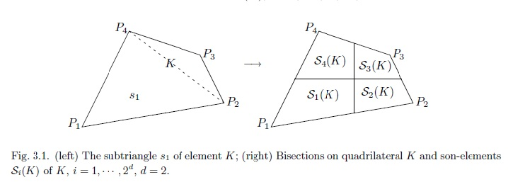
1-irregular mesh and hanging nodes
Assumption:
Ω is a bounded domain, decomposed by an initial mesh T‘
T‘ consists of elements K, which are open convex quadrilaterals in 2D-case or
open convex hexahedrons in 3D-case
T is a regular, multilevel adaptive mesh generated from T‘ by bisection of marked
elements in the following way:
[2] p. 624,figure 3.1.
F. Meyer
03.09.2012
06 1-irregular mesh and hanging nodes

Slide 7
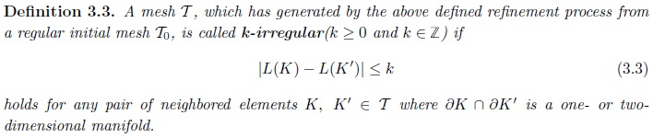
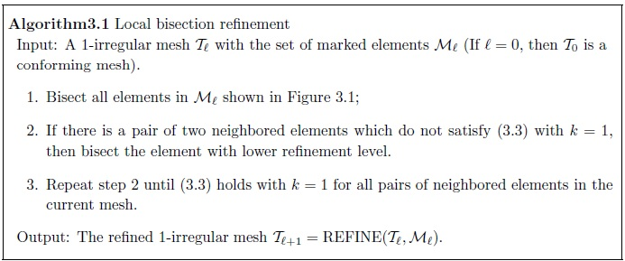
[2] p. 625
For our purpose we consider 1-irregular meshes generated by the following algorithm:
[2] p. 626
F. Meyer
03.09.2012
07 1-irregular mesh and hanging nodes

Slide 8
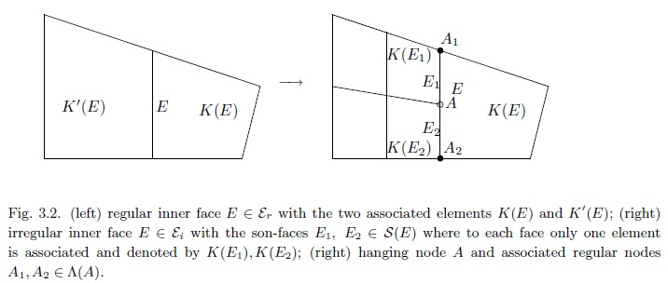
Now we deal with hanging nodes, which are generated by the refinement process:
[2] p. 627
F. Meyer
03.09.2012
08 1-irregular mesh and hanging nodes

Slide 9
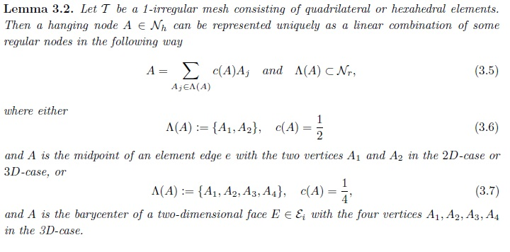
The following lemma characterizes a hanging node:
[2] p. 627-628
F. Meyer
03.09.2012
09 1-irregular mesh and hanging nodes

Slide 10
Now we go back to the original problem and the goal to use FEM to solve it. Therefore we first define the constrained approximation space with zero boundary (details view [2]):
We then consider the discrete weak formulation for the problem:
Find
such that
with
for the linear second order elliptic PDE:
F. Meyer
03.09.2012
10 1-irregular mesh and hanging nodes

Slide 11
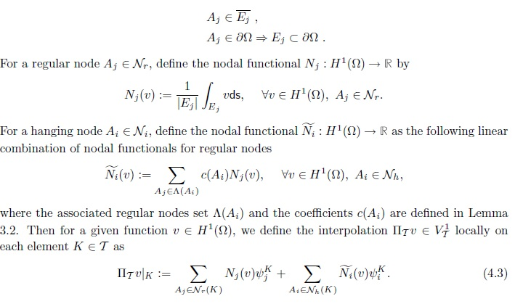
Then we need an H¹-interpolation operator. According to Zhao assign to each regular node A_{j} a face E_{j} such that:
[2] p. 628
Then this interpolation satisfies various approximation conditions.
F. Meyer
03.09.2012
11 1-irregular mesh and hanging nodes

Slide 12
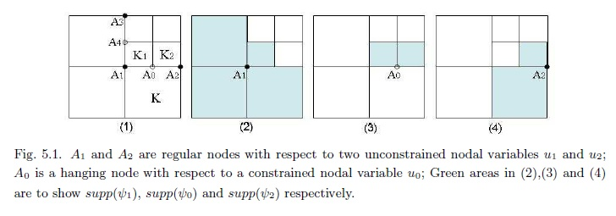
Example:
Let u₀,u₁,u₂ be nodal variables (or degrees of freedom) of an element K located on edge E as in Figure 5.1. below:
[2] p. 637
To keep the continuity across the edge A₁A₂ we modify u and the basis functions :
₀
F. Meyer
03.09.2012
12 1-irregular mesh and hanging nodes

Slide 13
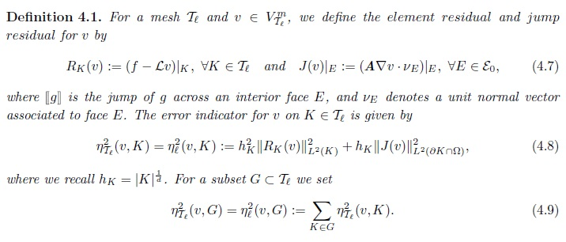
AFEM on 1-irregular mesh and error indicator
We will use the following residual-based a posteriori error estimate on 1-irregular meshes:
[2] p. 629
Then different estimations hold in respect to the error estimator above, for more details view [2].
F. Meyer
03.09.2012
13 AFEM on 1-irregular mesh and error indicator

Slide 14
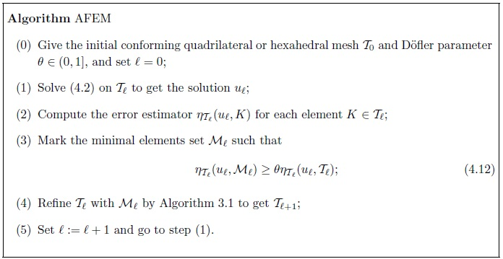
Then the AFEM algorithm is given as
[2] p. 629
The convergence of this algorithm is proved in [2].
F. Meyer
03.09.2012
14 AFEM on 1-irregular mesh and error indicator

Slide 15
Source materials
[1] C. Wolters, A. Anwander, G. Berti, U. Hartmann, Geometry-Adapted Hexahedral Meshes Improve Accuracy of Finite-Element-Method-Based EEG Source Analysis
[2] Xuying Zhao, Adaptive Quadrilateral And Hexahedral Finite Element Methods With Hanging Nodes and Convergence Analysis
F. Meyer
03.09.2012
15 source materials

