Slide 1
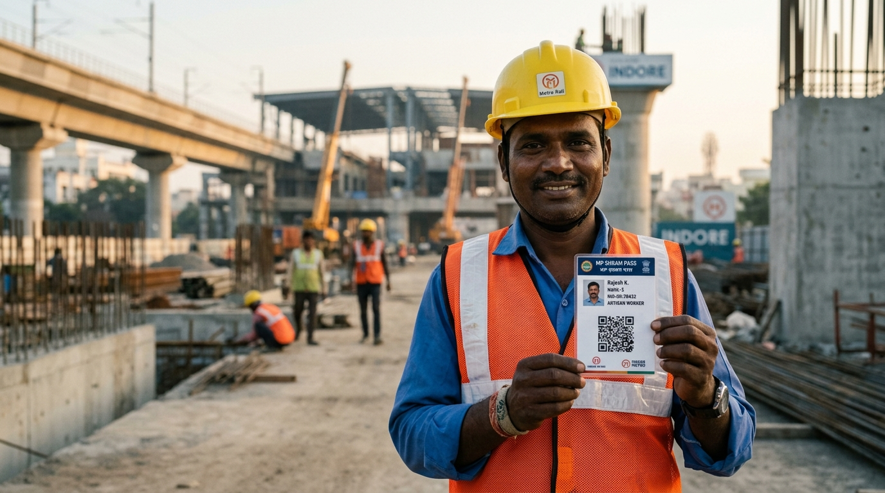
INDORE SAHODAYA · COMPUTER SCIENCE · 2026
Shram Setu 2.0
An offline-first, transparency-centred work and wage record system for India's daily-wage workforce.
Every shift recorded · Every wage explained · Every change traceable
LOCAL DEMO MODE · PROTOTYPE
PRESENTED BY
[Student name] · Class [ ] · Roll [ ]
GUIDE
[Guide / Supervisor name]
INSTITUTION
[School name] · Indore, Madhya Pradesh
Notes:
Open with the sentence the whole project rests on: a wage dispute usually begins where the record ends. Shram Setu 2.0 is a working React/TypeScript prototype, not a pitch deck: everything shown today runs in a browser, offline, on synthetic data. Say the tagline once: every shift recorded, every wage explained, every change traceable.

Slide 2
ROADMAP
01 CONTEXT
Four chapters, twelve minutes
01
02
03
04
Context
Design
Build
Close
— The record gap
— The core idea
— Demo scenarios
— Limitations
— Audit and court evidence
— Architecture & stack
— Offline sync & privacy
— What is genuinely new
— Question and objectives
— Wage engine, ledger, QR
— Tests, cost, honesty
— Questions
SLIDES 03 — 06
SLIDES 07 — 18
SLIDES 19 — 23
SLIDES 24 — 26
STATUS local demo mode · IndexedDB
React 19 · TypeScript · Vite · Web Crypto SHA-256 · QR passes
Shram Setu 2.0 · Indore Sahodaya Computer Science · 2026
02 / 26
Notes:
Signpost only — do not read the cards. Four chapters: the problem and its evidence, the design that answers it, what was actually built and tested, and an honest close. Tell the judges you will keep the honesty section at the end and not hide it.

Slide 3
THE PROBLEM
01 CONTEXT
A dispute begins where the record ends
One shift passes through six hands. No single artefact holds all six — so every disagreement becomes one person's memory against another's.
1
2
3
4
5
6
Agreed
Recorded
Calculated
Paid
Acknowledged
Disputed
rate spoken,
never written
register or
WhatsApp message
arithmetic not
shown to the worker
contractor's own
note of payment
no worker receipt
exists at all
memory against
memory
No shared record
No visible arithmetic
No preserved history
Worker, contractor and intermediary each keep a different version.
A total appears; the days, hours, deductions and reasons do not.
A correction overwrites the earlier value, and the reason vanishes.
The cost is not only unpaid money — it is the absence of evidence when a worker tries to claim it.
Shram Setu 2.0 · Indore Sahodaya Computer Science · 2026
03 / 26
Notes:
Walk the six-step chain left to right. Pause at step four: payment entered by a contractor is not the same event as a worker acknowledging receipt, and most systems merge the two. Then the three gaps — shared record, visible arithmetic, preserved history — are precisely the three things the design tries to fix.

Slide 4
WHY IT MATTERS
01 CONTEXT
This is not a hypothetical gap
31 crore
₹269 cr
₹704 cr
43%
workers registered on e-Shram by mid-2026 — a registry, not a wage record.
of Kerala MGNREGS wages released 16 to 90 days after muster closure.
in unpaid wages reported in Jammu & Kashmir as at March 2024.
of India's wages were still paid in cash in 2021, down from 79% in 2014.
Ministry of Labour & Employment
CAG Report No. 9 of 2025
CAG performance audit
ILO, 2024
COURT RECORD
THE DESIGN CONSEQUENCE
Calcutta High Court, WPA 25460 of 2025 — a principal employer was directed to pay contract workers' unpaid wages under Section 21(4) of the Contract Labour Act, 1970.
Contemporaneous, inspectable records of what was agreed and what was paid decide these cases. That is exactly what this prototype stores.
Shram Setu 2.0 · Indore Sahodaya Computer Science · 2026
04 / 26
Notes:
Four numbers, four sources — government registry, two CAG audits and ILO research. Do not overclaim: the CAG figures show delay inside a public programme, not fraud by any named party. The court case is included because it turns on documentary evidence, which is the design argument. Judge question you should expect: 'Is this a real problem or a made-up one?' — answer with the CAG delay figures.

Slide 5
RESEARCH QUESTION
01 CONTEXT
One question, seven objectives
THE QUESTION
How can an affordable, offline-capable web system make daily-wage work records, wage calculations, payment status and disagreements easier to verify?
OBJECTIVES
01
02
03
04
Low-cost workflow for low digital access
One deterministic wage engine, visible to all
Corrections preserve prior values and reasons
Tampering detected by explainable, rule-based checks
05
06
07
Offline operation inside a browser
A path to secure, cross-device approval
Repeatable evaluation on synthetic data
Scope is deliberately narrow: transparency and verifiability of records — not proving attendance, not guaranteeing payment, not deciding legal truth.
Shram Setu 2.0 · Indore Sahodaya Computer Science · 2026
05 / 26
Notes:
Read the research question once, slowly. The seven objectives are the marking scheme for the rest of the deck — every later slide maps back to one of them. Note the deliberate boundary sentence at the bottom: the project claims record transparency, nothing more.

Slide 6
EXISTING SYSTEMS
01 CONTEXT
What exists — and what it leaves open
SYSTEM
PRIMARY PURPOSE
WAGE CALCULATION
CORRECTION HISTORY
OFFLINE
e-Shram
National registry of unorganised workers
Not applicable
Not its purpose
Needs network
MGNREGS
Public rural employment and wage payment
System-generated
Social audit exists
Partial
Payroll apps
Employer payroll processing
Varies by product
Employer-controlled
Mostly online
Paper / WhatsApp
Informal record keeping
Manual and unshown
Easily altered or lost
Fully offline
Shram Setu 2.0
Work and wage reconciliation between two parties
One shared engine, shown step by step
Prior value, reason, actor, timestamp
Local only
Comparison of documented purpose, not assumed defects. Sources: e-Shram portal; CAG MGNREGS audits; product documentation; the project's own implementation report.
Shram Setu 2.0 · Indore Sahodaya Computer Science · 2026
06 / 26
Notes:
The gap is the empty middle of the table: systems either register workers, or run a public programme, or belong to the employer — none is a shared, two-party record of one shift with the arithmetic visible to both sides. The last row is the niche this project occupies. Be fair to e-Shram: it was never designed to do this.

Slide 7
THE CORE IDEA
02 DESIGN
Every shift recorded.
Every wage explained.
Every change traceable.
A shared muster roll that worker, contractor and reviewer can all read.
The arithmetic, line by line: days, rate, overtime, deductions, balance.
Prior value, new value, reason, actor and timestamp — kept, not replaced.
Transparency by mechanism, not by claim.
01
02
03
Shared record
Shown arithmetic
Preserved history
One domain model, three portals
Deterministic, in integer paise
Corrections and disputes stay visible
Shram Setu 2.0 · Indore Sahodaya Computer Science · 2026
07 / 26
Notes:
This is the thesis slide; give it time. Three commitments map one-to-one onto three mechanisms you will show: the shared muster, the wage engine, and the correction log with the hash chain. Then the sentence that matters: transparency is implemented by mechanism, not claimed in copy.

Slide 8
PROPOSED SYSTEM
02 DESIGN
One record, three points of view
W
Worker
C
Contractor
A
Auditor
SEE AND PROVE
RECORD AND SETTLE
VERIFY AND TEST
— Attendance history and balances
— Site roster and muster approval
— Ledger explorer, block by block
— Readable wage slip per shift
— Payments entered with method
— SHA-256 verification badges
— Acknowledgment and dispute claim
— CSV export for the office
— Deliberate tamper test bench
ONE DOMAIN MODEL
The same wage engine, the same ledger and the same history render in all three portals — no screen keeps its own copy of the arithmetic.
Role-specific views, shared truth. Access differs; the numbers never do.
Shram Setu 2.0 · Indore Sahodaya Computer Science · 2026
08 / 26
Notes:
Three portals, one dataset. The important phrase is 'no screen keeps its own copy of the arithmetic' — one calculation function feeds worker, contractor and auditor. If asked how roles are separated today: in the prototype they are demo roles; production roles would be enforced by Supabase row-level security, which is planned, not built.

Slide 9
DESIGN EVOLUTION
02 DESIGN
From NFC cards to printed QR passes
EXPLORED
ADOPTED
Inexpensive NFC worker cards
Printed QR pass
MP SHRAM PASS
मध्य प्रदेश श्रम सेतु
01
Cloning
01
A few rupees
Writable tags can be rewritten by anyone with a reader.
Ordinary paper or card stock, printed once. An estimate, not a quote.
Rajesh K.
MP-IND-2026-MM842
MASON · SITE 04
02
Hardware
02
Any camera
Every site needs a reader; every lost card needs a replacement reader trip.
No dedicated reader and no installation.
03
Cost
03
Replaceable
Tag plus reader per site is a recurring capital cost for a small contractor.
Reprint, reissue, re-link in a minute.
Removed from the design in v2.0 — cost and copyability.
Carried by every worker, reused every shift.
CAVEAT A QR code is an identifier, not an authentication device — a pass can be photographed and copied.
Shram Setu 2.0 · Indore Sahodaya Computer Science · 2026
09 / 26
Notes:
The evolution is honest engineering, not fashion: NFC was investigated, priced, and dropped because a writable tag is not a secure device and readers cost money. The QR solves cost and reach and moves the security argument to authentication — which is why the QR never opens private wage data on scan.

Slide 10
ARCHITECTURE
02 DESIGN
Five layers, one contract
PRESENTATION
Worker portal · Contractor portal · Audit & tamper bench
01
React never chooses storage
Components call services; services call one repository interface.
Wage engine · Payment states · Corrections · Disputes · Audit chain · Anomaly rules
SERVICES
02
Two adapters, same interface
IndexedDB today; Supabase is a swap, not a rewrite.
REPOSITORY
IDataRepository — one contract for workers, records, payments, disputes, audits
IndexedDB adapter
Supabase adapter PLANNED
03
Rules outlive the database
ADAPTERS
shram_setu_v2_db · local, seeded
Auth + PostgreSQL + row-level security
Wage arithmetic and hash chaining do not import a storage engine.
SYNC
Sync & conflict service — outbox · retry · idempotency · conflicts preserved (planned)
isLocalDemoMode: true
isSupabaseConnected: false
Shram Setu 2.0 · Indore Sahodaya Computer Science · 2026
10 / 26
Notes:
Read the stack from the top: the three portals are presentation only. All rules live in services. Every service talks to one interface, IDataRepository, and the adapter underneath is swappable — IndexedDB today, Supabase when configured. That is why the report can say the backend is planned without the calculation engine changing. Point at the two status flags: they are shown in the UI too.

Slide 11
TECHNOLOGY
02 DESIGN
Six choices, each with a reason
Re
React 19
TS
TypeScript
Vi
Vite
INTERFACE & STATE
TYPED APPLICATION CODE
DEV SERVER & BUILD
Component model, wide familiarity, lazy-loaded portals.
Wrong field names and shapes fail at compile time, not on a site.
Fast feedback while iterating; a small production bundle.
ID
IndexedDB
SH
Web Crypto
QR
QR encode
LOCAL STRUCTURED STORE
SHA-256 DIGESTS
WORKER REFERENCE
Offline, indexed, far larger than localStorage.
Native browser API — no library, no dependency risk.
A printed identifier needs no reader hardware.
Every dependency is open source and free. No licence cost, no vendor lock-in, and the whole app builds to a single offline HTML file for an exhibition desk.
Shram Setu 2.0 · Indore Sahodaya Computer Science · 2026
11 / 26
Notes:
One line each, then move on. The two that judges ask about: TypeScript, because data-shape mistakes in a wage ledger are expensive; and Web Crypto, because SHA-256 in the browser needs no dependency at all. Mention the single-file offline build — it is the demo trick if the venue Wi-Fi fails.

Slide 12
DATA MODEL
02 DESIGN
Seven entities, one work record
Worker
Contractor
MP-IND-2026-MM842
trade · token · account link
organisation · membership
authorised scope
WORK RECORD
Payment
date · shift start/end · site
agreed rate · days · hours · OT
gross, deductions, net, balance
schema version · sync metadata
Correction
amount · date · method
recorded ≠ acknowledged
prior value · new value
reason · actor · time
Dispute
AnomalyFinding
worker claim
contractor response
rule id · values examined
neutral guidance
ApprovalRequest
simulated locally today; cross-device after Supabase
Shram Setu 2.0 · Indore Sahodaya Computer Science · 2026
12 / 26
Notes:
Do not read every field. The point is that the work record is the hub, and payment, correction, dispute and anomaly all hang off it while keeping their own history. One design decision worth saying aloud: a correction is its own entity, not an edit — which is why the original value can never disappear.

Slide 13
WAGE ENGINE
02 DESIGN
The arithmetic, entirely in the open
CALCULATE RECORD BREAKDOWN
TRANSPARENT WAGE LEDGER
inspector · Ramesh Verma · site 04
agreed rate
₹650.00 / day
Agreed rate
₹650.00
days recorded
4 (32 h)
base wages
4 × 650.00 = ₹2,600.00
Days
4
overtime
0 h × 0 = ₹0.00
Hours
32.0
allowances
₹0.00
Wages due
₹2,600.00
deductions
₹0.00 (each with a reason)
Payments recorded
₹1,300.00
wages due
₹2,600.00
Outstanding
₹1,300.00
payment recorded
− ₹1,300.00
PARTIALLY PAID · ACKNOWLEDGEMENT PENDING
outstanding balance
₹1,300.00
(Days × Rate) + OT + Allowances − Deductions
Integer paise. Deterministic. The same function renders this card in every portal and in the inspector.
Shram Setu 2.0 · Indore Sahodaya Computer Science · 2026
13 / 26
Notes:
This is the slide judges remember. Walk the arithmetic out loud: four days at ₹650 is ₹2,600; ₹1,300 was recorded as paid; the balance is ₹1,300. Then point out what is visible that other systems hide — the rate, the hours, the empty overtime line, the deduction line, and a payment that is recorded but not yet acknowledged. All maths in integer paise, so no floating-point drift.

Slide 14
PAYMENT STATES
02 DESIGN
Recorded is not the same as received
Unpaid
Partially paid
Recorded as paid
Acknowledged
Disputed
nothing entered
some amount entered
contractor's entry
worker confirms
either party objects
PAYMENT RECORDED ≠ PAYMENT RECEIVED
Two separate facts, two separate actors, two separate timestamps — and the ledger shows both.
The contractor records
The worker acknowledges
The system keeps both
Amount, date and method entered against the work record. It proves an entry was made — not that cash or a transfer reached the worker.
The worker confirms receipt on their own device. Until then the record reads "unpaid (acknowledgement pending)" — deliberately.
No state is inferred, merged or auto-completed. A gap between the two is a fact the interface displays, not a glitch it hides.
This single separation removes the most common silent disagreement in daily-wage work: "I paid you" against "I never got it".
Shram Setu 2.0 · Indore Sahodaya Computer Science · 2026
14 / 26
Notes:
Explain the lifecycle as five explicit states rather than a paid/unpaid boolean. The middle state is the important one: a contractor entry is evidence of an entry, nothing more. If a judge asks who can mark a record acknowledged, the answer is: only the worker's own authenticated session — simulated in demo mode.

Slide 15
CORRECTIONS & DISPUTES
02 DESIGN
Nothing is silently overwritten
RULE-03
Retroactive record modification
DISPUTE
Open · D-2026-014
ORIGINAL RATE
CURRENT RATE
WORKER'S CLAIM
CONTRACTOR'S RESPONSE
₹550
₹650
"I worked four days. Only half the wages reached me."
"₹1,300 was paid in cash on 10 October; the balance is pending."
Reason given
"Corrected from helper rate to mason rate"
Actor / role
Contractor · site supervisor
ATTACHED EVIDENCE
site photo ×2
WhatsApp export
rate card
Timestamp
12 Oct 2026, 19:42
Tamper flag
None — modification is disclosed
Both statements are stored verbatim, with attachments and the correction history, until the parties resolve it outside the system. The software does not declare a winner.
The earlier value is preserved in the audit trail. The system surfaces the change; it does not accuse anyone of anything.
Never overwrite — prior value kept
Always a reason — free-text, attributed
Keep the status — survives edits and reversals
Shram Setu 2.0 · Indore Sahodaya Computer Science · 2026
15 / 26
Notes:
Two behaviours, one principle. RULE-03 shows a rate change from ₹550to ₹650 with the reason, the actor, the timestamp and no accusation. The dispute card keeps both statements verbatim. The design position: software should make disagreement legible, not adjudicate it.

Slide 16
INTEGRITY
02 DESIGN
Every block carries the one before it
#01
genesis · no predecessor
VALID
WHAT GETS HASHED
2026-10-01 · ₹650 · 8h · ₹650
prev_hash + date + agreed_rate + duration + earned_wages → SHA-256
sha256 3f9a…d210
#02
prev 3f9a…d210
VALID
2026-10-02 · ₹650 · 8h · ₹650
VERIFICATION OUTCOMES
sha256 71be…04fa
Integrity check passed
#03
prev 71be…04fa
VALID
2026-10-05 · ₹650 · 8h · ₹650
Record modified — hash mismatch
sha256 c4d8…9e31
Linkage broken or history incomplete
#04
prev c4d8…9e31
VALID
Verification could not be completed
2026-10-06 · ₹650 · 8h · ₹650
sha256 8a02…f7c5
What it does not claim
A valid hash does not prove the original entry was true, and a local chain can be recomputed by anyone who controls the device. This is tamper-evident, not tamper-proof — and not a blockchain.
#05
prev 8a02…f7c5
VALID
2026-10-09 · ₹650 · 8h · ₹650
sha256 e19d…2b76
+ 3 MORE BLOCKS · 8 TOTAL
Shram Setu 2.0 · Indore Sahodaya Computer Science · 2026
16 / 26
Notes:
Explain the mechanic in one sentence: each block hashes the previous block's hash together with the date, rate, duration and earned wages, so changing any past record breaks every link after it. Then immediately state the limit, before a judge does: a local chain is tamper-evident, not tamper-proof, and it is definitely not a blockchain. That honesty scores better than the overclaim.

Slide 17
ANOMALY DETECTION
02 DESIGN
Seven rules, zero black boxes
RULE-01
RULE-02
RULE-03
RULE-04
Duplicate date
Shift too long
Retroactive edit
Reconciliation gap
Two entries for the same worker on one calendar date.
Continuous duration above a configurable threshold, e.g. 12 h.
Record modified after initial registration.
Wages due, payments recorded and acknowledgements disagree.
Flag for review
Flag for review
Prior value preserved
Highlight mismatch
RULE-05
RULE-06
RULE-07
EVERY FINDING SHOWS
Silent deduction
Overdue balance
Below benchmark
the rule that fired
A deduction recorded without a stated reason.
Outstanding amount older than the configured window.
Agreed rate under a configurable statutory reference.
the exact values compared
the threshold in force
Flag unexplained
Follow-up, not a deadline
Alert only — verify notice
guidance, not a verdict
DETERMINISTIC, NOT AI Every check compares stored values against a stated threshold. No model, no score, no accusation — facts for joint resolution.
Shram Setu 2.0 · Indore Sahodaya Computer Science · 2026
17 / 26
Notes:
Seven cheap, explainable rules beat a black box here, because each one can be argued with. Point at RULE-03 and RULE-05 as the two that appear in the live demo, and RULE-07 as the one that must carry a warning: benchmark values are unverified prototype references, not legal minima.

Slide 18
QR & SECURITY
02 DESIGN
Identify, authenticate, authorise
MP SHRAM PASS
मध्य प्रदेश श्रम सेतु
Identify
01
HONEST LIMITS
The pass names a worker reference — nothing more.
A pass can be photographed, copied and reprinted.
Rajesh K.
MP-IND-2026-MM842
MASON · SITE 04
QR + opaque token · public verify page
Authenticate
A scan never opens private wage data by itself.
02
Prove the person acting is that worker.
Account sign-in (Supabase, planned)
A scan is not proof that a person was on site.
Authorise
03
Decide what that person may read or change.
Production authentication is not built yet.
Opaque token only: no name, no wage history, no address encoded in the printed code.
Row-level policies, role-scoped actions
Planned workflow: contractor scans → a pending request is created → the worker approves it in their own signed-in session on their own device.
Shram Setu 2.0 · Indore Sahodaya Computer Science · 2026
18 / 26
Notes:
The triad is the sentence to say: identification, authentication and authorisation are three different questions, and most QR-based projects quietly collapse them into one. The pass identifies; it never authorises. Cross-device approval is designed and simulated, not shipped.

Slide 19
DEMONSTRATION
03 BUILD
Twelve scenarios a judge can test
Partially paid record
Legitimate multi-day record
audit & tamper test — ledger explorer
BLOCK #08
a91e…7c42
VALID SHA-256
Fully paid and acknowledged
Duplicate shift (RULE-01)
BLOCK #07
4bd2…aa10
VALID SHA-256
Contractor entry pending worker ack
Deduction with no reason (RULE-05)
BLOCK #06
e77f…19b8
VALID SHA-256
Unpaid record
Deliberately corrupted hash
BLOCK #05
0c33…6d41
HASH MISMATCH
Dispute with both statements
Clean baseline verification
BLOCK #04
9f5b…20ea
LINKAGE BROKEN
Correction with preserved original
Reset to seeded baseline
> rate changed 650 → 900 after registration
> recompute → block #05 fails, every link after it fails
resetToBaseline() restores the 8 seeded blocks
Shram Setu 2.0 · Indore Sahodaya Computer Science · 2026
19 / 26
Notes:
This is the live-demo map. Twelve seeded states, all synthetic. The console on the right is the tamper bench: change a rate after the fact and the chain breaks visually, in front of the judge. Say the reset path out loud — resetToBaseline() — so they know the demo is reproducible after a failed attempt.

Slide 20
OFFLINE & SYNC
03 BUILD
Local first, shared when connected
TODAY
PLANNED
PLANNED
PLANNED
Capture locally
Queue the change
Sync when online
Preserve conflict
Attendance, rates and payments are written to IndexedDB before anything else. A site without signal keeps recording.
Every write becomes an outbox operation with an idempotency key, so a retry cannot post the same payment twice.
Supabase Auth, PostgreSQL and row-level security accept the operation and return the server timestamp.
If two versions disagree, both are kept for review. A wage is never silently overwritten by a sync.
WHY A LOCAL DATABASE IS NOT A BACKEND
IndexedDB belongs to one browser on one device. It can be cleared, inspected or edited by whoever holds that device — so sharing a record between a worker's phone and a contractor's laptop needs real authentication and a server. That layer is designed, not shipped.
isLocalDemoMode : true
isSupabaseConnected : false
storage engine : IndexedDB v1
The repository interface is what makes this a plan rather than a rewrite: business rules already call IDataRepository, not a storage engine.
Shram Setu 2.0 · Indore Sahodaya Computer Science · 2026
20 / 26
Notes:
Be precise about the word offline. The prototype records offline because everything lives in the browser. Sharing across devices needs the planned Supabase layer plus an outbox; that is designed and simulated, not implemented. The three flags on the slide are printed by the app itself — no hiding the status.

Slide 21
SECURITY & PRIVACY
03 BUILD
Privacy by separation, not by promise
Minimum data
Opaque token
Name, trade and a token. No Aadhaar number, no bank details, no caste or address fields in the prototype at all.
The printed QR carries a reference that resolves to a record — not the worker's name or wage history.
Public and private split
Device trust is the ceiling
The public verify page confirms a pass exists. Wage data needs an authenticated, authorised session.
Anyone holding the device can read or edit browser storage. That limit is documented, not disguised.
DATA GOVERNANCE, STILL OPEN Versioned export and import, retention policy and recovery procedure are specified as future work. The project makes no compliance claim under any data-protection statute — that needs legal review of a real deployment.
Shram Setu 2.0 · Indore Sahodaya Computer Science · 2026
21 / 26
Notes:
Four rules, one admission. The admission is the fourth card: on a shared or stolen device, browser storage is readable. Saying that plainly is more credible than a privacy claim the prototype cannot support. Also note what is deliberately absent from the schema: Aadhaar and bank details.

Slide 22
VERIFICATION
03 BUILD
Thirty-nine assertions, honestly reported
Audit & ledger integrity
23 / 23
REPORTED RESULT
PASS
test-audit-ledger
39
IndexedDB & repository
6 / 6
PASS
test-indexeddb-repository
Supabase adapter & migrations
5 / 5
assertions across
four automated suites
PASS
test-supabase-adapter
Simulated approvals
5 / 5
PASS
test-approvals-simulation
TypeScript errors
0
Production build
clean
Type checking
0 errors
PASS
npm run lint
Seeded ledger blocks
8
Production build
clean
PASS
npm run build
Synthetic workers
4
HONEST LINE These results are reported by the implementation team on synthetic data. They were not independently reproduced for the written report.
Shram Setu 2.0 · Indore Sahodaya Computer Science · 2026
22 / 26
Notes:
Six rows, one number: 39 assertions. Say clearly that these are self-reported results on synthetic data, and that independent reproduction is explicitly listed as future work in the report. Judges respond well to a team that labels its own evidence.

Slide 23
COST
03 BUILD
Zero hardware, near-zero marginal cost
PROTOTYPE TODAY
PRINTED PASS
BACKEND, IF DEPLOYED
₹0
≈ ₹5
Free tier
No hardware at all: NFC tags and readers were removed from the design. React, Vite, TypeScript and browser APIs are free and open source.
An estimate for a laminated pass on ordinary card stock. Reprinting a lost pass costs less than finding the old one.
Supabase free plan: 500 MB database, 5 GB egress, 50,000 monthly active users, 1 GB storage. Paid compute from about $10 a month.
· Per-site capital cost: nil
· No reader hardware
· Idle projects may pause
· Per-worker sign-up cost: nil
· Any phone camera works
· Quotas limit real use
· Demo runs from one HTML file
· Reissue in under a minute
· Real deployment costs not estimated
The cheapest part of this project is the software. The expensive part would be running it honestly — backups, authentication and support — and that cost is not estimated here, because it depends on volume.
Shram Setu 2.0 · Indore Sahodaya Computer Science · 2026
23 / 26
Notes:
The engineering argument: removing NFC removed the only hardware line item, which is what makes a per-site pilot plausible for a small contractor. Quote the free-tier numbers as checked in October 2026 and note they can change. Do not pretend production is free.

Slide 24
LIMITATIONS
04 CLOSE
What this prototype cannot do yet
Cannot
Next
Prove that a worker was physically present.
Supabase auth, PostgreSQL and row-level security.
Guarantee that a recorded payment reached anyone.
Authenticated cross-device approval requests.
Resist an attacker who controls the device and recomputes hashes.
Service-worker PWA shell for true offline loading.
Authenticate production users or enforce real permissions.
Outbox synchronisation that preserves conflicts.
Confirm the minimum-wage benchmarks it compares against.
Versioned, authenticated export and restore.
Survive a browser storage wipe, or leave the one device it lives on.
Usability testing with workers and contractors on site.
Every item on the left appears in the report's limitations section. None of it is glossed over.
Shram Setu 2.0 · Indore Sahodaya Computer Science · 2026
24 / 26
Notes:
Do not rush this slide — it is the most credible one in the deck. The strongest line: the hash chain is tamper-evident on one device, and a determined attacker with the device can recompute it. Then bridge to the roadmap: authentication and sync are the two unlocks.

Slide 25
CONCLUSION
04 CLOSE
The contribution is inspectability
Shram Setu 2.0 does not claim to prove attendance, guarantee payment or settle disputes. It makes the record of what was agreed, what was calculated, what was entered as paid and what remains contested inspectable — and durable within the honest limits of a browser.
THE LINE TO REMEMBER
Every shift recorded.
Every wage explained.
Every change traceable.
01
Transparency by mechanism
A shared muster, a shown calculation, a preserved history.
02
Payment is not receipt
Two actors, two timestamps, both visible.
An academic prototype, honestly scoped — and a foundation that a real deployment could stand on.
03
Integrity with limits
SHA-256 chaining that says what it can and cannot prove.
8 blocks · 39 assertions · ₹0 hardware
Shram Setu 2.0 · Indore Sahodaya Computer Science · 2026
25 / 26
Notes:
Land the argument in one breath: the contribution is not a database, it is inspectability — a record both parties can read, argue about, and verify. Then the three takeaways. Stop talking rather than overselling; the limitations slide already bought your credibility.

Slide 26
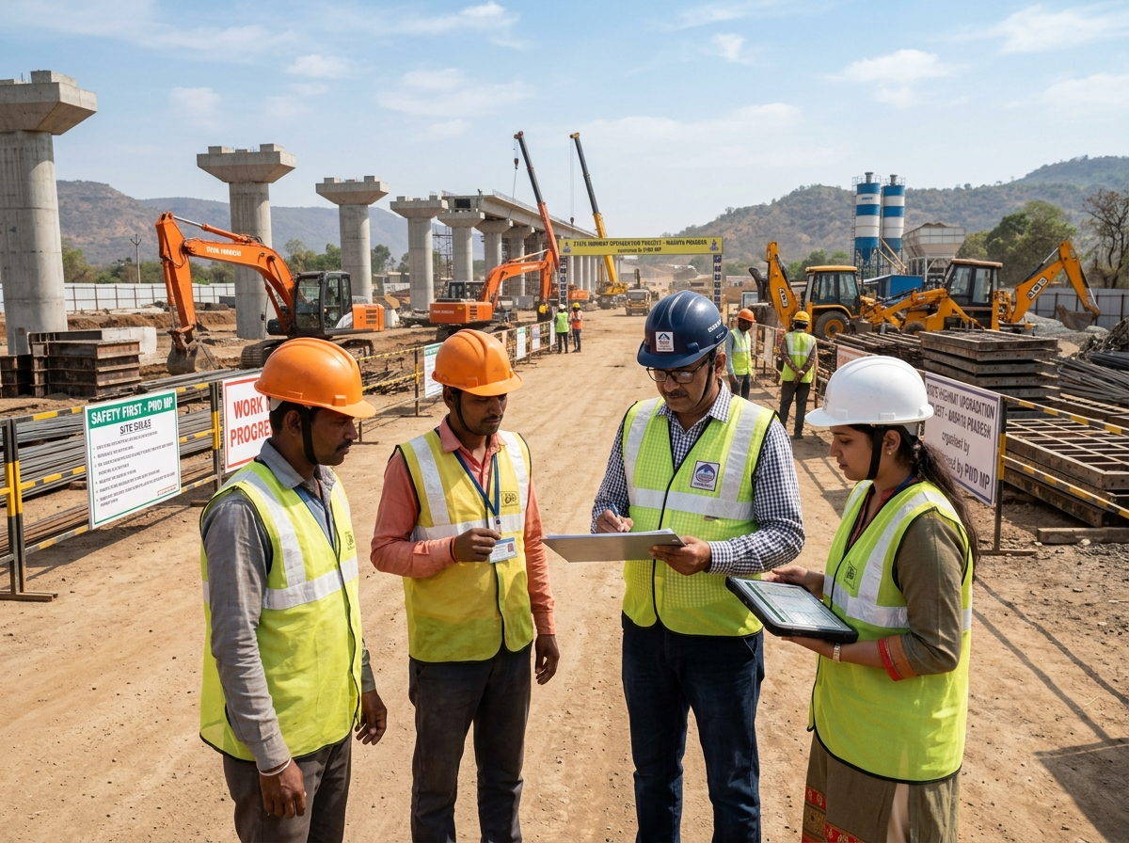
INDORE SAHODAYA · COMPUTER SCIENCE · 2026
Thank you
Questions, critique and field-test invitations are welcome — the next step is a site trial, not a bigger feature list.
PRESENTED BY
[Student name] · Class [ ]
GUIDE
[Guide / Supervisor name]
INSTITUTION
[School name] · Indore, Madhya Pradesh
SCAN TO VERIFY
public pass verification
Shram Setu 2.0 · Indore Sahodaya Computer Science · 2026
26 / 26
Notes:
Close on the invitation, not on a summary. If the QR placeholder is replaced with a real link, this is the slide judges photograph. Keep answers short and hand difficult questions to the limitations slide.

