Slide 1
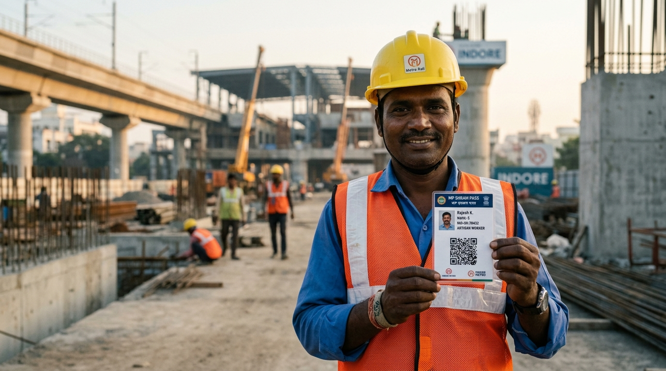
SHRAM SETU 2.0
INDORE SAHODAYA · COMPUTER SCIENCE · OCTOBER 2026
Shram Setu 2.0
An offline-first, transparency-centred digital work-record system for India's daily-wage workers.
Every shift recorded. Every wage explained. Every change traceable.
DEMO RECORD · 4 DAYS
PRESENTED BY
Student name · Class ___
GUIDE
Teacher name
₹2,600
4 days × ₹650 agreed rate
PAID
₹1,300
BALANCE
₹1,300
01 / 32
Notes:
Open with the one-line pitch: this is not an attendance app — it is a shared record of what was agreed, what was calculated, what was paid, and what is still disputed. Mention that the build shown is a working React prototype in local demo mode.

Slide 2
SHRAM SETU 2.0
SECTION 01 · CONTEXT
THE CORE IDEA
A wage you cannot inspect
is a wage you cannot defend.
Shram Setu is a shared, durable record of what was agreed, what was calculated, what was paid — and what is still in dispute.
01
02
03
Explainable arithmetic
Durable history
Verifiable record
One engine prints the same step-by-step breakdown to every side.
Corrections keep the prior value, reason, actor and time.
Each record carries a SHA-256 link to the one before it.
DEMO RECORD · 4 DAYS
₹2,600
4 days × ₹650 agreed rate
One demo record: 4 days × ₹650 = ₹2,600 due · ₹1,300 paid · ₹1,300 outstanding
PAID
₹1,300
BALANCE
₹1,300
02 / 32
Notes:
This is the thesis. Everything that follows either explains, implements or honestly bounds one of these three claims: explainable arithmetic, durable history, verifiable record.

Slide 3
SHRAM SETU 2.0
What this deck covers
01
Six movements: the problem, the design response, the engineering, the integrity model, the evidence, and the honest boundary.
SECTION 01
Context
01
Context
02
Design
The problem, the evidence, the research question
Why NFC became QR · scope · the four mechanisms
DEMO RECORD · 4 DAYS
₹2,600
4 days × ₹650 agreed rate
03
Engineering
04
Integrity
PAID
₹1,300
BALANCE
₹1,300
Architecture · data model · wage engine · payment states
Hash chain · seven rules · corrections · QR security
05
Evidence
06
Outlook
Demo bench · 39 assertions · cost
Limitations · roadmap · conclusion
Every shift recorded.
Every wage explained.
Every change traceable.
03 / 32
Notes:
Use this as the map. Each section is one colour: emerald for the problem space, brass for design decisions, clay for risk and integrity.

Slide 4
SHRAM SETU 2.0
Six ways a wage becomes an argument
01
None of them is a database problem. All of them are evidence problems.
SECTION 01
Context
The rate changes after the shift
01
Attendance is contested
02
₹550 agreed at the gate, ₹500 at settlement — and no version history either way.
Four days in one book, three in another, and no shared copy to compare.
DEMO RECORD · 4 DAYS
₹2,600
4 days × ₹650 agreed rate
Deductions with no reason
03
Recorded ≠ received
04
PAID
₹1,300
BALANCE
₹1,300
A number is cut from the wage slip with no line saying who decided or why.
The ledger says paid because the contractor typed it. The worker is still waiting.
Corrections erase the evidence
05
No shared record, no shared truth
06
Overwriting a cell destroys exactly the value a dispute would depend on.
Two private versions of the same week, and nothing to appeal to.
Every shift recorded.
Every wage explained.
Every change traceable.
04 / 32
Notes:
Ask the room: which of these six could you prove in front of a labour officer today? Each card is a mechanism the rest of the deck will answer.

Slide 5
SHRAM SETU 2.0
The gap is documented, not imagined
01
Audit reports, court orders and ILO research describe the same failure: the record of what was agreed does not survive the dispute.
SECTION 01
Context
CR
CR
%
%
₹269.27
₹704.39
90
79→43
DEMO RECORD · 4 DAYS
₹2,600
MGNREGS wages paid 16–90 days after muster closure · CAG Kerala, Report 9 of 2025
Still unpaid in Jammu & Kashmir as of March 2024 · CAG audit
of 3,16,178 rejected MGNREGS transactions were unskilled wages · CAG
Cash wages in India, 2014 → 2021, as digital payment scaled · ILO 2024
4 days × ₹650 agreed rate
PAID
₹1,300
BALANCE
₹1,300
Sources: CAG Report No. 9 of 2025 (Kerala); CAG audit of MGNREGS in J&K; ILO, Scaling up digital wages (2024). Figures as reported.
BSNL v Union of India, WPA 25460 of 2025 (Calcutta High Court, 7 January 2026): the principal employer was directed to pay contract workers' unpaid wages under s.21(4) of the Contract Labour (Regulation and Abolition) Act, 1970. A second 2026 ruling turned on the absence of documents linking workers to the claimed employer.
Every shift recorded.
Every wage explained.
Every change traceable.
05 / 32
Notes:
Two things to stress: (1) the amounts are administrative findings, not our claims; (2) the court case is about liability under existing law — it shows why contemporaneous, inspectable records matter.

Slide 6
SHRAM SETU 2.0
SECTION 01 · CONTEXT
RESEARCH QUESTION
How can an affordable, offline-capable web system make daily-wage work records, wage calculations, payment status and disagreements more transparent and easier to verify?
1
Understandable, low-cost workflow for low digital access
5
Work offline within browser-storage limits
2
Wage maths inspectable by both parties
6
Architecture that can later support a shared backend
3
Corrections and disagreements stay visible
7
Evaluate the prototype on repeatable synthetic tests
DEMO RECORD · 4 DAYS
4
Detect unauthorised edits with explainable checks
₹2,600
4 days × ₹650 agreed rate
PAID
₹1,300
BALANCE
₹1,300
06 / 32
Notes:
Seven objectives, one question. Objectives 1–4 are about transparency; 5–6 about affordability and architecture; 7 about honest evaluation.

Slide 7
SHRAM SETU 2.0
Where Shram Setu actually sits
01
Registration systems, public works, payroll software and paper registers each solve a different problem. The comparison is about purpose, not defects.
SECTION 01
Context
SYSTEM
PRIMARY PURPOSE
WAGE VISIBILITY
CORRECTIONS
OFFLINE
e-Shram (GoI)
Registry of unorganised workers; UAN and schemes
Not a wage system
Not designed for it
Registration needs connectivity
DEMO RECORD · 4 DAYS
₹2,600
MGNREGS / NREGASoft
Public rural employment and wage payment
System-generated; CAG documented delays
Administrative records
Field devices may sync
4 days × ₹650 agreed rate
PAID
₹1,300
BALANCE
₹1,300
Commercial payroll
Employer payroll processing
Varies by product
Employer-controlled
Usually online
Paper / messaging
Informal record keeping
Manual, hard to inspect
Erased on overwrite
Fully offline
Shram Setu 2.0
Work-record and wage reconciliation
Shared engine, step-by-step
Prior value, reason, actor, time
IndexedDB local demo
Every shift recorded.
Every wage explained.
Every change traceable.
Comparison focuses on documented purpose rather than assumed defects. e-Shram is a registration system, not a day-to-day wage ledger.
07 / 32
Notes:
Be careful and fair here: e-Shram and MGNREGS are not trying to do what we do. The point is that nobody in this row gives a private contractor–worker pair a shared, inspectable, offline-capable wage record.

Slide 8
SHRAM SETU 2.0
NFC cards → printed QR
02
The first concept was a physical tap-card. It was removed for cost and for a security property that could not be delivered cheaply.
SECTION 02
Design
Concept
NFC passes
Cost + clone audit
Printed QR
Repository split
DEMO RECORD · 4 DAYS
reusable physical pass
tap to identify a worker
tags are rewriteable
any phone camera
storage behind an interface
₹2,600
4 days × ₹650 agreed rate
NFC — removed
QR — adopted
PAID
₹1,300
BALANCE
₹1,300
Ordinary writable tags are not secure cryptographic devices: they can be cloned or rewritten, and a reader is an extra hardware cost at every site.
Printed on paper or card stock, replaced when damaged, read by any phone camera, and carrying an opaque reference rather than personal data.
A QR is an identifier, not an authenticator. Scanning one proves nothing about who is standing there.
Every shift recorded.
Every wage explained.
Every change traceable.
08 / 32
Notes:
This slide shows engineering judgement: we removed a feature because it created a false sense of security rather than real security.

Slide 9
SHRAM SETU 2.0
Four inspectable mechanisms
02
No dashboards of promises. Four things a worker, a contractor or a judge can actually check.
SECTION 02
Design
01
Explainable arithmetic
02
Explicit payment states
DEMO RECORD · 4 DAYS
One deterministic engine renders the same step-by-step breakdown in the worker portal, the contractor portal and the inspector.
Unpaid, recorded by contractor, acknowledged by worker, disputed — never collapsed into a single 'paid' tick.
₹2,600
4 days × ₹650 agreed rate
PAID
₹1,300
BALANCE
₹1,300
03
Preserved history
04
Chained audit trail
A correction keeps the prior value alongside the new one, with reason, actor role and timestamp.
Each record stores a SHA-256 digest that includes its predecessor, so edits break the chain visibly.
Every shift recorded.
Every wage explained.
Every change traceable.
09 / 32
Notes:
These four map one-to-one to the four questions in a dispute: what was the rate, what was recorded, was it changed, and can we trust the copy in front of us?

Slide 10
SHRAM SETU 2.0
Architecture: one clean seam
03
An abstract repository keeps the wage engine and the audit chain independent of whether records live in IndexedDB or PostgreSQL.
SECTION 03
Engineering
PRESENTATION
Worker portal · Contractor portal · Audit & tamper bench
React 19 single-page app
DEMO RECORD · 4 DAYS
₹2,600
SERVICES
wageEngine · anomalyEngine · cryptoAudit · auth · router
Deterministic business rules
4 days × ₹650 agreed rate
PAID
₹1,300
BALANCE
₹1,300
CONTRACT
workers · work records · payments · disputes · approvals
IDataRepository
STORAGE
Per-entity object stores · in-memory fallback for tests
IndexedDB · shram_setu_v2_db
PLANNED
PostgreSQL + row-level security · service worker · sync queue — not connected
Supabase + PWA
Every shift recorded.
Every wage explained.
Every change traceable.
10 / 32
Notes:
Point at the contract layer: this is why adding Supabase later does not mean rewriting the wage engine or the hash chain. The planned row is dashed because it is honestly not connected today.

Slide 11
SHRAM SETU 2.0
Technology choices and why
03
Every item is free, open source and already in the browser — no licence, no server and no hardware to buy.
SECTION 03
Engineering
React 19
TypeScript
Vite
DEMO RECORD · 4 DAYS
UI components and state
Typed application code
Dev server + build
₹2,600
Component model, wide ecosystem, familiar to reviewers
Catches a class of errors at compile time; tsc reports 0 errors
Fast iteration and a clean, small production bundle
4 days × ₹650 agreed rate
PAID
₹1,300
BALANCE
₹1,300
IndexedDB
Web Crypto
QR + jsQR
Browser-local storage
SHA-256 digests
QR encode / decode
Works offline, larger than localStorage, supports indexes
Standard browser API — no external crypto library needed
Any phone camera reads it; no dedicated reader hardware
Every shift recorded.
Every wage explained.
Every change traceable.
11 / 32
Notes:
The stack is deliberately boring. Nothing here needs a paid service, and every piece is inspectable by a teacher or a judge without installing anything.

Slide 12
SHRAM SETU 2.0
Eight entities, one ledger
03
Records reference a worker by synthetic ID, and every state change is its own entity instead of an overwritten field.
SECTION 03
Engineering
Worker
Attendance
Payment
Correction
id · skill · base rate
date · shift · hours
amount · method · ack
prior → new · reason
DEMO RECORD · 4 DAYS
₹2,600
MP-IND-2026-MM842
full_day · half_day · overtime
recorded ≠ received
who, when, why
4 days × ₹650 agreed rate
PAID
₹1,300
BALANCE
₹1,300
Dispute
Anomaly finding
Audit block
Approval request
worker claim + response
rule · values examined
index · prevHash · hash
state · target action
both statements kept
RULE-01 … RULE-07
SHA-256 chain
simulated in demo
The ledger is append-shaped: a correction is a new row that points at the old value, and a dispute is a row that points at both parties' statements.
Every shift recorded.
Every wage explained.
Every change traceable.
12 / 32
Notes:
The important design decision: nothing is mutated in place. A correction is data, not a UI action that hides the past.

Slide 13
SHRAM SETU 2.0
One wage, calculated in the open
03
The demonstration record used throughout the project. Every number below is produced by the same function that renders the portals.
SECTION 03
Engineering
Agreed daily rate
₹650.00
STATUS
PARTLY PAID
DEMO RECORD · 4 DAYS
Recorded work
4 days × 8 h
₹1,300 recorded by the contractor, ₹1,300 outstanding, worker acknowledgement still pending.
₹2,600
4 days × ₹650 agreed rate
Wages due 4 × 650
₹2,600.00
PAID
₹1,300
BALANCE
₹1,300
In integer paise
65,000 × 4 = 2,60,000
2,60,000 − 1,30,000
= 1,30,000 paise
= ₹1,300.00 exactly
Payment recorded by contractor
− ₹1,300.00
Worker acknowledgement
Pending
Outstanding balance
₹1,300.00
Every shift recorded.
Every wage explained.
Every change traceable.
4 × 650 = 2,600 and 2,600 − 1,300 = 1,300
13 / 32
Notes:
Walk the six rows out loud. The last row is the one that matters: the balance is derived, not typed. Then say the paise line, which is the engineering detail that stops rounding drift. If asked about the status word: the report's inspector shows this record as unpaid until the worker acknowledges; we label it partly paid so the recorded ₹1,300 is not hidden.

Slide 14
SHRAM SETU 2.0
One function, no surprises
03
calculateRecordBreakdown is the only place a rupee is computed. Portals render it; they never recalculate it.
SECTION 03
Engineering
(Days × Rate) + Overtime + Allowances − Deductions = Gross
Gross − Payments = Balance
DEMO RECORD · 4 DAYS
₹2,600
Integer paise
Shift-aware
De-duplicated
4 days × ₹650 agreed rate
PAID
₹1,300
BALANCE
₹1,300
Money is stored as whole paise and rounded once. 65000 paise, not 650.0 — so four days never accumulates a floating-point cent.
full_day, half_day (× 0.5), and pro-rata overtime at rate ÷ 8 per hour, so a 2-hour extension is arithmetic, not negotiation.
Ledger entries are keyed by ID, and payments only ever reduce the balance — they never count as new earnings.
Deterministic: the same record renders the same figures on the worker's phone, the contractor's laptop and the audit bench — because there is only one implementation of the arithmetic, not three.
Every shift recorded.
Every wage explained.
Every change traceable.
14 / 32
Notes:
If a judge asks one technical question, hope it is this one. One function, integer paise, explicit rounding, payments treated as credits against the balance.

Slide 15
SHRAM SETU 2.0
Payment states are separate
03
The single most common source of dispute is treating 'the contractor typed it' as 'the worker received it'.
SECTION 03
Engineering
01
02
03
04
Unpaid
Recorded
Acknowledged
Disputed
DEMO RECORD · 4 DAYS
Nothing recorded against the balance
Contractor enters a payment — an assertion, not a receipt
Worker confirms receipt on their own account
Both statements stored; nothing auto-resolved
₹2,600
4 days × ₹650 agreed rate
PAID
₹1,300
BALANCE
₹1,300
Partly paid is not a fifth state — it is a balance. ₹2,600 due with ₹1,300 recorded is simply ₹1,300 outstanding.
Disputed keeps the record visible. The system holds both claims and declines to declare who is right.
Contractor-entered payments never mutate earnings — they only reduce the balance due.
Every shift recorded.
Every wage explained.
Every change traceable.
15 / 32
Notes:
This is the slide that answers 'so what?'. Two people can look at the same ledger and still see different states, because the states are honestly distinguished.

Slide 16
SHRAM SETU 2.0
A correction keeps the value it replaced
03
The demonstration record was registered at a helper's rate and later corrected. Both values survive, with the reason attached.
SECTION 03
Engineering
ORIGINAL RATE
CURRENT RATE
₹550
₹650
RULE-03
DEMO RECORD · 4 DAYS
₹2,600
Helper category · registered at the gate
Skilled category · corrected after the shift was closed
4 days × ₹650 agreed rate
PAID
₹1,300
BALANCE
₹1,300
Reason stated
Corrected from the helper rate (₹550) to the skilled rate (₹650)
Actor + time
Contractor role · timestamped at edit
Tamper flag
None — the prior value is still in the audit trail
Mediation guidance is neutral: review the stated justification and the worker's acceptance state. The system does not judge intent.
Every shift recorded.
Every wage explained.
Every change traceable.
16 / 32
Notes:
The point is the word preserved. A payroll app would show ₹650 and move on; the dispute turns on the fact that it was once ₹550.

Slide 17
SHRAM SETU 2.0
SHA-256: a chain of records
04
Each block hashes a canonical string built from its own fields plus the previous block's digest. Eight blocks ship in the demo ledger.
SECTION 04
Integrity
Block 06
Block 07
Block 08
prev a41f…9c02
prev 8f2c…41de
prev c77b…0a19
DEMO RECORD · 4 DAYS
hash 8f2c…41de
hash c77b…0a19
hash 3a7e…b640
₹2,600
date · rate · hours · earned
date · rate · hours · earned
date · rate · hours · earned
4 days × ₹650 agreed rate
PAID
₹1,300
BALANCE
₹1,300
CANONICAL SERIALISATION · KEYS SORTED
VALID SHA-256
{"date":"2026-10-12",
"earned":2600,
"hours":8,
"prevHash":"c77b…0a19",
"rate":650}
Recomputed digest matches the stored one and the predecessor link is intact.
keys sorted · nulls preserved · floats normalised
→ integrity check passed
Every shift recorded.
Every wage explained.
Every change traceable.
17 / 32
Notes:
Show that the hash covers the predecessor. That single design choice is what turns a list of rows into a chain that notices its own edits.

Slide 18
SHRAM SETU 2.0
SECTION 04 · INTEGRITY
HONEST SCOPE
What the chain proves — and what it does not
It does prove
It cannot prove
✓
These bytes have not changed since they were chained
×
That the original entry was true
✓
The link to the previous record is intact
×
That the person was physically present
✓
A deliberate edit produces a visible mismatch
×
Safety against someone who controls the storage and recomputes every hash
✓
Worker and contractor verify the same digest
×
That this is a blockchain — it is not
DEMO RECORD · 4 DAYS
₹2,600
4 days × ₹650 agreed rate
A valid hash is evidence of integrity, not of truth.
PAID
₹1,300
BALANCE
₹1,300
18 / 32
Notes:
Say both columns out loud. Judges reward a team that can state the limits of its own mechanism without being asked.

Slide 19
SHRAM SETU 2.0
Seven rules, no machine learning
04
Every flag is a comparison against a configured threshold or a stated value — reproducible, explainable and never an accusation.
SECTION 04
Integrity
RULE-01
Duplicate date entries
RULE-05
Unreasoned deduction
Same worker, same calendar day, two records
A deduction with an empty reason field
DEMO RECORD · 4 DAYS
₹2,600
RULE-02
Excessive continuous shift
RULE-06
Overdue balance
4 days × ₹650 agreed rate
More than the configured limit, e.g. 12 h
Balance older than the configured limit
PAID
₹1,300
BALANCE
₹1,300
RULE-03
Retroactive modification
RULE-07
Benchmark comparison
Rate or hours changed after the shift closed
Agreed rate below a configured reference value
RULE-04
Payment reconciliation gap
Thresholds are configurable and are not presented as legal rules. The system flags for review; it does not judge intent.
Wages due vs payments vs acknowledgements
Every shift recorded.
Every wage explained.
Every change traceable.
19 / 32
Notes:
Explain why rule-based and not ML: a wage dispute needs a reason a worker can read, and a deterministic check can always print the exact values it compared.

Slide 20
SHRAM SETU 2.0
What a flag actually looks like
04
RULE-03 output from the interface: the trigger, the exact values examined, and a guidance note that assigns blame to nobody.
SECTION 04
Integrity
RULE-03
Retroactive record modification
NEUTRAL GUIDANCE
The prior value is preserved in the audit trail. Review the stated justification and the worker's acceptance state.
TRIGGER REASON
DEMO RECORD · 4 DAYS
“Record modified retroactively after initial registration.”
₹2,600
4 days × ₹650 agreed rate
VALUES EXAMINED
PAID
₹1,300
BALANCE
₹1,300
Original rate ₹550 → current rate ₹650
STATED REASON
DETERMINISTIC BY DESIGN
Corrected from helper rate (₹550) to skilled rate (₹650)
No model, no score, no probability. The same inputs always produce the same finding and the same printed values.
TAMPER FLAG
None
Every shift recorded.
Every wage explained.
Every change traceable.
20 / 32
Notes:
This is a replica of the real panel. Point out that the reason text is kept verbatim — the system stores the human explanation, not a category code.

Slide 21

SHRAM SETU 2.0
QR identifies — it does not secure
04
The pass carries an opaque reference. Everything that decides access happens somewhere else.
SECTION 04
Integrity
Identification
Which worker record does this code refer to?
DEMO RECORD · 4 DAYS
The QR answers this, and nothing else.
₹2,600
4 days × ₹650 agreed rate
Authentication
PAID
₹1,300
BALANCE
₹1,300
Is the person acting really that worker?
Not answered by a scan. Needs an account and a credential.
Authorization
Public verification page — opens with the token, shows no private wage data.
What is this person allowed to do?
Row-level rules, not the printed code.
A static QR can be photographed and reprinted. It is a reference, not a credential.
Every shift recorded.
Every wage explained.
Every change traceable.
21 / 32
Notes:
If asked 'isn't a QR insecure?': yes, and we say so. The QR only resolves an opaque reference; the security boundary is authentication and row-level authorization.

Slide 22
SHRAM SETU 2.0
Approval across devices (planned)
04
The intended flow needs a shared backend before it can work between two phones. In the demo it is simulated locally and labelled as such.
SECTION 04
Integrity
1
2
3
4
Contractor scans the worker's reusable QR
Site resolves the worker reference
Backend creates a pending request
Worker signs in on their own device
DEMO RECORD · 4 DAYS
₹2,600
4 days × ₹650 agreed rate
5
6
7
WHY IT CANNOT WORK YET
IndexedDB lives in one browser. Another device cannot read it.
PAID
₹1,300
BALANCE
₹1,300
Worker approves or rejects
Outcome recorded with full history
Contractor sees the status after sync
Demo disclaimer shown in the UI: “In Local Demo Mode this approval request is simulated locally via IndexedDB. Multi-device sync will be enabled with Supabase deployment.”
Every shift recorded.
Every wage explained.
Every change traceable.
What a real deployment needs: an authenticated account per worker, a pending-request table, and row-level security so a request is visible only to its owner.
22 / 32
Notes:
Be explicit: this is the one workflow we could not complete without a backend, so we simulated it and labelled the simulation inside the product.

Slide 23
SHRAM SETU 2.0
Offline-first, honestly bounded
04
IndexedDB really does work without a network — and really does not follow the worker to another phone.
SECTION 04
Integrity
Works today
Planned, not built
Records survive a refresh and a closed tab
PWA service worker so the site loads offline
DEMO RECORD · 4 DAYS
₹2,600
Structured object stores, larger than localStorage
Sync queue of pending operations
4 days × ₹650 agreed rate
PAID
₹1,300
BALANCE
₹1,300
In-memory fallback for tests and fresh browsers
Duplicate-submission detection
Restores the baseline demo state in one call
Conflicts preserved, never silently overwritten
Storage can be cleared by the user or the browser, and anyone who controls the device can read it. Local demo mode is a demonstration, not a deployment.
Every shift recorded.
Every wage explained.
Every change traceable.
23 / 32
Notes:
This is where most school projects overclaim. Say plainly: offline works within one browser; cross-device needs a backend.

Slide 24
SHRAM SETU 2.0
Privacy and governance
04
Collect less, separate public references from private wages, and never let a correction quietly disappear.
SECTION 04
Integrity
Data minimisation
Opaque references
Only what a wage record needs. The demo uses synthetic names and identifiers throughout.
A QR token does not print a name, a rate or a wage history.
DEMO RECORD · 4 DAYS
₹2,600
4 days × ₹650 agreed rate
Intact history
Access, not luck
PAID
₹1,300
BALANCE
₹1,300
Export, import and correction must preserve the prior value, not replace it.
Row-level rules decide who may read a record — not who holds a printed code.
We do not claim compliance with any data-protection statute. That would need a separate legal analysis of the applicable requirements and the actual deployment configuration — which this prototype does not have.
Every shift recorded.
Every wage explained.
Every change traceable.
24 / 32
Notes:
Explicitly refuse the compliance claim. It is the single easiest way to lose credibility with a judging panel that knows the law.

Slide 25
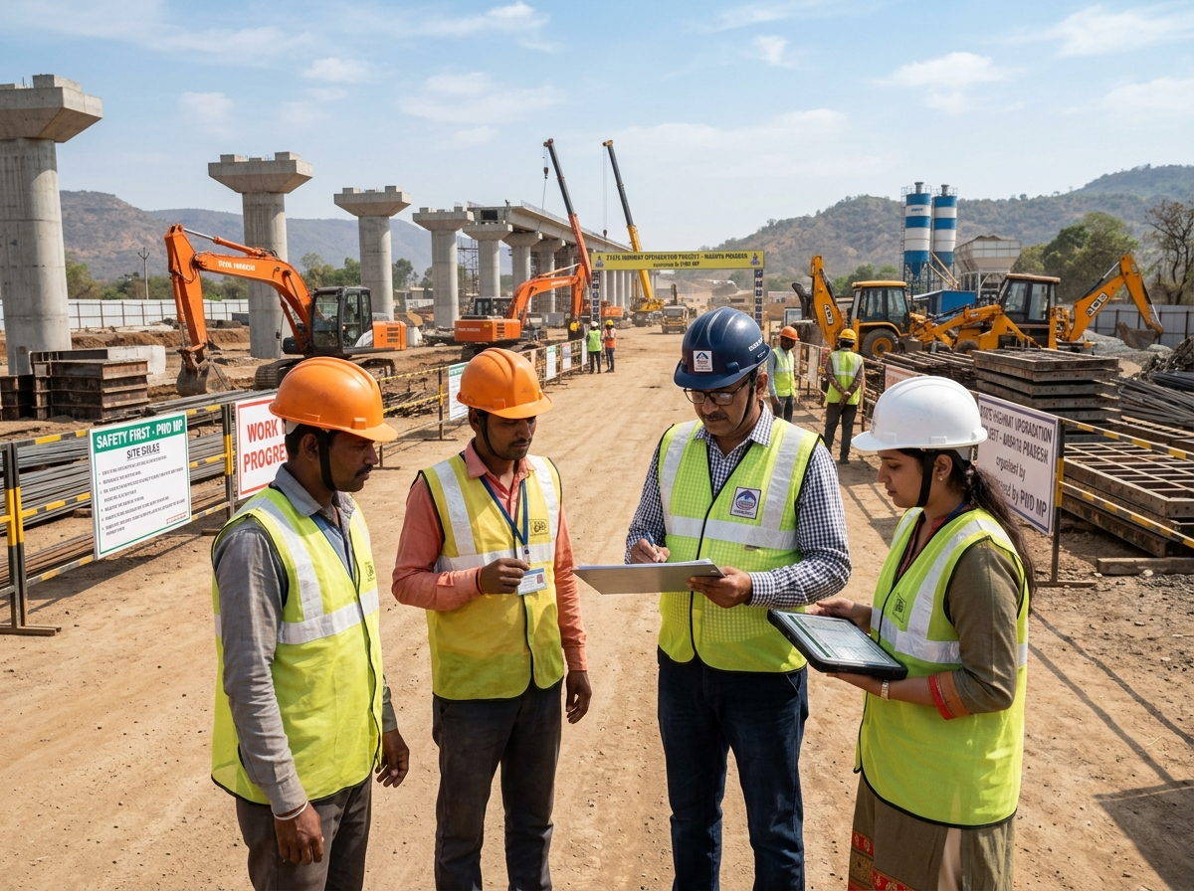
SHRAM SETU 2.0
The demo bench and its dataset
05
One shared dataset drives the worker portal, the contractor portal and the audit bench — so a change in one is visible in the others.
SECTION 05
Evidence
8
4
2
2
ledger blocks
workers
disputes
approval requests
DEMO RECORD · 4 DAYS
₹2,600
Site Super Corridor IT Park Phase-2
Firm M/s Sharma Infra Pvt Ltd · Ramesh Verma, Sunita Bai, Vikram Singh, Dilip Solanki (synthetic)
4 days × ₹650 agreed rate
PAID
₹1,300
BALANCE
₹1,300
Twelve scenarios on the bench
Partially paid · unpaid · fully paid and acknowledged · payment awaiting acknowledgement · dispute with both statements · correction with preserved value · legitimate multi-day record · duplicate shift (RULE-01) · unreasoned deduction (RULE-05) · corrupted hash · clean-baseline verification · resetToBaseline()
Every screen reads the same seeded store, so a tampered hash in the audit bench is immediately visible in both portals.
Every shift recorded.
Every wage explained.
Every change traceable.
25 / 32
Notes:
If you have a laptop, this is where you switch to the live app. The bench exists so a judge can deliberately corrupt a record and watch the badge flip.

Slide 26
SHRAM SETU 2.0
Reported results, honestly labelled
05
39 assertions across four suites, a clean type-check and a clean production build — all from the implementation verification report.
SECTION 05
Evidence
SUITE
ASSERTIONS
RESULT
EVIDENCE
Audit & ledger integrity
23 / 23
Passed (reported)
Verification report
DEMO RECORD · 4 DAYS
₹2,600
IndexedDB & repository
6 / 6
Passed (reported)
test-indexeddb-repository
4 days × ₹650 agreed rate
Supabase adapter & migrations
5 / 5
Passed (reported)
test-supabase-adapter
PAID
₹1,300
BALANCE
₹1,300
Simulated approvals
5 / 5
Passed (reported)
test-approvals-simulation
Type check / lint
0 errors
Passed (reported)
npm run lint
Production build
Clean
Passed (reported)
npm run build (Vite)
39
assertions passed
across four suites
Not independently reproduced for the report. The lab tests synthetic data only.
Every shift recorded.
Every wage explained.
Every change traceable.
26 / 32
Notes:
Say 'reported' every time. This is an honesty cue: the numbers come from our verification report, and the report itself says so.

Slide 27
SHRAM SETU 2.0
What it costs
05
The prototype runs at zero marginal cost, and the first real deployment target is a free tier that a school can actually sustain.
SECTION 05
Evidence
₹0
₹0
Free → ~$10
DEMO RECORD · 4 DAYS
HARDWARE
TOOLING
BACKEND
₹2,600
NFC tags and readers were removed from the design entirely. A printed QR pass costs a sheet of paper.
React, TypeScript, Vite, IndexedDB and the Web Crypto API are free and open source. Browser storage has no fee.
Supabase free plan: 500 MB database, 5 GB egress, 50,000 MAU, 1 GB storage. Paid compute starts near $10/month.
4 days × ₹650 agreed rate
PAID
₹1,300
BALANCE
₹1,300
Free tiers pause, quota and change. Figures were checked against Supabase's own documentation in October 2026 and should be re-checked before any deployment decision.
NOT ESTIMATED
A real deployment needs backups, authentication and maintenance. Those depend on volume we do not have.
Every shift recorded.
Every wage explained.
Every change traceable.
27 / 32
Notes:
The cost slide exists because a school project must be affordable. Zero hardware is the headline; the honest caveat is that real operations are not free.

Slide 28
SHRAM SETU 2.0
Limitations we will not hide
06
Ten of them, listed in the report and repeated here because a prototype is defined by what it refuses to claim.
SECTION 06
Outlook
01
Browser storage is readable by anyone who controls the device
06
Benchmark rates in the prototype are unverified
DEMO RECORD · 4 DAYS
02
No remote database is connected in the demo build
07
No production authentication or access control yet
₹2,600
4 days × ₹650 agreed rate
PAID
₹1,300
BALANCE
₹1,300
03
A QR can be copied; a scan does not authenticate anyone
08
Behaviour under real network interruption is untested
04
No independent proof of physical attendance
09
Multi-device conflict handling is still planned
05
A hash proves integrity, not truth
10
Usability has not been validated with real workers
Every shift recorded.
Every wage explained.
Every change traceable.
These are stated in the report as limitations, not as future features that already exist.
28 / 32
Notes:
Do not rush this slide. It is the one that distinguishes an engineering project from a demo reel.

Slide 29
SHRAM SETU 2.0
What happens next, in order
06
A credible sequence: fix storage durability first, then add a backend, then earn the right to call it a deployment.
SECTION 06
Outlook
NOW
NEXT
LATER
Demo-ready
Shared backend
Deployment-ready
DEMO RECORD · 4 DAYS
Baseline reset and seeded dataset
Supabase PostgreSQL + auth + RLS
PWA service worker + sync queue
₹2,600
4 days × ₹650 agreed rate
Bilingual worker and contractor portals
Real cross-device approval requests
Conflict preservation, never overwrite
PAID
₹1,300
BALANCE
₹1,300
Offline single-file exhibition build
Versioned, authenticated export / import
Usability research with workers
Print-ready pass and wage slip
Verified wage benchmark configuration
Broader automated and manual testing
Every shift recorded.
Every wage explained.
Every change traceable.
Nothing in the “Next” or “Later” columns exists in the current build.
29 / 32
Notes:
The sequence matters: durability, then sharing, then usability research. Adding features before fixing storage would just make the demo prettier.

Slide 30
SHRAM SETU 2.0
SECTION 06 · OUTLOOK
CONCLUSION
Transparency is a mechanism,
not a slogan.
SHIPPED
Shared wage engine · explicit payment states · preserved corrections · SHA-256 chain · seven explainable rules · QR pass
DELIBERATE
Removed NFC hardware and removed the claim that a QR is authentication
BOUNDED
No proof of attendance, no guarantee of payment, no legal ruling, no blockchain
DEMO RECORD · 4 DAYS
₹2,600
4 days × ₹650 agreed rate
Every shift recorded. Every wage explained. Every change traceable.
PAID
₹1,300
BALANCE
₹1,300
30 / 32
Notes:
Close the argument: we did not build a dashboard, we built evidence — and we stated its edges.

Slide 31
SHRAM SETU 2.0
References and sources
06
Every external claim in this deck comes from one of these documents; every internal figure comes from the prototype's own verification report.
SECTION 06
Outlook
01
Ministry of Labour & Employment, Government of India. e-Shram Portal.
05
International Labour Organization. Scaling up digital wages: lessons and challenges from India's enabling environment.
https://eshram.gov.in/ · accessed October 2026
ILO, 2024
DEMO RECORD · 4 DAYS
02
Comptroller & Auditor General of India. Report on Implementation of MGNREGA (Kerala), Report No. 9 of 2025.
06
MDN Web Docs. SubtleCrypto.digest() and Window.localStorage.
₹2,600
Laid before the Kerala Legislative Assembly, 24 February 2026
developer.mozilla.org · accessed October 2026
4 days × ₹650 agreed rate
PAID
₹1,300
BALANCE
₹1,300
03
Comptroller & Auditor General of India. Audit of MGNREGS in Jammu & Kashmir.
07
Supabase. About billing on Supabase — free-plan quotas and compute pricing.
As reported in 2026 secondary coverage of the CAG report
supabase.com/docs · accessed October 2026
04
Calcutta High Court. M/s. Bharat Sanchar Nigam Ltd v Union of India & Ors.
08
Vite documentation; WHATWG Storage Standard.
WPA 25460 of 2025 · judgment dated 7 January 2026
vitejs.dev · storage.spec.whatwg.org
Every shift recorded.
Every wage explained.
Every change traceable.
31 / 32
Notes:
Keep this slide in reserve — it is usually only needed if a judge asks where a figure came from. The CAG and ILO sources support the context; nothing here supports a claim about the prototype itself.

Slide 32
SHRAM SETU 2.0
SECTION 06 · OUTLOOK
THANK YOU
Questions, and a live demo.
The app runs offline from a single HTML file — no server, no install, no network.
Open the pass
Scan the QR on a printed pass to reach the public verification page
Break a hash
Corrupt a past record in the audit bench and watch the badge flip
DEMO RECORD · 4 DAYS
Read a correction
See the original ₹550 survive beside the corrected ₹650
₹2,600
4 days × ₹650 agreed rate
Shram Setu 2.0 · Independent student project · not a government portal · Indore Sahodaya, Computer Science, October 2026
PAID
₹1,300
BALANCE
₹1,300
32 / 32
Notes:
Invite the judge to break it. The tamper bench is the most persuasive thirty seconds in the whole presentation.

