Slide 1
Evolutionarily Learning Multi-aspect Interactions and Influences from Network Structure and Node Content
Songlei Jian^{1,2}, Liang Hu^{2,3}, Longbing Cao² , Kai Lu¹ , Hang Gao⁴
¹College of Computer, National University of Defense Technology, China ²Advanced Analytics Institute, University of Technology Sydney, Australia ³University of Shanghai for Science and Technology, ⁴Alibaba Group, China

Slide 2
Contents
Motivation & Challenges
Related work
Model
Experiments
Future work

Slide 3
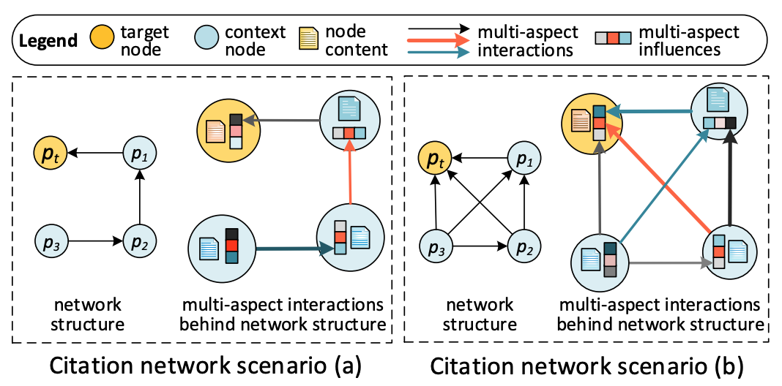
Motivation
What factors drive the formation of node connection (edges)?
For nodes: multi-aspect influences
For edges: multi-aspect interactions
Jointly modeling the network structure and node content in network representation.

Slide 4
Challenges
It is critical and challenging to represent multi-aspect and heterogeneous interactions and influences between nodes (objects)
This requires to involve, model and integrate:
(1) Explicit and heterogeneous sources of node content information (e.g., paper’s title and/or abstract) and network topological structure (e.g., paper citations)
(2) Implicit and heterogeneous aspects of node influences (e.g., a paper’s topic uniqueness and design novelty) and node interactions (e.g., a paper cites the algorithm introduced in another paper).

Slide 5
Related work
Plain Network Representation
Factorizing the node proximity matrix directly, e.g., Dimension reduction methods
Combining the random walk and word embedding, e.g., Deepwalk, Node2vec
Using Autoencoder and graph Laplacian eigenmaps, e.g., SDNE
Attributed Network Representation
Matrix factorization, e.g., TADW
Deep learning based methods, e.g., TriNDR, CANE
Modelling network and content independently
Shallow combination of network structure and node content

Slide 6
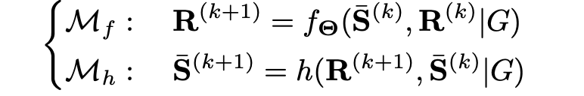
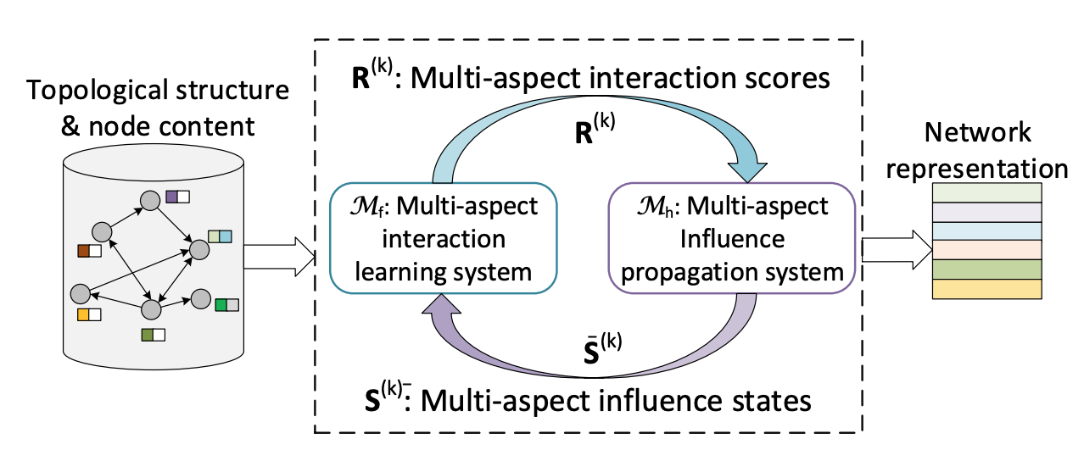
Model framework
Multi-aspect Evolutionary Coupled Systems

Slide 7
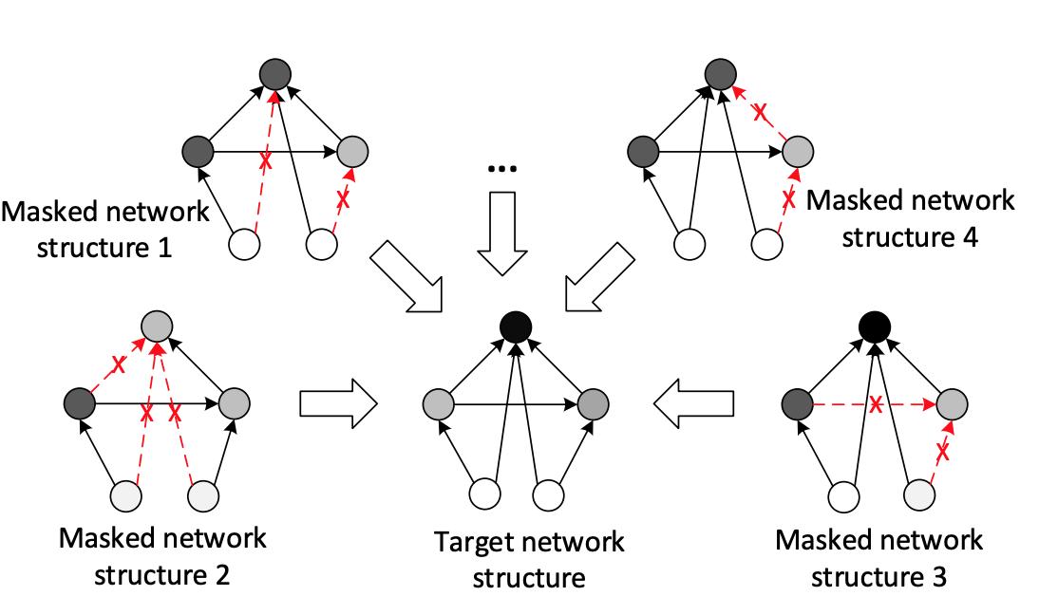
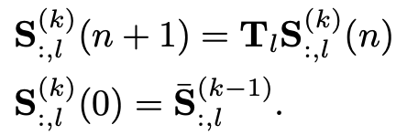
Model
Multi-aspect Interaction Learning System
Node Representation Model
Embedding nodes and content with neural network
Interaction Scoring Model
Modelling multi-aspect interaction between nodes
Multi-aspect Influence Propagation System
Involving dynamic system to learn a stable state
Evolutionary Learning Process

Slide 8
Experiments
Effectiveness evaluation
Node classification
Link prediction
Semantic Interpretability Demonstration
Multi-aspect node influences
Multi-aspect intereactions

Slide 9
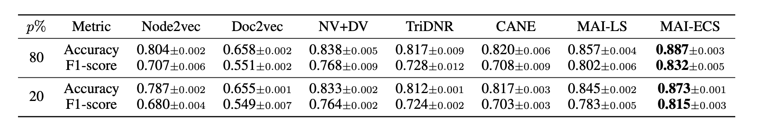
Node classification
Data set: citation network with 29,896 nodes and 66,166 edges
Comparison methods: Node2vec, Doc2vec, NV+DV, TriDNR, CANE
MAI-LS is Multi-aspect Interaction Learning System
MAI-ECS is the full model
Contribution of influence propagation system
Importance of considering node content
Importance of the way to learn node content

Slide 10
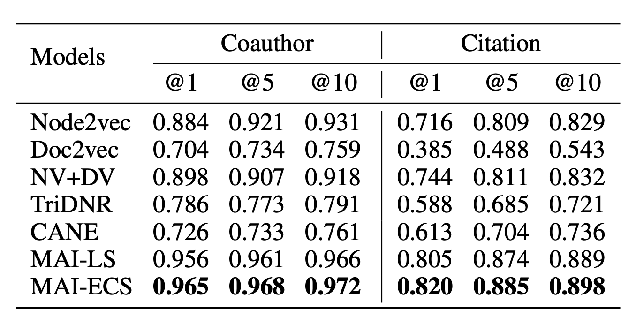
Link prediction
Evaluation metric: nDCG
Data sets:
Citation network: 29,896 nodes and 66,166 edges.
Coauthor network with 1,712,433 authors and 4,258,615 edges

Slide 11
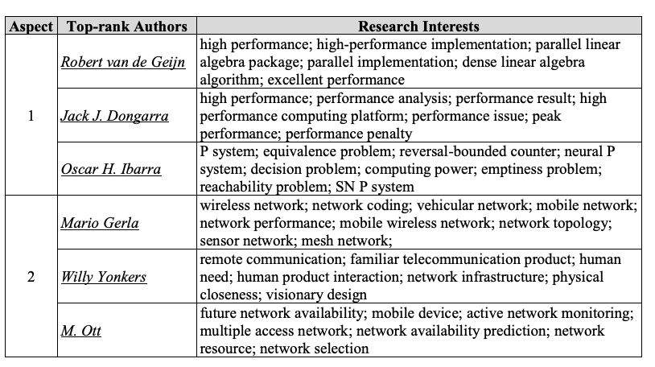
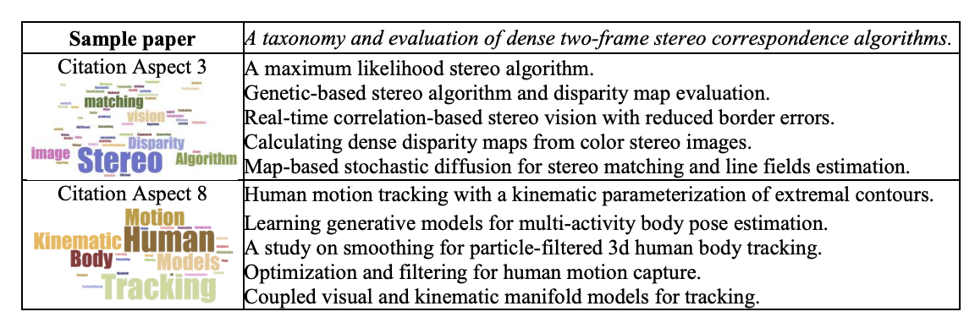
Semantic Interpretability Demonstration
The top-3 authors on aspect 1 and aspect 2 in terms of node influence in coauthor network
The top-5 papers on aspect 3 and aspect 8 in terms of the interaction scores in citation network

Slide 12
Future work
MAI-ECS can be extended to handle dynamical networks by modifying the evolutionary learning process to a time-dependent state model.
MAI-ECS can be customized for community detection and role detection because the multi-aspect influences can be regarded as a node’s community or roles in a network.
MAI-ECS has potential to infer the semantics of node text, such as topic deviation and text mining, as shown in the demonstration.

Slide 13
Thanks!

