Slide 1
AUTOMATIC OPTIMIZED
NEURAL ARCHITECTURE SEARCH
Under the supervision of Dr. Seba Susan
A project By :
Apoorva Verma
Karan Goyal
Mudit Verma
Pradyumn Verma

Slide 2
INTRODUCTION
In this project, we aim to use machine learning or more precisely neural nets in order to design neural nets only. Typically, reinforcement learning or evolutionary algorithms are used to design the new neural net architectures due to their discrete design, but we have used a HILL CLIMBING approach based on Network Morphism to automate the process.

Slide 3
INTRODUCTION – PROBLEM STATEMENT
Our problem is, given a neural architecture search space F, the input data X, and the cost metric Cost(·), we aim at finding an optimal neural network f ∗ ∈ F with its trained parameter θf*, which could achieve the lowest cost metric value on the given dataset X .
Mathematically, this definition is equivalent to find f ∗ satisfing:
f∗ = argmin Cost(f(X;θf)), f∈F θf where θf ∈ Rw(f) denotes the parameter set of network f , w(f) is the number of parameters in f.

Slide 4
INSPIRATION
Designing neural nets is extremely time intensive
Complicated Architectures
Parameter Tuning
It enables the true meaning of Machine Learning.

Slide 5
BACKGROUND
“Neural nets to design neural nets” is known as neural architecture search; typically reinforcement learning or evolutionary algorithms are used to design the new neural net architectures.
Neural Architecture Search is often very computational expensive.

Slide 6
BACKGROUND
.In evolutionary neural architecture search, we use evolutionary algorithms to generate the model descriptions of neural network.
Neural Architecture Search is an active subset of the field AutoML. The term AutoML has traditionally been used to describe automated methods for model selection and/or hyperparameter optimization.

Slide 7
Related work – nasnet (put reference)
The learned aspect of the design included elements such as which lower layer(s) each higher layer took as input, the transformations applied at that layer and to merge multiple outputs at each layer.
NASNet addressed this issue by transferring a building block designed for a small dataset to a larger dataset.
The approach yielded accuracy of 82.7% top-1 and 96.2% top-5.

Slide 8
RELATED WORK - ENAS
Multiple child models share parameters, ENAS requires fewer GPU-hours than other approaches and 1000-fold less than "standard" NAS.On CIFAR-10, the ENAS design achieved a test error of 2.89%, comparable to NASNet.On Penn Treebank, the ENAS design reached test perplexity of 55.8

Slide 9
RELATED WORK – DARTS (mention proposed by whom and when)
It addresses the scalability challenge of architecture search by formulating the task in a differentiable manner.
Unlike conventional approaches of applying evolution or reinforcement learning over a discrete and non-differentiable search space.
This method is based on the continuous relaxation of the architecture representation, allowing efficient search of the architecture using gradient descen

Slide 10
BASELINE APROACH – HILL CLIMBING
Neural Architecture Search by Hillclimbing (NASH) is a simple iterative approach
NASH finds and trains competitive architectures at a computational cost of the same order of magnitude as training a single network.
CNNs with an error rate around 6 % in roughly 12 hours on a single GPU.

Slide 11

MORPHISM
MORPH – 1 This morphism can be used to add a fully-connected or convolutional layer, as these layers are simply linear mappings
MORPH – II The layer can be widened (i.e., increasing the number of units in a fully connected layer or the number of channels in a CNN) by this type of morphism.
MORPH – III Every idempotent function can simply be replaced by:

Slide 12
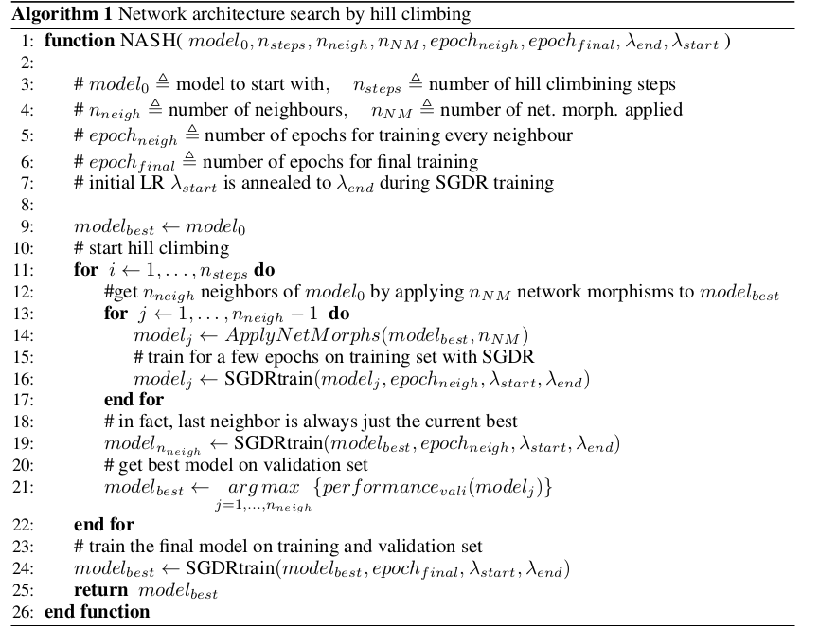
HILL CLIMBING ALGORITHM - NASH

Slide 13
PROPOSED WORK
We base our modifications on the NASH algorithm.
This section has been divided into two subsections describing our improvements in better implementation of the NASH and contributions of our ideas.

Slide 14
PROPOSED WORK – NASGRAPH OPERATIONS
Skip
Deepen
Widen
MaxPool
Add
Merge

Slide 15
PROPOSED WORK – GRAPH PROPERTIES
Skip
Deepen
Widen
MaxPool
Add
Merge

Slide 16
PROPOSED WORK – IMPLEMENTATIONAL
Padding
No Seed Architecture
MaxPool
Linear Layer Morphism

Slide 17
PROPOSED WORK – THEORETICAL
Learning Curve Predication
Probabilistic Operation Selection
Gradient Stopping
Gradient Starvation

Slide 18
EXPERIMENTATION – RETRAINING FROM SCRATCH
Add Table & Reasoning

Slide 19
EXPERIMENTATION – OUR IMPLEMENTATIONS
Algorithm | Runtime (hrs) | Parameters (mil.) | Avg. Error (%)
NASH N_{steps} = 5, N_{neigh} = 8, SGDR | 13.1 | 5.7 | 6.2
NASH N_{steps} = 5, N_{neigh} = 8, No SGDR | 11.3 | 5.8 | 7.4
Ours – NO LCP
Ours – LCP

Slide 20
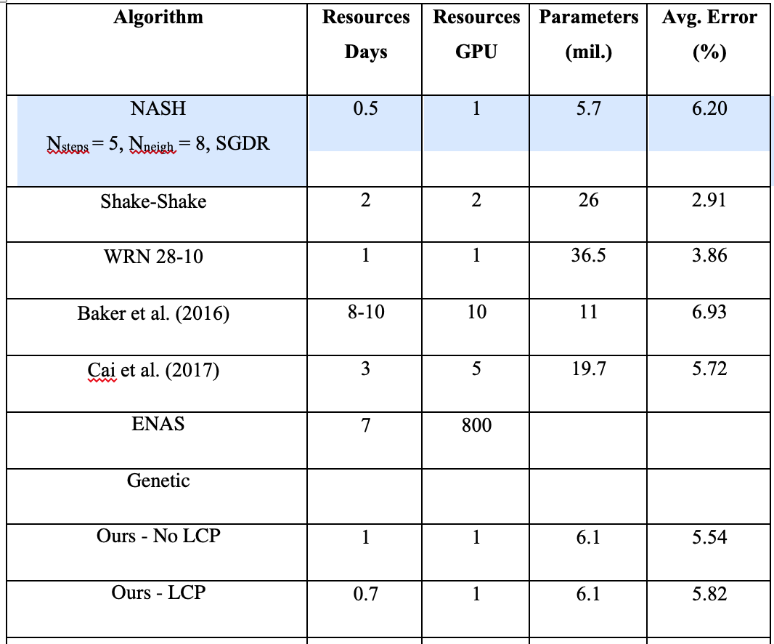
EXPERIMENTATION – OTHERS

Slide 21
EXPERIMENTATION – MNIST
Algorithm | Error (%) | Parameters
MCDNN | 0.23
Ours | 2.02

Slide 22
CONCLUSION
Talk about weight init

