Slide 1
NOVEL PARADIGMS FOR NEURAL ARCHITECTURE SEARCH IN THE HILL CLIMBING DOMAIN
PROJECT MEMBERS:
Apoorva Verma (2K15/IT/016)
Karan Goyal (2K15/IT/036)
Mudit Verma (2K15/IT/044)
Pradyumna Sinha (2K15/IT/053)
UNDER THE SUPERVISION OF :
Dr. Seba Susan
Associate Professor
Information Technology
Delhi Technological University

Slide 2
WORK PUBLISHED
International IEEE Conference on Artificial Intelligence and Knowledge Engineering, Cagliari, Italy
03 – 05 June 2019
Program Chairs from Google, USA General Chairs from UCLA, USA Industry Chairs from Facebook, USA

Slide 3
INTRODUCTION & RELATED WORKS

Slide 4
INTRODUCTION TO NAS
Automate learning of Artificial Neural Network Architectures.
Important Factors :
Search Space
Search Strategy
Performance Estimation Methods

Slide 5
INSPIRATION FOR NAS
Time Intensive
Discover Complicated Architectures
Parameter Tuning
True Meaning of Machine Learning

Slide 6
WORTH MENTIONING RELATED WORK
AutoML = Model Selection + Optimization
RENAS = Reinforcement Evolutionary NAS
NASNet = Operations on Conv Layers
ENAS = RNN Controllers + RL Policy Gradient Rewards
DARTS = Works on Continuous Space
NASH = Hill Climbing Approach

Slide 7
NASH BASELINE APPROACH
CIFAR – 10 Dataset
Error Rates ~ 6% in under 12 hours of Training
Hill Climbing
Uses Cosine Annealing in SGDR for Net Training
Best Baseline :
Very Fast
Competitive Results
Exiguous Resource Requirements

Slide 8



MORPHISMS OPERATIONS FOR SEARCH
TYPE 1 – FC Layers & Batch Norm (Deepening)
TYPE 2 – Skip Connections & Widen
TYPE 3 – Idempotent Functions
TYPE 4 – Skip Connections

Slide 9
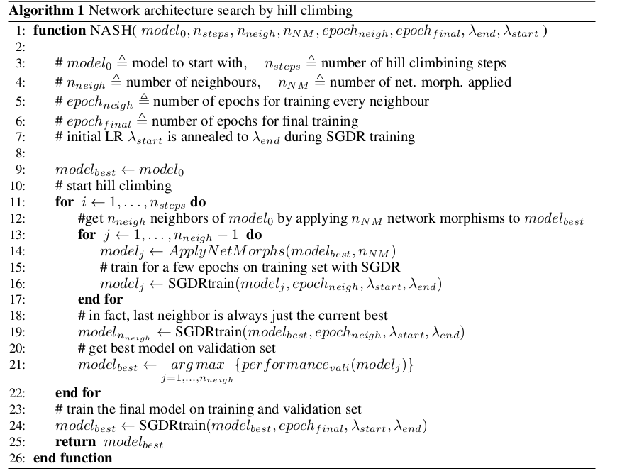
NASH BRIEF ALGORITHM

Slide 10
OUR CONTRIBUTIONS

Slide 11
PROPOSED WORK BRIEF
Based on NASH
Implementation Work
Research Work
No helper code available

Slide 12
NASGRAPH OPERATIONS
NASGraph Basics
NASGraph Operations
Skip
Widen
Deepen
Add
Merge
MaxPool

Slide 13
NASGRAPH OPERATIONS
Skip Operation
Widen
Deepen
Add
Merge
Maxpool
Check Topological Ordering Condition
Get candidate node pairs (x,y) s.t x has one child and y has one parent
Random Selection

Slide 14
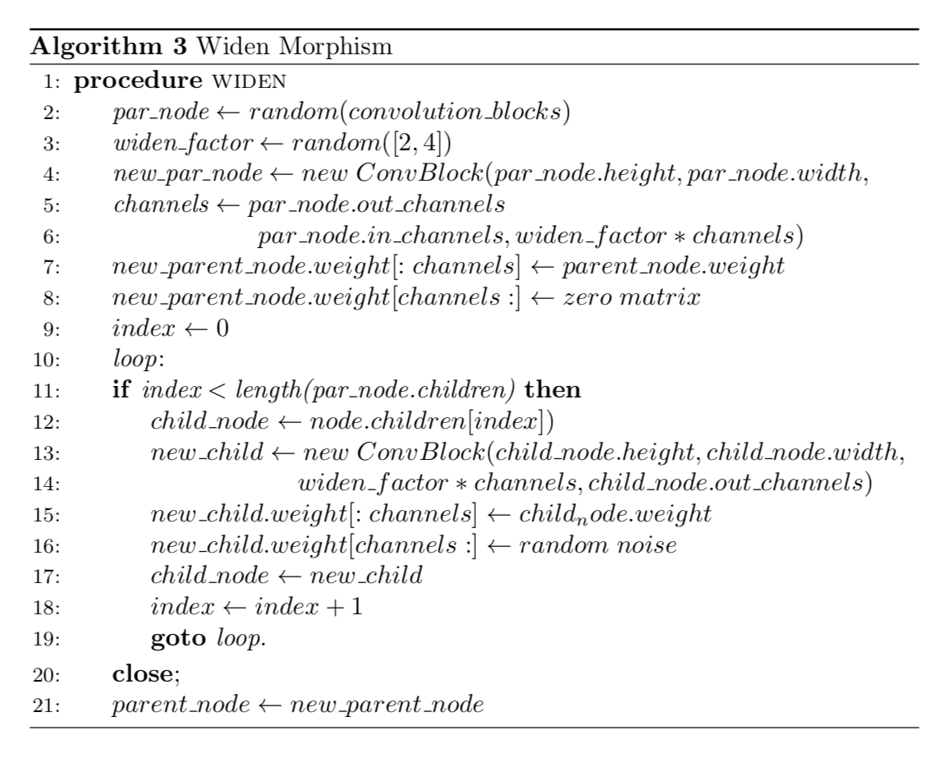
NASGRAPH OPERATIONS
Skip Operation
Widen
Deepen
Add
Merge
Maxpool

Slide 15
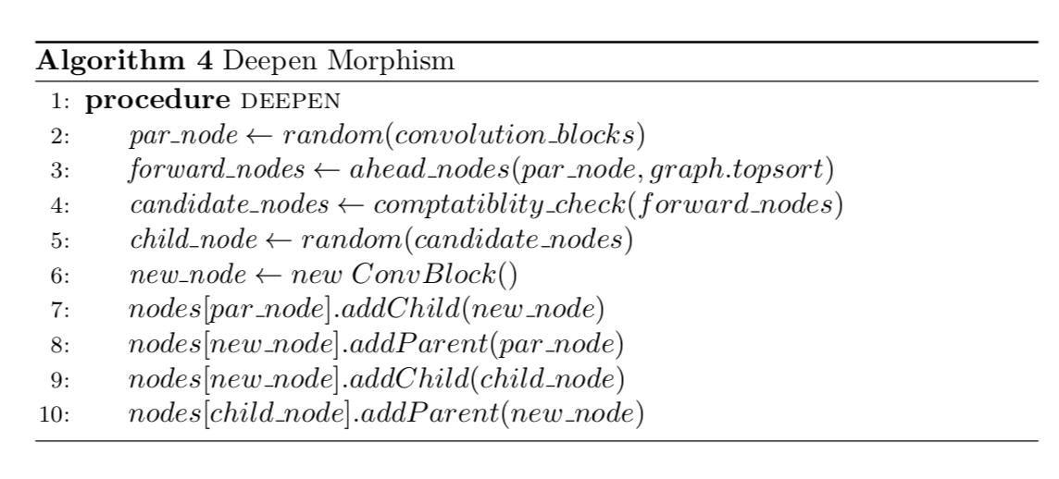
NASGRAPH OPERATIONS
Skip Operation
Widen
Deepen
Add
Merge
Maxpool

Slide 16
NASGRAPH OPERATIONS
Skip Operation
Widen
Deepen
Add
Merge
Maxpool

Slide 17
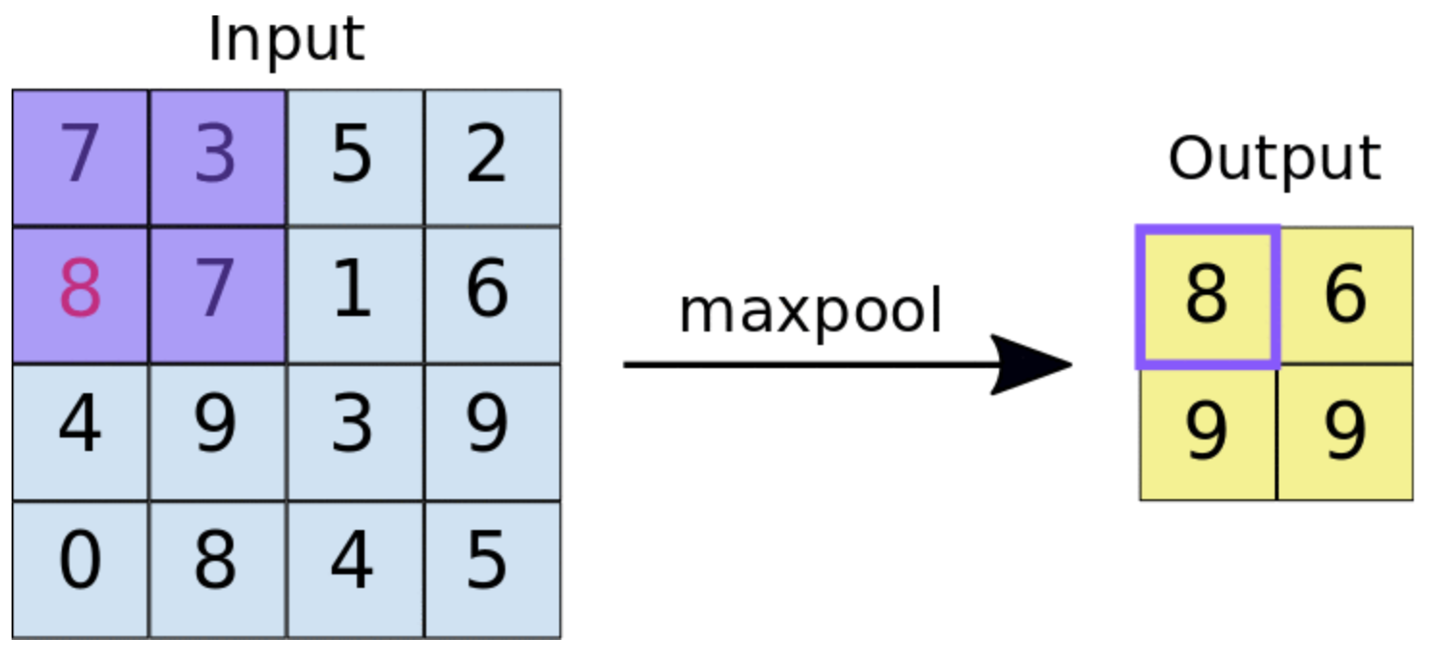
NASGRAPH OPERATIONS
Skip Operation
Widen
Deepen
Add
Merge
Maxpool

Slide 18
IMPLEMENTATION CONTRIBUTION -1
Padding
No Seed Architecture
Addition of Maxpool
Linear Layer Morphism
DEEPEN
WIDEN

Slide 19
RESEARCH CONTRIBUTION -2
Gradient Stopping
Gradient Starvation
Variable FC Hack
In Progress
Learning Curve Predication (DynamicLCP)
Probabilistic Operation Selection

Slide 20
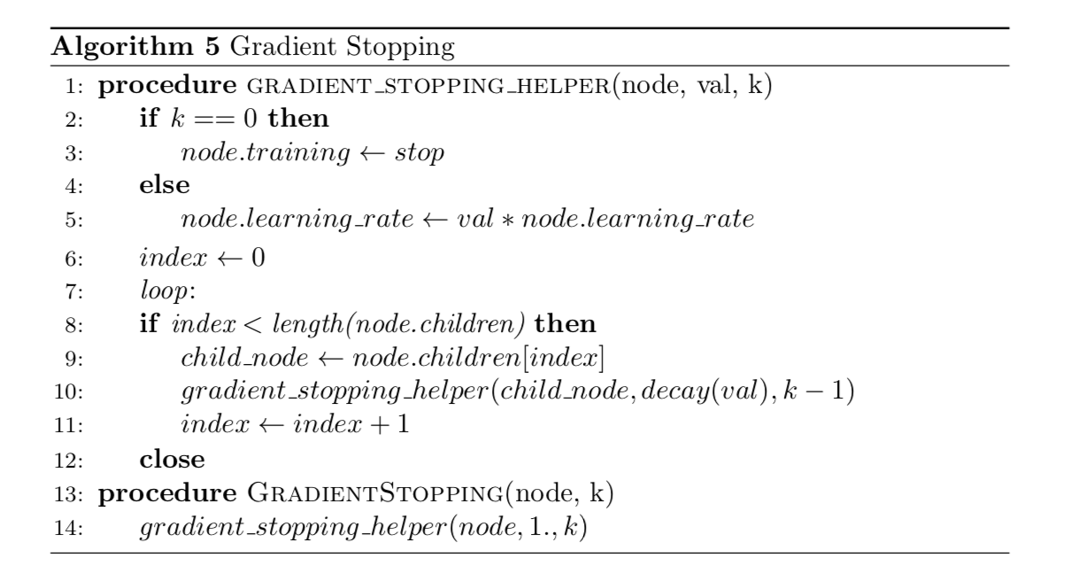
RESEARCH CONTRIBUTION -2
Gradient Stopping
Gradient Starvation
Variable FC Hack

Slide 21
RESEARCH CONTRIBUTION -2
Gradient Stopping
Gradient Starvation
Variable FC Hack

Slide 22
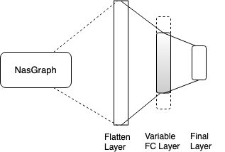
RESEARCH CONTRIBUTION - 2
Gradient Stopping
Gradient Starvation
Variable FC Hack

Slide 23
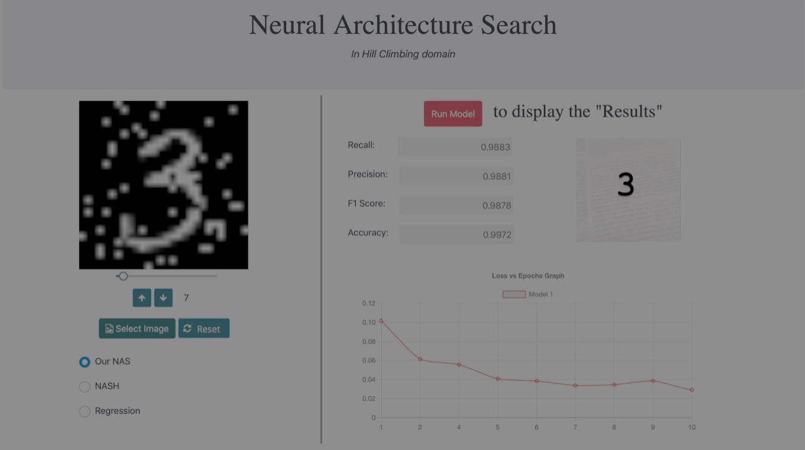
FUTURE WORK & USER INTERFACE

Slide 24
FUTURE WORK SOME IDEAS
Weight Initialization
Intelligent Conv-Block Selection
Intelligent Child Generation
LSTM/RNN Architecture
Simulated Annealing
Dynamic LCP
Probabilistic Selection of morphism operators

Slide 25
SETUP RESULTS IN PROGRESS WORK

Slide 26
EXPERIMENTS BASELINE
Learning Rate | Xavier Initialization 0/1 Initialization Time (hrs) / Error (%) | 0/1 Initialization Initialization Time (hrs) / Error (%)
SGDR + Gradient Stopping | 19.4 / 4.96 | 19.6 / 5.2
SGDR | 23.4 / 5.8 | 23.3 / 5.8
SGDR + Gradient Starvation | 18.2 / 4.98 | 18.6 / 5.1
Algorithm | Runtime (hrs) | Parameters (mil.) | Avg. Error (%)
NASH N_{steps} = 5, N_{neigh} = 8, SGDR | 13.1 | 5.7 | 6.2
NASH N_{steps} = 5, N_{neigh} = 8, No SGDR | 11.3 | 5.8 | 7.4
Ours – NO LCP | 25 | 6.1 | 5.54
Ours – LCP | 19 | 6.1 | 5.82

Slide 27
EXPERIMENTS PARAMETERS
Variable | NASH-Baseline | Ours
nsteps nNM n_neigh epoch_neigh epoch_final λstart λend | 8 5 8 17 100 0.05 0.0 | 10 5 8 16 64 0.1 0.0
Algorithm | Runtime (hrs) | Parameters (mil.) | Avg. Error (%)
NASH N_{steps} = 5, N_{neigh} = 8, SGDR | 13.1 | 5.7 | 6.2
NASH N_{steps} = 5, N_{neigh} = 8, No SGDR | 11.3 | 5.8 | 7.4
Ours – NO LCP | 25 | 6.1 | 5.54
Ours – LCP | 19 | 6.1 | 5.82

Slide 28
EXPERIMENTS OTHER ALGORITHMS
Model | Resource | Error(%)
Shake-Shake [11] | 2 days, 2 GPU | 2.9
RL-NAS [17] | ? days, 800 GPUs | 3.65
NASH-1 | 0.5 days, 1 GPU | 5.7
NASH-2 | 1 day, 1 GPU | 5.2
Ours-Stopping | 19.4 hours, 1 GPU | 4.96
Ours-Starvation | 18.2 hours, 1 GPU | 4.98
Algorithm | Resouces Days | Resources GPU | Parameters (mil.) | Avg. Error (%)
NASH | 0.5 | 13.1 | 5.7 | 6.2
Ours – NO LCP | 1 | 25 | 6.1 | 5.54
Ours – LCP | 0.7 | 19 | 6.1 | 5.82
Shake-Shake | 2 | 2 | 26 | 2.91
WRN-28-10 | 1 | 1 | 36.5 | 3.86
Baker et al. (2016) | 8-10 | 10 | 11 | 6.93
Cai et al. (2017) | 3 | 5 | 19.7 | 5.72
ENAS | 7 | 800 | ? | 2.91
Genetic | 20 | 2 | 16.4 | 7.10

Slide 29
EXPERIMENTS RETRAINING FROM SCRATCH
Algorithm | Time Taken (hrs) | Error (%)
Ours | 19.6 | 4.96
Ours – Scratch | 4.8 | 4.23

Slide 30
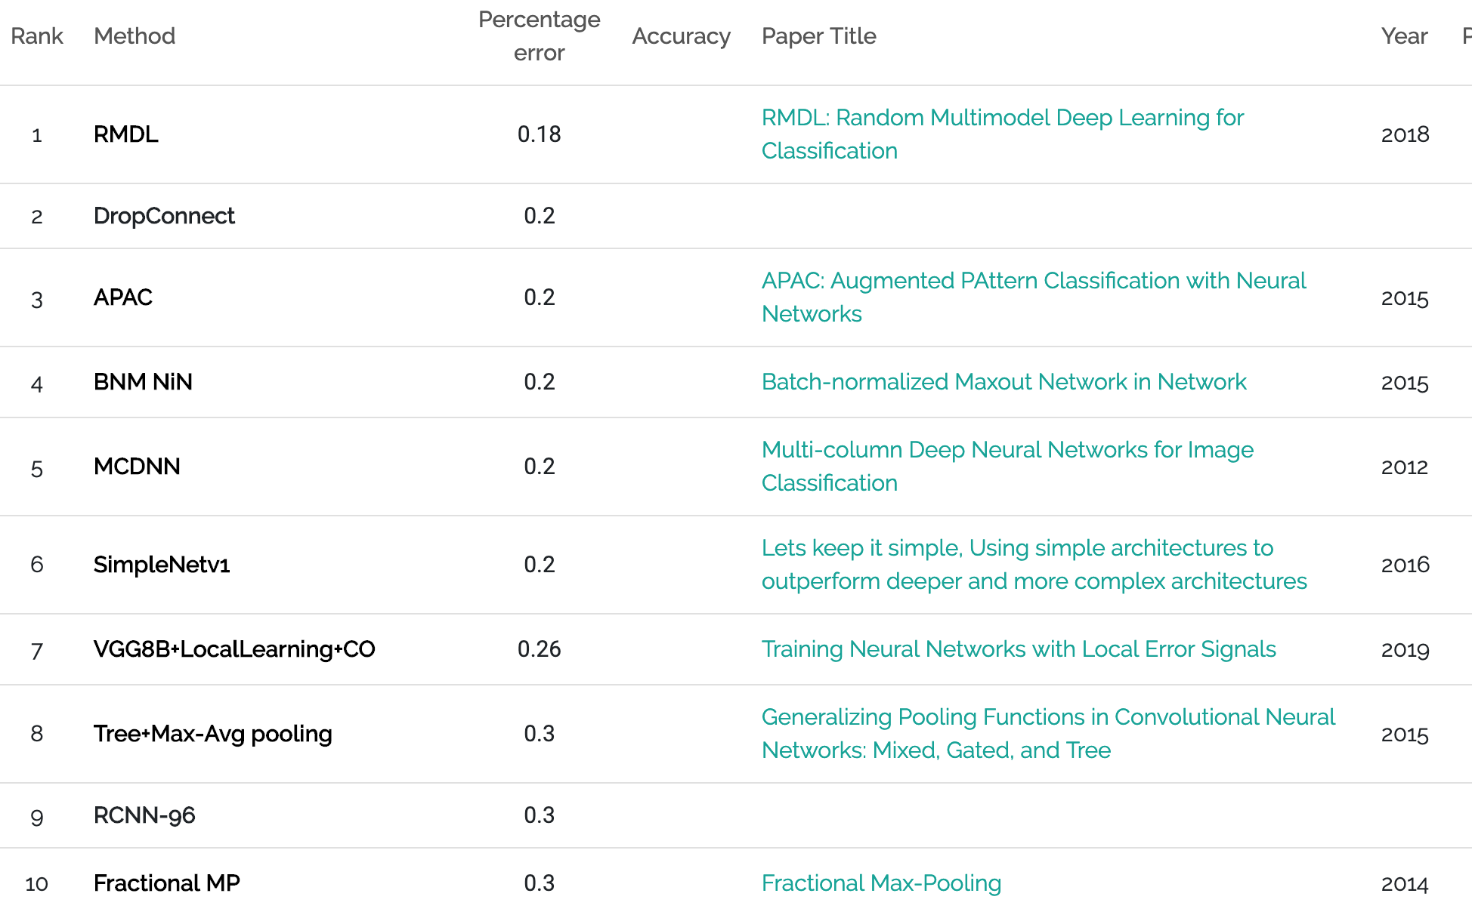
EXPERIMENTS MNIST
Algorithm | Error (%)
MCDNN | 0.23
Ours | 0.28
ENAS | 1.23

Slide 31
ACCOMPLISHMENTS
Fast
Robust
Feasible
Competitive Accuracy Values
Gradient Update Scheme as a Research Area
Python Based

