Slide 1
Fine-grained Language Identification with Multilingual CapsNet Model
Mudit Verma¹ & Arun Balaji Buduru²
1.Arizona State University, USA ^{2.IIIT-Delhi, India}

Slide 2
Need
Emergency Call Routing Services
Intelligent Voice Assistants
Conversational AI
Speech is the easiest form of communication for humans.

Slide 3
Trends
Language Embeddings (i-vector)
Use Hand Crafted Features ( & Phoneme Detection)
Mel Frequency Cepstral Coefficients
Spectrograms
P. Verma and P. K. Das, “i-vectors in speech processing applications: a survey,” International Journal of Speech Technology, vol. 18, no. 4, pp. 529–546, Dec 2015. [Online]. Available: https://doi.org/10.1007/s10772-015-9295-3

Slide 4
Trends
View it as a classification Problem
SVM / GMM / HMM
Logistic Regression
Fully connected Neural Networks
BLSTM
CNN (based on VGG)

Slide 5
Issues
Manual Feature Extraction is hard
Data Requirements
Robustness to Noise

Slide 6
Fine-Grained LID
Problem Characteristics :
Short Spoken Audio Snippets (5s-10s)
Multiple Languages
Noise
Exiguous Train Data
Trivial Data collection
Non-Class Identification
Multilingual

Slide 7
Dataset - Languages
Arabic - AR Bengali - BE Chinese(Mand.) - CH English - EN Hindi - HI Turkish Spanish Japanese Punjabi Portuguese
*used for Language Identification
**used for Non-Class Tests

Slide 8
Dataset - Languages
Arabic - AR Bengali - BE Chinese(Mand.) - CH English - EN Hindi - HI Turkish Spanish Japanese Punjabi Portuguese
*used for Language Identification
**used for Non-Class Tests
Deal with Indian Languages with more popular languages used for LID Task
Diverse set of languages
Exiguous Data requirements help with regional LID

Slide 9
Dataset - Collection
Type : Audio recordings of local and global news, interviews, speeches etc.
Source : YouTube
Data Size : 100 hrs / language for LID Task ( -> 500 hrs total) 30 hrs / language for Non-Class Task (-> 150 hrs total)
Train / Test Size :
70-30 for LID
20-10 for Non-Class

Slide 10
Dataset - Characteristics
Trivial and Easy Data Collection
Various Types of Noise :
1. Heard/Not-Understandable (spoken language is not understood) Background noise of cheers, slogans
2. Heard/Understandable (multiple spoken languages) Interviews/News reporting in multiple languages
3. Unheard (noise but not spoken language) Chimes/Mic Noise

Slide 11
Dataset - Processing
.wav format
Spectrogram Representation
Discretize using Hann window & 129 frequency bins
8-bit grayscale

Slide 12
Work
Handle Problem in Image Domain
Use Capsule Networks (CapsNet) for classification
Compare with variants of CNN CNN + Bi-GRU CNN + Bi-LSTM CNN + Bi-GRU + Attention
Test deeper variant of CapsNet
Verify Non-Class Detection (Out of Distribution Samples)

Slide 13
Image Domain
Use Spectrogram
Mel-Frequency Coeff. Cepstrum does not help much.

Slide 14
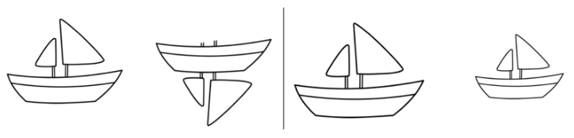
CapsNets - Theory
CNNs are great but they have a problem. They have :
Positional Invariance (Thanks to Pooling layers) Tolerant to ViewPoint Invariance
S. Sabour, N. Frosst, and G. E. Hinton, “Dynamic routing between capsules,” in Advances in Neural Information Pro- cessing Systems, 2017, pp. 3856–3866.
Notes:
Cnn provides invariance (discarding positional information) instead of equivariance (disentangling that information);
damages nearby feature detectors, by deleting the information they rely upon.
routes statically instead of communicating a potential "find" to the feature that can appreciate it;

Slide 15
CapsNets - Theory
Solves the “Picasso Problem”
CapsNets replace scalar-output feature detectors with vector-output capsules and max-pooling with routing-by-agreement.
Because capsules are independent, when multiple capsules agree, the probability of correct detection is much higher
S. Sabour, N. Frosst, and G. E. Hinton, “Dynamic routing between capsules,” in Advances in Neural Information Pro- cessing Systems, 2017, pp. 3856–3866.
Notes:
Cnn provides invariance (discarding positional information) instead of equivariance (disentangling that information);
damages nearby feature detectors, by deleting the information they rely upon.
routes statically instead of communicating a potential "find" to the feature that can appreciate it;

Slide 16
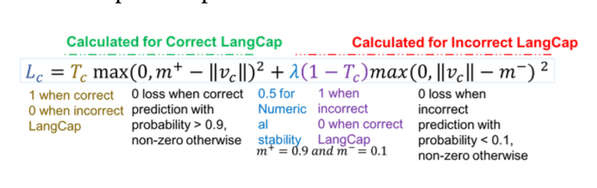
CapsNets - Theory
Notes:
Cnn provides invariance (discarding positional information) instead of equivariance (disentangling that information);
damages nearby feature detectors, by deleting the information they rely upon.
routes statically instead of communicating a potential "find" to the feature that can appreciate it;

Slide 17
CapsNets - Theory
Solves the “Picasso Problem”
CapsNets replace scalar-output feature detectors with vector-output capsules and max-pooling with routing-by-agreement.
Because capsules are independent, when multiple capsules agree, the probability of correct detection is much higher
Notes:
Cnn provides invariance (discarding positional information) instead of equivariance (disentangling that information);
damages nearby feature detectors, by deleting the information they rely upon.
routes statically instead of communicating a potential "find" to the feature that can appreciate it;

Slide 18
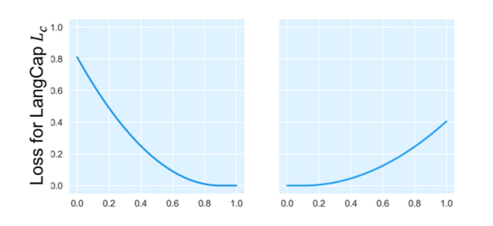
CapsNets - Theory
Notes:
Cnn provides invariance (discarding positional information) instead of equivariance (disentangling that information);
damages nearby feature detectors, by deleting the information they rely upon.
routes statically instead of communicating a potential "find" to the feature that can appreciate it;

Slide 19
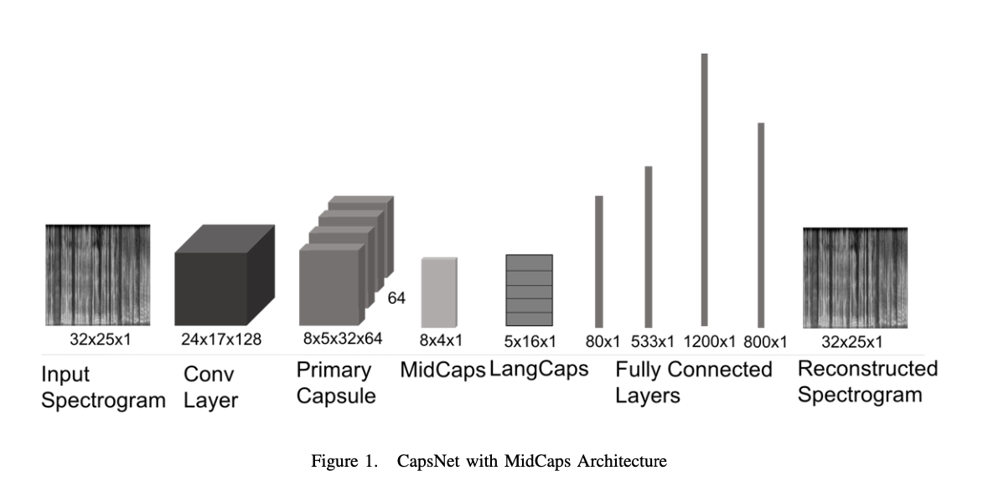
CapsNets Architecture
Notes:
Cnn provides invariance (discarding positional information) instead of equivariance (disentangling that information);
damages nearby feature detectors, by deleting the information they rely upon.
routes statically instead of communicating a potential "find" to the feature that can appreciate it;

Slide 20
CapsNets Architecture
Bottleneck
Notes:
Cnn provides invariance (discarding positional information) instead of equivariance (disentangling that information);
damages nearby feature detectors, by deleting the information they rely upon.
routes statically instead of communicating a potential "find" to the feature that can appreciate it;

Slide 21
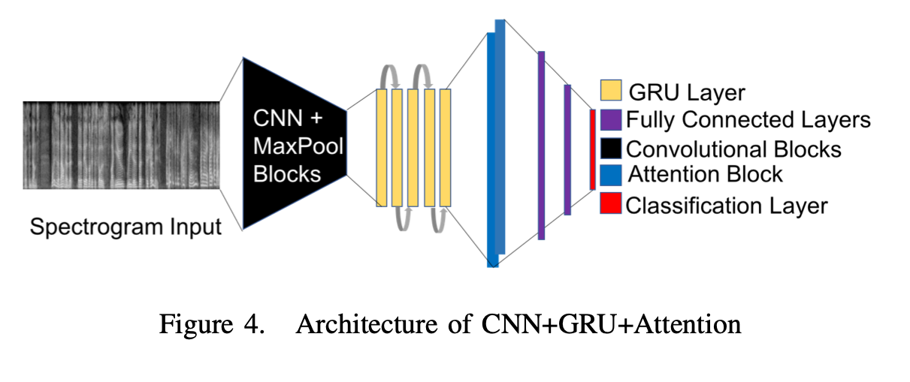
Baseline – CNN-(RNN)-Attention
C. Bartz, T. Herold, H. Yang, and C. Meinel, “Language identification using deep convolutional recurrent neural net- works,” in International Conference on Neural Information Processing. Springer, 2017, pp. 880–889.
Notes:
Why GRU?
Why not LSTM?
Both are utilizing different way if gating information to prevent vanishing gradient problem.
The GRU controls the flow of information like the LSTM unit, but without having to use a memory unit. It just exposes the full hidden content without any control.
GRU is computationally more efficient (less complex structure as pointed out). So we are seeing it being used more and more.
Why bidirectional ? There are debates here but it usually learns faster than one-directional approach although it depends on the task.
Attention Mechanism?
After theGRU.
Take attention probs. & product with gru ans. And forward.

Slide 22
Non-Class Detection
Verification Step.
Is CapsNet more robust* than baseline?
Thresholding Mechanism
*robustness here is over several languages.

Slide 23
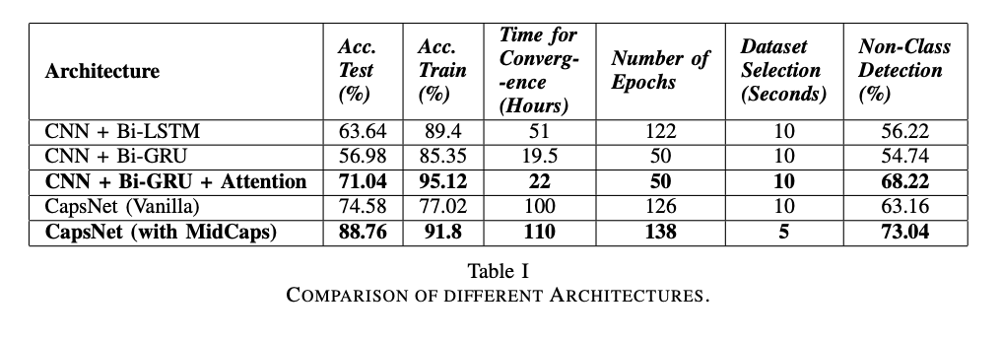
Results
Notes:
Cnn provides invariance (discarding positional information) instead of equivariance (disentangling that information);
damages nearby feature detectors, by deleting the information they rely upon.
routes statically instead of communicating a potential "find" to the feature that can appreciate it;

Slide 24
Results
Notes:
Cnn provides invariance (discarding positional information) instead of equivariance (disentangling that information);
damages nearby feature detectors, by deleting the information they rely upon.
routes statically instead of communicating a potential "find" to the feature that can appreciate it;

Slide 25
Results
Notes:
Cnn provides invariance (discarding positional information) instead of equivariance (disentangling that information);
damages nearby feature detectors, by deleting the information they rely upon.
routes statically instead of communicating a potential "find" to the feature that can appreciate it;

Slide 26
Results
CapsNet is bad. Or is it?
Notes:
Cnn provides invariance (discarding positional information) instead of equivariance (disentangling that information);
damages nearby feature detectors, by deleting the information they rely upon.
routes statically instead of communicating a potential "find" to the feature that can appreciate it;

Slide 27
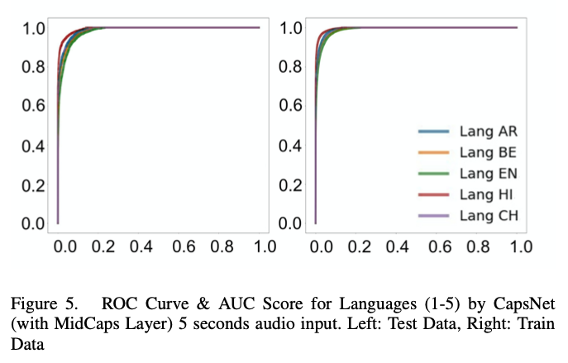
Results
ROC Curve & AUC Score for Languages (1-5) by CapsNet (with Midcaps Layers) – 5 second audio input.
Left : Test Data.
Right : Train Data.

Slide 28
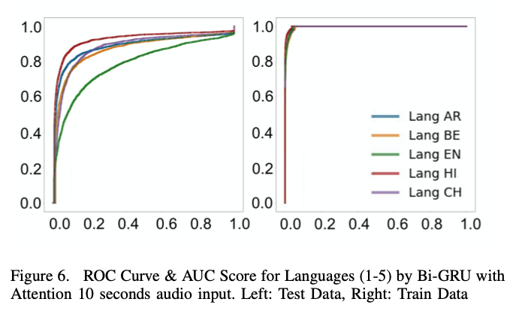
Results
ROC Curve & AUC Score for Languages (1-5) by Bi-GRU 10 second audio input.
Left : Test Data.
Right : Train Data.

Slide 29
Results
See a pattern?

Slide 30
Results
See a pattern? HI -> AR - > BE ~ CH > EN

Slide 31
Results
See a pattern? HI -> AR - > BE ~ CH > EN
Should we be expecting this order?

Slide 32
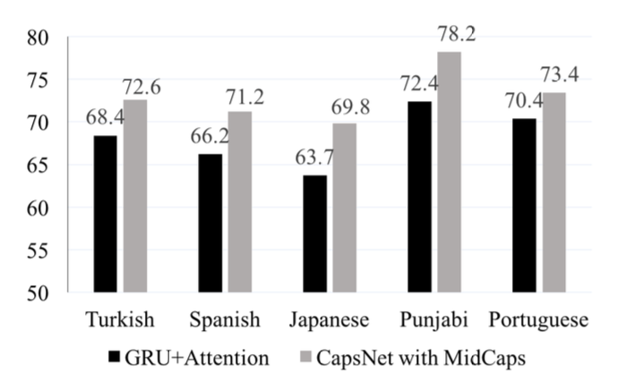
Results
Non Class Detection for languages (6-10)

Slide 33
Results
Why is Japanese low?
Why is Punjabi high?
Portuguese & Spanish
Turkish ~ Arabic
Non Class Detection for languages (6-10)

Slide 34
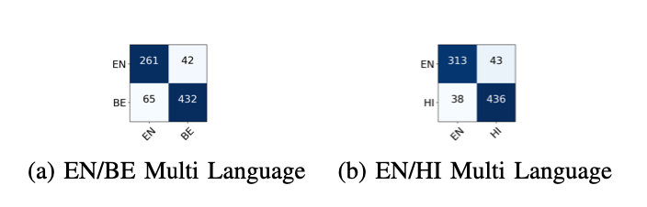
Results – CapsNet is Multilingual
S. Toshniwal, T. N. Sainath, R. J. Weiss, B. Li, P. Moreno, E. Weinstein, and K. Rao, “Multilingual speech recognition with a single end-to-end model,” in 2018 IEEE Interna- tional Conference on Acoustics, Speech and Signal Processing (ICASSP). IEEE, 2018, pp. 4904–4908.

Slide 35
Future Work
Recurrent Layers with CapsNet
NAS over CapsNet architectures
Non Class Detection

Slide 36

Thank You

