Slide 1
Final Project - Unsupervised Algorithms in Machine Learning -
Can we identify the type of news based on headlines and short descriptions?
Susumu Iwasaki

Slide 2
“Can we identify the type of news based on headlines and short descriptions?”
- The purpose of this project:
To classify news by using NMF (Non-negative Matrix Factorization) for reducing the dimension
Dataset:
"News Category Dataset" provided by Kaggle. (https://www.kaggle.com/datasets/rmisra/news-category-dataset)
Around 210k news headlines from 2012 to 2022 from HuffPost
Validation method:
Check the accuracy of clustering in comparison with the category in the dataset.

Slide 3
1. Exploratory Data Analysis
First 5 rows of “News_Category_Dataset_v3.json”
 | link | headline | category | short_description | authors | date
0 | https://www.huffpost.com/entry/covid-boosters-... | Over 4 Million Americans Roll Up Sleeves For O... | U.S. NEWS | Health experts said it is too early to predict... | Carla K. Johnson, AP | 2022-09-23
1 | https://www.huffpost.com/entry/american-airlin... | American Airlines Flyer Charged, Banned For Li... | U.S. NEWS | He was subdued by passengers and crew when he ... | Mary Papenfuss | 2022-09-23
2 | https://www.huffpost.com/entry/funniest-tweets... | 23 Of The Funniest Tweets About Cats And Dogs ... | COMEDY | "Until you have a dog you don't understand wha... | Elyse Wanshel | 2022-09-23
3 | https://www.huffpost.com/entry/funniest-parent... | The Funniest Tweets From Parents This Week (Se... | PARENTING | "Accidentally put grown-up toothpaste on my to... | Caroline Bologna | 2022-09-23
4 | https://www.huffpost.com/entry/amy-cooper-lose... | Woman Who Called Cops On Black Bird-Watcher Lo... | U.S. NEWS | Amy Cooper accused investment firm Franklin Te... | Nina Golgowski | 2022-09-22

Slide 4
Overview of dataset (1)
209527 news articles
6 columns: ‘category’, ‘headline’, ‘authors’, ‘link’, ‘short_description’, ‘date’
-> As the content of ‘headline’ and ‘short_description’ would be redundant, concatenate two columns into one.
There is not any null data in these columns.
As 15 news articles are duplicated, then remove them

Slide 5
Overview of data (2)
42 subjects in ‘category’:
POLITICS (35602), WELLNESS (17945), ENTERTAINMENT (17362), TRAVEL (9900), STYLE & BEAUTY (9814), PARENTING (8791), HEALTHY LIVING (6694), QUEER VOICES (6347), FOOD & DRINK (6340), BUSINESS (5992), COMEDY (5400), SPORTS (5077), BLACK VOICES (4583), HOME & LIVING (4320), PARENTS (3955), THE WORLDPOST (3664), WEDDINGS (3653), WOMEN (3572), CRIME (3562),IMPACT (3484), DIVORCE (3426), WORLD NEWS (3299),MEDIA (2944), WEIRD NEWS (2777), GREEN (2622), WORLDPOST (2579), RELIGION (2577), STYLE (2254), SCIENCE (2206), TECH (2104), TASTE (2096), MONEY (1756), ARTS (1509), ENVIRONMENT (1444), FIFTY (1401), GOOD NEWS (1398), ARTS & CULTURE (1339), COLLEGE (1144), LATINO VOICES (1130), CULTURE & ARTS (1074), EDUCATION (1014)
Some redundancy exists between subjects: eg., ‘parenting’ & ‘parent’, ‘arts’ & ‘arts & culture’ & ‘culture & arts’,etc.
-> Grouping is needed between categories

Slide 6
Grouping categories (except for ‘POLOTICS’)
‘LIFE & WELLNESS’ <= ['WELLNESS', 'HEALTHY LIVING', 'HOME & LIVING', 'STYLE & BEAUTY', 'STYLE’]
'PARENTING & EDUCATION’<= ['PARENTING', 'PARENTS', 'EDUCATION', 'COLLEGE']
'SPORTS & ENTERTAINMENT’<= ['SPORTS', 'ENTERTAINMENT', 'COMEDY','WEIRD NEWS', 'ARTS']
'TRAVEL & ART’<= ['TRAVEL', 'ARTS & CULTURE', 'CULTURE & ARTS', 'FOOD & DRINK', 'TASTE']
'EMPOWERED VOICES’<= ['WOMEN','QUEER VOICES', 'LATINO VOICES', 'BLACK VOICES’]
'BUSINESS & MONEY’<= ['BUSINESS', 'MONEY']
'WORLDNEWS’<= ['THE WORLDPOST', 'WORLDPOST', 'WORLD NEWS']
'SCIENCE & ENVIRONMENT’<= ['TECH', 'SCIENCE', 'ENVIRONMENT','GREEN’]
'GENERAL’<= ['FIFTY', 'IMPACT', 'GOOD NEWS','CRIME', 'U.S. NEWS']
'MISC’<= ['WEDDINGS', 'DIVORCE', 'RELIGION','MEDIA']

Slide 7
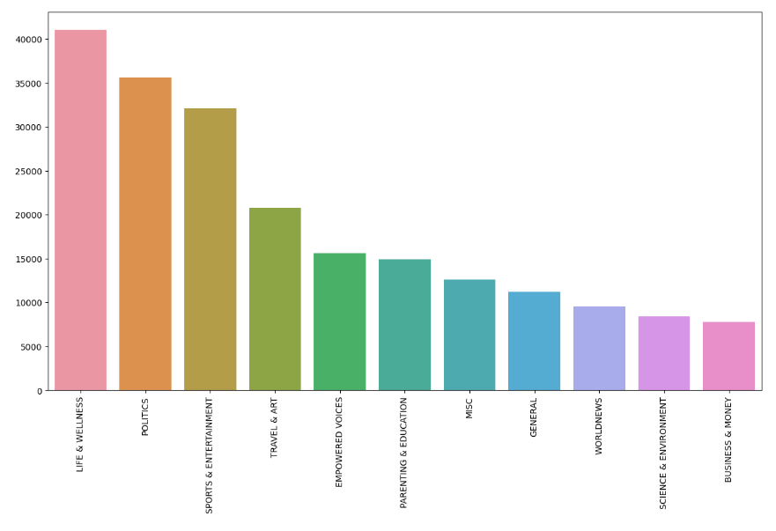

Slide 8
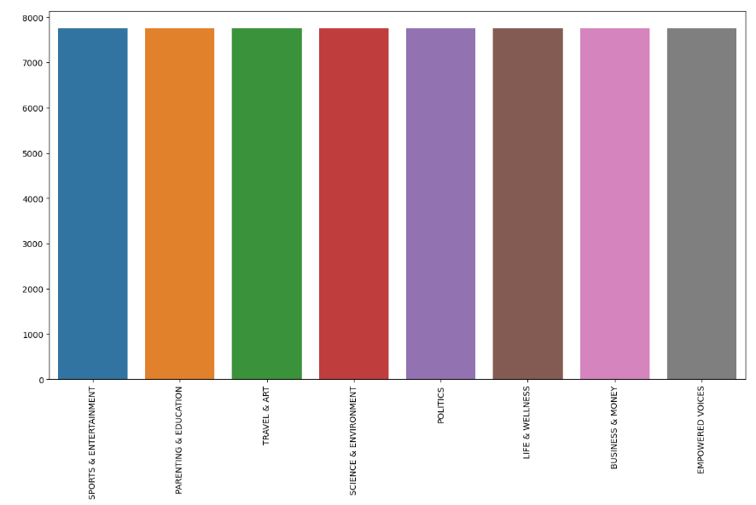
Remove 'MISC', 'GENERAL', 'WORLDNEWS' for reducing the total number of categories, because after clustering, in order to evaluate accuracy, which is calculated by comparing real category and permuted clustered group, so that the calculation of permutation does take too much time in case the number of categories is over 8.
Balance the volume of each category

Slide 9
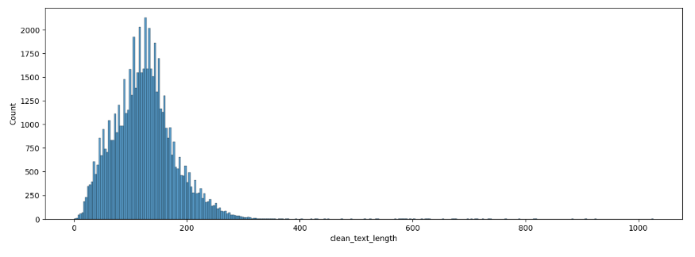
Cleaning text
Remove punctuation and English ‘stop words’ and normalize the case of words
Too long text are removed (# of words > 330) as outliners

Slide 10
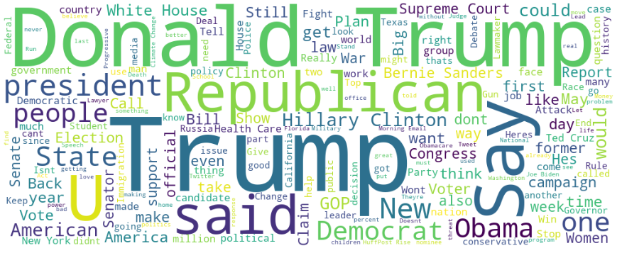
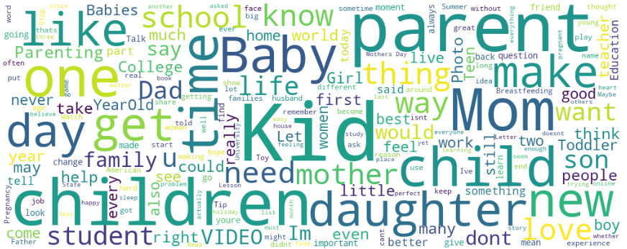
Wordcloud of ‘POLITICS’
Wordcloud of ‘PARENTING & EDUCATION’

Slide 11
Modelling
Vectorizing words:
TFIDF (term frequency-inverse document frequency)
The TFIDF value increases proportionally to the number of times a word appears in the document and is offset by the number of documents in the corpus that contain the word, which helps to adjust for the fact that some words appear more frequently in general.
Hyperparameter of TfidVectorizer:
(default setting) min_df = 1, max_df = 1, ngram = 1
Non-negative Matrix Factorization:
Hyperparameter of sklearn.decomposition.NMF: n_components = 8
(default setting) solver =‘cd’ (Coordinate Descent solver), beta_loss=’frobenius’
-> solver = ‘mu’, beta_loss = ‘kullback-leibler’
Calculation of accuracy:
Compare permutated 8 clusters with category of dataset for finding the best match

Slide 12
Hyperparamter tuning (1)
Default setting of TFIDF and NMF:
Accuracy is 0.2707
Hyperparameter of NMF is changed:
solver: ‘cd’ -> ‘mu’ (multiplicative update solver),
beta_loss: ‘frobenius’ -> ‘kullback-leibler’
Accuracy is improved: 0.2930
Hyperparameter of TfidVectorizer is changed:
ngam: 1 -> 2
Accuracy is getting worse: 0.1317
Hyperparameter of TfidVectorizer is changed:
min_df: 1 -> 2
Accuracy is improved: 0.3688

Slide 13
Hyperparamter tuning (2)
Hyperparameter of TfidVectorizer is changed:
min_df: 1 -> 3
Accuracy is getting worse: 0.3013
Hyperparameter of NMF is changed:
Other hyperparameters are the same as the model of the best score (min_df = 2)
max_iter: 1000 -> 10000
Accuracy is getting worse: 0.2414

Slide 14
 | max_df | min_df | ngram | NMF | max_iter | accuracy
(default) | 1 | 1 | 1 | ‘cd’, ‘frobenius’ | 1000 | 0.2707
Model 1 | ↑ | 1 | ↑ | ‘mu’,’KL’ | ↑ | 0.2930
Model 2 | ↑ | 1 | 2 | ↑ | ↑ | 0.1317
Model 3 | ↑ | 2 | 1 | ↑ | ↑ | 0.3688
Model 3’ | ↑ | 2 | ↑ | ↑ | 10000 | 0.2414
Model 4 | ↑ | 3 | ↑ | ↑ | 1000 | 0.3013

Slide 15

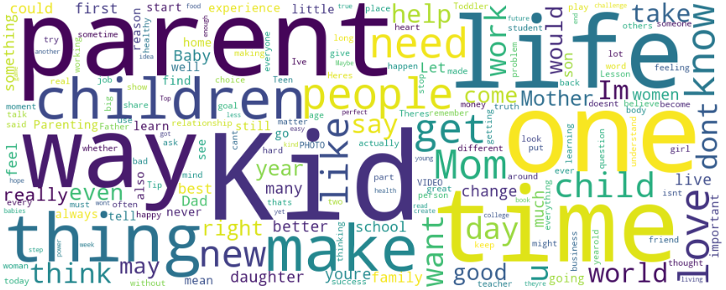
Wordcloud of ‘PARENTING & EDUCATION’ of original dataset
Wordcloud of estimated ‘PARENTING & EDUCATION’ of model3

Slide 16
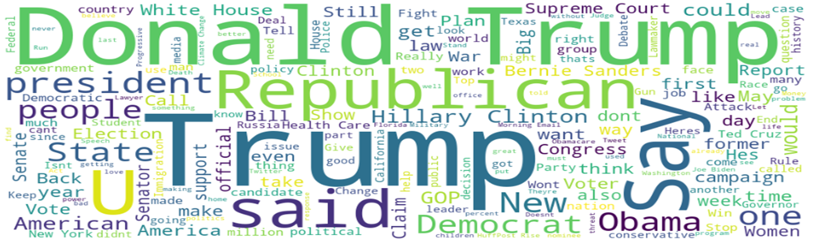
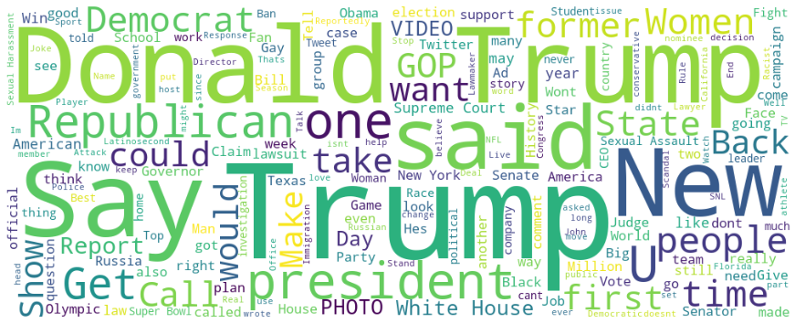
Wordcloud of ‘POLITICS’ of original dataset
Wordcloud of estimated ‘POLITICS’ of model 3

Slide 17
NMF vs MiniBatchKMeans
By using the best TFIDF vectorized model,
Kmeans and MiniBatchKMeans is tried in comparison with NMF.
Accuracy is 0.1870, 0.2250 respectively.

Slide 18
Analysis
The best hyperparameter setting is as follows:
TFIDF: max_df = 1, min_df = 2, ngram=1
NMF: solver = ‘mu’, beta_loss = ‘kullback-leibler’
-> The best accuracy is 0.3688…
Even this model does not work very well.
Compared with Kmeans, this NMF score is better.
The reason of not-good accuracy score assumes to be the similarity of word usage in different categories.

Slide 19
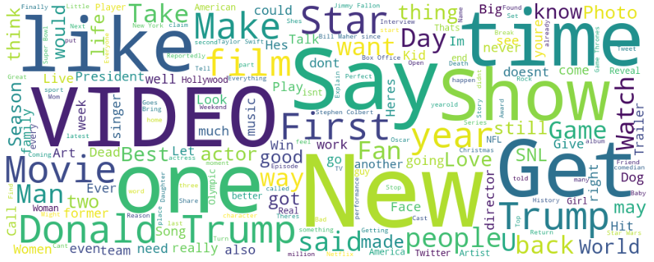

Wordcloud of original datasets
‘SPORTS & ENTAINMENT
BUSINESS & MONEY

Slide 20
For example, ‘POLITICS’ or ‘PARENTING & EDUCATION’ might be well caught by this model.
But even seeing the wordcloud of original category such as ‘SPORTS & ENTERTAINMENT’ and ‘BUSINESS & MONEY’, we could not discern the difference.
In this sense, preprocess for removing common words should be essential for better accuracy.
This would be a future subject.

Slide 21
Conclusion
In this project, we have executed clustering news articles by using NMF and TFIDF.
The best accuracy is 0.3688, which can be estimated that it would not work very well.
Under unsupervised learning algorithm, this might be the limit.
In order for more accuracy, to remove common words would be essential.

