Slide 1
Final Project - Introduction to Deep Learning -
Can we identify the type of news based on headlines and short descriptions?
Susumu Iwasaki

Slide 2
“Can we identify the type of news based on headlines and short descriptions?”
- The purpose of this project:
To predict the category of news articles by deep learning algorithms
Dataset:
"News Category Dataset" provided by Kaggle. (https://www.kaggle.com/datasets/rmisra/news-category-dataset)
Around 210k news headlines from 2012 to 2022 from HuffPost

Slide 3
1. Exploratory Data Analysis
First 5 rows of “News_Category_Dataset_v3.json”
 | link | headline | category | short_description | authors | date
0 | https://www.huffpost.com/entry/covid-boosters-... | Over 4 Million Americans Roll Up Sleeves For O... | U.S. NEWS | Health experts said it is too early to predict... | Carla K. Johnson, AP | 2022-09-23
1 | https://www.huffpost.com/entry/american-airlin... | American Airlines Flyer Charged, Banned For Li... | U.S. NEWS | He was subdued by passengers and crew when he ... | Mary Papenfuss | 2022-09-23
2 | https://www.huffpost.com/entry/funniest-tweets... | 23 Of The Funniest Tweets About Cats And Dogs ... | COMEDY | "Until you have a dog you don't understand wha... | Elyse Wanshel | 2022-09-23
3 | https://www.huffpost.com/entry/funniest-parent... | The Funniest Tweets From Parents This Week (Se... | PARENTING | "Accidentally put grown-up toothpaste on my to... | Caroline Bologna | 2022-09-23
4 | https://www.huffpost.com/entry/amy-cooper-lose... | Woman Who Called Cops On Black Bird-Watcher Lo... | U.S. NEWS | Amy Cooper accused investment firm Franklin Te... | Nina Golgowski | 2022-09-22

Slide 4
Overview of dataset (1)
209527 news articles
6 columns: ‘category’, ‘headline’, ‘authors’, ‘link’, ‘short_description’, ‘date’
-> As the content of ‘headline’ and ‘short_description’ would be redundant, concatenate two columns into one.
There is not any null data in these columns.
As 15 news articles are duplicated, then remove them

Slide 5
Overview of data (2)
42 subjects in ‘category’:
POLITICS (35602), WELLNESS (17945), ENTERTAINMENT (17362), TRAVEL (9900), STYLE & BEAUTY (9814), PARENTING (8791), HEALTHY LIVING (6694), QUEER VOICES (6347), FOOD & DRINK (6340), BUSINESS (5992), COMEDY (5400), SPORTS (5077), BLACK VOICES (4583), HOME & LIVING (4320), PARENTS (3955), THE WORLDPOST (3664), WEDDINGS (3653), WOMEN (3572), CRIME (3562),IMPACT (3484), DIVORCE (3426), WORLD NEWS (3299),MEDIA (2944), WEIRD NEWS (2777), GREEN (2622), WORLDPOST (2579), RELIGION (2577), STYLE (2254), SCIENCE (2206), TECH (2104), TASTE (2096), MONEY (1756), ARTS (1509), ENVIRONMENT (1444), FIFTY (1401), GOOD NEWS (1398), ARTS & CULTURE (1339), COLLEGE (1144), LATINO VOICES (1130), CULTURE & ARTS (1074), EDUCATION (1014)
Some redundancy exists between subjects: eg., ‘parenting’ & ‘parent’, ‘arts’ & ‘arts & culture’ & ‘culture & arts’,etc.
-> Grouping is needed between categories

Slide 6
Grouping categories (except for ‘POLOTICS’)
‘LIFE & WELLNESS’ <= ['WELLNESS', 'HEALTHY LIVING', 'HOME & LIVING', 'STYLE & BEAUTY', 'STYLE’]
'PARENTING & EDUCATION’<= ['PARENTING', 'PARENTS', 'EDUCATION', 'COLLEGE']
'SPORTS & ENTERTAINMENT’<= ['SPORTS', 'ENTERTAINMENT', 'COMEDY','WEIRD NEWS', 'ARTS']
'TRAVEL & ART’<= ['TRAVEL', 'ARTS & CULTURE', 'CULTURE & ARTS', 'FOOD & DRINK', 'TASTE']
'EMPOWERED VOICES’<= ['WOMEN','QUEER VOICES', 'LATINO VOICES', 'BLACK VOICES’]
'BUSINESS & MONEY’<= ['BUSINESS', 'MONEY']
'WORLDNEWS’<= ['THE WORLDPOST', 'WORLDPOST', 'WORLD NEWS']
'SCIENCE & ENVIRONMENT’<= ['TECH', 'SCIENCE', 'ENVIRONMENT','GREEN’]
'GENERAL’<= ['FIFTY', 'IMPACT', 'GOOD NEWS','CRIME', 'U.S. NEWS']
'MISC’<= ['WEDDINGS', 'DIVORCE', 'RELIGION','MEDIA']

Slide 7
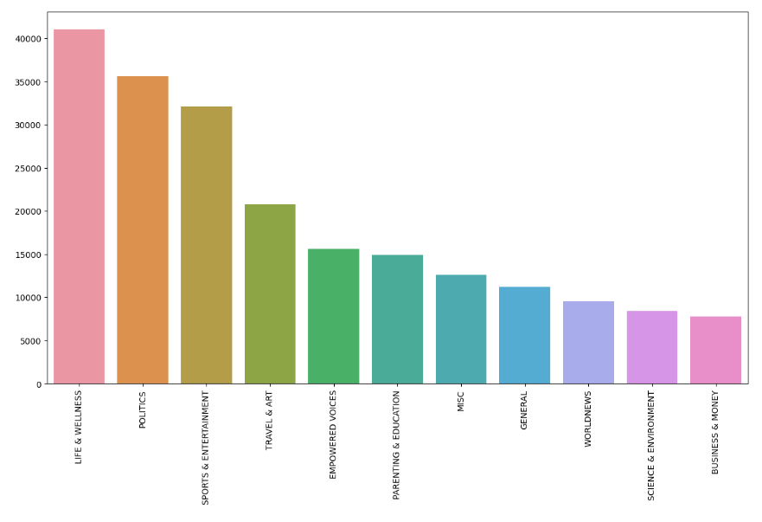

Slide 8
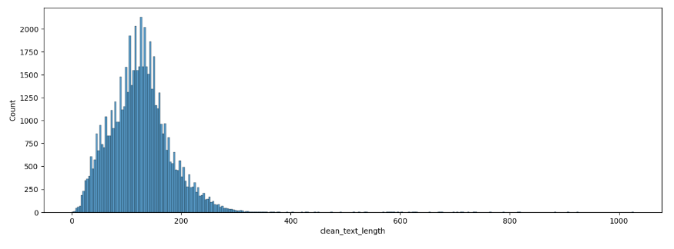
Cleaning text
Remove punctuation and English ‘stop words’ and normalize the case of words
Too long text are removed (# of words > 400) as outliners
Tokenizing & Padding
Embedding matrix with ‘GloVe’ embedding

Slide 9
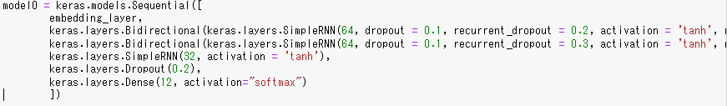
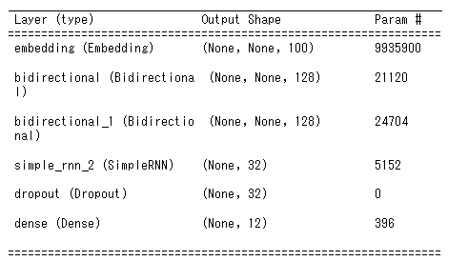
Modelling
Base model – simple RNN
Recurrent Neural Networks are designed to work with sequence data, and use the previous information in the sequence to produce the current output.

Slide 10
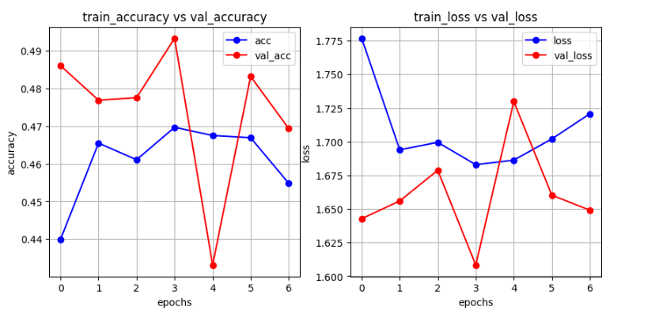

Slide 11
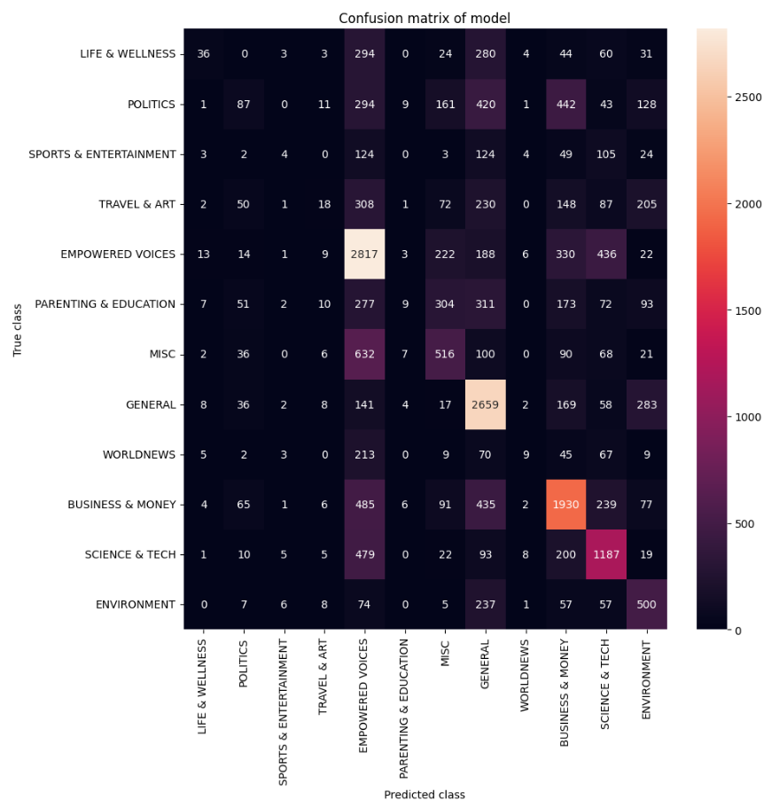
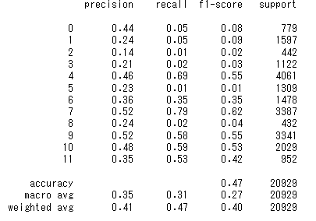

Slide 12
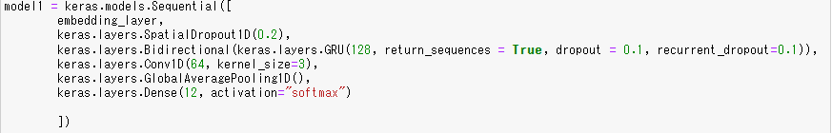
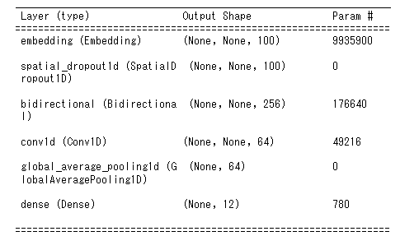
(2) Bidirectional GRU + Convolution The workflow of Gated Recurrent Units is the same as RNN but the difference is in the operations inside the unit: reset gate & update gate, in order to overcome vanishing gradient.

Slide 13
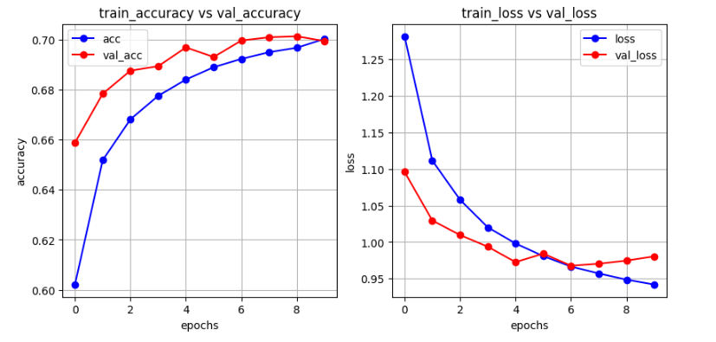

Slide 14
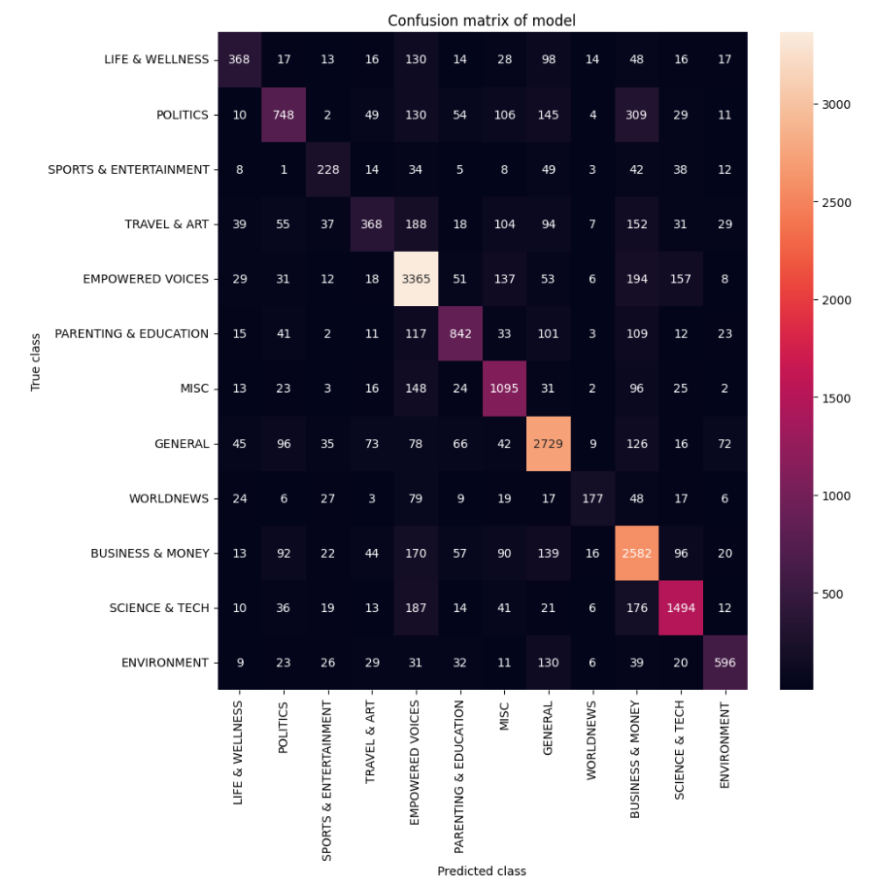
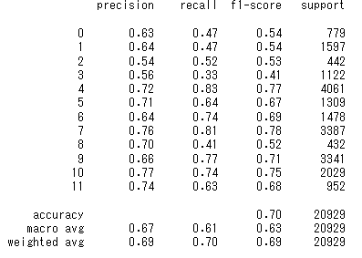

Slide 15
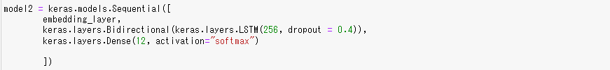
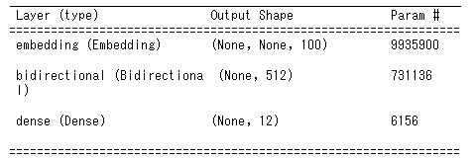
(3) LSTM Long Short-Term Memory’s architecture is similar to GRU’s, which adds 2 more gates: forget gate & output gate, in order to overcome vanishing gradients.

Slide 16
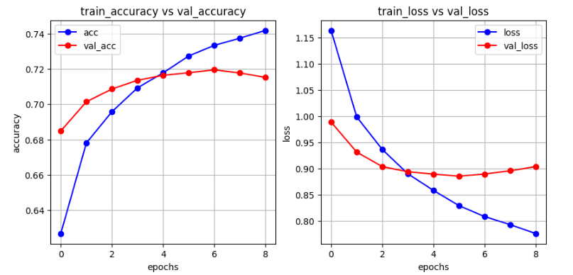

Slide 17
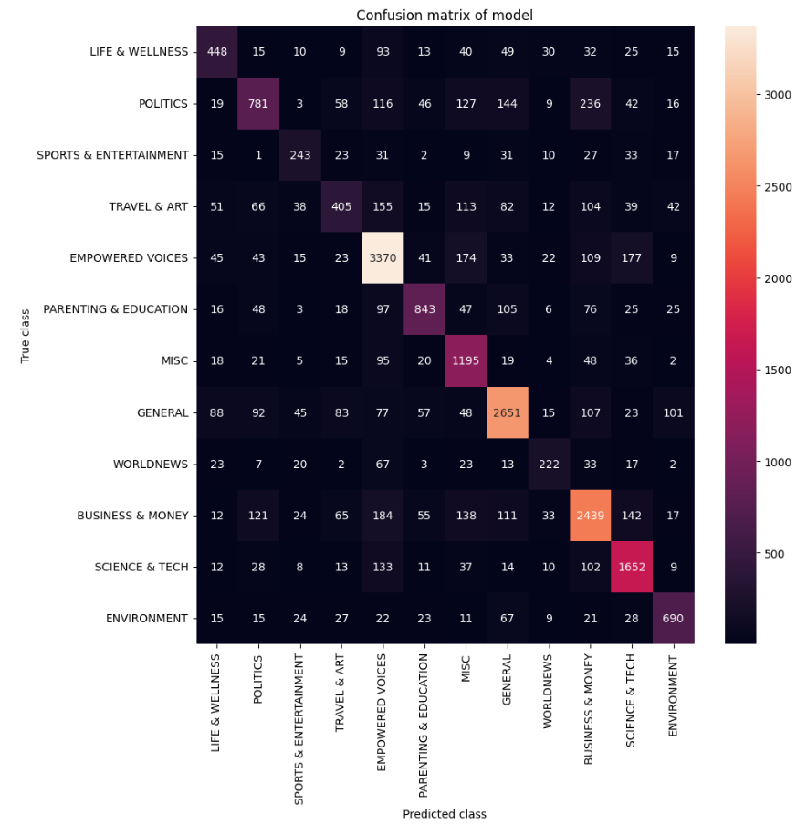
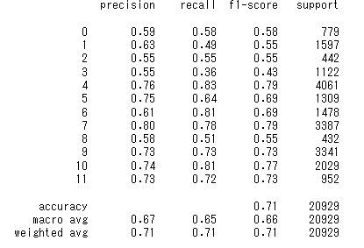

Slide 18
Analysis
Among 3 models (SimpleRNN, GRU, LSTM), accuracy of LSTM is the best: 0.71
It would be observed that the accuracy order such as LSTM > GRU > SimpleRNN would be reflected by the effect of memory for overcoming vanishing gradients.
In-detail observation of confusion matrix of the RNN model would show that several combination of categories has the bad result.
 | TRAVEL & ART | EMPOWERED VOICES
TRAVEL & ART | 18 | 308
EMPOWERED VOICES | 9 | 2817

Slide 19
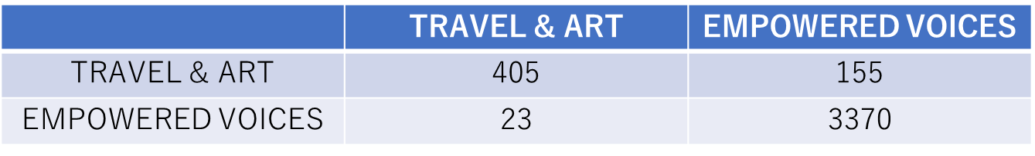
Confusion matrix at the specific combination would suggest an interesting fact:
For example, the same confusion matrix at the LSTM model shows not-so-good result:
It would be assumed that between two categories, there might be some similarity for word usages.
In order for more accuracy, there is some room for improving grouping method for differentiating each group in terms of word usages.

Slide 20
Conclusion
In this project, we have executed 3 deep learning algorithms for predicting category by headlines and short description of news articles.
The best accuracy is 0.71 under LSTM model, which can be estimated that it would work very well.
In order for more accuracy, to refine the grouping methods would be essential.

