Slide 1
Baupen Architecture
Florian Moser, 16.11.2021

Slide 2
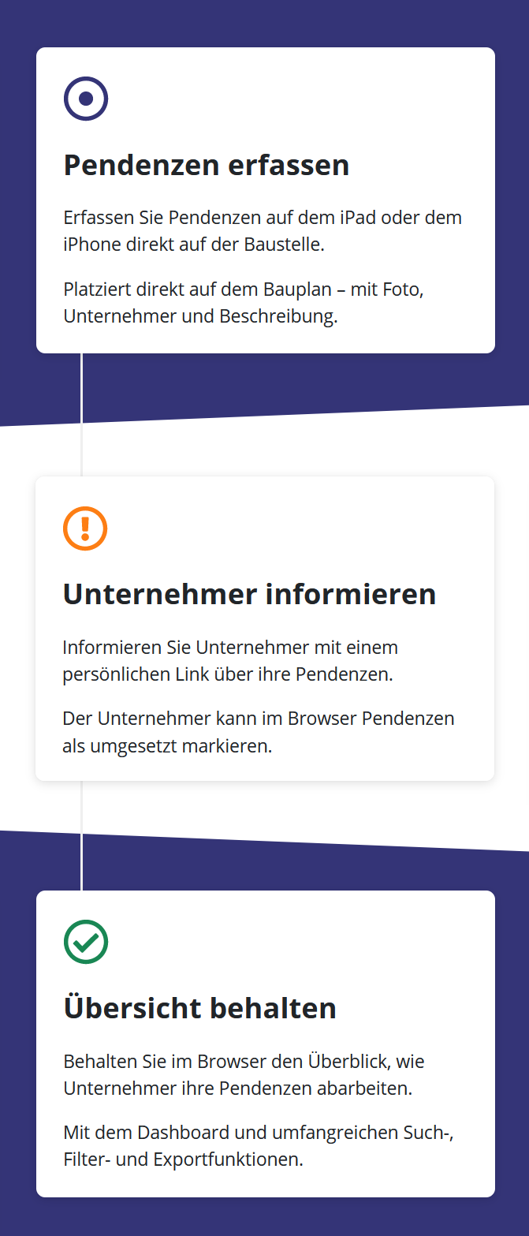
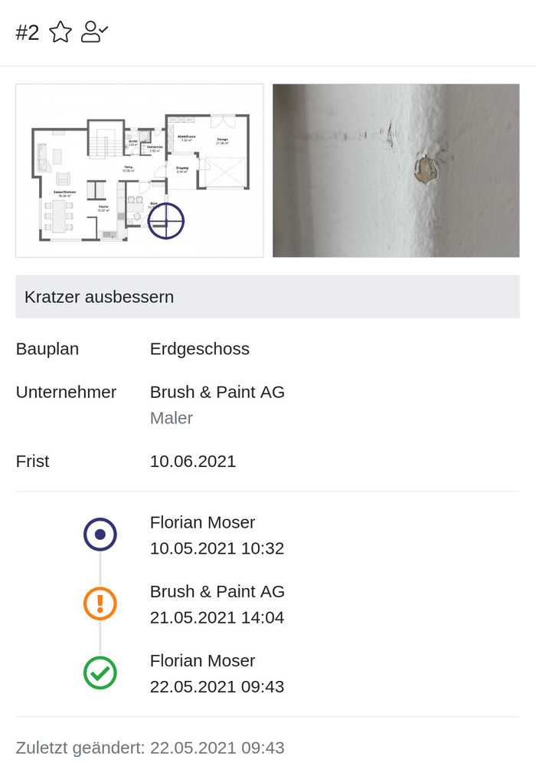
Business Case
Mängelmanagement: Unterstützung während des ganzen Lebenslaufs eines Mangels; von Erfassung über Umsetzung bis zur finalen Inspektion.
Abnahme: Im Abnahmemodus werden Abnahmemängel klar von anderen Vorgängen auf der Baustelle getrennt.
Dokumentation: Ein zentraler Ort für alle Pendenzen aller Unternehmer macht Vorgänge auch auf grossen Baustellen nachvollziehbar.

Slide 3
Architecture
Backend
Browser
Json / Swagger
Twig
ApiPlatform
VueJS
symfony
doctrine
bootstrap
FontAwesome
PHP
MariaDB
JavaScript
Setup by encore / webpack

Slide 4
Frontend Architecture (1/2)
App
Dashboard Dispatch Edit
…
Layout
DashboardConstructionSite DashboardFeed DashboardIssuesGraph
…
View Feed LoadingIndicator
Target: Push Down & Push Out
Naming: For Affiliation or Reuse

Slide 5
Frontend Architecture (2/2)
Layout
DispatchCraftsman
Action ComposeEmailButton
Form EmailForm
App: Entrypoint from HTML; authentication & global data Layout: Complex view with single purpose; purpose-specific requests View: Simple view with single purpose; formatting logic Action: Action wrapped in Button/Checkbox; action-specific requests Form: (Templated) entity edit; validation logic Library: Generic Behaviours and Views
Behaviour Modal
Target: Push Down & Push Out
Naming: For Affiliation or Reuse

Slide 6
Discussion Frontend Architecture
Opiniated Decisions
Minimize Dependencies (prefer extract & copy) No store (prefer strict layering, refactoring) No router (prefer offloading tasks to backend) Align UI & pattern (App, Layout, View, Action, Form, Library)
Current issues (but slim)
Table too complex (use Composition API) Filter too much data transfer (use store) Formatting inconsistent (write eslint plugin)
Note: Frontend was rewritten end 2020 for new api structure, bump to VueJS 3.0

Slide 7
Discussion Architecture
Targets
Usability (Performance, Simplicity, Iteration) Correctness (Testing, Maintainability)
Scalability (Deployability, Stability)
Current issues Report too limited & untestable (use own PDF implementation) ApiPlatform low quality (own expert knowledge) Frontend iterates rapidly (reduce dependencies)

