Slide 1
ALMA MATER STUDIORUM - UNIVERSITÀ DI BOLOGNA
At the Edge of Conservation:
Livelihoods & Household Welfare in Maasai-Associated Areas of Northern Tanzania
Candidate: Matteo Fantuz | ID: 0001113450
Department of Economics | Graduation Session - July 2026

Slide 2
Motivation
Conservation vs. pastoralism — Protected areas restrict grazing mobility and land access. Costs may not appear first in consumption, but in herd management and livestock health.
Two policy shocks — 2009 Wildlife Conservation Act (legal consolidation) and 2013 anti-poaching enforcement (reported cattle seizures, house burnings).
A measurement problem — Ethnicity is unobserved in modern Tanzanian surveys — a legacy of Nyerere-era nation-building. Maasai exposure must be reconstructed spatially.
Data: Tanzania National Panel Survey (NPS), Waves 1–4
W1
W2
W3
W4
2008–2009
2010–2011
2012–2013
2014–2015
Pre-Reform Baseline
Post-Wildlife Act (2009)
Enforcement Baseline
Post-2013 Pressure
2

Slide 3
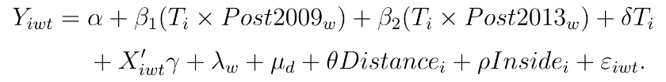
Empirical Strategy
Research question: Among households in the reserve risk set, did conservation exposure differentially affect those in Maasai-associated areas?
β₁ = differential shift after 2009 β₂ = additional shift after 2013 Total post-2013 = β₁ + β₂
Key Definitions
Risk Set: within 75 km of a game-reserve boundary
Treatment (T): within 25 km of Maasai-associated localities (validated areas)
Repeated cross-sections, wave & district fixed effects, household controls, EA-clustered standard errors.
3

Slide 4
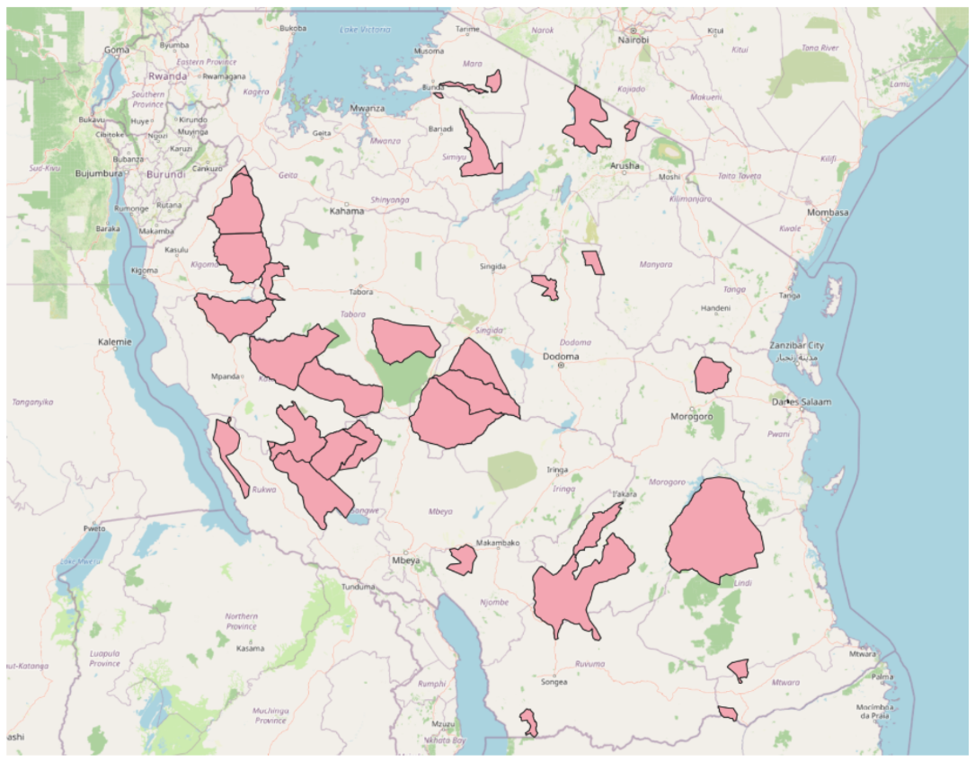
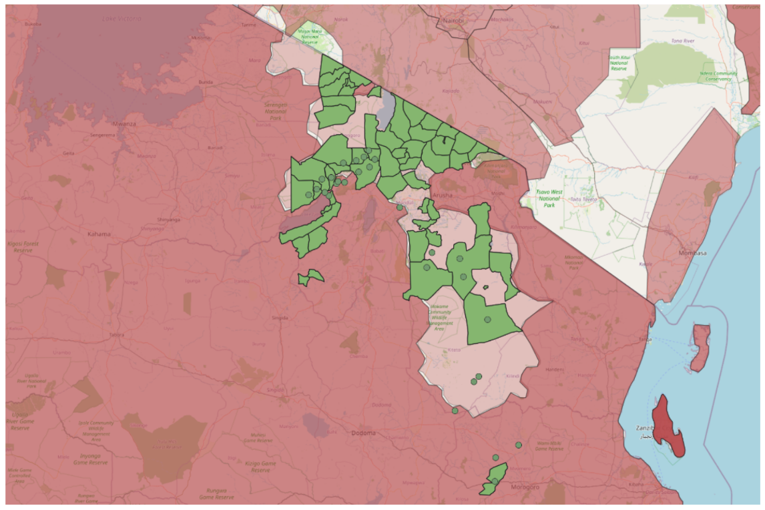
Game Reserve Risk Set & Maasai-Association
Game Reserve Shapefile
Reconstructed Maasai exposure (green) vs. GeoEPR historical benchmark (pink)
Treatment layer built from documentary evidence and manual GIS validation — an area-based proxy for exposure, not individual ethnicity.
4

Slide 5
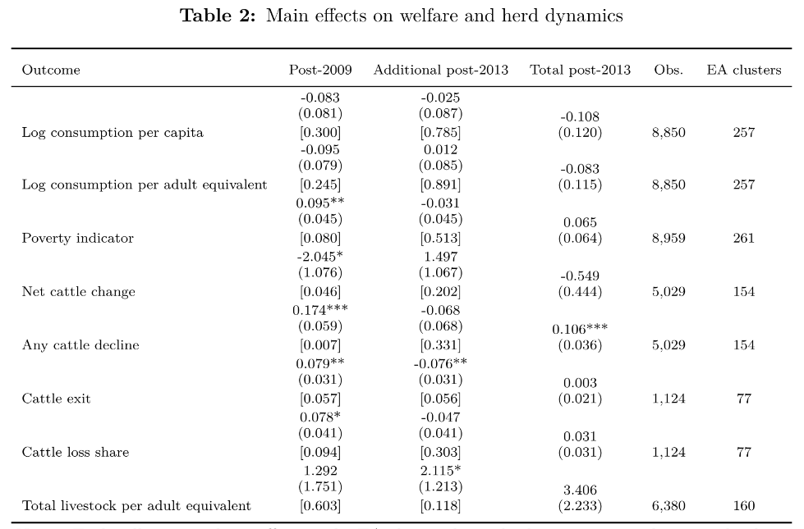
Main Regression Results
Takeaway: poverty rises after 2009; cattle dynamics deteriorate (decline, exit, loss share) — consumption effects stay negative but statistically imprecise.
5

Slide 6
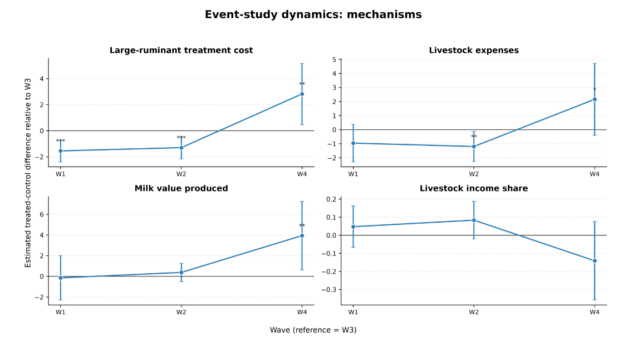
Mechanisms & Timing
Outcome | Post-2009 | Add. post-2013 | Total post-2013
Large-ruminant treatment cost | 0.979*** | 3.391*** | 4.370***
Livestock expenses | 0.431 | 2.682** | 3.113**
Large-ruminant disease | -0.006 | 0.152** | 0.147*
Milk value produced | 0.310 | 3.775** | 4.085***
Livestock income share | -0.009 | -0.179* | -0.188
Not “herd collapse” — a costly transformation under pressure.
Cost and productivity mechanisms rise sharply only after 2013 (Wave 4) — households stay engaged in livestock, but at higher cost and fragility.
6

Slide 7
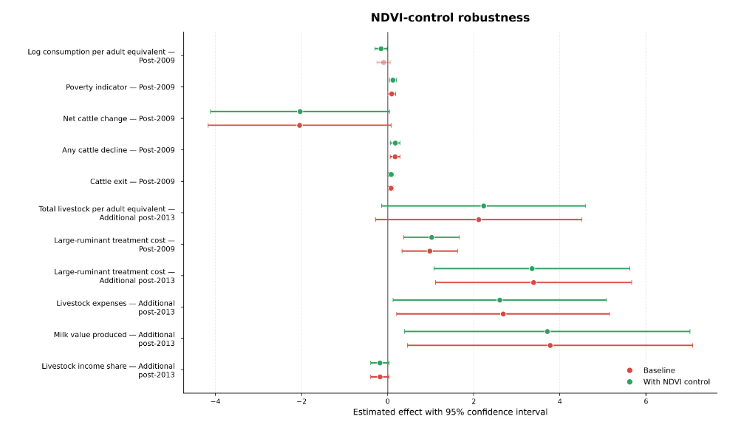
Climate Control
Could this just be drought, not conservation? NDVI is added as a robustness control for local vegetation conditions (EA-wave level, 1 km scale).
Result: poverty and livestock-stress coefficients remain stable — the poverty effect even strengthens — weakening a purely climate-based explanation.
7

Slide 8
Limitations
Non-random exposure
Maasai-associated areas may have unobserved time-varying differences vs. the rest of the risk set.
Spatial proxy
Treatment is locality-based (area-level); it does not identify individual household ethnicity.
Limited pre-period
Only one true pre-2009 wave — parallel trends cannot be fully tested for the 2009 shock.
Unobserved migration
Repeated cross-sections may understate displacement if whole households left treated areas.
8

Slide 9
Conclusion & Policy Implication
Livelihood stress — Conservation costs concentrate in pastoral margins: animal health, input costs, herd dynamics — more than in aggregate consumption.
Costly adaptation — Households remain engaged in livestock but face higher fragility, not simple herd collapse.
Policy implication — Evaluation should go beyond consumption. Target veterinary access and animal-health support to build pastoral resilience near protected areas.
Thank you for your attention — Questions?
Matteo Fantuz | matteo.fantuz@studio.unibo.it
9

