Slide 1
Programming in C++
https://fan1x.github.io/cpp22.html
tomas.faltin@matfyz.cuni.cz

Slide 2
Lab 2
https://fan1x.github.io/cpp22.html
tomas.faltin@matfyz.cuni.cz

Slide 3
Class/Struct
Put related things (data, functions, …) together
OOP
class calculator { void sum(); // private by default public: // change internal attributes, cannot be const void calc(const std::string &expression); // doesn’t change internals, should be const void print() const; private: // ... }; }; calculator c; // no need for `new`! c.calc("1+2*3/4");

Slide 4
Class vs. Struct
Use class if the class has an invariant; use struct if the data members can vary independently
struct coordinate { int x; int y; int z; void set(int x, int y, int z); };

Slide 5
std::vector<T>
#include <vector> int main() { std::vector<int> vi{1, 2, 3, 4, 5, 6}; std::vector<float> vf(5, 0.0f); std::cout << vi[3] << “ “ << vf.at(3) << std::endl; std::cout << vi.size(); vi[3] = 100; vi.at(6) = 600; vf.push_back(100.0f); vf.emplace_back(200.0f); vf.insert(3, 300.0f); vf.emplace(3, 300.0f); vi.pop_back(); vf.erase(3); vi.clear(); vi.resize(10); vi.reserve(100); }
Beware of time complexity
vector<bool>

Slide 6
Homework: Matrix for Integers
set(x, y, value), get(x, y), print()
set_width(), set_height(), get_width(), get_height()
get_row(x), get_column(x)
get_rows(), get_columns()
clear() – set all values to 0 (zero)
fill_with_value(value) – set all values to a given value
reverse() – reverse values from [x, y] to [y, x]
is_negative() – are all numbers in the matrix negative?
zero_count()

Slide 8
Lab 1
https://fan1x.github.io/cpp22.html
tomas.faltin@matfyz.cuni.cz

Slide 9
Basic information
Email: tomas.faltin@matfyz.cuni.cz
Labs web: https://fan1x.github.io/cpp22.html
Lecture web: https://www.ksi.mff.cuni.cz/teaching/nprg041-web/
Mattermost
Invite link in SIS/Notice-board
Channel: `nprg041-cpp-faltin`
Gitlab
https://gitlab.mff.cuni.cz/
https://gitlab.mff.cuni.cz/teaching/nprg041/2022-23/faltin

Slide 10
Communication is the key
Don’t be afraid to ask
Be proactive
via email
on Mattermost (instant)
DM if related to you only
Into a channel if others can benefit from it
If you struggle with something
If you feel like you might miss a deadline

Slide 11
Labs credit
Submitted homeworks before Sunday midnight (Sunday 23:59)
to Gitlab
Even if not attending!
Won’t be graded, for feedback only
Two large homeworks in ReCodex (total 40 points)
Points are included in the final score from the course
Smaller HW – 15 points, ~November
Larger HW – 25 points, ~December
Software project
Topic must be approved by 27/11/2022
POC: 18/12/2022
First submission: 02/04/2023
Final submission: 28/05/2023
All the steps typically mean multiple iterations within multiple days. If you wait for the last minute, there is a chance you won’t make it

Slide 12

Code Requirements - Consistency
Consistency
Be consistent within the code
keep a single code style

Slide 13
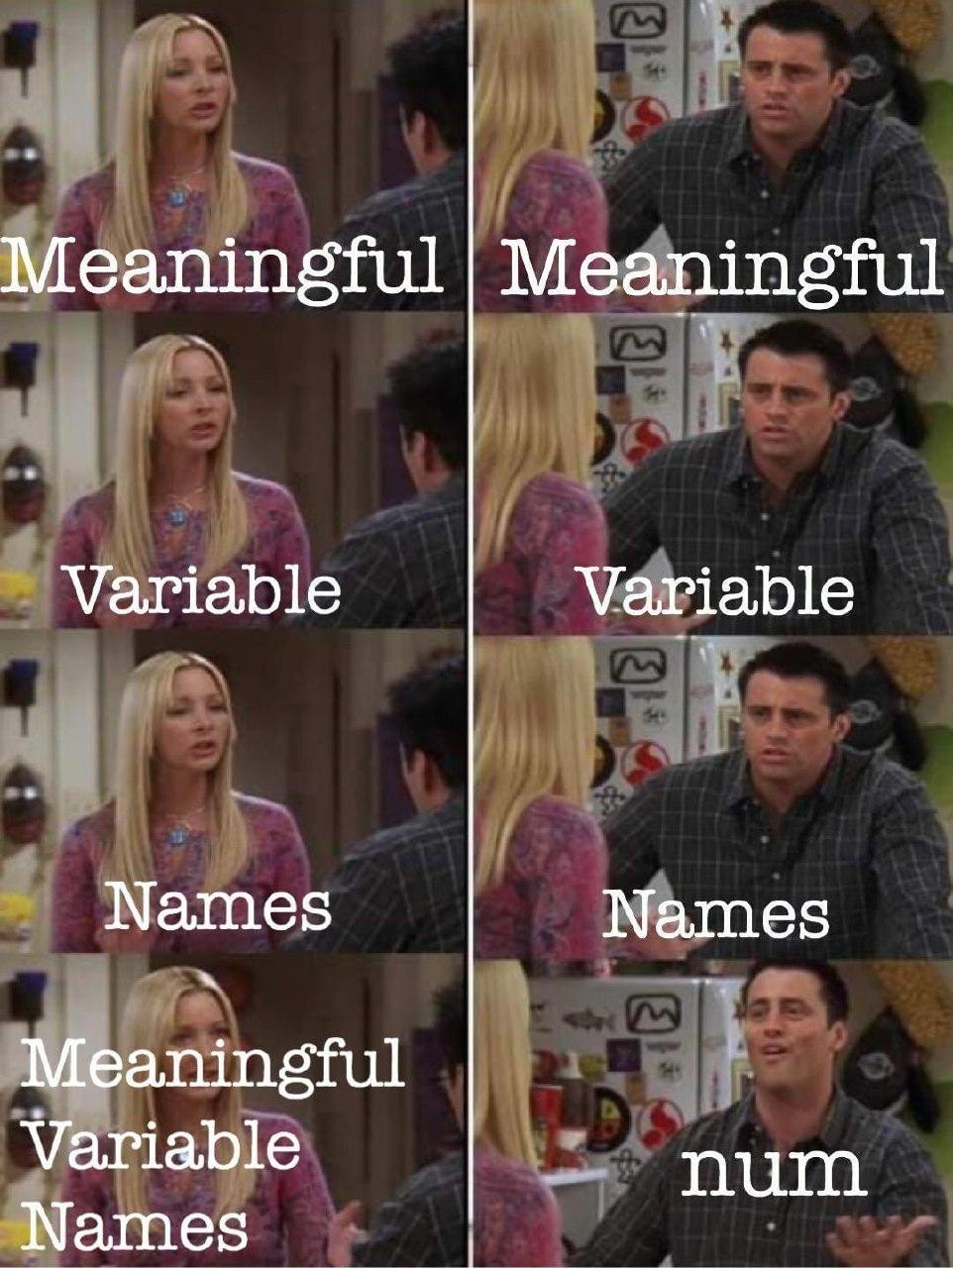
Code Requirements – Readability
Code doesn’t contain commented/dead parts
Code should be readable on its own
Comment complicated code

Slide 14
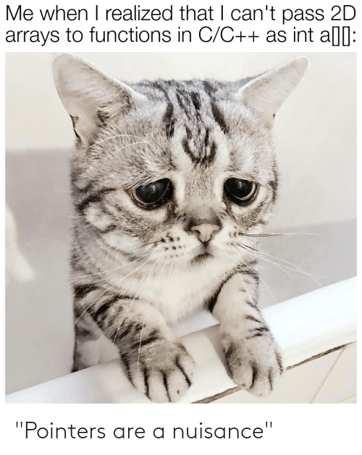
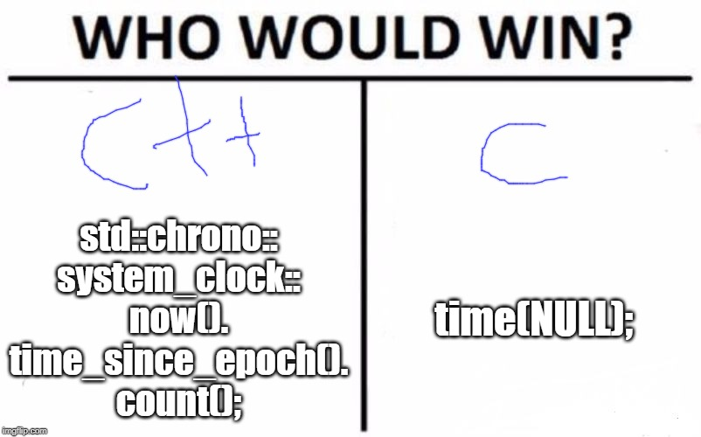
Code Requirements – Safe, Modern
Prefer using modern constructs
Additional safety
Maybe performance
E.g., prefer `std::vector<int>` to `new int[]`

Slide 15

Code Requirements – Working
OFC, if the code is not working, all the above points are not that important
they will help you with debugging at least ☺

Slide 16
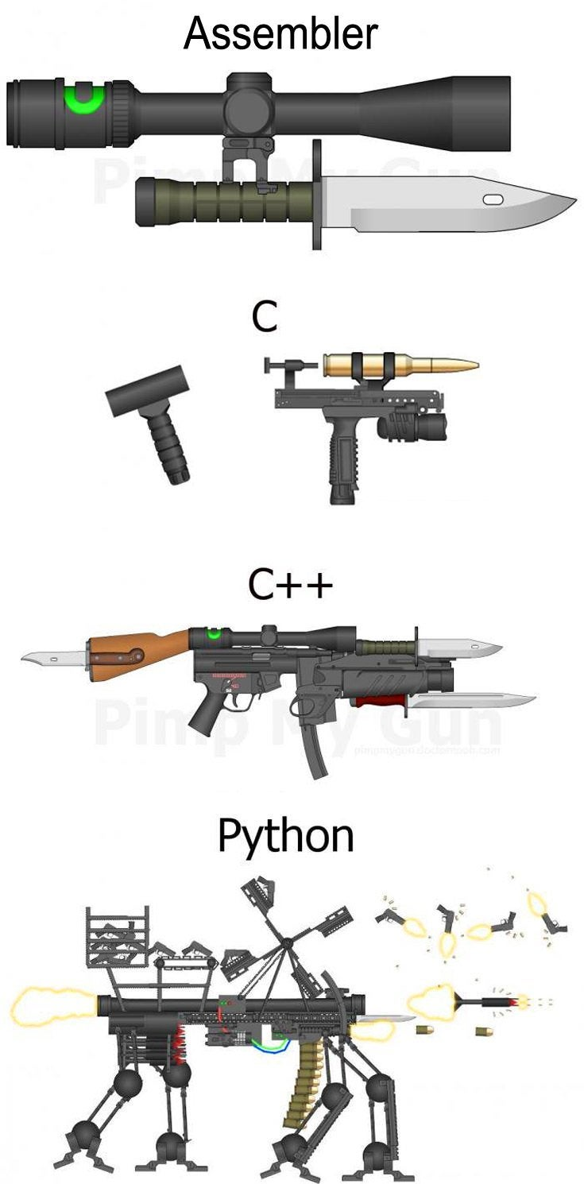
Why C++
“C makes it easy to shoot yourself in the foot. C++ makes it harder, but when you do, it blows away your whole leg.” -- Bjarne Stroustrup
“It was only supposed to be a joke, I never thought people would take the book seriously. Anyone with half a brain can see that object-oriented programming is counter-intuitive, illogical and inefficient.” -- Stroustrup C++ ‘interview’ (https://www-users.cs.york.ac.uk/susan/joke/cpp.htm)

Slide 17
Working Environment
Use anything you like ☺
IDEs
Visual Studio
License for students at https://portal.azure.com/...
VS Code
Clion
Code::Blocks
Eclipse
…
Compilers
MSVC, GCC, Clang+LLVM, ICC, …

Slide 18
C++ (interesting) links
Reddit, Slack, …
https://en.cppreference.com/w/
http://www.cplusplus.com/
http://isocpp.github.io/CppCoreGuidelines/CppCoreGuidelines
https://www.youtube.com/user/CppCon
https://isocpp.org/
http://www.open-std.org/jtc1/sc22/wg21/docs/papers/
https://godbolt.org/
…

Slide 19
Learning C++
C++ in 100 seconds: https://youtu.be/MNeX4EGtR5Y
C++ in 31h: https://youtu.be/8jLOx1hD3_o

Slide 20
Hello World
#include <iostream>
#include <string>
int main() {
std::string name;
std::cin >> name;
std::cout << "Greetings from " << name << std::endl;
return 0;
}

Slide 21
Hello World
Include the libraries which implements the used STL constructs (string, cin, cout)
#include <iostream> #include <string> int main() { std::string name; std::cin >> name; std::cout << “Greetings from ” << name << std::endl; return 0; }
The main entry point/function for all programs. The execution starts here
Declare a variable of type string
Read from standard input (keyboard)
Write to standard output (screen)
All the STL constructs live inside `std` namespace

Slide 22
Compilation
c++ --version
c++ is a compiler, here GCC
c++ hello_world.cpp -o hello_world
Compile program into `hello_world` executable (using default settings)
c++ -Wall -Wextra -Werror -O3 -std=c++2b hello_world.cpp -o hello_world
Wall: Show all warnings
Wextra: Show additional extra warnings
Werror: Thread all warnings as errors
O3: level of optimizations
std=c++2b: Used C++ standard
Or use IDE ☺

Slide 23
More Complex Program
#include <iostream>
#include <string>
#include <vector>
using namespace std;
void pretty_print(const vector<string>& args) {
// ... args[i]
}
int main(int argc, char** argv) {
vector<string> args(argv, argv+argc); pretty_print(args);
return 0;
}

Slide 24
More Complex Program
Include the whole std namespace
#include <iostream>
#include <string>
#include <vector>
using namespace std;
void pretty_print(const vector<string>& args) {
// ... args[i]
}
int main(int argc, char** argv) {
vector<string> args(argv, argv+argc); // Wrap arguments
pretty_print(args);
return 0;
}
Passing the argument by (const) reference
Arguments of the program on the command line
Number of arguments
Transform “magically” the arguments into C++ array of strings

Slide 25
Functions And Parameters
int get_max(int v1, int v2) {
return v1 > v2 ? v1 : v2;
}
int get_max1(const vector<int> &ints) {
int max = std::numeric_limits<int>::min();
for (int x : ints) {
max = get_max(x, max);
}
return max;
}
bool get_max2(const vector<int> &ints, int &max) {
max = std::numeric_limits<int>::min();
for (int x : ints) {
max = get_max(x, max);
}
return !ints.empty();
}
std::tuple<bool, int> get_max3(const vector<int> &ints) {
int max = std::numeric_limits<int>::min();
for (int x : ints) {
max = get_max(x, max);
}
return { !ints.empty(), max };
}

Slide 26
Functions And Parameters
read-only input parameter
Most of the types (string, vector, …) → use const-reference - const &
int get_max(const vector<int> &ints)
For small numeric types (int, float, double, …) → use direct parameter
int get_max(int v1, int v2)
output parameters
Single output parameter → use return value
int get_max(const vector<int> &ints)
Few output parameters → use tuple/pair/structure
std::tuple<bool, int> get_max(const vector<int> &ints)
Many output parameters → use reference - &
bool get_max(const vector<int> &ints, int &max)

Slide 27
Homeworks
Hello World
A greeting program (use names from arguments)
`hello.exe Adam Eve` → `Hello to Adam and Eve`
What is inside args[0]?
Summation of numbers from arguments
`sum.exe 1 2 3 4 5` → `15`
`stoi(), stod(), stoX()`
Functions for transformation from string to <something>
A simple calculator (only for operations +-)
`calc.exe 1+2+3-4` → `2`
to Gitlab
The previous programs are not needed, they should give you a lead

