Slide 1
Programming in C++
https://fan1x.github.io/cpp21.html
tomas.faltin@matfyz.cuni.cz

Slide 2
Programming in C++ - lab 2
https://fan1x.github.io/cpp21.html
tomas.faltin@matfyz.cuni.cz

Slide 3
Homework Feedback
Deadlines
Communication!
Use functions
Don’t put everything into main()
Function should do a single thing
Don’t put binaries into a repo
Source/header files, configs, project files, …
Search what to put into repo on-line
Use objects/structs
Use (const) references for large objects

Slide 4
Argument Passing – By Value
Creates a copy
Use for small/elementary types (int, double)
int max(int x, int y);

Slide 5
Argument Passing – By Const-reference
Doesn’t create a copy
Use for large objects (containers, e.g., vector, string, …)
int find_max(const vector<int> &numbers);

Slide 6
Argument Passing – By Reference
Doesn’t create a copy
Allows to change the passed object
For output parameters
! Is the function really doing a single things?
Could you use std::pair?
pair<iterator, bool> map::emplace(…)
void transform(Matrix &matrix);
pair<size_t, int> find_max(const vector<int> &numbers);

Slide 7
Argument Passing – By R-value Reference
To transfer a ownership
Moves the object into a function
the object no longer lives outside the function
Use std::move() on the caller side
vector<unique_ptr<int>>::push_back(unique_ptr<int> &&new_obj);
vector<unique_ptr<int>> vector_of_ints; vector_of_ints.push_back(move(make_unique<int>(x));

Slide 8
Class/Struct
Put related things (data, functions, …) together
OOP
class calculator { void sum(); // private by default public: // change internal attributes, cannot be const void calc(const std::string &expression); // doesn’t change internals, should be const void print() const; private: // ... }; }; calculator c; // no need for `new` c.calc("1+2*3/4");

Slide 9
Class vs. Struct
Use class if the class has an invariant; use struct if the data members can vary independently
struct coordinate { int x; int y; int z; void set(int x, int y, int z); };

Slide 10
std::vector<T>
#include <vector> int main() { std::vector<int> vi{1, 2, 3, 4, 5, 6}; std::vector<float> vf(5, 0.0f); std::cout << vi[3] << “ “ << vf.at(3) << std::endl; std::cout << vi.size(); vi[3] = 100; vi.at(6) = 600; vf.push_back(100.0f); vf.emplace_back(200.0f); vf.insert(3, 300.0f); vf.emplace(3, 300.0f); vi.pop_back(); vf.erase(3); vi.clear(); vi.resize(10); vi.reserve(100); }
Beware of time complexity
vector<bool>

Slide 11
Matrix for Integers
set(x, y, value), get(x, y), print()
set_width(), set_height(), get_width(), get_height()
get_row(x), get_column(x)
get_rows(), get_columns()
clear() – set all values to 0 (zero)
fill_with_value(value) – set all values to a given value
reverse() – reverse values from [x, y] to [y, x]
is_negative() – are all numbers in the matrix negative?
zero_count()

Slide 12
Programming in C++ - lab 1
https://fan1x.github.io/cpp21.html
tomas.faltin@matfyz.cuni.cz

Slide 13
Basic information
Email: tomas.faltin@matfyz.cuni.cz
Lab’s web: https://fan1x.github.io/cpp21.html
ZOOM for distance learning
https://cuni-cz.zoom.us/j/94350923737
Credentials in SIS/mail
Mattermost
Invite link: https://ulita.ms.mff.cuni.cz/mattermost/signup_user_complete/?id=z1knw5ag6p8nipop1i7iciga6a
Use ASAP, might expire eventually
Channel: `nprg041-cpp-english`
Gitlab
https://gitlab.mff.cuni.cz/
https://gitlab.mff.cuni.cz/teaching/nprg041/2021-22/eng

Slide 14
Communication is the key
Don’t be afraid to ask
via email
on Mattermost (instant)
DM if related to you only
Into a channel if others can benefit from it
If you struggle with something
If you feel like you might miss a deadline
Be proactive

Slide 15
Labs credit
Submitted homeworks before Monday midnight (to Gitlab)
Even if not attending!
Won’t be graded, for a feedback
Two large homeworks in ReCodex (40 points)
Points are included in the final score from the course
Smaller HW – 15 points, ~November
Larger HW – 25 points, ~December
Software project
Topic must be approved by 28/11/2021
First submission: 24/4/2022
Final submission: 22/5/2022
All the steps typically mean multiple iterations within multiple days. If you wait for the last minute, there is a chance you won’t make it

Slide 16
Code Requirements
Consistency
Be consistent within the code – keep a single code style
Cleanness, readability
Code doesn’t contain commented/dead parts
Code should be readable on its own
Safe, modern
E.g., prefer `std::vector<int>` to `new int[]`
Working
OFC, if the code is not working, all the above points are not that important, but they will help you with debugging at least ☺

Slide 17
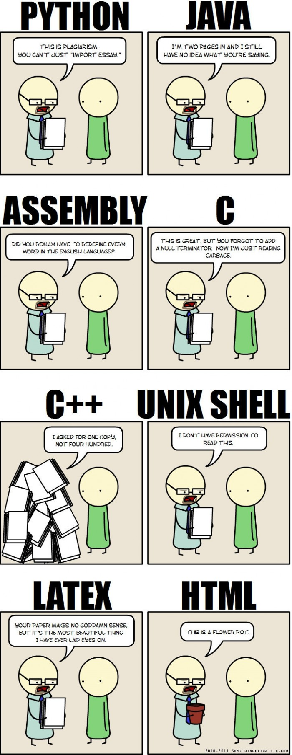
Why C++
“C makes it easy to shoot yourself in the foot. C++ makes it harder, but when you do, it blows away your whole leg.” -- Bjarne Stroustrup
“It was only supposed to be a joke, I never thought people would take the book seriously. Anyone with half a brain can see that object-oriented programming is counter-intuitive, illogical and inefficient.” -- Stroustrup C++ ‘interview’ (https://www-users.cs.york.ac.uk/susan/joke/cpp.htm)
C++ != speed, C++ ~ control

Slide 18
Working Environment
Use anything you like ☺
IDEs
Visual Studio
License for students at https://portal.azure.com/...
VS Code
Clion
Code::Blocks
Eclipse
…
Compilers
MSVC, GCC, Clang+LLVM, ICC, …

Slide 19
C++ (interesting) links
Reddit, Slack, …
https://en.cppreference.com/w/
http://www.cplusplus.com/
http://isocpp.github.io/CppCoreGuidelines/CppCoreGuidelines
https://www.youtube.com/user/CppCon
https://isocpp.org/
http://www.open-std.org/jtc1/sc22/wg21/docs/papers/
https://gcc.godbolt.org/
…

Slide 20
Hello World
#include <iostream> #include <string> int main() { std::string name; std::cin >> name; std::cout << “Greetings from ” << name << std::endl; return 0; }

Slide 21
Hello World
Include the libraries which implements the used STL constructs (string, cin, cout)
The main entry point/function for all programs. The execution starts here
#include <iostream> #include <string> int main() { std::string name; std::cin >> name; std::cout << “Greetings from ” << name << std::endl; return 0; }
Read from standard input (keyboard)
Write to standard output (screen)
All the STL constructs live inside `std` namespace

Slide 22
More Complex Program
#include <iostream> #include <string> #include <vector> using namespace std; int length(const string& s) { ... } void pretty_print(const vector<string>& a) { ... a[i] ... } int main(int argc, char** argv) { vector<string> arg(argv, argv+argc); if (arg.size() > 1 && arg[1] == "--help") { cout << "Usage: myprg [OPT]... [FILE]..." << endl; return 8; } pretty_print(arg); return 0; }

Slide 23
More Complex Program
Include the whole std namespace
#include <iostream> #include <string> #include <vector> using namespace std; int length(const string& s) { ... } void pretty_print(const vector<string>& a) { ... a[i] ... } int main(int argc, char** argv) { vector<string> arg(argv, argv+argc); if (arg.size() > 1 && arg[1] == "--help") { cout << "Usage: myprg [OPT]... [FILE]..." << endl; return 8; } pretty_print(arg); return 0; }
Passing the argument by (const) reference
Arguments of the program on the command line
Transform the arguments into C++ array of strings

Slide 24
Homeworks
Hello World
A greeting program (use names from arguments)
`hello.exe Adam Eve` → `Hello to Adam and Eve`
What is inside args[0]?
Summation of numbers from arguments
`sum.exe 1 2 3 4 5` → `15`
`stoi(), stod(), stoX()`
Functions for transformation from string to <something>
A simple calculator (only for operations +-)
`calc.exe 1+2+3-4` → `2`
to Gitlab
The previous programs are not needed, they should give you a lead

