Slide 1
Programming in C++
https://fan1x.github.io/cpp21.html
tomas.faltin@matfyz.cuni.cz

Slide 2
Programming in C++ - lab 12
https://fan1x.github.io/cpp21.html
tomas.faltin@matfyz.cuni.cz

Slide 3
Homework 2 Feedback

Slide 4
What is int(double)
std::function<int(double)> fn;

Slide 5
Variadic templates
→ Advanced Programming in C++

Slide 6
Performance
Compilation flags
Linked list vs. vector
→ High Performance Software Development

Slide 7
Parallel Programming
Parallel Summation
False-sharing
→ Programming in Parallel Environment

Slide 8
Programming in C++ - lab 11
https://fan1x.github.io/cpp21.html
tomas.faltin@matfyz.cuni.cz

Slide 9
Feedback: Generic Vector

Slide 10
Feedback: Data Aggregation
-5 points: missed deadline
-2 points
Not having virtual destructor with inheritance
Large tests not working
-1 point
Using const function for read only methods
Using const references for large objects
Warnings
Large functions
procedural code
no classes/objects

Slide 11
Streams
<iostream>
I/O
<fstream>
Work with files
<sstream>
Work with std::string

Slide 12
Homework – A Simple Text Editor
Open/Edit/Save a file
Print a directory
<filesystem>

Slide 13
Programming in C++ - lab 10
https://fan1x.github.io/cpp21.html
tomas.faltin@matfyz.cuni.cz

Slide 14
Feedback: Animal Database

Slide 15
2nd Large homework: Calculator
Deadline: 3/1/2022​ 03:59
25 points (17p + 8p)
Functionality: max 17 points
Code culture: max 8 points
~ points_for_functionality/2
-10 points per each week (even if partial)

Slide 16
Templates

Slide 17
Template Functions
class complex {
int real_; int im_; public: int &re() { return real_; } int re() const { return real_; }; int &im() { return im_; }; int im() const { return im_; }; };
void print(int v) { cout << v; } void print(double v) { cout << v; }
void print(const string &str) { cout << str; }
int main() {
complex c;
print(c.re());
}
template<typename T> class complex { T real_; T im_; public: T &re() { return real_; } T re() const { return real_; }; T &im() { return im_; }; T im() const { return im_; }; };
template<class T>
void print(const T &v) { cout << v; }
int main() {
complex<int> c;
print(c.re());
}

Slide 18
Template Classes
template<class Cont> class container_wrapper { Cont cont; public: void push_back(const typename Cont::value_type& val) { cont.push_back(val); } void push_back(typename Cont::value_type &&rval) { cont.push_back(std::move(rval)); } }; template<class Cont> auto make_wrapper() { return container_holder<Cont>(); }
auto vector_wrapper = make_wrapper<std::vector<int>>();
vector_wrapper.push_back(3);

Slide 19
Homework – vector<T>
Generic vector
Mandatory operations
default ctor, ctor(size_t, value_type), copy/move ctor/assignment
size(), capacity(), reserve(), push_back(), operator[]()

Slide 20
Programming in C++ - lab 9
https://fan1x.github.io/cpp21.html
tomas.faltin@matfyz.cuni.cz

Slide 21
Reminders
The first large homework: Data aggregation
Deadline: 9/12/2021​ 04:59
The second large homework
Deadline: 2/1/2022​ 23:59
Pick a software project
Topic must be approved by 9/12/2021
Send a specification via mail for approval

Slide 22
Inheritance comments
Think about the API
Hide type specific things inside methods/functions
if-else → bad design

Slide 23
Homework: Animal Database
Try to reuse + fix people database (from ReCodex)
Nice OOP architecture first
Make a sketch (~UML style)
At least 5 types of animals
>= 2 common attributes
>= 1 unique attribute
Family relations: parent (children)
Operations
print(), print_all(), insert, sort_by_name/age/type, remove_by_name/age/type
print_family_tree(animal *), set_parent(), set_child, get_parents(), get_children(), get_siblings()

Slide 24
Programming in C++ - lab 8
https://fan1x.github.io/cpp21.html
tomas.faltin@matfyz.cuni.cz

Slide 25
Reminders
The first large homework: Data aggregation
Deadline: 9/12/2021​ 04:59
Pick a software project
Topic must be approved by 28/11/2021
Send a specification via mail for approval
Extended to 9/12/2021
First submission: 24/4/2022
Final submission: 22/5/2022

Slide 26
Homework Feedback
Don’t use delete with smart pointers!
Prefer -> to (*).
Use `const` functions
For read only things
const void print() const
`const void` doesn’t make sense
head = NULL
Use nullptr instead

Slide 27
Data aggregation - Hints
Download example input+output and debug locally
PRG.exe < input_file.txt > output_file.txt
Check logs what’s wrong
Write your own tests!
(get inspired by ReCodex’s tests)
Time & memory limits
Store necessary things once
Use observers (pointers, references) instead
Use proper types
Don’t store numbers as string
Avoid copying – const &

Slide 28
Inheritance
To inherit (=use) attributes and methods of the ancestor class
class container {
public:
using size_type = size_t;
size_t size() const { return size_; }
protected:
size_t size_t;
};
class vector_int : public container { ... };
class list_int : public container { ... };
int main() {
vector_int vi;
cout << vi.size();
}

Slide 29
Inheritance Examples
class car {};
class volvo : public car {};
class skoda : public car {};
class animal {};
class dog : public animal {};
class cat : public animal {};
class employee {};
class accountant : public employee {};
class expression {};
class binary : public expression {};
class plus : public binary {};
class object {}; // JAVA
class XYZ : public object {};
expression
unary
binary
value
minus
minus
plus

Slide 30
Inheritance vs. Composition
Inheritance – logical hierarchy
Composition – no logical hierarchy
Can be implemented through inheritance
vehicle
car
wheel
bike
volvo
skoda

Slide 31
Polymorphism
Base class acts(=works) as the (internally stored) derived class
Function must be virtual and gets called via reference/pointer
class base {
protected:
int value = 0;
public:
virtual ~base() = default;
virtual void print() const { std::cout << "base: " << value; }
};
class derived : public base {
public:
void print() const override { std::cout << "derived: " << value; }
};
int main() {
derived d;
d.print(); // derived: 0
base &b = d;
b.print(); // derived: 0
base *b_ptr = &d;
b_ptr->print(); // derived: 0 base b2 = d;
b2.print(); // base: 0
}

Slide 32
Homework: Polymorphic Vector
Create a vector which can store different types
int, double, string
Use inheritance (no union, variant, …)
Dynamic allocation
// API
// insert a value
push_back(value); // print the value of i-th element
print(size_type i);
// print all values inside the array print_all();
int main() {
my_vec v;
v.push_back(1); v.push_back(2.3); v.push_back(“four”);
v.print(0); // 1
v.print(2); // “four”
v.print_all(); // [1, 2.3, “four”]
}

Slide 33
Programming in C++ - lab 7
https://fan1x.github.io/cpp21.html
tomas.faltin@matfyz.cuni.cz

Slide 34
Homework feedback
Great work ☺
Automated translation
Try all translation/languages
Take a word, find the language and translate the rest

Slide 35
Large homework – Data Aggregation
In ReCodex
Deadline: 12/9/2021​ (Thursday) 4:59
15 points (10p + 5p)
Functionality: max 10 points
Code culture: max 5 points
~ points_for_functionality/2

Slide 36
Dynamic allocation
Use smart pointers (no raw T* pointers, i.e., no new/new[])
Single owner
Most common case
Passing the ownership - move only, no copy
unique_ptr<T>
Shared ownership (multiple owners)
shared_ptr<T>
weak_ptr<T> // to break the cycle
Creation: make_unique<T>, make_shared<T>
Allocation of consecutive memory (~array)
make_unique<int[10]>()

Slide 37
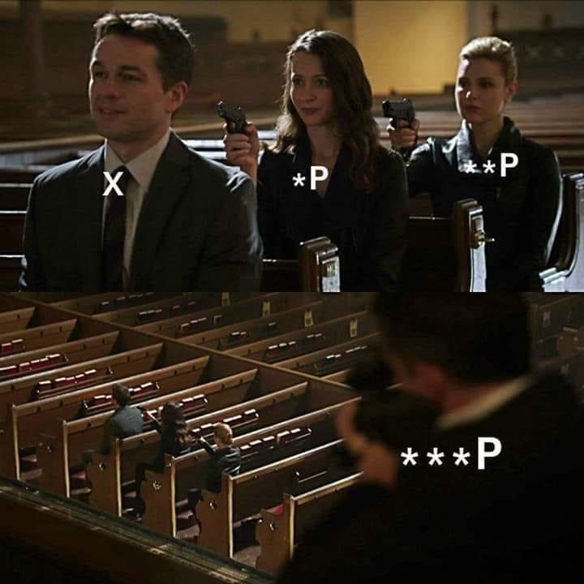
Observers
Working with the pointer with no changes to ownership
Returned type is a (const) pointer
Getting an address of an object
&x
Smart pointers
get()
To access the values through a pointer
operator*, operator->

Slide 38
Pointers in Memory
int main() { int i = 2; int *pi = &i; int **ppi = &pi; cout << i; // 2 cout << pi; // 102 cout << *pi; // 2 cout << ppi; // 104 cout << *ppi; // 102 cout << **ppi; // 2 }
Q: What if we call cout << *i?
Address | Value | (Variable)
….
100 | 2 | i
101
102 | 100 | pi
103
104 | 102 | ppi
105
….
operator*
*
**
*

Slide 39
Notes on Dynamic Allocation
Prefer static/automatic storage
Dynamic allocation is slow
Use only when necessary
Object lifetime doesn’t correspond to function invocations
Polymorphism

Slide 40
Linked List Example
struct node {
unique_ptr<node> next;
int value;
node(int value, unique_ptr<node> &&next) :
value(value), next(std::move(next)) {}
};
class linked_list {
unique_ptr<node> first_node;
public:
node *front() {
return first_node.get(); // Observer
}
const node *back() const {
node *ptr = first_node.get(); // Observer
if (ptr != nullptr) {
while (ptr->next != nullptr) {
ptr = (*ptr).next.get(); // Equivalent ->
}
}
return ptr;
}
void push_front(int value) {
auto new_node = std::make_unique<node>(value, std::move(first_node));
first_node = std::move(new_node);
}
void pop_front() {
auto first = std::move(first_node);
first_node = std::move(first->next);
} // automatic deallocation of first

Slide 41
Operator overloading
Implement your own operators
+, -, ->, /, [], …
Keep the semantic!
https://en.cppreference.com/w/cpp/language/operators

Slide 42
Homeworks: 1. Finish the LL
size(), print(), push_back(), pop_back()
ctor(), ctor(init_size, default_value), dtor
operator[]

Slide 43
Homeworks: 2. int vector
Implement your own integer vector
Mandatory operations
default ctor, ctor(size_t, value_type), copy/move ctor/assignment
size(), capacity(), reserve(), push_back(), operator[]()
Use allocations of arrays, no LL
Q: How many owners does it need?

Slide 44
Programming in C++ - lab 6
https://fan1x.github.io/cpp21.html
tomas.faltin@matfyz.cuni.cz

Slide 45
Homework feedback
Plagiarism
Passing large objects by (const-) reference
Using const functions
Warnings/cannot compile with another compiler
Using named constants instead of any number
Function decomposition
“Too complex solution”
vector<vector<string>>
map<string, tuple<int, int, int>>

Slide 46
Containers
std::vector<Type> - dynamic array
my_vec[idx] = value, push_back(), …
std::array<Type,Size> - fixed size array
my_array[idx] = value, …
std::deque<Type> - double ended dynamic queue/array
push_back(), push_front(), back(), front(), …
std::list<Type> - linked list
std::map<Key,Value>, std::unordered_map<Key, Value> - map
my_map[key] = value, find(), insert(), …
std::set<Key>, std::unordered_set<Key> - set
contains(), insert(), find(), …

Slide 47
Homeworks: 1. Dictionary
// An example of API
class Dictionary {
// Insert a new language and returns its ID
size_t add_language(const string &name);
// Insert new words into a dictionary
bool add_vocabulary(size_t words1_language_id, const string &word1, size_t words2_language_id, const string &word2);
// Translate a given text with the given language into the output language
string translate(size_t input_language_id, const string &text, size_t output_language_id) const;
// Automatically translate a given text into a given language
string translate(const string &text, size_t output_language_id) const;
// Return all vocabularies for a given language
const vector<string> &all_vocabulary(size_t language_id) const; };

Slide 48
Homeworks: 2. Simple People Database
A simple people database
In Recodex: https://recodex.mff.cuni.cz/

Slide 49
Programming in C++ - lab 5
https://fan1x.github.io/cpp21.html
tomas.faltin@matfyz.cuni.cz

Slide 50
Homework feedback
Lack of responsibility ☹
Lots of missed deadlines
Not working homeworks
No communication
Summing program
Used forbidden functions/constructs
Integer matrix
const functions

Slide 51
Declaration/definition
// file: my_class.hpp #ifndef MY_CLASS_HPP #define MY_CLASS_HPP void fn(int x); class my_class { public: my_class(); int exec(int x); private: double d; static size_t i; }; #endif // MY_CLASS_HPP
// file: my_class.cpp #include “my_class.hpp” #include <iostream> void fn(int x) { cout << “fn()”; } my_class::my_class() : d(1.0) { cout << “ctor”; } int my_class::exec(int x) { for(int i=0; i < x; ++i) { … } } size_t my_class::i = 0;

Slide 52
Homework: TicTacToe for 2 players
For 2 players only
Set the names at the beginning
Game ends when one of the player has 5 in a row
Write who is the winner
Validate user inputs

Slide 53
Programming in C++ - lab 4
https://fan1x.github.io/cpp21.html
tomas.faltin@matfyz.cuni.cz

Slide 54
Homework feedback

Slide 55
const with Classes
class Person {
const string name;
uint8_t age;
public:
Person(const string &name, uint8_t age) : name(name), age(age) {}
void inc_age() {
++age;
}
uint8_t get_age() const {
return age;
}
const string &get_name() const {
return name;
}
};

Slide 56
Homeworks
Create a verbose class C and show its usage
Prints identifier on each call to a class special method
Use the verbose class in another verbose class and show its usage
Usage:
a single C
a vector of Cs
Show usage – insert things into it
Finish the summing program
Finish/Fix Matrix for Integers

Slide 57
Summing Program
class C {
/* CAN ADD MORE ATTRIBUTES */
int value;
void print() const {
cout << value << "\n";
}
public:
/* IMPLEMENT SPECIAL FUNCTIONS */
};
class D {
std::vector<C> cs;
/* CANNOT ADD MORE ATTRIBUTES */
public:
/* IMPLEMENT SPECIAL FUNCTIONS */
};
int main(int argc, char *argv[]) {
int first, last;
cin >> first >> last;
cout << "Numbers:\n";
D d(first, last); // prints number first, first+1, ..., last
cout << "Preparing...\n";
D d2 = d;
cout << "Sum of the numbers:\n";
d2 = d; // prints sum of numbers first..last
}
Implement only special functions
ctors, dtor, operators
You can add O(1) attributes into C
E.g., cannot add a vector
Use print() for printing
Cannot use anything else for printing
Example
Input: 5 7
Output:
Numbers:
5
6
7
Preparing...
Sum of the numbers:
18

Slide 58
Programming in C++ - lab 3
https://fan1x.github.io/cpp21.html
tomas.faltin@matfyz.cuni.cz

Slide 59
Down to operator
void op_downto(int x) {
while (x --> 0) {
cout << x;
}
}
op_downto(10); // prints 9,8,7,…,1,0

Slide 60
Homework feedback
Enable warnings

Slide 61
Special Methods in Classes
class Verbose {
int x;
public:
Verbose() {
cout << "default ctor\n";
this->x = 1;
}
Verbose(const Verbose &v) {
cout << "copy ctor\n";
this->x = v.x;
}
Verbose(Verbose &&v) {
cout << "move ctor\n";
this->x = v.x;
v.x = 0;
}
~Verbose() {
cout << "dtor\n";
}
Verbose(int x) {
cout << "user ctor\n";
this->x = x;
}
Verbose &operator=(const Verbose &v) {
cout << "copy assignment\n";
this->x = v.x;
return *this;
}
Verbose &operator=(Verbose &&v) {
cout << "move assignment\n";
this->x = v.x;
return *this;
}
};
{
Verbose v1; // default ctor
Verbose v2(2); // user ctor
Verbose v3{3}; // user ctor
Verbose v4(v2); // copy ctor
Verbose v5 = v3; // copy ctor
Verbose v6(std::move(v1)); // move ctor
Verbose v7 = std::move(v4); // move ctor
v1 = v2; // copy assignment
v2 = std::move(v3); // move assignment
} // Calls destructors

Slide 62
Static with Classes
class CountingClass {
static size_t num_instances;
static void inc_num_instances() { ++num_instances; }
static void dec_num_instances() { --num_instances; }
public:
static bool has_instance() { return num_instances > 0; }
static size_t get_num_instances() { return num_instances; }
CountingClass() { inc_num_instances(); }
CountingClass(const CountingClass &) { inc_num_instances(); }
~CountingClass() { dec_num_instances(); }
}; size_t CountingClass::num_instances = 0; // initialization
assert(!CountingClass::has_instance() && "No instances"); {
CountingClass cc1;
assert(CountingClass::get_num_instances() == 1);
{
CountingClass cc2 = cc1;
assert(CountingClass::get_num_instances() == 2);
}
assert(CountingClass::get_num_instances() == 1);
}

Slide 63
Homework1: Implement class C
class C { /* implement me */ };
// Don’t touch anything below
void fn_copy(C) {}
void fn_cref(const C&) {}
void fn_rref(C&&) {}
int main(int argc, char* argv[])
{
cout << "1\n";
C c1;
cout << "3\n";
C c2(c1);
cout << "5\n";
C c3 = c2;
cout << "7\n";
fn_copy(c1);
cout << "9\n";
fn_cref(c1);
fn_copy(std::move(c1));
fn_rref(std::move(c2));
cout << "11\n";
}
Can touch only class C
Don’t use exit(), break, goto, …
Program writes: 1,2,3,…,12

Slide 64
Voluntary Homework2: Finish Matrix for Integers
Correct all issues in the previous HW
Implement correctly all special methods
Show usage/test all the methods with assertions
Not needed for the next week

Slide 65
Programming in C++ - lab 2
https://fan1x.github.io/cpp21.html
tomas.faltin@matfyz.cuni.cz

Slide 66
Homework Feedback
Deadlines
Communication!
Use functions
Don’t put everything into main()
Function should do a single thing
Don’t put binaries into a repo
Source/header files, configs, project files, …
Search what to put into repo on-line
Use objects/structs
Use (const) references for large objects

Slide 67
Argument Passing – By Value
Creates a copy
Use for small/elementary types (int, double)
int max(int x, int y);

Slide 68
Argument Passing – By Const-reference
Doesn’t create a copy
Use for large objects (containers, e.g., vector, string, …)
int find_max(const vector<int> &numbers);

Slide 69
Argument Passing – By Reference
Doesn’t create a copy
Allows to change the passed object
For output parameters
! Is the function really doing a single things?
Could you use std::pair?
pair<iterator, bool> map::emplace(…)
void transform(Matrix &matrix);
pair<size_t, int> find_max(const vector<int> &numbers);

Slide 70
Argument Passing – By R-value Reference
To transfer a ownership
Moves the object into a function
the object no longer lives outside the function
Use std::move() on the caller side
vector<unique_ptr<int>>::push_back(unique_ptr<int> &&new_obj);
vector<unique_ptr<int>> vector_of_ints; vector_of_ints.push_back(move(make_unique<int>(x));

Slide 71
Class/Struct
Put related things (data, functions, …) together
OOP
class calculator { void sum(); // private by default public: // change internal attributes, cannot be const void calc(const std::string &expression); // doesn’t change internals, should be const void print() const; private: // ... }; }; calculator c; // no need for `new` c.calc("1+2*3/4");

Slide 72
Class vs. Struct
Use class if the class has an invariant; use struct if the data members can vary independently
struct coordinate { int x; int y; int z; void set(int x, int y, int z); };

Slide 73
std::vector<T>
#include <vector> int main() { std::vector<int> vi{1, 2, 3, 4, 5, 6}; std::vector<float> vf(5, 0.0f); std::cout << vi[3] << “ “ << vf.at(3) << std::endl; std::cout << vi.size(); vi[3] = 100; vi.at(6) = 600; vf.push_back(100.0f); vf.emplace_back(200.0f); vf.insert(3, 300.0f); vf.emplace(3, 300.0f); vi.pop_back(); vf.erase(3); vi.clear(); vi.resize(10); vi.reserve(100); }
Beware of time complexity
vector<bool>

Slide 74
Homework: Matrix for Integers
set(x, y, value), get(x, y), print()
set_width(), set_height(), get_width(), get_height()
get_row(x), get_column(x)
get_rows(), get_columns()
clear() – set all values to 0 (zero)
fill_with_value(value) – set all values to a given value
reverse() – reverse values from [x, y] to [y, x]
is_negative() – are all numbers in the matrix negative?
zero_count()

Slide 75
Programming in C++ - lab 1
https://fan1x.github.io/cpp21.html
tomas.faltin@matfyz.cuni.cz

Slide 76
Basic information
Email: tomas.faltin@matfyz.cuni.cz
Lab’s web: https://fan1x.github.io/cpp21.html
ZOOM for distance learning
https://cuni-cz.zoom.us/j/94350923737
Credentials in SIS/mail
Mattermost
Invite link: https://ulita.ms.mff.cuni.cz/mattermost/signup_user_complete/?id=z1knw5ag6p8nipop1i7iciga6a
Use ASAP, might expire eventually
Channel: `nprg041-cpp-english`
Gitlab
https://gitlab.mff.cuni.cz/
https://gitlab.mff.cuni.cz/teaching/nprg041/2021-22/eng

Slide 77
Communication is the key
Don’t be afraid to ask
via email
on Mattermost (instant)
DM if related to you only
Into a channel if others can benefit from it
If you struggle with something
If you feel like you might miss a deadline
Be proactive

Slide 78
Labs credit
Submitted homeworks before Monday midnight (to Gitlab)
Even if not attending!
Won’t be graded, for a feedback
Two large homeworks in ReCodex (40 points)
Points are included in the final score from the course
Smaller HW – 15 points, ~November
Larger HW – 25 points, ~December
Software project
Topic must be approved by 28/11/2021
First submission: 24/4/2022
Final submission: 22/5/2022
All the steps typically mean multiple iterations within multiple days. If you wait for the last minute, there is a chance you won’t make it

Slide 79
Code Requirements
Consistency
Be consistent within the code – keep a single code style
Cleanness, readability
Code doesn’t contain commented/dead parts
Code should be readable on its own
Safe, modern
E.g., prefer `std::vector<int>` to `new int[]`
Working
OFC, if the code is not working, all the above points are not that important, but they will help you with debugging at least ☺

Slide 80
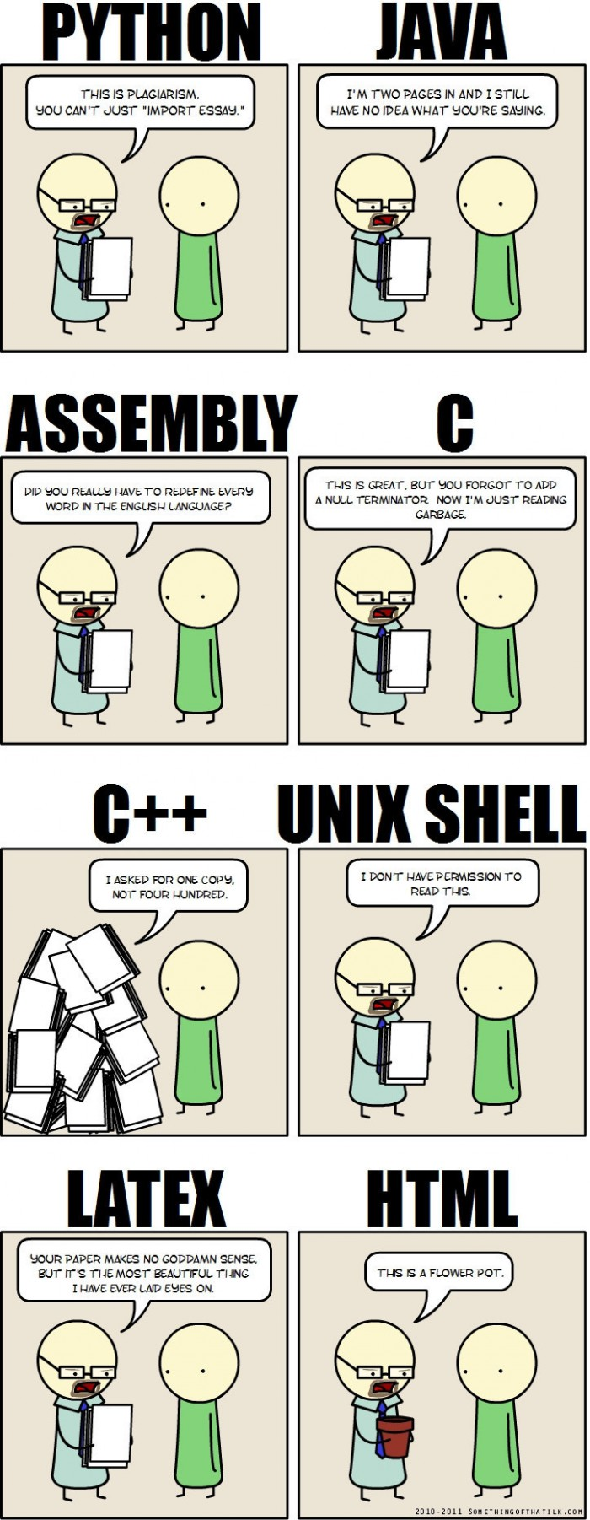
Why C++
“C makes it easy to shoot yourself in the foot. C++ makes it harder, but when you do, it blows away your whole leg.” -- Bjarne Stroustrup
“It was only supposed to be a joke, I never thought people would take the book seriously. Anyone with half a brain can see that object-oriented programming is counter-intuitive, illogical and inefficient.” -- Stroustrup C++ ‘interview’ (https://www-users.cs.york.ac.uk/susan/joke/cpp.htm)
C++ != speed, C++ ~ control

Slide 81
Working Environment
Use anything you like ☺
IDEs
Visual Studio
License for students at https://portal.azure.com/...
VS Code
Clion
Code::Blocks
Eclipse
…
Compilers
MSVC, GCC, Clang+LLVM, ICC, …

Slide 82
C++ (interesting) links
Reddit, Slack, …
https://en.cppreference.com/w/
http://www.cplusplus.com/
http://isocpp.github.io/CppCoreGuidelines/CppCoreGuidelines
https://www.youtube.com/user/CppCon
https://isocpp.org/
http://www.open-std.org/jtc1/sc22/wg21/docs/papers/
https://gcc.godbolt.org/
…

Slide 83
Hello World
#include <iostream> #include <string> int main() { std::string name; std::cin >> name; std::cout << “Greetings from ” << name << std::endl; return 0; }

Slide 84
Hello World
Include the libraries which implements the used STL constructs (string, cin, cout)
The main entry point/function for all programs. The execution starts here
#include <iostream> #include <string> int main() { std::string name; std::cin >> name; std::cout << “Greetings from ” << name << std::endl; return 0; }
Read from standard input (keyboard)
Write to standard output (screen)
All the STL constructs live inside `std` namespace

Slide 85
More Complex Program
#include <iostream> #include <string> #include <vector> using namespace std; int length(const string& s) { ... } void pretty_print(const vector<string>& a) { ... a[i] ... } int main(int argc, char** argv) { vector<string> arg(argv, argv+argc); if (arg.size() > 1 && arg[1] == "--help") { cout << "Usage: myprg [OPT]... [FILE]..." << endl; return 8; } pretty_print(arg); return 0; }

Slide 86
More Complex Program
Include the whole std namespace
#include <iostream> #include <string> #include <vector> using namespace std; int length(const string& s) { ... } void pretty_print(const vector<string>& a) { ... a[i] ... } int main(int argc, char** argv) { vector<string> arg(argv, argv+argc); if (arg.size() > 1 && arg[1] == "--help") { cout << "Usage: myprg [OPT]... [FILE]..." << endl; return 8; } pretty_print(arg); return 0; }
Passing the argument by (const) reference
Arguments of the program on the command line
Transform the arguments into C++ array of strings

Slide 87
Homeworks
Hello World
A greeting program (use names from arguments)
`hello.exe Adam Eve` → `Hello to Adam and Eve`
What is inside args[0]?
Summation of numbers from arguments
`sum.exe 1 2 3 4 5` → `15`
`stoi(), stod(), stoX()`
Functions for transformation from string to <something>
A simple calculator (only for operations +-)
`calc.exe 1+2+3-4` → `2`
to Gitlab
The previous programs are not needed, they should give you a lead

