Slide 1
Programming in C++
https://fan1x.github.io/cpp21.html
tomas.faltin@matfyz.cuni.cz

Slide 2
Programming in C++ - lab 4
https://fan1x.github.io/cpp21.html
tomas.faltin@matfyz.cuni.cz

Slide 3
Homework Feedback
Use const functions for read-only functions
print() const, get_matrix() const, get_vector() const
Use class or using to create new types
Decomposition!
using can be anywhere (inside the class as well)

Slide 4
Argument Passing - Recap
By copy/value
int max(int x, int y);
By const-reference:
Matrix sum(const Matrix &m1, const Matrix &m2);
By reference
void find_zero_matrix(const vector<Matrix> &ms, Matrix &zero_matrix);

Slide 5
Argument Passing – By R-value Reference (&&)
To transfer an ownership
Moves the object into a function
the object no longer lives outside the function
Typical usage
a single owner (std::unique_ptr)
moving large objects
Use std::move() on the caller side
vector<unique_ptr<int>>::push_back(unique_ptr<int> &&new_obj); vector<unique_ptr<int>> vector_of_ints; vector_of_ints.push_back(move(make_unique<int>(x));

Slide 6
Static With Classes
Attribute/method belongs to a class (not an object/instance)
Need to share attribute/method among the objects/instances
Most things belong to an object
class Verbose {}; // class
int main()
{
Verbose v1; // object/instance
Verbose v2(2); // object/instance
}

Slide 7
Static With Class
class CountingClass {
static size_t num_instances;
static void inc_num_instances() {
++num_instances;
}
static void dec_num_instances() {
--num_instances;
}
public:
static bool has_instance() {
return num_instances > 0;
}
static size_t get_num_instances() {
return num_instances;
}
CountingClass() { inc_num_instances(); }
CountingClass(const CountingClass &) {
inc_num_instances();
}
~CountingClass() { dec_num_instances(); }
};
void f() {
cout << CountingClass::get_num_instances() << endl; // 0
CountingClass cc1;
cout << CountingClass::get_num_instances() << endl; // 1
CountingClass cc2 = cc1;
cout << CountingClass::get_num_instances() << endl; // 2
std::vector<CountingClass> ccs(10);
cout << CountingClass::get_num_instances() << endl; // 12
}
int main() {
cout << CountingClass::get_num_instances() << endl; // 0
f();
cout << CountingClass::get_num_instances() << endl; // 0
}

Slide 8
Special Methods In Classes
class Verbose {
int x;
public:
Verbose() {
cout << "default ctor\n";
this->x = 1;
}
Verbose(const Verbose &v) {
cout << "copy ctor\n";
this->x = v.x;
}
Verbose(Verbose &&v) {
cout << "move ctor\n";
this->x = v.x;
v.x = 0;
}
~Verbose() {
cout << "dtor\n";
}
Verbose(int x) {
cout << "user ctor\n";
this->x = x;
}
Verbose &operator=(const Verbose &v) {
cout << "copy assignment\n";
this->x = v.x;
return *this;
}
Verbose &operator=(Verbose &&v) {
cout << "move assignment\n";
this->x = v.x;
return *this;
}
};
int main()
{
Verbose v1; // default ctor
Verbose v2(2); // user ctor
Verbose v3{3}; // user ctor
Verbose v4(v2); // copy ctor
Verbose v5 = v3; // copy ctor
Verbose v6(std::move(v1)); // move ctor
Verbose v7 = std::move(v4); // move ctor
v1 = v2; // copy assignment
v2 = std::move(v3); // move assignment
} // Calls destructors

Slide 9
Homework1: Implement class C
class C { /* implement me */ };
// Don’t touch anything below!!!
void fn_copy(C) {}
void fn_cref(const C&) {}
void fn_rref(C&&) {}
int main(int argc, char* argv[])
{
cout << "1\n";
C c1;
cout << "3\n";
C c2(c1);
cout << "5\n";
C c3 = c2;
cout << "7\n";
fn_copy(c1);
cout << "9\n";
fn_cref(c1);
fn_copy(std::move(c1));
fn_rref(std::move(c2));
cout << "11\n";
c3 = c2;
cout << "13\n";
c2 = std::move(c1);
cout << "15\n";
}
Finish program so it writes: 1,2,3,…,16
Touch only class C, nothing else
Nothing can be into main() or fn_XXX()
Don’t use exit(), break, goto, …
Hint: which methods are called?

Slide 10
Homework2: Finish Matrix for Integers
Correct all issues in the previous HW
Implement correctly all special methods
Show usage/test

Slide 11
Programming in C++ - lab 3
https://fan1x.github.io/cpp21.html
tomas.faltin@matfyz.cuni.cz

Slide 12
Down to operator
void op_downto(int x) {
while (x --> 0) {
cout << x;
}
}
op_downto(10); // prints 9,8,7,…,1,0

Slide 13
Homework Feedback
Use const & for large objects
Only source codes and project/config files to GIT
No binaries (they can be compiled from the source codes)
Use STL functions
isdigit(), stoi(), …
Prefer C++ strings to C-style strings
std::string, std::string_view

Slide 14
Class/Struct - Recap
Put all related things (data, functions) together
No real difference except for default visibility, inheritance, …
class – by default everything private
struct – by default everything public
Internal things → private
protected if need access from a child
Read-only functions → const
const-correctness
Special methods (constructor, destructor, …)

Slide 15
Defining your own types - using
Use using (or typedef in old C/C++)
Can be used together with templates (later)
using my_int = int;
using int_pair_t = std::pair<my_int, my_int>;
using my_string = std::vector<char>;
using int_vector_t = std::vector<int>;
my_int x = 3;
int_pair_t p{10, 20};
my_string str = {‘a’, ‘b’, ‘c’};
int_vector_t vi(10, 0);

Slide 16
Constant values – constexpr/const
Read only value that cannot be changed
Naming values in code
~ Every number in the code should be a named constant
constexpr – constant value (potentially) evaluated in the compile time
Can be used as arguments to templates
const – constant value
Both can be used together with static (later)
constexpr double PI = 3.14;
constexpr size_t MAX_SIZE = 16 * 1024 * 1024;

Slide 17
Coding: 3D Matrix for Integers - API
ctor(), ctor(width, length, heigth)
set(x, y, z, value), get(x, y, z), print()
set_width(), set_length(), set_heigth(), get_width(), get_length(), get_height()
get_matrix(x), get_matrix(y), get_matrix(z)
get_vector(x, y), get_vector(y, z), get_vector(x, z)
clear() – set all values to 0 (zero)
fill_with_value(value) – set all values to a given value
num_zeros(), num_negatives(), num_positives();

Slide 18
Coding: 3D Matrix for Integers - Hints
Think about the desing
array → matrix → 3D matrix → 4D matrix → … → XD matrix
Design simple first, then continue to the next level
No need to focus too much on performance yet
Focus:
Passing arguments: const-references, references, …
const functions
class design
Decomposition into functions
Function reusing
private/public

Slide 19
Coding: 3D Matrix - Improvements
print()
sort_vector(x, y)
Use std::sort()
change underlying matrix container - std::deque, std::list
the change to different container must be only few lines of change
Hint: use using
change underlying matrix container - std::array
Use large enough array
! Use constants
Report error in case of overflow

Slide 20
Programming in C++ - lab 2
https://fan1x.github.io/cpp21.html
tomas.faltin@matfyz.cuni.cz

Slide 21
Recap

Slide 22
Homework Example

Slide 23
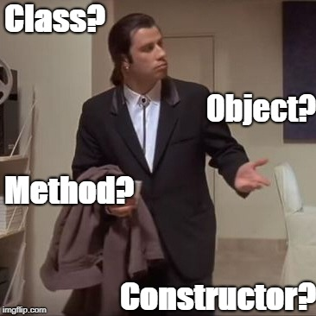
Class/Struct
Put all related things (data, functions) together
Represents objects in OOP
almost everything should belong to a class
No real difference except for default visibility, inheritance, …
class – by default everything private
struct – by default everything public
Internal things → private
protected if need access from a child
Read-only functions → const
const-correctness
Special methods (constructor, destructor, …)

Slide 24
Class Example
class calculator {
// by default everything is private
void sum();
void substract();
public:
calculator() { /* default ctor */ }
calculator(const std::string &str) () {
/* ctor */
}
void calc(const std::string &str);
void print_result() const;
private:
void multiply();
protected:
void init();
private:
};
calculator c; // no need for new!
c.calc("1+2-3");
c.print_result();
// calling non-default ctor
calculator c2("1+2-3");
c.print_result();
// creating a vector
std::vector<calculator> calcs;
can be used multiple times
semicolon at the end!

Slide 25
Class vs. Struct
Use class if the class has an invariant; use struct if the data members can vary independently
struct coordinate {
int x;
int y;
int z;
coordinate();
coordinate(int x);
coordinate(int x, int y);
coordinate(int x, int y, int z);
void set(int x, int y, int z);
};

Slide 26
Dynamic Array - std::vector<T>
Beware of time complexity
vector<bool> optimization
#include <vector>
int main() {
std::vector<int> vi{1, 2, 3, 4, 5, 6}; // [1, 2, 3, 4, 5, 6]
std::vector<float> vf(5, 0.0f); // [0.0, 0.0, 0.0, 0.0, 0.0]
std::cout << vi[3] << “ “ << vf.at(3) << std::endl; // access the 4th! element
std::cout << vi.size();
vi[3] = 100; vi.at(6) = 600; // access the 4th and 7th element
vf.push_back(100.0f); vf.emplace_back(200.0f); // insert at the end
vf.emplace_back(200.0f); // create element at the end
vf.insert(3, 300.0f); vf.emplace(3, 300.0f); // insert at the specific place
vf.emplace(3, 300.0f); // create element at the specific place
vi.pop_back(); // erase the last element
vf.erase(2); // erase the 3rd element
vi.clear(); // clear whole container
vi.reserve(10); // reserve space(=memory) for 10 elements
vi.resize(10); // actually create 10 elements using default ctor
}

Slide 27
3D Matrix for Integers – minimal API
ctor(), ctor(x, y, z)
set(x, y, z, value), get(x, y, z), print()
set_width(), set_length(), set_heigth(), get_width(), get_length(), get_height()
get_matrix(x), get_matrix(y), get_matrix(z)
get_vector(x, y), get_vector(y, z), get_vector(x, z)
clear() – set all values to 0 (zero)
fill_with_value(value) – set all values to a given value
num_zeros(), num_negatives(), num_positives();

Slide 28
3D Matrix for Integers - Hints
Think about the desing
array → matrix → 3D matrix → 4D matrix → … → XD matrix
Design simple first, then continue to the next level
No need to focus too much on performance yet
Focus:
Passing arguments: const-references, references, …
const functions
class design
Decomposition into functions
Function reusing
private/public

Slide 29
Programming in C++ - lab 1
https://fan1x.github.io/cpp21.html
tomas.faltin@matfyz.cuni.cz

Slide 30
Basic information
Email: tomas.faltin@matfyz.cuni.cz
Lab’s web: https://fan1x.github.io/cpp21.html
ZOOM for distance learning
https://cuni-cz.zoom.us/j/94350923737
Credentials in SIS/mail
Mattermost
Invite link: https://ulita.ms.mff.cuni.cz/mattermost/signup_user_complete/?id=z1knw5ag6p8nipop1i7iciga6a
Use ASAP, might expire eventually
Channel: `nprg041-cpp-english`
Gitlab
https://gitlab.mff.cuni.cz/
https://gitlab.mff.cuni.cz/teaching/nprg041/2021-22/eng

Slide 31
Communication is the key
Don’t be afraid to ask
via email
on Mattermost (instant)
DM if related to you only
Into a channel if others can benefit from it
If you struggle with something
If you feel like you might miss a deadline
Be proactive

Slide 32
Labs credit
Submitted homeworks before Monday midnight (to Gitlab)
Even if not attending!
Won’t be graded, for a feedback
Two large homeworks in ReCodex (40 points)
Points are included in the final score from the course
Smaller HW – 15 points, ~November
Larger HW – 25 points, ~December
Software project
Topic must be approved by 28/11/2021
First submission: 24/4/2022
Final submission: 22/5/2022
All the steps typically mean multiple iterations within multiple days. If you wait for the last minute, there is a chance you won’t make it

Slide 33
Code Requirements
Consistency
Be consistent within the code – keep a single code style
Cleanness, readability
Code doesn’t contain commented/dead parts
Code should be readable on its own
Safe, modern
E.g., prefer `std::vector<int>` to `new int[]`
Working
OFC, if the code is not working, all the above points are not that important, but they will help you with debugging at least ☺

Slide 34
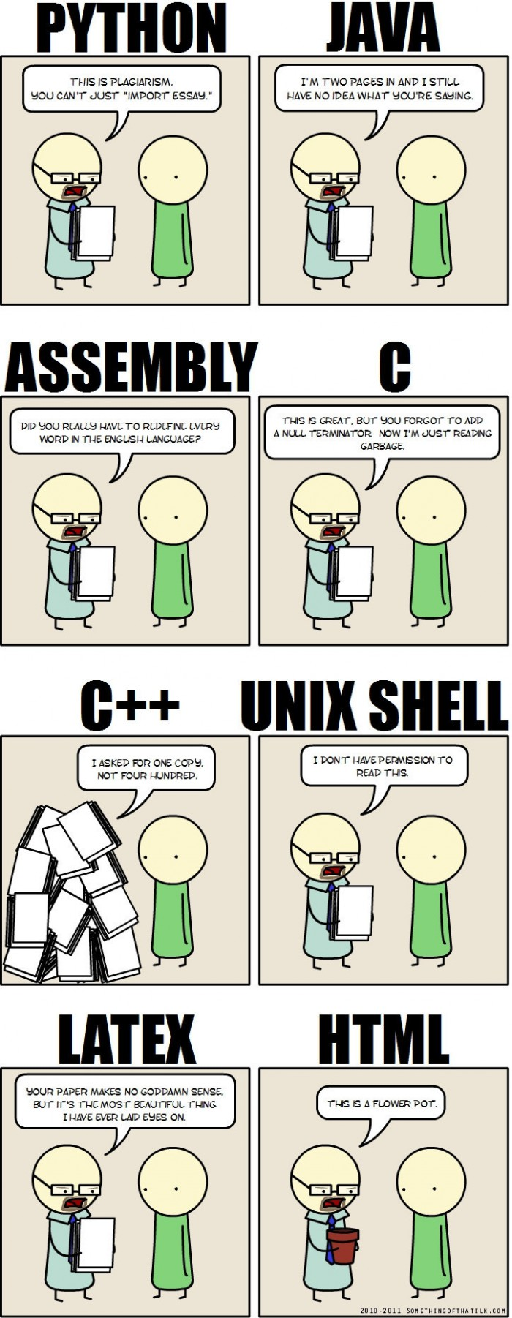
Why C++
“C makes it easy to shoot yourself in the foot. C++ makes it harder, but when you do, it blows away your whole leg.” -- Bjarne Stroustrup
“It was only supposed to be a joke, I never thought people would take the book seriously. Anyone with half a brain can see that object-oriented programming is counter-intuitive, illogical and inefficient.” -- Stroustrup C++ ‘interview’ (https://www-users.cs.york.ac.uk/susan/joke/cpp.htm)
C++ != speed, C++ ~ control

Slide 35
Working Environment
Use anything you like ☺
IDEs
Visual Studio
License for students at https://portal.azure.com/...
VS Code
Clion
Code::Blocks
Eclipse
…
Compilers
MSVC, GCC, Clang+LLVM, ICC, …

Slide 36
C++ (interesting) links
Reddit, Slack, …
https://en.cppreference.com/w/
http://www.cplusplus.com/
http://isocpp.github.io/CppCoreGuidelines/CppCoreGuidelines
https://www.youtube.com/user/CppCon
https://isocpp.org/
http://www.open-std.org/jtc1/sc22/wg21/docs/papers/
https://gcc.godbolt.org/
…

Slide 37
Hello World
#include <iostream> #include <string> int main() { std::string name; std::cin >> name; std::cout << “Greetings from ” << name << std::endl; return 0; }

Slide 38
Hello World
Include the libraries which implements the used STL constructs (string, cin, cout)
The main entry point/function for all programs. The execution starts here
#include <iostream> #include <string> int main() { std::string name; std::cin >> name; std::cout << “Greetings from ” << name << std::endl; return 0; }
Read from standard input (keyboard)
Write to standard output (screen)
All the STL constructs live inside `std` namespace

Slide 39
More Complex Program
#include <iostream> #include <string> #include <vector> using namespace std; int length(const string& s) { ... } void pretty_print(const vector<string>& a) { ... a[i] ... } int main(int argc, char** argv) { vector<string> arg(argv, argv+argc); if (arg.size() > 1 && arg[1] == "--help") { cout << "Usage: myprg [OPT]... [FILE]..." << endl; return 8; } pretty_print(arg); return 0; }

Slide 40
More Complex Program
Include the whole std namespace
#include <iostream> #include <string> #include <vector> using namespace std; int length(const string& s) { ... } void pretty_print(const vector<string>& a) { ... a[i] ... } int main(int argc, char** argv) { vector<string> arg(argv, argv+argc); if (arg.size() > 1 && arg[1] == "--help") { cout << "Usage: myprg [OPT]... [FILE]..." << endl; return 8; } pretty_print(arg); return 0; }
Passing the argument by (const) reference
Arguments of the program on the command line
Transform the arguments into C++ array of strings

Slide 41
Homeworks
Hello World
A greeting program (use names from arguments)
`hello.exe Adam Eve` → `Hello to Adam and Eve`
What is inside args[0]?
Summation of numbers from arguments
`sum.exe 1 2 3 4 5` → `15`
`stoi(), stod(), stoX()`
Functions for transformation from string to <something>
A simple calculator (only for operations +-)
`calc.exe 1+2+3-4` → `2`
to Gitlab
The previous programs are not needed, they should give you a lead

