Slide 1
Programming in C++
https://fan1x.github.io/cpp21.html
tomas.faltin@matfyz.cuni.cz

Slide 2
Programming in C++ - lab 6
https://fan1x.github.io/cpp21.html
tomas.faltin@matfyz.cuni.cz

Slide 3
Reminder
Two large homeworks in ReCodex (total 40 points)
Points are included in the final score from the course
Smaller HW – 15 points, assigned 15/11
Larger HW – 25 points, ~December
Software project
Topic must be approved by 27/11/2022
POC: 18/12/2022
First submission: 02/04/2023
Final submission: 28/05/2023

Slide 4
Homework1 Solution

Slide 5
Returning A (Const) Reference
To give an access to data inside an object
E.g., getters, operator=(), …
The returned data lives even after end of the function

Slide 6
Returning A (Const) Reference - Example
class complex_double {
double im;
double re;
public:
explicit complex_double(double re, double im = 0.0) {
this->im = im;
this->re = re;
}
double &real_part() {
return re;
}
double real_part() const {
return re;
}
double &imaginary_part() {
return im;
}
double imaginary_part() const {
return im;
}
};
int main() {
complex_double cd(1, 2);
cout << '{' << cd.real_part()
<< ',' << cd.imaginary_part() << '}' << endl;
cd.imaginary_part() = 0;
cout << '{' << cd.real_part()
<< ',' << cd.imaginary_part() << '}' << endl;
}

Slide 7
Containers
std::vector<Type> - dynamic array
my_vec[idx] = value, push_back(), …
std::array<Type, Size> - fixed size array
my_array[idx] = value, …
std::deque<Type> - double ended dynamic queue/array
push_back(), push_front(), back(), front(), …
std::list<Type> - linked list
std::map<Key,Value>, std::unordered_map<Key, Value> - map
my_map[key] = value, find(), insert(), …
std::set<Key>, std::unordered_set<Key> - set
contains(), insert(), find(), …

Slide 8
Homework1: Dictionary
// An example of API
class Dictionary {
// Insert a new language and returns its ID
size_t add_language(const string &name);
// Insert new words into a dictionary
bool add_vocabulary(size_t words1_language_id, const string &word1,
size_t words2_language_id, const string &word2);
// Translate a given text with the given language into the output language
string translate(size_t input_language_id, const string &text,
size_t output_language_id) const;
// Automatically translate a given text into a given language
string translate(const string &text, size_t output_language_id) const;
// Return all vocabularies for a given language
const vector<string> &all_vocabulary(size_t language_id) const;
};

Slide 9
Homework2: Simple People Database
In Recodex: https://recodex.mff.cuni.cz/
Deadline: Monday 13:00
NOT the official large homework
Just to test your knowledge and the access to the ReCodex

Slide 10
Programming in C++ - lab 5
https://fan1x.github.io/cpp21.html
tomas.faltin@matfyz.cuni.cz

Slide 11
Reminder
Two large homeworks in ReCodex (total 40 points)
Points are included in the final score from the course
Smaller HW – 15 points, ~November
Larger HW – 25 points, ~December
Software project
Topic must be approved by 27/11/2022
POC: 18/12/2022
First submission: 02/04/2023
Final submission: 28/05/2023

Slide 12
Homework1 Solution

Slide 13
Declaration/Definition
// file: my_class.hpp
#ifndef MY_CLASS_HPP #define MY_CLASS_HPP void fn(int x); class my_class { public: my_class(); int exec(int x); private: double d; static size_t i; }; #endif // MY_CLASS_HPP
// file: my_class.cpp
#include “my_class.hpp” #include <iostream> void fn(int x) { cout << “fn()”; } my_class::my_class() : d(1.0) { cout << “ctor”; } int my_class::exec(int x) { for(int i=0; i < x; ++i) { … } } size_t my_class::i = 0;

Slide 14
Declaration/Definition
// file: my_class.hpp
#ifndef MY_CLASS_HPP #define MY_CLASS_HPP void fn(int x); class my_class { public: my_class(); int exec(int x); private: double d; static size_t i; }; #endif // MY_CLASS_HPP
// file: my_class.cpp
#include “my_class.hpp” #include <iostream> void fn(int x) { cout << “fn()”; } my_class::my_class() : d(1.0) { cout << “ctor”; } int my_class::exec(int x) { for(int i=0; i < x; ++i) { … } } size_t my_class::i = 0;
#include header
guards
declarations
definitions

Slide 15
Homework1: Summing Program
class C {
/* CAN ADD MORE ATTRIBUTES */
const int value;
/* USE THIS FUNCTION FOR PRINTING */
void print() const {
cout << value << "\n";
}
public:
/* IMPLEMENT SPECIAL METHODS ONLY */
};
class D {
std::vector<C> cs;
/* CANNOT ADD MORE ATTRIBUTES */
public:
/* IMPLEMENT SPECIAL METHODS ONLY */
};
int main(int argc, char *argv[]) {
int first, last;
cin >> first >> last;
cout << ”Summing numbers:\n";
D d(first, last); // prints number first, first+1, ..., last
cout << "Preparing...\n";
D d2 = d;
cout << "Sum of the numbers:\n";
d2 = d; // prints sum of numbers first..last
}
Implement special methods only
ctors, dtor, operators, …
You can add O(1) attributes into C
E.g., cannot add a vector
Use C::print() for printing
Cannot use anything else for printing
Example (
Input: 5 7
Output:
Summing numbers:
5
6
7
Preparing...
Sum of the numbers:
18

Slide 16
Homework2: Piškvorky for 2 players
For 2 players only
Set the names at the beginning
Game ends when one of the player has 5 in a row
Write who is the winner
Validate user inputs

Slide 17
Programming in C++ - lab 4
https://fan1x.github.io/cpp21.html
tomas.faltin@matfyz.cuni.cz

Slide 18
Homework Feedback
Use const functions for read-only functions
print() const, get_matrix() const, get_vector() const
Use class or using to create new types
Decomposition!
using can be anywhere (inside the class as well)

Slide 19
Argument Passing - Recap
By copy/value
int max(int x, int y);
By const-reference:
Matrix sum(const Matrix &m1, const Matrix &m2);
By reference
void find_zero_matrix(const vector<Matrix> &ms, Matrix &zero_matrix);

Slide 20
Argument Passing – By R-value Reference (&&)
To transfer an ownership
Moves the object into a function
the object no longer lives outside the function
Typical usage
a single owner (std::unique_ptr)
moving large objects
Use std::move() on the caller side
vector<unique_ptr<int>>::push_back(unique_ptr<int> &&new_obj); vector<unique_ptr<int>> vector_of_ints; vector_of_ints.push_back(move(make_unique<int>(x));

Slide 21
Static With Classes
Attribute/method belongs to a class (not an object/instance)
Need to share attribute/method among the objects/instances
Most things belong to an object
class Verbose {}; // class
int main()
{
Verbose v1; // object/instance
Verbose v2(2); // object/instance
}

Slide 22
Static With Class
class CountingClass {
static size_t num_instances;
static void inc_num_instances() {
++num_instances;
}
static void dec_num_instances() {
--num_instances;
}
public:
static bool has_instance() {
return num_instances > 0;
}
static size_t get_num_instances() {
return num_instances;
}
CountingClass() { inc_num_instances(); }
CountingClass(const CountingClass &) {
inc_num_instances();
}
~CountingClass() { dec_num_instances(); }
};
size_t CountingClass::num_instances = 0;
void f() {
cout << CountingClass::get_num_instances() << endl; // 0
CountingClass cc1;
cout << CountingClass::get_num_instances() << endl; // 1
CountingClass cc2 = cc1;
cout << CountingClass::get_num_instances() << endl; // 2
std::vector<CountingClass> ccs(10);
cout << CountingClass::get_num_instances() << endl; // 12
}
int main() {
cout << CountingClass::get_num_instances() << endl; // 0
f();
cout << CountingClass::get_num_instances() << endl; // 0
}

Slide 23
Special Methods In Classes
class Verbose {
int x;
public:
Verbose() {
cout << "default ctor\n";
this->x = 1;
}
Verbose(const Verbose &v) {
cout << "copy ctor\n";
this->x = v.x;
}
Verbose(Verbose &&v) {
cout << "move ctor\n";
this->x = v.x;
v.x = 0;
}
~Verbose() {
cout << "dtor\n";
}
Verbose(int x) {
cout << "user ctor\n";
this->x = x;
}
Verbose &operator=(const Verbose &v) {
cout << "copy assignment\n";
this->x = v.x;
return *this;
}
Verbose &operator=(Verbose &&v) {
cout << "move assignment\n";
this->x = v.x;
return *this;
}
};
int main()
{
Verbose v1; // default ctor
Verbose v2(2); // user ctor
Verbose v3{3}; // user ctor
Verbose v4(v2); // copy ctor
Verbose v5 = v3; // copy ctor
Verbose v6(std::move(v1)); // move ctor
Verbose v7 = std::move(v4); // move ctor
v1 = v2; // copy assignment
v2 = std::move(v3); // move assignment
} // Calls destructors

Slide 24
Homework1: Implement class C
class C { /* implement me */ };
// Don’t touch anything below!!!
void fn_copy(C) {}
void fn_cref(const C&) {}
void fn_rref(C&&) {}
int main(int argc, char* argv[])
{
cout << "1\n";
C c1;
cout << "3\n";
C c2(c1);
cout << "5\n";
C c3 = c2;
cout << "7\n";
fn_copy(c1);
cout << "9\n";
fn_cref(c1);
fn_copy(std::move(c1));
fn_rref(std::move(c2));
cout << "11\n";
c3 = c2;
cout << "13\n";
c2 = std::move(c1);
cout << "15\n";
}
Finish program so it writes: 1,2,3,…,16
Touch only class C, nothing else
Nothing can be into main() or fn_XXX()
Don’t use exit(), break, goto, …
Hint: which methods are called?

Slide 25
Homework2: Finish 3DMatrix For Integers
Correct all issues in the previous HW
Implement correctly all special methods
Show usage/test

Slide 26
Programming in C++ - lab 3
https://fan1x.github.io/cpp21.html
tomas.faltin@matfyz.cuni.cz

Slide 27
Down to operator
void op_downto(int x) {
while (x --> 0) {
cout << x;
}
}
op_downto(10); // prints 9,8,7,…,1,0

Slide 28
Homework Feedback
Use const & for large objects
Only source codes and project/config files to GIT
No binaries (they can be compiled from the source codes)
Use STL functions
isdigit(), stoi(), …
Prefer C++ strings to C-style strings
std::string, std::string_view

Slide 29
Class/Struct - Recap
Put all related things (data, functions) together
No real difference except for default visibility, inheritance, …
class – by default everything private
struct – by default everything public
Internal things → private
protected if need access from a child
Read-only functions → const
const-correctness
Special methods (constructor, destructor, …)

Slide 30
Defining your own types - using
Use using (or typedef in old C/C++)
Can be used together with templates (later)
using my_int = int;
using int_pair_t = std::pair<my_int, my_int>;
using my_string = std::vector<char>;
using int_vector_t = std::vector<int>;
my_int x = 3;
int_pair_t p{10, 20};
my_string str = {‘a’, ‘b’, ‘c’};
int_vector_t vi(10, 0);

Slide 31
Constant values – constexpr/const
Read only value that cannot be changed
Naming values in code
~ Every number in the code should be a named constant
constexpr – constant value (potentially) evaluated in the compile time
Can be used as arguments to templates
const – constant value
Both can be used together with static (later)
constexpr double PI = 3.14;
constexpr size_t MAX_SIZE = 16 * 1024 * 1024;

Slide 32
Coding: 3D Matrix for Integers - API
ctor(), ctor(width, length, heigth)
set(x, y, z, value), get(x, y, z), print()
set_width(), set_length(), set_heigth(), get_width(), get_length(), get_height()
get_matrix(x), get_matrix(y), get_matrix(z)
get_vector(x, y), get_vector(y, z), get_vector(x, z)
clear() – set all values to 0 (zero)
fill_with_value(value) – set all values to a given value
num_zeros(), num_negatives(), num_positives();

Slide 33
Coding: 3D Matrix for Integers - Hints
Think about the desing
array → matrix → 3D matrix → 4D matrix → … → XD matrix
Design simple first, then continue to the next level
No need to focus too much on performance yet
Focus:
Passing arguments: const-references, references, …
const functions
class design
Decomposition into functions
Function reusing
private/public

Slide 34
Coding: 3D Matrix - Improvements
print()
sort_vector(x, y)
Use std::sort()
change underlying matrix container - std::deque, std::list
the change to different container must be only few lines of change
Hint: use using
change underlying matrix container - std::array
Use large enough array
! Use constants
Report error in case of overflow

Slide 35
Programming in C++ - lab 2
https://fan1x.github.io/cpp21.html
tomas.faltin@matfyz.cuni.cz

Slide 36
Recap

Slide 37
Homework Example

Slide 38
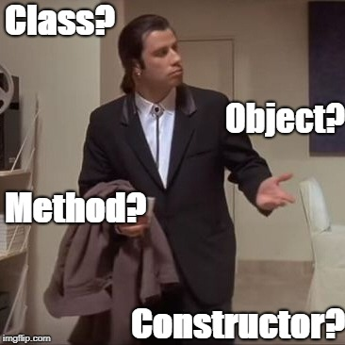
Class/Struct
Put all related things (data, functions) together
Represents objects in OOP
almost everything should belong to a class
No real difference except for default visibility, inheritance, …
class – by default everything private
struct – by default everything public
Internal things → private
protected if need access from a child
Read-only functions → const
const-correctness
Special methods (constructor, destructor, …)

Slide 39
Class Example
class calculator {
// by default everything is private
void sum();
void substract();
public:
calculator() { /* default ctor */ }
calculator(const std::string &str) () {
/* ctor */
}
void calc(const std::string &str);
void print_result() const;
private:
void multiply();
protected:
void init();
private:
};
calculator c; // no need for new!
c.calc("1+2-3");
c.print_result();
// calling non-default ctor
calculator c2("1+2-3");
c.print_result();
// creating a vector
std::vector<calculator> calcs;
can be used multiple times
semicolon at the end!

Slide 40
Class vs. Struct
Use class if the class has an invariant; use struct if the data members can vary independently
struct coordinate {
int x;
int y;
int z;
coordinate();
coordinate(int x);
coordinate(int x, int y);
coordinate(int x, int y, int z);
void set(int x, int y, int z);
};

Slide 41
Dynamic Array - std::vector<T>
Beware of time complexity
vector<bool> optimization
#include <vector>
int main() {
std::vector<int> vi{1, 2, 3, 4, 5, 6}; // [1, 2, 3, 4, 5, 6]
std::vector<float> vf(5, 0.0f); // [0.0, 0.0, 0.0, 0.0, 0.0]
std::cout << vi[3] << “ “ << vf.at(3) << std::endl; // access the 4th! element
std::cout << vi.size();
vi[3] = 100; vi.at(6) = 600; // access the 4th and 7th element
vf.push_back(100.0f); vf.emplace_back(200.0f); // insert at the end
vf.emplace_back(200.0f); // create element at the end
vf.insert(3, 300.0f); vf.emplace(3, 300.0f); // insert at the specific place
vf.emplace(3, 300.0f); // create element at the specific place
vi.pop_back(); // erase the last element
vf.erase(2); // erase the 3rd element
vi.clear(); // clear whole container
vi.reserve(10); // reserve space(=memory) for 10 elements
vi.resize(10); // actually create 10 elements using default ctor
}

Slide 42
3D Matrix for Integers – minimal API
ctor(), ctor(x, y, z)
set(x, y, z, value), get(x, y, z), print()
set_width(), set_length(), set_heigth(), get_width(), get_length(), get_height()
get_matrix(x), get_matrix(y), get_matrix(z)
get_vector(x, y), get_vector(y, z), get_vector(x, z)
clear() – set all values to 0 (zero)
fill_with_value(value) – set all values to a given value
num_zeros(), num_negatives(), num_positives();

Slide 43
3D Matrix for Integers - Hints
Think about the desing
array → matrix → 3D matrix → 4D matrix → … → XD matrix
Design simple first, then continue to the next level
No need to focus too much on performance yet
Focus:
Passing arguments: const-references, references, …
const functions
class design
Decomposition into functions
Function reusing
private/public

Slide 44
Programming in C++ - lab 1
https://fan1x.github.io/cpp21.html
tomas.faltin@matfyz.cuni.cz

Slide 45
Basic information
Email: tomas.faltin@matfyz.cuni.cz
Labs web: https://fan1x.github.io/cpp22.html
Lecture web: https://www.ksi.mff.cuni.cz/teaching/nprg041-web/
Mattermost
Invite link in SIS/Notice-board
Channel: `nprg041-cpp-faltin`
Gitlab
https://gitlab.mff.cuni.cz/
https://gitlab.mff.cuni.cz/teaching/nprg041/2022-23/faltin

Slide 46
Communication is the key
Don’t be afraid to ask
Be proactive
via email
on Mattermost (instant)
DM if related to you only
Into a channel if others can benefit from it
If you struggle with something
If you feel like you might miss a deadline

Slide 47
Labs credit
Submitted homeworks before Sunday midnight (Sunday 23:59)
to Gitlab
Even if not attending!
Won’t be graded, for feedback only
Two large homeworks in ReCodex (total 40 points)
Points are included in the final score from the course
Smaller HW – 15 points, ~November
Larger HW – 25 points, ~December
Software project
Topic must be approved by 27/11/2022
POC: 18/12/2022
First submission: 02/04/2023
Final submission: 28/05/2023
All the steps typically mean multiple iterations within multiple days. If you wait for the last minute, there is a chance you won’t make it

Slide 48

Code Requirements - Consistency
Consistency
Be consistent within the code
keep a single code style

Slide 49
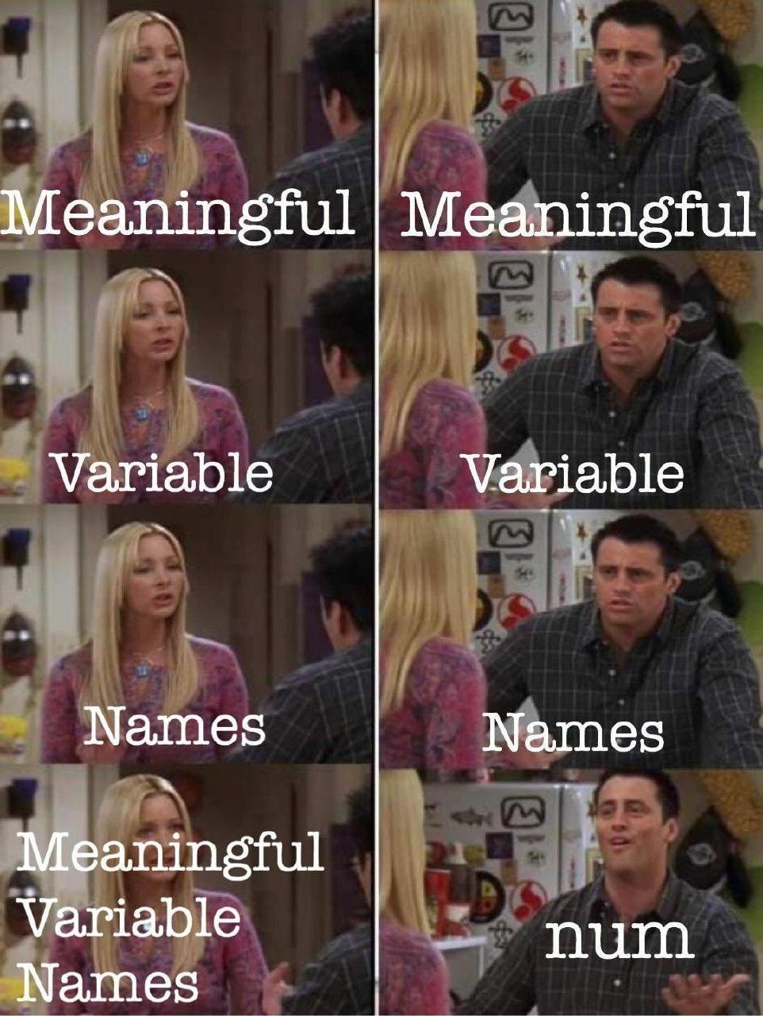
Code Requirements – Readability
Code doesn’t contain commented/dead parts
Code should be readable on its own
Comment complicated code

Slide 50
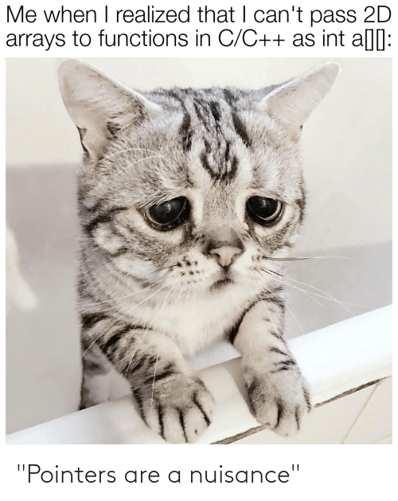
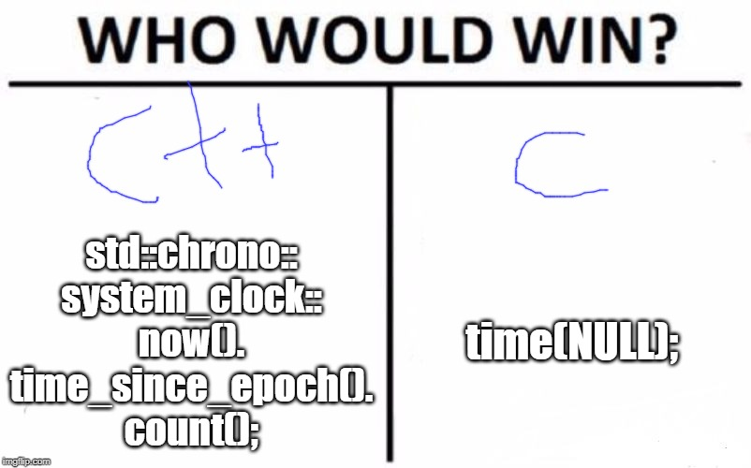
Code Requirements – Safe, Modern
Prefer using modern constructs
Additional safety
Maybe performance
E.g., prefer `std::vector<int>` to `new int[]`

Slide 51

Code Requirements – Working
OFC, if the code is not working, all the above points are not that important
they will help you with debugging at least ☺

Slide 52
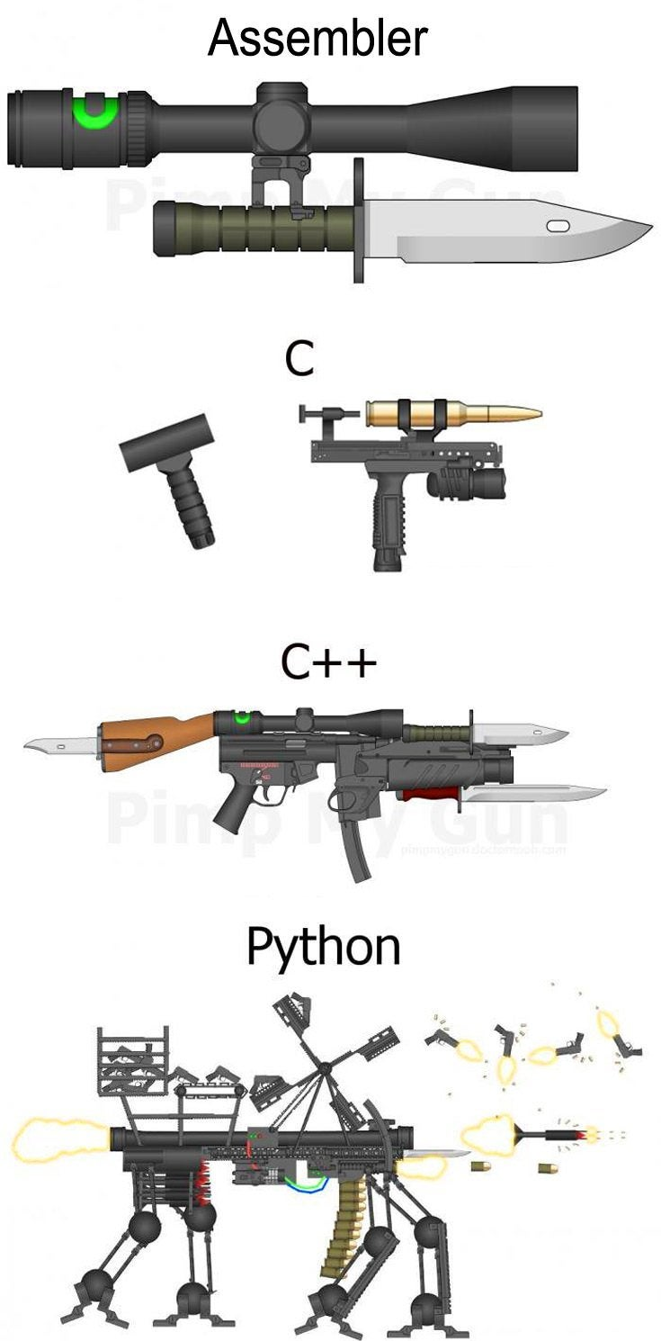
Why C++
“C makes it easy to shoot yourself in the foot. C++ makes it harder, but when you do, it blows away your whole leg.” -- Bjarne Stroustrup
“It was only supposed to be a joke, I never thought people would take the book seriously. Anyone with half a brain can see that object-oriented programming is counter-intuitive, illogical and inefficient.” -- Stroustrup C++ ‘interview’ (https://www-users.cs.york.ac.uk/susan/joke/cpp.htm)

Slide 53
Working Environment
Use anything you like ☺
IDEs
Visual Studio
License for students at https://portal.azure.com/...
VS Code
Clion
Code::Blocks
Eclipse
…
Compilers
MSVC, GCC, Clang+LLVM, ICC, …

Slide 54
C++ (interesting) links
Reddit, Slack, …
https://en.cppreference.com/w/
http://www.cplusplus.com/
http://isocpp.github.io/CppCoreGuidelines/CppCoreGuidelines
https://www.youtube.com/user/CppCon
https://isocpp.org/
http://www.open-std.org/jtc1/sc22/wg21/docs/papers/
https://godbolt.org/
…

Slide 55
Learning C++
C++ in 100 seconds: https://youtu.be/MNeX4EGtR5Y
C++ in 31h: https://youtu.be/8jLOx1hD3_o

Slide 56
Hello World
#include <iostream>
#include <string>
int main() {
std::string name;
std::cin >> name;
std::cout << "Greetings from " << name << std::endl;
return 0;
}

Slide 57
Hello World
Include the libraries which implements the used STL constructs (string, cin, cout)
#include <iostream> #include <string> int main() { std::string name; std::cin >> name; std::cout << “Greetings from ” << name << std::endl; return 0; }
The main entry point/function for all programs. The execution starts here
Declare a variable of type string
Read from standard input (keyboard)
Write to standard output (screen)
All the STL constructs live inside `std` namespace

Slide 58
Compilation
c++ --version
c++ is a compiler, here GCC
c++ hello_world.cpp -o hello_world
Compile program into `hello_world` executable (using default settings)
c++ -Wall -Wextra -Werror -O3 -std=c++2b hello_world.cpp -o hello_world
Wall: Show all warnings
Wextra: Show additional extra warnings
Werror: Thread all warnings as errors
O3: level of optimizations
std=c++2b: Used C++ standard
Or use IDE ☺

Slide 59
More Complex Program
#include <iostream>
#include <string>
#include <vector>
using namespace std;
void pretty_print(const vector<string>& args) {
// ... args[i]
}
int main(int argc, char** argv) {
vector<string> args(argv, argv+argc); pretty_print(args);
return 0;
}

Slide 60
More Complex Program
Include the whole std namespace
#include <iostream>
#include <string>
#include <vector>
using namespace std;
void pretty_print(const vector<string>& args) {
// ... args[i]
}
int main(int argc, char** argv) {
vector<string> args(argv, argv+argc); // Wrap arguments
pretty_print(args);
return 0;
}
Passing the argument by (const) reference
Arguments of the program on the command line
Number of arguments
Transform “magically” the arguments into C++ array of strings

Slide 61
Functions And Parameters
int get_max(int v1, int v2) {
return v1 > v2 ? v1 : v2;
}
int get_max1(const vector<int> &ints) {
int max = std::numeric_limits<int>::min();
for (int x : ints) {
max = get_max(x, max);
}
return max;
}
bool get_max2(const vector<int> &ints, int &max) {
max = std::numeric_limits<int>::min();
for (int x : ints) {
max = get_max(x, max);
}
return !ints.empty();
}
std::tuple<bool, int> get_max3(const vector<int> &ints) {
int max = std::numeric_limits<int>::min();
for (int x : ints) {
max = get_max(x, max);
}
return { !ints.empty(), max };
}

Slide 62
Functions And Parameters
read-only input parameter
Most of the types (string, vector, …) → use const-reference - const &
int get_max(const vector<int> &ints)
For small numeric types (int, float, double, …) → use direct parameter
int get_max(int v1, int v2)
output parameters
Single output parameter → use return value
int get_max(const vector<int> &ints)
Few output parameters → use tuple/pair/structure
std::tuple<bool, int> get_max(const vector<int> &ints)
Many output parameters → use reference - &
bool get_max(const vector<int> &ints, int &max)

Slide 63
Homeworks
Hello World
A greeting program (use names from arguments)
`hello.exe Adam Eve` → `Hello to Adam and Eve`
What is inside args[0]?
Summation of numbers from arguments
`sum.exe 1 2 3 4 5` → `15`
`stoi(), stod(), stoX()`
Functions for transformation from string to <something>
A simple calculator (only for operations +-)
`calc.exe 1+2+3-4` → `2`
to Gitlab
The previous programs are not needed, they should give you a lead

