Slide 1

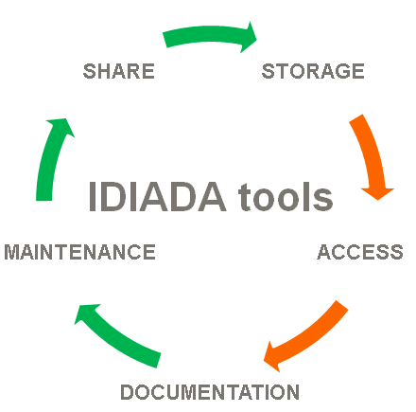
Jan Stekly, Frantisek Siegl
IDIADA tools concept
27/09/2019
PUBLIC
INTERNAL
CONFIDENTIAL
SECRET

Slide 2

Motivation
Typical script related issues
User perspective
the same script at multiple locations..
different versions of the same script at multiple locations..
Where to find a script I need and how to run it?
Is there a list of scripts which are available?
How to use the script and what does it do?
Developer perspective
Team script development
Version handling
Installation
How to send existing script somewhere else?
share
Storage
IDIADA tools
maintenance
Access
documentation
PUBLIC
INTERNAL
CONFIDENTIAL
SECRET

Slide 3
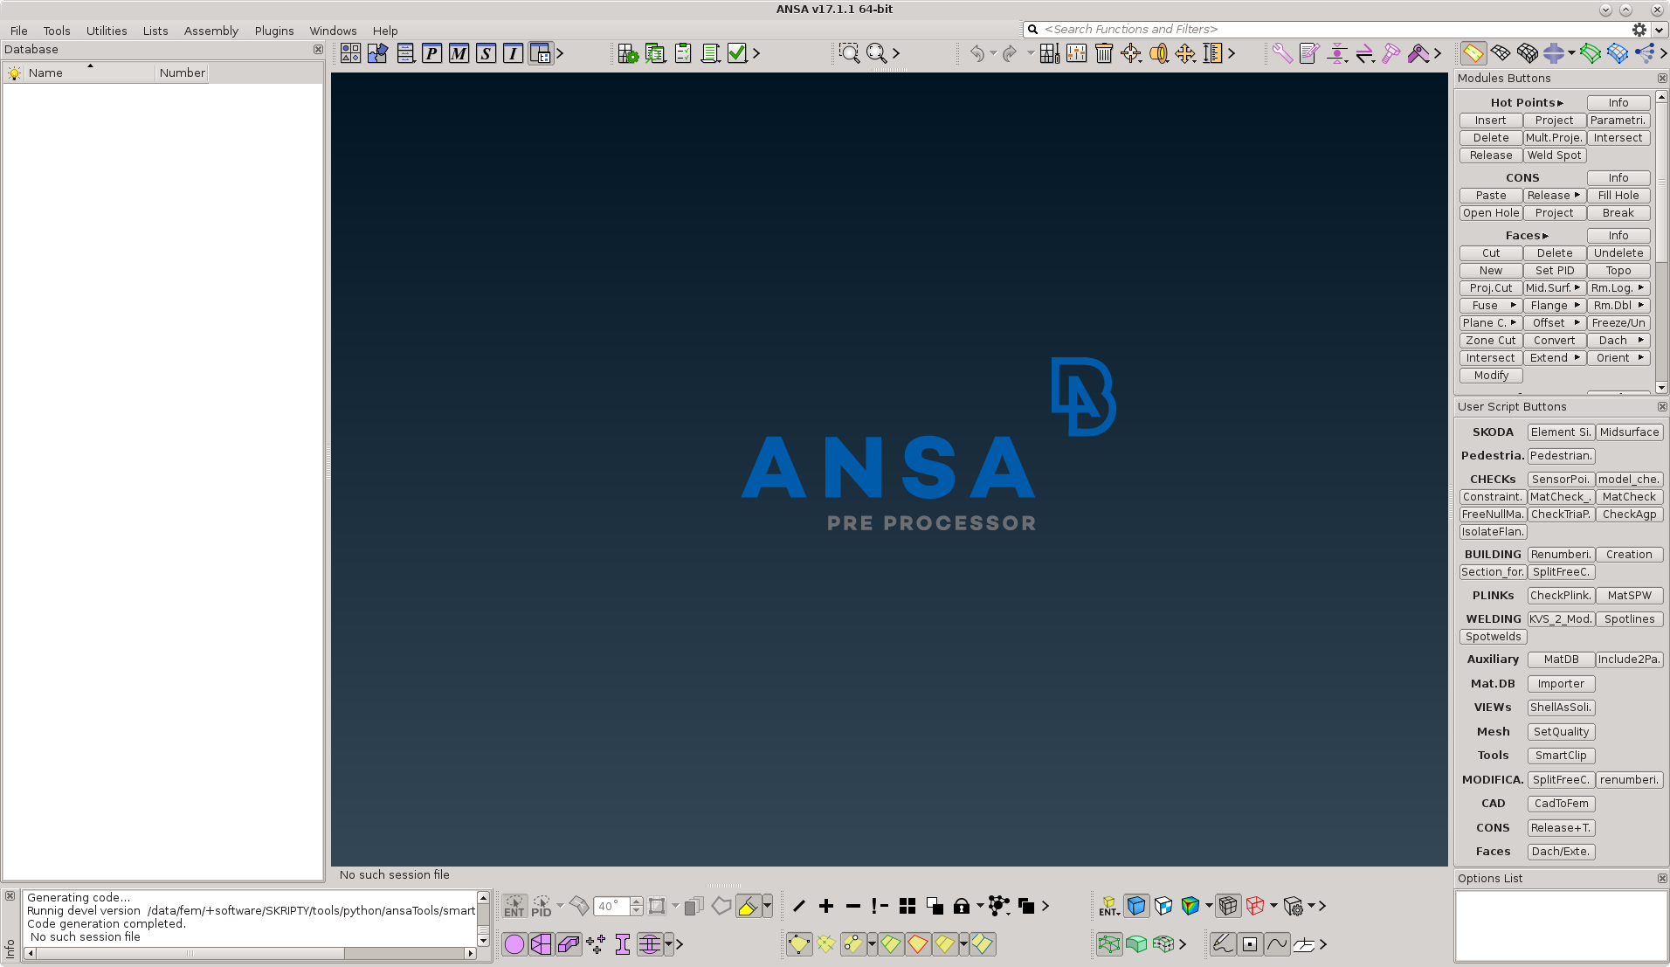
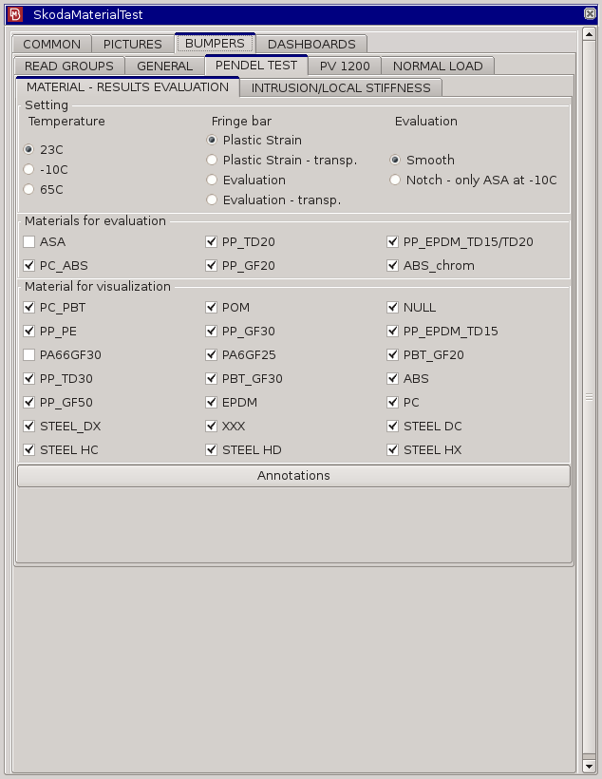
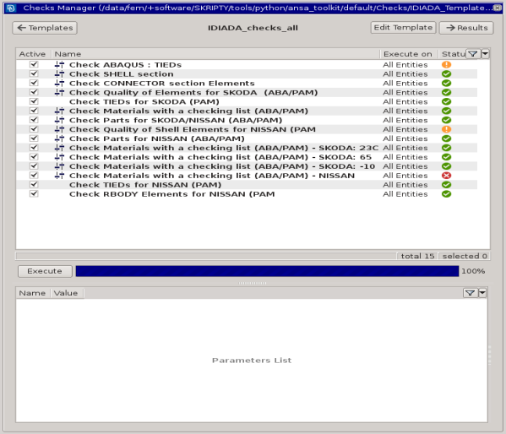
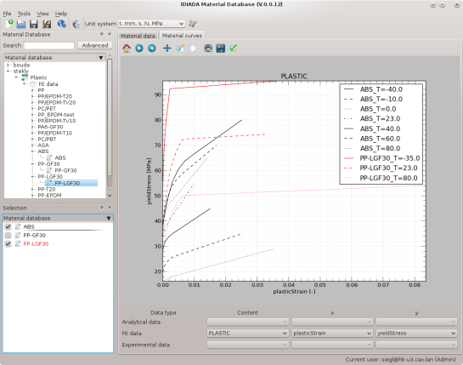

Applications
Which types of tools do we currently maintain
Stand-alone
Command line executable script/application
ANSA Toolkit*
ANSA User Script Buttons and Plugins
ANSA checks
META toolkit
META toolbar script
share
storage
IDIADA tools
maintenance
access
documentation
IDIADA tools
* A package of custom tools which is loaded during ANSA start (LINUX and WINDOWS compatible)
PUBLIC
INTERNAL
CONFIDENTIAL
SECRET
3

Slide 4
STORAGE: Common directory structure for all scripts
share
storage
All scripts are located in the same customer project-independent location
../tools/
C++/ - C++ script productive version directory
bash/ - bash script productive version directory
bin/ - directory added to $PATH system variable
envs/ - directory with compatible python interpreters
python/ - python script productive version directory
matlab/ - matlab script productive version directory
…
repos/ - script repository directory
IDIADA tools
maintenance
access
documentation
Scripts are sorted into separate directories according to their source code type
Scripts share one common repository location
PUBLIC
INTERNAL
CONFIDENTIAL
SECRET

Slide 5
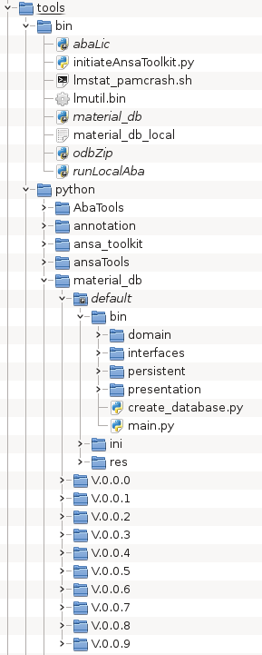
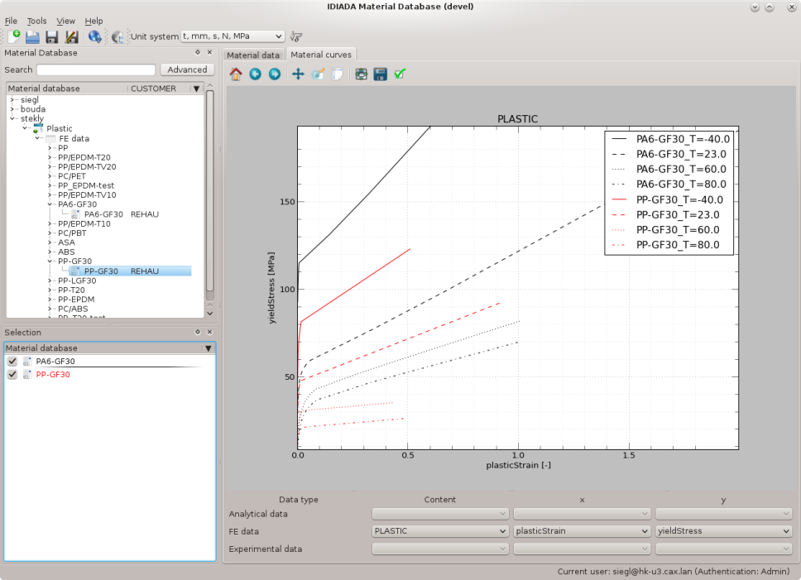
ACCESS: Instant access from command line
share
storage
Application start example
IDIADA tools
maintenance
access
documentation
5

Slide 6
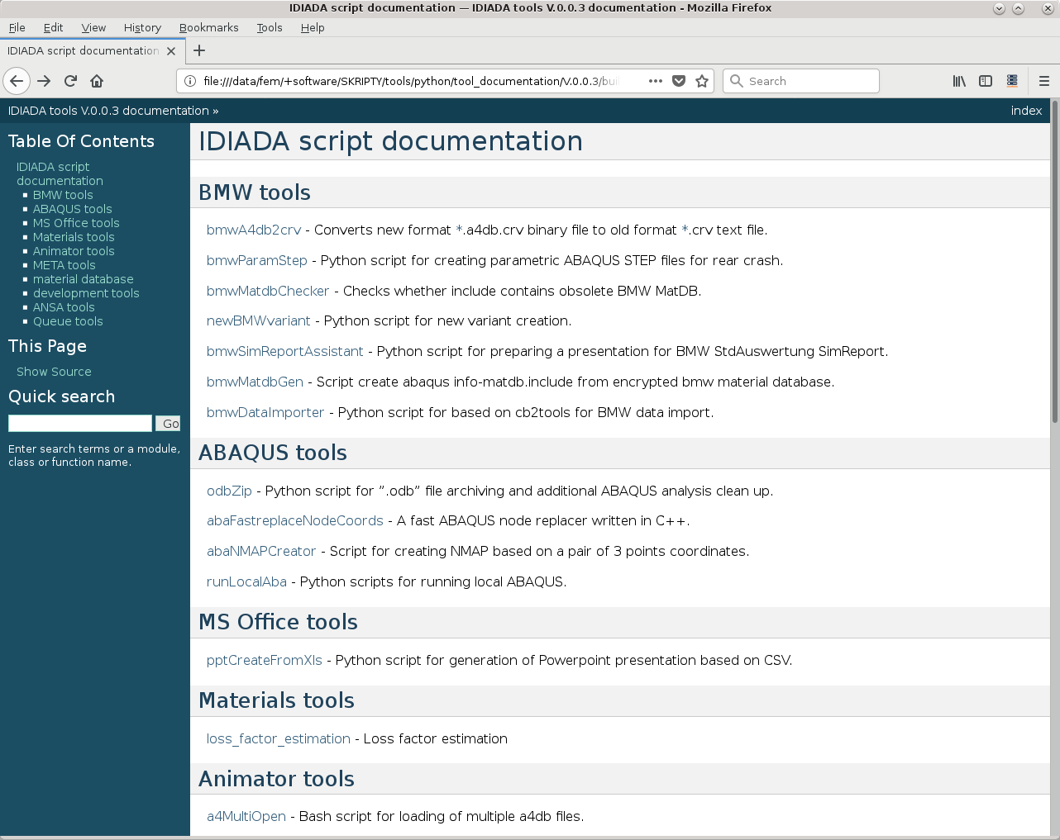
DOCUMENTATION: User access
User documentation of all scripts is available in one html-based document
share
storage
IDIADA tools
maintenance
access
documentation
can be opened directly from the command line
[user@machine ~]$ doc
is included as a link in DOKUWIKI
PUBLIC
INTERNAL
CONFIDENTIAL
SECRET
6

Slide 7
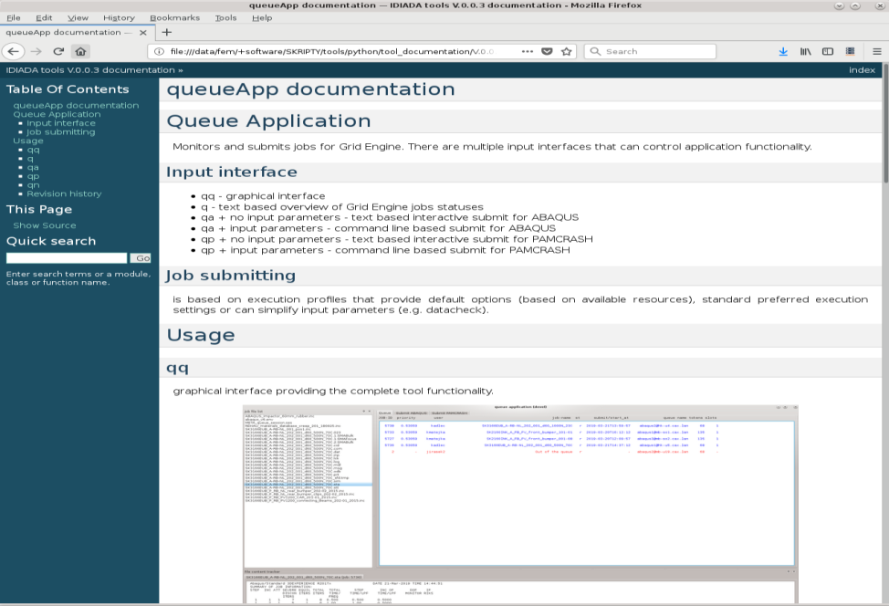
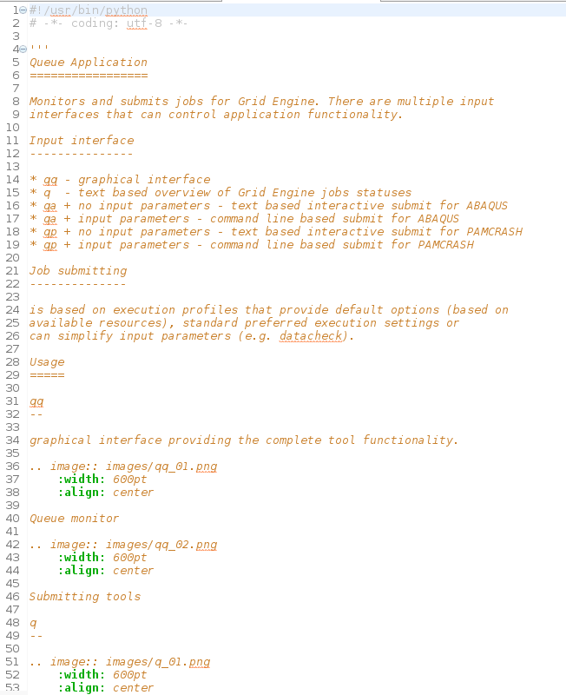
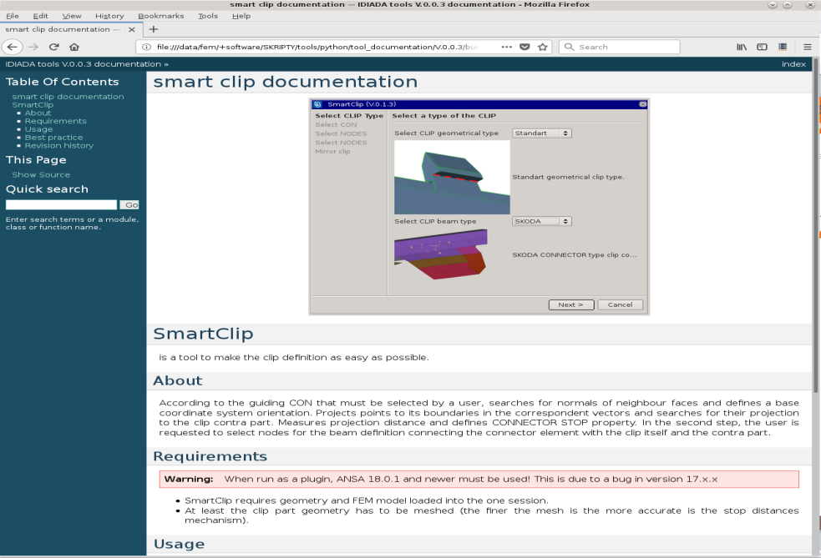
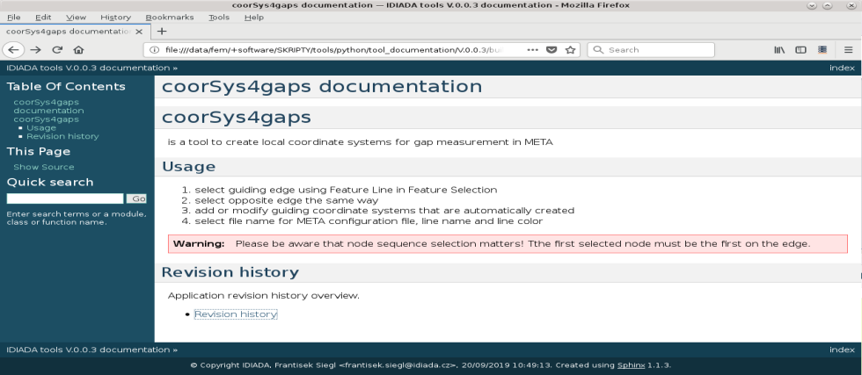
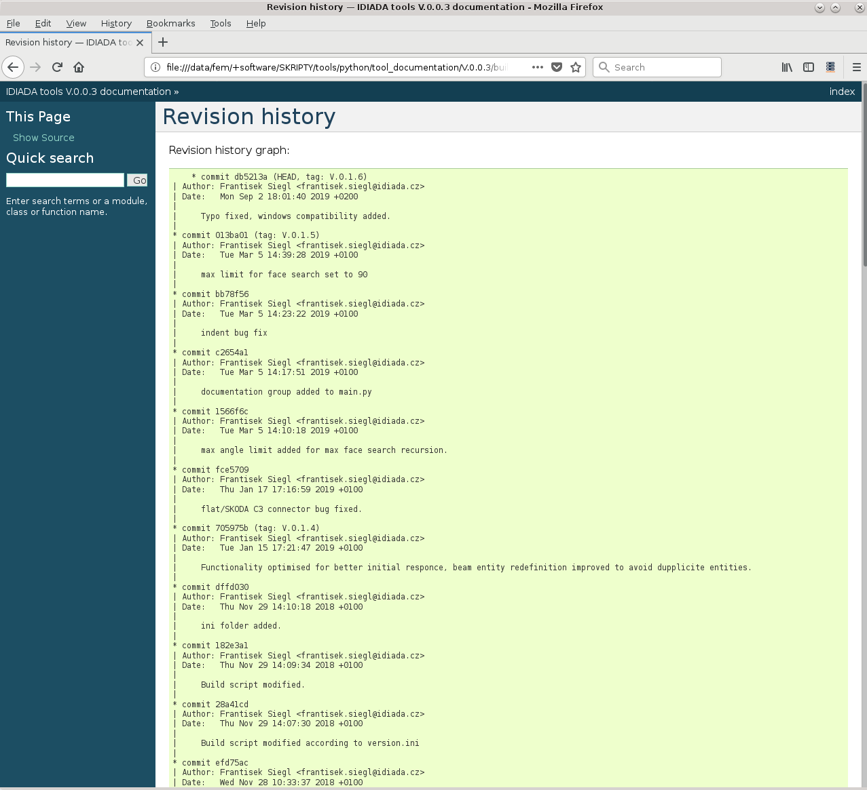
DOCUMENTATION: Content
Tool user documentation example
share
storage
IDIADA tools
maintenance
access
documentation
generated automatically from the documentation string of the script
provides basic information about the tool, how to run it and any other information that might be useful to a user
provides requirements, warnings and user best practice
provides automatically revision history
PUBLIC
INTERNAL
CONFIDENTIAL
SECRET
7

Slide 8
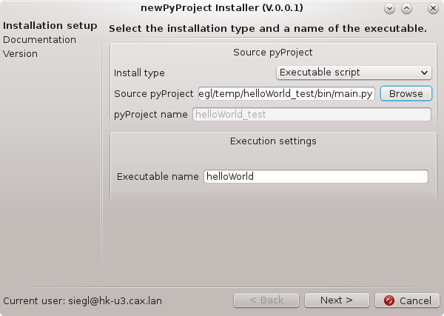
MAINTENANCE: Tool development workflow
pyProjectTools concept: newPyProject, pyProjectInstaller, doc
share
storage
newPyProject
provides a new python project template for different tool types
base executable
wraps code in different programming language
ANSA user script button
ANSA check
IDIADA tools
maintenance
access
documentation
pyProjectInstaller
wizard-based tool for different tool type installation
handles sphinx documentation source files creation and publication
handles git repository and productive version installation
doc
handles html documentation generation and synchronization
PUBLIC
INTERNAL
CONFIDENTIAL
SECRET

Slide 9


SHARE: GitHub master repository storage
newPyProject – pyProjectInstaller – doc – remote storage (GitHub)
Tool documentation sharing
share
storage
IDIADA tools
maintenance
access
BU CZ
newPyProject
documentation
BU HQ
documentation
- HQ (local)
- DE (remote)
- IN (remote)
- CZ (remote)
myProject
projects
[user@machine ~]$ doc
pyProjectInstaller
BU DE
documentation
- HQ (remote)
- DE (local)
- IN (remotel)
- CZ (remote)
documentation
- HQ
- DE
- IN
- CZ
[user@machine ~]$ doc
documentation
- HQ (remote)
- DE (remote)
- IN (remote)
- CZ (local)
local productive version installation:
myProject V.0.0.1
BU IN
documentation
- HQ (remote)
- DE (remote)
- IN (local)
- CZ (remote)
[user@machine ~]$ doc
Automated synchronization during “doc” execution
PUBLIC
INTERNAL
CONFIDENTIAL
SECRET

Slide 10
SHARE: GitHub master repository storage
newPyProject – pyProjectInstaller – doc – remote storage (GitHub)
Tool sharing – remote tool installation
share
storage
IDIADA tools
maintenance
access
BU CZ
local productive version installation:
remoteProject V.0.0.1
documentation
BU HQ
documentation
- HQ (local)
- DE (remote)
- IN (remote)
- CZ (remote)
projects
pyProjectInstaller
BU DE
documentation
- HQ (remote)
- DE (local)
- IN (remotel)
- CZ (remote)
documentation
- HQ
- DE
- IN
- CZ
documentation
- HQ (remote)
- DE (remote)
- IN (remote)
- CZ (local)
BU IN
documentation
- HQ (remote)
- DE (remote)
- IN (local)
- CZ (remote)
PUBLIC
INTERNAL
CONFIDENTIAL
SECRET

Slide 11
Summary
Typical script related issues
User perspective
the same script at multiple locations..
different versions of the same script at multiple locations..
Where to find a script I need and how to run it?
Is there a list of scripts which are available?
How to use the script and what does it do?
share
storage
common storage
always up-to-date version available from the command line
always up-to-date web-browser-based documentation
✓
✓
✓
IDIADA tools
maintenance
access
documentation
Developer perspective
Team script development
Version handling
Installation
How to send existing script somewhere else?
newPyProject tool for efficient various-script-type development
productive version concept
pyProjectInstaller tool for efficient installation process
pyProjectInstaller tool for github sharing
✓
✓
✓
✓
PUBLIC
INTERNAL
CONFIDENTIAL
SECRET

Slide 12
For further information:
Applus IDIADA
Headquarters and Main Technical Centre
L’Albornar – PO Box 20
E-43710 Santa Oliva (Tarragona) Spain
T +34 977 166 000
F +34 977 166 007
e-mail: idiada@idiada.com
www.idiada.com
Applus IDIADA Belgium
T +32 2 719 02 45 (Brussels)
e-mail: idiada_belgium@idiada.com
Applus IDIADA Brazil
T +55 11 4330 9880 (São Paulo) T +55 31 3591 6832 (Betim) T +55 41 3373 0411 (Curitiba) T +55 15 3205 2952 (Tatuí)
e-mail: idiada_brasil@idiada.com
Applus IDIADA China
T +86 (21) 6210 0894 (Shanghai) T +86 10 8446 3317 (Beijing) T +86 431 8190 9680 (Changchun) T +86 23 6756 8060 (Chongqing) T +86 20 2282 9202 (Guangzhou) T +86 (772) 3166 619 (Liuzhou) T +86 (772) 0532 66019017 (Qingdao) T +86 (755) 29184532 (Shenzhen) T +86 0535 8933658 (Zhaoyuan)
e-mail: idiada_china@idiada.com
Applus IDIADA Czech Republic
T +420 493 654 811 (Hradec Králové)
T +420 778 430 095 (Brno) T +420 482 424 243 (Liberec) T +420 326 736 860 (Mladá Boleslav)
e-mail: info@idiada.cz
Applus IDIADA France
T +33 (0) 141 146 085 (Paris)
e-mail: idiada_france@idiada.com
Applus IDIADA Germany
T +49 (0) 841 88538-0 (Ingolstadt) T +49 (0) 69 97503116 (Frankfurt) T +49 (0) 89 309056-0 (Munich) T +49 (0) 711 67400109 (Stuttgart) T +49 (0) 5374 920606-0 (Wolfsburg)
e-mail: idiada_germany@idiada.com
Applus IDIADA India
T +91 994 0679 933 (Chennai) T +91 124 4028 888 (New Delhi) T +91 20 6605 6800 (Pune)
e-mail: idiada_india@idiada.com
Applus IDIADA Indonesia
T +6221 2939 1143 (Jakarta)
e-mail: idiada_indonesia@idiada.com
Applus IDIADA Iran
T +98 21 26650719 (Tehran)
e-mail: idiada_iran@idiada.com
Applus IDIADA Italy
T +39 011 264 4000 (Turin)
e-mail: idiada_italia@idiada.com
Applus IDIADA Japan
T +81 (0) 42 512 8982 (Tokyo) T +81 (0) 56 464 3463 (Aichi)
e-mail: idiada_japan@idiada.com
Applus IDIADA Malaysia
T +603 9207 7018 (Kuala Lumpur) T +601 2410 7686 (Penang)
e-mail: idiada_malaysia@idiada.com
Applus IDIADA Mexico
T +52 (1) 222 170 6722 (Puebla)
e-mail: idiada_mexico@idiada.com
Applus IDIADA Poland
T +48 61 6226 905 (Poznan)
e-mail: idiada_polska@idiada.com
Applus IDIADA Russia
T +7 (831) 297 94 32 (Nizhny Novgorod) T +7 (831) 261 37 06 (Togliatti)
e-mail: idiada_russia@idiada.com
Applus IDIADA Saudi Arabia
T +966 53 4147 301 (Riyadh)
e-mail: idiada_GCC@idiada.com
Applus IDIADA Scandinavia
T +46 (0) 31 320 1844 (Gothenburg)
e-mail: idiada_scandinavia@idiada.com
Applus IDIADA Slovakia
T +420 778 430 098 (Košice)
e-mail: idiada_slovakia@idiada.com
Applus IDIADA South Africa
T +27 83 450 8925 (Pretoria)
e-mail: idiada_southafrica@idiada.com
Applus IDIADA South Korea
T +82 31 478 1821 (Seoul)
e-mail: idiada@idiada.co.kr
Applus IDIADA Spain
T +34 977 166 000 (Santa Oliva) T +34 928 587 447 (Las Palmas) T +34 915 095 795 (Madrid) T +34 950 473 256 (Mojácar) T +34 868 912 179 (Murcia) T +34 948 292 921 (Pamplona) T +34 986 900 300 (Vigo)
e-mail: idiada@idiada.com
Applus IDIADA Taiwan
T +886 47 810 702 (Lukang)
e-mail: idiada_taiwan@idiada.com
Applus IDIADA Thailand
T +66 86 7917 071 (Bangkok)
e-mail: idiada_thailand@idiada.com
Applus IDIADA Turkey
T +90 216 250 6050 (Istanbul)
e-mail: idiada_turkey@idiada.com
Applus IDIADA UK
T +44 1223 441 434 (Cambridge) T +44 2476 328 083 (Nuneaton) e-mail: idiada_uk@idiada.com
Applus IDIADA USA
T +1 248 978 0111 (Detroit) T +1 760 246 1672 (Los Angeles) e-mail: idiada_USA@idiada.com

