Slide 1

Data Interpretation
Historic Aircraft Wrecks
We were provided with the full history of airplane crashes throughout the world, from 1908-present which we have interpreted using Tableau and Excel.
In the following slides we will see some major causes of airplane crash, some related graphs, which type of flying is safer and survival rate.
Team Iter_Fanatic’s
Team Members:
Biswajit Mohapatra
Smriti Sharma
Sada Mahwish

Slide 2
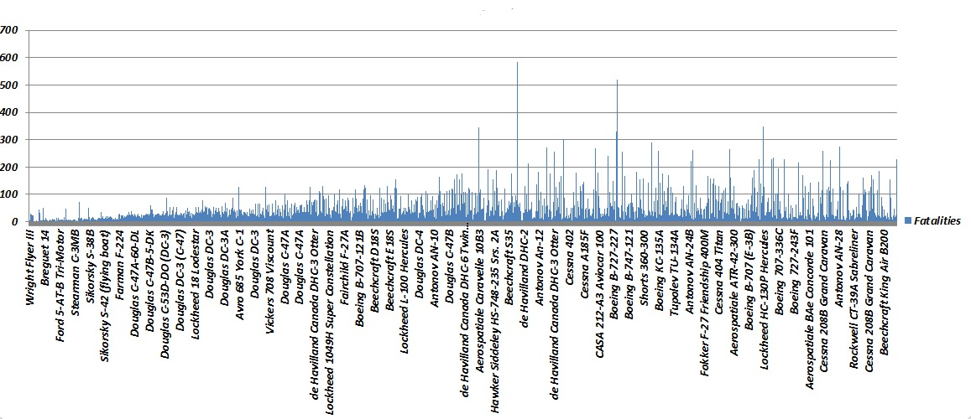
Accident By Cause
Survival Rates
Causes | % Fatalities | Raw Data
pilot error | 27% | 335
mechanical | 12.20% | 154
sabotage | 5% | 59
weather | 24% | 309
others | 32% | 405
Year | Total Aboard | Total Fatalities | Total Survivals | Survival Rate
1908-28 | 932 | 810 | 122 | 13%
1929-49 | 11288 | 9478 | 1810 | 16%
1950-70 | 34865 | 27503 | 7362 | 21.12%
1971-92 | 60976 | 43580 | 17396 | 28.52%
1993-09 | 32960 | 22013 | 10947 | 33.19%
Which type of flight is safer

Slide 3
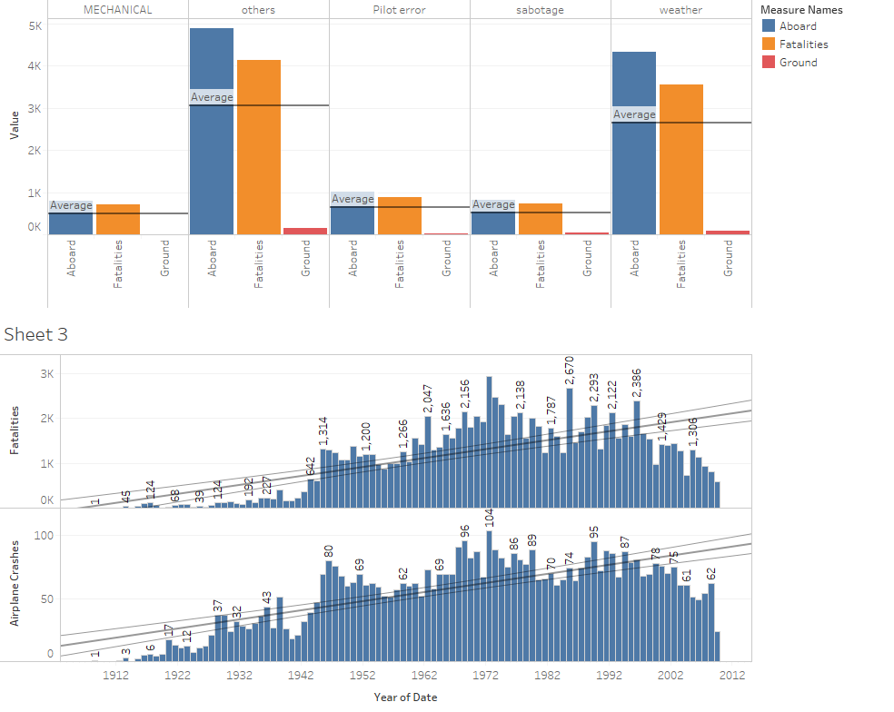







Airplane
Crashes
Related
with Year and
causes

Slide 4
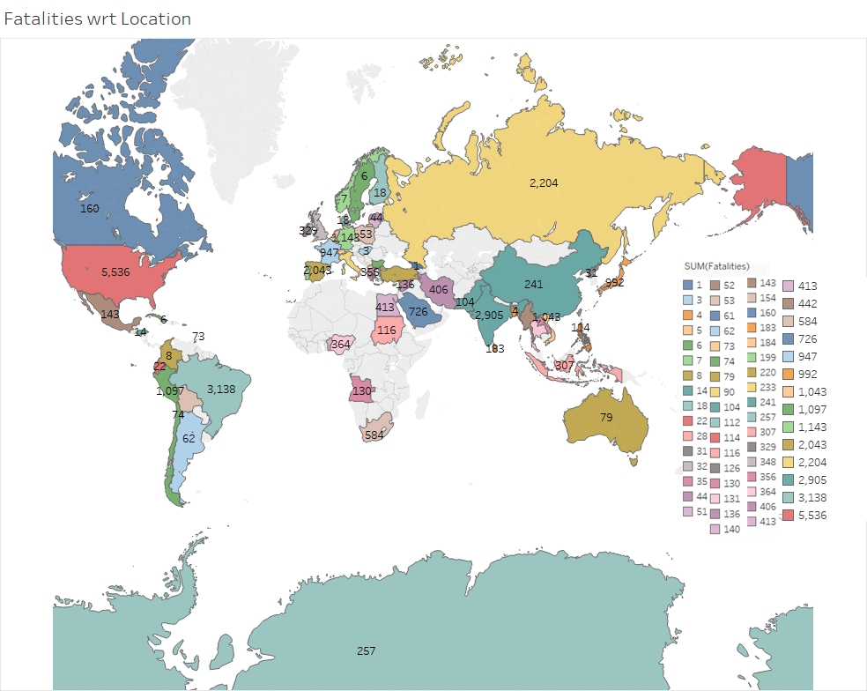

Slide 5
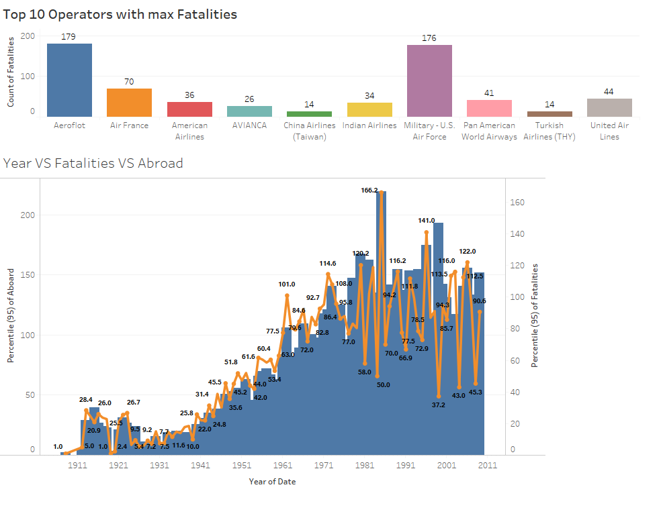

Slide 6
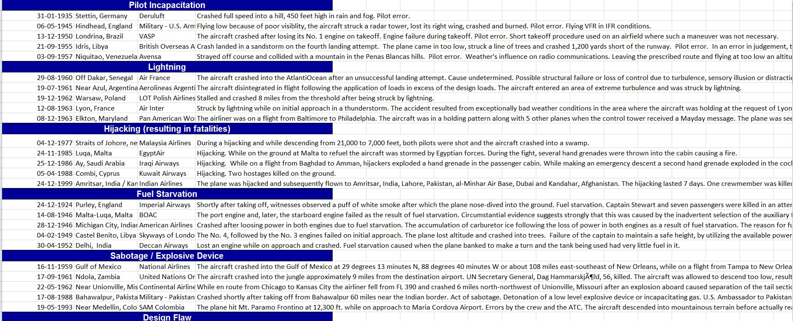
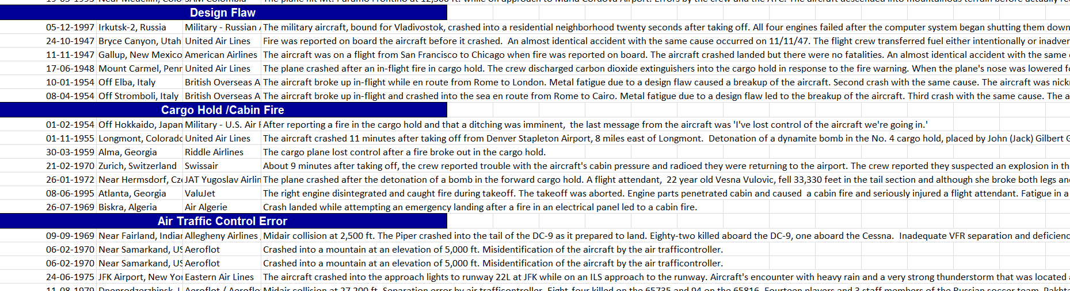
Notable causes of accidents

Slide 7
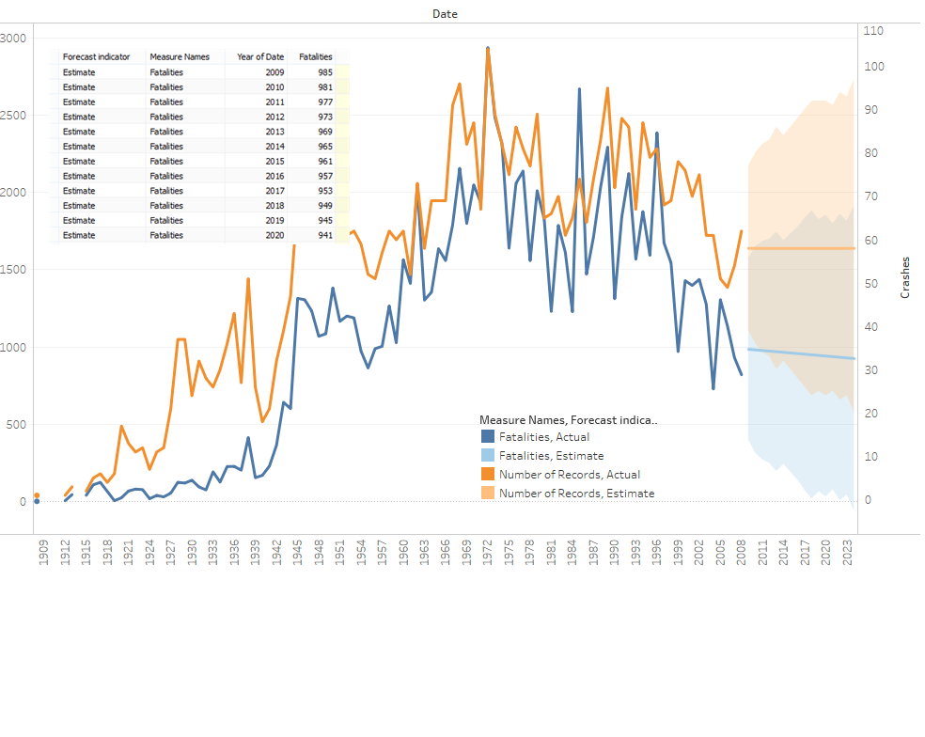
Fatalities Forecast

Slide 8
Conclusion
From these data we concluded that most of the fatal accidents are caused by overloading , bird strike or mid air collisions and then due to pilot error.
Survival rate was lesser in the year 1970-1992 as compared to 1993-2009, though the number of passengers were greater in the former year.
The maximum number of fatalities and airplane crashes occurred around the year 1972 and the minimum occurred around the year 1912.
Also the maximum number of fatalities .i.e. 5,536 were from the United States.
Maximum air crashes have occurred under Aeroflot and Military U.S. Airforce operators.

