Slide 1
HTML & CSS
Presenter: James Huang
Date: Sept. 26, 2014

Slide 2
Outline
Introduction
Basics
Lists
Links
Forms
CSS

Slide 3
Introduction
HTML is a markup language for web documents (web pages).
It stands for Hyper Text Markup Language.
A markup language uses a set of tags to describe elements of a document.
E.g. <p> for paragraph, <h1> for heading 1, <img> for images, etc.
Tags are normally used in pairs: <p> and </p>, <h1> and </h1>, <img> and </img>.
Structure
Head section: title, style, Javascript
Body section: visible content
Attributes
Specify additional information about an element
E.g. id attribute specifies an unique identifier for an element

Slide 4
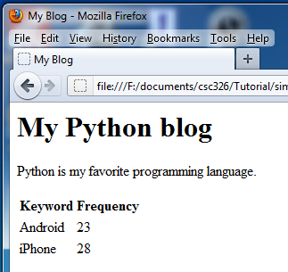
Example HTML document
Web page
HTML document
<html>
<head><title>My Blog</title>
</head>
<body>
<h1>My Python blog</h1>
<p>Python is my favorite programming language.</p>
<table id=“table1”>
<tr><th>Keyword</th>
<th>Frequency</th></tr>
<tr><td>Android</td>
<td>23</td></tr>
<tr><td>iPhone</td>
<td>28</td></tr>
</table>
</body>
</html>

Slide 5
Basics
Headings
Defined with <h1>, <h2>, <h3>,...,<h6> tags.
Paragraph
Defined with <p> tag. Web browsers display margins before and after a paragraph.
Images
Defined with <img> tag.
Attributes:
src: URL of the image file
alt: alternate text for the image
width: the width of the image in pixels
height: the height of the image in pixels

Slide 6
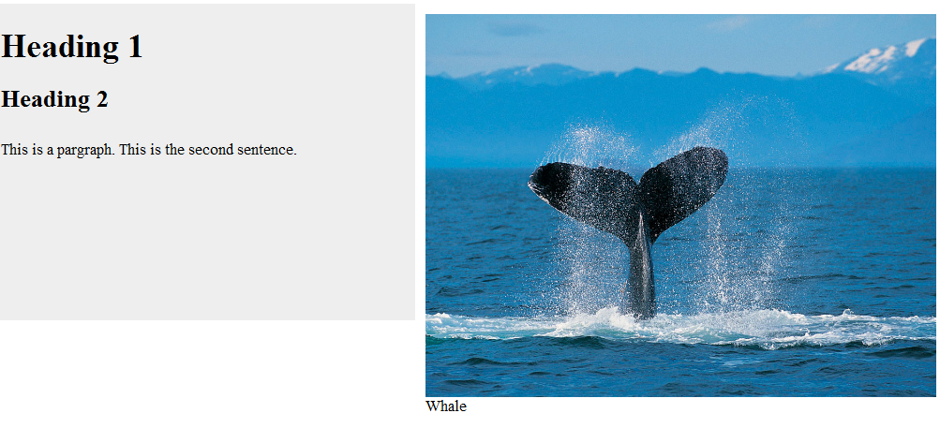
Basics - Example
<h1>Heading 1</h1>
<h2>Heading 2</h2>
<p>This is a paragraph.This is the
second sentence</p>
<img src=“whale.jpg” width=300>

Slide 7
Lists
HTML supports unordered lists, ordered lists, and description lists.
List Type | List Tag | Item Tag | Types
Unordered lists | <ul> tag | <li> tag | bullets (default) Circles Squares None
Ordered lists | <ol> tag | <li> tag | by numbers by letters by roman numbers
Description lists | <dl> tag | <dt> tag: term <dd> tag: description

Slide 8
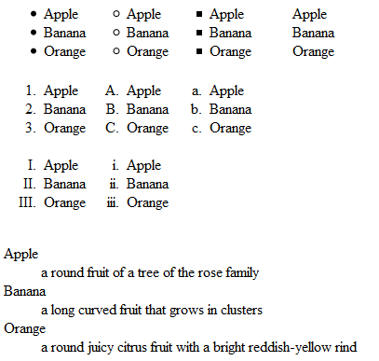
Lists - Example
<ul
style="list-style-type:disc">
<li>Apple</li>
<li>Banana</li>
<li>Orange</li>
</ul>
<ol type="I">
<li>Apple</li>
<li>Banana</li>
<li>Orange</li>
</ol>
<dl><dt>Apple</dt>
<dd>a round fruit of a tree of the rose family</dd>
<dt>Banana</dt>
<dd>a long curved fruit that grows in clusters</dd>
<dt>Orange</dt>
<dd>a round juicy citrus fruit with a bright reddish-yellow rind</dd></dl>

Slide 9
Links
A link (hyperlink) refers to another document that a user can jump to by clicking the link.
It is defined with <a> tag.
It can be a text or an image.
Attributes:
href: specifies the URL of the linked document
target: specifies where to open the linked document
A link can be used as a bookmark of a web document.

Slide 10
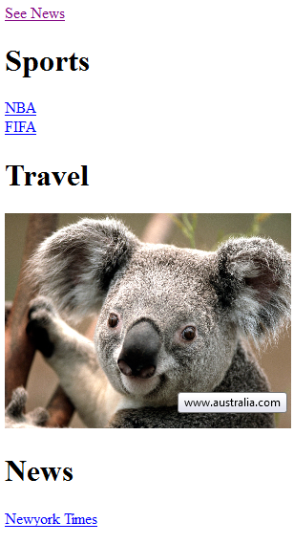
Links - Example
<a href="#news">See News</a>
<a href="http://www.nba.com">NBA</a>
<a href="http://www.Australia.com">
<img src="Koala.jpg" alt="Australia"
width=300 title="www.australia.com">
</a>
<h1><a id="news">News</a></h1>

Slide 11
Forms
A HTML form allows a user to input data.
<form> tag is used to create a form
<input> tag creates an individual input field
Form Attributes:
action: URL to which the form data is sent
method: HTTP method (get or post) that uses to send the form data
Input Attributes:
name: name of the input field
type: type of the input field (e.g. text fields, checkboxes, or radio-buttons)
value: default value of the input field
input type “Submit” defines a submit button

Slide 12
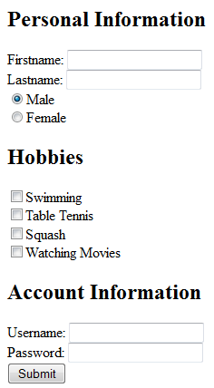
Forms - Example
Firstname: <input type="text" name="firstname">
<input type="radio" name="sex" value="female">Female
<input type="checkbox" name="squash" value="squash">Squash
Password: <input type="password" name="password">
<input type="submit" value="Submit">

Slide 13
CSS
CSS is a style language that describes the visual presentation (e.g. colors, fonts, alignments) of web documents.
It stands for Cascading Style Sheets
Separation of HTML from CSS makes it easier to adapt web document to different running environments (e.g. types of different display)
CSS can be applied to HTML in three ways:
Inline – using style attribute in HTML elements
<h1 style="font-size:300%">This is a heading</h1>
Internal – using style element in <head> section
<head><style>h1 {color:blue} </style></head>
External – using external CSS files
<head><link rel="stylesheet" href="styles.css"></head>

Slide 14
CSS - continued
CSS is defined as a set of rules.
Each rule consists of two parts: a selector and a group of declarations.
E.g. <style>h1 {color:blue; font-weight:bold} p {font-style: italic} </style>
A selector specifies the element to which the style applies.
types of selector: tag name, id name, class name
A declaration is made up of the name of a property and the value for the property.

Slide 15
Grouping Elements for Styling
Use container element (<div> and <span>) and use id selector: e.g. #nav {color: green}
<div id=“nav”>
<p>This is a paragraph</p>
<h2>This is a list</h2>
<ul><li>Item1</li><li>Item2</li></ul>
</div>
Define a class for elements and use class selector: e.g. .intro {color: blue} .important {color: red}
<h1 class=“intro”>Header 1</h1>
<p class=“intro”>A paragraph</p>
<p class=“important”>Note that this is important.</p>

Slide 16
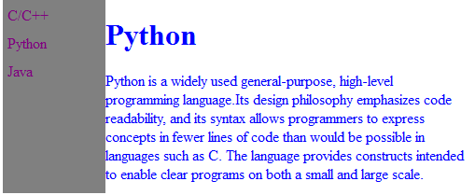
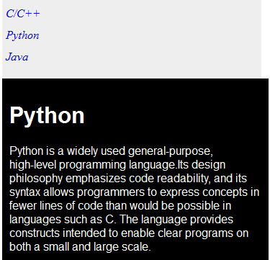
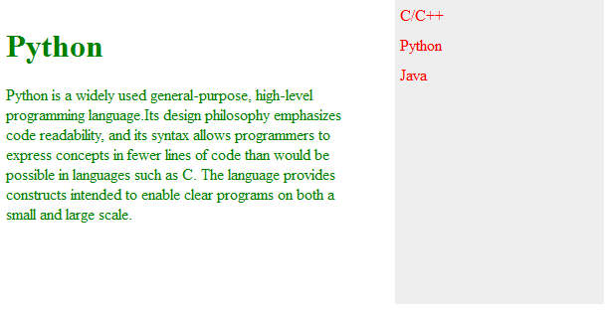
CSS - Example
#nav {
line-height:30px;
background-color: gray;
height:600px;
width:100px;
float:left;
padding:5px;
}
#section {
width:350px;
float:left;
padding:10px;
}
#nav {
background-color:#eeeeee;
height:100px;
width: 350px;
float:top;
padding:5px;
color: blue;
font-style: italic;
}
#section {
width:350px;
float:bottom;
padding:10px;
color: white;
font-style: bold;
font-family: arial;
background-color: black;
}
<div id="nav">C/C++<br>Python<br>
Java<br></div>
<div id="section"">
<h1>Python</h1>
Python is a widely used general-purpose, high-level programming language.Its design philosophy emphasizes code readability, and its syntax allows programmers to express concepts in fewer lines of code than would be possible in languages such as C. The language provides constructs intended to enable clear programs on both a small and large scale.
</div>

Slide 17
Thank you!
contact: z.huang@utoronto.ca

