Slide 1
Partial Reproduction of LiTS Math Search
A controlled modification of answer extraction rules
Yufan GUO
1155265986
01

Slide 2
Presentation outline
PART I Paper and Background
LiTS framework, math search and reproduction scope
PART II Experimental Process
Local setup, paired evaluation and extraction modification
PART III Experimental Results
Measured accuracy, case audit, sensitivity and conclusions
02

Slide 3
PART I Paper and Background
03

Slide 4
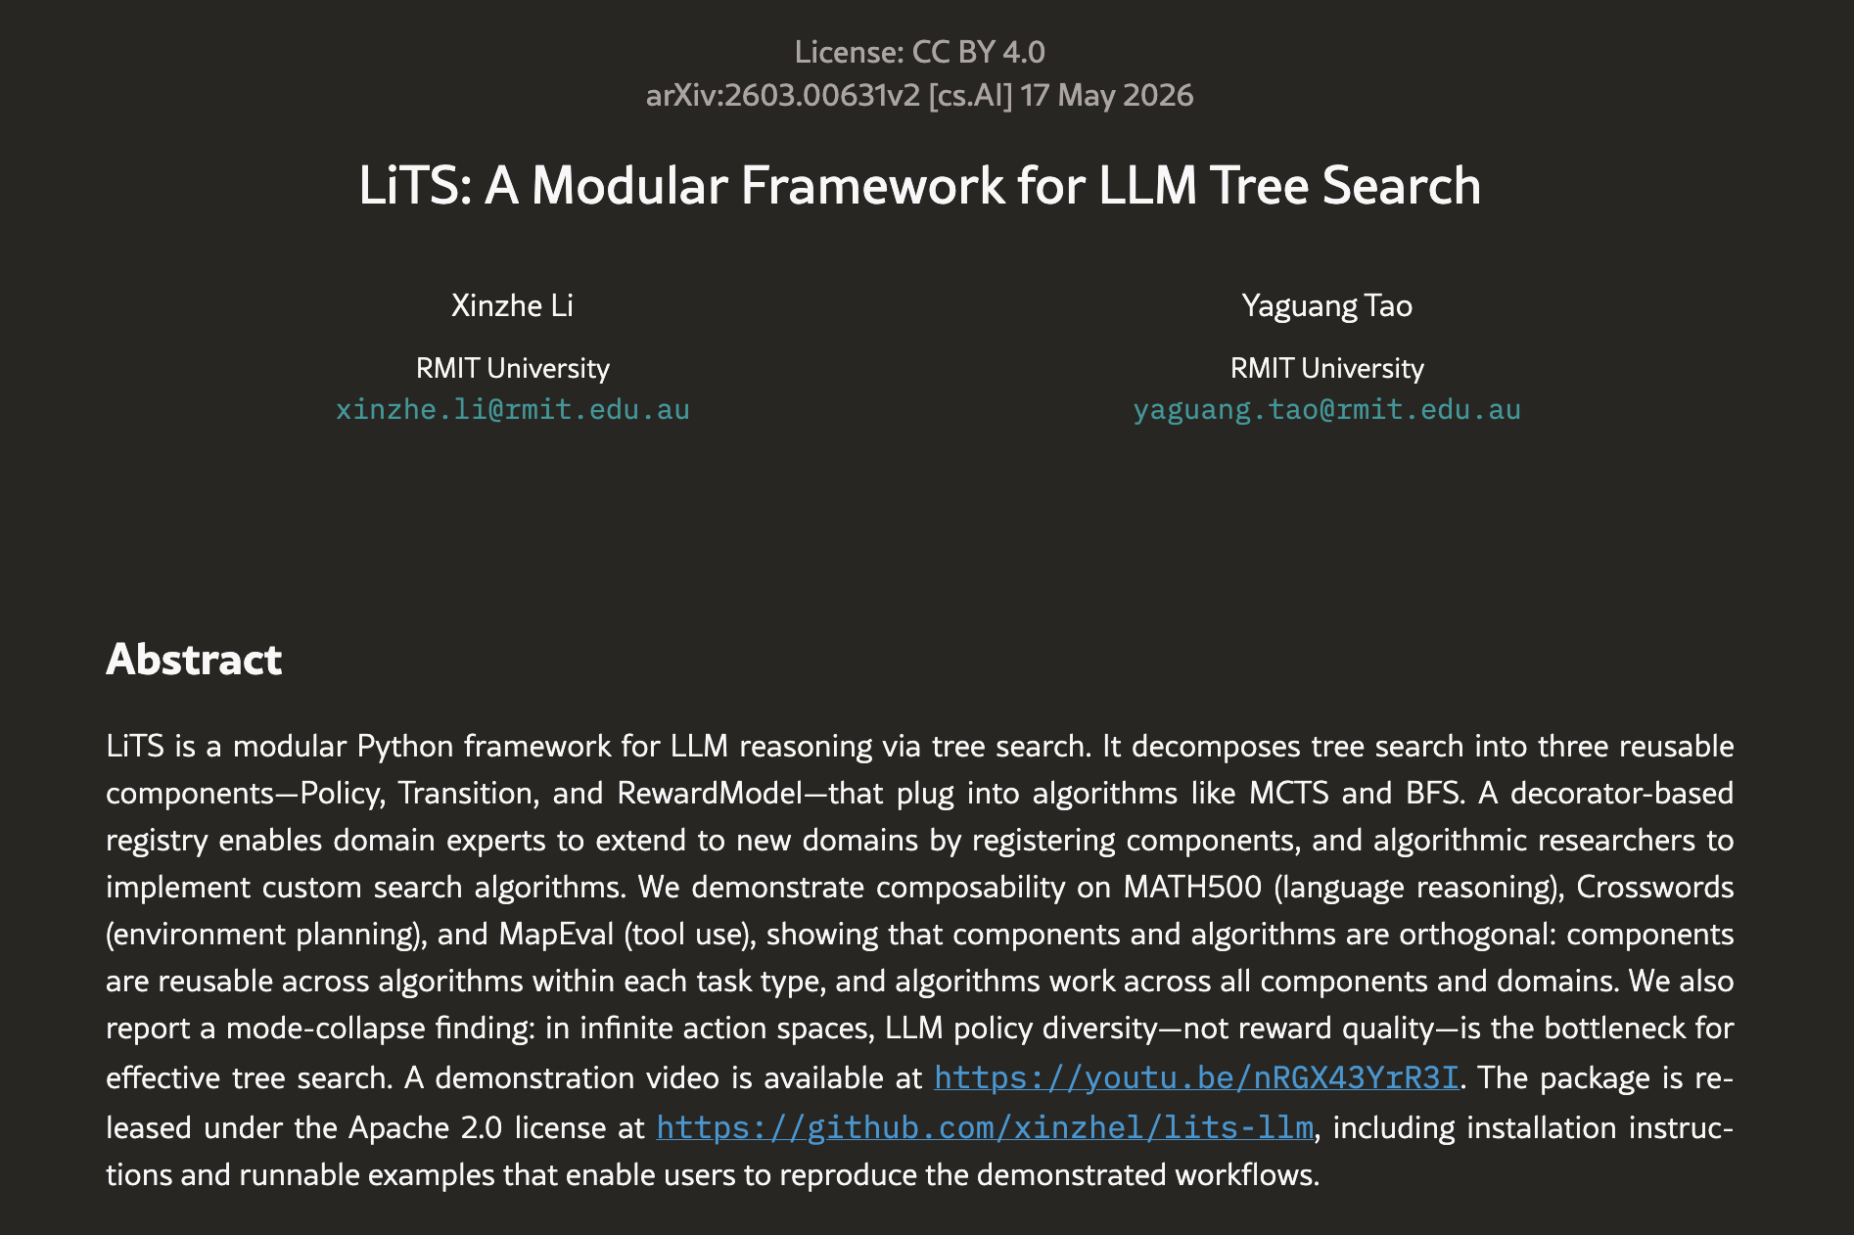
PART I PAPER AND BACKGROUND
LiTS paper and research background
Li, X. and Tao, Y. (2026), LiTS: A Modular Framework for LLM Tree Search
Motivation: mathematical reasoning
requires multiple dependent steps
Tree search explores alternative reasoning
paths using reward guidance
LiTS separates policy, transition and
reward components for reuse
This study uses the authors’ MCTS
math pipeline under laptop constraints
[1,2,5]
04

Slide 5
PART I PAPER AND BACKGROUND
LiTS workflow and the intervention point
SEARCH: policy proposals, state transitions and reward scoring
MCTS explores candidate reasoning paths and saves terminal answers.
EVALUATION: answer extraction, plurality selection, numeric checking
The experiment changes extraction only. Search outputs remain identical.
[1,2,5,8]
05

Slide 6
PART I PAPER AND BACKGROUND
Reproduction boundary: paper versus local study
Setting | Paper reference | Local study
Accuracy | 37% | See Part III
Model | Llama3-8B-Instruct | Qwen2.5-1.5B-Instruct
Questions | 100 numerical examples | 10 fixed questions
Search iterations | 10 | 2
Evaluation | Paper protocol | Extraction helper + local voter
Different conditions prevent a direct replication claim or a single-cause explanation.
[1–5]
06

Slide 7
PART II Experimental Process
07

Slide 8
PART II EXPERIMENTAL PROCESS
Experimental design: one generation, two scores
Sample: first 10 of 316 numerical rows, seeds 42 / 43 / 44
Model: pinned Qwen2.5-1.5B-Instruct on CPU, 4 threads
Search: 2 iterations, 2 actions, depth 2, rollout 1
Both scorers use identical terminal text, plurality and numeric checker
Accuracy = correct predictions / 10 planned questions per seed
Empty or unparsed outputs remain incorrect in the denominator
[3–6]
08

Slide 9
PART II EXPERIMENTAL PROCESS
Modification: conservative answer format extension
Baseline: author-provided numeric extraction helper
Modified: preserve baseline answers, then recognize additional forms
Numeric boxed answers and unambiguous final conclusions
Explicit count statements may restate the counted object
No reference answer input. No additional generation calls.
[5,8]
09

Slide 10
PART II EXPERIMENTAL PROCESS
Motivating case: the answer is present but missed
Question: How many positive divisors does 196 have?
196 = 2² × 7² Divisor count = 3 × 3 = 9
Saved terminal conclusion gives 9 divisors of 196
Baseline: empty, incorrect Modified: 9, correct
This pilot also appears as Q0 in the formal sample
[5,7,8]
10

Slide 11
PART III Experimental Results
11

Slide 12
PART III EXPERIMENTAL RESULTS
Results: improvement appears in all three seeds
Mean: 16.7% → 30.0%
Paired change: +13.3 pp
Across-seed sample SD
Baseline: 15.3 pp
Modified: 10.0 pp
Seed | Baseline | Modified | Change
42 | 3/10 (30%) | 4/10 (40%) | +10 pp
43 | 0/10 (0%) | 2/10 (20%) | +20 pp
44 | 2/10 (20%) | 3/10 (30%) | +10 pp
[6]
12

Slide 13
PART III EXPERIMENTAL RESULTS
Case audit: parsing and correctness differ
Seed / question | Extracted value | Reference | Outcome
42 / Q0 | empty → 9 | 9 | Correct recovery
42 / Q8 | empty → 56 | 28 | Still incorrect
43 / Q1 | empty → 42 | 42 | Correct recovery
43 / Q6 | empty → 5 | 5 | Correct recovery
44 / Q0 | empty → 9 | 9 | Correct recovery
44 / Q9 | empty → 1 | 3 | Still incorrect
6 changed predictions: 4 incorrect-to-correct, 0 correct-to-incorrect, 2 still incorrect
[6,7]
13

Slide 14
PART III EXPERIMENTAL RESULTS
Sensitivity check: exclude the development question
9 unique questions, 27 repeated executions
18.5%
25.9%
Baseline: 5/27
Modified: 7/27
+7.4 percentage points, after excluding Q0
Descriptive check. This is not an independent held-out test.
[5–7]
14

Slide 15
PART III EXPERIMENTAL RESULTS
Execution results and unresolved failures
All 30 planned executions completed. No missing execution files.
392 LLM calls, 157,581 input tokens, 20,357 output tokens
Modified scoring requires 0 additional generation calls
7 executions have no terminal answer; 32 policy calls reach token limit
Timing fields disagree (130.04 vs 116.45 min), so no speed claim
Shared fixes: CPU configuration and termination settings
[5,6]
15

Slide 16
PART III EXPERIMENTAL RESULTS
Conclusion: evaluation rules affect reported accuracy
Reproduced: adapted multi-step search and inspectable saved evidence
Measured: 16.7% to 30.0%, +13.3 pp on identical generations
Interpretation: better answer recovery under this local evaluator
Limits: small sample, development overlap, model and voter changes
Next: larger independent test set, then structured outputs or full voter
[1–8]
13

Slide 17
PART III EXPERIMENTAL RESULTS
References: original research and pinned resources
[1] Li, X. & Tao, Y. (2026). LiTS: A Modular Framework for LLM Tree Search. arXiv:2603.00631v2
https://arxiv.org/html/2603.00631v2
[2] xinzhel/lits-llm, pinned commit 25e94d862cb4514c22d9a80a635e392461769df7
[3] Qwen/Qwen2.5-1.5B-Instruct, revision 989aa7980e4cf806f80c7fef2b1adb7bc71aa306
[4] xinzhel/math500-float, revision d27dc61b1123c2fdc4eea855c802be87dfa9d536
[1–4]
14

Slide 18
PART III EXPERIMENTAL RESULTS
References: report and measured evidence
[5] fancecy. LiTS Reproducibility Report and experiments/README.md
[6] experiments/results/main/report_statistics.json
[7] experiments/results/main/manual_audit.json
[8] experiments/answer_format.py
Repository: github.com/fancecy/FTEC5660-LiTS-Reproducibility
[5–8]
15

