Slide 1

Web Search Engine
Group members:
Darshil Maganbhai Bhakhar
Junaid Jehangir Bhat
Wen Dong

Slide 2
Contents
Overview
Features
Systems architecture
Technical concepts applied
Demo
Summary

Slide 3
Overview
Our Web Search Engine offers keyword search and regular expression search, starting search from a given initial URL and spreading on to the descendant pages.

Slide 4
Features
Keyword string matching web search
Regular expression web search
Web pages Scrawler
HTML to plain text

Slide 5
Features
Ranking web pages with sorting
Inverted index customized
Cached dictionary with Hash table

Slide 6
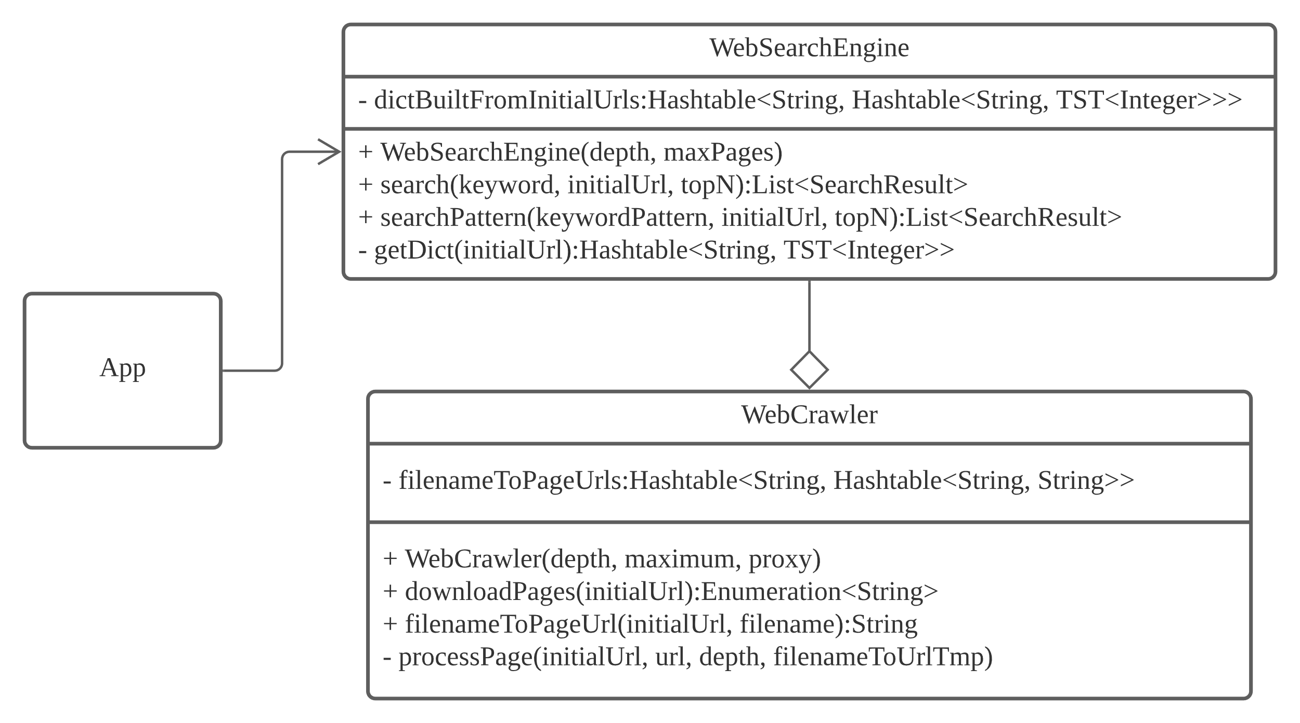
System Architecture

Slide 7
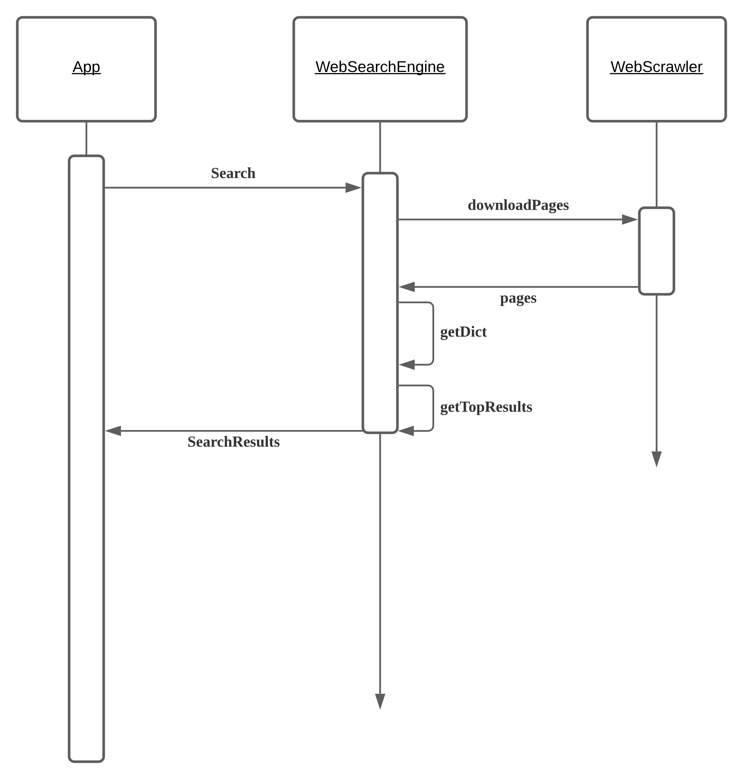
System Architecture

Slide 8
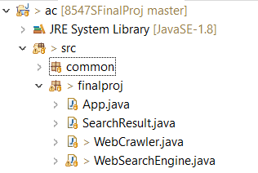
Source Code Structure

Slide 9
Technical concepts applied
Tier Search Tree
Binary Heap
Hash table
Regular expression

Slide 10
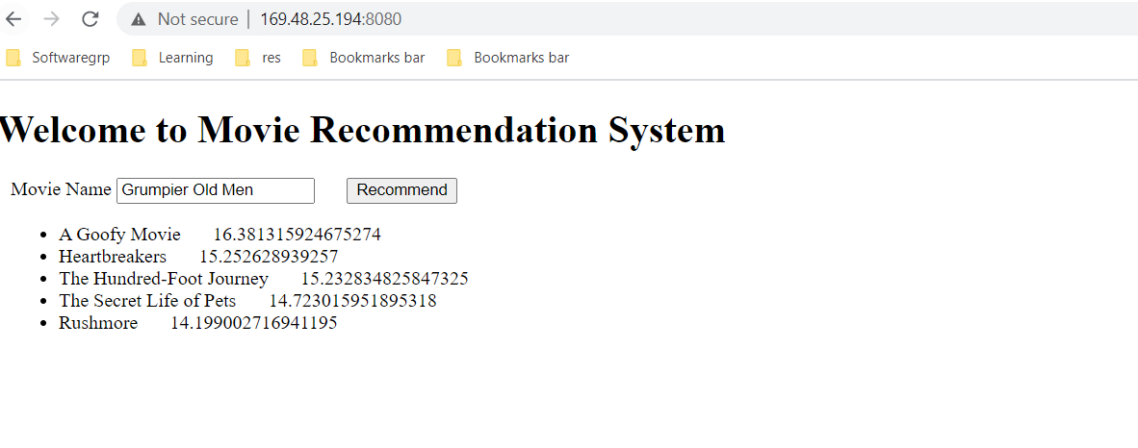
System Demo

Slide 11
Summary
Used several concepts learned from Advanced Computing to build a plain and simply web search engine, with basic and searching capabilities like String matching search and regular expression search, with a word frequency cache.
Project code repository: https://github.com/fanchuanster/8547SFinalProj

