Slide 1

Web Search Engine
Darshil Maganbhai Bhakhar
Junaid Jehangir Bhat
Wen Dong
Notes:
COMP-8547 Advanced Computing Concepts – Fall 2020
Final Project

Slide 2
Contents
Overview
Features
System Architecture
Technical Concepts Applied
Demo
Summary

Slide 3
Overview
Our Web Search Engine offers keyword search and regular expression search, starting search from a given initial URL and spreading on to the descendant pages.

Slide 4
Features
Keyword string matching web search
Regular expression web search
Web pages Scrawler
HTML to plain text
Ranking web pages with sorting
Inverted index customized
Cached dictionary with Hash table

Slide 5
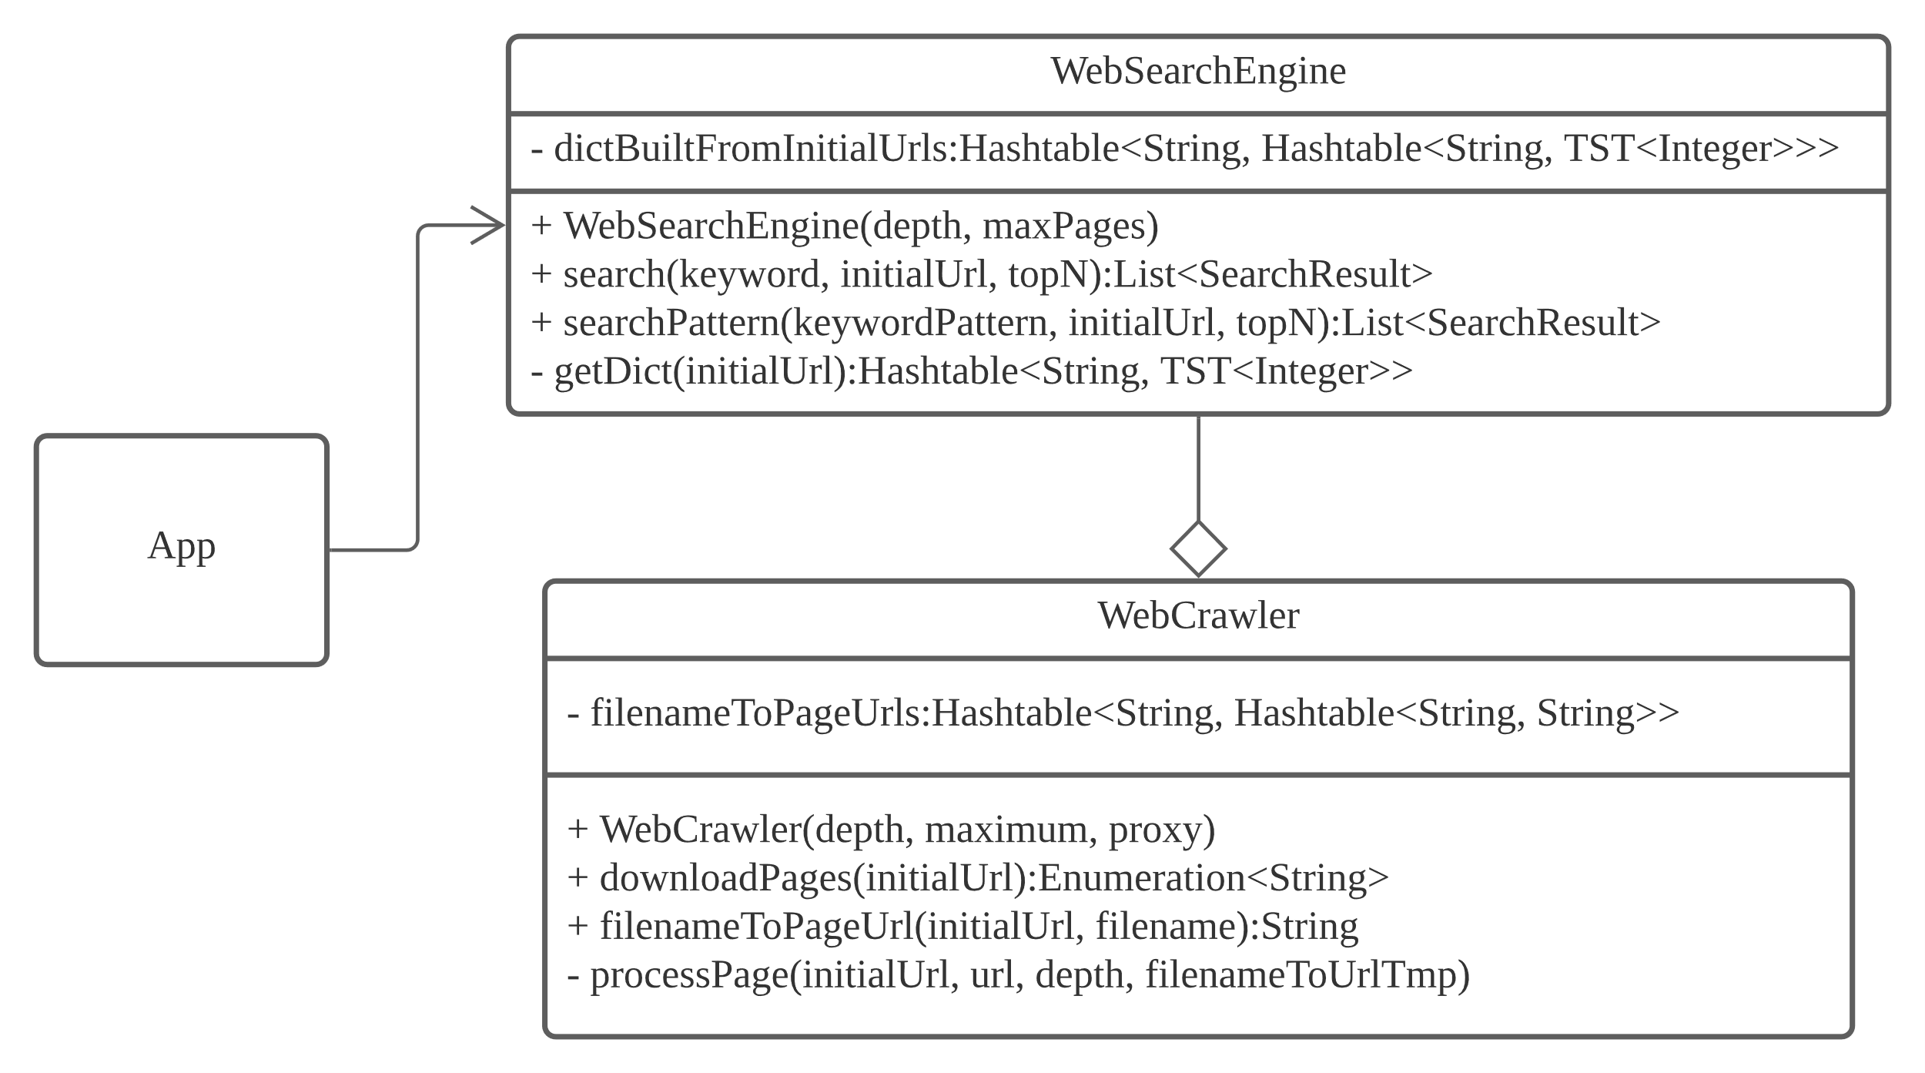
System Architecture – Class Diagram

Slide 6
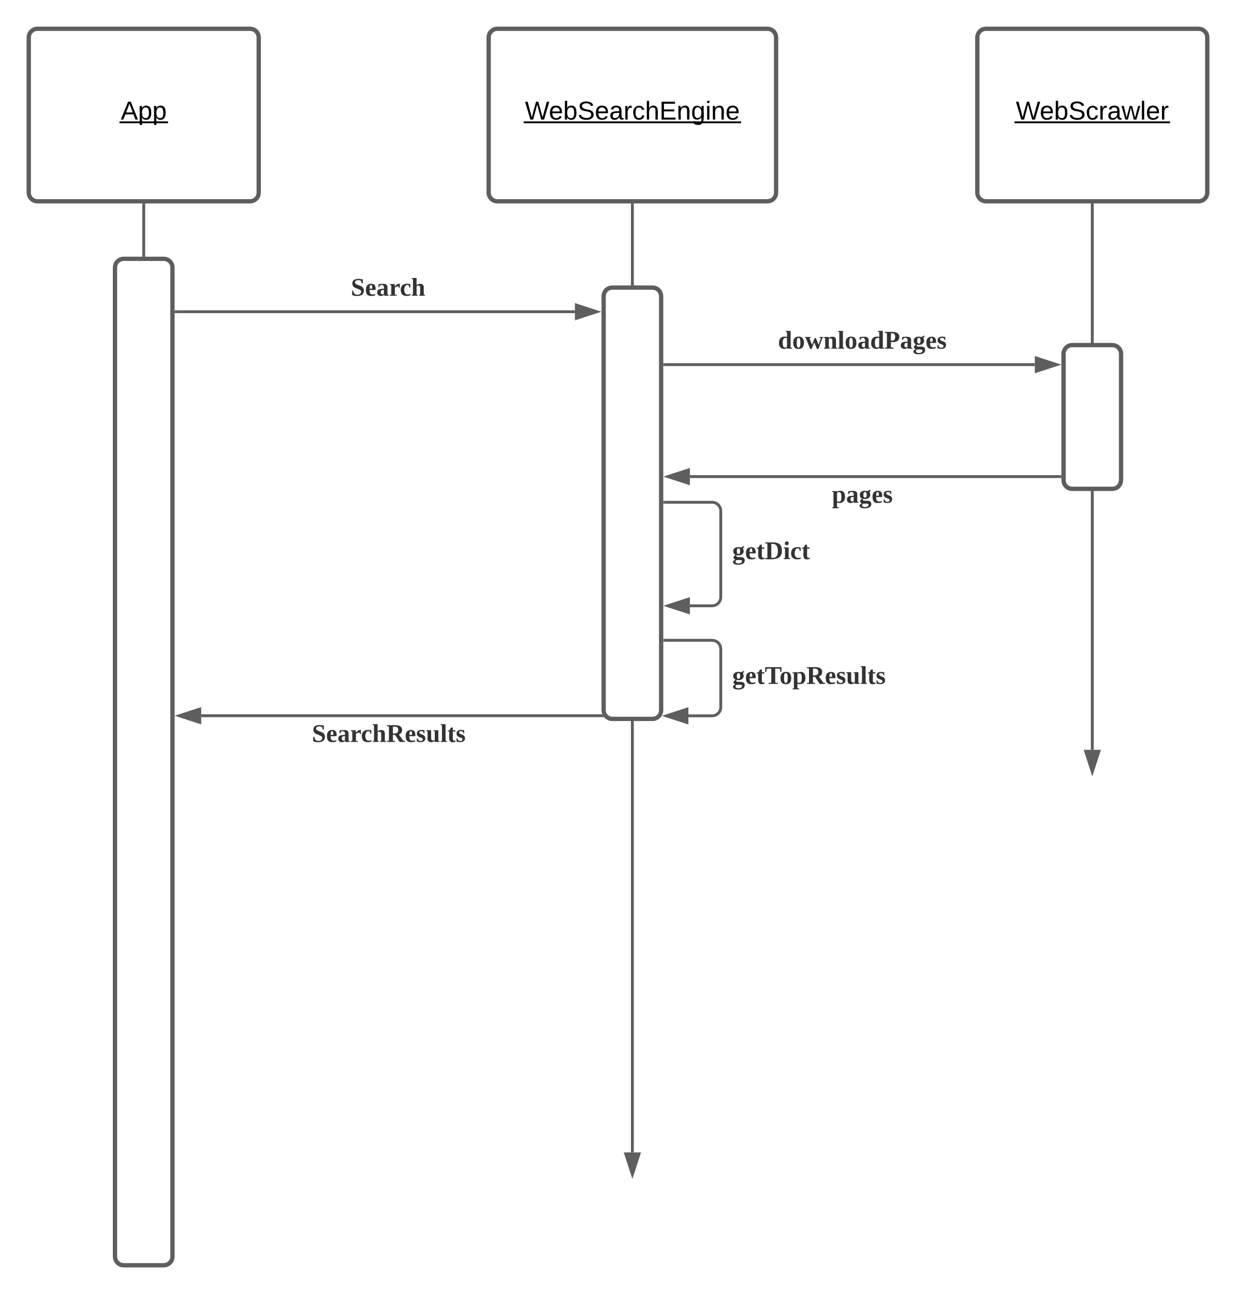
System Architecture – Sequence Diagram

Slide 7
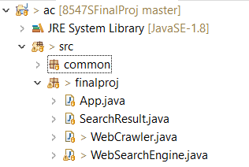
Source Code Structure

Slide 8
Technical concepts applied
Hash table
Tier Search Tree
Binary Heap
Regular expression

Slide 9
Demo

Slide 10
Summary
Used several concepts learned from Advanced Computing to build a plain and simply web search engine, with basic and searching capabilities like String matching search and regular expression search, with a word frequency cache.
Project code repository: https://github.com/fanchuanster/8547SFinalProj

