Slide 1

Assignment Lab 1
Pledge: “As a student of the University of Windsor, I pledge to pursue all endeavors with honor and integrity and will not tolerate or engage in academic or personal dishonesty. I confirm that I have not received any unauthorized assistance in preparing for or writing this assignment. I acknowledge that a mark of 0 may be assigned for copied work.”
Wen Dong #110057395

Slide 2
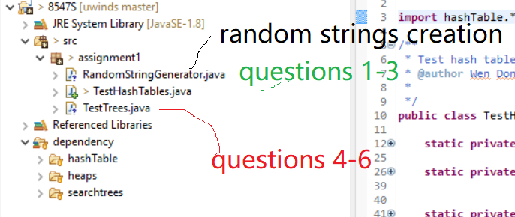
This is the source code structure corresponding to all the questions. a. Run TestHashTales.java for questions 1-3; b. Run TestTrees.java for questions 4-6

Slide 3
Output of the program for questions 1-3
i | Cuck I | Cuck D | Quad I | Quad D | SpCh I | SpCh D
1 | 33712 | 12420 | 32727 | 6112 | 93055 | 4929
2 | 11040 | 7196 | 1873 | 1380 | 2464 | 1281
3 | 110355 | 7343 | 37606 | 936 | 3795 | 1133
4 | 18877 | 6530 | 1010 | 739 | 1601 | 788
5 | 53501 | 2341 | 1121 | 837 | 1306 | 690
6 | 3012 | 3135 | 2248 | 2636 | 1164 | 708
7 | 3376 | 2150 | 2760 | 431 | 13252 | 877
8 | 4018 | 2542 | 999 | 696 | 5141 | 349
9 | 1286 | 679 | 1133 | 408 | 4336 | 428
10 | 1569 | 4079 | 1026 | 820 | 2938 | 309
11 | 5240 | 550 | 1009 | 255 | 2317 | 292
12 | 2148 | 530 | 1515 | 1511 | 9599 | 223
13 | 540 | 248 | 433 | 438 | 2461 | 270
14 | 547 | 209 | 202 | 93 | 428 | 131
15 | 1072 | 306 | 278 | 161 | 958 | 242
16 | 1093 | 645 | 726 | 276 | 1813 | 281
17 | 1200 | 640 | 770 | 212 | 1171 | 225
18 | 1637 | 673 | 873 | 261 | 1667 | 187
19 | 2289 | 826 | 1345 | 296 | 1697 | 248
20 | 1413 | 940 | 1126 | 322 | 1538 | 306
Cuck I: Cuckoo hash table Insertion average time in nano seconds, likewise for “Quad I” and “SpCh I” in the table headers.
Cuck D: Cuckoo hash table Search or Deletion average time in nano seconds, likewise for “Quad D” and “SpCh D” in the table headers.

Slide 4
How the output of 1-3 looks like in graph?

Slide 5
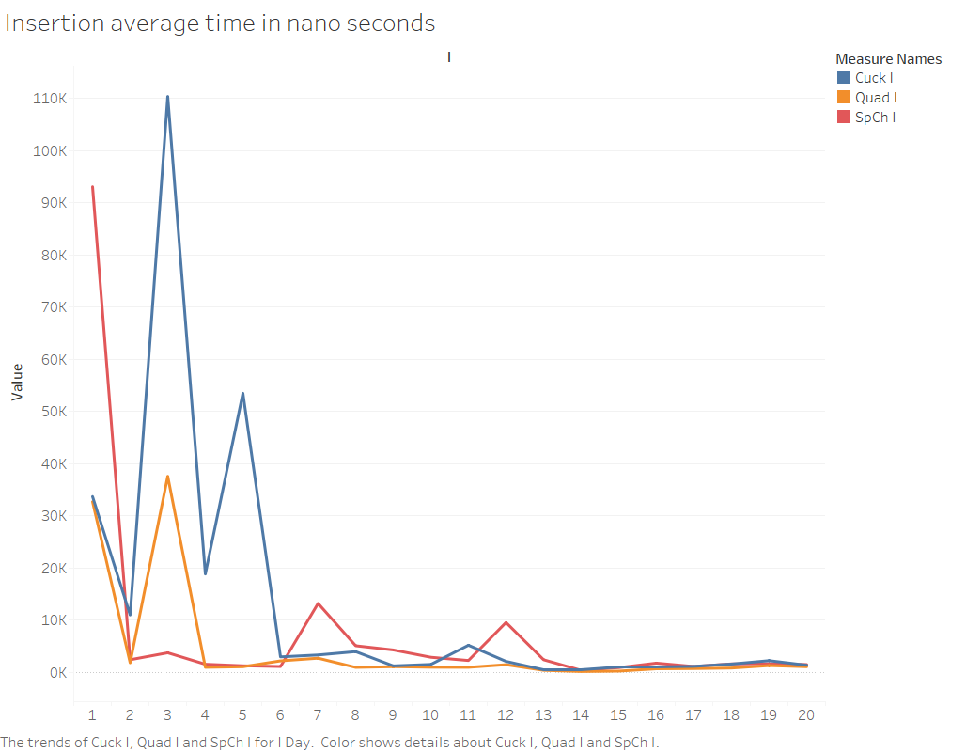

Slide 6
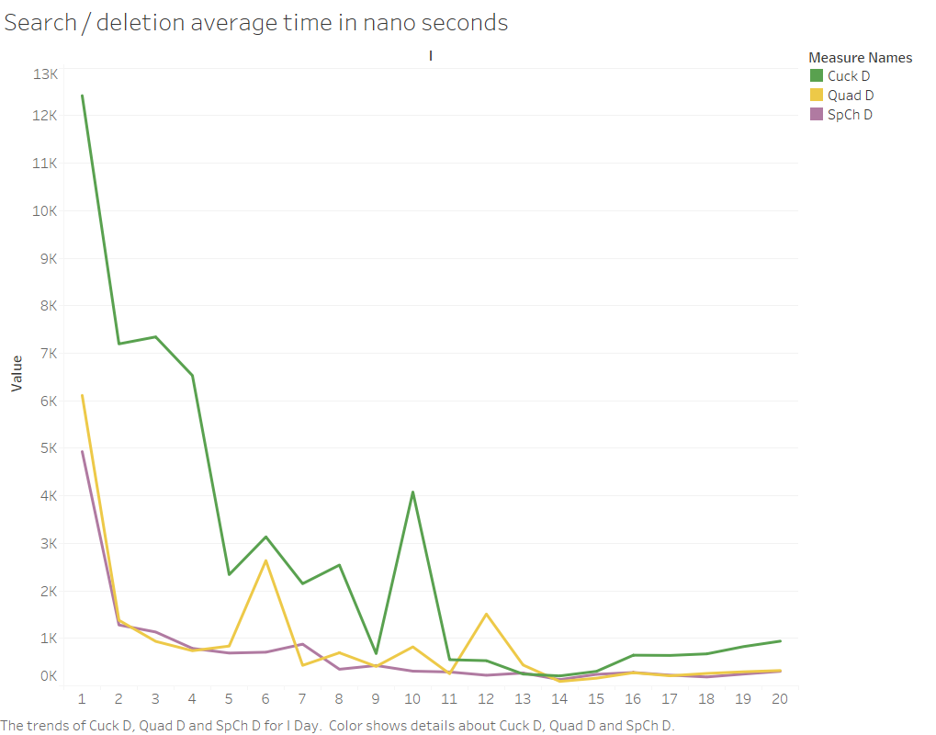

Slide 7
Result analysis
For all Hash tables, expected running time of insertion, search, and deletion is O(1), as showing in the two preceding slides all the average time are approaching a horizontal line.
Whereas it displays unstable with high average time at the beginning for each line, that is owing to two reasons:
Overhead caused by environmental factors are augmented for average time when N is small
Overhead caused by accessory actions are augmented for average time when N is small, for example, increasing table capacity, or rebuilding hash table, et cetera.

Slide 8
Output of the program for questions in 4 and 5
Tree | 4.a | 4.b | 4.c | 5.a | 5.b | 5.c
BST | 1159902 | 655528 | 1159699 | 961 | 1162 | 1162
AVL | 736 | 1144 | 953 | 1613 | 854 | 1337
RedBlck | 898 | 1016 | 1899 | 1784 | 1212 | 3413
Splay | 313 | 1345 | 460 | 2090 | 1947 | 1440
4.a, 4.b, 4.c represent insertion, search and deletion average time in nano seconds for sequential inputs in question 4
5.a, 5.b, 5.c represent insertion, search and deletion average time in nano seconds for random inputs in question 5

Slide 9
Result analysis for trees test

Slide 10
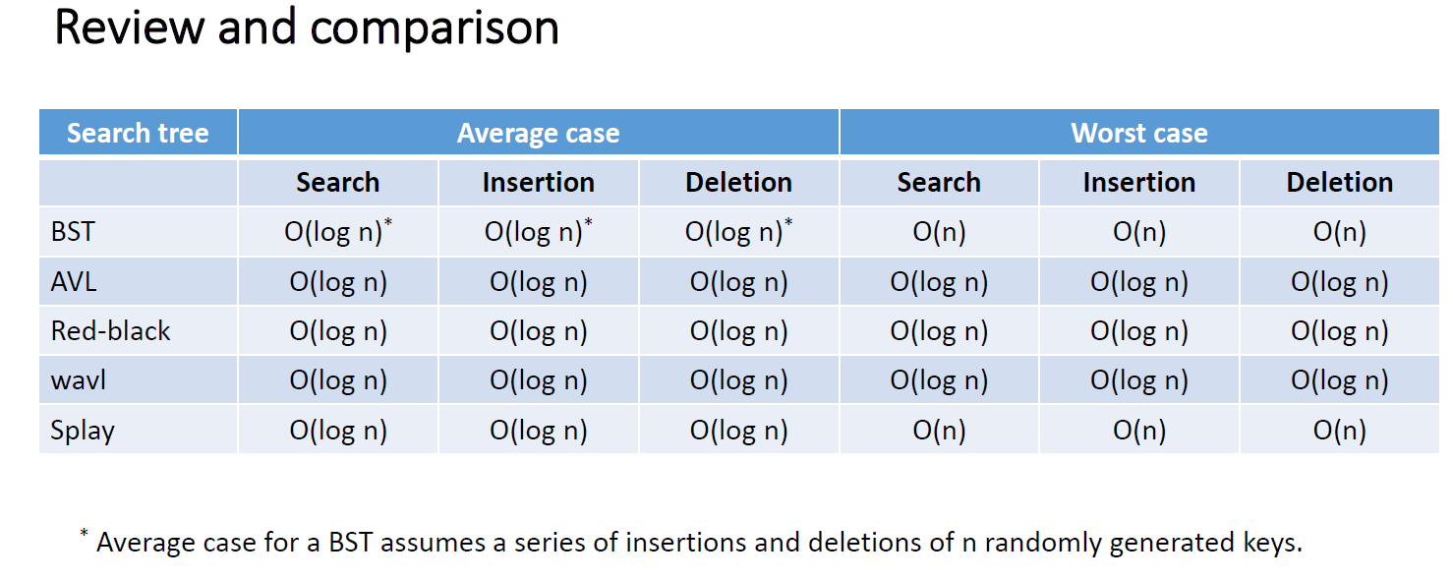
As we learned from class

Slide 11
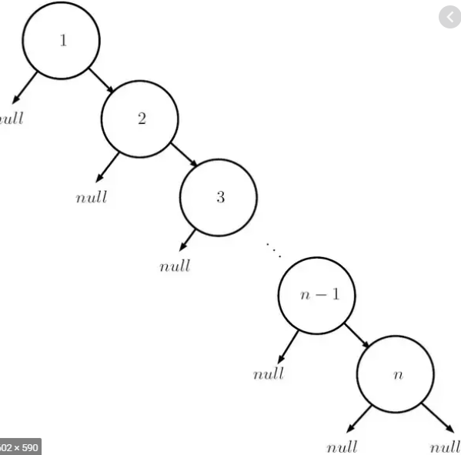
Binary Search Tree – sequential inputs
Tree | 4.a(insert) | 4.b(search) | 4.c(deletion) | 5.a(insertion) | 5.b(search) | 5.c(deletion)
BST | 1159902 | 655528 | 1159699 | 961 | 1162 | 1162
4.a - insertion integers [1, 100000] in order, will result in worst performance case O(n) and end up with a tree of height N (100000).
4.c - likewise deletion [100000,1] in order from the constructed tree by the insertions would perform in worst case O(n) as well, because each deletion needs to traverse to the rightest/highest node.
4.b - actual deletion average time for random numbers is O(n/2) as the average depth is n/2, which is O(100000/2)

Slide 12
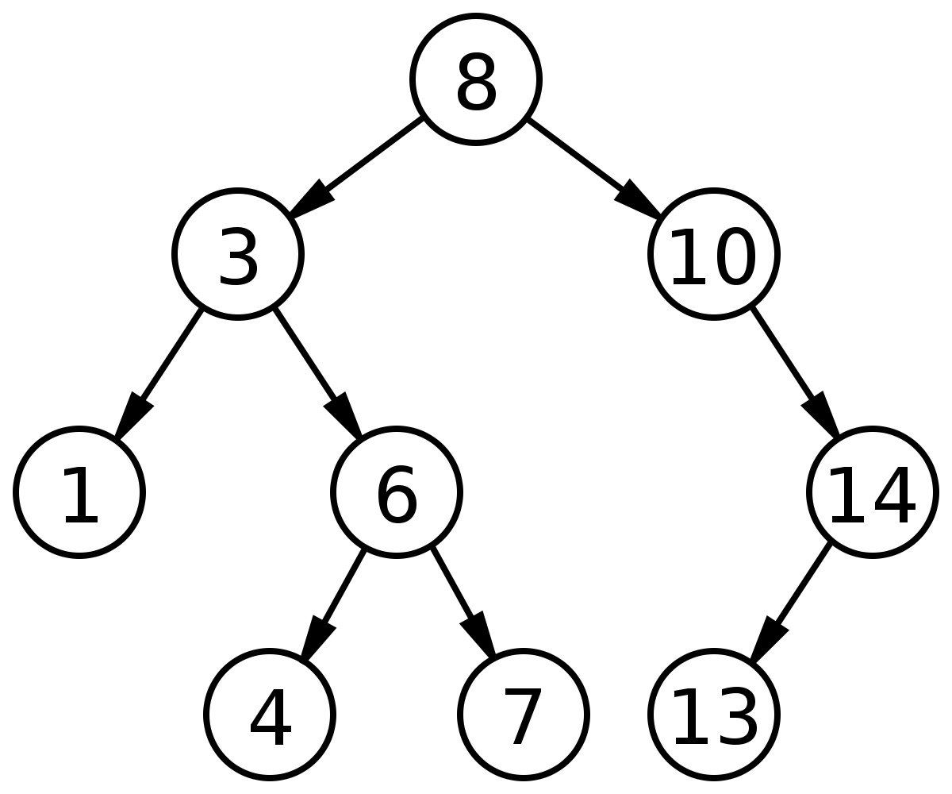
Binary Search Tree – random inputs
5.a – insertion of random numbers will result in a tree of height approaching O(log n), running time is O(log n), it is same true for 5.b search and 5.c deletion.
Tree | 4.a | 4.b | 4.c | 5.a | 5.b | 5.c
BST | 1159902 | 655528 | 1159699 | 961 | 1162 | 1162

Slide 13
AVLTree & Red-Black Tree
AVLTree and Red-Black trees are balanced trees, with height log(n), so Insertion, search, and deletion are all of time complexity O(log n).
Tree | 4.a(insert) | 4.b(search) | 4.c(deletion) | 5.a(insertion) | 5.b(search) | 5.c(deletion)
BST | 1159902 | 655528 | 1159699 | 961 | 1162 | 1162
AVL | 736 | 1144 | 953 | 1613 | 854 | 1337
RedBlck | 898 | 1016 | 1899 | 1784 | 1212 | 3413
Splay | 313 | 1345 | 460 | 2090 | 1947 | 1440

Slide 14
Splay Tree
As we learned, SplayTree’s insertion, search and deletion are of O(log n) and at worst O(n), it can be analyzed case by case.
For 4.a (insertion), the splaying will make each insertion of ordered numbers as the root’s child therefore the time complexity is approaching O(1)
For 4.b (search), the tree is getting more and more balanced due to splaying along with searches, so complexity is O(log n)
For 4.c, deletion of reversely ordered numbers [100000,1] looks better then O(log n), because when a key is deleted the slightly smaller parent will get splayed, which is likely to benefit the next deletion.
5.a,b,c – all the actions all are of O(log n) for random inputs as the numbers show.
Tree | 4.a(insert) | 4.b(search) | 4.c(deletion) | 5.a(insertion) | 5.b(search) | 5.c(deletion)
BST | 1159902 | 655528 | 1159699 | 961 | 1162 | 1162
AVL | 736 | 1144 | 953 | 1613 | 854 | 1337
RedBlck | 898 | 1016 | 1899 | 1784 | 1212 | 3413
Splay | 313 | 1345 | 460 | 2090 | 1947 | 1440

Slide 15
Answer of question 6
Tree | 4.a(insert) | 4.b(search) | 4.c(deletion) | 5.a(insertion) | 5.b(search) | 5.c(deletion)
BST | 1159902 | 655528 | 1159699 | 961 | 1162 | 1162
AVL | 736 | 1144 | 953 | 1613 | 854 | 1337
RedBlck | 898 | 1016 | 1899 | 1784 | 1212 | 3413
Splay | 313 | 1345 | 460 | 2090 | 1947 | 1440
Let’s render them in graph for comparison.

Slide 16
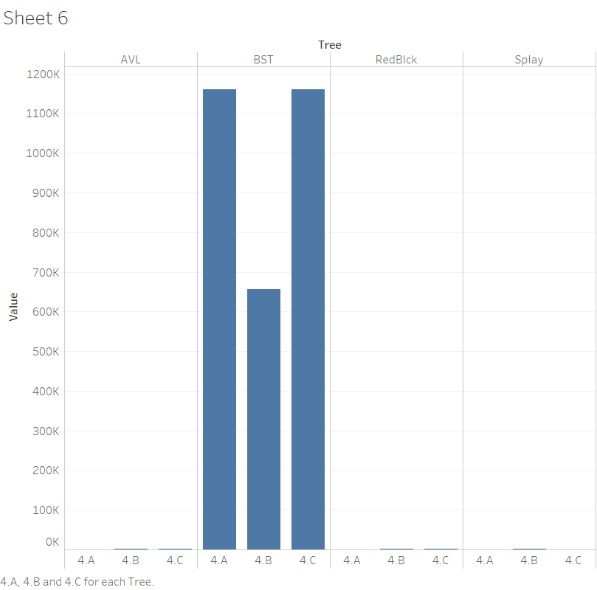
For sequential inputs, BST tree average times are markedly higher

Slide 17
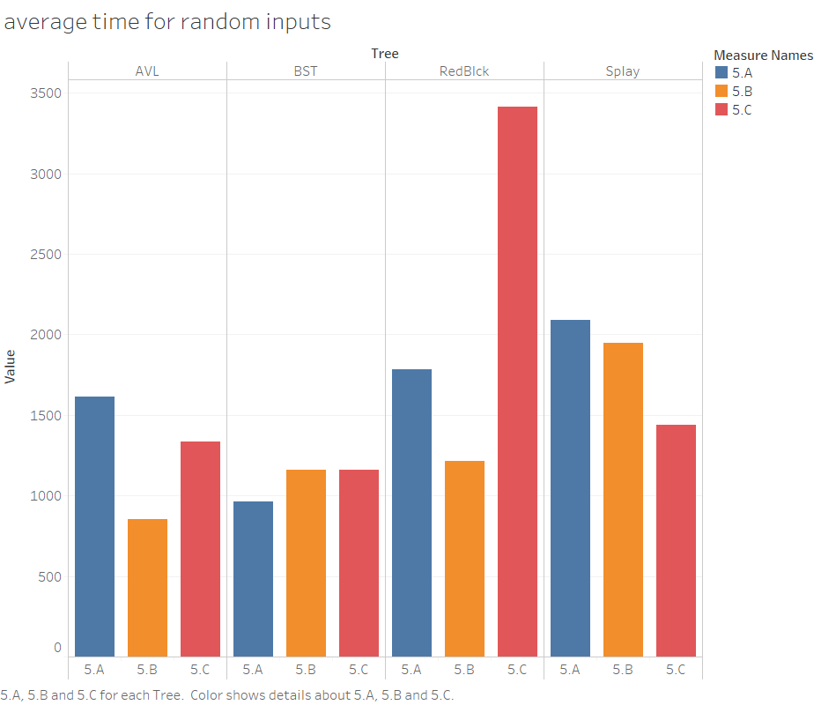
For random inputs, average time for all are decent at average complexity O(log n)

Slide 18
Answer of question 6
Tree | 4.a(insert) | 4.b(search) | 4.c(deletion) | 5.a(insertion) | 5.b(search) | 5.c(deletion)
BST | 1159902 | 655528 | 1159699 | 961 | 1162 | 1162
AVL | 736 | 1144 | 953 | 1613 | 854 | 1337
RedBlck | 898 | 1016 | 1899 | 1784 | 1212 | 3413
Splay | 313 | 1345 | 460 | 2090 | 1947 | 1440
we can see actions on all the tables are of average-time complexity O(log n), except Binary Search tree for sequential inputs which Performs at worst case O(n). For real problems, if the inputs are random data, I will choose Binary Search Tree or AVLTree, otherwise for sequential inputs I will choose AVLTree, and choose Splay tree especially when there is many reoccurrences of search for a same key.
(* average time in nano seconds.)

Slide 19
Real Application Optional Challenge

Slide 20
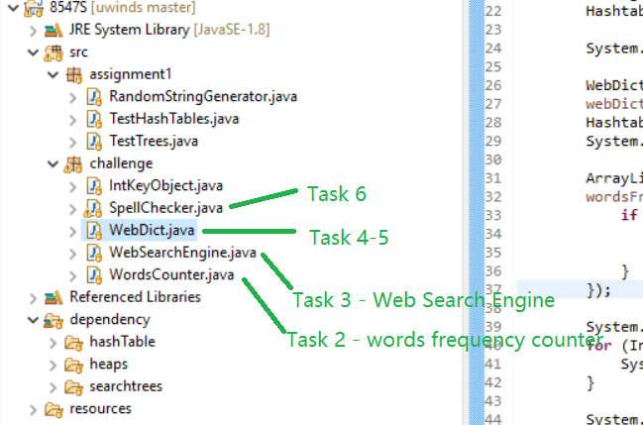
This is the source code structure corresponding to all the questions. Run each java file for corresponding task/question as below.

Slide 21
Answer #5 - The algorithm for Challenge.5 is efficient because it leverages SplayTree's findMax and findMin methods with a subsequent remove(), which are all at average time complexity of O(log n), as the average height of the SplayTree is log n. The overall time complexity for each most/least element is O(log n)

