Slide 1

Assignment Lab 1

Slide 2
Output of the program for questions 1-3
i | Cuck I | Cuck D | Quad I | Quad D | SpCh I | SpCh D
1 | 33712 | 12420 | 32727 | 6112 | 93055 | 4929
2 | 11040 | 7196 | 1873 | 1380 | 2464 | 1281
3 | 110355 | 7343 | 37606 | 936 | 3795 | 1133
4 | 18877 | 6530 | 1010 | 739 | 1601 | 788
5 | 53501 | 2341 | 1121 | 837 | 1306 | 690
6 | 3012 | 3135 | 2248 | 2636 | 1164 | 708
7 | 3376 | 2150 | 2760 | 431 | 13252 | 877
8 | 4018 | 2542 | 999 | 696 | 5141 | 349
9 | 1286 | 679 | 1133 | 408 | 4336 | 428
10 | 1569 | 4079 | 1026 | 820 | 2938 | 309
11 | 5240 | 550 | 1009 | 255 | 2317 | 292
12 | 2148 | 530 | 1515 | 1511 | 9599 | 223
13 | 540 | 248 | 433 | 438 | 2461 | 270
14 | 547 | 209 | 202 | 93 | 428 | 131
15 | 1072 | 306 | 278 | 161 | 958 | 242
16 | 1093 | 645 | 726 | 276 | 1813 | 281
17 | 1200 | 640 | 770 | 212 | 1171 | 225
18 | 1637 | 673 | 873 | 261 | 1667 | 187
19 | 2289 | 826 | 1345 | 296 | 1697 | 248
20 | 1413 | 940 | 1126 | 322 | 1538 | 306
Cuck I: Cuckoo Insertion average time in nano seconds, likewise for Quad I and SCh I.
Cuck D: Cuckoo Search or Deletion average time in nano seconds, likewise for Quad D and SpCh D.

Slide 3
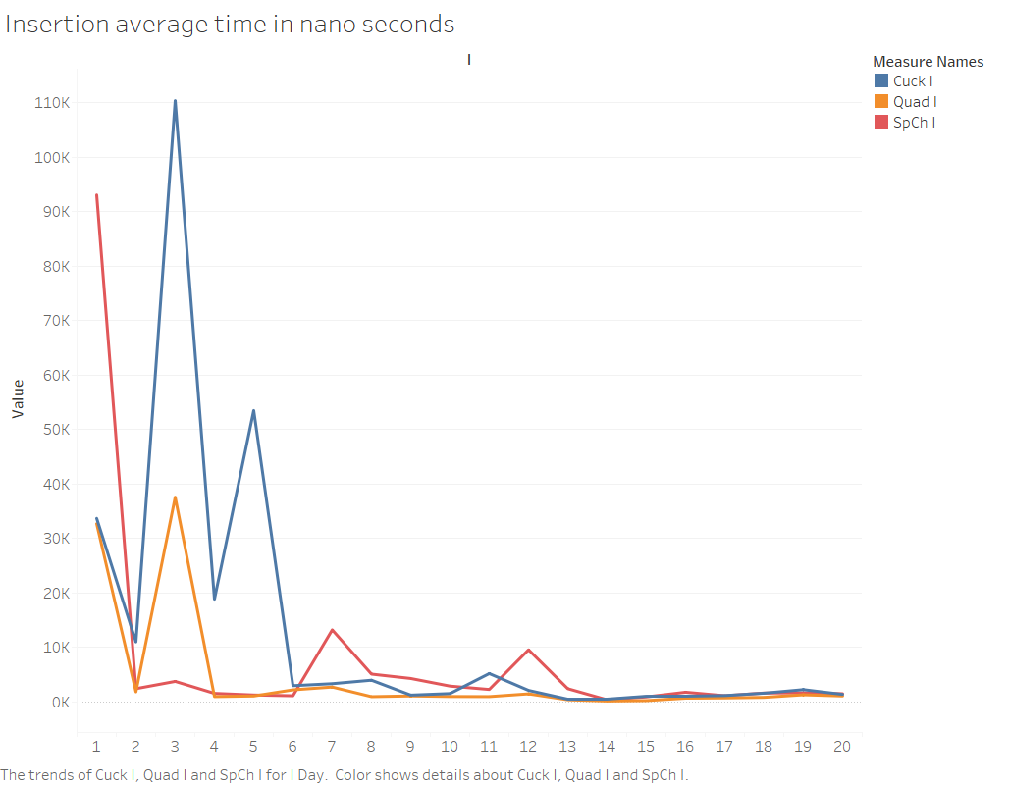

Slide 4
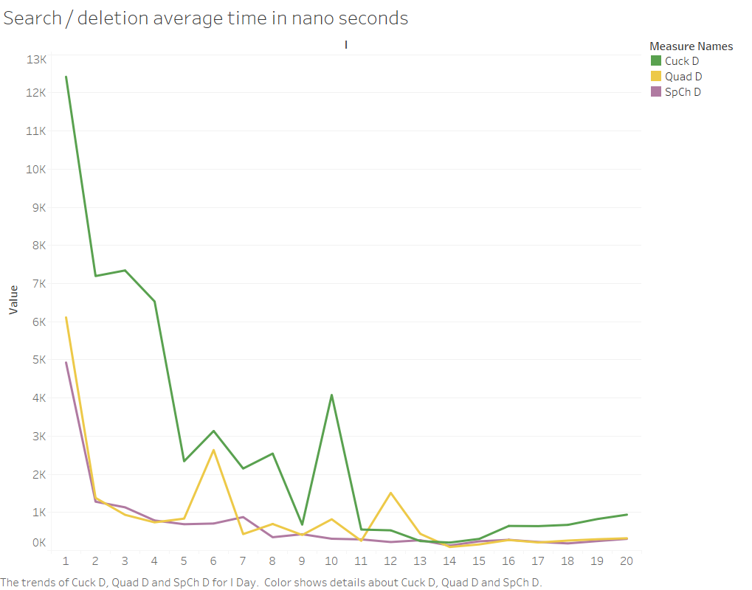

Slide 5
Result analysis
For Hash tables, expected running time of insertion, search, and deletion is O(1), as showing in the two preceding slides all the average time are approaching a horizontal line.
Whereas it displays unstable with high average time at the beginning for each line, that is owing to two reasons:
Overhead caused by environmental factors are augmented for average time when N is small
Overhead caused by accessory actions are augmented for average time when N is small, for example, increasing table capacity, or rebuilding hash table, et cetera.

Slide 6
Output of the program for questions in 4 and 5
Tree | 4.a | 4.b | 4.c | 5.a | 5.b | 5.c
BST | 1159902 | 655528 | 1159699 | 961 | 1162 | 1162
AVL | 736 | 1144 | 953 | 1613 | 854 | 1337
RedBlck | 898 | 1016 | 1899 | 1784 | 1212 | 3413
Splay | 313 | 1345 | 460 | 2090 | 1947 | 1440

Slide 7
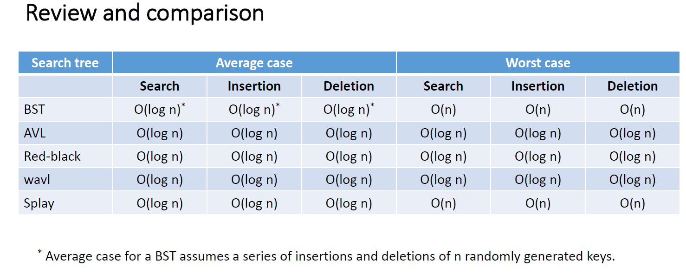
As we learned from class

Slide 8
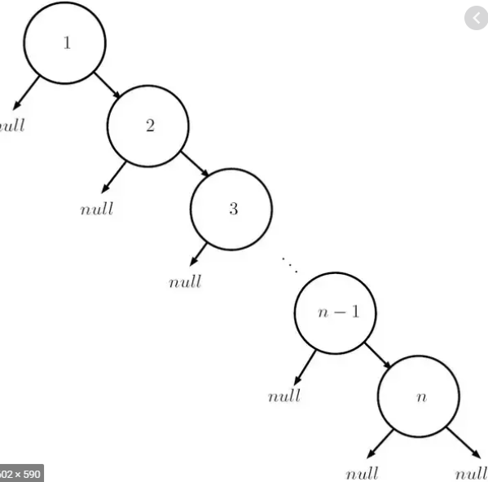
Binary Search Tree
Tree | 4.a | 4.b | 4.c | 5.a | 5.b | 5.c
BST | 1159902 | 655528 | 1159699 | 961 | 1162 | 1162
4.a - insertion integers [1, 100000] in order, will result in worst performance case O(n) and end up with a tree of height N (100000).
4.c - likewise deletion [100000,1] in order from the constructed tree by the insertions would perform in worst case O(n) as well, because each deletion needs to traverse to the rightest/highest node.
4.b - actual deletion average time for random numbers is O(n/2), which is O(100000/2)

Slide 9
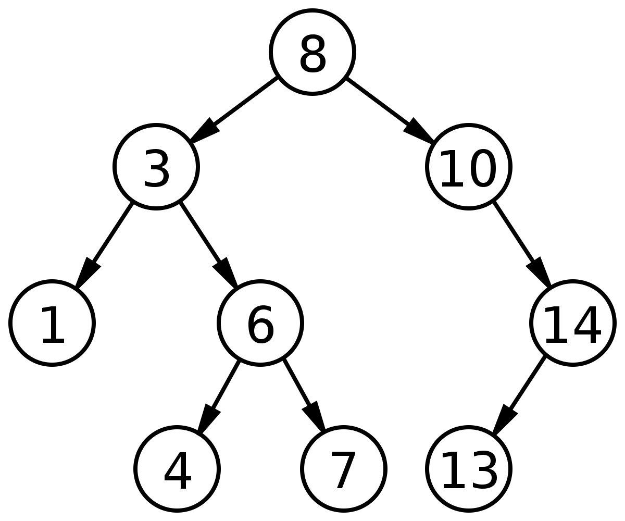
Binary Search Tree - Cont
5.a – insertion of random numbers will result in a tree of height approaching O(log n), running time is O(log n), it is same true for 5.b search and 5.c deletion.
Tree | 4.a | 4.b | 4.c | 5.a | 5.b | 5.c
BST | 111261 | 60310 | 107332 | 1255 | 1177 | 1587

Slide 10
AVLTree & Red-Black Tree
AVLTree and Red-Black trees are balanced tree, with height log(n), so Insertion, search, and deletion are all of time complexity O(log n).
Tree | 4.a | 4.b | 4.c | 5.a | 5.b | 5.c
BST | 1159902 | 655528 | 1159699 | 961 | 1162 | 1162
AVL | 736 | 1144 | 953 | 1613 | 854 | 1337
RedBlck | 898 | 1016 | 1899 | 1784 | 1212 | 3413
Splay | 313 | 1345 | 460 | 2090 | 1947 | 1440

Slide 11
Splay Tree
As we learned, SplayTree’s insertion, search and deletion are of O(log n) and O(n) at worst, but it can be analyzed case by case.
For 4.a, the splaying will make each insertion of ordered numbers as the root’s child therefore the time complexity is approaching O(1)
For 4.b, and 5.a,b,c, all are of O(log n) as the numbers show.
For 4.c, deletion of reversely ordered numbers [100000,1] looks better then O(log n), because when a key is deleted the slightly smaller parent will get splayed, which is likely to benefit the next deletion.
Tree | 4.a | 4.b | 4.c | 5.a | 5.b | 5.c
BST | 1159902 | 655528 | 1159699 | 961 | 1162 | 1162
AVL | 736 | 1144 | 953 | 1613 | 854 | 1337
RedBlck | 898 | 1016 | 1899 | 1784 | 1212 | 3413
Splay | 313 | 1345 | 460 | 2090 | 1947 | 1440

