Slide 1

Assignment Lab 1

Slide 2
Output data of the assignment1
i | Cuck I | Cuck D | Quad I | Quad D | SCh I | SCh D
1 | 319779 | 1268865 | 47119 | 5717 | 162255 | 5323
2 | 94435 | 93055 | 2365 | 2365 | 3351 | 1380
3 | 852432 | 21292 | 1626 | 985 | 2365 | 1183
4 | 26664 | 156414 | 2267 | 3425 | 5840 | 1010
5 | 17164 | 22179 | 998 | 1145 | 1429 | 800
6 | 14311 | 13202 | 2156 | 3696 | 1632 | 702
7 | 17145 | 22481 | 12540 | 985 | 22333 | 449
8 | 63203 | 14733 | 1534 | 1209 | 3200 | 706
9 | 7465 | 10077 | 1256 | 466 | 7510 | 315
10 | 7844 | 8012 | 2562 | 331 | 2496 | 350
11 | 9736 | 8894 | 1054 | 231 | 3356 | 341
12 | 18295 | 9011 | 720 | 222 | 2104 | 274
13 | 14260 | 10646 | 762 | 203 | 2844 | 307
14 | 18422 | 11844 | 459 | 215 | 779 | 269
15 | 23989 | 13068 | 464 | 241 | 1115 | 322
16 | 32834 | 15118 | 1224 | 213 | 1965 | 254
17 | 22597 | 18637 | 1128 | 230 | 1351 | 234
18 | 26485 | 18343 | 894 | 236 | 1100 | 244
19 | 41665 | 22487 | 1075 | 287 | 1840 | 251
20 | 55114 | 25591 | 1223 | 306 | 1787 | 277
Cuck I: Cuckoo Insertion average time in nano seconds, likewise for Quad I and SCh I.
Cuck D: Cuckoo Search or Deletion average time in nano seconds, likewise for Quad D and SCh D.

Slide 3
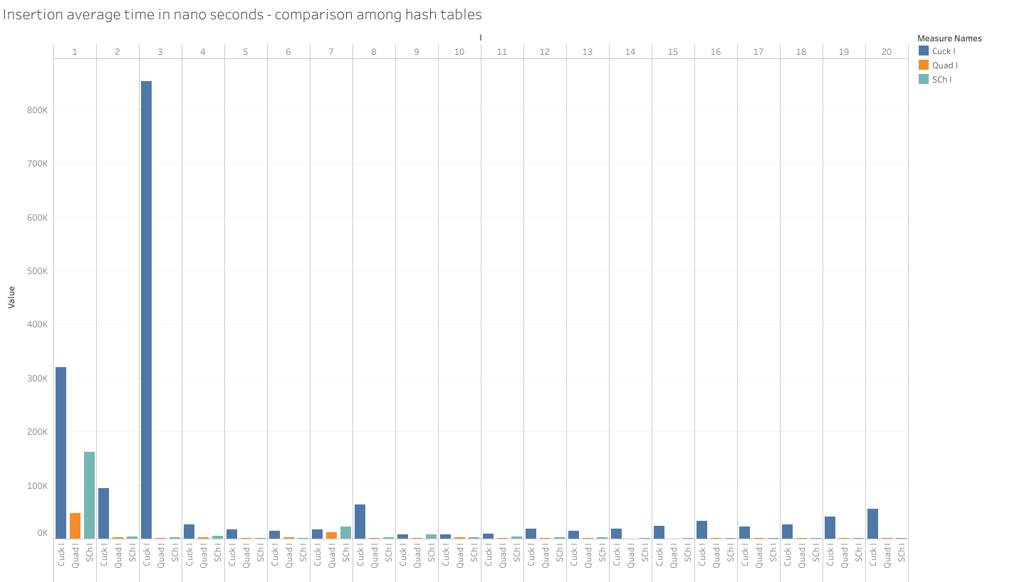

Slide 4
Remove first 4 records, where average time is affected by environmental factors.
See how it looks

Slide 5
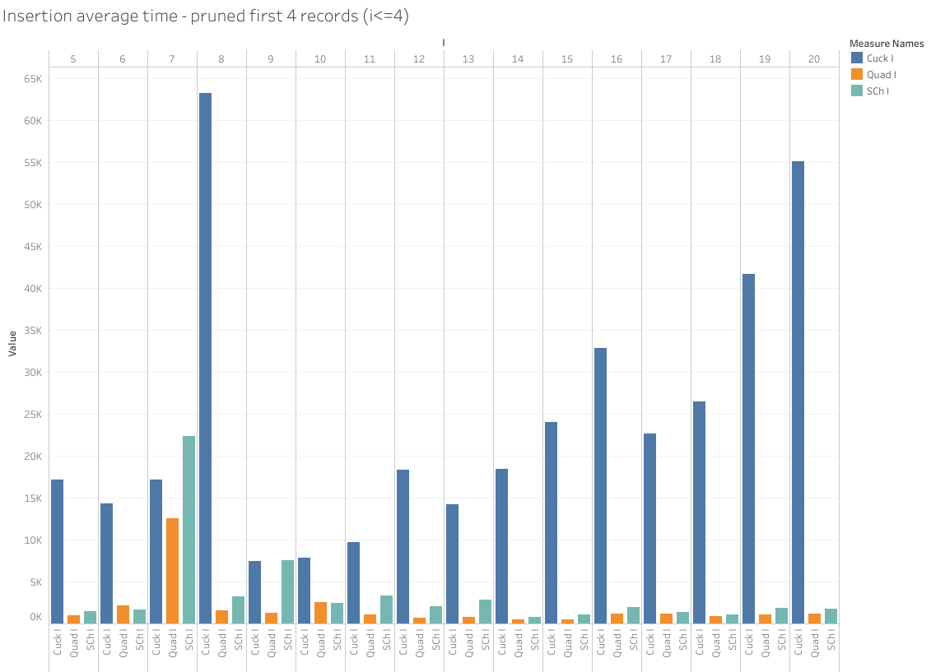

Slide 6
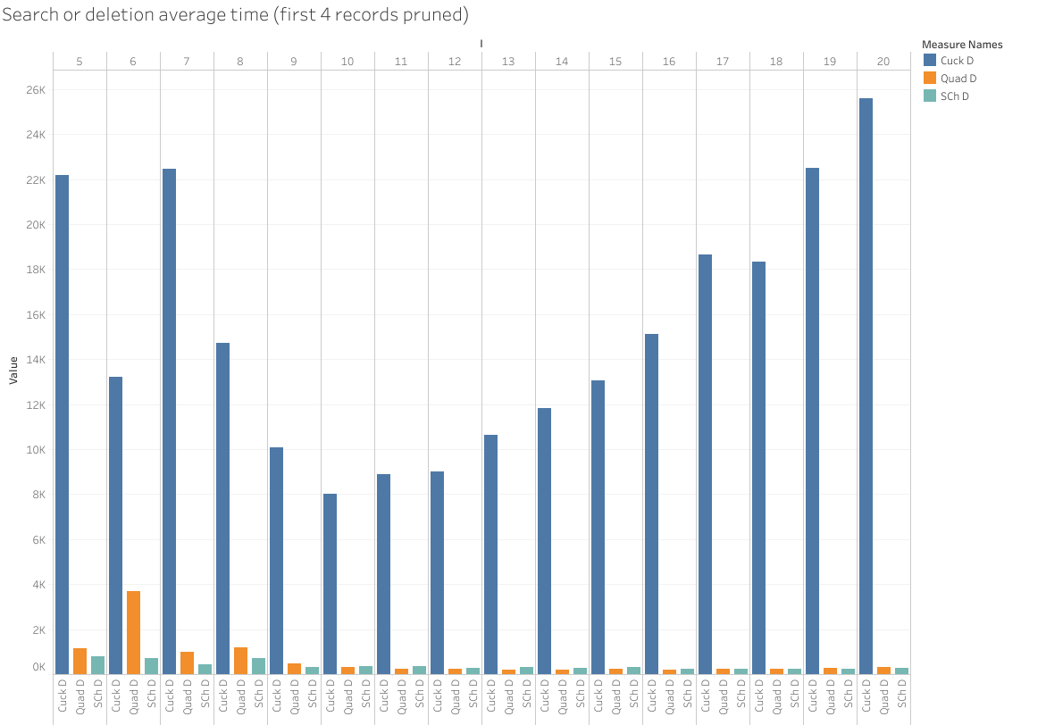

Slide 7
Result analysis
Hash table running time of insertion, search, and deletion is O(1), but for CuckooHashTable there is a replacement cost of O(log N) at worst.
So in the collected data, average time for SeparateChainingHashTable and QuadraticProbingHashTable stays at a constant level along I, while for CuckooHashTable the average time grows slowly along with i.

