Slide 1
Public Key Infrastructure

Slide 2
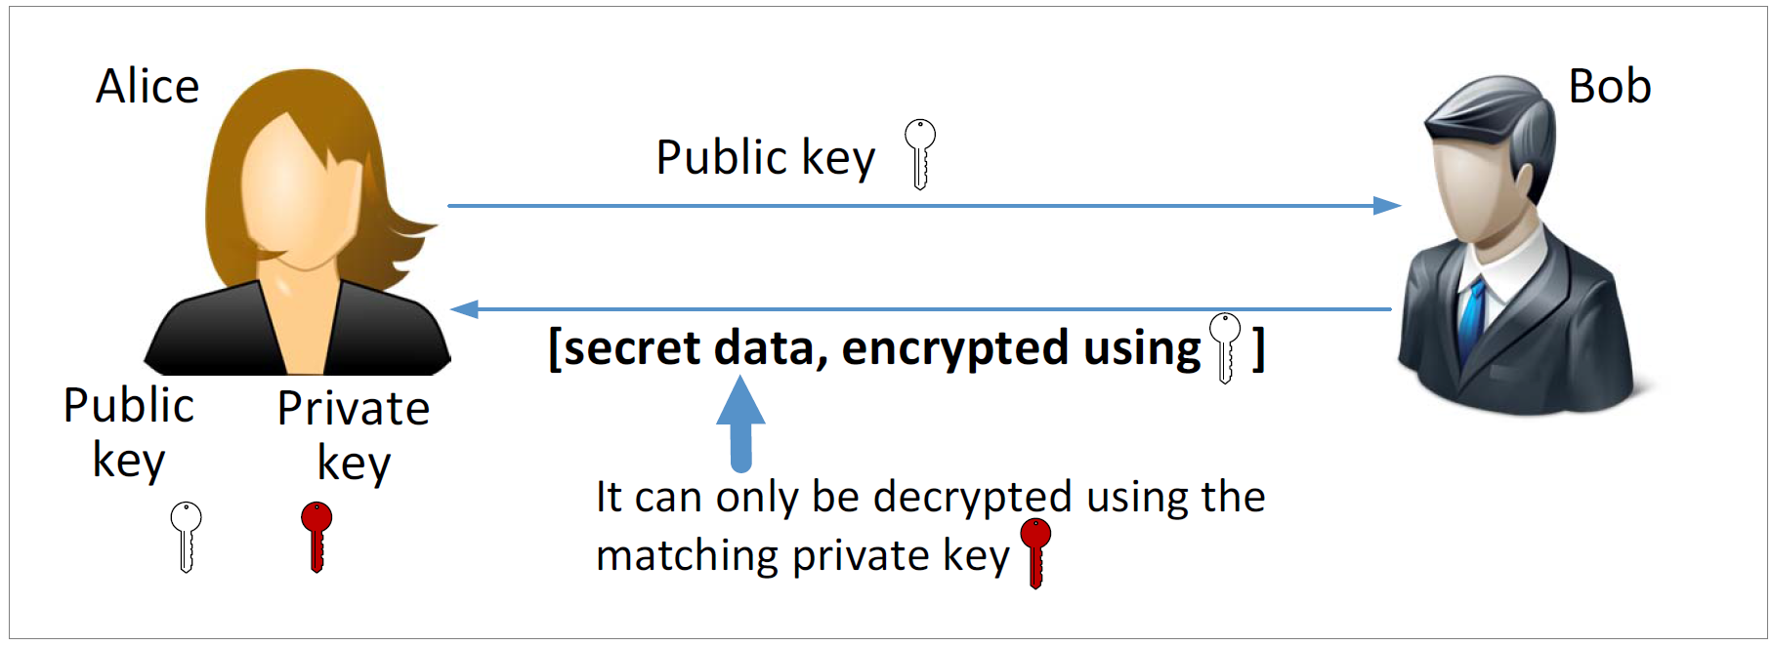
Public Key Cryptography

Slide 3
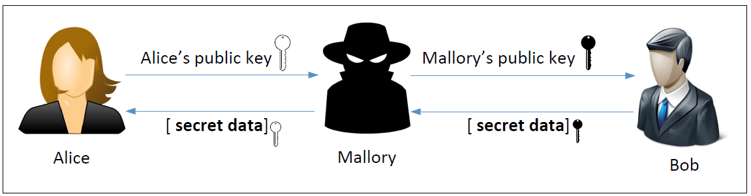
Man-in-the-Middle (MITM) Attack

Slide 4
What Is the Fundamental Problem?
Fundamental Problem: Bob has no way to tell whether the public key he has received belongs to Alice or not.
Solution:
Find a trusted party to verify the identity
Bind an identity to a public key in a certificate
The certificate cannot be forged or tampered with (using digital signature)
Notes:
Alice can not trust the certificate signing to be done over the internet as that may also be under attack by a MITM. She has to go in person.
After sending the certificate to Bob, even if Mallory intercepts the traffic; she cannot replace Alice’s public key with her own, as that would invalidate the DMV’s signature
There is no way for Mallory to get a certificate from DMV for her public key with Alice’s name as the DMV will not approve it

Slide 5
Defeating MITM Attacks using Digital Signature
Alice needs to go to a trusted party to get a certificate.
After verifying Alice’s identity, the trusted party issues a certificate with Alice’s name and her public key.
Alice sends the entire certificate to Bob.
Bob verifies the certificate using the trusted party’s public key.
Bob now confirms the true owner of a public key is Alice.

Slide 6
Certificate Authority (CA): a trusted party who verifies the public key is owned by an ID (such as www. uwindsor.ca), provide a proof about this (i.e., sign on (PK_uw, www.uwindsor.ca)).
Digital Certificate: The proof described above.
X.509 standard: the standard to generate the certificate

Slide 7
Digital Certificate
Root CA is the highest CA that has nobody to sign a certificate for it.
It signs a certificate for itself.
They are famous and this type of certificate has already be saved
in your computer at the time of your computer installation.
To see an example of such certificate, go to /etc/ssl/certs
view one of the file (ex: WoSign.pem) using x509:
openssl x509 –in WoSign.pem –text -noout
Notes:
An Actual X.509 certificate contains binary data. Therefore when stored in files, X.509 certificates use encoders.
A common scheme used here is Base64 encoder and are usually saved in a file with PEM extension (Privacy Enhanced Mail)
We can copy and paste the content into a file (paypal.pem) and run another openssl command to decode it.
The best way to view an X.509 certificate it to convert PEM to text :
openssl x509 –in paypal.pem –text -noout

Slide 8
Be a root CA and generate certificates for users.
In the lab file, we provide a procedure for you to play as a root CA to
genertate a certificate for yourself.
After this, you can generate certificate for other users’ public key.
Then, apply this certificate to experiment on TLS that comes next

Slide 9
Transport Layer Security

Slide 10
Overview of TLS
Transport Layer Security (TLS) is a protocol that provides a secure channel between two communicating applications. The secure channel has 3 properties:
Confidentiality: Nobody other than the two ends of the channel can see the actual content of the data transmitted.
Integrity: Channel can detect any changes made to the data during transmission
Authentication: At least one end of the channel needs to be authenticated, so the other end knows who it is talking to.
Notes:
TLS evolved from its predecessor SSL and is gradually replacing SSL
When SSL was standardized by IETF, it was renamed to TLS
SSL version 3.0 was deprecated and replaced by TLS in June 2015
TLS is designed to run on top of TCP but can be implemented with other protocols such as UDP

Slide 11
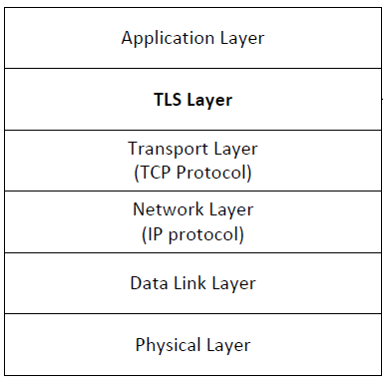
TLS Layer
TLS sits between the Transport and Application layer
Unprotected data is given to TLS by Application layer
TLS handles encryption, decryption and integrity checks
TLS gives protected data to Transport layer

Slide 12
TLS Handshake
Before a client and server can communicate securely, several things need to be set up first:
Encryption algorithm and key
MAC algorithm
Algorithm for key exchange
These cryptographic parameters need to be agreed upon by the client and server
This is the primary purpose of the handshake protocol

Slide 13
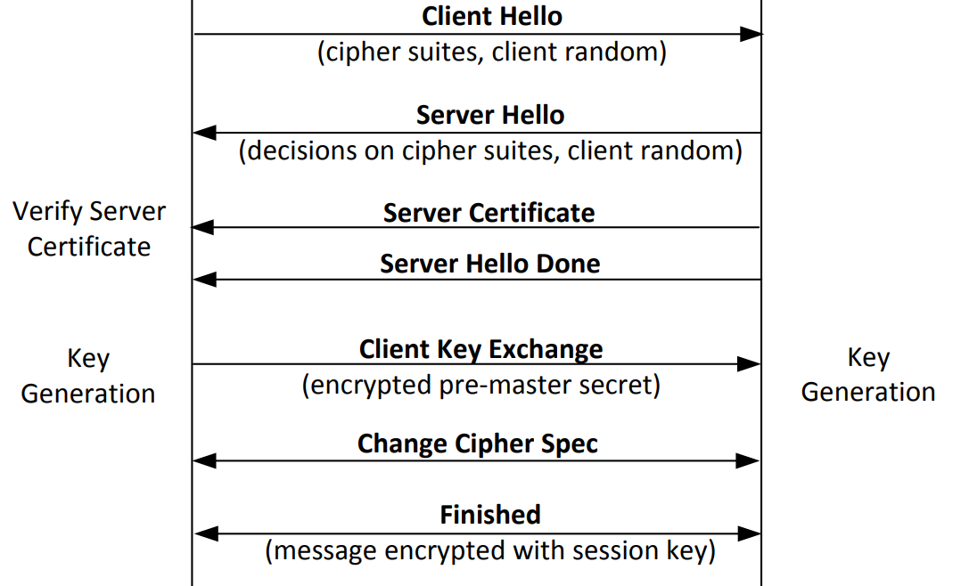
TLS Handshake Protocol
Notes:
Explanation in further slides

Slide 14
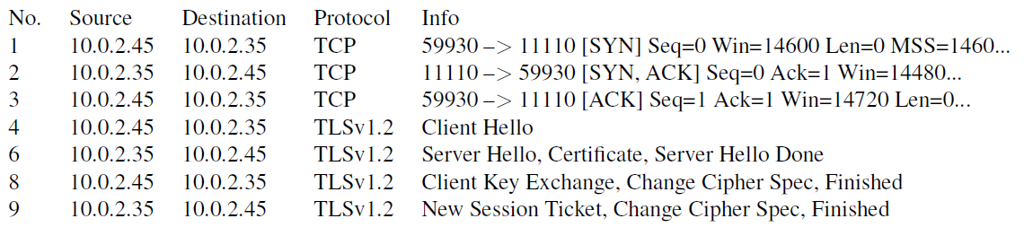
Network Traffics During TLS Handshake
Since TLS runs top of TCP, a TCP connection needs to be established before the handshake protocol. This is how the packet exchange looks between a client and server during a TLS handshake protocol captured using Wireshark:

Slide 15
Certificate Verification
Certificate is a signature from an authority (e.g., VeriSign): the public key (e.g., RSA public key) belongs to the hostname or ip address.
The client first does a validation check of the certificate
Check expiration date, signature validity, etc.
Hostname and certificate’s common name match
The client needs to have the singing CA’s public-key certificate.
Notes:
Client programs, such as browsers, need to load a list of trusted CA certificated beforehand, or they will not be able to verify any certificate
If the signing CA is on the list, the certificate can be directly verified

Slide 16
Key Generation and Exchange
Although public-key algorithms can be used to encrypt data, it is much more expensive than secret-key algorithms.
TLS uses Public-key algorithm for key exchange.
After that, server and client switch to secret-key encryption algorithm
The entire key generation consists of three steps:
Step 1: Generating pre-master secret
Step 2: Generating master secret
Step 3: Generating session keys

Slide 17
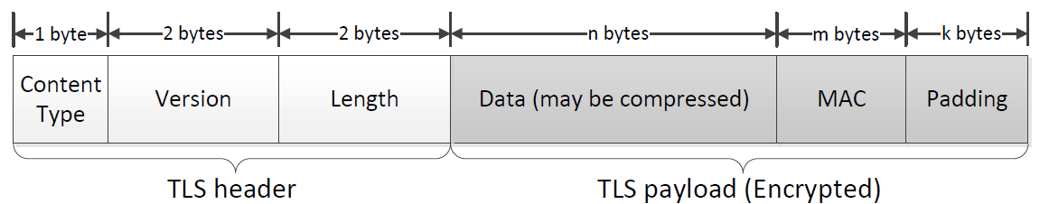
TLS Data Transmission
Once the handshake protocol is finished, client and server can start exchanging data.
Data is transferred using records.
Each record contains a header and a payload
Notes:
In this section, we focus on the application record type, which is used to transfer application data between a client and a server
Content Type: Indicates the type of protocol data carried by current record (handshake, alert, application, heartbeat or ChangeCipherSpec)
Version: This field identifies major and minor version of TLS being used
Length: The length of the payload field.

Slide 18
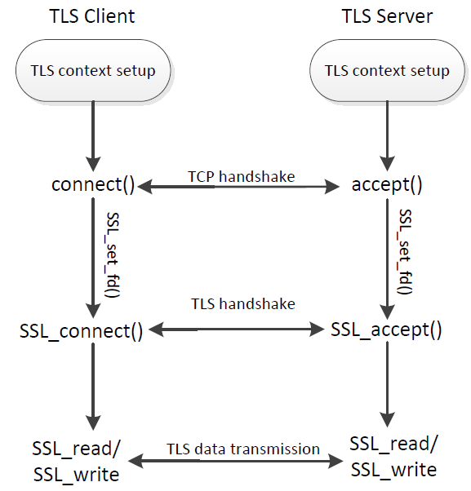
TLS Programming : Overall Picture

Slide 19
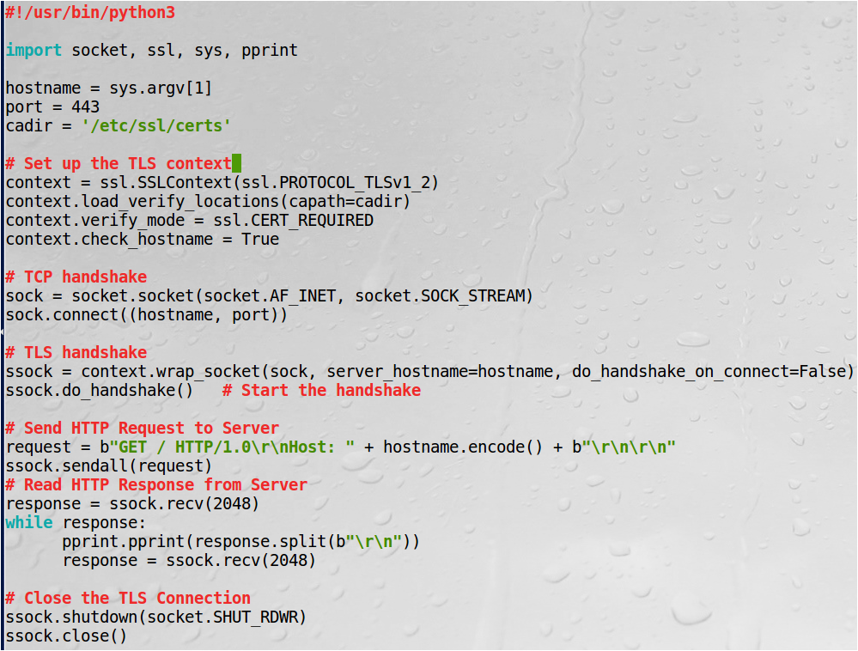
Python TLS Client Program
Test: $ python3 client.py www.google.com You will received the initial get response.

Slide 20
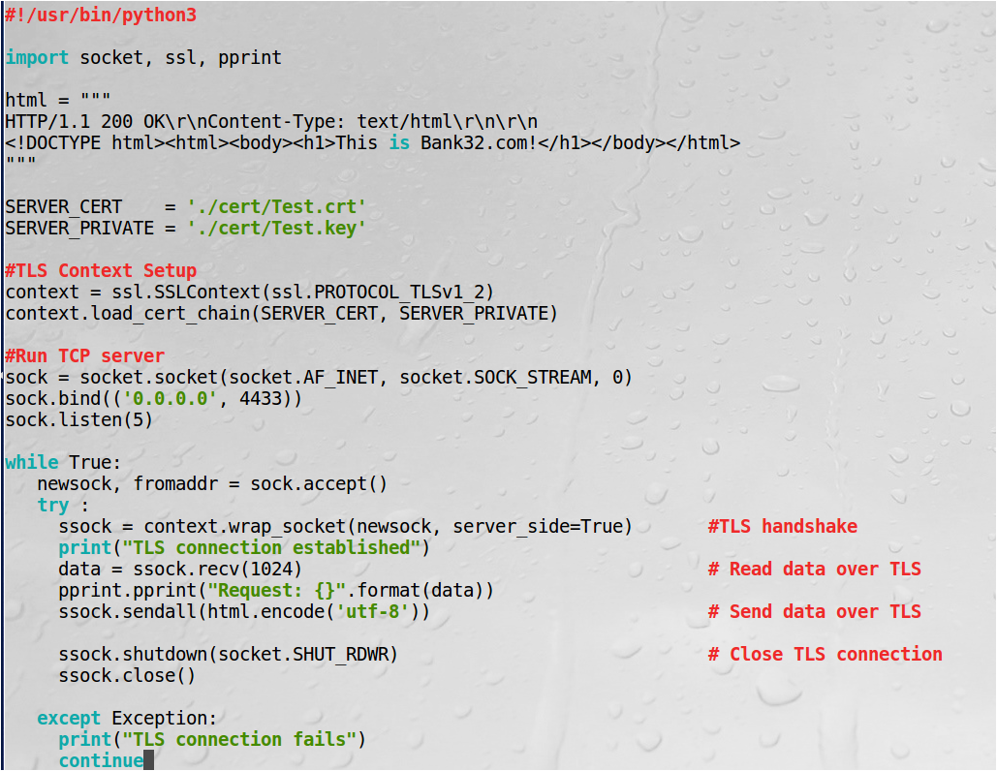
Python TLS Server Program
Follow reference file to create and use certificate and key.
$ python3 server.py
run client.py (with port 4433) on another VM to test client and server communication
$python3 client.py 10.0.2.4
10.0.2.4 is th server ip.

