Slide 1

Data Visualization for Research
Presenting Results Effectively

Slide 2
The Whats and Whys of Data Visualization

Slide 3
Introduction
Data Visualization is the graphical representation of data. It involves using charts, graphs, maps, and other visual elements to reveal patterns, trends, outliers, and insights more effectively than raw numbers.
There are two different approaches to data visualization:
Exploratory: Your purpose for visualization is the exploration and understanding of trends in your data, either for the purpose of data analysis or the preparation of it.
Explanatory: Your purpose for visualization is to clearly and effectively communicate something about your data to a wider audience.

Slide 4
Why Visualize Data?
01
Simplify Complex Data
It turns large and complicated data into visual formats like charts and graphs, making the information easier to understand.
02
Reveals Patterns and Trends
It helps identify trends, relationships, and patterns that are not easily seen in raw data or tables.
03
Improve Communication
It makes it easier to explain data insights to others, especially those who may not be familiar with the technical details.

Slide 5
Limitations
Oversimplification Risk
Important context or nuances may be lost when data is reduced to visual form.
Bias & Misleading Design
Truncated axes, cherry-picked data, or misleading chart types can distort interpretation.
Cognitive Overload
Complex or cluttered visuals can confuse more than clarify.
Data Quality Dependency
Poor or incomplete data leads to misleading visuals, no matter how well designed.

Slide 6

Tools for Visualization
Programming: R (ggplot2, Shiny), Python (Matplotlib, Seaborn, Plotly, Altair)
Web based tools: Javascript libraries like D3.js
Third Party Apps: Microsoft Excel, Tableau, Power BI
Temporal, Geospatial, and Exhibition tools: Omeka, StoryMap, Timeline.js, WorldMap, and Carto

Slide 7
What makes a Good Visualization

Slide 8
Pre-Attentive Attributes
A human can distinguish differences in length, shape, orientation, distances, and color readily without significant processing effort; these are referred to as pre-attentive attributes. Compelling graphics take advantage of the attributes.
There are 4 pre-attentive visual properties: Form, Color, Spatial Position and Movement. From these four, we are able to derive specific visual features that the visual system can detect instantly.

Slide 9
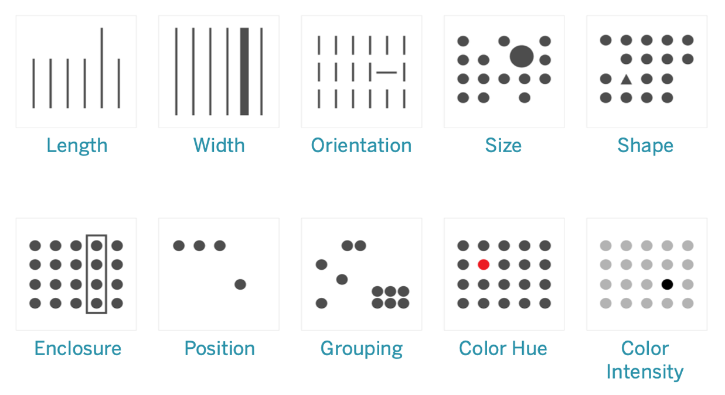
Specific Pre-attentive Visual Features in Data Visualization

Slide 10
Quantitative Messages
Quantitative Messages describe the type of insight or comparison a user wants to extract from numerical data, guiding how the data should be visualized.
Each message type is best conveyed through a specific kind of graph or chart, which helps highlight the intended relationship or pattern.
There are 8 types of quantitative messages.

Slide 11
Quantitative Messages
Time-Series
Shows how a variable changes over time e.g., temperature over 10 years
→ Line chart
Ranking
Orders categories by size (ascending or descending) e.g., top-performing sales reps
→ Bar chart
01
02
Part-to-Whole
Shows proportions of a whole (percentages) e.g., market share by brand
→ Pie chart, bar chart
Deviation
Highlights difference from a reference point e.g., budget vs. actual expenses
→ Bar chart
03
04

Slide 12
Quantitative Messages
Frequency Distribution
Shows how often values occur within defined intervals e.g., stock returns grouped in ranges
→ Histogram, boxplot
Correlation
Shows the relationship between two numerical variables e.g., inflation vs. unemployment
→ Scatter plot
05
06
Nominal Comparison
Compares values across unordered categories e.g., sales by product code
→ Bar chart
Geospatial
Displays data across geographic or spatial layouts e.g., population by state or floor
→ Choropleth map, cartogram
07
08

Slide 13
Tufte’s Principles
Edward Tufte, a pioneer in data visualization, proposed a set of principles to guide the creation of clear, honest, and efficient visual representations of data.
He argued that graphics should communicate data directly and efficiently, without unnecessary decoration or distraction. Instead of focusing on design flair, Tufte advocated for visuals that induce the viewer to focus on the substance of the data itself.

Slide 14
Tufte’s Principles
Tufte states that graphical displays should:
show the data
induce the viewer to think about the substance rather than about methodology, graphic design, the technology of graphic production, or something else
avoid distorting what the data has to say
present many numbers in a small space
make large data sets coherent
encourage the eye to compare different pieces of data
reveal the data at several levels of detail, from a broad overview to the fine structure
serve a reasonably clear purpose: description, exploration, tabulation, or decoration
be closely integrated with the statistical and verbal descriptions of a data set.

Slide 15
THANK YOU

