Slide 1
Differentially Privacy TD Learning
Meeting 2
July 29，2021

Slide 2
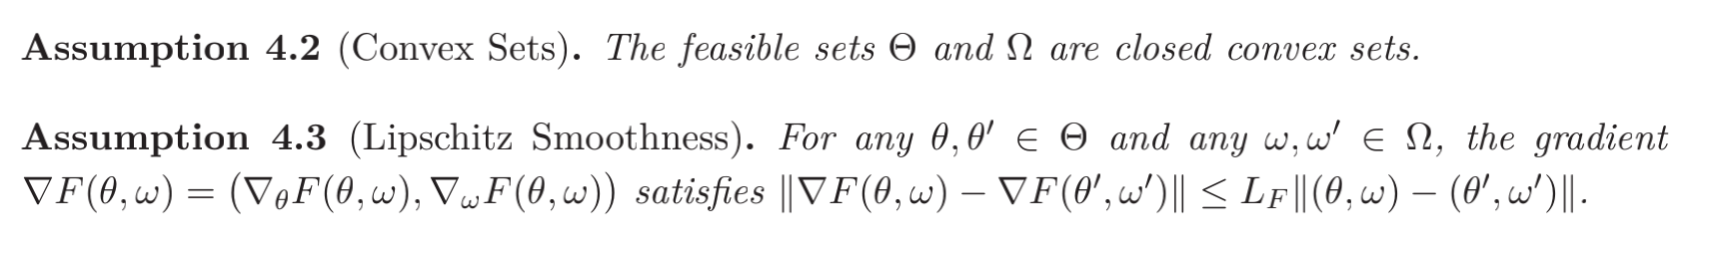
1 Setting

Slide 3
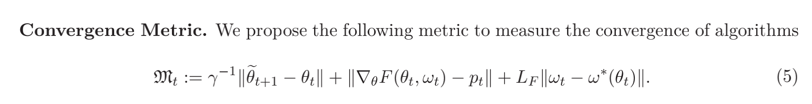
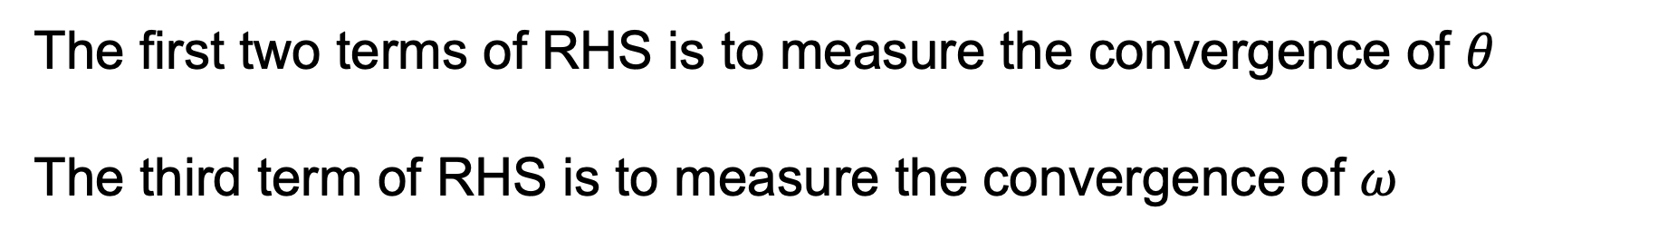
1 Setting
The first two terms of RHS is to measure the convergence of $θ$
The third term of RHS is to measure the convergence of $ω$

Slide 4
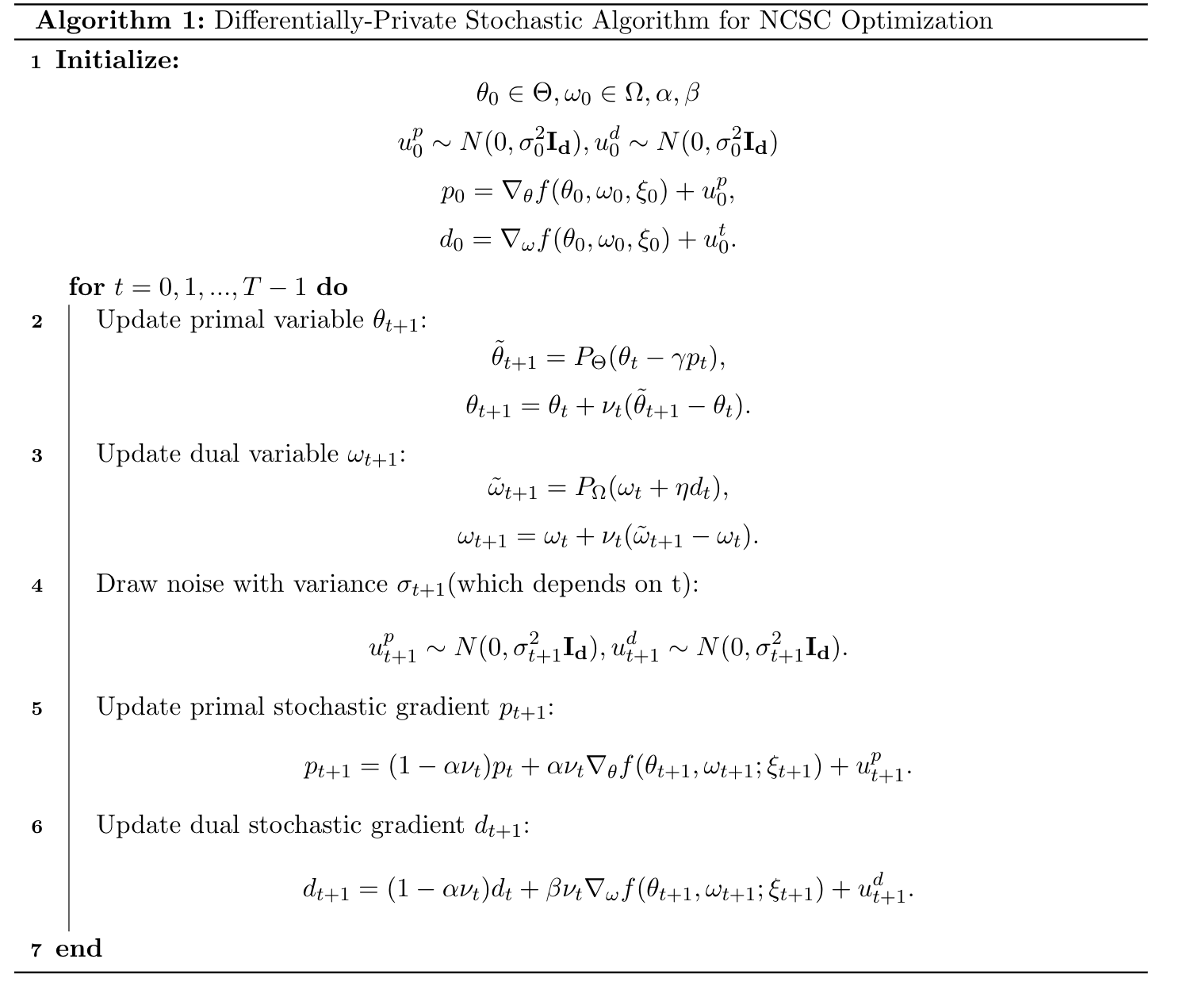
2 Our Algorithm

Slide 5
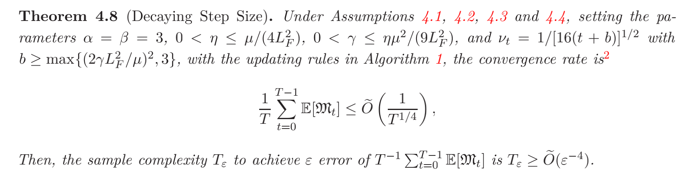
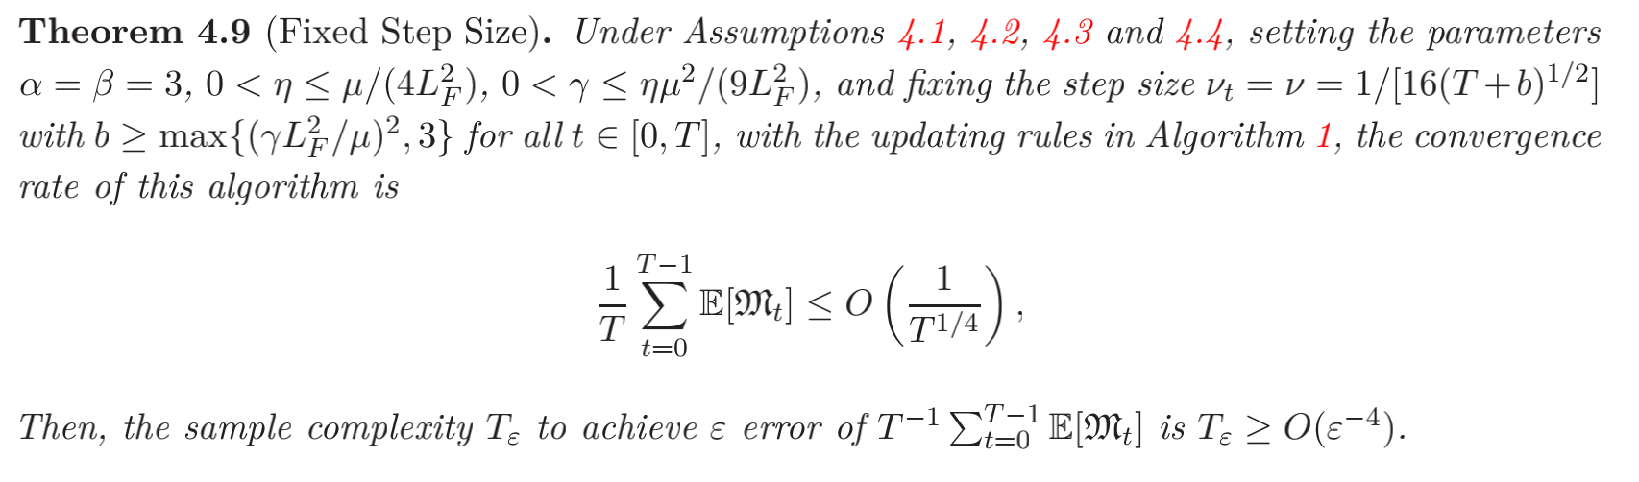
3 Convergence
In Shuang Qiu’s work, she proposes two theorems. One is with Decaying Step Size, and another one is with Fixed Step Size.

Slide 6
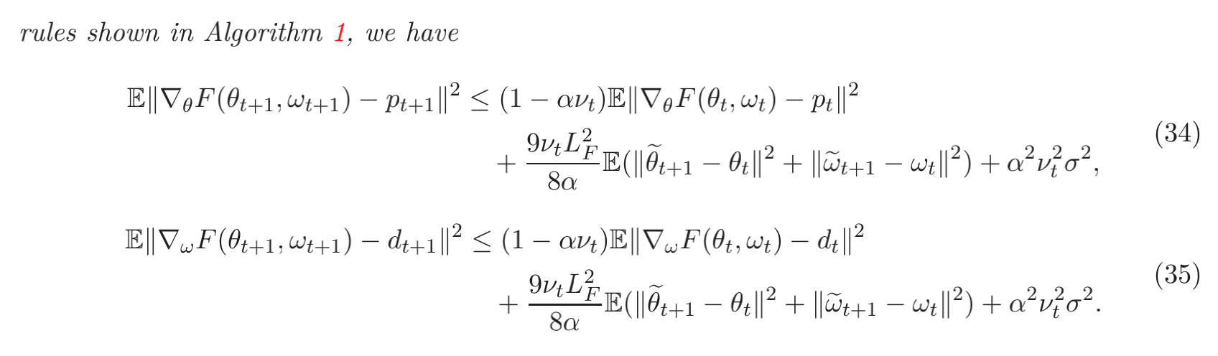
3 Convergence
We first follow the proof of theorem 4.8(decaying step size), with DP noise. Proof of Theorem 4.9 is similar to Theorem 4.8.
Our noise influence Lemma B.4. The original form is shown below.

Slide 7
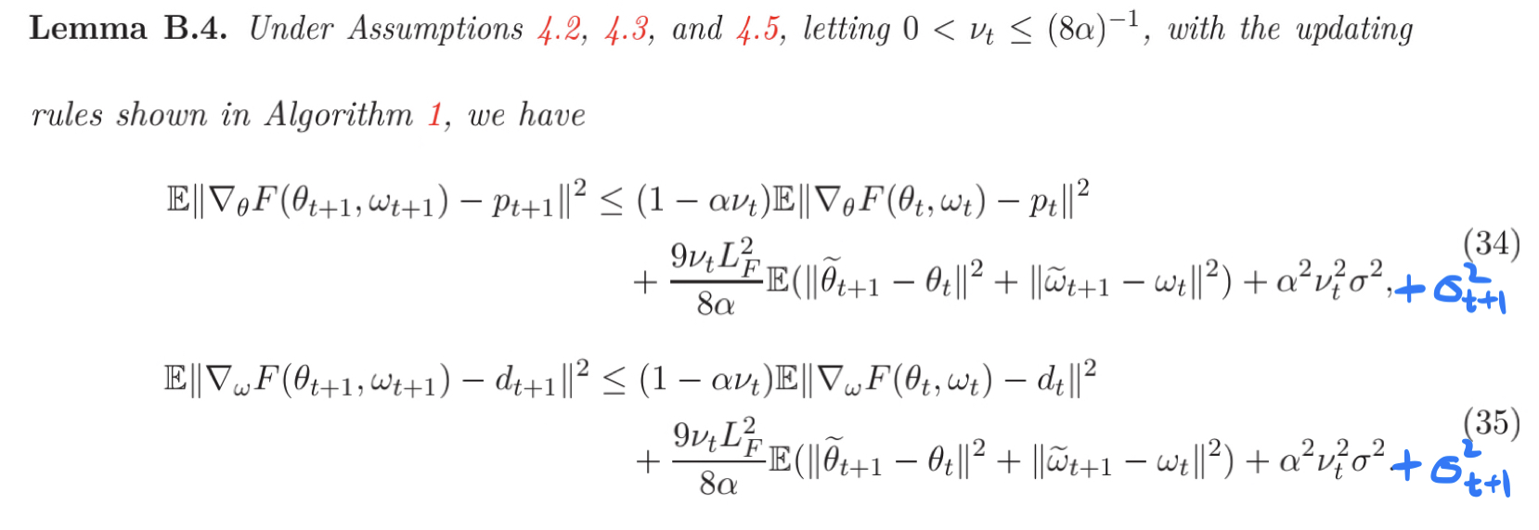
3 Convergence
Our new form is slightly different, with noise in it.

Slide 8
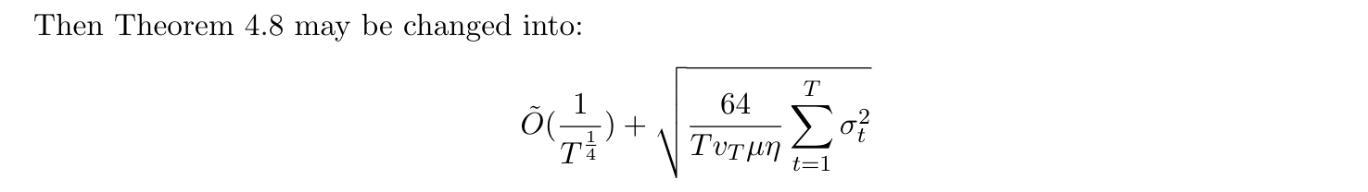
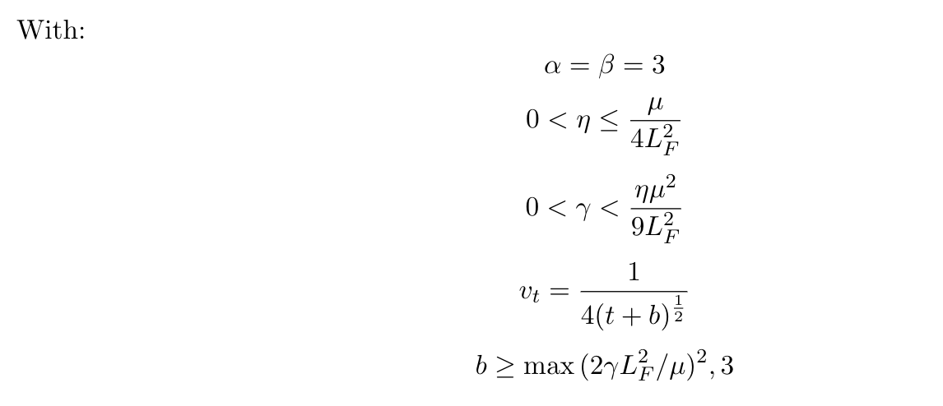
3 Convergence
The final bound is also different:

Slide 9
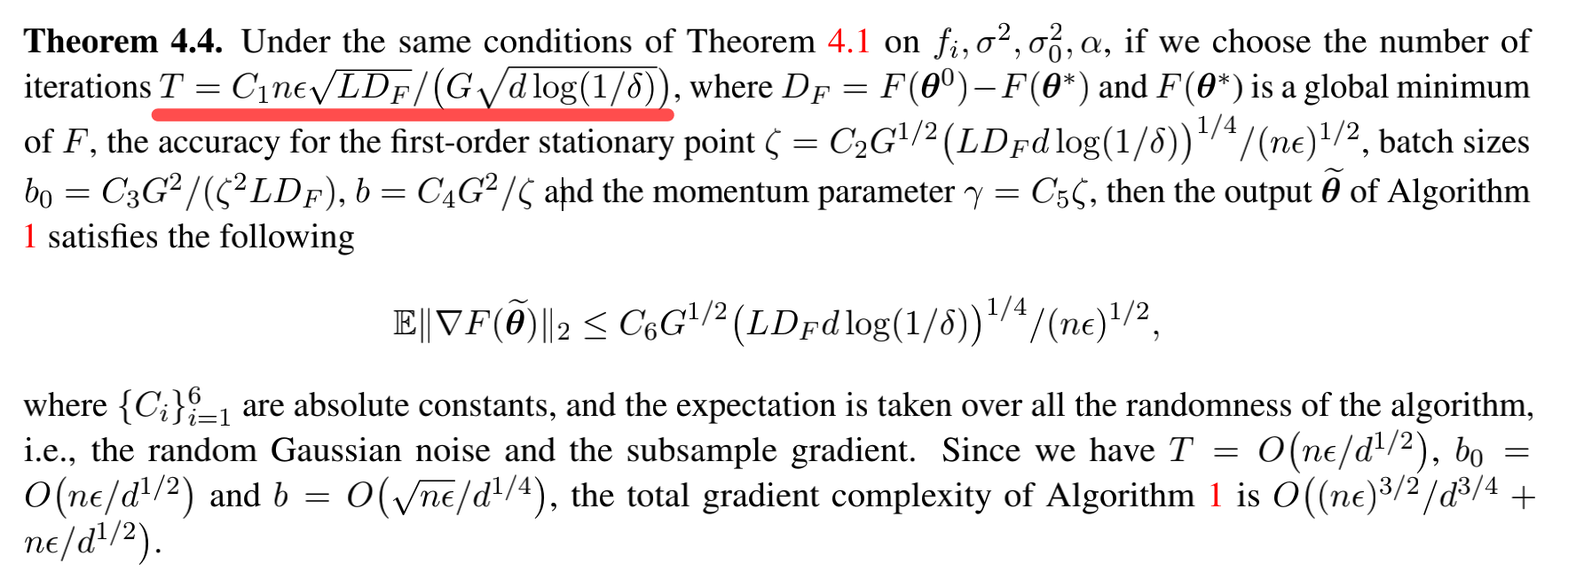
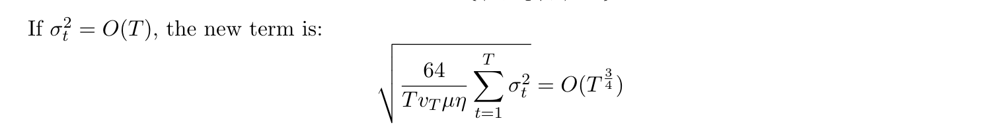
3 Convergence
We can assume the value of \sigma_t as O(T), which is used in the DP:
Then, the new term is:

Slide 10
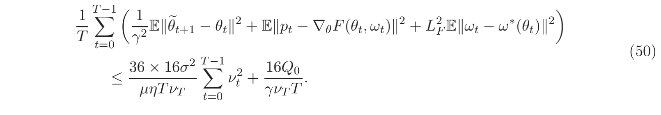
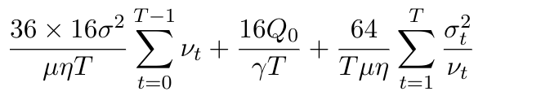
3 Convergence
To make this term smaller, we try to do some changes.
One try is that we divide the right side of Q_t by v_t.
Then we can change RHS of inequality (50). The changes are shown below.

Slide 11
3 Convergence
The sum of v_t is:
It seems that the noise’s bound is now O(T^{1/4})

Slide 12
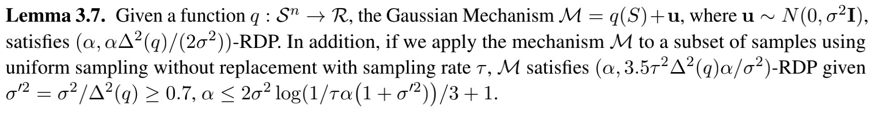
4 Privacy
The process of proving Differential Privacy is:
1. We discuss two cases: t=0 and t>0
2. In each case, we first consider the case without subsampling. Because we can get a subsampled mechanism by Lemma 3.7.
3. We then get l2-sensitivity.

Slide 13
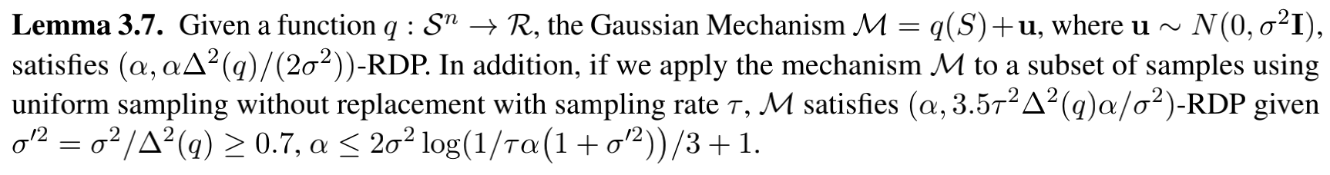
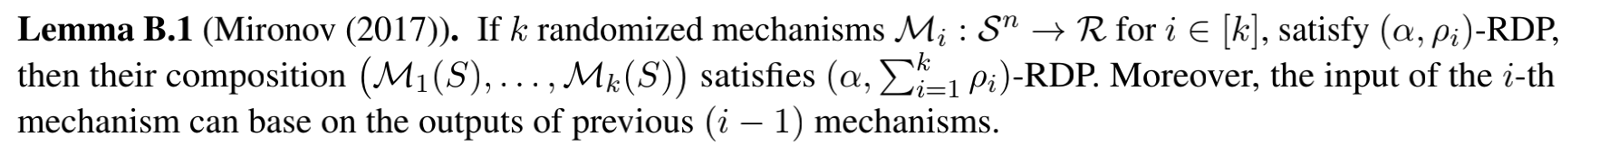
4 Privacy
4. We then get RDP by Lemma 3.7 .
5. Finally, we get the overall RDP, for t>=0, by Lemma B.1 .
6. It’s time to transform RDP to DP by Lemma 3.9 .

Slide 14
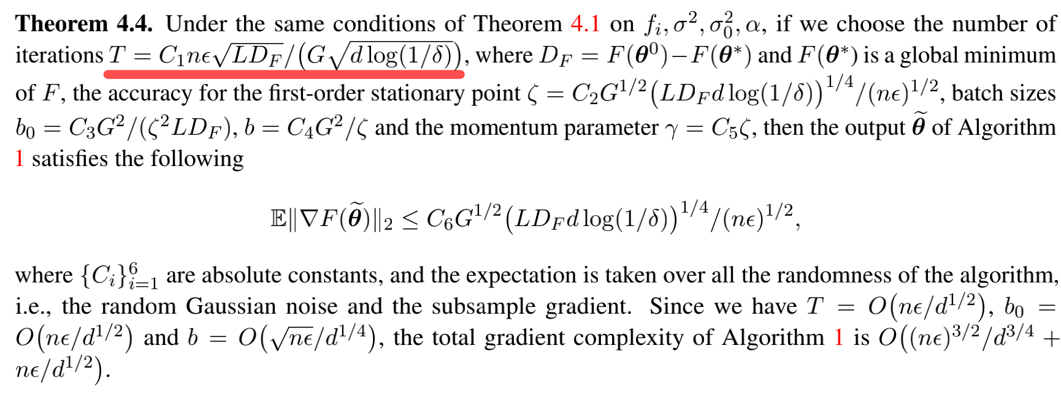
5 Problems
1. In DP’s proof, T is fixed and dependent on delta,epsilon,n. While in TD’s proof, the bound is dependent on T.
2. The influence of the noise

Slide 15
THANKS

